Slide 1
Chapter 1 Language History and Change

Slide 2
Faeder ure bu be eart on heofonum,
si bin nama gehalgod.
Tobecume bin rice
Gewurpe bin willa on eoroan swa swa on
heofonum.
The Lord’s Prayer (circa 1000)

Slide 3
Philology:
The study of language history and change.
Investigating the features of older languages, and the way in which they developed into modern languages.
19th c.
Family trees / to show how languages were related.

Slide 4
Sir William Jones (18th c.)
A number of languages from very different geographical areas must have some common ancestor.
Similar features (e.g. roots of verbs- forms of grammar…)
Around 30 language families
Almost 7,000 languages in the world
Chinese/ the most native speakers (1 b.)
English (350 m.) native speakers
Proto-Indo European
Great-great grandmother
With the largest population and distribution in the world.

Slide 5
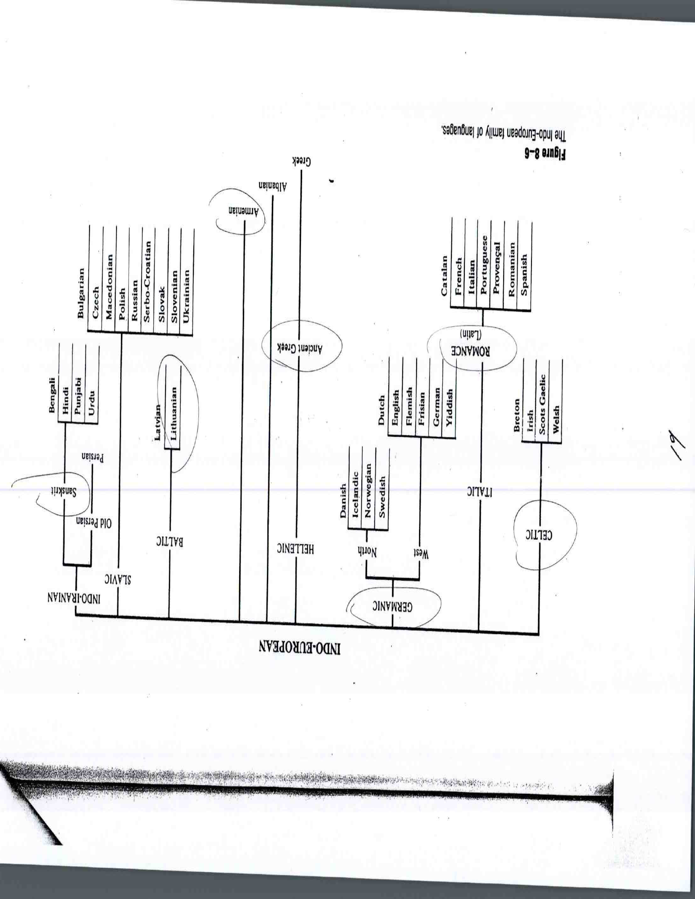

Slide 6
Family connections
The Indo-European languages share similar linguistic features (pronunciation-meaning- grammatical structure)
Evidence of related languages.
e.g.
English | Old Slavic | Irish | Sanskrit | German | Greek | Gothic
brother | bratu | brathair | bhratar | bruder | phrater
father |  |  | pitar | vater | pater | fadar
water |  |  |  | wasser
bread |  |  |  | brot
milk |  |  |  | milch

Slide 7
Cognates
Cognate:
A cognate of a word in one language is a word in another language that gas a similar form and a similar meaning.
e.g.
English: mother/ father/ friend
German: mutter/ vater/ freund
Good evidence of a common ancestor/in this example: the ‘Germanic’ branch of the Indo-European

Slide 8
The History of English
Old English: before 1100
Middle English: 1100 to 1500
Early Modern English: 1500 to 1700
Modern (present-day English): after 1700

Slide 9
Old English
5th c./ Anglo-Saxons/ Germanic (child- wife)
6th – 8th /Christianity/ Latin (church- angel)
8th – 10th / Vikings/ Old Norse (law- leg)

Slide 10
Middle English
Norman French/ William the conqueror 1100/ law & civilization/ (court- prison – tax)
peasants remained English (sheep- cow)
French ‘prestige’ language (mutton- beef)

Slide 11
Early Modern English
1500/ introduction of printing
Standardized pronunciation, spelling and grammar

Slide 12
External Changes
Influences from the outside.
E.g. ‘borrowed words’ from other languages

Slide 13
Internal Changes
1/ Sound changes
Sound loss e.g. dropping /h/ (hlud –loud)
Silent letters (knee)
Reversal in position (frist/ first)
2/ Syntactic changes
Differences in structure/ word order
S – V – O (e.g. ‘ferde he’ / ‘he travelled’)
3/ Semantic changes
Some words ceased to be used (e.g. ‘foin’)
Broadening (e.g. holy day/ dog)
Narrowing (e.g. mete/ wife)

Slide 14
Diachronic & Synchronic changes
Changes happened gradually.
Main cause of change was ‘ cultural transmission.’
Diachronic:
Variations in language viewed from a historical perspective / change through time.
Synchronic:
Variations in language in different places and among different groups at the same time.

