Slide 1
Biostatistics for the Biological and Health Sciences
Chapter 3
Describing, Exploring, and Comparing Data
Copyright © 2018, 2014, 2012 Pearson Education, Inc. All Rights Reserved

Slide 2
Describing, Exploring, and Comparing Data
3-1 Measures of Center
3-2 Measures of Variation
3-3 Measures of Relative Standing and Boxplots

Slide 3
Key Concept
The focus of this section is to obtain a value that measures the center of a data set. In particular, we present measures of center, including mean and median. Our objective here is not only to find the value of each measure of center, but also to interpret those values.

Slide 4
Measure of Center
Measure of Center
  A measure of center is a value at the center or middle of a data set.

Slide 5
Mean (or Arithmetic Mean)
Mean (or Arithmetic Mean)
  The mean (or arithmetic mean) of a set of data is the measure of center found by adding all of the data values and dividing the total by the number of data values.

Slide 6
Important Properties of the Mean
Sample means drawn from the same population tend to vary less than other measures of center.
The mean of a data set uses every data value.
A disadvantage of the mean is that just one extreme value (outlier) can change the value of the mean substantially. (Using the following definition, we say that the mean is not resistant.)

Slide 7
Resistant
Resistant
  A statistic is resistant if the presence of extreme values (outliers) does not cause it to change very much.

Slide 8
Notation (1 of 2)
∑ denotes the sum of a set of data values.
x is the variable usually used to represent the individual data values.
n represents the number of data values in a sample.
N represents the number of data values in a population.

Slide 9
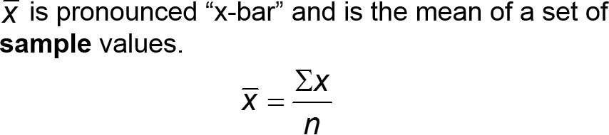

Notation (2 of 2)
µ is pronounced “mu” and is the mean of all values in a population.

Slide 10
Example: Mean (1 of 2)
Data Set 32 “Airport Data Speeds” in Appendix B includes measures of data speeds of smartphones from four different carriers. Find the mean of the first five data speeds for Verizon: 38.5, 55.6, 22.4, 14.1, and 23.1 (all in megabits per second, or Mbps).

Slide 11
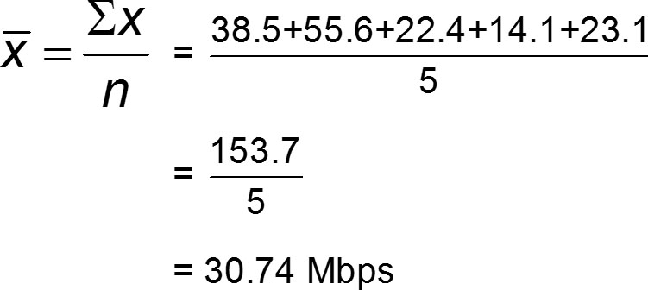
Example: Mean (2 of 2)
Solution

Slide 12
Mean
Caution
  Never use the term average when referring to a measure of center. The word average is often used for the mean, but it is sometimes used for other measures of center.
The term average is not used by statisticians.
The term average is not used by the statistics community or professional journals.

Slide 13
Median
Median
  The median of a data set is the measure of center that is the middle value when the original data values are arranged in order of increasing (or decreasing) magnitude.

Slide 14
Important Properties of the Median
The median does not change by large amounts when we include just a few extreme values, so the median is a resistant measure of center.
The median does not directly use every data value. (For example, if the largest value is changed to a much larger value, the median does not change.)

Slide 15
Calculation and Notation of the Median
To find the median, first sort the values (arrange them in order) and then follow one of these two procedures:
If the number of data values is odd, the median is the number located in the exact middle of the sorted list.
If the number of data values is even, the median is found by computing the mean of the two middle numbers in the sorted list.

Slide 16
Example: Median with an Odd Number of Data Values (1 of 2)
Find the median of the first five data speeds for Verizon: 38.5, 55.6, 22.4, 14.1, and 23.1 (all in megabits per second, or Mbps).

Slide 17

Example: Median with an Odd Number of Data Values (2 of 2)
Solution
First sort the data values by arranging them in ascending order, as shown below:
Because there are 5 data values, the number of data values is an odd number (5), so the median is the number located in the exact middle of the sorted list, which is 23.1 Mbps.

Slide 18
Example: Median with an Even Number of Data Values (1 of 2)
Repeat of the previous example after including the sixth data speed of 24.5 Mbps. That is, find the median of these data speeds: 38.5, 55.6, 22.4, 14.1, 23.1, 24.5 (all in Mbps).

Slide 19

Example: Median with an Even Number of Data Values (2 of 2)
Solution
First arrange the values in ascending order:
14.1 22.4 23.1 24.5 38.5 55.6
Because the number of data values is an even number (6), the median is found by computing the mean of the two middle numbers, which are 23.1 and 24.5.

Slide 20
Mode
Mode
  The mode of a data set is the value(s) that occur(s) with the greatest frequency.

Slide 21
Important Properties of the Mode
The mode can be found with qualitative data.
A data set can have no mode or one mode or multiple modes.

Slide 22
Finding the Mode
A data set can have one mode, more than one mode, or no mode.
When two data values occur with the same greatest frequency, each one is a mode and the data set is said to be bimodal.
When more than two data values occur with the same greatest frequency, each is a mode and the data set is said to be multimodal.
When no data value is repeated, we say that there is no mode.

Slide 23

Example: Mode
Find the mode of these Sprint data speeds (in Mbps):
Solution
The mode is 0.3 Mbps, because it is the data speed occurring most often (three times).

Slide 24
Other Mode Examples
Two modes: The data speeds (Mbps) of 0.3, 0.3, 0.6, 4.0, and 4.0 have two modes: 0.3 Mbps and 4.0 Mbps.
No mode: The data speeds (Mbps) of 0.3, 1.1, 2.4, 4.0, and 5.0 have no mode because no value is repeated.

Slide 25
Midrange
Midrange
  The midrange of a data set is the measure of center that is the value midway between the maximum and minimum values in the original data set. It is found by adding the maximum data value to the minimum data value and then dividing the sum by 2, as in the following formula:

Slide 26
Important Properties of the Midrange (1 of 2)
Because the midrange uses only the maximum and minimum values, it is very sensitive to those extremes so the midrange is not resistant.

Slide 27
Important Properties of the Midrange (2 of 2)
In practice, the midrange is rarely used, but it has three redeeming features:
  The midrange is very easy to compute.
  The midrange helps reinforce the very important point that there are several different ways to define the center of a data set.
  The value of the midrange is sometimes used incorrectly for the median, so confusion can be reduced by clearly defining the midrange along with the median.

Slide 28
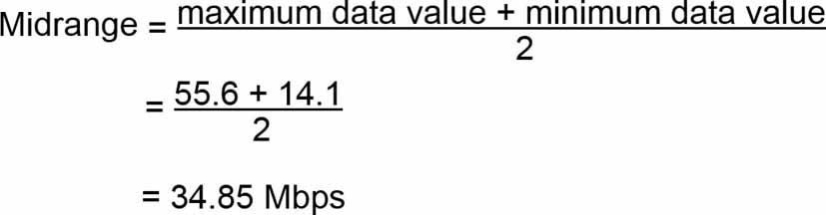
Example: Midrange
Find the midrange of these Verizon data speeds: 38.5, 55.6, 22.4, 14.1, and 23.1 (all in Mbps)
Solution
The midrange is found as follows:

Slide 29
Round-Off Rules for Measures of Center
For the mean, median, and midrange, carry one more decimal place than is present in the original set of values.
For the mode, leave the value as is without rounding (because values of the mode are the same as some of the original data values).

Slide 30
Critical Thinking
We can always calculate measures of center from a sample of numbers, but we should always think about whether it makes sense to do that.
We should also think about the sampling method used to collect the data.

Slide 31
Example: Critical Thinking and Measures of Center (1 of 2)
See each of the following illustrating situations in which the mean and median are not meaningful statistics.
a. Zip codes of the Gateway Arch in St. Louis, White House, Air Force division of the Pentagon, Empire State Building, and Statue of Liberty: 63102, 20500, 20330, 10118, 10004. The zip codes don’t measure or count anything. The numbers are just labels for geographic locations.

Slide 32
Example: Critical Thinking and Measures of Center (2 of 2)
See each of the following illustrating situations in which the mean and median are not meaningful statistics.
b. Ranks of selected national universities of Harvard, Yale, Duke, Dartmouth, and Brown (from U.S. News & World Report): 2, 3, 7, 10, 14. The ranks reflect an ordering, but they don’t measure or count anything.

Slide 33
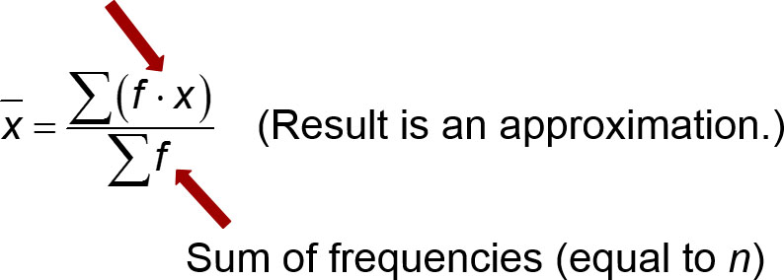
Calculating the Mean from a Frequency Distribution
Mean from a Frequency Distribution
  First multiply each frequency and class midpoint; then add the products.

Slide 34
Example: Computing the Mean from a Frequency Distribution (1 of 2)
The first two columns of the table shown here are the same as the frequency distribution of Table 2-2 from Chapter 2. Use the frequency distribution in the first two columns to find the mean.
Time (seconds) | Frequency f | Class Midpoint x | f · x
75 – 124 | 11 | 99.5 | 1094.5
125 – 174 | 24 | 149.5 | 3588.0
175 – 224 | 10 | 199.5 | 1995.0
225 – 274 | 3 | 249.5 | 748.5
275 – 324 | 2 | 299.5 | 599.0
Totals: | ∑f = 50 | Blank | ∑(f · x) = 8025.0

Slide 35
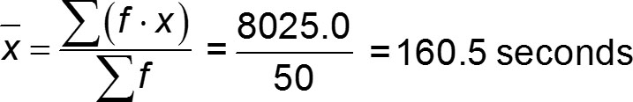
Example: Computing the Mean from a Frequency Distribution (2 of 2)
Solution
When working with data summarized in a frequency distribution, we make calculations possible by pretending that all sample values in each class are equal to the class midpoint.
The result of x = 160.5 seconds is an approximation because it is based on the use of class midpoint values instead of the original list of service times.

Slide 36

Calculating a Weighted Mean
Weighted Mean
  When different x data values are assigned different weights w, we can compute a weighted mean.

Slide 37
Example: Computing Grade-Point Average (1 of 4)
In her first semester of college, a student of the author took five courses. Her final grades, along with the number of credits for each course, were A (3 credits), A (4 credits), B (3 credits), C (3 credits), and F (1 credit).
The grading system assigns quality points to letter grades as follows: A = 4; B = 3; C = 2; D = 1; F = 0. Compute her grade-point average.

Slide 38
Example: Computing Grade-Point Average (2 of 4)
Solution
Use the numbers of credits as weights: w = 3, 4, 3, 3, 1.
Replace the letter grades of A, A, B, C, and F with the corresponding quality points: x = 4, 4, 3, 2, 0.

Slide 39
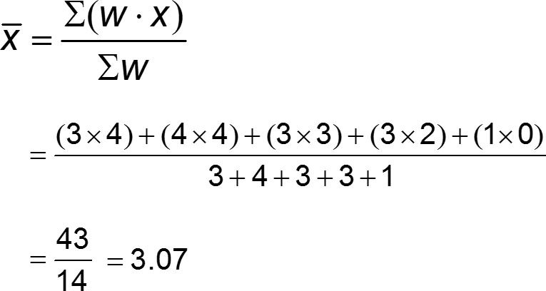
Example: Computing Grade-Point Average (3 of 4)
Solution

Slide 40
Example: Computing Grade-Point Average (4 of 4)
Solution
The result is a first-semester grade-point average of 3.07. (In using the preceding round-off rule, the result should be rounded to 3.1, but it is common to round grade-point averages to two decimal places.)

Slide 41
Describing, Exploring, and Comparing Data
3-1 Measures of Center
3-2 Measures of Variation
3-3 Measures of Relative Standing and Boxplots

Slide 42
Key Concept
Variation is the single most important topic in statistics, so this is the single most important section in this book. This section presents three important measures of variation: range, standard deviation, and variance.
These statistics are numbers, but our focus is not just computing those numbers but developing the ability to interpret and understand them.

Slide 43
Round-off Rule for Measures of Variation
Round-off Rule for Measures of Variation
  When rounding the value of a measure of variation, carry one more decimal place than is present in the original set of data.

Slide 44
Range
Range
  The range of a set of data values is the difference between the maximum data value and the minimum data value.
Range = (maximum data value) − (minimum data value)

Slide 45
Important Property of Range
The range uses only the maximum and the minimum data values, so it is very sensitive to extreme values. The range is not resistant.
Because the range uses only the maximum and minimum values, it does not take every value into account and therefore does not truly reflect the variation among all of the data values.

Slide 46
Example: Range
Find the range of these Verizon data speeds (Mbps): 38.5, 55.6, 22.4, 14.1, 23.1.
Solution
Range = (maximum value) − (minimum value)
= 55.6 − 14.1 = 41.50 Mbps

Slide 47
Standard Deviation of a Sample (1 of 2)
Standard Deviation
  The standard deviation of a set of sample values, denoted by s, is a measure of how much data values deviate away from the mean.
Notation
s = sample standard deviation
σ = population standard deviation

Slide 48
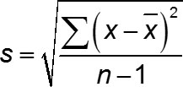
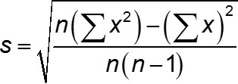
Standard Deviation of a Sample (2 of 2)
Standard Deviation
sample standard deviation
Shortcut formula for sample standard deviation (used by calculators and software)

Slide 49
Important Properties of Standard Deviation (1 of 2)
The standard deviation is a measure of how much data values deviate away from the mean.
The value of the standard deviation s is never negative. It is zero only when all of the data values are exactly the same.
Larger values of s indicate greater amounts of variation.

Slide 50
Important Properties of Standard Deviation (2 of 2)
The standard deviation s can increase dramatically with one or more outliers.
The units of the standard deviation s (such as minutes, feet, pounds) are the same as the units of the original data values.
The sample standard deviation s is a biased estimator of the population standard deviation σ, which means that values of the sample standard deviation s do not center around the value of σ.

Slide 51
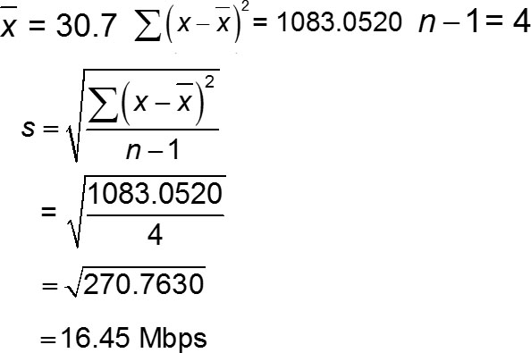
Example: Calculating Standard Deviation
Use sample standard deviation formula to find the standard deviation of these Verizon data speed times (in Mbps): 38.5, 55.6, 22.4, 14.1, 23.1.
Solution

Slide 52
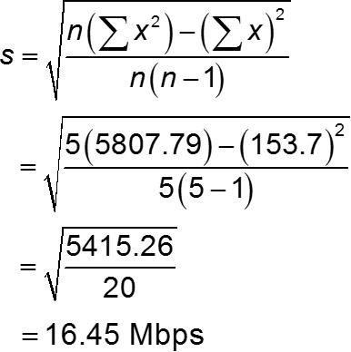
Example: Calculating Standard Deviation Using Shortcut Formula
Find the standard deviation of the Verizon data speeds (Mbps) of 38.5, 55.6, 22.4, 14.1, 23.1
Solution

Slide 53
Range Rule of Thumb for Understanding Standard Deviation
Range Rule of Thumb
  The range rule of thumb is a crude but simple tool for understanding and interpreting standard deviation. The vast majority (such as 95%) of sample values lie within 2 standard deviations of the mean.

Slide 54
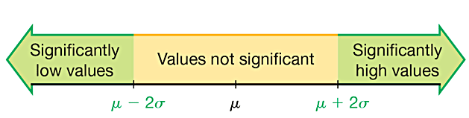
Range Rule of Thumb for Identifying Significant Values
Significantly low values are µ − 2σ or lower.
Significantly high values are µ + 2σ or higher.
Values not significant are between (µ − 2σ ) and (µ + 2σ).

Slide 55

Range Rule of Thumb for Estimating a Value of the Standard Deviation s
Range Rule of Thumb for Estimating a Value of the Standard Deviation
  To roughly estimate the standard deviation from a collection of known sample data, use

Slide 56
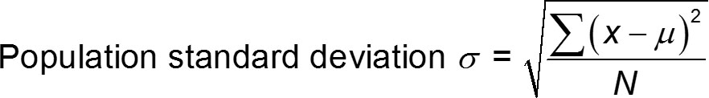
Standard Deviation of a Population
Standard Deviation of a Population
  A different formula is used to calculate the standard deviation σ of a population: Instead of dividing by n − 1 for a sample, we divide by the population size N.

Slide 57
Variance of a Sample and a Population
Variance
  The variance of a set of values is a measure of variation equal to the square of the standard deviation.
    Sample variance: s² = square of the standard deviation s.
    Population variance: σ² = square of the population standard deviation σ.

Slide 58
Notation Summary
s = sample standard deviation
s² = sample variance
σ = population standard deviation
σ² = population variance

Slide 59
Important Properties of Variance
The units of the variance are the squares of the units of the original data values.
The value of the variance can increase dramatically with the inclusion of outliers. (The variance is not resistant.)
The value of the variance is never negative. It is zero only when all of the data values are the same number.
The sample variance s² is an unbiased estimator of the population variance σ².

Slide 60
Why Divide by (n – 1)?
There are only n − 1 values that can assigned without constraint. With a given mean, we can use any numbers for the first n − 1 values, but the last value will then be automatically determined.
With division by n − 1, sample variances s² tend to center around the value of the population variance σ²; with division by n, sample variances s² tend to underestimate the value of the population variance σ².

Slide 61
Empirical Rule for Data with a Bell-Shaped Distribution
The empirical rule states that for data sets having a distribution that is approximately bell-shaped, the following properties apply.
  About 68% of all values fall within 1 standard deviation of the mean.
  About 95% of all values fall within 2 standard deviations of the mean.
  About 99.7% of all values fall within 3 standard deviations of the mean.

Slide 62
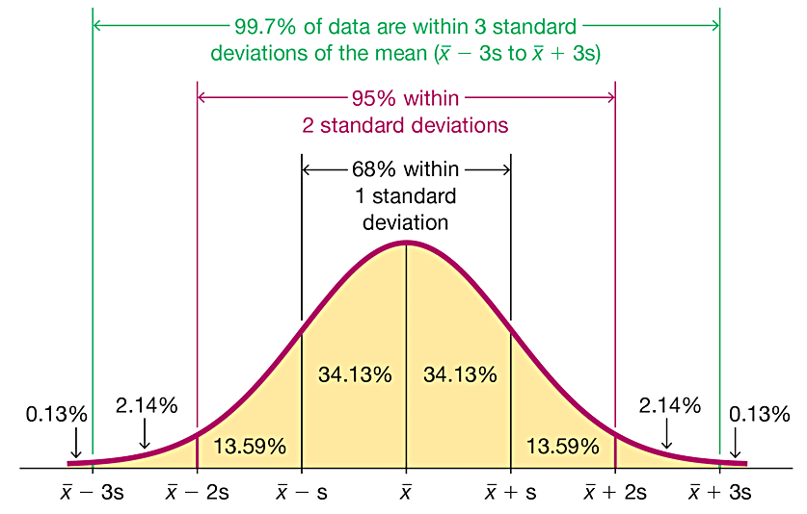
The Empirical Rule

Slide 63
Example: The Empirical Rule (1 of 2)
IQ scores have a bell-shaped distribution with a mean of 100 and a standard deviation of 15. What percentage of IQ scores are between 70 and 130?

Slide 64
Example: The Empirical Rule (2 of 2)
Solution
The key is to recognize that 70 and 130 are each exactly 2 standard deviations away from the mean of 100.
2 standard deviations = 2s = 2(15) = 30
2 standard deviations from the mean is
100 − 30 = 70
or 100 + 30 = 130
About 95% of all IQ scores are between 70 and 130.

Slide 65
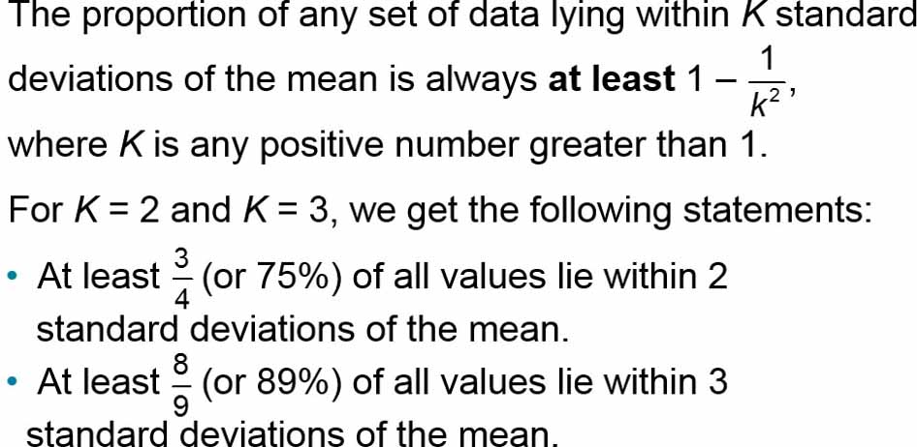
Chebyshev’s Theorem

Slide 66
Example: Chebyshev’s Theorem (1 of 2)
IQ scores have a mean of 100 and a standard deviation of 15. What can we conclude from Chebyshev’s theorem?

Slide 67
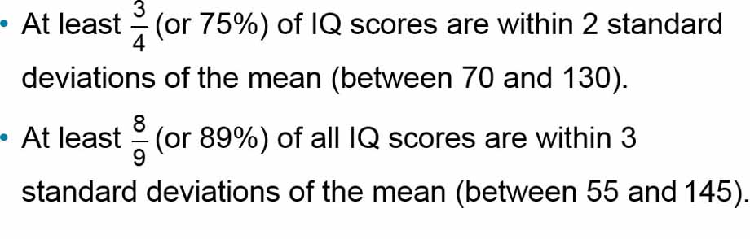
Example: Chebyshev’s Theorem (2 of 2)
Solution
Applying Chebyshev’s theorem with a mean of 100 and a standard deviation of 15, we can reach the following conclusions:

Slide 68
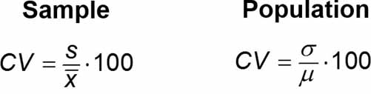
Comparing Variation in Different Samples or Populations
Coefficient of Variation
  The coefficient of variation (or CV) for a set of nonnegative sample or population data, expressed as a percent, describes the standard deviation relative to the mean, and is given by the following:

Slide 69
Round-off Rule for the Coefficient of Variation
Round the coefficient of variation to one decimal place (such as 25.3%).

Slide 70
Biased and Unbiased Estimators
The sample standard deviation s is a biased estimator of the population standard deviation s, which means that values of the sample standard deviation s do not tend to center around the value of the population standard deviation σ.
The sample variance s² is an unbiased estimator of the population variance σ², which means that values of s² tend to center around the value of σ² instead of systematically tending to overestimate or underestimate σ².

Slide 71
Describing, Exploring, and Comparing Data
3-1 Measures of Center
3-2 Measures of Variation
3-3 Measures of Relative Standing and Boxplots

Slide 72
Key Concept
This section introduces measures of relative standing, which are numbers showing the location of data values relative to the other values within the same data set.
The most important concept in this section is the z score.
We also discuss percentiles and quartiles, which are common statistics, as well as another statistical graph called a boxplot.

Slide 73
z Scores
z Score
  A z score (or standard score or standardized value) is the number of standard deviations that a given value x is above or below the mean. The z score is calculated by using one of the following:
Sample
Population
or

Slide 74
Round-off Rule for z Scores
Round z scores to two decimal places (such as 2.31).

Slide 75
Important Properties of z Scores
A z score is the number of standard deviations that a given value x is above or below the mean.
​z scores are expressed as numbers with no units of measurement.
A data value is significantly low if its z score is less than or equal to −2 or the value is significantly high if its z score is greater than or equal to +2.
If an individual data value is less than the mean, its corresponding z score is a negative number.

Slide 76
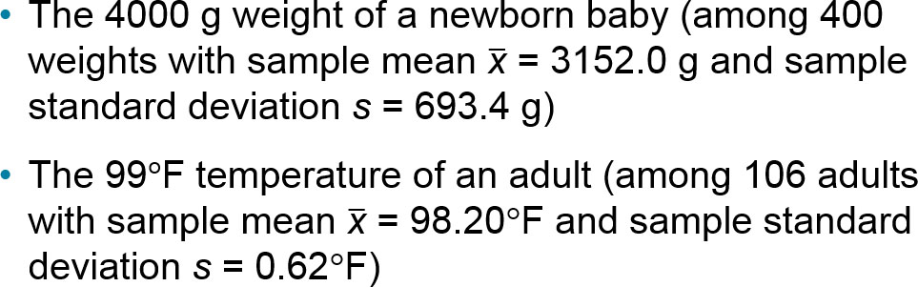
Example: Comparing a Baby’s Weight and Adult Body Temperature (1 of 3)
Which of the following two data values is more extreme relative to the data set from which it came?

Slide 77
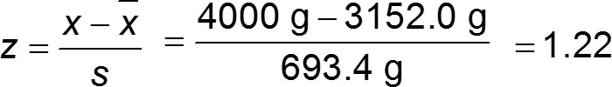

Example: Comparing a Baby’s Weight and Adult Body Temperature (2 of 3)
Solution
4000 g birth weight:

Slide 78
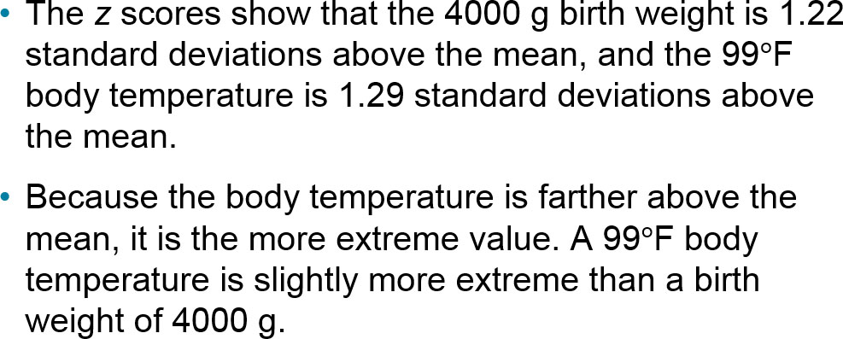
Example: Comparing a Baby’s Weight and Adult Body Temperature (3 of 3)
Interpretation

Slide 79
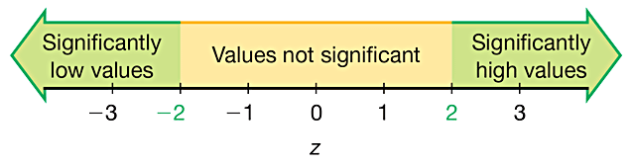
Using z Scores to Identify Significant Values
Significant values are those with
z scores ≤ −2.00 or ≥ 2.00.

Slide 80
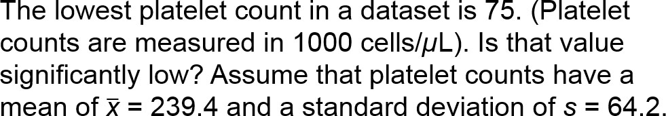
Example: Is a Platelet Count of 75 Significantly Low? (1 of 3)

Slide 81

Example: Is a Platelet Count of 75 Significantly Low? (2 of 3)
Solution
The platelet count of 75 is converted to a z score as shown below:

Slide 82
Example: Is a Platelet Count of 75 Significantly Low? (3 of 3)
Interpretation
The platelet count of 75 converts to the z score of −2.56. z = −2.56 is less than −2, so the platelet count of 75 is significantly low. (Low platelet counts are called thrombocytopenia, not for the lack of a better term.)

Slide 83
Percentiles
Percentiles
  Percentiles are measures of location, denoted P₁, P₂, . . . , P₉₉, which divide a set of data into 100 groups with about 1% of the values in each group.

Slide 84
Finding the Percentile of a Data Value
The process of finding the percentile that corresponds to a particular data value x is given by the following (round the result to the nearest whole number):

Slide 85
Example: Finding a Percentile (1 of 3)
The airport Verizon cell phone data speeds listed below are arranged in increasing order. Find the percentile for the data speed of 11.8 Mbps.
0.8 | 1.4 | 1.8 | 1.9 | 3.2 | 3.6 | 4.5 | 4.5 | 4.6 | 6.2
6.5 | 7.7 | 7.9 | 9.9 | 10.2 | 10.3 | 10.9 | 11.1 | 11.1 | 11.6
11.8 | 12.0 | 13.1 | 13.5 | 13.7 | 14.1 | 14.2 | 14.7 | 15.0 | 15.1
15.5 | 15.8 | 16.0 | 17.5 | 18.2 | 20.2 | 21.1 | 21.5 | 22.2 | 22.4
23.1 | 24.5 | 25.7 | 28.5 | 34.6 | 38.5 | 43.0 | 55.6 | 71.3 | 77.8

Slide 86

Example: Finding a Percentile (2 of 3)
Solution
From the sorted list of airport data speeds in the table, we see that there are 20 data speeds less than 11.8 Mbps, so

Slide 87
Example: Finding a Percentile (3 of 3)
Interpretation
A data speed of 11.8 Mbps is in the 40th percentile. This can be interpreted loosely as this:
A data speed of 11.8 Mbps separates the lowest 40% of values from the highest 60% of values. We have P₄₀ = 11.8 Mbps.

Slide 88
Notation
n total number of values in the data set
k percentile being used (Example: For the 25th percentile, k = 25.)
L locator that gives the position of a value (Example: For the 12th value in the sorted list, L = 12.)
P_{k} kth percentile (Example: P₂₅ is the 25th percentile.)

Slide 89
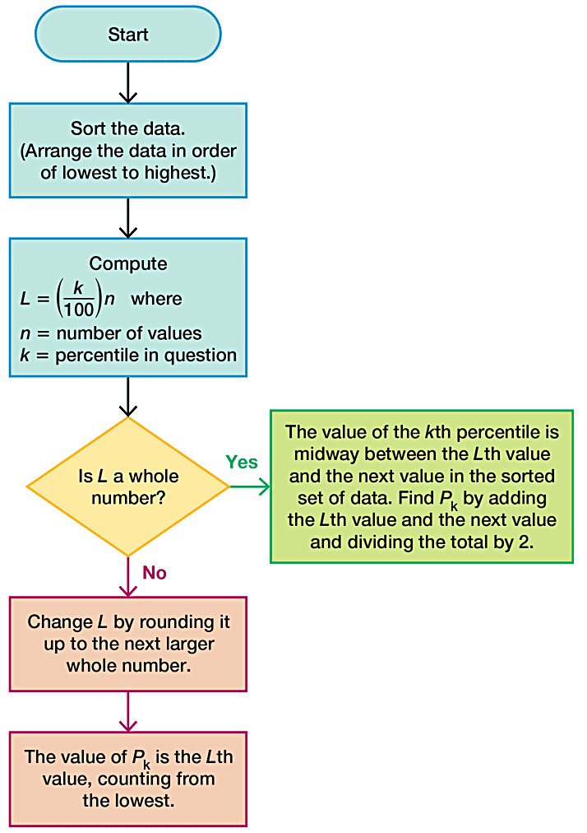
Converting a Percentile to a Data Value

Slide 90
Example: Converting a Percentile to a Data Value (1 of 4)
Refer to the sorted data speeds below. Find the 40th percentile, denoted by P₄₀.
0.8 | 1.4 | 1.8 | 1.9 | 3.2 | 3.6 | 4.5 | 4.5 | 4.6 | 6.2
6.5 | 7.7 | 7.9 | 9.9 | 10.2 | 10.3 | 10.9 | 11.1 | 11.1 | 11.6
11.8 | 12.0 | 13.1 | 13.5 | 13.7 | 14.1 | 14.2 | 14.7 | 15.0 | 15.1
15.5 | 15.8 | 16.0 | 17.5 | 18.2 | 20.2 | 21.1 | 21.5 | 22.2 | 22.4
23.1 | 24.5 | 25.7 | 28.5 | 34.6 | 38.5 | 43.0 | 55.6 | 71.3 | 77.8

Slide 91

Example: Converting a Percentile to a Data Value (2 of 4)
Solution
We can proceed to compute the value of the locator L. In this computation, we use k = 40 because we are attempting to find the value of the 40th percentile, and we use n = 50 because there are 50 data values.

Slide 92
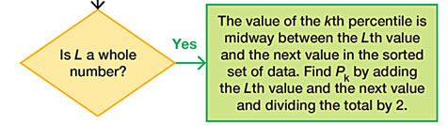
Example: Converting a Percentile to a Data Value (3 of 4)
Solution
Since L = 20 is a whole number, we proceed to the box located at the right.
We now see that the value of the 40th percentile is midway between the Lth (20th) value and the next value in the original set of data. That is, the value of the 40th percentile is midway between the 20th value and the 21st value.

Slide 93
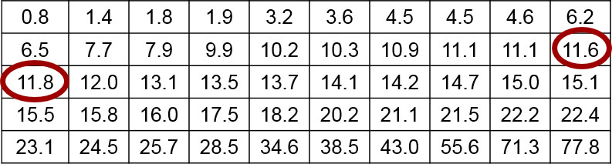
Example: Converting a Percentile to a Data Value (4 of 4)
Solution
The 20th value in the table is 11.6 and the 21st value is 11.8, so the value midway between them is 11.7 Mbps. We conclude that the 40th percentile is P₄₀ = 11.7 Mbps.

Slide 94
Quartiles
Quartiles
  Quartiles are measures of location, denoted Q₁, Q₂, and Q₃, which divide a set of data into four groups with about 25% of the values in each group.

Slide 95
Descriptions of Quartiles (1 of 2)
Q₁ (First quartile):
  Same value as P₂₅. It separates the bottom 25% of the sorted values from the top 75%.
  Q₂ (Second quartile):
  Same as P₅₀ and same as the median. It separates the bottom 50% of the sorted values from the top 50%.

Slide 96
Descriptions of Quartiles (2 of 2)
Q₃ (Third quartile):
  Same as P₇₅. It separates the bottom 75% of the sorted values from the top 25%.
Caution Just as there is not universal agreement on a procedure for finding percentiles, there is not universal agreement on a single procedure for calculating quartiles, and different technologies often yield different results.

Slide 97
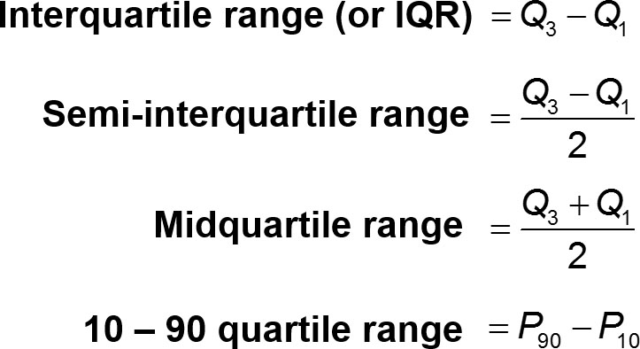
Statistics defined using quartiles and percentiles

Slide 98
5-Number Summary
5-Number Summary
  For a set of data, the 5-number summary consists of these five values:
  Minimum
  First quartile, Q₁
  Second quartile, Q₂ (same as the median)
  Third quartile, Q₃
  Maximum

Slide 99
Example: Finding a 5-Number Summary (1 of 3)
Use the Verizon airport data speeds to find the 5-number summary.
0.8 | 1.4 | 1.8 | 1.9 | 3.2 | 3.6 | 4.5 | 4.5 | 4.6 | 6.2
6.5 | 7.7 | 7.9 | 9.9 | 10.2 | 10.3 | 10.9 | 11.1 | 11.1 | 11.6
11.8 | 12.0 | 13.1 | 13.5 | 13.7 | 14.1 | 14.2 | 14.7 | 15.0 | 15.1
15.5 | 15.8 | 16.0 | 17.5 | 18.2 | 20.2 | 21.1 | 21.5 | 22.2 | 22.4
23.1 | 24.5 | 25.7 | 28.5 | 34.6 | 38.5 | 43.0 | 55.6 | 71.3 | 77.8

Slide 100
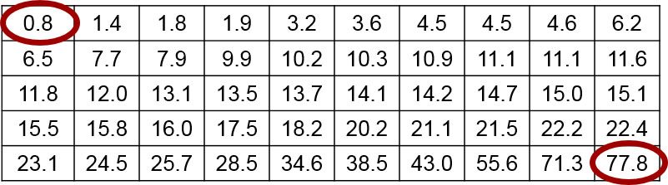
Example: Finding a 5-Number Summary (2 of 3)
Solution
Because the Verizon airport data speeds are sorted, it is easy to see that the minimum is 0.8 Mbps and the maximum is 77.8 Mbps.

Slide 101
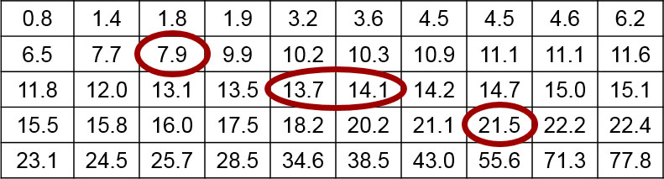
Example: Finding a 5-Number Summary (3 of 3)
Solution
The value of the first quartile is Q₁ = 7.9 Mbps. The median is equal to Q₂, and it is 13.9 Mbps. Also, we can find that
Q₃ = 21.5 Mbps by using the same procedure for finding P_{75.}
The 5-number summary is therefore 0.8, 7.9, 13.9, 21.5, and 77.8 (all in units of Mbps).

Slide 102
Boxplot (or Box-and-Whisker Diagram)
Boxplot (or Box-and-Whisker Diagram)
  A boxplot (or box-and-whisker diagram) is a graph of a data set that consists of a line extending from the minimum value to the maximum value, and a box with lines drawn at the first quartile Q₁, the median, and the third quartile Q₃.

Slide 103
Procedure for Constructing a Boxplot
Find the 5-number summary (minimum value, Q₁, Q₂, Q₃, maximum value).
Construct a line segment extending from the minimum data value to the maximum data value.
Construct a box (rectangle) extending from Q₁ to Q₃, and draw a line in the box at the value of Q₂ (median).

Slide 104
Example: Constructing a Boxplot (1 of 2)
Use the Verizon airport data speeds to construct a boxplot.
0.8 | 1.4 | 1.8 | 1.9 | 3.2 | 3.6 | 4.5 | 4.5 | 4.6 | 6.2
6.5 | 7.7 | 7.9 | 9.9 | 10.2 | 10.3 | 10.9 | 11.1 | 11.1 | 11.6
11.8 | 12.0 | 13.1 | 13.5 | 13.7 | 14.1 | 14.2 | 14.7 | 15.0 | 15.1
15.5 | 15.8 | 16.0 | 17.5 | 18.2 | 20.2 | 21.1 | 21.5 | 22.2 | 22.4
23.1 | 24.5 | 25.7 | 28.5 | 34.6 | 38.5 | 43.0 | 55.6 | 71.3 | 77.8

Slide 105
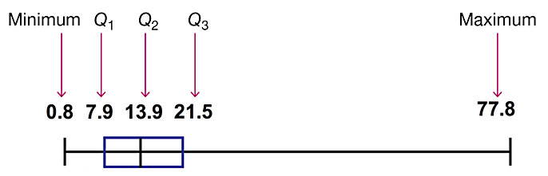
Example: Constructing a Boxplot (2 of 2)
Solution
The boxplot uses the 5-number summary found in the previous example: 0.8, 7.9, 13.9, 21.5, and 77.8 (all in units of Mbps). Below is the boxplot representing the Verizon airport data speeds.

Slide 106
Skewness
Skewness
  A boxplot can often be used to identify skewness. A distribution of data is skewed if it is not symmetric and extends more to one side than to the other.

Slide 107
Identifying Outliers for Modified Boxplots
Find the quartiles Q₁, Q₂, and Q₃.
Find the interquartile range (IQR), where IQR = Q₃ − Q₁.
Evaluate 1.5 × IQR.
In a modified boxplot, a data value is an outlier if it is above Q₃, by an amount greater than 1.5 × IQR or below Q₁, by an amount greater than 1.5 × IQR.

Slide 108
Modified Boxplots
Modified Boxplots
  A modified boxplot is a regular boxplot constructed with these modifications:
  A special symbol (such as an asterisk or point) is used to identify outliers as defined above, and
  the solid horizontal line extends only as far as the minimum data value that is not an outlier and the maximum data value that is not an outlier.

