Slide 1
Cryptography and Network Security
Chapter 11
Fifth Edition
by William Stallings
Lecture slides by Lawrie Brown
Notes:
Lecture slides by Lawrie Brown for “Cryptography and Network Security”, 5/e, by William Stallings, Chapter 11 – “Cryptographic Hash Functions”.

Slide 2
Cryptographic Hash Functions
  A hash function maps a message of an arbitrary length to a m-bit output (160 bits -512 bits)
  h = H(M)
  Output h known as the fingerprint or the message digest
  If the message digest is transmitted securely, then changes to the message can be detected
  The principal object of a hash function is data integrity.
  usually assume hash function is public
A hash is a many-to-one function, so collisions can happen.
To check the integrity of a message M' at a later time,compute h' = H(M') and verify that h = h'.

Slide 3
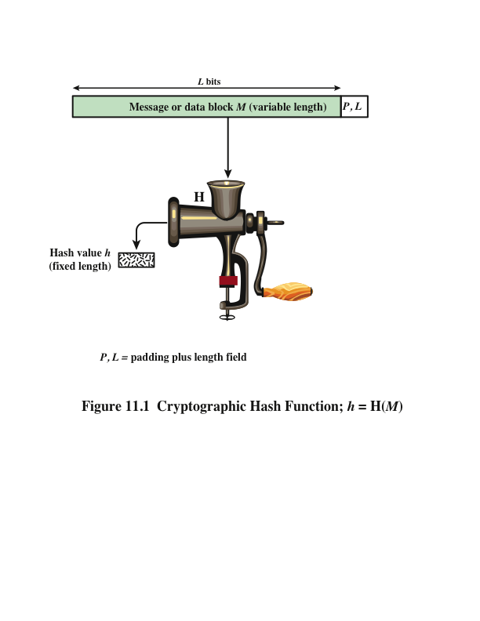
Notes:
Figure 11.1 depicts the general operation of a cryptographic hash function.
Typically, the input is padded out to an integer multiple of some fixed length
(e.g., 1024 bits), and the padding includes the value of the length of the original message
in bits. The length field is a security measure to increase the difficulty for an
attacker to produce an alternative message with the same hash value.

Slide 4
Hash function example
To see the change in the hash code produced by an innocuous (practically invisible) change in a message, h
  Message: "A hungry brown fox jumped over a lazy dog"
  SHA1 hash code: a8e7038cf5042232ce4a2f582640f2aa5caf12d2
  Message: "A hungry brown fox jumped over a lazy dog"
  SHA1 hash code: d617ba80a8bc883c1c3870af12a516c4a30f8fda
The only diﬀerence between the two messages shown above is the extra space between the words “hungry” and “brown” in the second message

Slide 5
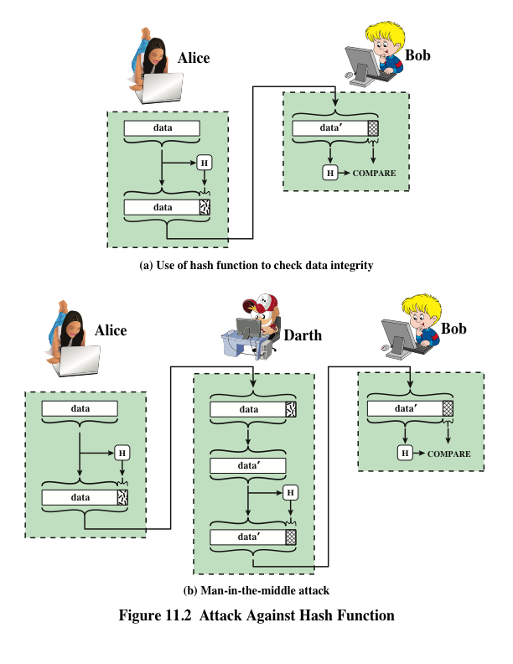
Notes:
Message authentication is a mechanism or service used to verify the integrity of
a message. Message authentication assures that data received are exactly as sent
(i.e., contain no modification, insertion, deletion, or replay). In many cases, there is
a requirement that the authentication mechanism assures that purported identity of
the sender is valid. When a hash function is used to provide message authentication,
the hash function value is often referred to as a message digest .
The essence of the use of a hash function for message authentication is as
follows. The sender computes a hash value as a function of the bits in the message
and transmits both the hash value and the message. The receiver performs the same
hash calculation on the message bits and compares this value with the incoming
hash value. If there is a mismatch, the receiver knows that the message (or possibly
the hash value) has been altered (Figure 11.2a).
The hash function must be transmitted in a secure fashion. That is, the hash
function must be protected so that if an adversary alters or replaces the message,
it is not feasible for adversary to also alter the hash value to fool the receiver. This
type of attack is shown in Figure 11.2b. In this example, Alice transmits a data block
and attaches a hash value. Darth intercepts the message, alters or replaces the data
block, and calculates and attaches a new hash value. Bob receives the altered data
with the new hash value and does not detect the change. To prevent this attack, the
hash value generated by Alice must be protected.

Slide 6
Preimage and Collisions
For hash value h = H(x), x is preimage of h
H is a many-to-one mapping; h has multiple preimages
Collision occurs if x ≠ y and H(x) = H(y)
Collisions are undesirable
How many preimages for given hash value?
  If H takes b-bit input block, 2^{b} possible messages
  For n-bit hash code, where b > n, 2^{n} possible hash codes
  On average, if uniformly distributed hash values, then each hash value has 2 ^{b-n} preimages

Slide 7
Requirements for Cryptographic Hash Functions
Compression: h reduces M to a ﬁxed size.
For any M, H(M) is easy to compute.
preimage resistant (one-way):
  For any value h, it is computationally infeasible to ﬁnd M such that h = H(M).
2-nd preimage resistant (weak collision resistant):
  For any values h and M such that h = H(M), it is computationally infeasible to ﬁnd M'≠ M such that h = H(M').
collision resistant (strong collision resistant):
  It is computationally infeasible to ﬁnd any pair M1, M2 such that H(M1) = H(M2).

Slide 8
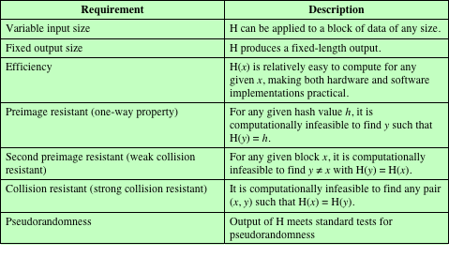
Table 11.1
Requirements for a Cryptographic Hash Function H
(Table can be found on page 323 in textbook.)
Notes:
Table 11.1 lists the generally accepted requirements for a cryptographic hash function.
The first three properties are requirements for the practical application of a
hash function.
The fourth property, preimage resistant , is the one-way property: it is easy
to generate a code given a message, but virtually impossible to generate a message
given a code. This property is important if the authentication technique involves the
use of a secret value (Figure 11.3c). The secret value itself is not sent.
The fifth property, second preimage resistant , guarantees that it is impossible
to find an alternative message with the same hash value as a given message. This
prevents forgery when an encrypted hash code is used (Figures 11.3b and 11.4a). If
this property were not true, an attacker would be capable of the following sequence:
First, observe or intercept a message plus its encrypted hash code; second, generate
an unencrypted hash code from the message; third, generate an alternate message
with the same hash code.
A hash function that satisfies the first five properties in Table 11.1 is referred
to as a weak hash function. If the sixth property, collision resistant , is also satisfied,
then it is referred to as a strong hash function. A strong hash function protects
against an attack in which one party generates a message for another party to sign.
For example, suppose Bob writes an IOU message, sends it to Alice, and she signs
it. Bob finds two messages with the same hash, one of which requires Alice to pay a
small amount and one that requires a large payment. Alice signs the first message,
and Bob is then able to claim that the second message is authentic
The final requirement in Table 11.1, pseudorandomness , has not traditionally
been listed as a requirement of cryptographic hash functions but is more or less implied.
[JOHN05] points out that cryptographic hash functions are commonly used
for key derivation and pseudorandom number generation, and that in message integrity
applications, the three resistant properties depend on the output of the hash
function appearing to be random. Thus, it makes sense to verify that in fact a given
hash function produces pseudorandom output..

Slide 9
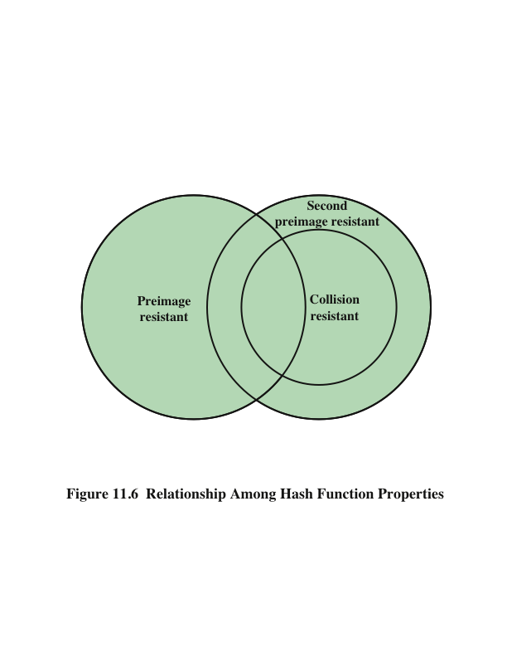
Notes:
Figure 11.6 shows the relationships among the three resistant properties.
A function that is collision resistant is also second preimage resistant, but the
reverse is not necessarily true. A function can be collision resistant but not preimage
resistant and vice versa. A function can be preimage resistant but not second
preimage resistant and vice versa. See [MENE97] for a discussion.

Slide 10
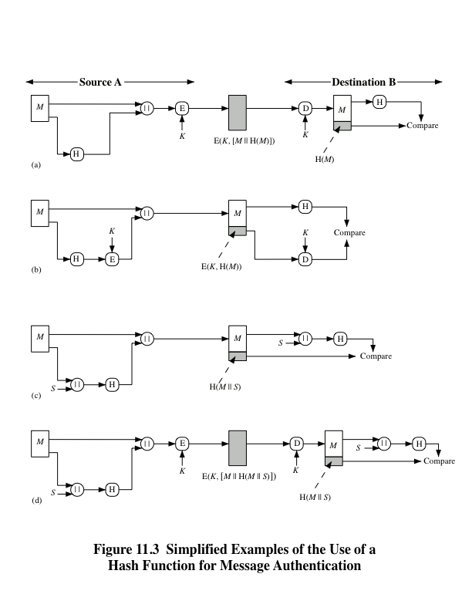
Notes:
Figure 11.3 illustrates a variety of ways in which a hash code can be used to
provide message authentication, as follows:
a. The message plus concatenated hash code is encrypted using symmetric
encryption. Because only A and B share the secret key, the message must
have come from A and has not been altered. The hash code provides the structure
or redundancy required to achieve authentication. Because encryption is
applied to the entire message plus hash code, confidentiality is also provided.
b. Only the hash code is encrypted, using symmetric encryption. This reduces the
processing burden for those applications that do not require confidentiality.
c. It is possible to use a hash function but no encryption for message authentication.
The technique assumes that the two communicating parties share a common secret
value S. A computes the hash value over the concatenation of M and S and
appends the resulting hash value to M. Because B possesses S, it can recompute
the hash value to verify. Because the secret value itself is not sent, an opponent
cannot modify an intercepted message and cannot generate a false message.
d. Confidentiality can be added to the approach of method (c) by encrypting the
entire message plus the hash code.
When confidentiality is not required, method (b) has an advantage over
methods (a) and (d), which encrypts the entire message, in that less computation
is required. Nevertheless, there has been growing interest in techniques that
avoid encryption (Figure 11.3c). Several reasons for this interest are pointed out in
[TSUD92].
• Encryption software is relatively slow. Even though the amount of data to be
encrypted per message is small, there may be a steady stream of messages into
and out of a system.
• Encryption hardware costs are not negligible. Low-cost chip implementations
of DES are available, but the cost adds up if all nodes in a network must have
this capability.
• Encryption hardware is optimized toward large data sizes. For small blocks
of data, a high proportion of the time is spent in initialization/invocation
overhead.
• Encryption algorithms may be covered by patents, and there is a cost associated
with licensing their use.

Slide 11
Authentication and Encryption
Sometimes desirable to avoid encryption when performing authentication
  Encryption in software can be slow
  Encryption in hardware has financial costs
  Encryption hardware can be ineficient for small amounts of data
  Encryption algorithms may be patented, increasing costs to use

Slide 12
Other Hash Function Uses
Uses of hash function
  message authentication,
  digital signatures,
  one-way password file -store hash of password not actual password
  intrusion/virus detection - keep & check hash of files on system
  pseudorandom function (PRF) or pseudorandom number generator (PRNG)
Notes:
Hash functions are commonly used to create a one-way password file. Chapter 20 explains a scheme in which a hash of a password is stored by an operating system rather than the password itself. Thus, the actual password is not retrievable by a hacker who gains access to the password file. In simple terms, when a user enters a password, the hash of that password is compared to the stored hash value for verification. This approach to password protection is used by most operating systems.
Hash functions can be used for intrusion detection and virus detection. Store H(F) for each file on a system and secure the hash values (e.g., on a CD-R that is kept secure). One can later determine if a file has been modified by recomputing H(F). An intruder would need to change F without changing H(F).
A cryptographic hash function can be used to construct a pseudorandom function (PRF) or a pseudorandom number generator (PRNG). A common application for a hash-based PRF is for the generation of symmetric keys. We discuss this application in Chapter 12.

Slide 13
Message Authentication Code (MAC)
Also known as a keyed hash function
Typically used between two parties that share a secret key to authenticate information exchanged between those parties
  Combining hash function and encryption produces same result as MAC; but MAC algorithms can be more efficient than encryption algorithms ( which figure in slide#6 that illustrates that ?)
Takes as input a secret key and a data block and produces a hash value (MAC) which is associated with the protected message
If the integrity of the message needs to be checked, the MAC function can be applied to the message and the result compared with the associated MAC value
An attacker who alters the message will be unable to alter the associated MAC value without knowledge of the secret key
Notes:
More commonly, message authentication is achieved using a message authentication
code (MAC ), also known as a keyed hash function . Typically, MACs are
used between two parties that share a secret key to authenticate information exchanged
between those parties. A MAC function takes as input a secret key and a
data block and produces a hash value, referred to as the MAC, which is associated
with the protected message. If the integrity of the message needs to be checked, the
MAC function can be applied to the message and the result compared with the associated
MAC value. An attacker who alters the message will be unable to alter the
associated MAC value without knowledge of the secret key. Note that the verifying
party also knows who the sending party is because no one else knows the secret key.
Note that the combination of hashing and encryption results in an overall
function that is, in fact, a MAC (Figure 11.3b). That is, E(K , H(M )) is a function of
a variable-length message M and a secret key K , and it produces a fixed-size output
that is secure against an opponent who does not know the secret key. In practice,
specific MAC algorithms are designed that are generally more efficient than an encryption
algorithm.

Slide 14
Digital Signature
Operation is similar to that of the MAC
The hash value of a message is encrypted with a user’s private key
Anyone who knows the user’s public key can verify the integrity of the message
An attacker who wishes to alter the message would need to know the user’s private key
Implications of digital signatures go beyond just message authentication
Notes:
Another important application, which is similar to the message authentication
Application, is the digital signature . The operation of the digital signature is similar
to that of the MAC. In the case of the digital signature, the hash value of a message
is encrypted with a user’s private key. Anyone who knows the user’s public key
can verify the integrity of the message that is associated with the digital signature.
In this case, an attacker who wishes to alter the message would need to know the
user’s private key. As we shall see in Chapter 14, the implications of digital signatures
go beyond just message authentication.

Slide 15
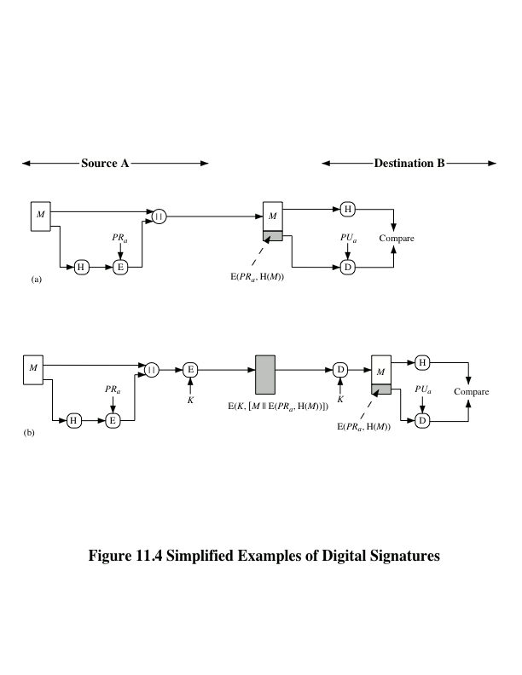
Notes:
Figure 11.4 illustrates, in a simplified fashion, how a hash code is used to provide
a digital signature.
a. The hash code is encrypted, using public-key encryption with the sender’s private
key. As with Figure 11.3b, this provides authentication. It also provides a
digital signature, because only the sender could have produced the encrypted
hash code. In fact, this is the essence of the digital signature technique.
b. If confidentiality as well as a digital signature is desired, then the message
plus the private-key-encrypted hash code can be encrypted using a symmetric
secret key. This is a common technique.

Slide 16
Other Hash Function Uses
Commonly used to create a one-way password file
When a user enters a password, the hash of that password is compared to the stored hash value for verification
This approach to password protection is used by most operating systems
Can be used for intrusion and virus detection
Store H(F) for each file on a system and secure the hash values
One can later determine if a file has been modified by recomputing H(F)
An intruder would need to change F without changing H(F)
Can be used to construct a pseudorandom function (PRF) or a pseudorandom number generator (PRNG)
A common application for a hash-based PRF is for the generation of symmetric keys
Notes:
Hash functions are commonly used to create a one-way password file . Chapter 21
explains a scheme in which a hash of a password is stored by an operating system
rather than the password itself. Thus, the actual password is not retrievable by
a hacker who gains access to the password file. In simple terms, when a user enters
a password, the hash of that password is compared to the stored hash value
for verification. This approach to password protection is used by most operating
systems.
Hash functions can be used for intrusion detection and virus detection . Store
H(F) for each file on a system and secure the hash values (e.g., on a CD-R that is
kept secure). One can later determine if a file has been modified by recomputing
H(F). An intruder would need to change F without changing H(F).
A cryptographic hash function can be used to construct a pseudorandom
function (PRF) or a pseudorandom number generator (PRNG) . A common application
for a hash-based PRF is for the generation of symmetric keys. We discuss this
application in Chapter 12.

Slide 17
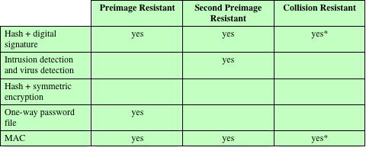
Table 11.2
Hash Function Resistance Properties Required for Various Data Integrity Applications
* Resistance required if attacker is able to mount a chosen message attack
Notes:
Table 11.2 shows the resistant properties required for various hash function
applications.

Slide 18
Two Simple Insecure Hash Functions
consider two simple insecure hash functions
bit-by-bit exclusive-OR (XOR) of every block
  reasonably effective as data integrity check
one-bit circular shift on hash value
  good for data integrity but useless for security
Notes:
To get some feel for the security considerations involved in cryptographic hash functions, we present two simple, insecure hash functions in this section. One of the simplest hash functions is the bit-by-bit exclusive-OR (XOR) of every block, which can be expressed as shown. This operation produces a simple parity for each bit position and is known as a longitudinal redundancy check. It is reasonably effective for random data as a data integrity check. Each n-bit hash value is equally likely. Thus, the probability that a data error will result in an unchanged hash value is 2^{–n}. With more predictably formatted data, the function is less effective. For example, in most normal text files, the high-order bit of each octet is always zero. So if a 128-bit hash value is used, instead of an effectiveness of 2^{–128}, the hash function on this type of data has an effectiveness of 2^{–112}.
A simple way to improve matters is to perform a one-bit circular shift, or rotation, on the hash value after each block is processed. Although this second procedure provides a good measure of data integrity, it is virtually useless for data security when an encrypted hash code is used with a plaintext message. Given a message, it is an easy matter to produce a new message that yields that hash code: Simply prepare the desired alternate message and then append an n-bit block that forces the new message plus block to yield the desired hash code.

Slide 19
Bit-by-Bit Exclusive OR
C_{i} = b_{i1} xor b_{i2} xor b_{i3} xor ::: b_{im}
C_{i} is ith bit of hash code, 1 ≤ i ≤ n
m is number of n-bit blocks in input
bij is ith bit in jth block
Probability data error result in unchanged hash value:2^{–n}
With structured data, ectiveness decreases
Notes:
To get some feel for the security considerations involved in cryptographic hash functions, we present two simple, insecure hash functions in this section. One of the simplest hash functions is the bit-by-bit exclusive-OR (XOR) of every block, which can be expressed as shown. This operation produces a simple parity for each bit position and is known as a longitudinal redundancy check. It is reasonably effective for random data as a data integrity check. Each n-bit hash value is equally likely. Thus, the probability that a data error will result in an unchanged hash value is 2^{–n}. With more predictably formatted data, the function is less effective. For example, in most normal text files, the high-order bit of each octet is always zero. So if a 128-bit hash value is used, instead of an effectiveness of 2^{–128}, the hash function on this type of data has an effectiveness of 2^{–112}.
A simple way to improve matters is to perform a one-bit circular shift, or rotation, on the hash value after each block is processed. Although this second procedure provides a good measure of data integrity, it is virtually useless for data security when an encrypted hash code is used with a plaintext message. Given a message, it is an easy matter to produce a new message that yields that hash code: Simply prepare the desired alternate message and then append an n-bit block that forces the new message plus block to yield the desired hash code.

Slide 20
Attacks on Hash Functions
Brute-Force Attacks
Cryptanalysis
Does not depend on the specific algorithm, only depends on bit length
In the case of a hash function, attack depends only on the bit length of the hash value
Method is to pick values at random and try each one until a collision occurs
An attack based on weaknesses in a particular cryptographic algorithm
Seek to exploit some property of the algorithm to perform some attack other than an exhaustive search
Notes:
As with encryption algorithms, there are two categories of attacks on hash
functions: brute-force attacks and cryptanalysis. A brute-force attack does not depend
on the specific algorithm but depends only on bit length. In the case of a hash
function, a brute-force attack depends only on the bit length of the hash value. A
cryptanalysis, in contrast, is an attack based on weaknesses in a particular cryptographic
algorithm.

Slide 21
SHA
Secure Hash Algorithm, developed by NIST
Standardized by NIST in FIPS 180 in 1993
Improvements over time: SHA-0, SHA-1, SHA-2,SHA-3
SHA-1 (and SHA-0) are considered insecure; no longer recommended
SHA -2 known as SHA-224, SHA-256, SHA-384, and SHA-512.
SHA-3 in development, competition run by NIST
Notes:
In 2002, NIST produced a revised version of the standard, FIPS 180-2, that defined three new versions of SHA, with hash value lengths of 256, 384, and 512 bits, known as SHA-256, SHA-384, and SHA-512. Collectively, these hash algorithms are known as SHA-2. These new versions have the same underlying structure and use the same types of modular arithmetic and logical binary operations as SHA-1, hence analyses should be similar. A revised document was issued as FIP PUB 180-3 in 2008, which added a 224-bit version. SHA-2 is also specified in RFC 4634, which essentially duplicates the material in FIPS 180-3, but adds a C code implementation.
In 2005, NIST announced the intention to phase out approval of SHA-1 and move to a reliance on the other SHA versions by 2010.

Slide 22
SHA Versions
 | SHA-1 | SHA-224 | SHA-256 | SHA-384 | SHA-512
Message digest size | 160 | 224 | 256 | 384 | 512
Message size | < 2⁶⁴ | < 2⁶⁴ | < 2⁶⁴ | < 2¹²⁸ | < 2¹²⁸
Block size | 512 | 512 | 512 | 1024 | 1024
Word size | 32 | 32 | 32 | 64 | 64
Number of steps | 80 | 64 | 64 | 80 | 80
Notes:
Stallings Table 11.3 provides a comparison of the various parameters for the SHA hash functions.

Slide 23
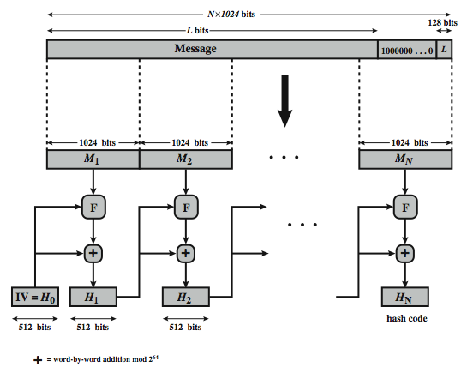
SHA-512 Overview
Notes:
Now examine the structure of SHA-512, noting that the other versions are quite similar.
SHA-512 follows the structure depicted in Stallings Figure 11.8. The processing consists of the following steps:
• Step 1: Append padding bits, consists of a single 1-bit followed by the necessary number of 0-bits, so that its length is congruent to 896 modulo 1024
• Step 2: Append length as an (big-endian) unsigned 128-bit integer
• Step 3: Initialize hash buffer to a set of 64-bit integer constants (see text)
• Step 4: Process the message in 1024-bit (128-word) blocks, which forms the heart of the algorithm. Each round takes as input the 512-bit buffer value H_{i}, and updates the contents of that buffer.
• Step 5: Output the final state value as the resulting hash
See text for more details.

Slide 24
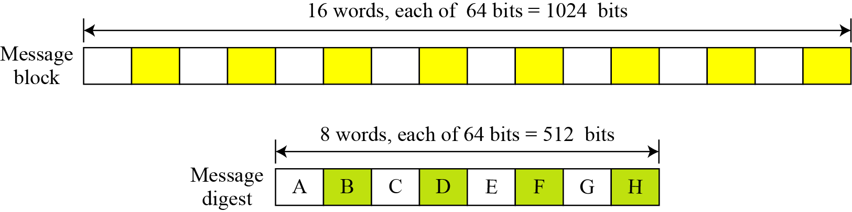
Words
Figure A message block and the digest as words

Slide 25
Example
What is the number of padding bits if the length of the original message is 2590 bits?
Solution
We can calculate the number of padding bits as follows:
The padding consists of one 1 followed by 353 0’s.

Slide 26
Example
Do we need padding if the length of the original message is already a multiple of 1024 bits?
Solution
Yes we do, because we need to add the length field. So padding is needed to make the new block a multiple of 1024 bits.

Slide 27
Summary
Applications of cryptographic hash functions
  Message authentication
  Digital signatures
  Other applications
Requirements and security
  Security requirements for cryptographic hash functions
  Brute-force attacks
  Cryptanalysis
Notes:
Chapter 11 summary.

