Slide 1
Modern Systems Analysis and Design Third Edition
Chapter 10
Structuring System Requirements:
Conceptual Data Modeling
10.1

Slide 2
Conceptual Data Modeling
Process and logic modeling does not show the definition, structure and relationships within the data but show how, where, and when data are used or changed
Most common format used for data modeling is entity-relationship (E-R) diagramming

Slide 3
Conceptual Data Modeling
Conceptual data model is a representation of organizational data
Purpose is to show as many rules about the meaning and interrelationships among data as are possible
Entity-Relationship (E-R) diagrams are commonly used to show how data are organized
Main goal of conceptual data modeling is to create accurate E-R diagrams
Methods such as interviewing, questionnaires and JAD are used to collect information
10.3

Slide 4
Deliverables and Outcomes
Primary deliverable is the entity-relationship diagram
There may be as many as four E-R diagrams produced and analyzed during conceptual data modeling
An E-R diagram that covers just the data needed in the project’s application
An E-R diagram for system being replaced
An E-R diagram for the whole database from which the new application’s data is extracted
An E-R diagram for the whole database from which data for the application system being replaced is drawn
10.4

Slide 5
Deliverables and Outcome
Second deliverable is a set of entries about data objects to be stored in repository or project dictionary
Repository links data, process and logic models of an information system
Data elements that are included in the DFD must appear in the data model and visa versa
Each data store in a process model must relate to business objects represented in the data model

Slide 6
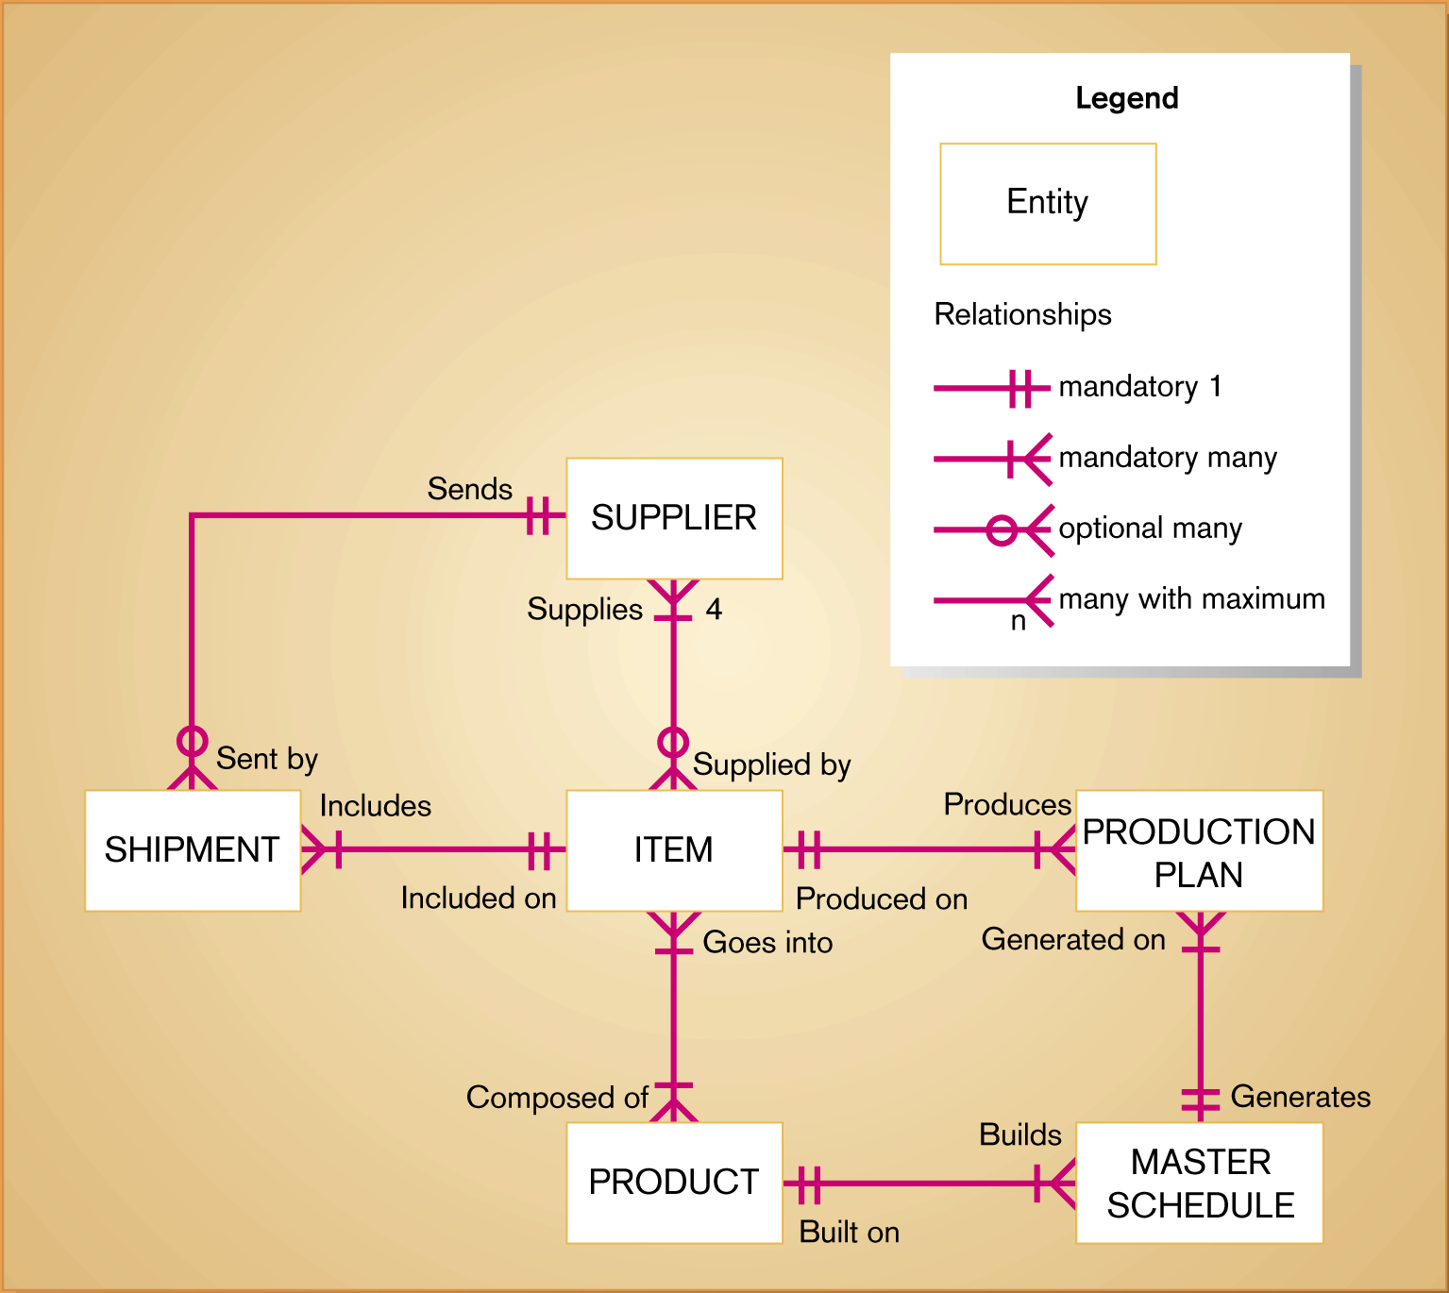
Figure 10-3 Sample conceptual data model diagram
10.6

Slide 7
Gathering Information for Conceptual Data Modeling
Requirements Determination Questions for Data Modeling
What are the subjects/objects of business? What type of people, places, things, events, etc., are used or interact in business whose data must be maintained? How many instances of each object might exist? – data entities and their descriptions
What unique characteristic (or characteristics) distinguishes each object from other objects of same type? Does this distinguish character change over time or is it permanent? – primary key
What characteristics describe each object? On what basis are objects referenced, selected, sorted and categorized? – attributes and secondary keys
How do you use this data? Are you the source of data, do you modify it or just refer it? Who is not permitted to use it? – security controls

Slide 8
Gathering Information for Conceptual Data Modeling
Are all instances of each object the same? Are some objects summaries or combinations of more detailed objects – supertypes, subtypes, and aggregations
What events occur that imply associations between various objects? – relationships and their cardinality and degree

Slide 9
Introduction to Entity-Relationship (E-R) Modeling
The basic E-R modeling notation uses three main constructs
Data entities
Relationships
Attributes
Several different E-R notations exist but we use crow’s foot notations
Entity-Relationship Data Model (E-R model)
A detailed, logical representation of the data for an organization or for a business area
E-R model is expressed in terms of entities in business environment, the relationships or associations among those entities, and attributes or properties of both the entities and their relationships
Entity-Relationship Diagram (E-R diagram)
A graphical representation of an E-R model
10.9

Slide 10
Entity-Relationship (E-R) Modeling Key Terms
Entity
A person, place, object, event or concept in the user environment about which the organization maintains data
It has its own identity that distinguishes it from other entity
Examples – Person: EMPLOYEE, STUDENT, PATIENT
Event: SALE, RENEWAL, REGISTRATION
Object: MACHINE, AUTOMOBILE, BUILDING
Represented by a rectangle in E-R diagrams
Distinction between entity types and entity instances
Entity Type or Entity Class
A collection of entities that share common properties or characteristics
Each entity type is given a name
Use a simple noun to name an entity type – use capital letters
Name is placed inside rectangle representing entity
Entity Instance
It is a single occurrence of an entity type
An entity type can have many instances of that entity type represented by data stored in the database
10.10

Slide 11
Entity-Relationship (E-R) Modeling Key Terms
Attribute
A named property or characteristic of an entity that is of interest to an organization
Examples of entities and their associated attributes
STUDENT: Student_ID, Student_Name, Student_Address, Major
AUTOMOBILE: Vehicle_ID, Color, Weight, Power, Wheels
Attribute names are nouns with initial capital letter, followed by lowercase letters
Attributes are represented in E-R diagrams by an ellipse with name inside and a line connecting it to the associated entity

Slide 12
Entity-Relationship (E-R) Modeling Key Terms
Candidate keys and Identifiers
Each entity type must have an attribute or set of attributes that distinguishes one instance from other instances of the same type
Candidate key
Attribute (or combination of attributes) that uniquely identifies each instance of an entity type
Candidate key for STUDENT entity type may be Student_ID
Sometimes more than one attribute is needed to identify a unique entity
Some entities may have more than one candidate key
EMPLOYEE may have one candidate key Employee_ID or a combination of Employee_Name and Address
10.12

Slide 13
Entity-Relationship (E-R) Modeling Key Terms
Identifier
A candidate key that has been selected as the unique identifying characteristic for an entity type
Selection rules for an identifier
Choose a candidate key that will not change its value like Employee_Address
Choose a candidate key that will never be null
Avoid using intelligent keys whose structure indicates classifications, locations, and so on like first 2 digits of a key for a STUDENT entity might indicate college name
Consider substituting single value surrogate keys for large composite keys
The name of the identifier is underlined on an E-R diagram
10.13

Slide 14
Entity-Relationship (E-R) Modeling Key Terms
Multivalued Attribute
An attribute that may take on more than one value for each entity instance
A STUDENT can attend more than one class – multivalued attribute
Represented on E-R Diagram in two ways:
double-lined ellipse
weak entity – separate repeating data into another entity and then using relationship link it to its associated regular entity
Repeating group – several attributes that repeat together like EMPLOYEE Dependents – name, age, relation (spouse, child)
Relationships
An association between the instances of one or more entity types that is of interest to the organization
Association indicates that an event has occurred or that there is a natural link between entity types
Relationships are always labeled with verb phrase
10.14

Slide 15
Degree of Relationship
Degree
Number of entity types that participate in a relationship
Three cases
Unary
A relationship between two instances of one entity type (also called recursive relationship)
Binary
A relationship between the instances of two entity types
Ternary
A simultaneous relationship among the instances of three entity types
Not the same as three binary relationships
It is recommended that all ternary and higher relationships be represented as associative entities
10.15

Slide 16
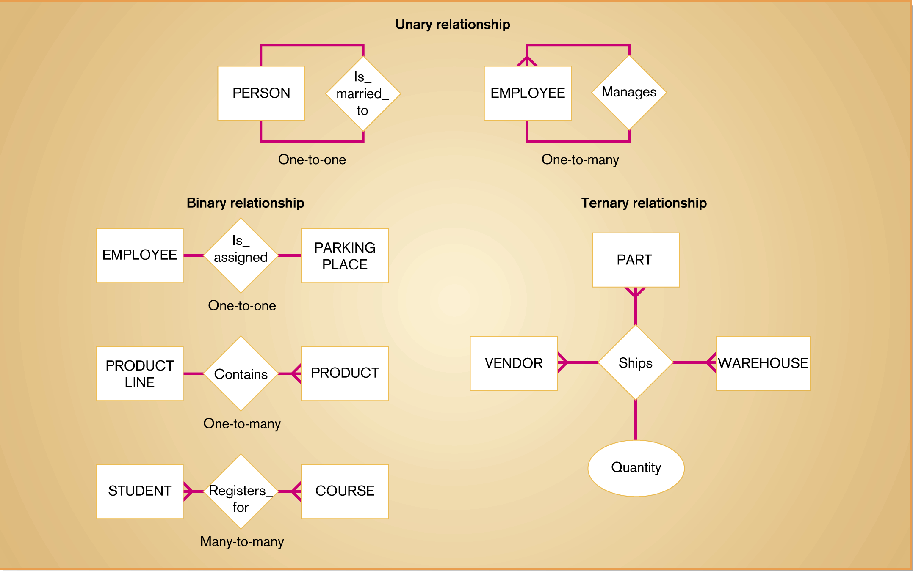
Figure 10-6 Example relationships of different degrees
10.16

Slide 17
Cardinality
The number of instances of entity B that can be associated with each instance of entity A
Minimum Cardinality
The minimum number of instances of entity B that may be associated with each instance of entity A
If minimum cardinality of an entity is 0, then that entity is optional participant in relationship
If minimum cardinality of an entity is 1, then that entity is mandatory participant in relationship
Maximum Cardinality
The maximum number of instances of entity B that may be associated with each instance of entity A
10.17

Slide 18
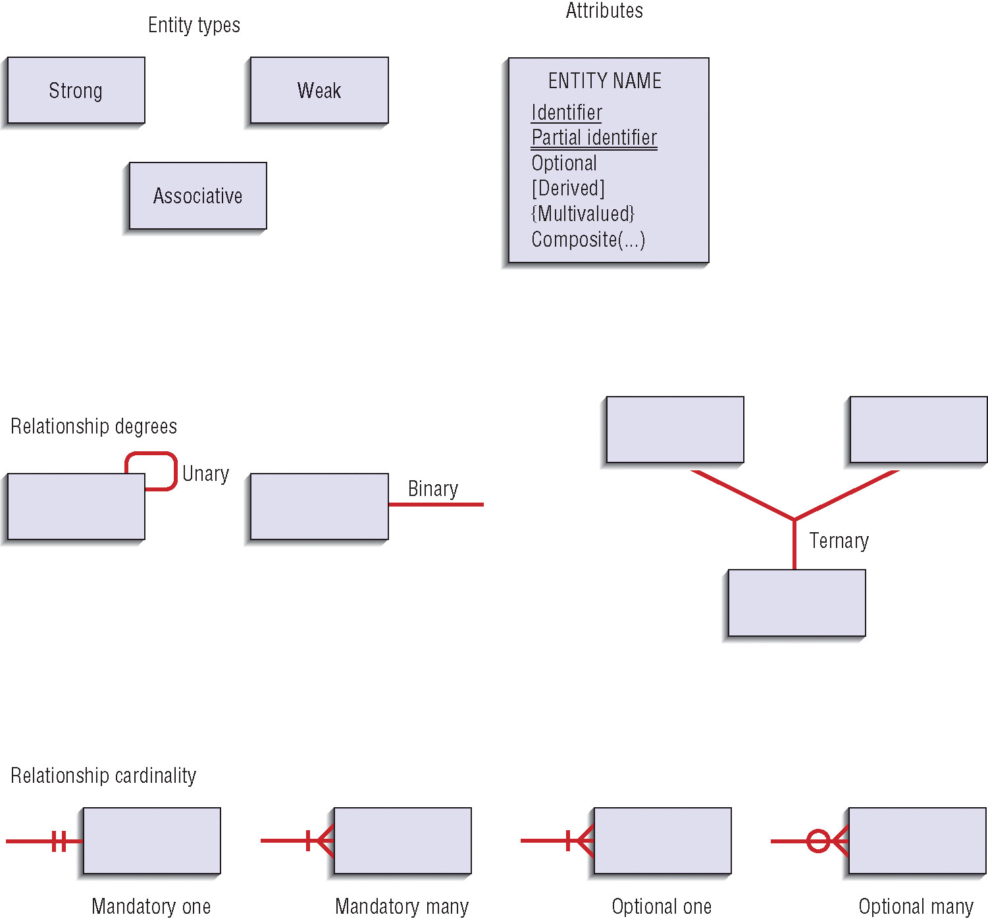

Slide 19
Naming and Defining Relationships
Relationship name is a verb phrase
Avoid vague names
Guidelines for defining relationships
Definition explains what action is being taken and why it is important
Give examples to clarify the action
Optional participation should be explained
Explain reasons for any explicit maximum cardinality
Explain any restrictions on participation in the relationship
Explain extent of the history that is kept in the relationship
Explain whether an entity instance involved in a relationship instance can transfer participation to another relationship instance
10.19

Slide 20
Representing Supertypes and Subtypes
Often two or more entity types share common properties but also have one or more distinct attributes or relationships
Subtype – a subgrouping of the entities in an entity types meaningful to an organization. Example – STUDENT is an entity type that has two subtypes GRADUATE STUDENT and UNDERGRADUATE STUDENT
Supertype – a generic entity type that has a relationship with one or more subtypes
Total specialization rule – each entity instance of the supertype must be a member of some subtype in the relationship (shown by double line)
Partial specialization rule – an entity instance of the supertype is allowed not to belong to any subtype in the reationship (shown by single line)
Disjoint rule – if an entity instance of the supertype is a member of one subtype, it cannot simultaneously be a member of any other subtype
Overlap rule – an entity instance can simultaneously be a member of two or more subtypes.
Disjoint is shown by a “d” and overlap is shown by a “o” in the circle

Slide 21
Business Rules
The specifications that preserve the integrity of logical data model
Four basic types of business rules:
Entity integrity – each instance of an entity type must have unique identifier that is not null
Referential integrity constraints – rules concerning the relationships between entity types
Domains – constraints on valid values for attributes
Triggering operations – other business rules to protect validity of attribute values
Domains
The set of all data types and ranges of values that an attribute can assume – data type, length, format, range, allowable values, meaning
Several advantages
Verify that the values for an attribute are valid
Ensure that various data manipulation operations are logical
Help conserve effort in describing attribute characteristics
10.21

Slide 22
Triggering Operations
An assertion or rule that governs the validity of data manipulation operations such as insert, update and delete
Scope of triggering operations may be limited to attributes with one entity or attributes of two or more entities
Includes the following components:
User rule
Statement of the business rule to be enforced by the trigger
Event
Data manipulation operation that initiates the operation
Entity Name
Name of entity being accessed or modified
Condition
Condition that causes the operation to be triggered
Action
Action taken when the operation is triggered
10.22

Slide 23
The Role of CASE in Conceptual Data
Responsibility for data integrity lies within scope of database management system, not individual applications
Business rules should be documented in CASE repository so that rules would be checked automatically by database software
CASE tools provide two important functions:
Maintain E-R diagrams as a visual depiction of structured data requirements
Link objects on E-R diagrams to corresponding descriptions in a repository
10.23

Slide 24
The real estate database contains an entity called PROPERTY, which is a property for sale by the agency. Each time a potential property buyer makes a purchase offer on a property, the agency records the date, offering price, and name of the person making the offer.
Represent the PROPERTY entity and its purchase offer attributes using the notation for multivalued attributes.
Represent the PROPERTY entity and its purchase offer attributes using two entity types.
Finally, assume the agency decides to also keep data about buyers and potential buyers, including their name, address, and phone number. Augment your answer to part b to accommodate this new entity type.

Slide 25
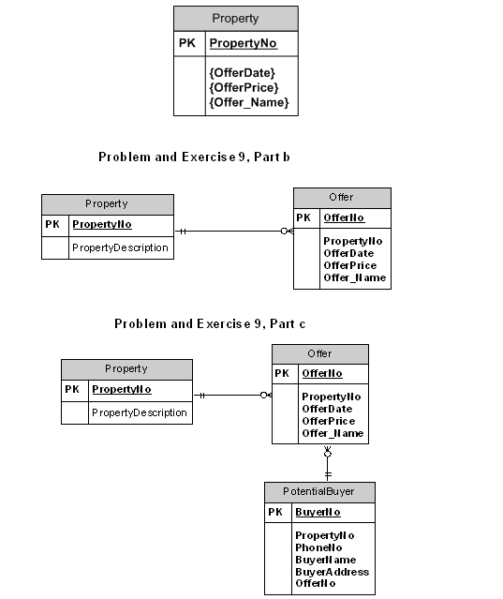
Part a

