Slide 1
Chapter 9
Illustrated Industrial Automation Applications
9.1 Machine tool automation problem (drilling process automation).
9.2 Metal forming process (forming a simple clip using multiple-slide pressing machine).
9.3 Process assembly automation.
9.4 Volumetric filling automation system (chemical/food Industries)

Slide 2
Drilling process automation
The conventional Drilling Process:
In production lines, drilling units are used where mass production is required.
Multi-spindle head is sometimes used to increase the production rate.
Furthermore, pneumatic or hydraulic power fixtures are used to clamp the work piece and hold drilling bushes to reduce the labor cost.
Automated Drilling Process

Slide 3
Drilling process automation
Drilling operations are based on 3 steps.
Rapid approaching of the drilling bit is carried out using pneumatic (or hydraulic power for larger drilling capacity) double acting feed cylinder and 5/2 (or 5/3) solenoid valves.
The regulated feed is accomplished using adjustable hydro-pneumatic feed devices, which also adjusted longitudinally to the required drilling depth.
Rapid retraction is carried out using the feed cylinder by reversing the direction of airflow through the 5/2 or 5/3 solenoid direction valves
Rapid Approach
Regular feed
Start Point
Rapid Retraction

Slide 4
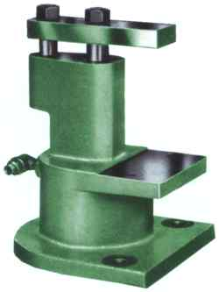
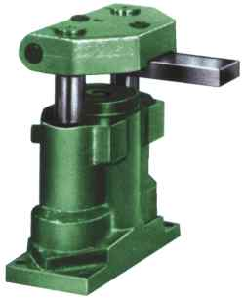
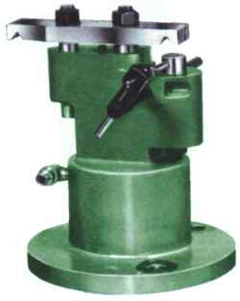
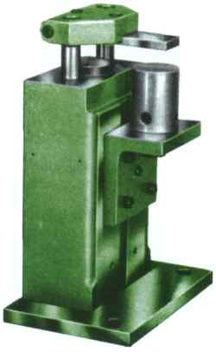
Drilling process automation
Machine Actuators and Feed-back sensors:
Two contact limit switches, or reed switches: Two extreme positions of the feed cylinder.
Single phase (or three-phase motor): Spindle drive
Powered drilling fixture: Clamp and guide the drilling bits through drilling bushes.
(Using pneumatic double acting cylinder and through the 5/2 or 5/3 solenoid valve)
Fig. 9.2 Some powered pneumatic drilling fixtures.

Slide 5
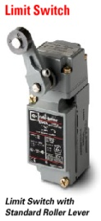
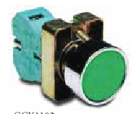
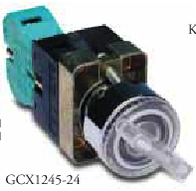
Where:
9.1 Machine tool automation problem (drilling process automation)
Machine switching elements and actuators:
Push-button and selector contact switches will be used for machine-user control panel.
Reed or limit switches will be used to monitor the extreme positions of the feed cylinder and clamping fixture-cylinder.
Fig. 9.3 Suggested user-panel control and limit contact-switches. (limit switch, push-button switch and selector switch)
Suggested machine actuator and machine cycle
Two machine cycles will be used; automatic and manual cycles. Manual cycle will be used during machine setup (i.e. during adjustment of drilling depth). The automatic cycle will be used to carry out the production run. The machine cycle will be written as follows:
M+; Spindle Motor On | B+; Clamp the work piece | A+ ;Feed cylinder forward toward work piece
M- ; Motor Off | B- ; Unclamp the work piece | A- ; Feed cylinder retract from work piece

Slide 6
Where:
9.1 Machine tool automation problem (drilling process automation)

Slide 7
Where:
Development of RLL for the given machine sequence:
The machine sequence can be grouped using CASCADE method and given as follows
Flip_flop Module
Manual Cycle
Sustain Output
Start
Auto
0
Two position selector switch with mechanical memory
Non-Sustain Output
Man or Jog
Man M+
Output Module
Stop
0
Man B-
Man B+
Three position selector switch without mechanical memory
Two position push button switch without mechanical memory
0
Man A-
Man A+

Slide 8
Where:
9.3 Process assembly automation : Insulation Paper Cutting Machine
Machine Function
The insulation paper is supplied as roll strip to machine rack where pulled out using feeding mechanism longitudinally. At the end of feeding stroke, cutting plad mechanism is used to cut the paper to the specified paper length. As protection for machine structure, the machine will not operate if no paper stock on the paper moving mechanism through an optical sensor SW1.

Slide 9
Where:
9.3 Process assembly automation : Insulation Paper Cutting Machine
Summery of machine cycle is given as follows:
Griping paper stock : Pneumatic cylinder Y+.
Forward movement of paper stock: moving mechanism through pneumatic cylinder X+, where 5/3 directional valve is used to actuate cylinder X.
Optical sensor SW2: detect the position of paper strip when reach the specified length.
Cutoff mechanism : cutoff slide using pneumatic cylinder Z+.
Simultaneously cutoff slide will retract to its original position (Z-).
Releasing paper stock by retracting griping cylinder (Y-).
Back movement for stock moving mechanism using cylinder (X-).
End.
Repeat when needed

Slide 10
Where:
9.3 Process assembly automation : Insulation Paper Cutting Machine
These cutting processes can be repeated for agiven number of cutting stripes. Machine cycle can be written as follows:
RLL for cutting single paper stripe is given as follows:

Slide 11
9.3 Process assembly automation : Insulation Paper Cutting Machine
RLL for cutting single paper stripe is given as follows:

Slide 12
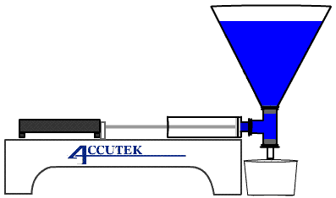
9.4 Volumetric filling automation process
Solenoid Valve V
(Non-sustain)
Machine actuators and sensors are given as follows:
Pneumatic cylinder used to move the filling piston.
Solenoid valve, open and closed to fill in the hopper. Two approximate sensors used to monitor upper and lower hopper levels.
AC induction motors used to move the conveyer and two optical sensors used to monitor conveyer position.
(v+)
Upper limit level monitor sensor.
Lower limit level monitor sensor.
(v-)
(m+)
sensor
Filling piston
Filling can
Two optical sensors used to monitor the position on cans on the liner conveyer element.
Solenoid Valve P
(Non-sustain)
(m-) sensor
Conveyer Motor M (Sustain)

Slide 13
9.4 Volumetric filling automation process
9.4.1Machine Processes:
3)Hooper Filling Process .
1)Volumetric Pump Process .
2)Conveyor Process.
Solenoid Valve V
(Non-sustain)
(v+)
Upper limit level monitor sensor.
Lower limit level monitor sensor.
(v-)
(m+)
sensor
Filling piston
Filling can
Two optical sensors used to monitor the position on cans on the liner conveyer element.
Solenoid Valve P
(Non-sustain)
(m-) sensor
Conveyer Motor M (Sustain)

Slide 14
9.4 Volumetric filling automation process
Solenoid Valve V
(Non-sustain)
9.4.3Actuators, control signals and switching elements
Volumetric displacement pump: driven using double acting cylinders and having 5x3 solenoid directional valve as switching element with NON-SUSTAIN control signals. ( Symbolic address P⁺ (pump discharge state), P⁻ (pump in suction state)
Conveyor :driven using three phase induction gear motor having ONE electromechanical relay as witching element with SUSTAIN control signal. (Symbolic address M+ (motor on state), M- (motor off state).
Hooper storage: Solenoid directional valve having two solenoids to fill in the Hooper having NON-SUSTAIN control signals. (Symbolic address V+ (valve open state), V- (valve close state) )
(v+)
Upper limit level monitor sensor.
Lower limit level monitor sensor.
(v-)
(m+)
sensor
Filling piston
Filling can
Two optical sensors used to monitor the position on cans on the liner conveyer element.
Solenoid Valve P
(Non-sustain)
(m-) sensor
Conveyer Motor M (Sustain)

Slide 15
9.4 Volumetric filling automation process
9.4.4 Feedback signals:
Volumetric Pumps : Two magnetic reed switches at discharge and suction piston strokes (Symbolic address p+, p- )
Conveyor motor : Two photo-detectors (reflection from target type) (Symbolic address m+, m-).
Hooper unit: Two capacitive proximity on top and bottom on Hooper (Symbolic address v+ ,v-)
Solenoid Valve V
(Non-sustain)
(v+)
Upper limit level monitor sensor.
Lower limit level monitor sensor.
(v-)
(m+)
sensor
Filling piston
Filling can
Two optical sensors used to monitor the position on cans on the liner conveyer element.
Solenoid Valve P
(Non-sustain)
(m-) sensor
Conveyer Motor M (Sustain)

Slide 16
9.4 Volumetric filling automation process
G1
G2
G3
Solenoid Valve V
(Non-sustain)
Filling Unit
START
V+, V-, V- (dummy)
(v+)
Upper limit level monitor sensor.
Lower limit level monitor sensor.
Disp-Pump+ Conv.
(v-)
Repeat 5 cycles
P+, P-, M+, M-
(m+)
sensor
Filling piston
Filling can
Two optical sensors used to monitor the position on cans on the liner conveyer element.
G4
G6
G5
Solenoid Valve P
(Non-sustain)
(m-) sensor
Conveyer Motor M (Sustain)
9.4.2Control Strategy :
The Hooper Filling Process will be effected as long the two processes (volumetric pump + conveyor) is enabled. (Parallel process)
Volumetric pump and conveyor will run together in series. (Single path).

Slide 17
9.4 Volumetric filling automation process
G1
G2
G3
Filling Unit
START
V+, V-, V- (dummy)
Recommend to insert delay timer
Disp-Pump+ Conv.
Repeat 5 cycles
P+, P-, M+, M-
G4
G5
G6
9.4.2Control Strategy :
The Hooper Filling Process will be effected as long the two processes (volumetric pump + conveyor) is enabled. (Parallel process)
Volumetric pump and conveyor will run together in series. (Single path).

Slide 18
9.4 Volumetric filling automation process
G1
G2
G3
Filling Unit
START
V+, delay 10sec, V-, V- (dummy)
Disp-Pump+ Conv.
Repeat 5 cycles
P+, P-, M+, M-
G4
G5
G6
9.4.2Control Strategy :
The Hooper Filling Process will be effected as long the two processes (volumetric pump + conveyor) is enabled. (Parallel process)
Volumetric pump and conveyor will run together in series. (Single path).

Slide 19
9.4 Volumetric filling automation process
G1
G2
G3
Filling Unit
START
V+, delay 10sec, V-, V- (dummy)
Disp-Pump+ Conv.
Repeat 5 cycles
P+, P-, M+, M-
G4
G5
G6

Slide 20
Filling Unit RLL

Slide 21
Displacement Pump + Conveyor Unit RLL

