Slide 1
Electrochemical Analysis
Dr. Amal Al-Mohaimeed
Bulding 5, office 188

Slide 2
Electrochemical Analysis
References
Analytical Chemistry, Gary Christian( ch.12,13,14,15)
الكيمياء التحليلية- التحليل الآليو الدكتور ابراهيم الزامل
مسائل وحلول في الكيمياء التحليلية و الدكتور حسن السويدان

Slide 3
Chapter 12: Electrochemical Cell and Electrode Potentials
At the end of this Chapter (12) , the student is expected to be able to :
1- Understand the concepts of oxidation and reduction .
2- Distinguish between oxidizing and reducing agents in a redox reaction .
3- Understand the electrochemical Cells.
4- Write and Balance redox reaction equations .
5- Realize the role of standard potential in expecting the completeness and the direction of a redox reaction .
6- Understand and write the symbol for a galvanic cell reaction .
7- Calculate the electrode potential .
8- Understand the Nernst Equation and effects of concentrations on potentials.

Slide 4
12.1 What Are Redox Reaction
Redox reactions, or oxidation - reduction reactions , are a family of reactions that are concerned with the transfer of electrons between species. There is no oxidation reaction without a reduction reaction happening at the same time. Oxidation refers to the loss of electrons, while reduction refers to the gain of electrons. Each reaction by itself is called a "half-reaction", simply because we need two (2) half-reactions to form a whole redox reaction.

Slide 5
12.1 What Are Redox Reaction
An Oxidizing substance will tend to take on an electron or electrons and be reduced to a lower oxidation state:

Slide 6
12.2 Electrochemical Cell- What Electroanalytical Chemists Use
There are two kind of electrochemical cells:
Voltaic (galvanic), spontaneous, ex. Battery
Electrolytic, non spontaneous, ex. The electrolysis of water
In both type of these cells, the electrode at which oxidation occurs is the anode, and that at which reduction occure is cathode.

Slide 7
what is the cell potential
Consider the following redox reaction in Voltaic cell:
redox reaction
half- reaction
anode( electron donor, reducing agent)
half- reaction
cathode (electron acceptor, oxidizing agent)

Slide 8
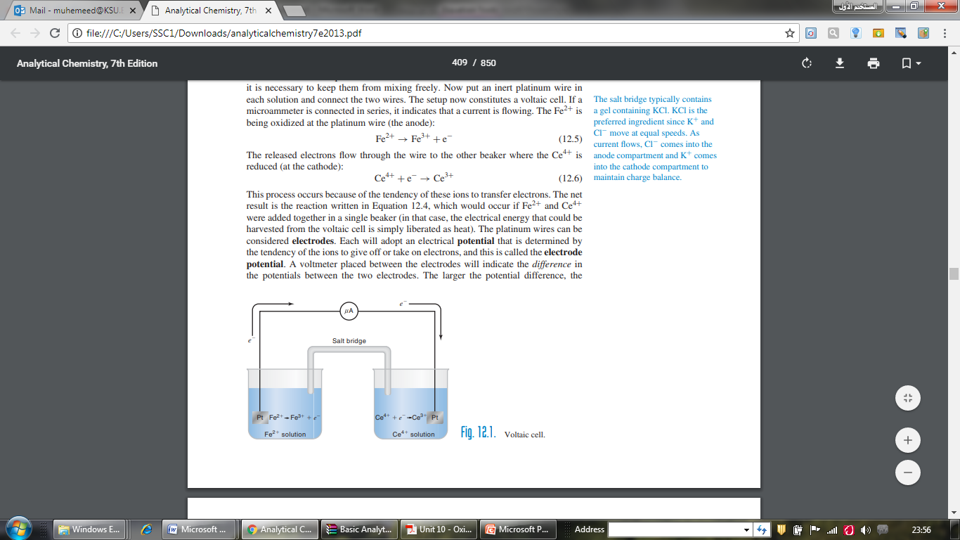

Slide 9
Half- reaction potentials-they are measured relative to each other:
Standard electrode potential is given the symbol E° and it is an electrode potential measured under standard conditions; a room temperature (25°C), 1 atmosphere pressure and at 1 mole of the activity of redox participants of the half-reaction (i.e the Ox and the Red forms) Ox means the oxidized form and Red means the reduced form of a redox couple
The Standard electrode potential of a redox couple cannot be measured alone ( because free electrons do not exist in solution) unless is coupled to another electrode usually a standard hydrogen electrode (NHE ) .

Slide 10
Both unknown and NHE electrodes are under standard conditions. The following graph shows the way that standard potential of the zinc couple is measured against NHE.
The E⁰ values for the common redox couples are measured by the same above way .This is how we established the electrochemical series, some of which are shown in the following table .It is assumed that the E⁰ for NHE under the standard conditions is equal to 0.00

Slide 11
1.The Ox form of a couple will oxidize the Red form of the couple under it in series but will not oxidize the Red form of the couple over it in the series e.g. Fe3+ will oxidize Sn2+ but not Ag0.
2.All have reactions are written as reduction whatever the direction of the have reaction.
3.The more negative the E° value, the more readily the element loses electrons and becoming a reducing agent .i.e the stronger its Red form and the weaker its Ox form.
4.The more positive (or less negative) the E° value, the more readily the element gains electrons and becomes an oxidizing agent. I.e the stronger its Ox form and the weaker its Red form.

Slide 13
5.Therefore, for the two have reactions of the redox reaction, the one with the more positive E⁰ value is the oxidizing agent.
6- The – sign of E0 value indicates that this couple when joint with NHE under standard conditions will become reducing agent and its half reaction will proceed in the opposite direction (from right to left). In other words, the standard potential is a measure of the tendency of the oxidizing agent to be reduced. Its value is zero for H⁺ + e− → ½ H₂ by definition, positive for oxidizing agents stronger than H⁺ (e.g., +1.44 V for Ce ) and negative for oxidizing agents that are weaker than H⁺ (e.g., –0.76 V for Zn²⁺).

Slide 14
7-It is possible for a redox couple to be an oxidizing agent in a reaction and to be a reducing agent in another reaction e.g. Fe3+ will oxidize Sn2+ but Fe2+ will reduce Ag+ . However principal oxidising agents are: Potassium permanganate, potassium dichromate, iodine , cerium(IV) salt and potassium iodate . Also frequently used Reducing Agents are: iron (ii), tin (ii) compounds, sodium thiosulphate . 3-The oxidizing agent represents the cathode while the reducing agent represents the anode in a galvanic cell.

Slide 15
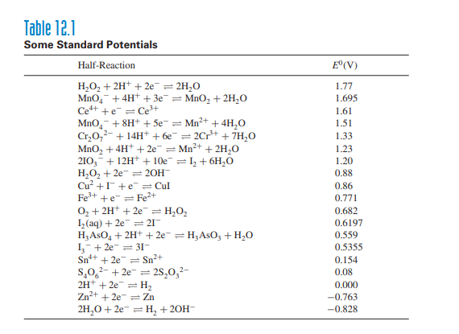

Slide 16
What substances react

Slide 17
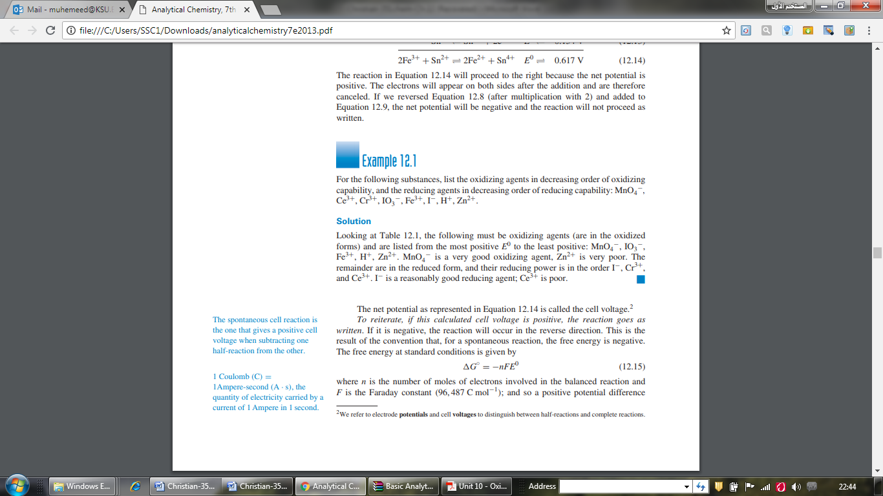

Slide 18
Cell voltage and free energy:
The spontaneous cell reaction is the one that gives a positive cell voltage when subtracting one half-reaction from the other

Slide 19
Which is the anode and cathode
drawing a cell
Instead of drawing a cell diagram chemists have devised a shorthand way of completely describing a cell called symbol or line notation. This notation scheme places the constituents of the cathode on the right of the salt bridge [which is shown in the notation as a double line (||)] and the anode components on the left.
The phases of all reactive species are listed and their concentrations or pressures are given if those species are not in their standard states. All phase interfaces are noted with a single line ( | ) and multiple species in a single phase are separated by commas. For example, the previous iron – zinc cell would be written as:

Slide 20
Which is the anode and cathode
Anode/ solution/ cathode
Pt/Fe²⁺(C₁), Fe³⁺(C₂)//Ce⁴⁺(C₃), Ce³⁺(C₄)/Pt
Pt/Sn²⁺(C₁), Sn⁴⁺(C₂)//Fe³⁺(C₃), Fe²⁺(C₄)/Pt
The potential of the voltaic cell is given by:
E_{cell} = E_{right} − E_{left} = E_{cathode} − E_{anode} = E₊ − E₋
E⁰ cell = E⁰ _{Fe3+,Fe2+} − E⁰ _{Sn4+,Sn2+} = 0.771 − 0.154 = 0.617 V

Slide 21
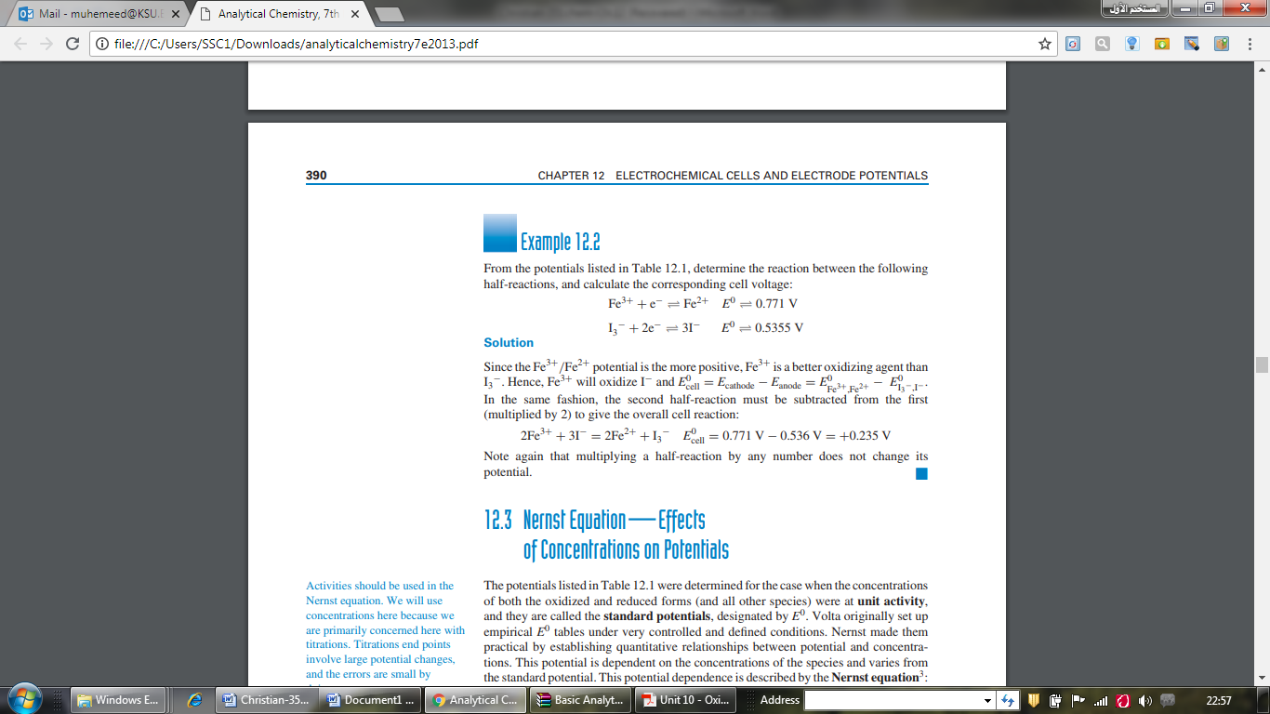

Slide 22
12.3 Nernst Equation—Effects of Concentrations on Potentials
1- The potentials listed in Table 12.1were determined for the case when the concentrations both the oxidized and reduced forms (and all other species) were at unit activity.
2- They are called the standard potentials, designated by E⁰.
3- One of the more useful calculations in redox reactions is the Nernst Equation. This equation allows us to calculate the electric potential of a redox reaction in "non-standard" situations
4- The electrode potential is dependent on temperature, the concentrations of the Ox and the Red form of the electrode couple and the number of electrons transferred during half reaction.

Slide 23


where a and b are the numbers of Ox and Red species in the half-reaction, E is the reduction potential at the specific concentrations, n is the number of electrons involved in the half-reaction (equivalents per mole),
R is the gas constant (8.3143 V coul deg⁻¹ mol⁻¹) or J/K.mol
T is the absolute temperature in Kelvin,
F is the Faraday constant (96,487 coul eq⁻¹) or J/V.
At 25◦C (298.16 K), the value of 2.3026 RT/F is 0.05916 V
The concentration of pure substances such as precipitates and liquids (H₂O) is taken as unity.

Slide 24
Note: Activities should be used in the Nernst equation. We will use concentrations here because we are primarily concerned here with titrations. Titrations end points involve large potential changes,
and the errors are small by doing so.
Note : That the log term of the reduction half-reaction is the ratio of the concentrations of the right-side product(s) over the left-side reactants(s).

Slide 25
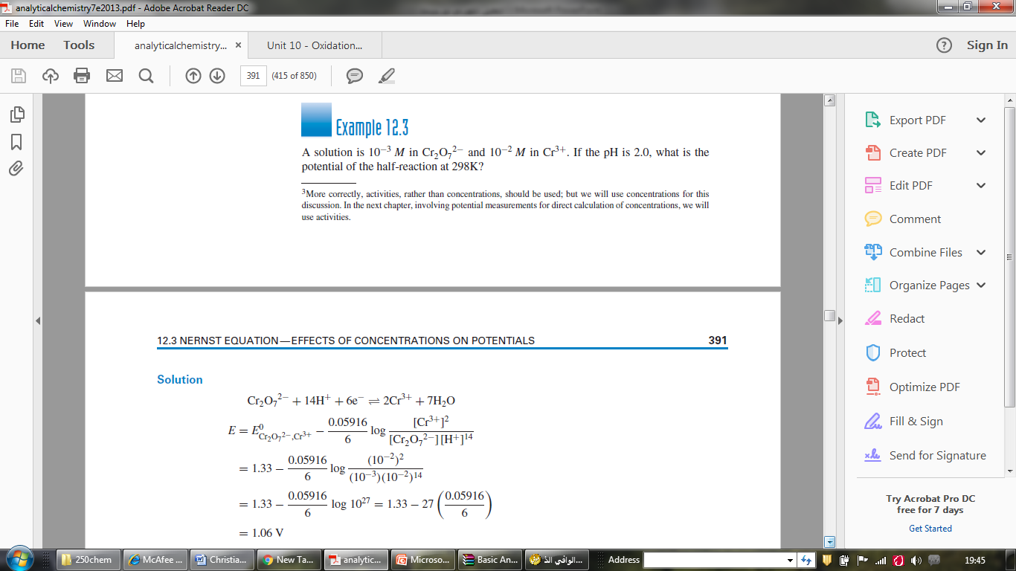

Slide 26
EQUILIBRIUM POTENTIAL——AFTER THE REACTION HAS OCCURRED
1- When the equilibrium is reached, Ec will be equal to Ea i.e the electrical current will stop and the battery will be dead (E_{cell} = 0).
2-Suppose you have two water tanks connected through pipe, one is filled with water the other is half full . The water will flow from the filled one to the half filed till the level of water in both tanks are equal, then the water flow will stop. This is what happens in galvanic cell.
3- The potential of an inert electrode in a solution containing the ions of two half-reactions at equilibrium can be calculated relative to the NHE using the Nernst equation for either half-reaction.

Slide 27
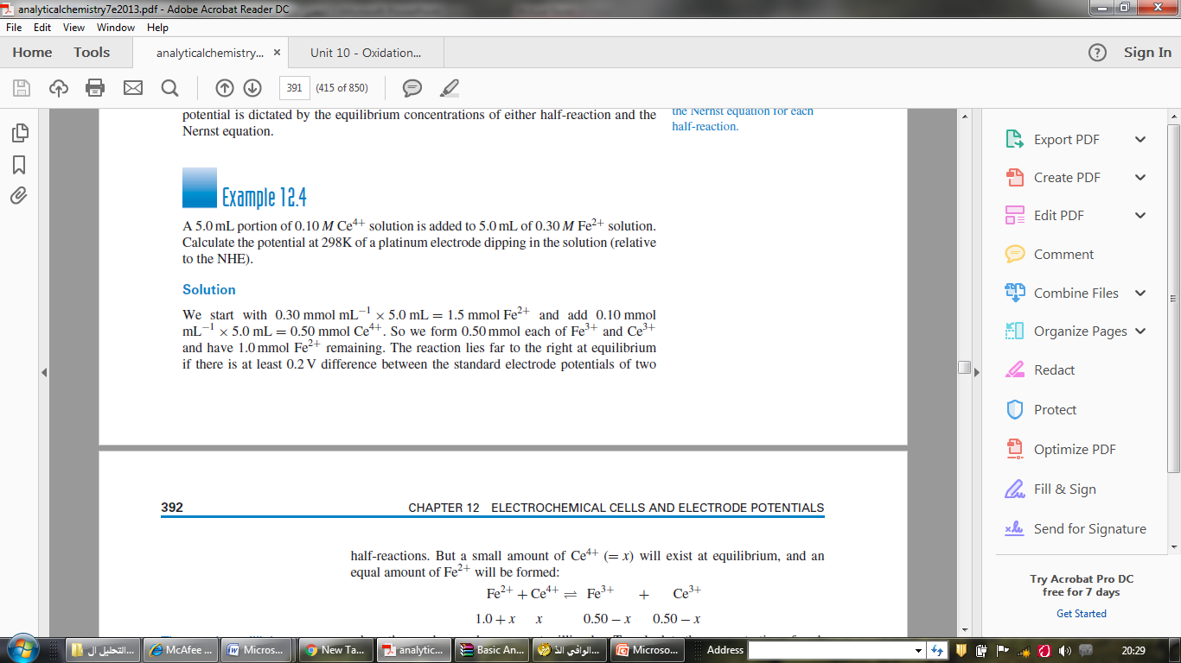
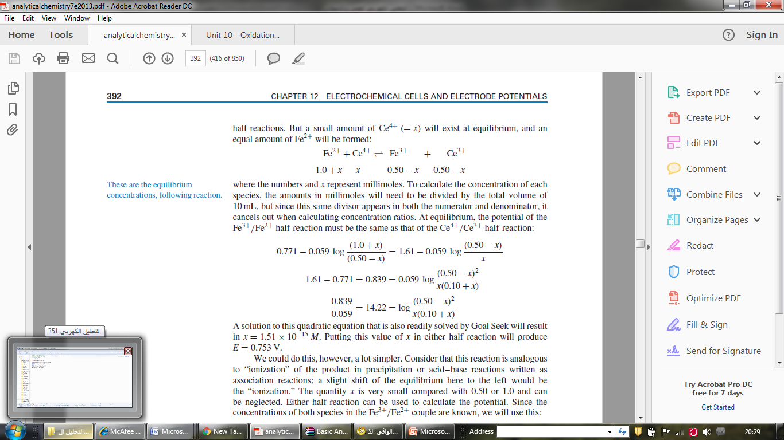

Slide 28
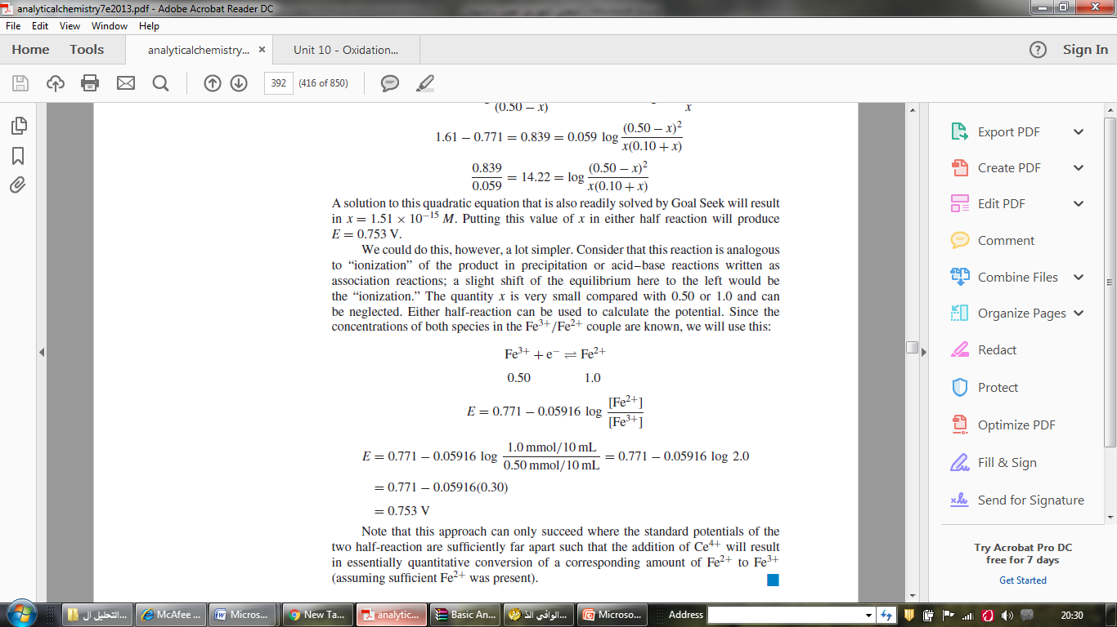

Slide 29
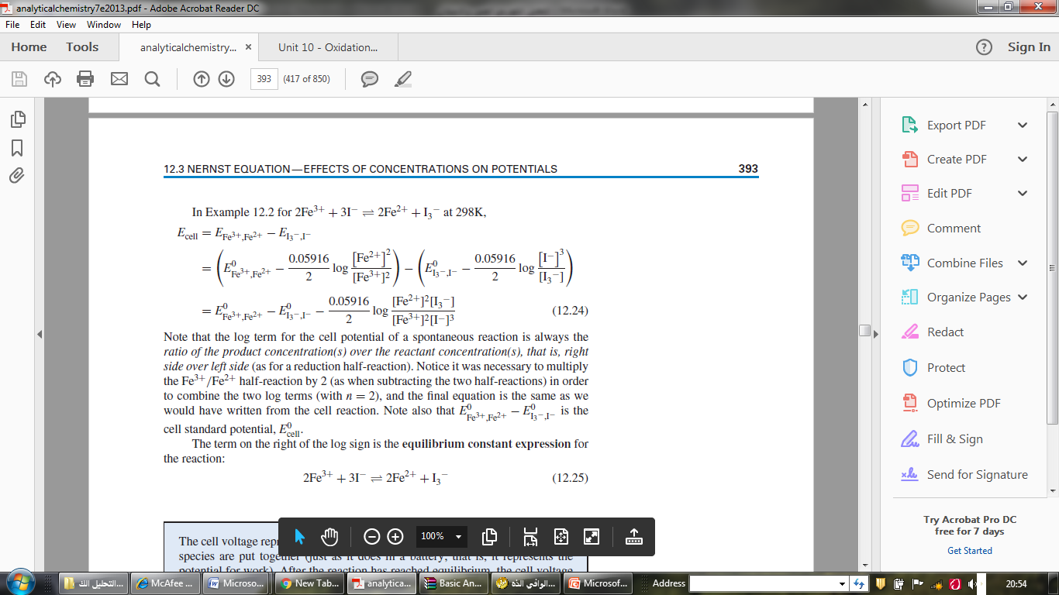
CELL VOLTAGE——BEFORE REACTION
The voltage of a cell can be calculated by taking the difference in potentials of the two half-reactions, to give a positive potential, calculated using the Nernst equation,

Slide 30
Note that the log term for the cell potential of a spontaneous reaction is always the ratio of the product concentration(s) over the reactant concentration(s), that is, right side over left side (as for a reduction half-reaction). Notice it was necessary to multiply the Fe³⁺ /Fe²⁺ half-reaction by 2 (as when subtracting the two half-reactions) in order to combine the two log terms (with n = 2), and the final equation is the same as we would have written from the cell reaction. Note also that E⁰ _{Fe3+,Fe2+} − E⁰ _{I3 −,I−} is the cell standard potential, E⁰_{cell}.
The term on the right of the log sign is the equilibrium constant expression for the reaction:

Slide 31
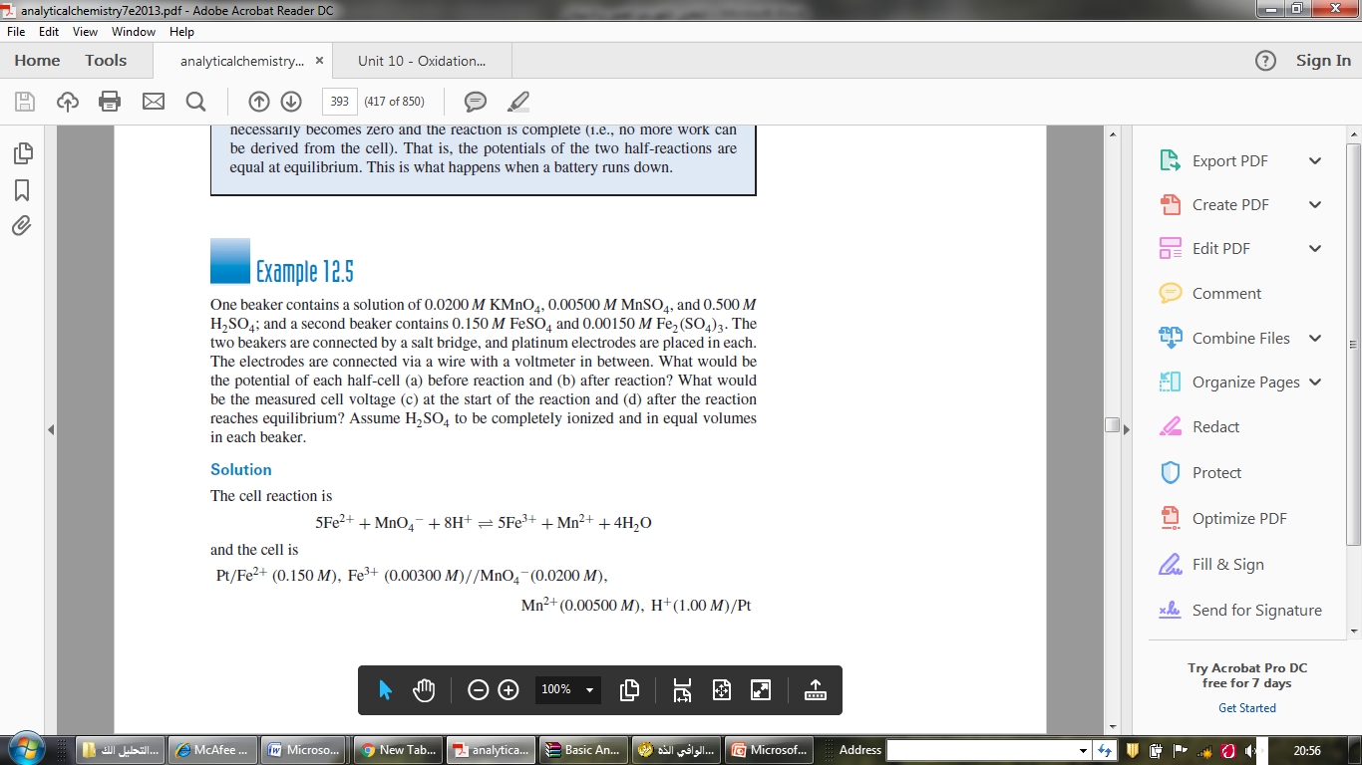
0.5
0.003

Slide 32
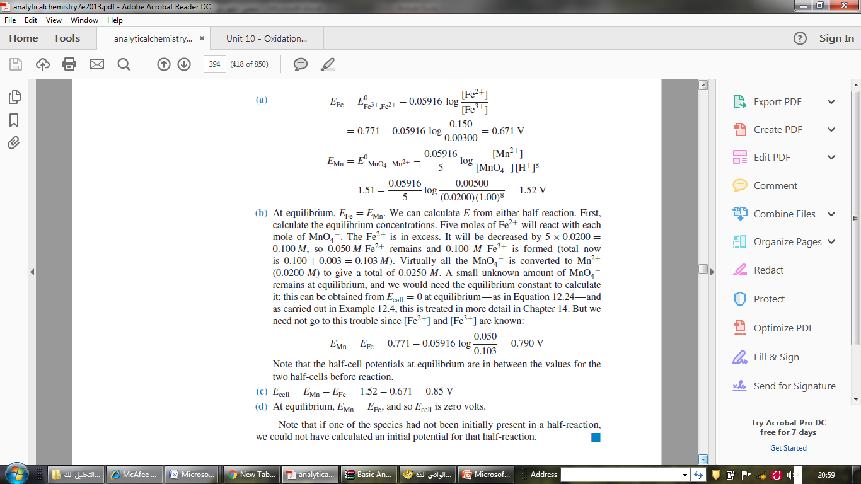

Slide 33
12.4 Formal Potential—Use It for Defined
Nonstandard Solution Conditions
1- The E⁰ values listed in Table 12.1 refer to standard conditions, all species are at an activity of 1 M.
2- The potential of a half-reaction may depend on the conditions of the solution.
example, the E⁰ value for Ce⁴⁺ + e⁻ = Ce³⁺ is 1.61 V.
3- we can change this potential by changing the acid used to acidify the solution. (See Table C.5 in Appendix C.)
4- The change in potential happens because the anions of the different acids differ in their ability to form complexes with one form of the cerium relative to the other, and the concentration ratio of the two forms of the free cerium ion is thereby affected.
5- If we know the form of the complex, we could write a new half-reaction involving the acid anion and determine an E⁰ value for this reaction, keeping the acid and all other species at unit activity.

Slide 34
12.4 Formal Potential—Use It for Defined
Nonstandard Solution Conditions
5- the complexes are frequently of unknown composition. So we define the formal potential and designate this as E^{0'}.
6- This is the standard potential of a redox couple with the oxidized and reduced forms at 1 M concentrations and with the solution conditions specified.
example, the formal potential of the Ce⁴⁺ /Ce³⁺ couple in 1 M HCl is 1.28 V.
The formal potential is used when not all species are known. In a sense, the formal potential provides the same convenience as available with the use of conditional complexation constants or solubility products.

Slide 35



DEPENDENCE OF POTENTIAL ON pH
Hydrogen or hydroxyl ions are involved in many redox half-reactions. We can change the potential of these redox couples by changing the pH of the solution.
Consider the As(V)/As(III) couple:
H₃AsO₄ + 2H+ + 2e- = H₃AsO₃ + H₂O

Slide 36
The term E⁰ - 0.05916 pH, where E0 is the standard potential for the half-reaction, can be considered as equal to a formal potential E⁰', which can be calculated from the pH of the solution.
In 0.1 M HCl (pH 1), E^{0'} = E⁰ − 0.05916. In neutral condition,
E⁰' - 0.05916(7) = E0 − 0.41.
In strongly acid solution, H₃AsO₄ will oxidize I⁻ to I₂. But in neutral solution, the potential of the As(V)/As(III) couple (E⁰' = 0.146 V) is less than that for I₂/I⁻, and the reaction goes in the reverse; that is, I₂ will oxidize H₃AsO₃.

Slide 37

DEPENDENCE OF POTENTIAL ON COMPLEXATION
In HCl (1M),the formal potential (E^{0'}) is 0.70 V.
If we assume that the complex is FeCl₄⁻, then the half-reaction would be:
(assume that [HCl] is constant at 1 M),
In effect, we have stabilized the Fe³⁺ by complexing it, making it more difficult to reduce.
So the reduction potential is decreased. If we complexed the Fe²⁺, the reverse effect would be observed. So the presence of complexing agents that have different
Complexing one ion reduces its effective concentration, which changes the potential.

Slide 38
12.5 Limitations of Electrode Potentials
Electrode potentials ( E⁰ or E^{0'} ) predict whether a reaction can occur. They say nothing about the kinetics or rate of the reaction.

