Slide 1
King Saud University College of Engineering IE – 462: “Industrial Information Systems” Fall – 2018 (1st Sem. 1439-40H)
Introduction (Chapter 1)
part 2 – Introduction to Industrial Information Systems (IIS)
Prepared by: Ahmed M. El-Sherbeeny, PhD

Slide 2
Lesson Overview
Part 2:
MRP / MRP II
ERP
MES
ERP/MES/Control
Information flow within the IS
Network Architecture
Functions of an Information System

Slide 3
Why IS in Industry?
An industrial firm is a set of activities, or processes, that interact with each other (creating and exchanging information)
Example: the fact that quality control has given final approval to use material is “information” passed on to production before production personnel can process the material

Slide 4
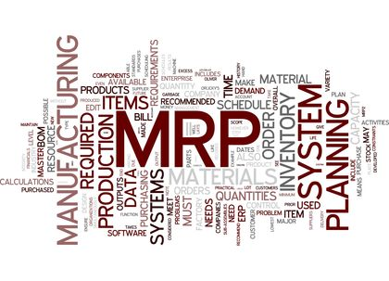
Material Requirements Planning (MRP) as an IIS
MRP represents a typical instance of IIS for inventory/production management
Input to the MRP is the Master Production Schedule (MPS) through sales order or warehouse stock replenishment request
MPS contains how much and when (gross requirements) of finished product units (see e.g. below)

Slide 5
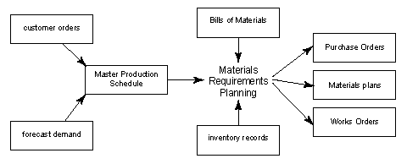
Material Requirements Planning (MRP) as an IIS (cont.)
The demands for subassemblies and components are determined through Bill of Materials (BOM) explosion.
The demand of raw materials are determined from subassemblies and components demands
The demand for raw materials are fulfilled either from stock or through purchase requisitions

Slide 6
Material Requirements Planning (MRP) as an IIS (cont.)

Slide 7
Material Requirements Planning (MRP) as an IIS (cont.)
MRP II is an extension of MRP for the inclusion of capacity planning (resources planning: workers, machines, etc.) required to meet the manufacturing activities
MRP II answers the question of whether or not a sufficient week-by-week plant capacity exists to meet the planned production schedule

Slide 8
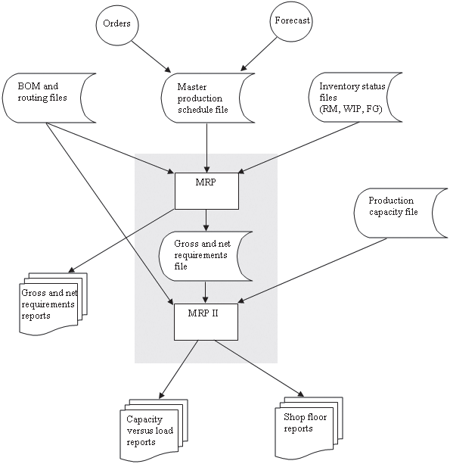
MRP
MRP II

Slide 9
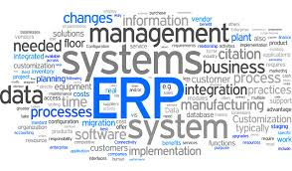
Enterprise Resource Planning (ERP)
The standard MRP system has been expanded to include much more functionality within a concept known as enterprise resource planning (ERP).
In addition to the traditional MRP, ERP has added support for some of the following functions:
Quality management
Sales and distribution
Human resource management
Project management

Slide 10
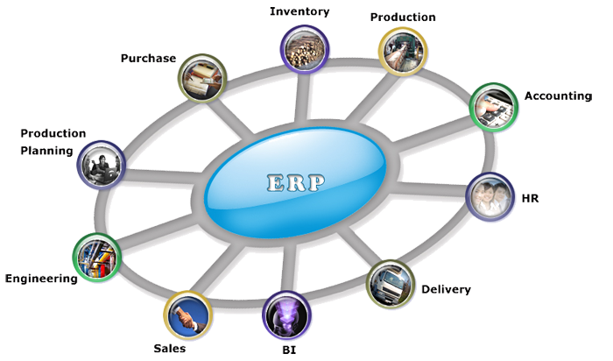
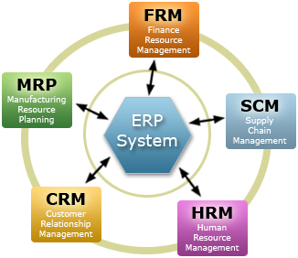
Enterprise Resource Planning (ERP) – cont.
More recently, ERP was extended beyond the factory and the firm to include functions that link the company to its customers and suppliers, such as the following:
Logistics supply chain management
Inter-company communications
Electronic commerce
Notes:
BI: Business Intelligence

Slide 11
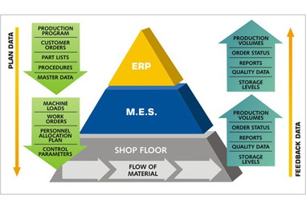
Manufacturing Execution System
MRP / MRPII / ERP are generally considered as “planning” systems. They are not very well integrated into the execution of production
The absence of available software solutions for production execution in the shop floor has led to the development of the manufacturing execution system (MES)
MES manages resources (materials, machines, and personnel, etc) on a daily or hourly basis.

Slide 12
Manufacturing Execution System (cont.)

Slide 13
MES functions
Typical MES functions include the following:
Dispatching and monitoring production : controlling the release of work orders to the shop floor and tracking work-in-process inventory.
Detailed scheduling
Data collection from factory floor operation to provide a history of factory events
Quality data analysis: real-time analysis of manufacturing, notifying out-of-tolerance values, and sometimes recommending corrective action.

Slide 14
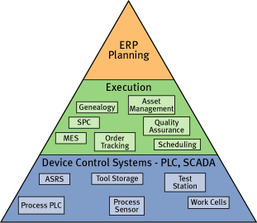
ERP/MES/Control: A hierarchy of Information Systems in the Industrial Plant
A hierarchy of decisions must be made in manufacturing, from the machine, or unit operation control level, up through the overall planning of plant operations.

Slide 15
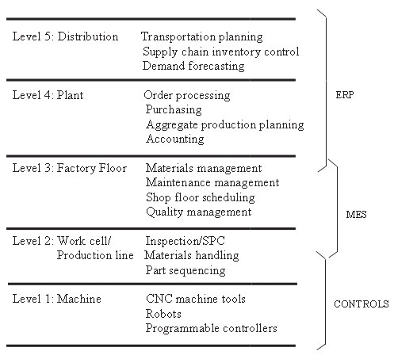
ERP/MES/Control: A hierarchy of Information Systems in the Industrial Plant (cont.)

Slide 16
Production Line or Work Cell Level
Control the interactions between a group of related machines or processes
This level of decision making is concerned with the release and delivery of materials at the correct time
Examples of decisions at this level include routing of material among machines, and the decision to extract out-of-specification components while they are being processed
The work cell or production line level is considered part of the MES level, but there is some overlap with the controls level

Slide 17
The Nature and Role of IIS
The industrial system is modeled as a hierarchy of decisions, where the upper levels of the hierarchy place constraints and control decisions on each succeeding lower level
The complete integration of all levels of decision processes, supported by computer information systems, is the domain of an industrial information system

Slide 18
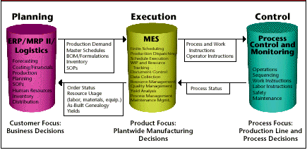
Information Flow within the IS
ERP, MES & Control are standard software solutions
ERP provides the MES level with an overall plan of what is to be produced during the current planning horizon
The MES level is then responsible for detailed production operations on the factory floor.

Slide 19
Information Flow within the IS (cont.)
The MES level tells the machine controllers how to produce a particular part by controller programs
As production is executed, actual results concerning what was produced are fed back to the planning level.
The MES level monitors real-time actual results, and data summaries are logged for storage in factory databases.

Slide 20
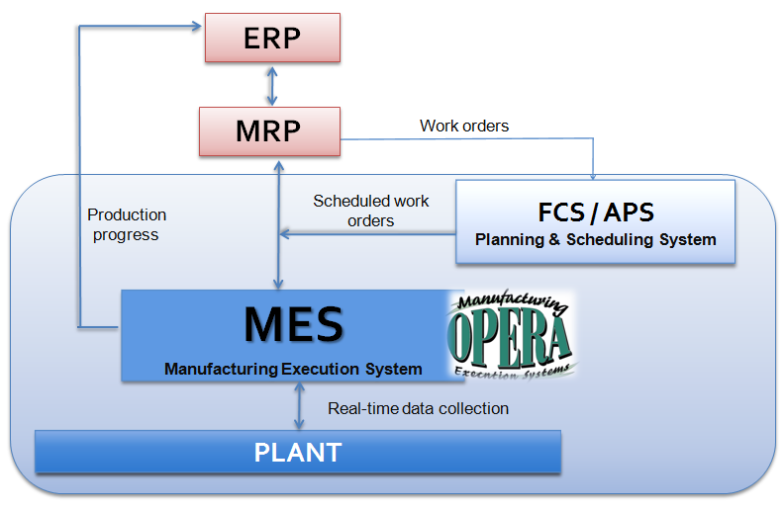
Coordinating the Layer Interaction in the Industrial Information System

Slide 21
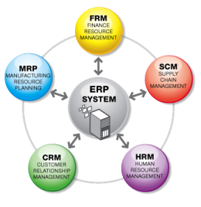
Network Architecture
Enterprise integration is about the integration of functional areas through information sharing
To realize efficient information sharing, it is desirable to network the levels of the hierarchy of the manufacturing enterprise
The network architecture is a description of how the various layers of the decision hierarchy will communicate with one another
The network architecture is typically implemented with the use of local area networks (LAN)

Slide 22
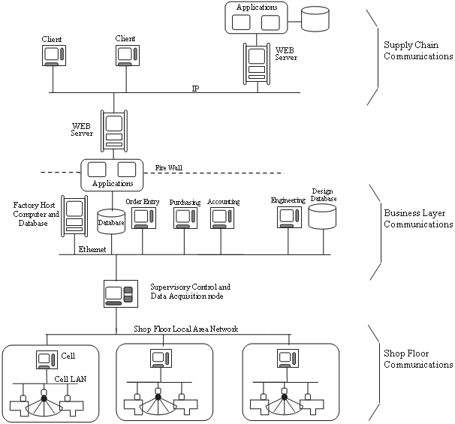
Typical Network Architecture for Modern Industrial Company
Notes:
Very important diagram

Slide 23
Functions of an Information System
Data collection: captures data about events affecting the system and its environment, and loads data into input devices Collected data are classified and indexed in order to make retrieval of desired information easy
Data storage: storing past data and information into database for future retrieval.
Information retrieval: database management system extract necessary processed data as information for decision making

Slide 24
Functions of an Information System (cont.)
Data processing: computation or summarization, includes all transformation process on input data into information
Data / information transmission: communication of coded information between geographically separated points
Data display: presentation of output information in a form for human perception, by means of printed form, or temporary display on CRT display, etc.

