Slide 1
Chapter 3
The sounds of language

Slide 2
Introduction
I take it you already know
Of tough and bough and cough and dough?
Others may stumble but not you
On hiccough, thorough, lough and through.
Well done! And now you wish, perhaps,
To learn of less familiar traps?
Beware of heard, a dreadful word,
That looks like beard and sounds like bird.
And dead: it’s said like bed, not bead
For goodness sake don’t call it “deed”!
Watch out for meat and great and threat
(They rhyme with suite and straight and debt).

Slide 3
Cont…
•The sounds of spoken English do not match up, a lot of the time, with letters of written English.
  e.g. Bernard Shaw’s ‘ghoti’ (tough/ women/ nation)
•One solution is to produce a separate alphabet with symbols that represent sounds; it is called the phonetic alphabet.
•In this chapter, we will look at how these symbols are used to represent both the consonant and vowel sounds of English words and what physical aspects of the human vocal tract are involved in the production of those sounds.

Slide 4
Phonetics
•Phonetics —The general study of the characteristics of speech sounds.
•There are 3 kinds of phonetics:
1- articulatory phonetics, the study of how speech sounds are made, or articulated.
2- acoustic phonetics, which deals with the physical properties of speech as sound waves in the air.
3- auditory phonetics which deals with the perception, via the ear, of speech sounds.

Slide 5
Voiced and voiceless sounds
•The air is pushed out by the lungs up through the trachea (or windpipe) to the larynx. Inside the larynx are your vocal folds (or vocal cords), which take two basic positions:
•1 .When the vocal folds are spread apart, the air from the lungs passes between them unimpeded (no vibration). Sounds produced in this way are described as voiceless. (ssss / ffff)
•2. When the vocal folds are drawn together, the air from the lungs repeatedly pushes them apart as it passes through, creating a vibration effect. Sounds produced in this way are described as voiced. (zzzz/ vvvv)

Slide 6
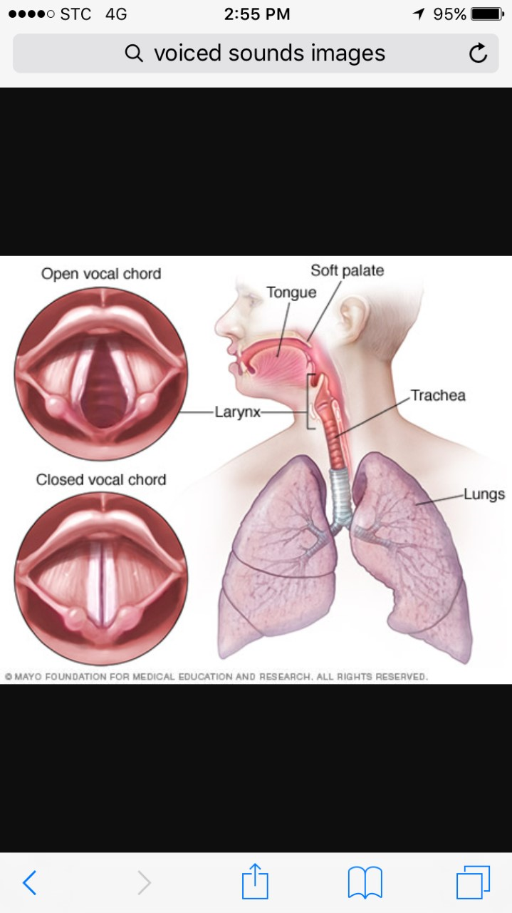

Slide 7
Place of articulation
•Most consonant sounds are produced by using the tongue and other parts of the mouth to constrict, in some way, the air is passing in the oral cavity. The terms used to describe many sounds are those which denote the place of articulation of the sound: that is, the location inside the mouth at which the constriction takes place. The phonetic alphabet symbols will be enclosed within square brackets [ ].

Slide 8
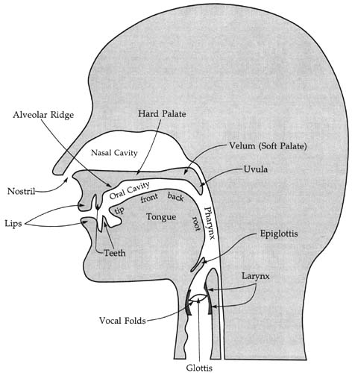

Slide 9
Bilabials
•Bilabials--sounds formed using both (= bi) upper and lower lips (= labia). The initial sounds in the words pat, bat and mat are all bilabials. They are represented by the symbols [p], which is voiceless, and [b] and [m], which are voiced. We can also describe the [w] sound found at the beginning of way, walk and world as a bilabial.

Slide 10
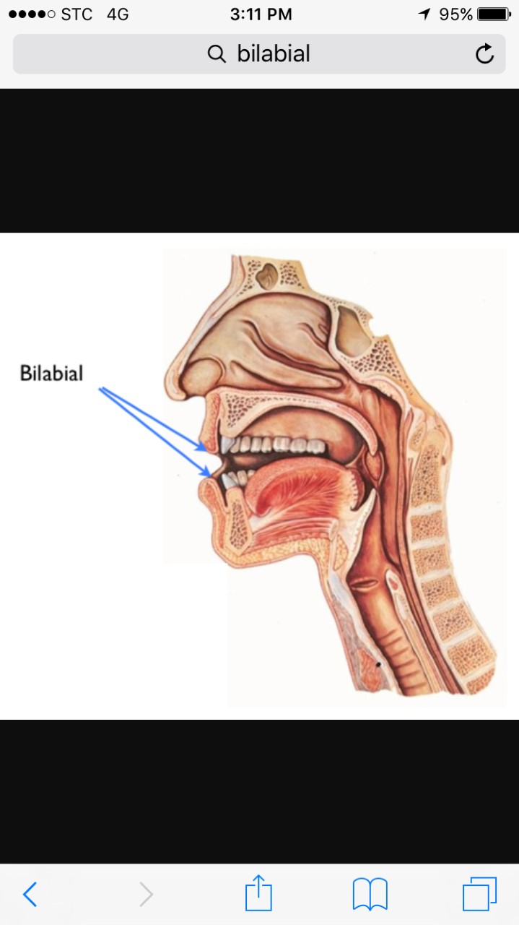

Slide 11
Labiodentals
•sounds formed with the upper teeth and the lower lip. The initial sounds of the words fat and vat and the final sounds in the words safe and save are labiodentals.
•They are represented by the symbols [f], which is voiceless, and [v], which is voiced.
•Notice that the final sound in the word cough and the initial sound in photo, despite the spelling differences, are both pronounced as [f].

Slide 12
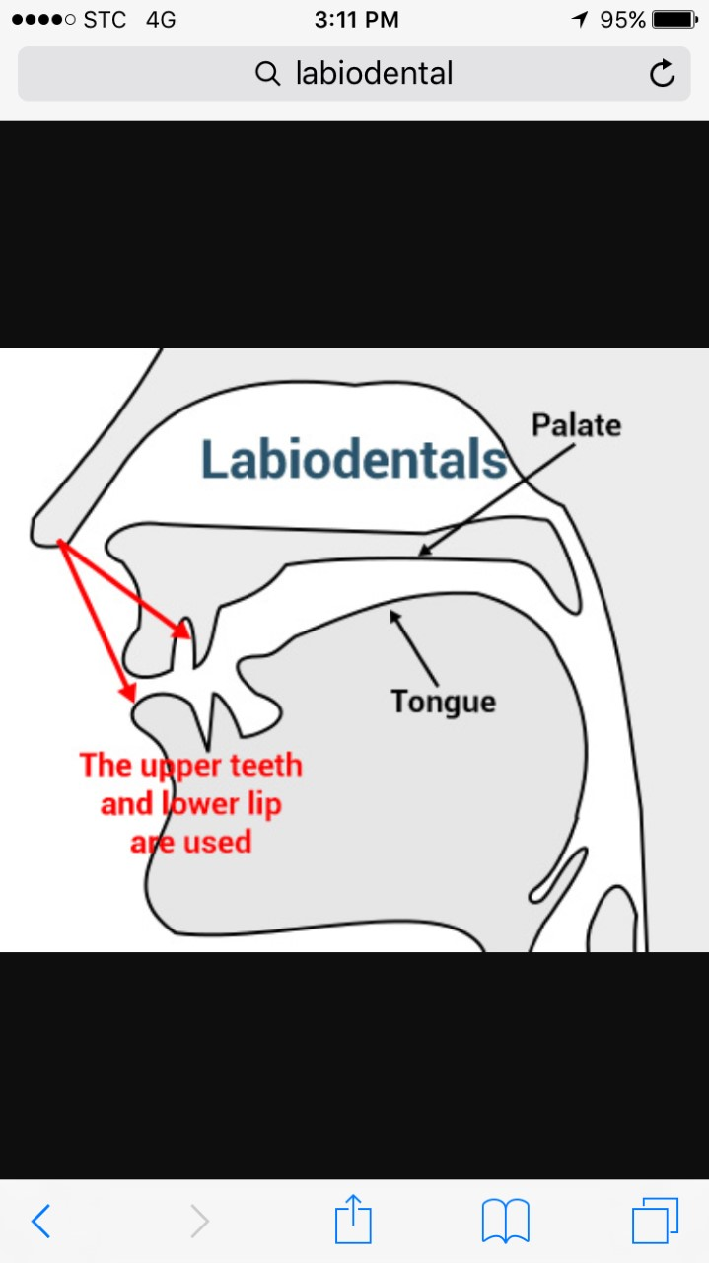

Slide 13
Dentals
•These sounds are formed with the tongue tip behind the upper front teeth. E.g. thin, bath, three, teeth. The symbol used for this sound is [θ], a voiceless dental
•The voiced dental is represented by the symbol [ð]. This sound is found in common words like the, there, then and thus. It is also the middle consonant sound in feather and the final sound of bathe.

Slide 14
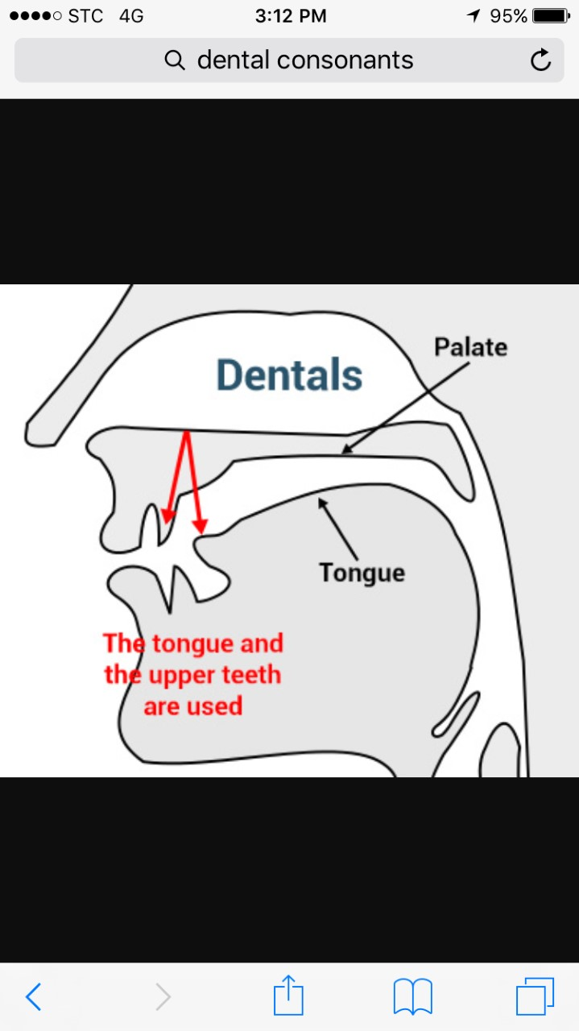

Slide 15
Alveolars
•These are sounds formed with the front part of the tongue on the alveolar ridge, which is the rough, bony ridge immediately behind and above the upper teeth. E.g. the initial sounds in top, dip, sit, zoo and nut .
The symbols for these sounds are – [t], [d], [s], [z], [n]. Of these, [t] and [s] are voiceless whereas [d], [z] and [n] are voiced.
•Other alveolars are the [l] sound found at the beginning of words such as lap and lit, and the [r] sound at the beginning of right and write.

Slide 16
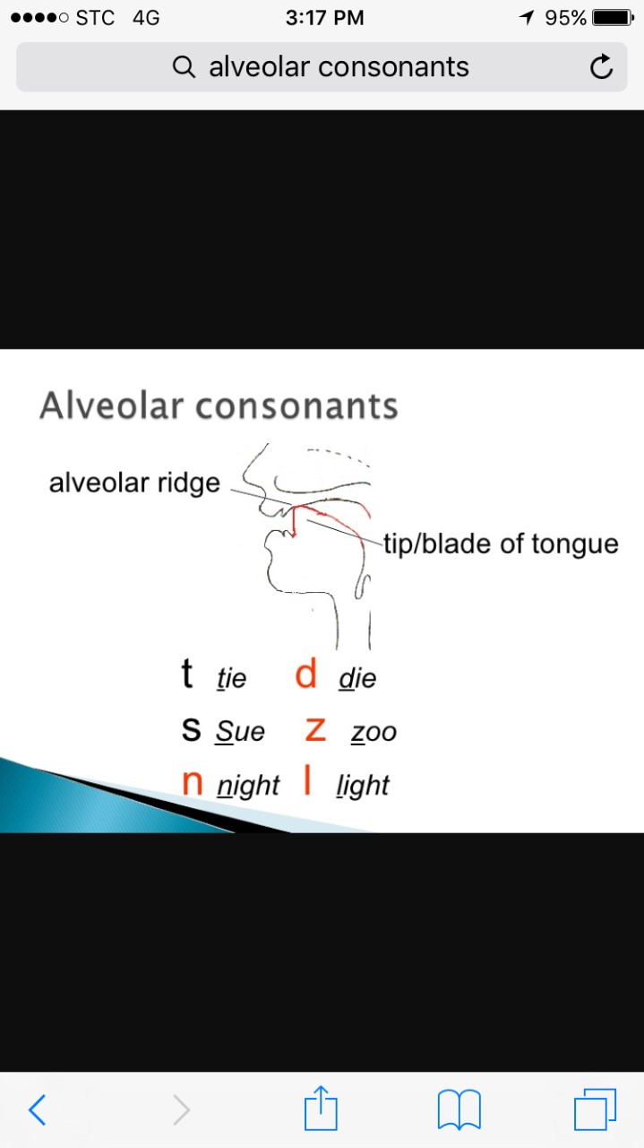

Slide 17
Palatals
•Sounds produced with the tongue and the palate (the hard part in the roof of the mouth behind the alveolar ridge) are called palatals. Examples of palatals are the initial sounds in the words shout and child, which are both voiceless.
The “sh”sound is represented as [ʃ] and the “ch” sound is represented as [ʧ]. So, the word shoe-brush begins and ends with the voiceless palatal sound [ʃ] and the word church begins and ends with the other voiceless palatal sound [ʧ].

Slide 18
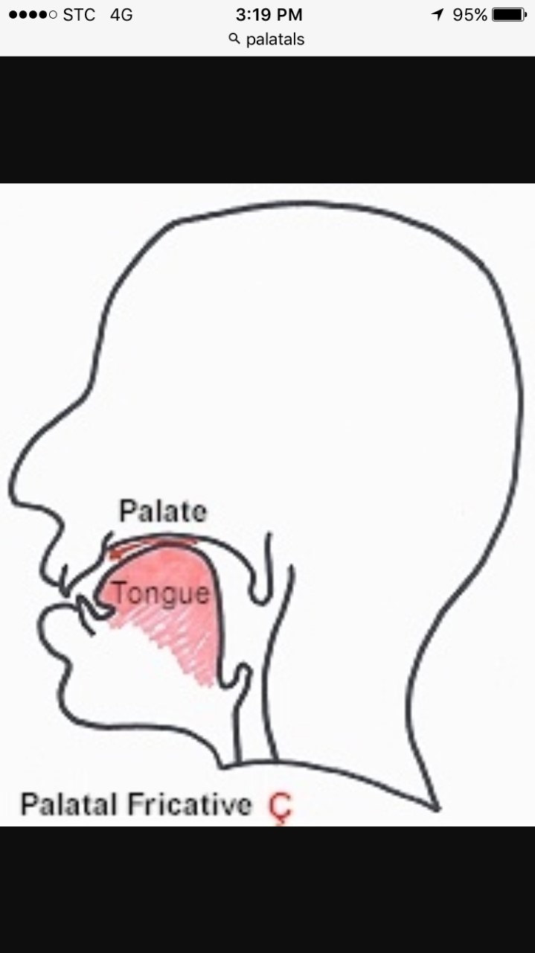

Slide 19
Cont…
•One of the voiced palatals, represented by the symbol [ʒ], is not very common in English, but can be found as the middle consonant sound in words like treasure and pleasure, or the final sound in rouge. The other voiced palatal is [ʤ],which is the initial sound in words like joke and gem. The word judge and the name George both begin and end with the sound [ʤ] despite the obvious differences in spelling.
•One other voiced palatal is the [j] sound used at the beginning of words like you.

Slide 20
Velars
• Sounds produced with the back of the tongue against the velum (the soft area behind the palate) are called velars. There is a voiceless velar sound, represented by the symbol [k], which occurs not only in kid and kill, but is also the initial sound in car and cold. Despite the variety in spelling, this [k] sound is both the initial and final sound in the words cook, kick and coke.

Slide 21
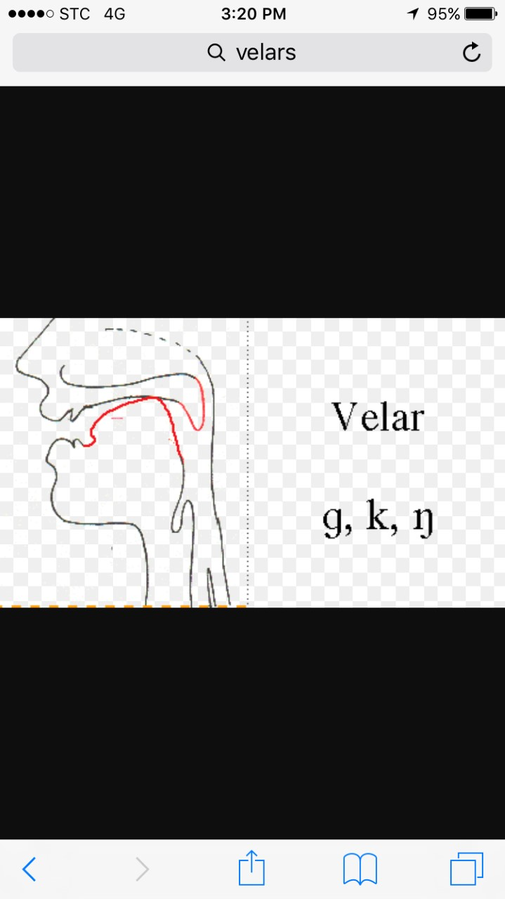

Slide 22
Cont…
•The voiced velar sound heard at the beginning of words like go, gun and give is represented by [ɡ]. Also in bag, mug and, despite the spelling, plague.
•The velum can be lowered to allow air to flow through the nasal cavity and thereby produce another voiced velar, represented by the symbol [ŋ], typically referred to as “angma.” In written English, this sound is normally spelled as the two letters “ng.” So, the [ŋ] sound is at the end of sing, sang and, despite the spelling, tongue. It occurs twice in the form ringing. Be careful not to be misled by the spelling of a word like bang – it ends with the [ŋ] sound only. There is no [ɡ] sound in this word.

Slide 23
Glottals
•There is one sound that is produced without the active use of the tongue and other parts of the mouth. It is the sound [h] which occurs at the beginning of have, house, who and whose. This sound is usually described as a voiceless glottal.
•The “glottis” is the space between the vocal folds in the larynx. When the glottis is open, as in the production of other voiceless sounds, and there is no manipulation of the air passing out of the mouth, the sound produced is that represented by [h].

Slide 24
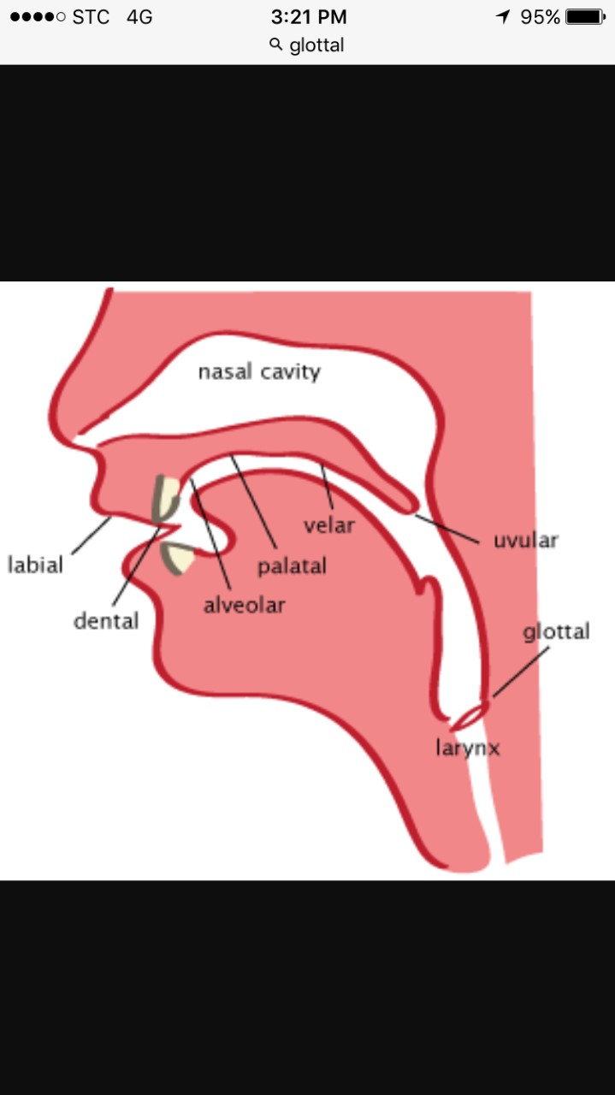

Slide 25
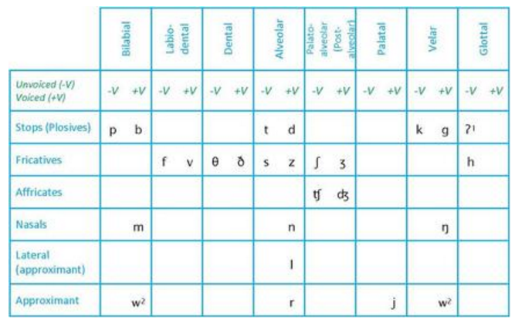

Slide 26
Manner of articulation
Describe the same consonant sounds in terms of how they are articulated.
We need it in order to differentiate between some sounds which we have placed in the same category earlier.
  E.g. [t] and [s] sounds are both voiceless alveolar sounds. How do they differ? In the manner (way) they are produced ( [t] is a stop sound and [s] is a fricative )

Slide 27
•Stops--[p], [b], [t], [d], [k], [ɡ] are all produced by some form of “stopping” of the air stream (very briefly) then letting it go abruptly. This type of consonant sound, resulting from a blocking or stopping effect on the air stream, is called a ‘stop’.
  E.g. [t] sound in a word like ten is a voiceless alveolar stop.

Slide 28
Cont…
• Fricatives--[f], [v], [θ],[ð],[s], [z], [ʃ], [ʒ], [h] involves almost blocking the air stream and having the air push through the very narrow opening. As the air is pushed through, a type of friction is produced and the resulting sounds are called ‘fricatives’. The usual pronunciation of the word fish begins and ends with the voiceless fricatives [f] and [ʃ]. The word those begins and ends with the voiced fricatives [ð] and [z].

Slide 29
Cont…
•Affricates-- If you combine a brief stopping of the air stream with an obstructed release which causes some friction, you will be able to produce the sounds [ʧ] and [ʤ]. These are
called affricates and occur at the beginning of the words cheap and jeep. In the first of these, there is a voiceless affricate [ʧ], and in the second, a voiced affricate [ʤ].

Slide 30
Cont….
•Nasals-- Most sounds are produced orally, with the velum raised, preventing airflow from entering the nasal cavity. However, when the velum is lowered and the air stream is allowed to flow out through the nose to produce [m], [n] and [ŋ], the sounds are described as nasals. These three sounds are all voiced. The words morning, knitting and name begin and end with nasals.

Slide 31
Cont…
•Liquids--The initial sounds in led and red are described as liquids. They are both voiced. The [l] sound is called a lateral liquid and is formed by letting the air stream flow around the sides of the tongue as the tip of the tongue makes contact with the middle of the alveolar ridge. The [r] sound at the beginning of red is formed with the tongue tip raised and curled back near the alveolar ridge.

Slide 32
Cont…
•Glides--The sounds [w] and [j] are described as glides. They are both voiced and occur at the beginning of we, wet, you and yes. These sounds are typically produced with the tongue in motion (or “gliding”) to or from the position of a vowel and are sometimes called semi-vowels.

Slide 33
cont..
•The glottal stop, represented by the symbol [ʔ], occurs when the space between the vocal folds (the glottis) is closed completely (very briefly), then released.
  E.g. Oh oh! / Uh-uh (meaning “no”)
  in place of “t” when they pronounce Batman quickly.
  You can also produce a glottal stop if you try to say the words butter or bottle without pronouncing the “-tt-” part in the middle, a characteristic of Cockney (London) speech (e.g. Harry Potter)

Slide 34
Cont…
•If, however, you are someone who pronounces the word butter in a way that is close to “budder,” then you are making a flap. It is represented by [D]or sometimes [ɾ].This sound is produced by the tongue tip tapping the alveolar ridge briefly.
Many American English speakers have a tendency to “flap” the [t] and [d] consonants between vowels so that, in casual speech,
  E.g the pairs latter and ladder (do not have distinct middle consonants. )
  Nor do writer and rider,
  metal and medal.
- play-dough instead of Plato

Slide 35
Vowels
•While the consonant sounds are mostly articulated via closure or obstruction in the
vocal tract, vowel sounds are produced with a relatively free flow of air. They are all
typically voiced. To describe vowel sounds, we consider the way in which the tongue
influences the shape through which the airflow must pass. Refer to pg. 54 (look at the chart and the examples)

Slide 36
Diphthongs
•In addition to single vowel sounds, we regularly create sounds that consist of a combination of two vowel sounds, known as diphthongs.
•Our vocal organs move from one vocalic position [a] to another [ɪ] as we
produce the sound [aɪ], as in Hi or Bye.
•Refer to pg. 55 for examples

Slide 37
Cont…
•You may not make a significant distinction between the central vowels [ə], called
“schwa,” and [ʌ], called “wedge.” If you’re trying to transcribe, just use schwa [ə]
•unstressed vowel (underlined) in the everyday use of words such as afford, collapse,
photograph, wanted, and in those very common words a and the.

Slide 38
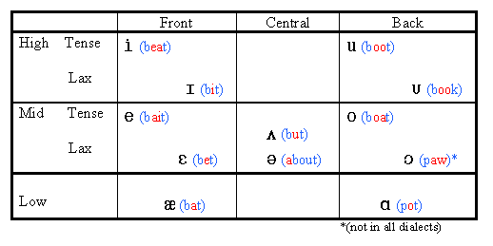
Vowel Chart

