Slide 1
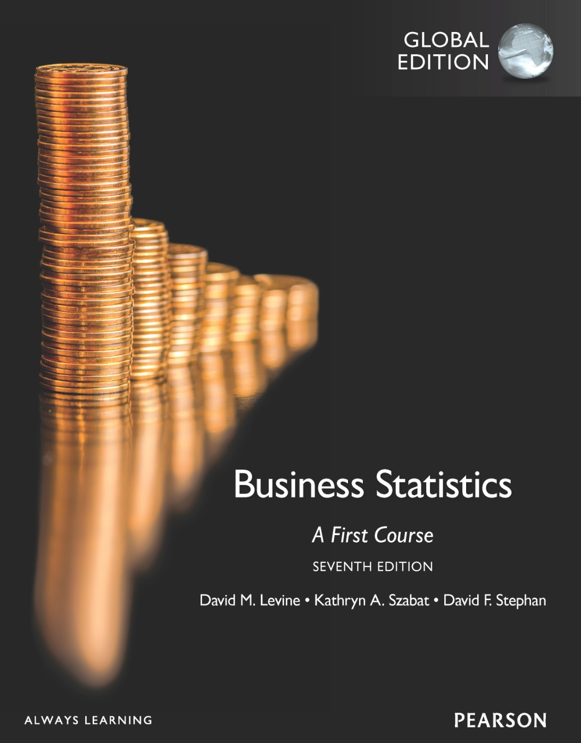
Chapter 3
Numerical Descriptive Measures

Slide 2
Objectives
In this chapter, you learn to:
Describe the properties of central tendency, variation, and shape in numerical data
Construct and interpret a Boxplot
Compute descriptive summary measures for a population
Calculate and interpret the Coefficient of Variation (CV)

Slide 3
Summary Definitions
The central tendency is the extent to which the values of a numerical variable group around a typical or central value.
The variation is the amount of dispersion or scattering away from a central value that the values of a numerical variable show.
The shape is the pattern of the distribution of values from the lowest value to the highest value.

Slide 4
Measures of Central Tendency:
Central Tendency
Mean
Median
Mode

Slide 5
Measures of Central Tendency: The Population Mean
The population mean is the sum of the values in the population divided by the population size, N
μ = population mean
N = population size
X_{i} = i^{th} value of the variable X

Slide 6
Measures of Central Tendency: The Sample Mean
The Arithmetic Mean (often just called the “mean”) is the most common measure of central tendency
For a sample of size n:
The i^{th} value
Pronounced x-bar
Sample size
Observed values

Slide 7
Measures of Central Tendency: The Mean
The most common measure of central tendency
Mean = sum of values divided by the number of values
Affected by extreme values (outliers)
11 12 13 14 15 16 17 18 19 20
11 12 13 14 15 16 17 18 19 20
Mean = 13
Mean = 14

Slide 8
Measures of Central Tendency: The Median
In an ordered array, the median is the “middle” number (50% above, 50% below)
Less sensitive than the mean to extreme values
11 12 13 14 15 16 17 18 19 20
11 12 13 14 15 16 17 18 19 20
Median = 13
Median = 13

Slide 9
Measures of Central Tendency: Locating the Median
The location of the median when the values are in numerical order (smallest to largest):
If the number of values is odd, the median is the middle number
If the number of values is even, the median is the average of the two middle numbers
Note that is not the value of the median, only the position of
the median in the ranked data

Slide 10
Measures of Central Tendency: The Mode
Value that occurs most often
Not affected by extreme values
Used for either numerical or categorical data
There may be no mode
There may be several modes
0 1 2 3 4 5 6 7 8 9 10 11 12 13 14
0 1 2 3 4 5 6
Mode = 9
No Mode

Slide 11
Measures of Central Tendency: Review Example
House Prices: $2,000,000
$ 500,000 $ 300,000 $ 100,000 $ 100,000
Sum $ 3,000,000
Mean: ($3,000,000/5)
= $600,000
Median: middle value of ranked data = $300,000
Mode: most frequent value = $100,000

Slide 12
Measures of Central Tendency: Which Measure to Choose?
The mean is generally used, unless extreme values (outliers) exist.
The median is often used when extreme values (outliers) exist, since the median is not sensitive to extreme values.
For example, median home prices may be reported for a region; it is less sensitive to outliers.
In some situations it makes sense to report both the mean and the median (for example family income).

Slide 13
Measures of Central Tendency: Summary
Central Tendency
Arithmetic Mean
Median
Mode
Middle value in the ordered array
Most frequently observed value

Slide 14
Shape of a Distribution
Describes how data are distributed
Two useful shape related statistics are:
Skewness
Measures the extent to which data values are not symmetrical
Kurtosis
Kurtosis affects the peakedness of the curve of the distribution—that is, how sharply the curve rises approaching the center of the distribution

Slide 15
Shape of a Distribution (Skewness)
Measures the extent to which data is not symmetrical
Left-Skewed
Symmetric
Right-Skewed
Mean < Median
Mean = Median
Median < Mean
Skewness
Statistic
< 0 0 >0

Slide 16
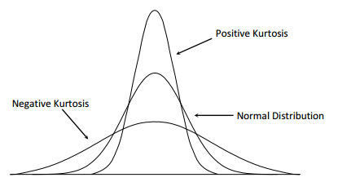
Shape of a Distribution (Kurtosis)

Slide 17
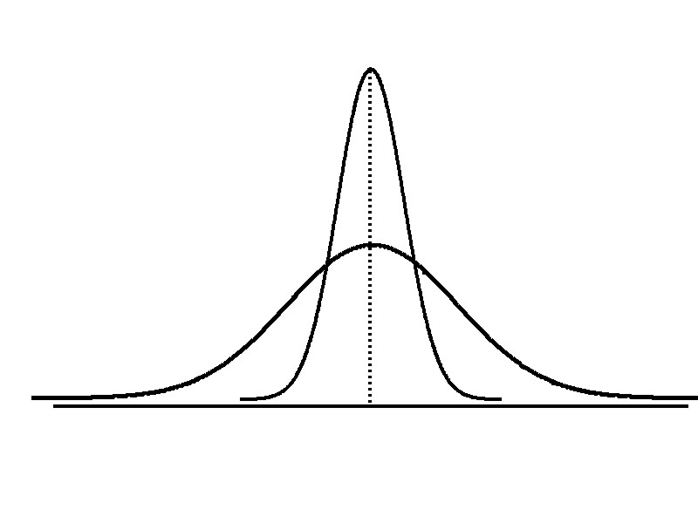
Measures of Variation
Variation
Range
Variance
Standard Deviation
Coefficient of Variation
Measures of variation give information on the spread or variability or dispersion of the data values.
Same center,
different variation

Slide 18
Measures of Variation: The Range
Simplest measure of variation
Difference between the largest and the smallest values:
Range = X_{largest} – X_{smallest}
Example:
0 1 2 3 4 5 6 7 8 9 10 11 12 13 14
Range = 13 - 1 = 12

Slide 19
Measures of Variation: Why The Range Can Be Misleading?
Does not account for how the data are distributed
Sensitive to outliers
7 8 9 10 11 12
7 8 9 10 11 12
Range = 12 - 7 = 5
Range = 12 - 7 = 5
1,1,1,1,1,1,1,1,1,1,1,2,2,2,2,2,2,2,2,3,3,3,3,4,5
Range = 5 - 1 = 4
1,1,1,1,1,1,1,1,1,1,1,2,2,2,2,2,2,2,2,3,3,3,3,4,120
Range = 120 - 1 = 119

Slide 20
Measures of Variation: The Sample Variance
Average (approximately) of squared deviations of values from the mean
Sample variance:
Where
X = arithmetic mean
n = sample size
X_{i} = i^{th} value of the variable X

Slide 21
Measures of Variation: The Sample Standard Deviation
Most commonly used measure of variation
Shows variation about the mean
Is the square root of the variance
Has the same units as the original data
Sample standard deviation:

Slide 22
Measures of Variation: The Standard Deviation
Steps for Computing Standard Deviation
1. Compute the difference between each value and the mean.
2. Square each difference.
3. Add the squared differences.
4. Divide this total by n-1 to get the sample variance.
5. Take the square root of the sample variance to get the sample standard deviation.

Slide 23
Measures of Variation: Sample Standard Deviation: Calculation Example
Sample Data (X_{i}) : 10 12 14 15 17 18 18 24
n = 8 Mean = X = 16
A measure of the “average” scatter around the mean

Slide 24
Measures of Variation: Comparing Standard Deviations
Data A
Mean = 15.5
S = 3.338
11 12 13 14 15 16 17 18 19 20 21
Data B
Mean = 15.5
S = 0.926
11 12 13 14 15 16 17 18 19 20 21
Data C
Mean = 15.5
S = 4.567
11 12 13 14 15 16 17 18 19 20 21

Slide 25
Measures of Variation: Comparing Standard Deviations
Smaller standard deviation
Larger standard deviation

Slide 26
Numerical Descriptive Measures For A Population: The Variance σ²
Average of squared deviations of values from the mean
Population variance:
Where
μ = population mean
N = population size
X_{i} = i^{th} value of the variable X

Slide 27
Numerical Descriptive Measures For A Population: The Standard Deviation σ
Most commonly used measure of variation
Shows variation about the mean
Is the square root of the population variance
Has the same units as the original data
Population standard deviation:

Slide 28
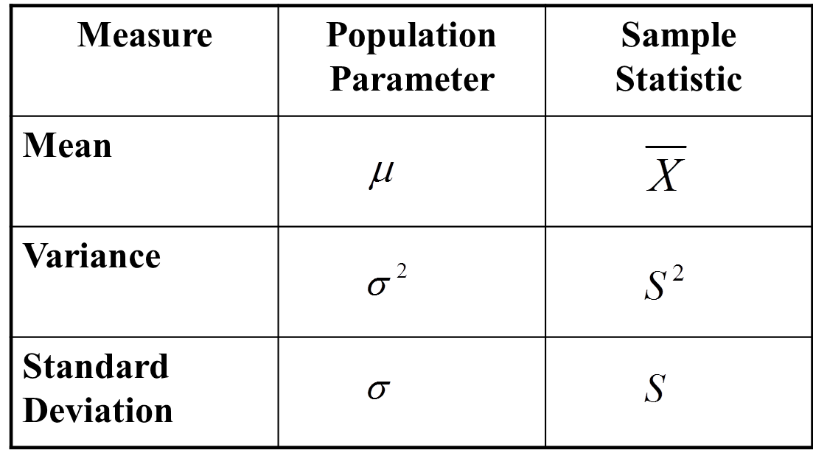
Sample statistics versus population parameters

Slide 29
Measures of Variation: Summary Characteristics
The more the data are spread out, the greater the range, variance, and standard deviation.
The more the data are concentrated, the smaller the range, variance, and standard deviation.
If the values are all the same (no variation), all these measures will be zero.
None of these measures are ever negative.

Slide 30
Measures of Variation: The Coefficient of Variation
Measures relative variation
Always in percentage (%)
Shows variation relative to mean
Can be used to compare the variability of two or more sets of data measured in different units

Slide 31
Measures of Variation: Comparing Coefficients of Variation
Stock A:
Average price last year = $50
Standard deviation = $5
Stock B:
Average price last year = $100
Standard deviation = $5
Both stocks have the same standard deviation, but stock B is less variable relative to its price

Slide 32
Measures of Variation: Comparing Coefficients of Variation
Stock A:
Average price last year = $50
Standard deviation = $5
Stock C:
Average price last year = $8
Standard deviation = $2
Stock C has a much smaller standard deviation but a much higher coefficient of variation

Slide 33
Quartile Measures (other measures of location)
Quartiles split the ranked data into 4 segments with an equal number of values per segment
25%
25%
25%
25%
Q1
Q2
Q3
The first quartile, Q₁, is the value for which 25% of the observations are smaller and 75% are larger
Q₂ is the same as the median (50% of the observations are smaller and 50% are larger)
Only 25% of the observations are greater than the third quartile

Slide 34
Quartile Measures: Locating Quartiles
Find a quartile by determining the value in the appropriate position in the ranked data, where
First quartile position: Q₁ = (n+1)/4 ranked value
Second quartile position: Q₂ = (n+1)/2 ranked value
Third quartile position: Q₃ = 3(n+1)/4 ranked value
where n is the number of observed values

Slide 35
Quartile Measures: Calculation Rules
When calculating the ranked position use the following rules:
If the result is a whole number then it is the ranked position to use
If the result is a fractional half (e.g. 2.5, 7.5, 8.5, etc.) then average the two corresponding data values.
If the result is not a whole number or a fractional half then round the result to the nearest integer to find the ranked position.

Slide 36
Quartile Measures: Locating Quartile: Example
Sample Data in Ordered Array: 11 12 13 16 16 17 18 21 22
(n = 9)
Q₁ is in the (9+1)/4 = 2.5 position of the ranked data
so use the value half way between the 2nd and 3rd values,
so Q₁ = 12.5
Q₁ and Q₃ are measures of non-central location
Q₂ = median, is a measure of central tendency

Slide 37
Quartile Measures Calculating The Quartiles: Example
Sample Data in Ordered Array: 11 12 13 16 16 17 18 21 22
(n = 9)
Q₁ is in the (9+1)/4 = 2.5 position of the ranked data,
so Q₁ = (12+13)/2 = 12.5
Q₂ is in the (9+1)/2 = 5th position of the ranked data,
so Q₂ = median = 16
Q₃ is in the 3(9+1)/4 = 7.5 position of the ranked data,
so Q₃ = (18+21)/2 = 19.5
Q₁ and Q₃ are measures of non-central location
Q₂ = median, is a measure of central tendency

Slide 38
Quartile Measures: The Interquartile Range (IQR)
The IQR is Q₃ – Q₁ and measures the spread in the middle 50% of the data
The IQR is also called the midspread because it covers the middle 50% of the data
The IQR is a measure of variability that is not influenced by outliers or extreme values
Measures like Q₁, Q₃, and IQR that are not influenced by outliers are called resistant measures

Slide 39
Calculating The Interquartile Range
Example:
Median
(Q₂)
X
X
Q₁
Q₃
minimum
maximum
25% 25% 25% 25%
12 30 45 57 70
Interquartile range
= 57 – 30 = 27

Slide 40
The Five Number Summary
The five numbers that help describe the center, spread and shape of data are:
X_{smallest}
First Quartile (Q₁)
Median (Q₂)
Third Quartile (Q₃)
X_{largest}

Slide 41
Relationships among the five-number summary and distribution shape
Left-Skewed | Symmetric | Right-Skewed
Median – X_{smallest} > X_{largest} – Median | Median – X_{smallest} ≈ X_{largest} – Median | Median – X_{smallest} < X_{largest} – Median
Q₁ – X_{smallest} > X_{largest} – Q₃ | Q₁ – X_{smallest} ≈ X_{largest} – Q₃ | Q₁ – X_{smallest} < X_{largest} – Q₃
Median – Q₁ > Q₃ – Median | Median – Q₁ ≈ Q₃ – Median | Median – Q₁ < Q₃ – Median
Q₁
Q₂
Q₃
Q₁
Q₂
Q₃
Q₁
Q₂
Q₃

Slide 42
Five Number Summary and The Boxplot
The Boxplot: A Graphical display of the data based on the five-number summary:
X_{smallest} -- Q₁ -- Median -- Q₃ -- X_{largest}
Example:
25% of data 25% 25% 25% of data
of data of data
X_{smallest} Q₁ Median Q₃ X_{largest}

Slide 43
Five Number Summary: Shape of Boxplots
If data are symmetric around the median then the box and central line are centered between the endpoints
A Boxplot can be shown in either a vertical or horizontal orientation
X_{smallest} Q₁ Median Q₃ X_{largest}

Slide 44
Distribution Shape and The Boxplot
Left-Skewed
Symmetric
Right-Skewed
Q₁
Q₂
Q₃
Q₁
Q₂
Q₃
Q₁
Q₂
Q₃

Slide 45
Boxplot Example
Below is a Boxplot for the following data:
0 2 2 2 3 3 4 5 5 9 27
The data are right skewed, as the plot depicts
X_{smallest} Q₁ Q₂ / Median Q₃ X_{largest}
0 2 3 5 27

Slide 46
Locating Extreme Outliers: Z-Score (It is studied with Chapter 6)
To compute the Z-score of a data value, subtract the mean and divide by the standard deviation.
The Z-score is the number of standard deviations a data value is from the mean.
A data value is considered an extreme outlier if its Z-score is less than -3.0 or greater than +3.0.
The larger the absolute value of the Z-score, the farther the data value is from the mean.

Slide 47
Locating Extreme Outliers: Z-Score
where X represents the data value
X is the sample mean
S is the sample standard deviation

Slide 48
Locating Extreme Outliers: Z-Score
Suppose the mean math SAT score is 490, with a standard deviation of 100.
Compute the Z-score for a test score of 620.
A score of 620 is 1.3 standard deviations above the mean and would not be considered an outlier.

Slide 49
The Empirical Rule (It is studied with Chapter 6(
The empirical rule approximates the variation of data in a bell-shaped distribution
Approximately 68% of the data in a bell shaped distribution is within 1 standard deviation of the mean or μ ± 1σ
68%
μ
μ ± 1σ

Slide 50
The Empirical Rule
Approximately 95% of the data in a bell-shaped distribution lies within two standard deviations of the mean, or µ ± 2σ
Approximately 99.7% of the data in a bell-shaped distribution lies within three standard deviations of the mean, or µ ± 3σ
95%
99.7%
μ ± 2σ
μ ± 3σ

Slide 51
Using the Empirical Rule
Suppose that the variable Math SAT scores is bell-shaped with a mean of 500 and a standard deviation of 90. Then,
Approximately 68% of all test takers scored between 410 and 590, (500 ± 90).
Approximately 95% of all test takers scored between 320 and 680, (500 ± 180).
Approximately 99.7% of all test takers scored between 230 and 770, (500 ± 270).

Slide 52
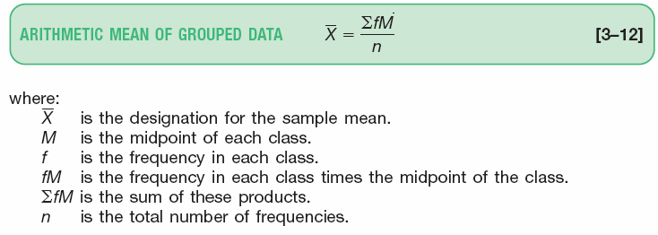
The Arithmetic Mean of Grouped Data

Slide 53
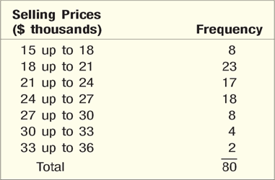
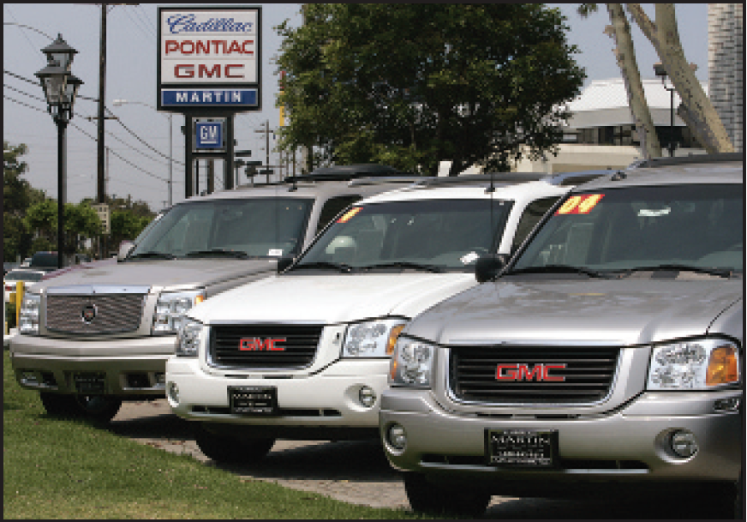
The Arithmetic Mean of Grouped Data - Example
Recall in Chapter 2, we constructed a frequency distribution for the vehicle selling prices. The information is repeated below. Determine the arithmetic mean vehicle selling price.

Slide 54
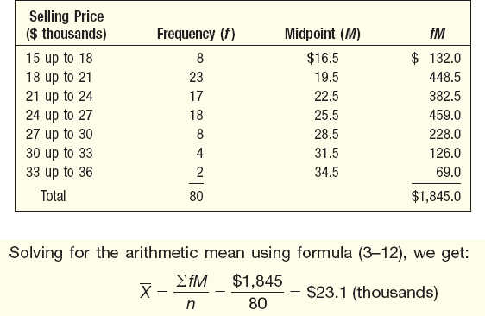
The Arithmetic Mean of Grouped Data - Example

Slide 55
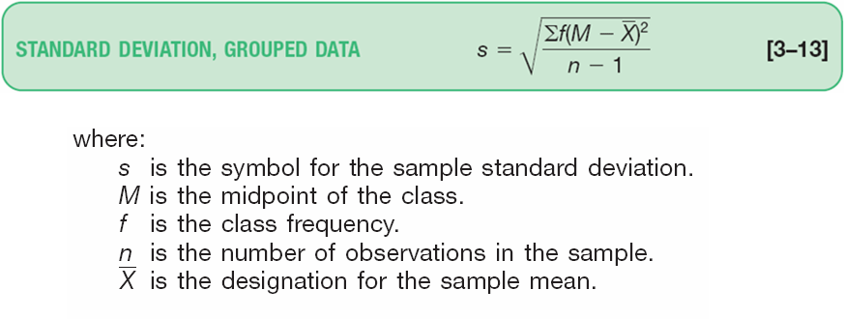
Standard Deviation of Grouped Data

Slide 56
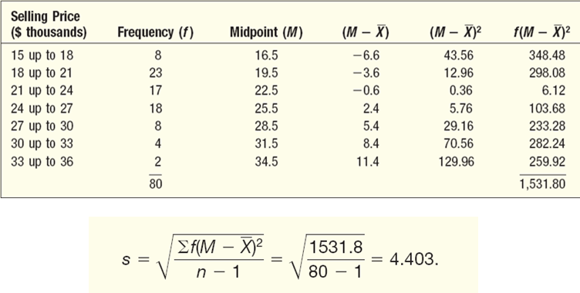
Standard Deviation of Grouped Data - Example
Refer to the frequency distribution for the Whitner Autoplex data used earlier. Compute the standard deviation of the vehicle selling prices

Slide 57
Chapter Summary
In this chapter we have discussed:
Describing the properties of central tendency, variation, and shape in numerical data
Constructing and interpreting a boxplot
Computing descriptive summary measures for a population
Calculate and interpret the Coefficient of Variation (CV)

