Slide 1
Phenols
340 Chem 1st 1439

Slide 2
Structure of Phenols
Phenols are compounds of the general formula ArOH, where Ar is an groups.
Phenols differ from alcohols in having the OH group attached directly to an aromatic ring.
phenol is the specific name for hydroxybenzene, and it is the general name for the family of compounds derived from hydroxybenzene.
340 Chem 1st 1439

Slide 3
Many pharmaceutically and pharmacologically important compounds, either of natural or synthetic origin, belong to this class of compounds, e.g. salicylic acid and quercetin.
340 Chem 1st 1439

Slide 4
Nomenclature of phenols
The simplest member of this class of compounds is named phenol. Others can be
named as substituted phenols, and also retain by the IUPAC system.
Numbering of the ring begins at the hydroxyl-substituted carbon and proceeds in the direction that gives the lower number to the next substituted carbon. Substituents are cited in alphabetical order.
340 Chem 1st 1439

Slide 5
α- Naphthol
β- Naphthol
340 Chem 1st 1439

Slide 6
Classifications of phenols.
Dihydroxypenols
Polyhydroxypenols
340 Chem 1st 1439

Slide 7
Physical properties of phenols
phenols are liquids or low-melting solids and colorless.
The presence of hydroxyl groups in phenols means that phenols are like alcohols. For example, they are able to form strong intermolecular hydrogen bonds, and therefore have higher boiling points than hydrocarbons of the same molecular weight.
Phenols are also modestly soluble in water because of their ability to form strong hydrogen bonds with water molecules.
340 Chem 1st 1439

Slide 8
Acidity of phenols
phenols are more acidic than alcohols, and weaker acids than carboxylic acids
Phenol is a strong acid than alcohols because the negative charge in oxygen is dispersed by resonance through the benzene ring.
340 Chem 1st 1439

Slide 9
The inductive effect of an electron-withdrawing group such as chlorine changes the charge distribution in the molecule so as to decrease the electron density of the ring and oxygen, causing the proton to be held less strongly; it also can stabilize the phenoxide ion by dispersing its negative charge. These effects make the substituted phenol more acidic than phenol itself.
The inductive effect of an electron-releasing group (i.e., CH₃) changes the charge distribution in the molecule so as to increase the electron density of the ring and oxygen, causing the proton to be held more strongly; it also destabilizes the phenoxide anion by intensifying its negative charge. These effects make the substituted phenol less acidic than phenol itself.
340 Chem 1st 1439

Slide 10
Preparation of phenols
Hydrolysis of diazonium salts
Diazonium salts react with water in the presence of mineral acids to yield phenols.
340 Chem 1st 1439

Slide 11
Alkali fusion of sodium benzene-sulphonates
Hydrolysis of chlorobenzene (The Dow process)
340 Chem 1st 1439

Slide 12
Oxidation of isopropylbenzene
or

Slide 13
Reactions of phenols
Phenols undergo electrophilic substitutions. In phenol, the substitutions take place in ortho and para positions.
Salt formation via strong base or active metal
Williamson ether synthesis
Ester formation
Friedel-Crafts acylation: Fries rearrangement
Halogenation
Coupling with diazonium salts
Kolbe-Schmitt Carboxylation
Reimer-Tiemann reaction
340 Chem 1st 1439

Slide 14
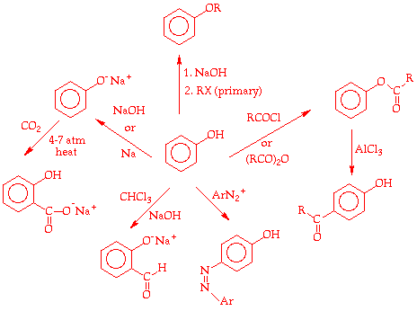
340 Chem 1st 1439

Slide 15
Salt formation via strong base or active metal
With active metals:
With bases
CH₄< NH₃ < CH=CH < ROH < H₂O < ArOH <H₂CO₃ <RCOOH < HF

Slide 16
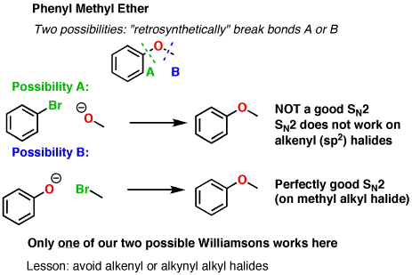
Williamson ether synthesis
Phenol, a poor nucleophile, reacts with sodium hydroxide in the aqueous phase to form the phenoxide ion, a good nucleophile. Alkyl-aryl ethers can be synthesized by treating the sodium salt of a phenol with an alkyl halide.

Slide 17
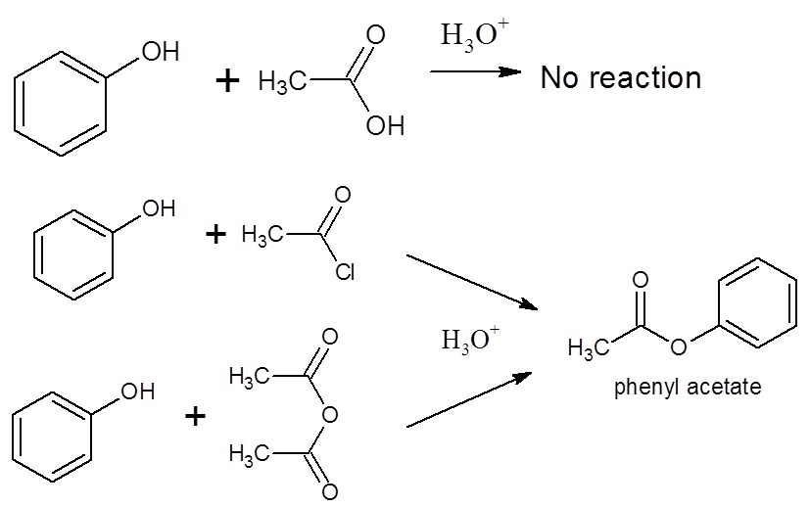
Formation of Esters From Phenols
nucleophilic substitution

Slide 18
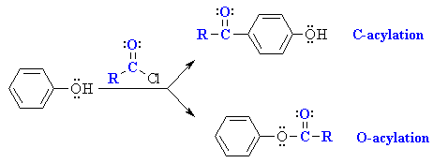
Reaction of aromatic nucleus of phenol
Friedel-Crafts acylation
Acylation
Sulphonation
AlCl3
acyl chloride or anhydride/AlCl3
electrophilic aromatic substitution
acyl chloride or anhydride (fast)
nucleophilic acyl substitution
340 Chem 1st 1439

Slide 19
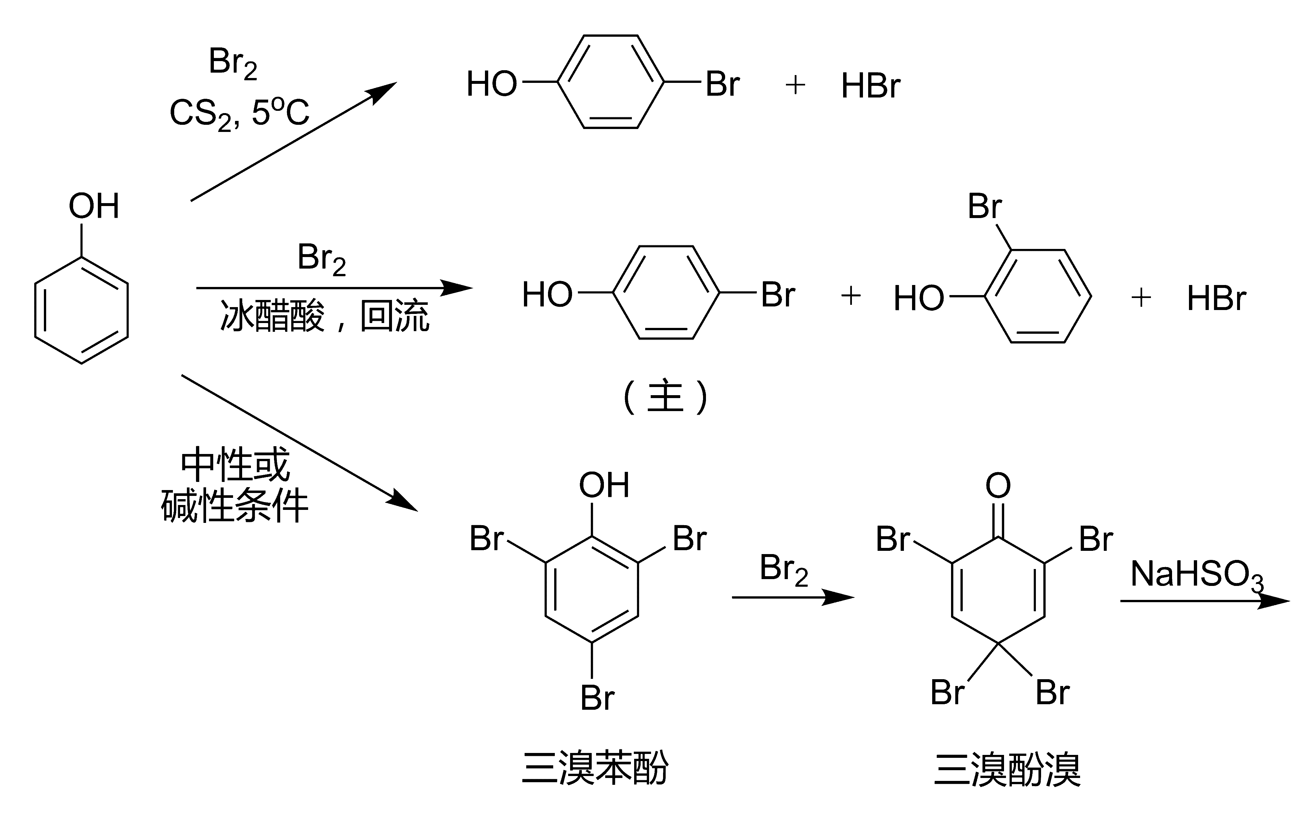
Nitration
Halogenation
FeCl₃
Br₂/H₂O
2,4,6-Tribromophenol
340 Chem 1st 1439

Slide 20
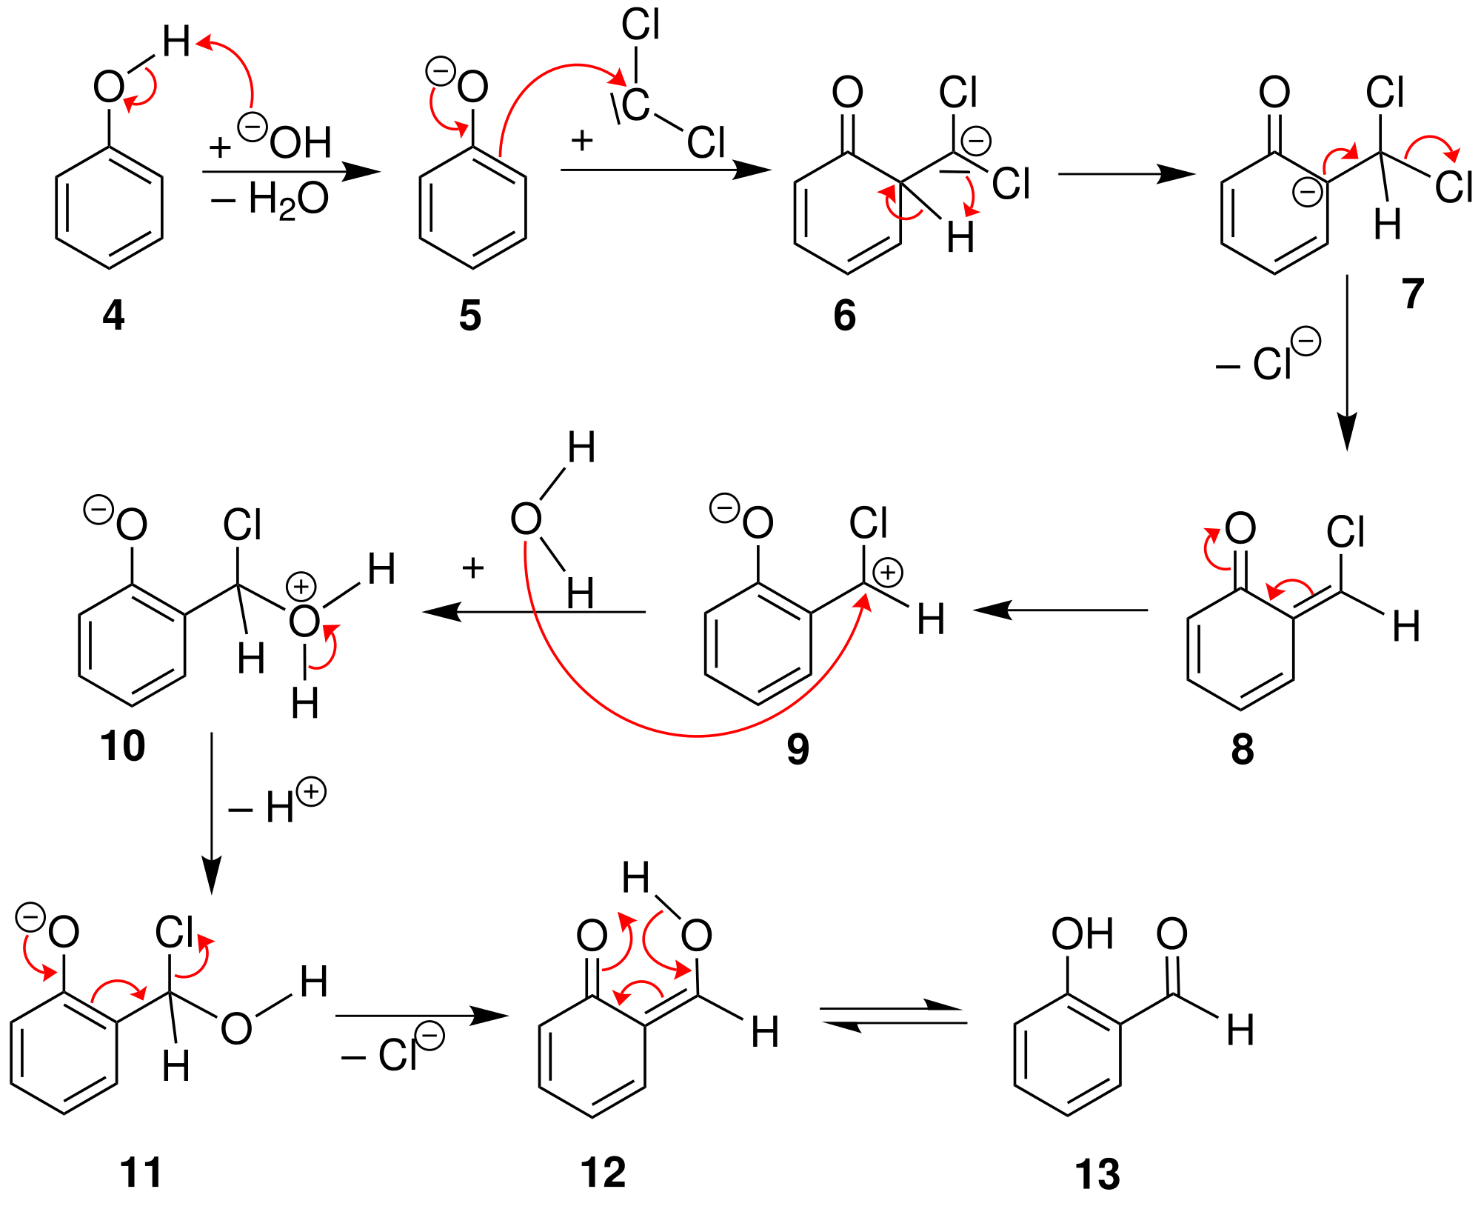
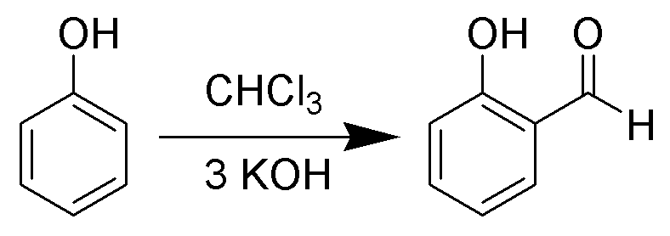
Aldehyde formation: Reimer–Tiemann reaction
340 Chem 1st 1439

Slide 21
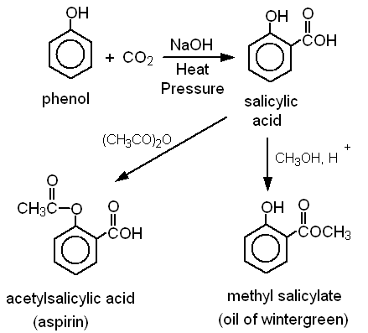
Carbonation: Kolbe reaction
340 Chem 1st 1439

Slide 22
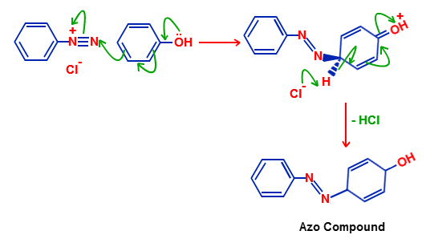
Coupling with diazonium salts

Slide 23
Oxidation of Phenols
Phenols are more easily oxidized than alcohols. Oxidation of compounds of this type with silver oxide, potassium dichromate K₂Cr₂O₇ or with chromic acid H₂Cr₂O₇ yields conjugated dicarbonyl compounds called p-quinones (1,4-benzoquinone).
340 Chem 1st 1439

