Slide 1
Chapter 5
Electric Logic Sensors and Actuators

Slide 2
5.1 Introduction to Electric Logic Sensors and Actuators
Electric sensors and actuators can be classified to be as continuous and logic. Logic sensors are used with PLC to detect the state of the process as true or false (on or off) in logic control. Similarly logic actuators are used with PLC to activate or deactivate the logic switching elements, that will drive the mechanical system.
Examples of using logic sensors:
Mechanical limit switch used to detect the object approaching.
Optical sensor or detector used to detect an object is breaking the beam of light.
Capacitive detector used to detect the existing of dielectric object.
Inductive detector switch used to detect the existence of a ferrous metal object.
A thermostat switch (such as those used in refrigeration and air conditioning) opens or closes a contact when a certain temperature is reached.

Slide 3
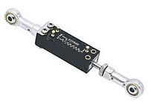
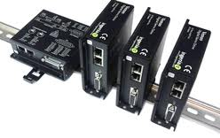
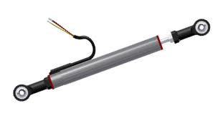
5.1 Introduction to Electric Logic Sensors and Actuators
On the other hand, continuous sensors are those, which generate a continuous signal (voltage or current) that proportional with the actual physical variable. This signal has either analog or digital values depend of the type of the sensor and can be fed very easily to the PLC module to measure the physical variable. For example, a linear potentiometer will generate analog output signal proportional to linear displacements.
The continuous actuators are also used with PLC to activate or deactivate the digital or with analog amplifier that will drive the mechanical system proportional to the value of the control signal. For example, the analog output signal from PLC can be used to activate a linear amplifier that will control the speed of a DC motor.
Linear Analog DC servodrives
Linear potentiometer

Slide 4
5.2 Nearby or Proximity Logic Detectors
There are two ways to detect the existence of an object, either by direct mechanical contact using a physical force contact or using proximity technique (no physical contact)
Contact switches
Internally, contact switches consist of electric contacts driven by mechanical lever and spring. When applying a small force on this mechanical liver it will actuates the contact. Removing the force will return contact to its original position.
Contact switches are available with either normally closed NC or normally opened NO contacts. Micro limit switches can be found with small equipment, while heavy-duty limit switches (more expensive) can be found with large equipment.
Contact switches can be used as motion limit switches or as push bottoms switches and used as user-machine interface switches, e.g. start/stop push button switches.

Slide 5
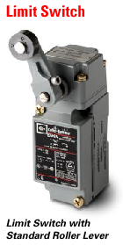
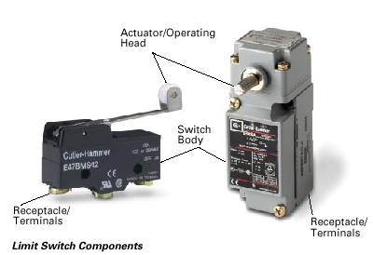
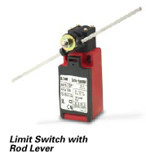
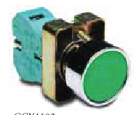
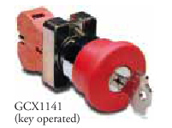
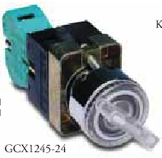
5.2 Nearby or Proximity Logic Detectors
Contact switches
Internally, contact switches consist of electric contacts driven by mechanical lever and spring. When applying a small force on this mechanical liver it will actuates the contact. Removing the force will return contact to its original position.
Contact switches are available with either normally closed NC or normally opened NO contacts. Micro limit switches can be found with small equipment, while heavy-duty limit switches (more expensive) can be found with large equipment.
Fig 5.1 Examples of contact switches used as industrial limits switches.
Fig 5.2 Examples of contact switches used as push-bottom, key type and selector switches used as machine-user interface bottoms.

Slide 6
5.2 Nearby or Proximity Logic Detectors
Contact switches
In many automation applications, the limit switches represent the weakest link of the control system. It has been estimated that 90% of machine automation failures are from limits switches. This is because in fact that these sensors are located almost in the places where action is. These switches are usually located in hot area, moisture, corrosive atmosphere …etc.
According to the contact configuration, contact switches are of two types, single-pole single-throw (SPST) contact. The majority of limit switches contain both an NO and NC contact, but with a common pole producing what is called single-pole double-throw (SPDT) configuration. This type of switches is called “change over” or “transfer” contacts, see Fig. 5.4.

Slide 7
5.2 Nearby or Proximity Logic Detectors
Contact switches
In any electric circuit diagrams, it is customary to draw each switch contact (no matter whether it is NO or NC) the way it appears at the beginning of a machine cycle, with system at rest.
For example, cylinders frequently have two limit switches mounted along the piston-rod path, in order to indicate piston position, One switch, say switch a-, is usually mounted to be actuated when the cylinder is retracted, whereas the second, switch a+, is actuated when the cylinder piston is completely extracted. Assume that the cylinder is retracted at the beginning of a cycle.
We would therefore draw all contacts of switch a- (no matter whether it is NO or NC) in their actuated position, whereas contacts of switch a+ would be drawn in their normal position.

Slide 8
5.2 Nearby or Proximity Logic Detectors
Contact switches

Slide 9
5.2 Nearby or Proximity Logic Detectors
Reed switches
An example for this application, is a magnet attached to piston rod or pneumatic cylinder, the two extreme positions of the cylinder are reported, using two reed switches on the extreme positions

Slide 10
5.2 Nearby or Proximity Logic Detectors
Mercury switches

Slide 11
5.2 Nearby or Proximity Logic Detectors
Photoelectric switches
Photoelectric sensors consist basically of a source emitting a light beam and a light-sensing detector receiving the beam. The object to be sensed interrupts or reflects the beam, thereby making its presence known without physical contact between sensors and object.

Slide 12
5.2 Nearby or Proximity Logic Detectors
Photoelectric switches
Photoelectric sensors operate according to one of the following three modes of operation, see Fig. 5.7.
In the operation mode of the through-beam photoelectric sensor, the emitter and detector are mounted in separate housings which is aligned carefully so as to face each other exactly. As the target to be detected approaches, it breaks the beam. In this type of operation the sensor can work for larger length up to 100 m, provided the beam is concentrated and the air is clean also the emitter and detector are accurately aligned. An interesting variation of the through-beam principle can be used as smoke detector (such as in domestic fire alarm).

Slide 13
5.2 Nearby or Proximity Logic Detectors
Photoelectric switches
Photoelectric sensors operate according to one of the following three modes of operation, see Fig. 5.7.
2. In the reflection operation mode of photoelectric sensor, the emitter and detector are built into a single housing, which reduces wiring and mounting cost. The target, when it reaches the proper location, reflects the beam back into the detector. Since only part of the emitter light returns to the detector, this mode is only suitable for fairly small distances, where the air must be reasonably clean of contamination. The method can be used for detecting the liquid level.

Slide 14
5.2 Nearby or Proximity Logic Detectors
Photoelectric switches
Photoelectric sensors operate according to one of the following three modes of operation.
3. In the retroflection operation mode, a special reflector (typically a formed plastic surface with small embedded spheres or pyramids) reflects the light beam back into the detector, regardless of the angle of incidence, unless the target interrupts it. Here also the emitter and detector are mounted on the same housing. This method can be used to sense a distance up to 10 m in the absence of atmospheric contaminations.

Slide 15
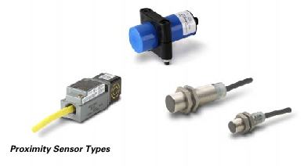
5.2 Nearby or Proximity Logic Detectors
Inductive proximity switches
Strictly speaking, the reed switches and photoelectric sensors discussed so far, are all proximity sensors. However, the term “proximity sensors” generally refers to devices based on inductive, capacitive or magnetic effects, with some electronic circuits, that can detect the presence of an object.
These proximity sensors are usually packed in one of two ways. Some come in standard limit-switch enclosures, which facilitate interchangeability and maintenance and other called threaded-barrel type.
Most inductive proximity sensors operate by generating high-frequency electromagnetic fields that induces eddy current in the metal target.
The sensor inductance is part of an oscillator circuit. When the target (which must be a conducting material) near the sensor the oscillations are damped. This resulting in change in oscillator current which actuates a solid-state switch. Sensing distance from 2 to 30 mm, also depends on the target size, thickness, material, and temperature. The material of the object must be ferrous material

Slide 16
5.2 Nearby or Proximity Logic Detectors
Capacitive proximity switches

Slide 17
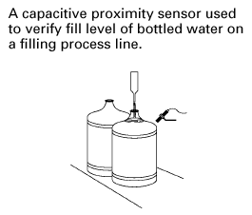
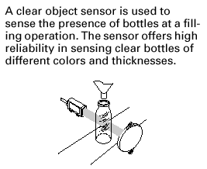
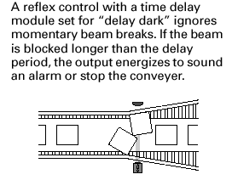
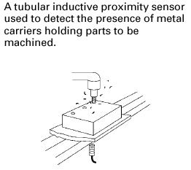
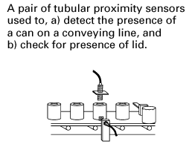
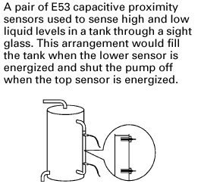
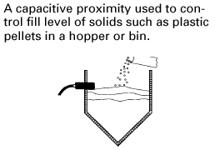
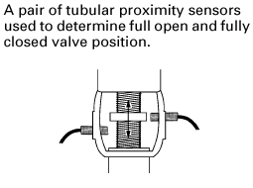
5.3 Applications Nearby or Proximity Logic Detectors
(a)
(b)
(c)
(d)
(e)
(f)
a) Capacitive type.
b) Retro-reflection optical.
c) Retro-reflection optical.
d) Inductive type.
e) Inductive or capacitive
f) Capacitive.
g) Retro-reflection or thru-beam.
h) Capacitive.
i) Inductive.
j) Capacitive or thru-beam.
k) Thru-beam
(h)
(i)
l) Thru-beam optical type.
m) Thru-beam type.
n) Inductive (steel cans) or reflection from target optical type.

Slide 18
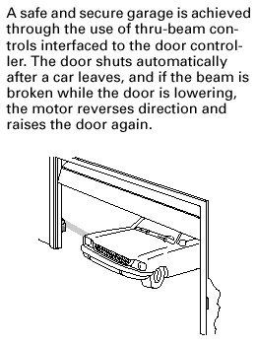
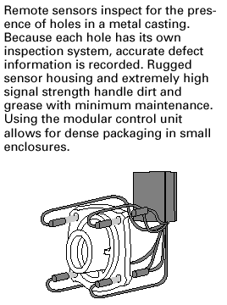
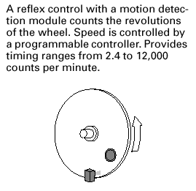
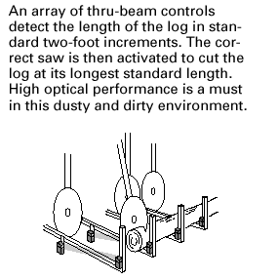
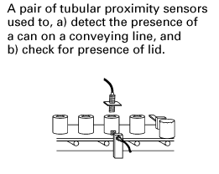
5.3 Applications Nearby or Proximity Logic Detectors
(h)
(i)
(g)
(l)
(k)
(j)
(m & n)
g) Retro-reflection or thru-beam.
h) Capacitive.
i) Inductive.
j) Capacitive or thru-beam.
k) Thru-beam
l) Thru-beam optical type.
m) Thru-beam type.
n) Inductive (steel cans) or reflection from target optical type.

Slide 19
5.4 Logic actuators

Slide 20
5.4 Logic actuators
Displacement Solenoids

Slide 21
5.4 Logic actuators
Duty cycle equal to 20/(20+150)= 0.117 or ~11% . It is clearly observed that solenoid-C will not provide the required linear displacement (maximum displacement 3.81 mm in current case). Solenoid-B provides the required displacement at duty cycle 11%, however it will not provide the required force. Solenoid-A provides the required force and displacement at the calculated duty cycle.

Slide 22
5.4 Logic actuators
Duty cycle equal to 20/(20+150)= 0.117 or ~11% .
It is clearly observed that solenoid-C will not provide the required linear displacement (maximum displacement 3.81 mm in current case).
Solenoid-B provides the required displacement at duty cycle 11%. While solenoid –A, quite big for this application

Slide 23
5.4 Logic actuators
Displacement Solenoids
Solenoid can be actuated using AC or DC current. AC current is noisier compared to DC type. On other hand, DC type require external power supply and much more likely to burn out on excessive loads. Furthermore, AC solenoids develop more force at the beginning than DC solenoid of same size.
In DC solenoids, coil inductance produces high reverse-voltage transients when the solenoid is shut off. Hence, to prevent serious degradation of the switch contacts by arcing, special devices should be used. This phenomenon is more serious at high switching rate (on/off).
The simplest suppression means is a diode connected across the coil winding, which limits reverse voltage to the supply voltage level. However, the solenoid terminals must be polarized to prevent damage to the diode

Slide 24
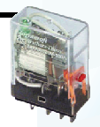
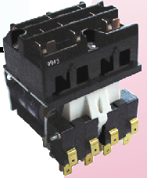
5.4 Logic actuators
Relay Switch Element
There are three basic relay types: Electromechanical relay, reed relay, and solid-state relays.
Relays are used for two purpose as logic switching elements (i.e. control relay), or as current or voltage amplifiers (i.e. power relays).
4-CR
(b)
(c)
(d)
(e)
4-CR
4-CR
4-CR
(a)
4-CR
Fig. 5.13, a) Structure of electromechanical relay, b) Relay ladder notation, c) NO notation) NC notation and e) changeover contact notation.

Slide 25
5.4 Logic actuators
Relay Switch Element
Relay coil
Spring
Contact switch (power)
Advantages of using electromechanical relays can be summarized as follows:
Relays provide complete electric insulation between the control signal (i.e. coil) and the output load (i.e. contact).
Relays permit a small voltage to control a larger one. For instance, an electronic circuit could actuate a 5 Volt relay coil with contact transmitting 115V.
Relays act as current amplifier. For instance, a tiny limit switch with limited current-carrying capacity can actuate a relay coil whose, contacts transmit a current driving a large motor.
By multi-contact relay, one input signal can control many different loads (possible with different voltages for each load).
Armature
Control switch

Slide 26
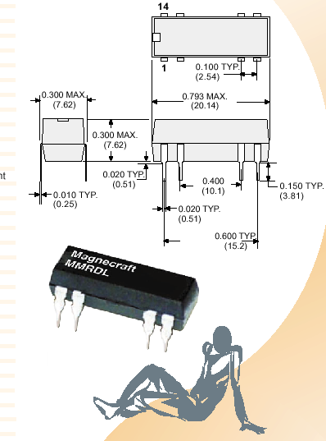
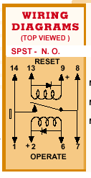
5.4 Logic actuators
Reed Relay Switch Element
Reed relays are close to the reed switches. However, while reed switches are actuated by a moving permanent magnet, reed relays contain several reed capsules actuated by one stationary electromagnet. Thus the armature and mechanical like is eliminated in EMR and seal reed tubes or capsules replace the contacts, see Fig. 5.14. Life is more that EMR, nearly 10⁸ operations, contact rating up to 1 Amp and operating time up to 0.5 msec.

Slide 27
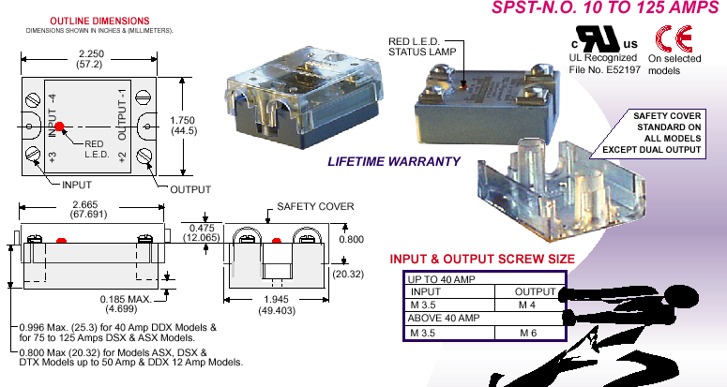
5.4 Logic actuators
Solid State Relay Switch Element
Solid-state relays (SSRs) are invariably compared with EMR and reed relays. Most SSR switches one circuit, equivalent to SPST relay. It is not suitable switching logic operations; used as output elements which interfaces the logic gates to the outside load.

Slide 28
5.4 Logic actuators
Solid State Relay Switch Element
Advantages | Drawbacks
SSR switch is much faster than EMR and has quite operation. | Their initial cost is greater that EMR
The life of SSR is nearly infinite compared to EMR life. | They can switch only one circuit, hence, muti-SSR required to switch multi-loads
SSR can be switched using low power electronic devices (gates) | They are not a good as positive shutoff devices, since they have a leakage current
Resistance for shocks and vibration, which falsely the EMR | SSR usually fail in the on state, which quite dangerous.
 | The application of SSR is not forward like EMR; for example, two types of SSR are used for DC and AC load.
 | SSR are not suitable for very high temperature operation.

Slide 29
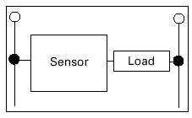
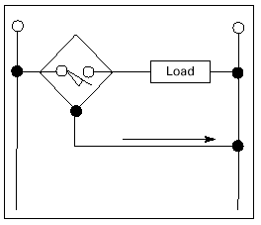
5.5 Sensor Wiring
When detecting the logic state of a process, the sensor must signal this state to the PLC through switching either voltage or current from on to off or from off to on. The output from the sensor will be an input to the PLC.
Sensor interface to other control circuits (sensor output circuit) are different. The control voltage type, whether AC,DC or AC/DC can be grouped to be as Load-Power Sensor or Line-Power Sensor.
Fig.5.16 types of sensors a) two-wired load-powered sensor, and b)three-wired line-powered sensors.

Slide 30
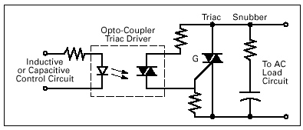
5.5 Sensor Wiring
Sensor Output Types:
There are mainly three output types: Realy, Traic and Transistor outputs.
1. Relay output: A relay is a mechanical device that can handle load current at higher voltage. This allows the sensor to directly interface with motor, solenoids and other inductive load. They can be used to switch either AC or DC voltage. Relays are subjected to contact wear and resistance build up, which is a function of drawn current, frequency and voltage. Furthermore, due to contact bounce, they can produce erratic results with counters, PLC and other devices, unless the input to these devices is filtered. Furthermore, response time of relay output is too high.
2. A Triac Output: A triac is a solid-state device designed to control AC current. A triac switch turn on in less than microsecond when its gate (control gate) is energized. As long as triac is used within its rated maximum current and voltage, triac has infinite life. Triac devices used with sensors are generally rated at 2A loads or less, and can be used directly interfaced to PLCs. Furthermore, it can be used directly to drive an inductive load using snubber circuit, as shown in Fig. 5.17. The short circuit in triac will destroy the triac, so the device should be short circuit protected to avoid this.
Fig. 5.17 Triac output circuit

Slide 31
Sensor Output Types:
There are mainly three output types: Realy, Traic and Transistor outputs.
3. A Transistor Output: It is also solid state device designed to control DC current. There are mainly two types of circuits depending on the switching function:
NPN (Current Sink) open collector; Here the output transistor is connected to the negative DC. Current flows from the positive terminal through the load, to the sensor, to the negative terminal. The sensor “sinks” the current from the load, as shown Fig. 5.18.
PNP (Current Source); the sensor is connected to the positive DC and current flows from the positive terminal through the sensor, to the load, to the negative terminal. The sensor “sources” the current to the load.
Fig. 5.18 Transistor output circuit (Sinking type).
Fig. 5.19 Transistor output circuit (Current Source).

Slide 32
Broblems
5-1) Complete the following statements:
Sensors can detect the ………..or ………. Of objects. (ans: presence,absence)
The three main sensor categories are: ………….., …………., ………. (ans: contact switches, proximity sensors, photoelectric sensors).
The sensor type that can only detect metallic objects is the ……… sensor (ans: inductive type)
The sensor type that uses a broken beam of light to detect objects is commonly referred as a ……….. sensor. (ans: photoelectric type).
Inductive proximity sensors work best with …….. metals. (ans: Ferrous)
The transparency of the container has no effects on the sensing of …….. sensors. (ans: Capacitive)
The initials designating a transistor output that sinks current from the load are ……… (ans: NPN)
The initials designating a transistor output that sources current to the load are ………. (ans: PNP)
5-2) State the main difference between the electromechanical and solid-state relays, what are the advantages and Drawbacks of both devices?
5-3) What are the differences between Load-Power Sensors and Line-Powered Sensors?
5-4) State the main difference between NPN and PNP sensor output signals, sketch the two output circuits?

