Slide 1
CARBOXYLIC ACIDS AND THEIR DERIVATIVES
340 Chem 1st 1439

Slide 2
Outline
Structure
Nomenclature
Carboxylic Acids derivatives
Physical Properties
Acidity
Preparation of Carboxylic Acids
Reaction
340 Chem 1st 1439

Slide 3
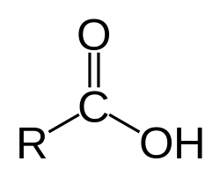
Structure
The combination of a carbonyl group and a hydroxyl on the same carbon atom is called a carboxyl group (-CO₂H or –COOH).
Carboxylic acids are classified according to the substituent bonded to the carboxyl group. An aliphatic acid has an alkyl group bonded to the carboxyl group, and an aromatic acid has an aryl group. The simplest acid is formic acid, with a hydrogen atom bonded to the carboxyl group. Fatty acids are long-chain aliphatic acids derived from the hydrolysis of fats and oils.
340 Chem 1st 1439

Slide 4
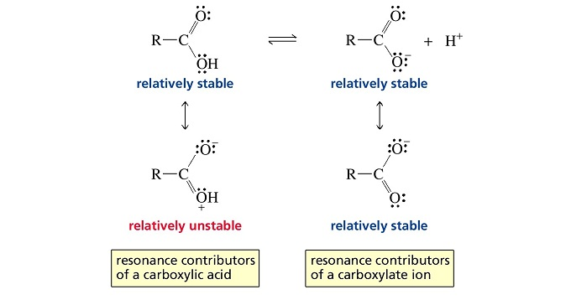
The following resonance forms can be written for a carboxyl group.
340 Chem 1st 1439

Slide 5
Nomenclature
IUPAC name
The root name is based on the longest continuous chain of carbon atoms bearing the carboxyl group. The -e is replaced by -oic acid.
The chain is numbered starting with the carboxyl carbon atom.
Cycloalkanes with carboxyl substituents are named as cycloalkanecarboxylic acids.
340 Chem 1st 1439

Slide 6
common name
ε δ γ β α
C-C-C-C-C-COOH
In common names, the positions of substituents are named using Greek letters. Notice that the lettering begins with the carbon atom next to the carboxyl carbon, the α carbon.
commmone: α,β- Dimethyl butyric acid
IUPAC: 2,3-Dimethyl butanoic acid
α -Bromo valeric acid
340 Chem 1st 1439

Slide 7
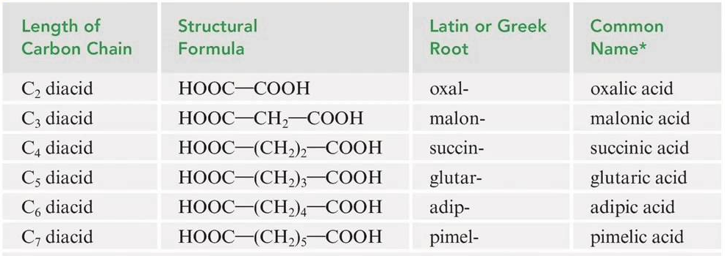
Common | IUPAC | Formula | No. C
Formic acid Acetic acid Prpionic acid Butyric acid valeric acid | Methanoic acid Ethanoic acid Prpanoic acid Butanoic acid Pentanoic acid | HCOOH CH₃COOH CH₃CH₂COOH CH₃(CH₂)₂COOH CH₃(CH₂)₃COOH | 1 2 3 4 5
340 Chem 1st 1439

Slide 8
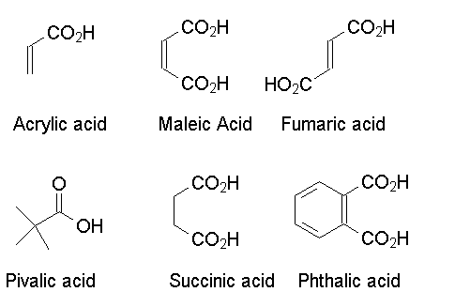
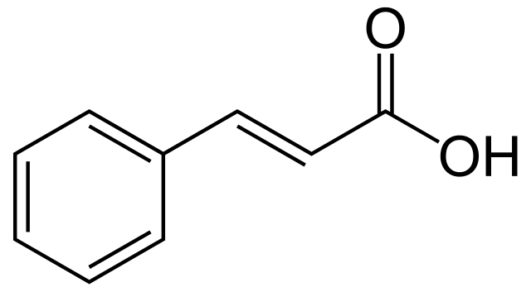
1,4-Benzenedicarboxylic acid 1,2-Benzenedicarboxylic acid 1,3-Benzenedicarboxylic acid
(Terephthalic acid) (Phthalic acid) (Isophthalic acid)
trans-3-Phenylpropenoic acid
(Cinnamic acid)
340 Chem 1st 1439

Slide 9
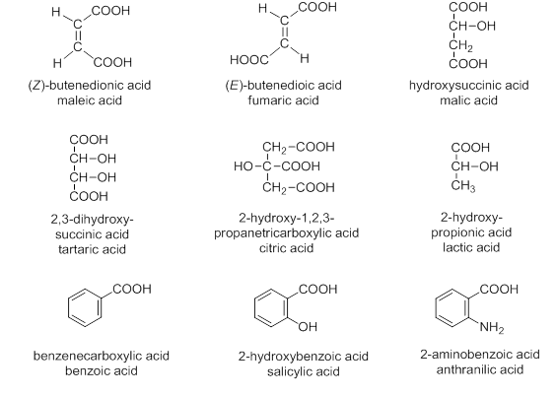
340 Chem 1st 1439

Slide 10
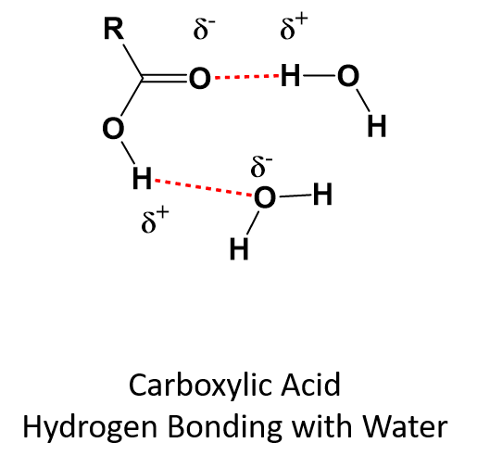
Physical Properties
Solubility
Carboxylic acids interact with water molecules by hydrogen bonding through both the carbonyl and hydroxyl groups. Because of greater hydrogen bonding interactions, carboxylic acids are more soluble in water than are alcohols, ethers, aldehydes, and ketones of comparable molecular weight.
A carboxylic acid consists of two regions of distinctly different polarity: a polar hydrophilic carboxyl group and, a nonpolar hydrophobic hydrocarbon chain. The hydrophilic carboxyl group increases water solubility; the hydrophobic hydrocarbon chain decreases water solubility.
As the size of the hydrocarbon chain increases relative to the size of the hydrophilic group, water solubility decreases.
340 Chem 1st 1439

Slide 11
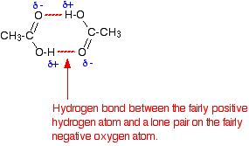
Boiling Point
Carboxylic acids have significantly higher boiling points than other types of organic compounds of comparable molecular weight, such as alcohols, aldehydes, and ketones.
The hydroxyl group of one carboxylic acid molecule acts as a proton donor toward the carbonyl oxygen of a second. In a reciprocal fashion, the hydroxyl proton of the second carboxyl function interacts with the carbonyl oxygen of the first. The result is that the two carboxylic acid molecules are held together by two hydrogen bonds. So efficient is this hydrogen bonding that some carboxylic acids exist as hydrogen-bonded dimers even in the gas phase. In the pure liquid a mixture of hydrogen-bonded dimers and higher aggregates is present.
340 Chem 1st 1439

Slide 12
Acidity
Carboxylic acids are the most acidic class of compounds, they are much stronger acids than water and alcohols.
Carboxylic acids are weak acids.
Dissociation of either an acid or an alcohol involves breaking an O-H bond, but dissociation of a carboxylic acid gives a carboxylate ion with the negative charge spread out equally over two oxygen atoms, compared with just one oxygen in an alkoxide ion .This charge delocalization makes the carboxylate ion more stable than the alkoxide ion; therefore, dissociation of a carboxylic acid to a carboxylate ion is less endothermic than dissociation of an alcohol to an alkoxide ion.
340 Chem 1st 1439

Slide 13
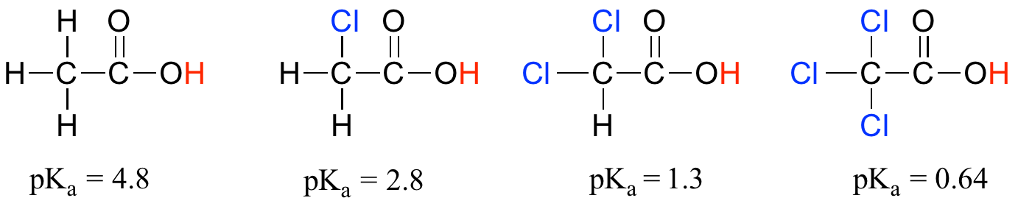
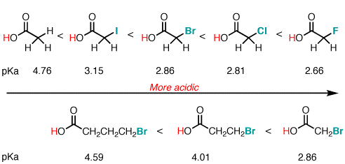
Electron-withdrawing groups enhance acidity because they help to
stabilize the negative charge of the conjugate base (the carboxylate ion).
The amount of stabilization depends on:
1. the number of electron-withdrawing groups;
2. the strength of the electron-withdrawing groups; and
3. the distance of the electron-withdrawing groups from the COOH group.
340 Chem 1st 1439

Slide 14
Electron donating substituents decrease the acidity
Whereas Electron withdrawing substituents near the carboxyl group increase the acidity
340 Chem 1st 1439

Slide 15
340 Chem 1st 1439

Slide 16
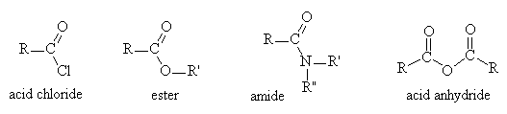
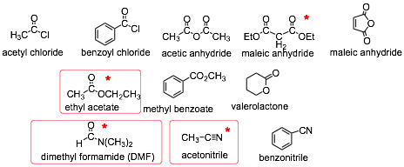
Carboxylic acid derivatives
all carboxylic acid derivatives consist of an acyl group (R-C=O) attached to an electronegative atom
340 Chem 1st 1439

Slide 17
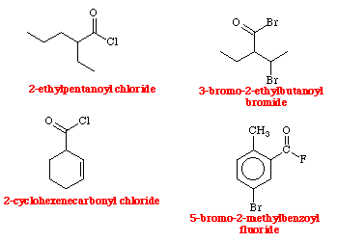
Nomenclature of Acyl Chlorides
Replace the -ic acid ending in the name of the parent acid by –yl chloride.
IUPAC: Ethanoyl chloride Benzoylchloride Propanoyl chloride
Common : Acetyl chloride
340 Chem 1st 1439

Slide 18
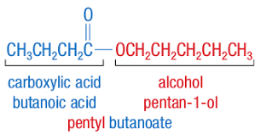
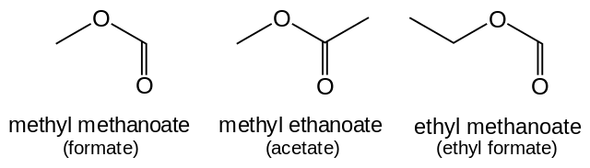
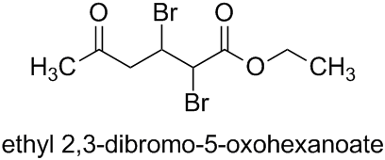
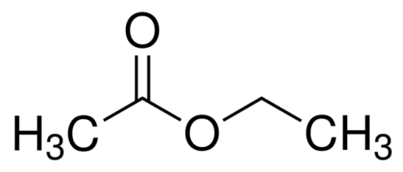
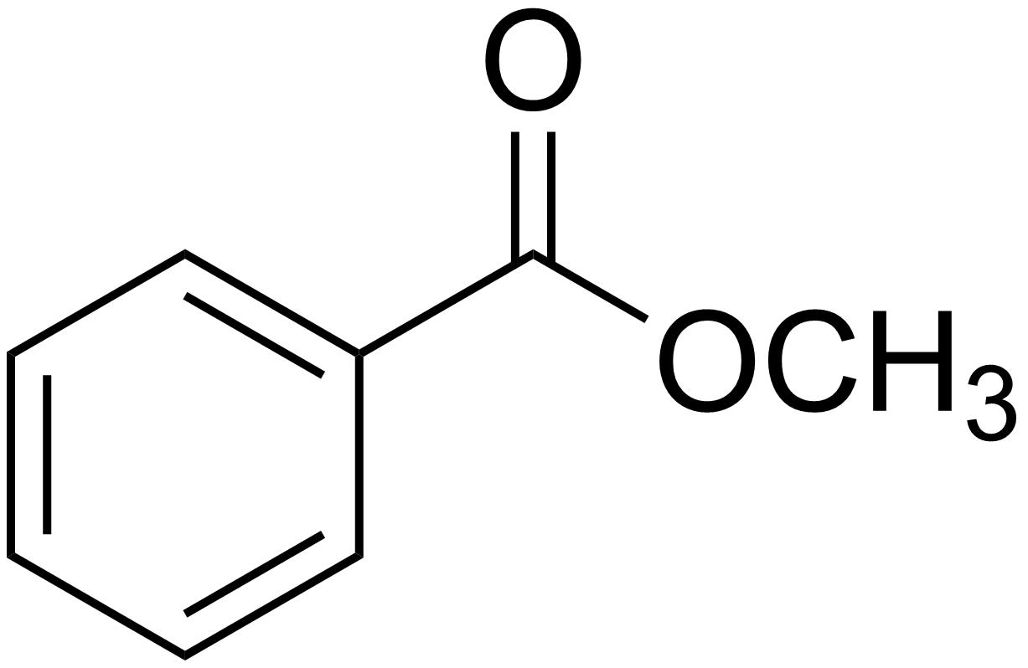
Nomenclature of Esters
The names of esters are derived from the names of the alcohol (with the ending -yl) and the acid (with the ending -ate or -oate).
(IUPAC) Ethyl ethanoate Methyl benzoate
(common) Ethyl acetate
Methyl propanoate Isopropyl-4-hydroxy-5-methyl-5- hexenoate
340 Chem 1st 1439

Slide 19

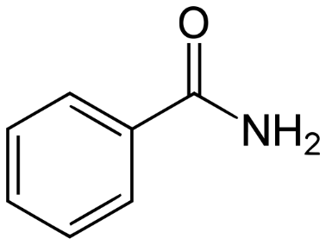
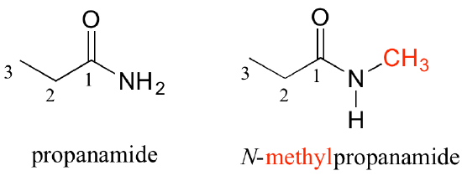
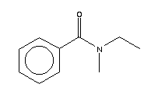
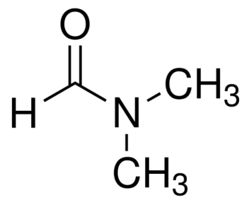
Nomenclature of Amides
Amides that have no substituent on nitrogen are named by dropping -ic acid from the common name of the acid (or -oic acid from the substitutive name) and then adding -amide.
Alkyl groups on the nitrogen atom of amides are named as substituents, and the named substituent is prefaced by N- or N,N-.
(IUPAC) Ethanamide Benzamide
(common) Acetamide
N-Methylpropanamide
N-Methylpropionamide
N,N-Dimethylmethanamide N-Ethyl-N-methylbenzamide
N,N-Dimethylformamide
340 Chem 1st 1439

Slide 20
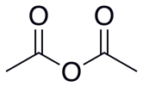
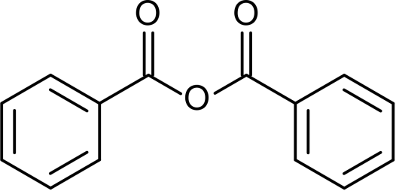

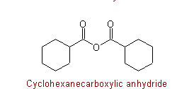
Nomenclature of Anhydrides
Most anhydrides are named by dropping the word acid from the name of the carboxylic acid and then adding the word anhydride
(IUPAC) Ethanoic anhydride Benzoic anhydride Butandioic anhydride
(Common) Acetic anhydride Succinic anhydride
340 Chem 1st 1439

Slide 21
Preparation of Carboxylic Acids
By oxidation of aldehydes and primary alcohols.
340 Chem 1st 1439

Slide 22
By oxidation of alkylbenzenes
340 Chem 1st 1439

Slide 23
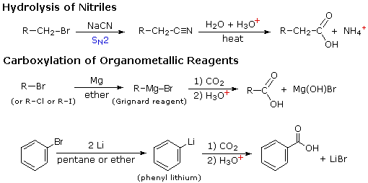
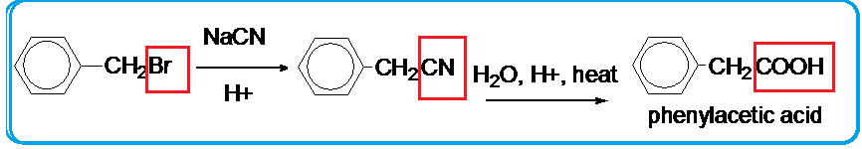
By hydrolysis of cyanohydrins and other nitriles
340 Chem 1st 1439

Slide 24
carbonation of Grignard reagents.
Grignard reagents react with carbon dioxide to yield magnesium carboxylates. Acidification produces carboxylic acids
340 Chem 1st 1439

Slide 25
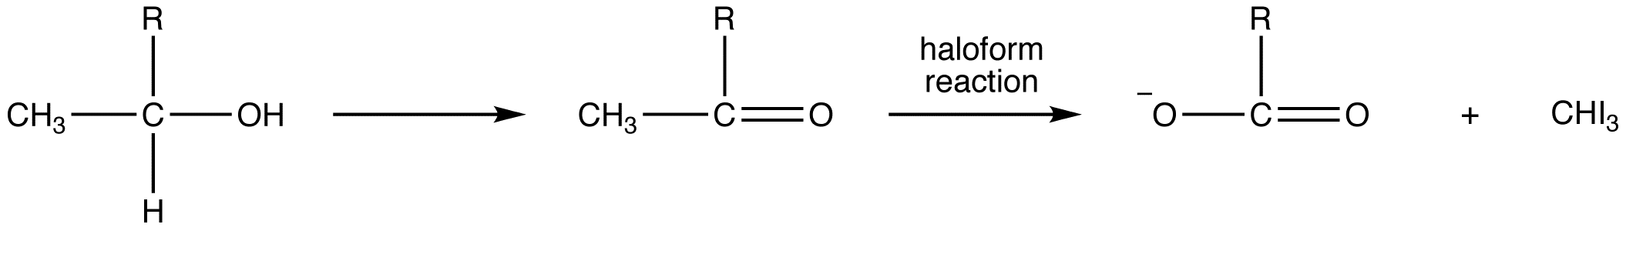
The haloform reaction
(converts methyl ketones to acids and iodoform
340 Chem 1st 1439

Slide 26
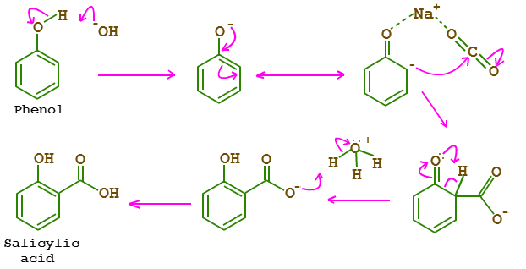
Kolbe-Schmitt Carboxylation using in synthesis of salicylic acid
340 Chem 1st 1439

Slide 27
Reaction of Carboxylic Acids
Reaction with Bases
340 Chem 1st 1439

Slide 28
Nucleophilic Substitution of Hydroxyl Group
340 Chem 1st 1439

Slide 29
Formation of Easter
Fischer Esterification
Formation of amide
340 Chem 1st 1439

Slide 30
Formation of acid anhydride:
Formation of acid chloride:
340 Chem 1st 1439

Slide 31
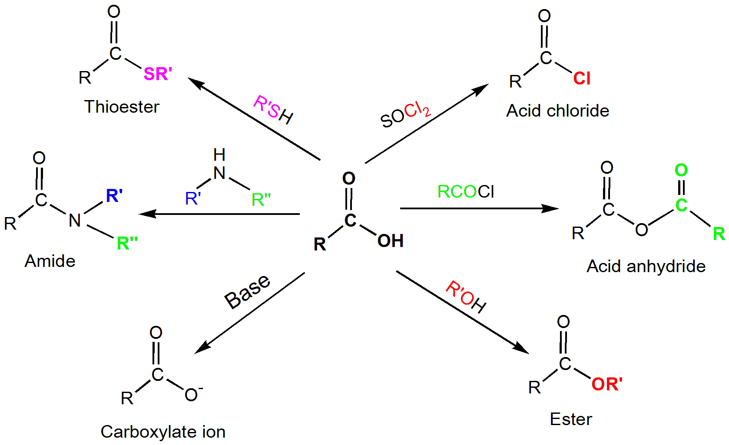
340 Chem 1st 1439

Slide 32
Preparation of acid derivatives from acid chloride
340 Chem 1st 1439

Slide 33
Reaction of Derivatives of carboxylic acid
On hydrolysis (reaction with H₂O) all carboxylic acid derivatves convert to carboxylic acid.
340 Chem 1st 1439

Slide 34
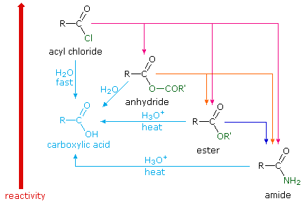
Overview Reaction
340 Chem 1st 1439

Slide 35
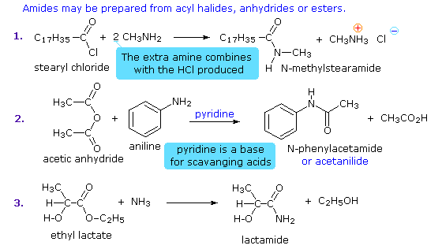
AMIDES
340 Chem 1st 1439

Slide 36
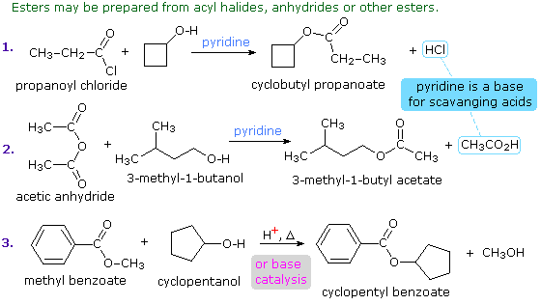
Esters
340 Chem 1st 1439

Slide 37
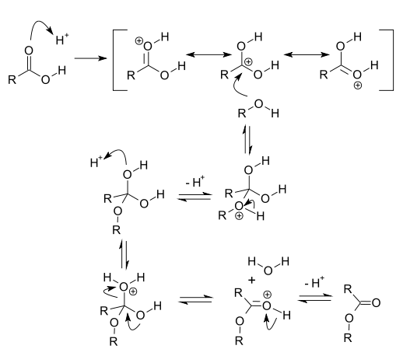
Fischer Mechanism (1)
Protonation of carbonyl and attack of alcohol, a weak nucleophile.
340 Chem 1st 1439

Slide 38
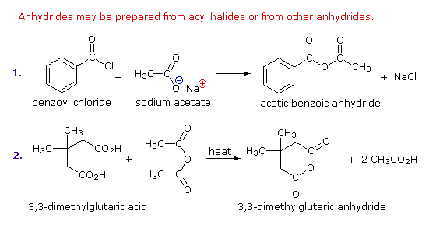
ANHYDRIDES
340 Chem 1st 1439

Slide 39
Reactions of acid derivatives
a) Acid chlorides:
Reduction:
340 Chem 1st 1439

Slide 40
B] Acid anhydride:
340 Chem 1st 1439

Slide 41
C] Esters:
Reduction:
340 Chem 1st 1439

Slide 42
d] Amide:
1-Reduction:
340 Chem 1st 1439

Slide 43
2-Dehydration:
3-Hoffman degradation:
340 Chem 1st 1439

