Slide 1
INTERNATIONAL COMPENSATION
Chapter 8

Slide 2
Compensation is increasingly seen as
Mechanism to develop & reinforce a global corporate culture
Primary source of corporate control
Explicitly linking performance outcomes with associated costs

Slide 3
International compensation complexities
Pay
Taxes
Cost of living
Housing
Safety
Transportation
Education of children
Length of stay

Slide 4
Objectives of international compensation
The policy …
should be consistent with overall strategy, structure, & business needs of the MNE
must attract & retain staff in areas where the MNE has the greatest needs & opportunities
should facilitate the transfer of international employees in the most cost-effective way for the firm
must give due consideration to equity & ease of administration

Slide 5
International employee expectations
Financial protection in terms of benefits, social security, & living costs in the foreign location
Opportunities for financial advancement through income & savings
Housing, children’s education, & recreation will be addressed
Career will be advanced

Slide 6
Key components for expatriates
Base salary
Foreign service inducement & hardship premium
Allowances COLA, housing, home leave, education, relocation, spouse assistance
Benefits

Slide 7
Three approaches to international compensation
Going rate approach
Balance sheet approach
Local plus

Slide 8
Table 8.1
Going rate approach

Slide 9
Table 8.2
Advantages & disadvantages of the going rate approach

Slide 10
Table 8.3
The balance sheet approach

Slide 11
4 balance sheet approach categories
Goods & services
Housing
Income taxes PC & HC income taxes
Reserve contributions to savings, payments for benefits, pension contributions, investments, education expenses, S.S. taxes, etc.

Slide 12
Local plus approach
The expatriate employee is paid according to prevailing salary levels, structure, & administrative guidelines of the home country …
expatriate-type benefits in recognition of foreign status
Does not typically include: COLA, mobility premiums, hardship allowances, familiarization visits, home leave, cross-cultural training, other pre-departure or spouse assistance

Slide 13
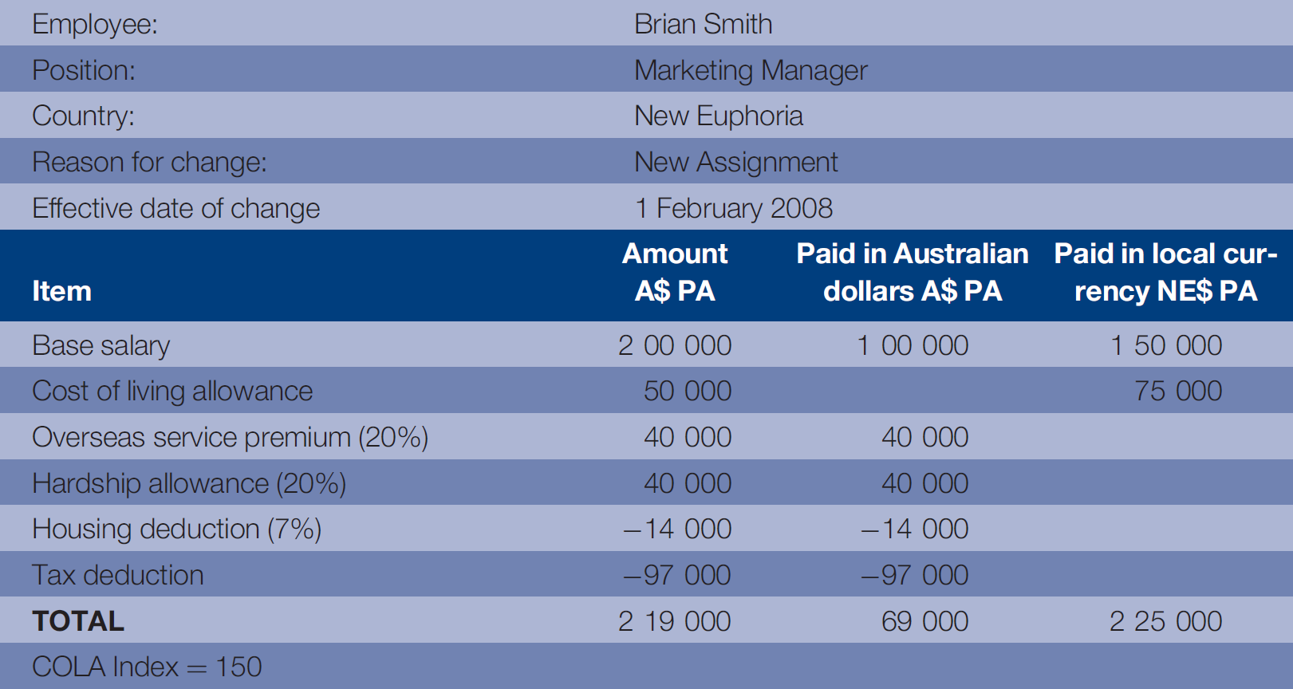
Table 8.4
Expatriation compensation worksheet

Slide 14
Table 8.5
Advantages & disadvantages of the balance sheet approach

Slide 15
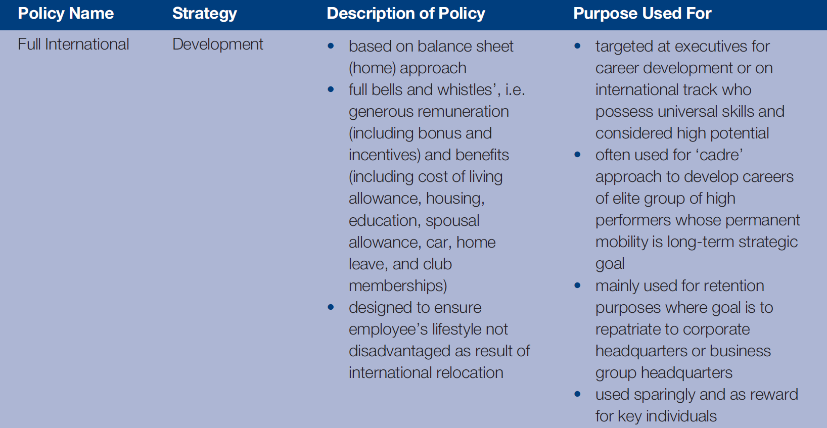
Table 8.6a
Compensation approaches & strategies for long-term international assignments
Chapter 8

Slide 16
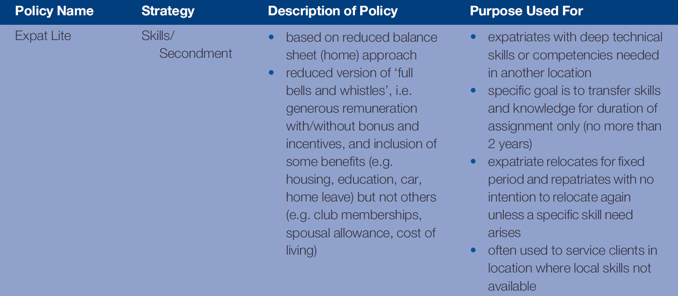
Table 8.6b
Compensation approaches & strategies for long-term international assignments

Slide 17
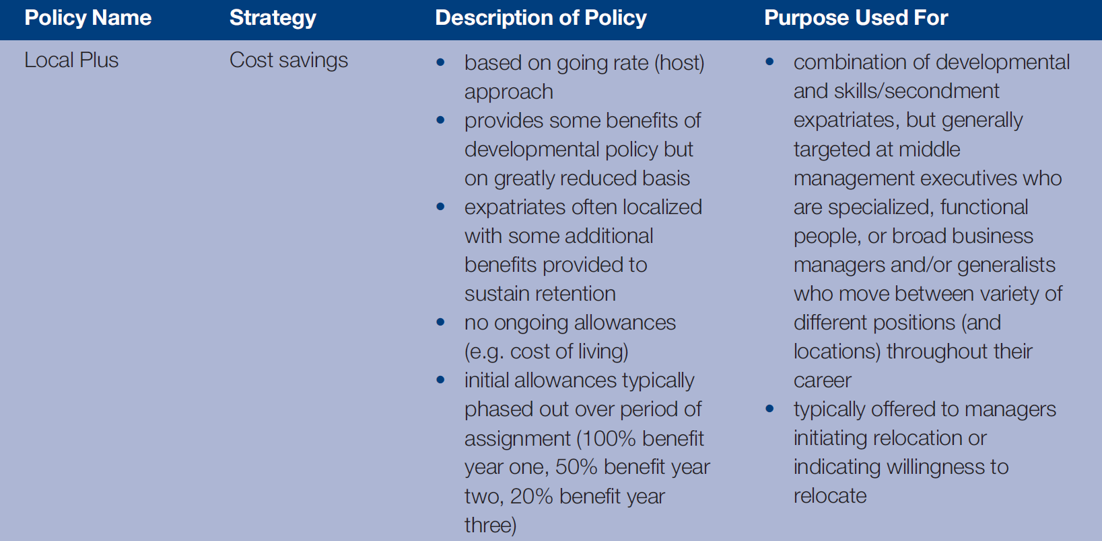
Table 8.6c
Compensation approaches & strategies for long-term international assignments

Slide 18
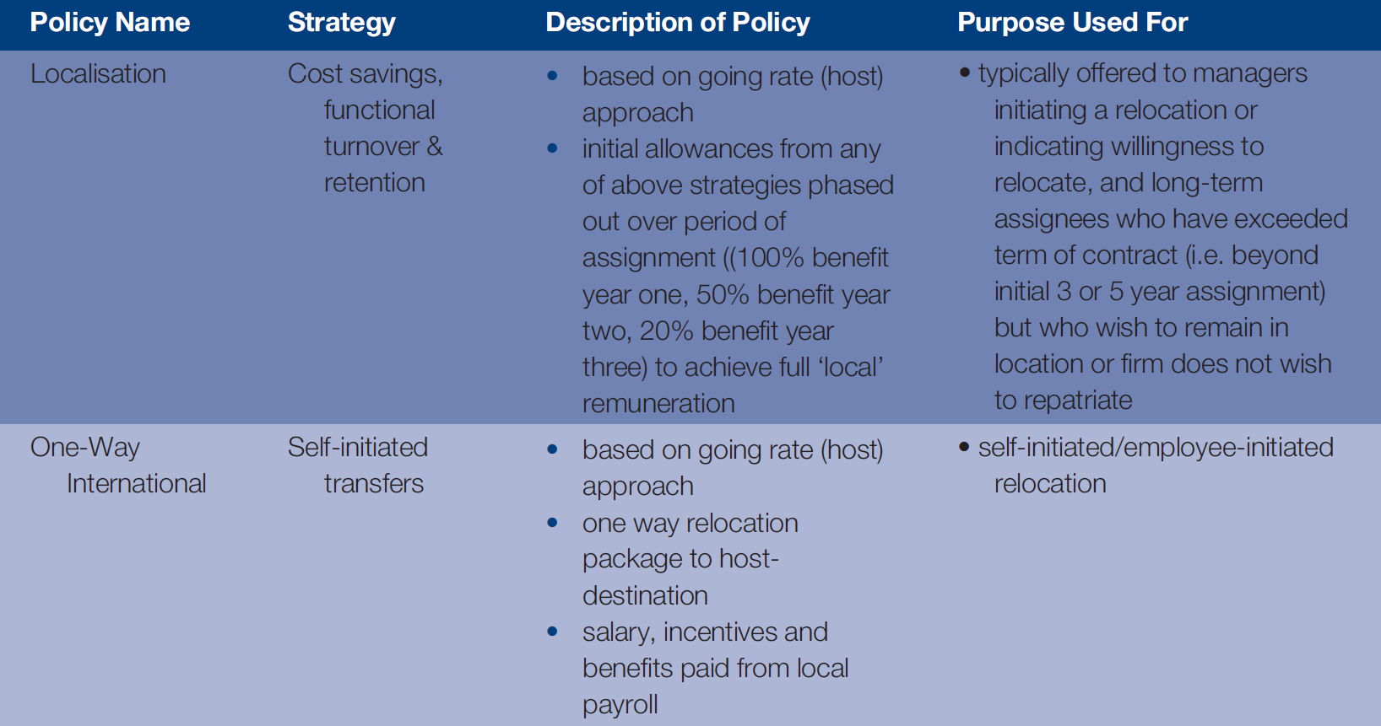
Table 8.6d
Compensation approaches & strategies for long-term international assignments

Slide 19
MNE approaches to international taxation
Tax equalization MNE withholds tax obligation & then pays all taxes in HC
Tax protection Employee pays up to amount s/he would pay on compensation in HC
Ad hoc – each expatriate handled differently
Laissez-faire – each is on their own

Slide 20
Table 8.7
Maximum marginal federal tax rates
Country | Max. marginal % rate
Australia | 45.00
Belgium | 50.00
Canada | 29.00
Chile | 40.00
Denmark | 26.48
France | 40.00
Germany | 45.00
Italy | 43.00
Japan | 40.00
Korea | 35.00
Country | Max. marginal % rate
Mexico | 28.00
Netherlands | 52.00
New Zealand | 39.00
Poland | 40.00
Spain | 27.13
Sweden | 25.00
Switzerland | 11.50
Turkey | 35.00
United Kingdom | 40.00
United States | 35.00
Chapter 8

Slide 21
Table 8.7a
Working time required to buy one Big Mac
City | 1 Big Mac in min
Chicago, Tokyo, Toronto | 12
London, Los Angeles, Miami | 13
Hong Kong, New York, Sydney | 14
Dublin, Frankfurt, Luxembourg, Montreal, Zurich | 15
Copenhagen, Geneva, Vienna | 17
Dubai, Nicosia | 18
Amsterdam, Auckland, Berlin, Brussels | 19
Lyon, Munich, Paris, Stockholm, Taipei | 20
Barcelona, Moscow, Oslo | 21
Lisbon | 23
Tel Aviv | 24
Manama | 25
Johannesburg | 26

Slide 22
Table 8.7b
Working time required to buy one Big Mac
 | 1 Big Mac in min
Helsinki, Madrid, Milan, Rome, Seoul | 27
Athens, Shanghai, Tallinn | 30
Warsaw, Doha | 31
Ljubljana | 34
Singapore | 34
Prague | 38
São Paulo | 40
Kuala Lumpur, Vilnius | 41
Bucharest, Riga | 42
Beijing | 44
Bangkok, Kiev | 45
Istanbul | 48
Delhi | 49
Río de Janeiro | 51

Slide 23
Table 8.7c
Working time required to buy one Big Mac
 | 1 Big Mac in min
Sofia | 56
Buenos Aires | 57
Bogotá, Lima | 58
Budapest | 59
Mumbai | 61
Bratislava | 62
Santiago de Chile | 69
Cairo | 82
Manila | 88
Caracas | 126
Mexico City | 129
Jakarta | 136
Nairobi | 158

Slide 24
Issues to consider for expatriate benefits
Keep expatriates in home-country programs, particularly if the firm receives no tax deduction for it?
Option to enroll expatriates in host-country benefit programs &/or make up any difference in coverage?
Do expatriates receive home-country or are eligible to receive host-country social security benefits?

Slide 25
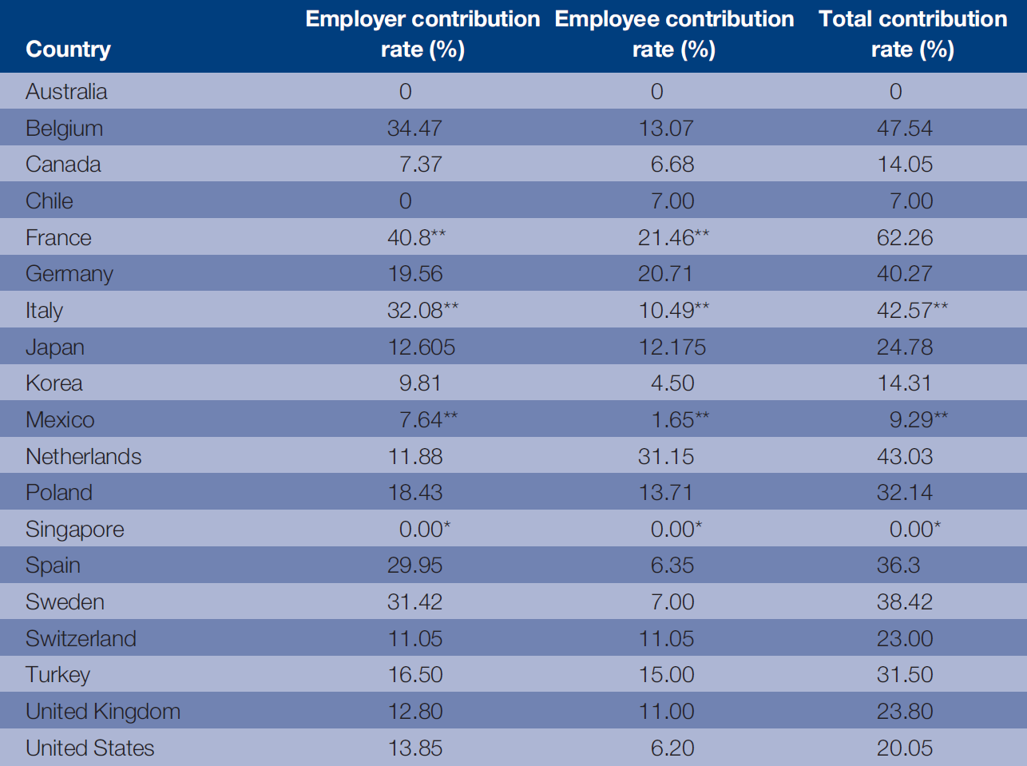
Table 8.8
Social security contributions by employers & employees

Slide 26
Tentative conclusions: patterns in complexity, challenges, & choices

Slide 27
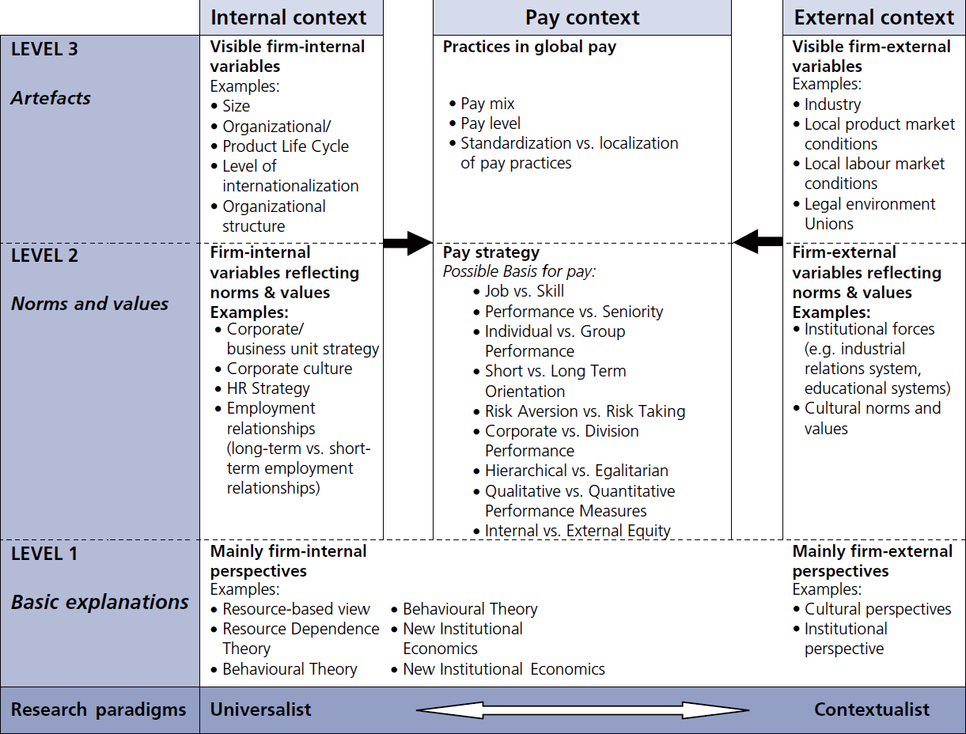
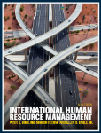
Figure 8.1
Complexity, challenges & choices in global pay
Chapter 8

