Slide 1
Net Present Value and Other Investment Criteria
Chapter 9

Slide 2
Course Roadmap
Chapter | Topic | Focus | Exam
15 | Raising Capital | All
14 | Cost of Capital | All
9 | Net Present Value and Other Investment Criteria | All | Mid-Term
11 | Project Analysis and Evaluation | All
16 | Financial Leverage and Capital Structure Policy | All
10 | Making Capital Investment Decision | All | Mid-Term
17 | Dividends Theory | All

Slide 3
Key Concepts and Skills
payback and understand their shortcomings
Understand accounting rates of return and their shortcomings
Be able to compute internal rates of return (standard and modified) and understand their strengths and weaknesses
Be able to compute the net present value and understand why it is the best decision criterion

Slide 4
Chapter Outline
Net Present Value
The Payback Rule
The Discounted Payback
The Average Accounting Return
The Internal Rate of Return

Slide 5
Good Decision Criteria
We need to ask ourselves the following questions when evaluating capital budgeting decision rules:
Does the decision rule adjust for the time value of money?
Does the decision rule adjust for risk?
Does the decision rule provide information on whether we are creating value for the firm?

Slide 6
Net Present Value
The difference between the market value of a project and its cost
How much value is created from undertaking an investment?
The first step is to estimate the expected future cash flows.
The second step is to estimate the required return for projects of this risk level.
The third step is to find the present value of the cash flows and subtract the initial investment.

Slide 7
Project Example Information
You are reviewing a new project and have estimated the following cash flows:
Year 0: CF = -165,000
Year 1: CF = 63,120; NI = 13,620
Year 2: CF = 70,800; NI = 3,300
Year 3: CF = 91,080; NI = 29,100
Average Book Value = 72,000
Your required return for assets of this risk level is 12%.

Slide 8
NPV – Decision Rule
If the NPV is positive, accept the project
A positive NPV means that the project is expected to add value to the firm and will therefore increase the wealth of the owners.
Since our goal is to increase owner wealth, NPV is a direct measure of how well this project will meet our goal.

Slide 9
Computing NPV for the Project
Using the formulas:
NPV = -165,000 + 63,120/(1.12) + 70,800/(1.12)² + 91,080/(1.12)³ = 12,627.41
Using the calculator:
CF₀ = -165,000; C01 = 63,120; F01 = 1; C02 = 70,800; F02 = 1; C03 = 91,080; F03 = 1; NPV; I = 12; CPT NPV = 12,627.41
Do we accept or reject the project?

Slide 10
Decision Criteria Test - NPV
Does the NPV rule account for the time value of money?
Does the NPV rule account for the risk of the cash flows?
Does the NPV rule provide an indication about the increase in value?
Should we consider the NPV rule for our primary decision rule?

Slide 11
Example 9.1
Suppose we are asked to decide whether a new consumer product should be launched. Based on projected sales and costs, we expect that the cash flows over the five-year life of the project will be $2000 in the first two years, $4000 in the next two and $5000 in the last year. It will cost about $10000 to begin production. We use a 10 percent discount rate to evaluate new products. What should we do here?

Slide 12
Example 9.1
Present Value of the expected cash flows = (2000/1.1) + (2000/1.1²) + (4000/1.1³) + (4000/1.1⁴) + (5000/1.1⁵) = $12313
NPV = -10000 + 12313 = $2313
The decision : accept to take on the project because the NPV is positive.

Slide 13
Payback Period
How long does it take to get the initial cost back in a nominal sense?
Computation
Estimate the cash flows
Subtract the future cash flows from the initial cost until the initial investment has been recovered
Decision Rule – Accept if the payback period is less than some preset limit

Slide 14
Computing Payback for the Project
Assume we will accept the project if it pays back within two years.
Year 1: 165,000 – 63,120 = 101,880 still to recover
Year 2: 101,880 – 70,800 = 31,080 still to recover
Year 3: 31,080 – 91,080 = -60,000 project pays back in year 3
Do we accept or reject the project?

Slide 15
Decision Criteria Test - Payback
Does the payback rule account for the time value of money?
Does the payback rule account for the risk of the cash flows?
Does the payback rule provide an indication about the increase in value?
Should we consider the payback rule for our primary decision rule?

Slide 16
Example 9.2
The proposed cash flows for a proposed project that costs $500, are as follows:
$100 in one year, $200 in two years and $500 in three years.
Should we accept or reject this project if the payback period in the market is 3 years?

Slide 17
Example 9.2
Year 1: 500 – 100 = $400
Year 2: 400 – 200 = $200
Year 3: 200 – 500 = (300)
This means that we need only $200 from the third year 500, so we have to wait 200/500 = 0.4 years
Therefore, The payback period is 2.4 years and since it is less than 3 years the market payback period the project should be accepted.

Slide 18
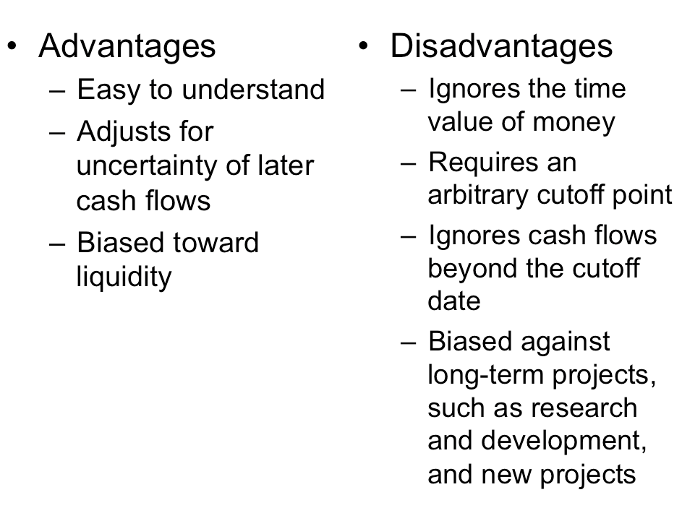
Advantages and Disadvantages of Payback

Slide 19
Discounted Payback Period
Compute the present value of each cash flow and then determine how long it takes to pay back on a discounted basis
Compare to a specified required period
Decision Rule - Accept the project if it pays back on a discounted basis within the specified time

Slide 20
Computing Discounted Payback for the Project
Assume we will accept the project if it pays back on a discounted basis in 2 years.
Compute the PV for each cash flow and determine the payback period using discounted cash flows
Year 1: 165,000 – 63,120/1.12¹ = 108,643
Year 2: 108,643 – 70,800/1.12² = 52,202
Year 3: 52,202 – 91,080/1.12³ = -12,627 project pays back in year 3
Do we accept or reject the project?

Slide 21
Decision Criteria Test – Discounted Payback
Does the discounted payback rule account for the time value of money?
Does the discounted payback rule account for the risk of the cash flows?
Does the discounted payback rule provide an indication about the increase in value?
Should we consider the discounted payback rule for our primary decision rule?

Slide 22
Advantages and Disadvantages of Discounted Payback

Slide 23
Average Accounting Return
There are many different definitions for average accounting return
The one used in the book is:
Average net income / average book value
Note that the average book value depends on how the asset is depreciated.
Need to have a target cutoff rate
Decision Rule: Accept the project if the AAR is greater than a preset rate

Slide 24
Computing AAR for the Project
Assume we require an average accounting return of 25%
Average Net Income:
(13,620 + 3,300 + 29,100) / 3 = 15,340
AAR = 15,340 / 72,000 = .213 = 21.3%
Do we accept or reject the project?

Slide 25
Decision Criteria Test - AAR
Does the AAR rule account for the time value of money?
Does the AAR rule account for the risk of the cash flows?
Does the AAR rule provide an indication about the increase in value?
Should we consider the AAR rule for our primary decision rule?

Slide 26
Example
Suppose we are deciding whether to open a store in a new shopping mall. The required investment in improvements is $500000. The store would have a five year life because everything reverts to the mall owners after that time. The required investment would be 100 percent depreciated (straight line) over five years. The projected net income each year is as follows: year1: $100000, year2: $150000, year3:$50000, year4: $0 & year5: $(50000)

Slide 27
Example
The depreciation would be 500000/5=100000
The average net income= [100000+150000+50000+0+(-50000)]/5 = $50000
The average book value= (500000+0)/2 = $250000
AAR = 50000/250000 = 20%
The decision: is to accept the investment if the firm has a target AAR of less than 20%.

Slide 28
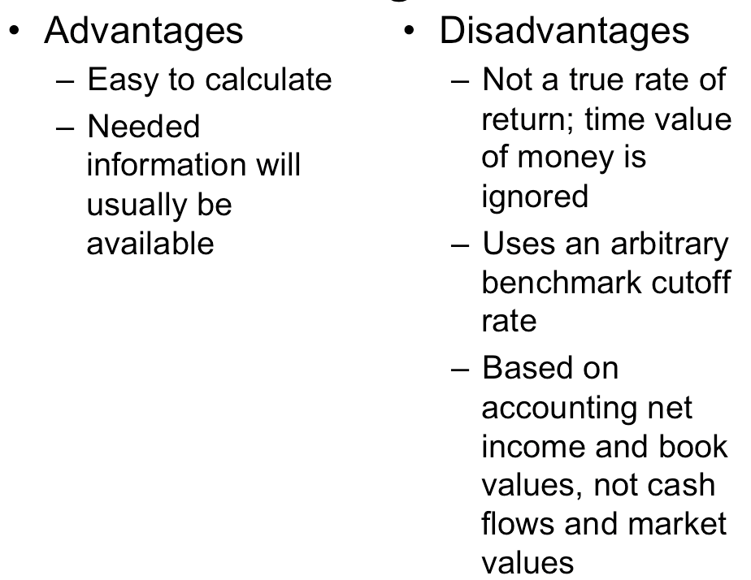
Advantages and Disadvantages of AAR

Slide 29
Internal Rate of Return
This is the most important alternative to NPV
It is often used in practice and is intuitively appealing
It is based entirely on the estimated cash flows and is independent of interest rates found elsewhere

Slide 30
IRR – Definition and Decision Rule
Definition: IRR is the return that makes the NPV = 0
Decision Rule: Accept the project if the IRR is greater than the required return

Slide 31
Computing IRR for the Project
If you do not have a financial calculator, then this becomes a trial and error process
Calculator
Enter the cash flows as you did with NPV
Press IRR and then CPT
IRR = 16.13% > 12% required return
Do we accept or reject the project?

Slide 32
Consider a project that costs $100 today and pays $110 in one year. Suppose you were asked, “What is the return on this investment?” What would you say?

Slide 34
Example 9.4
A project has a total up-front cost of $435.44. The cash flows are $100 in the first year, $200 in the second year and $300 in the third year. What’s the IRR? If we require an 18 percent return, should we take this investment?
The NPV is zero at 15%, so 15% is the IRR.
The decision: is to reject to take this investment because its 15% return is below the required 18% return.

Slide 35
Decision Criteria Test - IRR
Does the IRR rule account for the time value of money?
Does the IRR rule account for the risk of the cash flows?
Does the IRR rule provide an indication about the increase in value?
Should we consider the IRR rule for our primary decision criteria?

Slide 36
Advantages of IRR
Knowing a return is intuitively appealing
It is a simple way to communicate the value of a project to someone who doesn’t know all the estimation details
If the IRR is high enough, you may not need to estimate a required return, which is often a difficult task

Slide 37
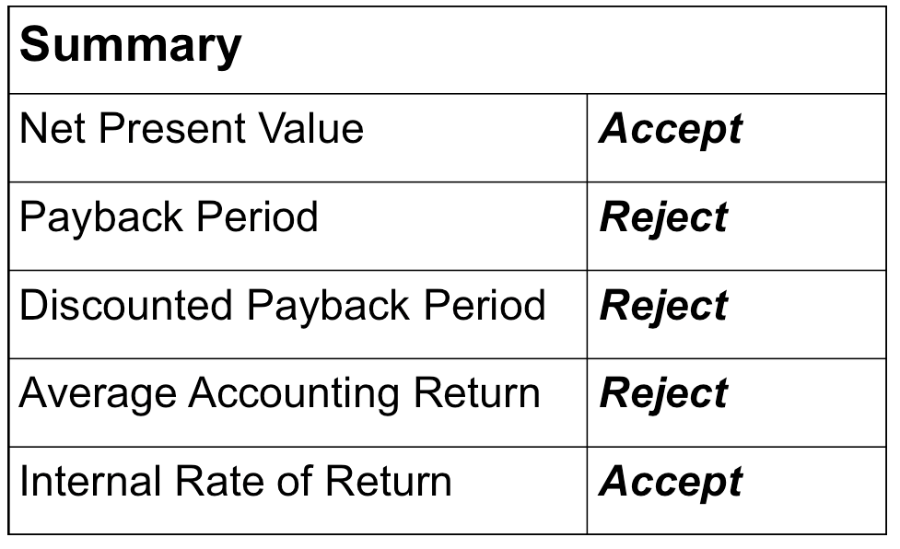
Summary of Decisions for the Project

Slide 38
NPV vs. IRR
NPV and IRR will generally give us the same decision
Exceptions
Nonconventional cash flows – cash flow signs change more than once
Mutually exclusive projects
Initial investments are substantially different (issue of scale)
Timing of cash flows is substantially different

Slide 39
Summary – Payback Criteria
Payback period
Length of time until initial investment is recovered
Take the project if it pays back within some specified period
Doesn’t account for time value of money, and there is an arbitrary cutoff period
Discounted payback period
Length of time until initial investment is recovered on a discounted basis
Take the project if it pays back in some specified period
There is an arbitrary cutoff period

Slide 40
Summary – Accounting Criterion
Average Accounting Return
Measure of accounting profit relative to book value
Similar to return on assets measure
Take the investment if the AAR exceeds some specified return level
Serious problems and should not be used

