Slide 1
The Emergence of the Quantum Theory

Slide 2
Historical Background
In the first half of the 19th century, many discoveries ware made such as:
Magnetic and electrical effects by Faraday, Maxwell and Hertz.
Three laws of mechanics by Newton.
Three laws of thermodynamics by Rumfold, Joule, Gibbs and Carnot.
Kinetic theory of gases and statistical mechanics by Maxwell, Gibbs and Boltzmann.
Wave theory of light by Huygen.
Optics by Young and Frensel.
The body of these accomplishments in physics is considered the development of what we now call classical physics.

Slide 3
The Motivation for Quantum Mechanics
Toward the end of the nineteenth century, many scientists believed that most of the fundamental physical laws had been worked out and little remained but to clear up a few minor problems and to improve experimental methods to measure physical results to a greater number of decimal places.
However, at late 19th century and early 20th century, classical physics failed to explain some important naturally occurring physical phenomena. Some of the phenomena that demonstrated the inadequacy of classical physics are:
Blackbody Radiation
Photoelectric effect
Atomic spectra
The limitation of classical physics to explain such phenomena led to the development of quantum mechanics in the early twentieth century.
McQuarrie, Donald A. “Quantum Chemistry.” 2nd Ed., University Science Books, Mill Valey, CA, 1983.

Slide 4
Quantum Mechanics Definition and Its Importance
Quantum mechanics— is the set of laws that describe the behavior of very small particles such as the electrons and nuclei of atoms and molecules.
Quantum chemistry— is the branch of chemistry that applies quantum mechanics to solve problems in chemistry.
The Importance of learning Quantum Mechanics for Chemists
Quantum mechanics forms the foundation upon which all of chemistry is built. Our current understanding of atomic structure and molecular bonding is cast in terms of the fundamental principles of quantum mechanics, and no understanding of chemical systems is possible without knowing the basics of this current theory of matter.
Levine, Ira N. “Quantum Chemistry.” 7th Ed., Pearson Education, 2014.
McQuarrie, Donald A. “Quantum Chemistry.” 2nd Ed., University Science Books, Mill Valey, CA, 1983.

Slide 5
Blackbody Radiation
The series of experiments that revolutionized the concepts of physics was concerned with the radiation given off by material bodies when they are heated.
How do heated bodies radiate?
Any body at any temperature above absolute zero radiates to some extent, the intensity and frequency distribution of the radiation depends on the detailed structure of the body.
A blackbody is an idealized object which absorbs and emits all frequencies.
Thermal radiation in visible light can be seen on this hot metalwork. Its emission in the infrared is invisible to the human eye. Infrared cameras are capable of capturing this infrared emission.

Slide 6
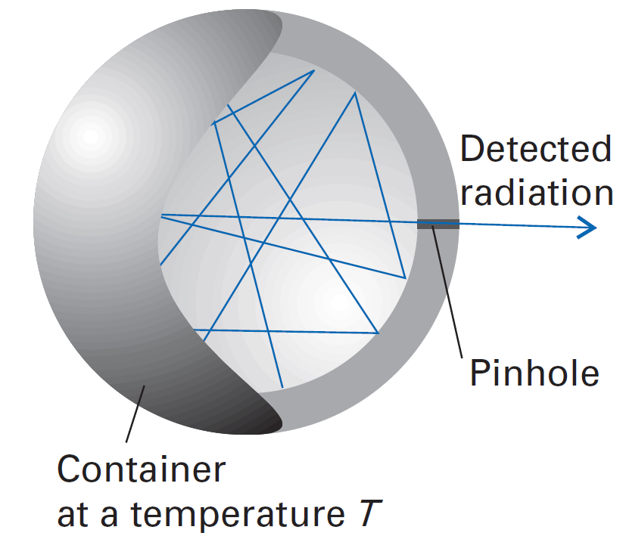
Blackbody Radiation
A black-body emitter can be simulated by a heated container with a pinhole in the wall. The electromagnetic radiation is reflected many times inside the container and reaches thermal equilibrium with the walls.
Atkins, P. W. “Molecular Quantum Mechanics.”, 2nd Ed., Oxford University Press. Oxford 1983.

Slide 7
Blackbody Radiation
What was experimentally observed?
Two characteristics of the radiation emitted from heated bodies had been identified by the end of the 19th century and summarized in two laws.
First law: Stefan–Boltzmann law
This law states that the intensity radiated over all wavelengths (that is, the area under the curve) is proportional to the fourth power of the temperature.
$$I= σT^{4}$$
Where σ is he Stefan–Boltzmann constant which is independent of the material from which the body is composed, and its value is $5.67 × {10}^{−8} Watt m^{−2}K^{−4}$.

Slide 8
Blackbody Radiation
Second law: Wien’s displacement law
This law states that when the temperature of a blackbody radiator increases, the overall radiated energy increases and the peak of the radiation curve moves to shorter wavelengths (high frequencies). Therefore, The product of the peak wavelength and the temperature is found to be a constant.
$$λ_{max}T=constant$$
with the constant equal to $2.9 mm K$.
One of the most challenging problems in physics at the end of the nineteenth century was to explain these two laws.

Slide 9
Blackbody Radiation
Lord Rayleigh, with minor help from James Jeans formulated the theoretical Rayleigh–Jeans law for the energy density (the energy divided by the volume), in the frequency range $ν to ν‏+dν:$
$$ρ\left(ν, T\right)dν \text{= }\frac{8πkT}{c^{3}}ν^{2}dν$$
Where $ρ(ν, T)$ is the radiant energy density between the frequencies ν and $ν‏+dν$and has units of joules per cubic meter ($J·m^{−3}$), $k$ is Boltzmann’s constant ($k=1.381 ×{10}^{−23} JK^{−1}$), $c$ is the speed of light, and $T$ is temperature in kelvin.
Although the Rayleigh-Jeans law works for low frequencies, it diverges as frequency increases; this divergence for high frequencies is called the ultraviolet catastrophe.
In other word, It suggests that regardless of the temperature, there should be an infinite energy density at very high frequencies.

Slide 10
Blackbody Radiation
In 1900 Max Planck made his historic contribution when he explained the blackbody radiation by assuming that the energies of the oscillations of electrons which gave rise to the radiation were discrete and had to be proportional to an integral multiple of the frequency, i.e.
$$E=nhν$$
where
$E$ is the energy of an oscillator.
$n$ is an integer.
$h$ is a proportionality constant.
$ν$ is the frequency.

Slide 11
Blackbody Radiation
Using this quantization of energy and some statistical thermodynamic ideas, Planck derived the equation
$$ρ\left(ν, T\right)dν \text{= }\frac{8πhν^{3}}{c^{3}}\frac{dν}{e^{\frac{hν}{kT}} −1}$$
All the symbols except “$h$” in this equation have the same meaning as in Rayleigh–Jeans law.
The only undetermined constant here is “$h$”. Planck showed that this equation avoids the ultraviolet catastrophe, gives excellent agreement with the experimental data for all frequencies and temperatures if:
$$h = 6.626 ×{10}^{−34} \text{joule}\text{·}\text{seconds}\text{ (}\text{J}\text{·}\text{s}\text{)}$$

Slide 12
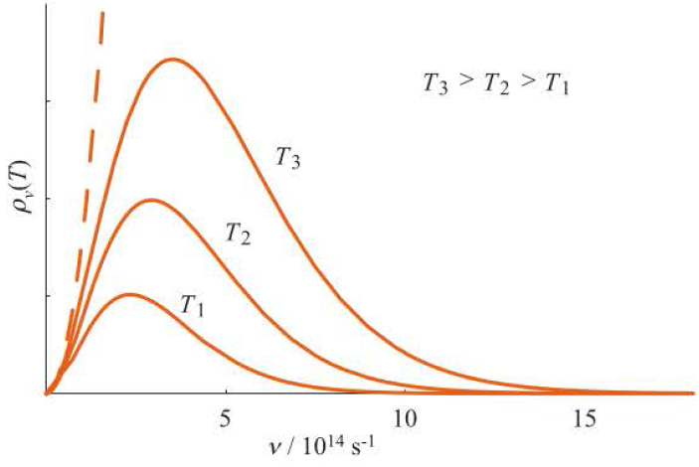
Blackbody Radiation
Prediction of Rayleigh-Jeans Law (classical physics)
Experimentally observed curves
(Planck Radiation Formula)
Spectral distribution of the intensity of blackbody radiation as a function of frequency for several temperatures.
McQuarrie, Donald A. “Quantum Chemistry.” 2nd Ed., University Science Books, Mill Valey, CA, 1983.

Slide 13
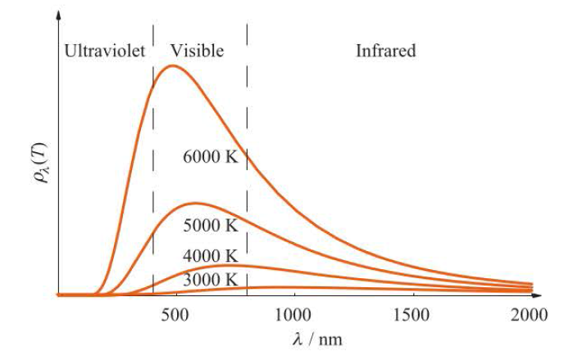
Blackbody Radiation
The distribution of the intensity of the radiation emitted by a blackbody versus wavelength for various temperatures. As the temperature increases, the total radiation emitted (the area under the curve) increases.
McQuarrie, Donald A. “Quantum Chemistry.” 2nd Ed., University Science Books, Mill Valey, CA, 1983.

Slide 14
Blackbody Radiation
The theory of blackbody radiation is used regularly in astronomy to estimate the surface temperatures of stars. The figure in the next slide shows the electromagnetic spectrum of the sun measured at the earth's upper atmosphere. A comparison of this figure with the figure in previous slide suggests that the solar spectrum can be described by a blackbody at approximately 6000 K. If we estimate $λ_{max}$ to be 500 nm, then the Wein displacement law gives the temperature of the surface of the sun to be
The star Sirius, which appears blue, has a surface temperature of about 11000 K.
McQuarrie, Donald A. “Quantum Chemistry.” 2nd Ed., University Science Books, Mill Valey, CA, 1983.

Slide 15
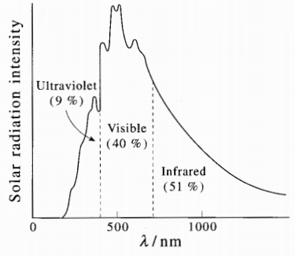
Blackbody Radiation
The electromagnetic spectrum of the sun as measured in the upper atmosphere of the earth. A comparison of this figure with Figure 1.2 shows that the sun's surface radiates as a blackbody at a temperature of about 6000 K.
McQuarrie, Donald A. “Quantum Chemistry.” 2nd Ed., University Science Books, Mill Valey, CA, 1983.

Slide 16
The Photoelectric Effect
In 1886 and 1887, Hertz discovered that ultraviolet light causes electrons to be ejected from a metal surface.
The ejection of electrons from the surface of a metal by radiation is called the photoelectric effect.
light
Metal
_
_
+
+
Electrons
Battery
Battery
Ammeter
Ammeter
No electrical current flows
Electrical current flows

Slide 17
The Photoelectric Effect
Two experimental observations of the photoelectric effect are in stark contrast with the classical wave theory of light.
Classical Physics |  | Experimental observations
The intensity of the light determines the amplitude of the wave, and so a greater light intensity should cause the electrons on the metal to oscillate more violently and to be ejected with a greater kinetic energy. |  | The kinetic energy of the ejected electrons is independent of the light’s intensity but increases as the light’s frequency increases.
The photoelectric effect should occur for any frequency of light as long as the intensity is sufficiently high. |  | There is a threshold frequency, $ν₀$ , characteristic of the metallic surface, below which no electrons are ejected, regardless of the intensity of the radiation. Above $ν₀$ , the kinetic energy of the ejected electrons varies linearly with the frequency $ν$.

Slide 18
The Photoelectric Effect
In 1905, Einstein showed that these observations could be explained by regarding light as composed of particlelike entities (called photons), with each photon having an energy
$$Ephoton=hν$$
When an electron in the metal absorbs a photon, part of the absorbed photon energy is used to overcome the forces holding the electron in the metal; the remainder appears as kinetic energy of the electron after it has left the metal.
Conservation of energy gives
$$hν=Φ+(K.E.)electron$$
where
$Φ$ is the minimum energy needed by an electron to escape the metal (the metal’s work function). Work function is a characteristic of each metal.
$K.E.$ is the maximum kinetic energy of an ejected electron.

Slide 19
The Photoelectric Effect
In classical mechanics, the kinetic energy of an object (the ejected electron) of mass m traveling at a speed v is
$$(K.E.)electron=\frac{1}{2}m{\text{v}}^{2}$$
Experimentally, The kinetic energy of the electron is measured by applying an apposing potential to the direction of the electron until the electron stops. The required potential that stops the electron is called the stopping potential and is denoted to as $V_{s}$ , and therefore we can write:
$$\frac{1}{2}m{\text{v}}^{2}=−eV_{s}$$
Where $e$ denotes the charge of electron and it is a negative quantity, therefore, the minus sign in the equation is added to make the right side of the equation a positive value.

Slide 20
The Photoelectric Effect
If the incident light on the metal surface energy is equal to the work function of the metal then:
$$Φ=hν_{ₒ}$$
where $ν_{ₒ}$ is the threshold frequency of the metallic surface.
$\frac{1}{2}m{\text{v}}^{2}=hν −hν_{ₒ}=−eV_{s}$ $ν≥ν_{ₒ}$
This equation shows that a plot of KE versus ν should be linear and that the slope of the line should be h, in complete agreement with the experimental data (See Next Slide).
Einstein obtained a value of h in close agreement with Planck's value deduced from the blackbody radiation formula. This surely was a fantastic result because the whole business of energy quantization was quite mysterious and not well accepted by the scientific community of the day.

Slide 21
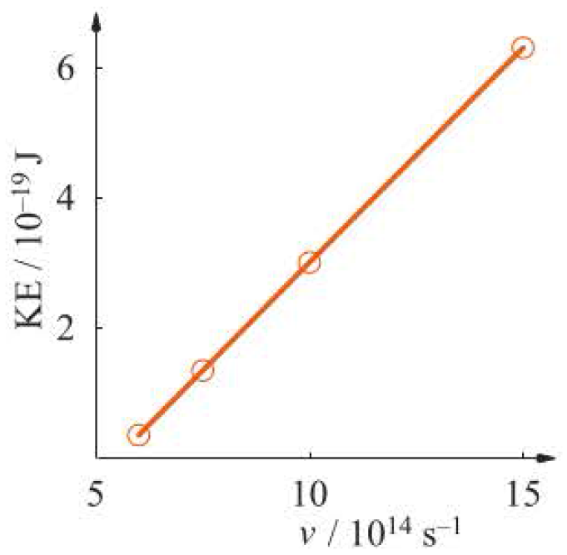
The Photoelectric Effect
The kinetic energy of electrons ejected from the surface of sodium metal versus the frequency of the incident ultraviolet radiation. The threshold frequency here is 5.51 x 10¹⁴ Hz (1 Hz = 1 s⁻¹).
McQuarrie, Donald A. “Quantum Chemistry.” 2nd Ed., University Science Books, Mill Valey, CA, 1983.

Slide 22
Atomic spectra
Atomic spectra were another puzzle that classical physics failed to explain.
What was experimentally observed?
It was observed that the radiation emitted by atoms was not continuous but consisted of discrete frequencies, or spectral lines as shown below.
6562.8 Å
4861.3 Å
4340.5 Å
4101.7 Å
Emission spectrum of the hydrogen atom in the visible region showing that the emission spectrum of atomic hydrogen is a line spectrum.

Slide 23
Atomic spectra
For many years, scientists had tried to explain the hydrogen atomic spectrum. In 1885, Balmer, suggested an empirical formula that fitted the observed spectral lines of hydrogen atom. This equation is called Balmer's formula and it has the following expression:
$$\frac{1}{λ}= R_{H}\left(\frac{1}{2^{2}}−\frac{1}{n_{2}^{2}}\right), n=3, 4, …$$
where
$λ$ is the wavelength of the emitted line.
$RH$ is a constant known later as Rydberg constant and has the value of $109677.57 {cm}^{−1}$.
This is another strong evidence for the quantization of energy and the need for development of quantum mechanics.

Slide 24
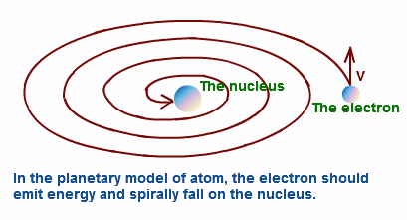
Rutherford’s Atomic Model
In 1911, Rutherford proposed that electrons orbit about the nucleus of an atom. similar to the planets revolve around the Sun (solar system).
Limitation of Rutherford's Atomic Model
According to classical electromagnet theory, an accelerated charged particle radiates energy in the form of electromagnetic (light) waves. An electron circling the nucleus at constant speed is being accelerated, since the direction of its velocity vector is continually changing.
Hence the electrons in the Rutherford model should continually lose energy by radiation and will gradually come closer to the nucleus by a spiral path.
The ultimate result of this spiral path will be that the electron will fall into the nucleus. Thus, according to classical (nineteenth-century) physics, the Rutherford atom is unstable and would collapse.
In reality this does not happen . Thus, this model failed to explain the stability of an atom.
Therefore, scientists were looking for a way out of this difficulty.

Slide 25
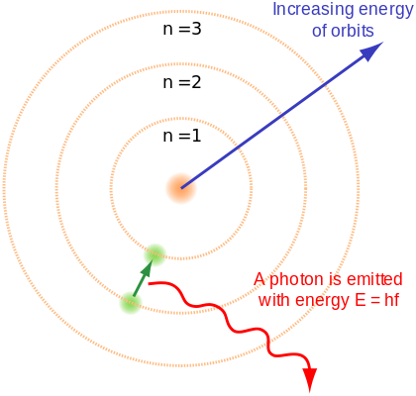
Bohr Theory
In 1913 Niels Bohr introduced a theory based on some hypothesis that he made in order to explain the noticed atomic spectra. These hypothesis are:
The energy of the electron in a hydrogen atom was quantized, with the electron rotate in a specific orbital around the nucleus. When an electron is given energy equal to the difference in energy between this orbital and a higher energy orbital, the electron is promoted to the higher orbital. When this electron returns back to its original orbital, it releases energy in the form of a photon as proposed by Einstein, so that:
$$ΔE=Ephoton=hν$$
$$E_{upper}−E_{lower}=hν$$

Slide 26
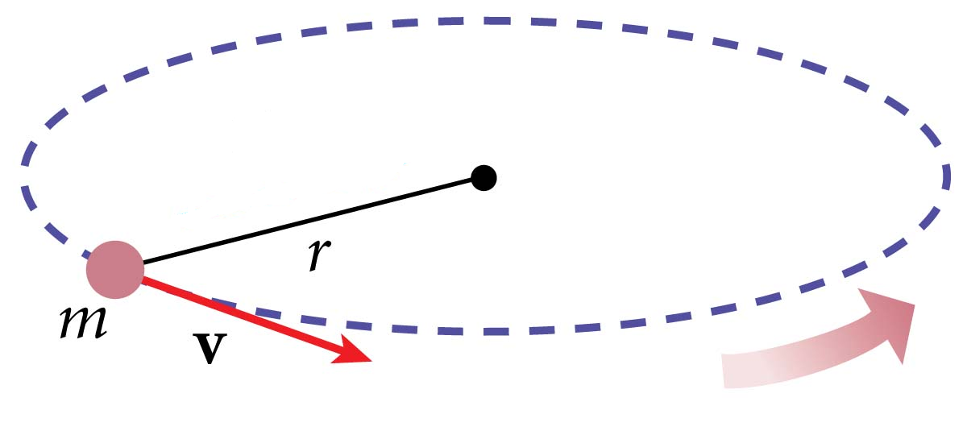
Bohr Theory: Quantization of Electronic Angular Momentum
2. The Hydrogen atom consists of a nucleus and an electron. The nucleus is so heavy compared to the mass of the electron. Therefore the nucleus is considered to be stationary and the electron is moving around the nucleus in an orbit without losing any of its energy.
In this case, the electron move under the influence of tow forces:
The centrifugal force which is given by
where
$m$ is the electron mass.
$\text{v}$ is the electron velocity.
$r$ is the radius of the orbital (the distance between the electron
and nucleus).
$$F_{centrifugal}= \frac{m{\text{v}}^{2}}{r}$$

Slide 27
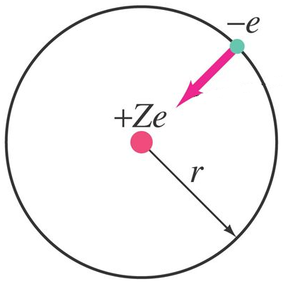
Bohr Theory: Quantization of Electronic Angular Momentum
The second force that holds an electron in its orbit is:
The coulombic force of attraction between the proton and the electron which is given by Coulomb’s law.
$$F_{coulombic}=\frac{Ze^{2}}{4πε_{0}r^{2}}=\frac{{Ze}^{2}}{4πε_{0}r^{2}}$$
Where
$Z$ is the number of proton in the nucleus
(e.g., for $H$ atom $Z=1$, and $Z=2$ for
$He$ atom and so on).
$e$ is the charge on the electron.
$ε_{0}$ is the permittivity of free space
($ε_{0}=8.8541878×{10}^{−12}C^{2}/Nm^{2}$).
$r$is the distance between the electron and
the proton (the radius of the orbital).

Slide 28
Bohr Theory: Quantization of Electronic Angular Momentum
For an electron to stay in a certain orbital, the two forces (centrifugal force and coulombic force) have to be equal
$$\frac{m{\text{v}}^{2}}{r}=\frac{{Ze}^{2}}{{4πε_{0}r}^{2}}$$
Assuming that the electrons is moving in a fixed orbitals with constant energy contradict laws of classical physics.
3. Because of its circular motion around the nucleus, the electron has an angular momentum ($l$) given by
$$l=m\text{v} r$$
Bohr proposed the quantization of the angular momentum in the form:
$$l=m\text{v} r=nℏ$$
where $ℏ=\frac{h}{2π}$ (called h-bar) and $n= 1, 2, …$
Bohr didn’t introduce any proof to this hypothesis, but it was proved by de Broglie later on.

Slide 29
Bohr Theory: Quantization of Electronic Angular Momentum
From this equation ($l=m\text{v} r=nℏ$) where $ℏ=\frac{h}{2π}$ , we can write
$$m^{2}{\text{v}}^{2}r^{2}=\frac{n^{2}h^{2}}{4π^{2}}$$
Solving the equation above for $\text{v}$ gives
Using the two equation below we can write
and
$${\text{v}}^{2}=\frac{n^{2}h^{2}}{4π^{2}}\frac{1}{m^{2}r^{2}}$$
$$\text{v}= \frac{nh}{2π}\frac{1}{mr}$$
This equation enables us form calculating the speed of electron.
$$⇒$$
$$\frac{m{\text{v}}^{2}}{r}=\frac{Ze^{2}}{{4πε_{0}r}^{2}}$$
$${\text{v}}^{2}=\frac{n^{2}h^{2}}{4π^{2}}\frac{1}{m^{2}r^{2}}$$
$$⇓$$
$$⇓$$
$$m{\text{v}}^{2}=\frac{{Ze}^{2}}{4πε_{0}r}$$
$$m{\text{v}}^{2}=m\frac{n^{2}h^{2}}{4π^{2}}\frac{1}{m^{2}r^{2}}$$

Slide 30
Bohr Theory: Quantization of Electronic Angular Momentum
From the last two equation, we can then write
$$m\frac{n^{2}h^{2}}{4π^{2}}\frac{1}{m^{2}r^{2}}=\frac{Ze^{2}}{4πε_{0}r}$$
For hydrogen atom Z=1 and therefore,
This equation enables us to calculate the radius of the orbital at which the electron is orbiting.
$$r=\frac{{ε_{0}n}^{2}h^{2}}{\text{π}mZe^{2}}$$

Slide 31
Bohr Theory: Quantization of Electronic Angular Momentum
Example: If you know that:
$$the charge on the electron \left(e\right)=1.602177×{10}^{−19} C$$
$$the mass of the electron \left(m\right)=9.10939×{10}^{−31} kg$$
$$the permittivity of free space \left(ε_{0}\right)= 8.8541878×{10}^{−12}\frac{C^{2}}{Nm^{2}}$$
$$Planck constatn \left(h\right)=6.626×{10}^{−34} Js$$
Calculate the radius of the first orbital in hydrogen atom (orbit with $n=1$).
Example:
Using equation $r=\frac{{ε_{0}n}^{2}h^{2}}{\text{π}mZe^{2}}$
$$r= \frac{8.8541878×{10}^{−12}\frac{C^{2}}{Nm^{2}}×1^{2}{×\left(6.626×{10}^{−34} Js\right)}^{2}}{π×9.10939×{10}^{−31} kg{×1×\left(1.602177×{10}^{−19} C\right)}^{2}}$$
$=5.29×{10}^{−11} m$ $= 52.9 pm = 0.529 Å$
The radius of the first Bohr orbit is often denoted by $a_{0}$
$$(Remember 1J=\frac{1kg m^{2}}{s^{2}} and 1N=\frac{1kg m}{s^{2}})$$

Slide 32
Bohr Theory: Quantization of Electronic Angular Momentum
The total energy of the electron is equal to the sum of its kinetic energy and potential energy $(V).$
$$E=KE+V$$
The kinetic energy and the potential energy of an electron and a proton separated by a distance $r$ are
$$K.E.=\frac{1}{2}m{\text{v}}^{2} and V=−\frac{Ze^{2}}{4πε_{0}r}$$
The negative sign in the potential energy expression indicates that the proton and electron attract each other.
Since
$$\frac{1}{2}m{\text{v}}^{2}=\frac{1}{2}\left(\frac{{Ze}^{2}}{4πε_{0}r}\right)$$
Therefore the total energy is give by
$$E=\frac{1}{2}\left(\frac{{Ze}^{2}}{4πε_{0}r}\right)−\frac{{Ze}^{2}}{4πε_{0}r}=−\frac{1}{2}\left(\frac{{Ze}^{2}}{4πε_{0}r}\right)=−\frac{{Ze}^{2}}{8πε_{0}r}$$

Slide 33
Bohr Theory: Quantization of Electronic Angular Momentum
We have already found the only allowed values of $r$ are given by
$$r=\frac{{ε_{0}n}^{2}h^{2}}{\text{π}mZe^{2}} (slide 28)$$
so if we substitute for $r$ into the previous equation, we get the only allowed energies are
$$E_{n}=−\frac{Z^{2}me^{4}}{8{ε_{0}^{2}n}^{2}h^{2}} n=1, 2, …$$
$$(for H atom Z=1)$$
Notice that:
The total energy of the electron in a given orbital depends on the $n2$. this means that the energy of the electron is quantized.
$n = 1$corresponds to the state of lowest energy, called the ground-stale energy .
The negative sign in this equation indicates that the energy states are bound states.

Slide 34
Bohr Theory: Quantization of Electronic Angular Momentum
At ordinary temperatures, hydrogen atoms, as well as most other atoms and molecules, will be found almost exclusively in their ground electronic state.
The states of higher energy are called excited slates and are generally unstable with respect to the ground state.
An atom or molecule in an excited state will usually relax back to the ground state and give off the energy as electromagnetic radiation
Bohr assumed that the observed emission spectrum of the hydrogen atom was due to transitions from one allowed energy state to a lower state, and so
$$∆E= E_{n_{2}}−E_{n_{1}}=−\frac{me^{4}}{{8ε}_{0}^{2}n_{2}^{2}h^{2}}+\frac{me^{4}}{{8ε}_{0}^{2}n_{1}^{2}h^{2}}$$
$$=\frac{me^{4}}{{8ε}_{0}^{2}h^{2}}\left(\frac{1}{n_{1}^{2}}−\frac{1}{n_{2}^{2}}\right)$$

Slide 35
Bohr Theory: Quantization of Electronic Angular Momentum
Remember that, Bohr assumed that as the electron falls from one level to another, the energy evolved is given off as a photon of energy
$$E=hν=\frac{hc}{λ}=hc\overline{ν}$$
where $\overline{ν}$ is called wavenumber (defined as $\frac{1}{λ}$).
From the previous two equations we can write
$$\overline{ν}=\frac{1}{λ}=\frac{me^{4}}{{8ε}_{0}^{2}ch^{3}}\left(\frac{1}{n_{1}^{2}}−\frac{1}{n_{2}^{2}}\right)$$
Now, if we compare this equation with the previously shown equation
$$\frac{1}{λ}= R_{H}\left(\frac{1}{2^{2}}−\frac{1}{n_{2}^{2}}\right) (slide 21)$$
we conclude that
$$R_{H}=\frac{me^{4}}{{8ε}_{0}^{2}ch^{3}}=\text{109 73}\text{7 }{cm}^{−1}$$
This is in great agreement with the experimental value of 109 677.6 ${cm}^{−1}$.

Slide 36
Hydrogen Atomic Spectra And Rydberg Formula
The empirical equation that Balmer suggested to fit the observed line spectrum for hydrogen is just on case of a general equation called Rydberg equation given by
$$\overline{ν}=R_{H}\left(\frac{1}{n_{1}^{2}}−\frac{1}{n_{2}^{2}}\right)$$
$n_{1}$ and $n_{2}$ are two numbers that represent the two energy levels involved in a transition of the electron. For each value of $n_{1}$ there are several transitions of $n_{1}$ to different levels of $n_{2}$ so that $n_{2}$ > $n_{1}$. each series of line is named after the scientist who discover that series.
$$Series name$$ | $$n2$$ | $$n1$$
$$Lyman$$ | $$2, 3, 4, …$$ | $$1$$
$$Balmer$$ | $$3, 4, 5, …$$ | $$2$$
$$Baschen$$ | $$4, 5, 6, …$$ | $$3$$
$$Brackett$$ | $$5, 6, 7, …$$ | $$4$$

Slide 37
Hydrogen Atomic Spectra And Rydberg Formula
Continuum
8
7
6
5
4
Brackett
series
Energy
3
Paschen
series
2
Balmer
series
n = 1
Lyman
series
Note that the energy levels merge as $n→∞$

Slide 38
Example
Calculate the amount of energy needed to completely remove the electron from hydrogen atom.
Solution:
In this example we are required to calculate the ionization energy $I.E.$ of the hydrogen atom. We will use the following equation
$$I.E.=R_{H}\left(\frac{1}{n_{1}^{2}}−\frac{1}{n_{2}^{2}}\right)$$
Here, $n_{1}=1$ and $n_{2}=∞$, thus,
$$I.E.=R_{H}\left(1−0\right)=109677.6 {cm}^{−1}$$
$109677.6 {cm}^{−1}×\frac{1 Joule (J)}{5.034 × {10}^{22} {cm}^{−1}}=2.179× {10}^{−18}$ $J$
McQuarrie, Donald A. “Quantum Chemistry.” 2nd Ed., University Science Books, Mill Valey, CA, 1983.

Slide 39
Example
Calculate the speed of the electron in the first orbital in hydrogen atom (orbit with $n=1$).
Solution:
We will use equation
$$\text{v}= \frac{nh}{2π}\frac{1}{mr}$$
In $slide 29$, we found that the radius of the first orbital in hydrogen atom (orbit with $n=1$).
$5.29×{10}^{−11} m$ $= 52.9 pm = 0.529 Å$
$$\text{v}= \frac{(6.626×{10}^{−34} Js) }{2π(9.10939×{10}^{−31} kg)(5.29×{10}^{−11} m)}$$
$$=2.187×{10}^{6}\frac{Js}{kg m}=2.187×{10}^{6}\frac{m}{s}$$

Slide 40
Wave-Particle Duality
Scientists have always had trouble describing the nature of light.
In many experiments light shows a definite wave-like character.
Dispersion of white light into its spectrum by a prism is an example of wave-like character.
In many others light seems to behave as a stream of photons (Particle-like).
The photoelectric effect is an example the particle-like character.
Because light appears wavelike in some instances and particle-like in others, this disparity is referred to as the wave-particle duality of light.

Slide 41
De Broglie Postulate
In 1924, De Broglie, suggested that if light can display this wave-particle duality, then matter, which certainly appears particle-like, might also display wavelike properties under certain conditions.
De Broglie was able to put his idea into a quantitative scheme
From relativity theory of Einstein, it was shown that
$$E=mc^{2} (c is the speed of light)$$
And from the Planck–Einstein relation, the photon energy is given by
$$E=hν$$
therefore,
$$mc^{2}=hν=h\frac{c}{λ}$$
and
$$λ=\frac{h}{mc}$$

Slide 42
Louis de Broglie Postulate
This equation is for light. De Broglie said that we can replace the speed of light $c$ by the speed of the moving particle v. Then
$$λ=\frac{h}{m\text{v}}= \frac{h}{p}$$
where
$p$ is the linear momentum of the moving object.
$λ$ is known here as de Broglie wave length of the moving particle.
De Broglie also confirmed the quantization of angular momentum that Bohr had hypothesized in his theory of hydrogen atom. De Broglie said that when the electron in a certain orbit around the nucleus, it moves with a certain wave length $λ$. For the electron to be stable in that orbital, the wave must be inphase when the electron completes a circle in that orbital (i.e. the wave must complete an integral number of wavelengths during its orbit).

Slide 43
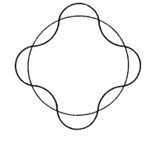
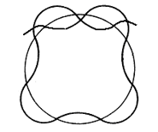
De Broglie Postulate
An illustration of matching (a) and mismatching (b) of a de Broglie wave traveling in Bohr orbits.
As can bee seen here, the wave (electron) must complete an integral number of wavelengths during its orbit. Otherwise, it would interfere destructively with itself. This condition may be written as
$$2πr=nλ$$
Rearranging this equation gives
$$λ= \frac{2πr}{n}= \frac{h}{m\text{v}}$$
$$m\text{v} r=l=\frac{nh}{2π}=nℏ$$
which is identical to what Bohr has hypothesized.

Slide 44
Heisenberg Uncertainty Principle
Although de Broglie's equation justifies Bohr's quantization assumption, it also demonstrates a deficiency of Bohr's model. Heisenberg showed that the wave-particle duality leads to the famous uncertainty principle
This principle states that it is impossible to specify the position of the electron and its momentum precisely at the same time. There is an uncertainty in position ($Δx$) and uncertainty in momentum ($Δp$) and this principle says that
$$∆x∆p≥\frac{1}{2}ℏ$$
One result of the uncertainty principle is that if the orbital radius of an electron in an atom $r$ is known exactly, then the angular momentum must be completely unknown. The problem with Bohr's model is that it specifies $r$ exactly and it also specifies that the orbital angular momentum must be an integral multiple of $ℏ$. Thus the stage was set for a new quantum theory which was consistent with the uncertainty principle.

Slide 45
Heisenberg Uncertainty Principle
Example:
calculate the uncertainty in the position of a baseball thrown at 90 mph if the uncertainty in its momentum is$5.6×{10}^{−8} kg·m·s^{−1}$
Solution:
$$∆x∆p≥\frac{h}{4π}$$
The uncertainty in the position of the baseball is
$$∆x=\frac{h}{4π∆p}= \frac{6.626×{10}^{−34} J·s}{4×3.142×5.6×{10}^{−8} kg·m·s^{−1}}$$
$$∆x=9.41×{10}^{−28} m$$
This distance is drastically insignificant.
McQuarrie, Donald A. “Quantum Chemistry.” 2nd Ed., University Science Books, Mill Valey, CA, 1983.

Slide 46
Heisenberg Uncertainty Principle
Example:
calculate the uncertainty in the momentum and the uncertainty of its speed it the uncertainty of its position $∆x=$ 50 pm.
Solution:
$$∆p=\frac{h}{4π∆x}= \frac{6.626×{10}^{−34} J·s}{4×3.142×50×{10}^{−12} m}$$
$$=1.05×{10}^{−24} kg·m·s^{−1}$$
The relation between linear momentum and speed is give by
$$p=m\text{v}$$
Thus
$$∆\text{v}=\frac{∆p}{m}= \frac{1.05×{10}^{−24} kg·m·s^{−1}}{9.11×{10}^{−31} kg}=1.15×{10}^{6} m·s^{−1}$$
Which is a very large uncertainty in the speed.
McQuarrie, Donald A. “Quantum Chemistry.” 2nd Ed., University Science Books, Mill Valey, CA, 1983.

Slide 47
References
المراجع العربية:
الأزهري، عادل عباس و القحطاني عبدالله علي، أسس كيمياء الكم، الرياض: جامعة الملك سعود، إدارة النشر العملي والمطابع، 1425 هـ.
المبارك، راشد عبدالعزيز وخليل، معتصم إبراهيم. كيمياء الكم، الرياض، دار الخريجي للنشر والتوزيع، 1417 هـ.
English References:
McQuarrie, Donald A. “Quantum Chemistry.” 2nd Ed., University Science Books, Mill Valey, CA, 1983.
Levine, Ira N. “Quantum Chemistry.” 7th Ed., Pearson Education, 2014.
Atkins, P. W. “Molecular Quantum Mechanics.”, 2nd Ed., Oxford University Press. Oxford 1983.
Sherrill, C. D. “A Brief Review of Elementary Quantum Chemistry.” 2001
http://vergil.chemistry.gatech.edu/notes/quantrev/quantrev.html
Undergraduate Quantum Chemistry by Jussi Eloranta (2018).

