Slide 1
The Schrödinger Equation ,Particle in a Box and The Postulates of Quantum Mechanics

Slide 2
Derivation of the Schrödinger equation
Waves are classified into two kinds:
Standing waves
Progressive wave
To derive the Schrödinger equation we use standing wave equations because it give better description for the motion of electron in its orbit around nucleus.
An important property of light is that it obeys the next differential equation for standing waves
$$\frac{∂^{2}φ}{{∂x}^{2}}= \frac{1}{υ^{2}}\frac{∂^{2}φ}{{∂t}^{2}}$$
where $φ$ is defined as
$φ=2r\sin{\frac{2π}{λ} x\cos{2π}}$νt
In these two equation, $t$ is the time, $υ$ is the speed of light, $λ$ is the wave length, ν is the frequency, $x$is the displacement and $r$ is the amplitude of the standing wave.

Slide 3
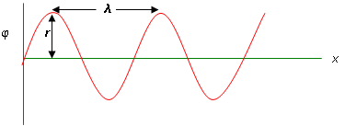
Derivation of the Schrödinger equation
We note that the last two equations are functions of both $t$ and $x$.
The last equation can be written as
$φ=ψ{(x)\cos{2π}}$νt
Now, if this equation is differentiated twice with respect to displacement ($x$) and time ($t$) we get
$$\frac{∂φ}{∂x}= ψ^{′}\left(x\right) cos 2π\text{ν}\text{t}$$
$$\frac{∂2φ}{∂x2}= ψ^{′′}\left(x\right) cos 2π\text{ν}\text{t}$$
$$\frac{∂φ}{∂t}=−2π\text{ν}ψ\left(x\right)sin 2π\text{ν}\text{t}$$
$$\frac{∂2φ}{∂t2}=−4π2\text{ν}\text{2}ψ\left(x\right) cos 2π\text{ν}\text{t}$$

Slide 4
Derivation of the Schrödinger equation
When substituting the two right equations into the equation
$$\frac{∂^{2}φ}{{∂x}^{2}}= \frac{1}{υ^{2}}\frac{∂^{2}φ}{{∂t}^{2}}$$
we get
Dividing this equation by $\cos{2π}$νt gives
By doing this we eliminate the time factor ($t$) of the equation.
Since the speed of light is related to its frequency by this relation:
Therefore,
By rearrangement, we get
$$ψ^{′′}\left(x\right) cos 2π\text{ν}\text{t} \text{= }\frac{1}{υ^{2}} [−4π2\text{ν}\text{2}ψ\left(x\right) cos 2π\text{ν}\text{t}]$$
$$ψ^{′′}\left(x\right)=−\frac{4π2\text{ν}\text{2}}{υ^{2}} ψ\left(x\right)$$
$$\frac{υ}{\text{ν}}= λ$$
$$ψ^{′′}\left(x\right)=−\frac{4π2}{λ^{2}} ψ\left(x\right)$$
$$\frac{d^{2}ψ}{{dx}^{2}}+\frac{4π2}{λ^{2}} ψ=0$$

Slide 5
Derivation of the Schrödinger equation
From de Broglie principle, we have
And therefore we can write,
$$\frac{1}{λ^{2}}= \frac{p^{2}}{h^{2}}= \frac{m^{2}υ^{2}}{h^{2}}$$
And by substitution in the last equation of the last slide, we get
$$\frac{d^{2}ψ}{{dx}^{2}}+ \frac{{4π}^{2}m^{2}υ^{2}}{h^{2}}ψ=0$$
Now, the total energy ($E$) of any system is the sum of the kinetic energy ($T$) and the potential energy ($V$)
$$E=T+V ⇒T=E−V$$
Since, $T= \frac{1}{2} m\text{v}2$ , therefore, $m\text{v}2=2(E−V$).
$$λ= \frac{h}{p}$$

Slide 6
Derivation of the Schrödinger equation
Substituting $m υ2=2(E−V$) into equation
gives
$$\left(−\frac{ℏ^{2}}{2m}\frac{d^{2}}{{dx}^{2}}+V\right)ψ=Eψ$$
This last equation is the time independent Schrodinger equation in one dimension and usually written as
$$\hat{H}ψ=Eψ$$
Where
$\hat{H}$ is called the Hamiltonian operator.
$$\frac{d^{2}ψ}{{dx}^{2}}+ \frac{{4π}^{2}m^{2}υ^{2}}{h^{2}}ψ=0$$
$$\frac{d^{2}ψ}{{dx}^{2}}+ \frac{{8π}^{2}m}{h^{2}}\left(E−V\right) ψ=0$$
$$\hat{H}=− \frac{ℏ^{2}}{2m}\frac{d^{2}}{{dx}^{2}}+V$$

Slide 7
Derivation of the Schrödinger equation
This operator, $\hat{H}$ is the most operator in quantum mechanics. It is the energy operator and known as the Hamiltonian operator.
The time independent Schrodinger equation in three dimensions is
$$\left[−\frac{ℏ^{2}}{2m}\left(\frac{∂^{2}}{{∂x}^{2}}+\frac{∂^{2}}{{∂y}^{2}}+\frac{∂^{2}}{{∂z}^{2}}\right)+V\right]ψ=Eψ$$
$$\left(−\frac{ℏ}{2m}∇^{2}+V\right)ψ=Eψ$$
The operator $∇^{2}$is called the Laplacian operator (read as “del squared”).
$∇^{2}≡$ $\left(\frac{∂2}{∂x2}+ \frac{∂2}{∂y2}+\frac{∂2}{∂z2}\right)$

Slide 8
Interpretation of the Wavefunction $ψ$
The function $ψ$ by itself does not give any valuable information regarding the movement or position of the microscopic particle since some functions contain imaginary parts in their definitions.
What is important is the product $ψ^{∗}⋅ψ$ noticing that the product of multiplying a complex number by its complex conjugate is a real number. The product $ψ^{∗}⋅ψ$is directly proportional to the probability of finding a particle in a certain place in space. In particular, the quantity $ψ^{∗}⋅ψ$ represents the probability of finding a particle in the small volume element $dτ$ of space.
The probability of finding the particle in all space must add to one. This means that
$$\int{ψ^{∗}ψ dτ}=1$$
$$all space$$

Slide 9
Solution to the Schrödinger Equation
The solutions to the Schrödinger equation are called wave functions. A wave function gives a complete description of any system.
The time-independent Schrödinger equation can be solved analytically only in a few special cases such as:
The Particle in a Box
The Harmonic Oscillator
The Rigid Rotor
The Hydrogen Atom
In this next section we will discuss the solution of the Schrödinger equation for particle in a box. The remaining cases will be discussed later throughout the course.

Slide 10
Particle in a One-Dimensional Box
Particle in a one-dimensional box system may seem physically unreal, but this model can be applied with some success to the $π$ conjugated molecules.
$$V=∞$$ | $$V=0$$ | $$V=∞$$
Suppose we have a particle of mass ($m$) moving in one direction $x$. And suppose that this particle is confined to a limited space in which the potential energy ($V$) is set to zero. Lets suppose that this space starts at $x$ = 0 and end at $x$ = a as shown in the next figure.
$$0$$
$$a$$
The potential energy out side this space is set to infinity. Now the conditions of the potential energy of the particle are summarized as
$$x→$$
This is like saying the particle is put inside a pox whose length is $a$. The potential energy inside the pox is zero and infinity elsewhere.
$$V\left(x\right)=0 when 0<x<a$$
$$V\left(x\right)=∞ when 0≥x≤a$$

Slide 11
Particle in a One-Dimensional Box
Now, we want to solve Schrödinger equation ($\hat{H}ψ=Eψ$) for this system.
Solving this equation means finding the wave function $ψ$ and the allowed energy $(E)$ levels of the particle inside this box under these specified conditions.
$$\hat{H}= \hat{T}+ \hat{V}$$
When we derived Schrödinger equation, we found that
$$\hat{H}=−\frac{ℏ}{2m}∇^{2}+V$$
And because the movement of the particle is only in the $x$ direction, and the potential energy in the allowed space for the particle movement (inside the box) is zero, we have
$$\hat{H}=− \frac{ℏ^{2}}{2m}\frac{d^{2}}{{dx}^{2}}$$
Substituting this in the Schrödinger equation of the system, we get
$$− \frac{h^{2}}{8π2m}\frac{d^{2}ψ}{{dx}^{2}}=Eψ$$

Slide 12
Particle in a One-Dimensional Box
By rearrangement, we get
$$\frac{d^{2}ψ}{{dx}^{2}}+\frac{8π2m}{h^{2}}Eψ=0$$
This equation can be rewritten as
$$\frac{d^{2}ψ}{{dx}^{2}}+k2ψ=0$$
where
$$k2= \frac{8π2mE}{h^{2}}$$
Equation ($\frac{d^{2}ψ}{{dx}^{2}}+k2ψ=0)$is a second order homogeneous linear deferential equation, the solution of such equation is very well known as we saw earlier. The solution is given by
$ψ\left(x\right)=A\sin{kx+B\cos{kx}}$ or $ψ\left(x\right)=Ce^{ikx}+De^{−ikx}$
Where $A, B, C and D$ are constants.

Slide 13
Particle in a One-Dimensional Box
$$\frac{d^{2}ψ}{{dx}^{2}}+k2ψ=0$$
sln. 1. $ψ\left(x\right)=A\sin{kx+B\cos{kx}}$
sln. 2. $ψ\left(x\right)=Ce^{ikx}+De^{−ikx}$
These two solutions are equivalent but there are three important deferences between them:
The first solution can be graphed whereas is the second can not be because it contains imaginary numbers.
The wave function in the second solution is an eigenfunction of the angular momentum whereas the first solution is not.
In the second solution, the exponent in the first term is positive, and the negative in the second term. In both terms, there is only one variable $x$ that can have a negative value. Therefore, the first term represent the movement in the positive direction of $x$ axis and the second term represents the movement in the negative direction of $x$ axis. The first solution, represents a standing wave equation and the sine and cosine terms represent two waves that move into two different directions at the same time.

Slide 14
Particle in a One-Dimensional Box
$$\text{For} \text{the} \text{particle} \text{in} \text{the} \text{box} \text{problem} \text{we} \text{choose} \text{the} \text{first} \text{solution}$$
$ψ\left(x\right)=A\sin{kx+B\cos{kx}}$
Now, we want to find the values of the two constants $A$ and $B$. To do this, we make use of the boundary conditions which are
$$ψ\left(0\right)=ψ\left(a\right)=0$$
Now, when we substitute into the chosen solution of Schrodinger equation, we get
$$ψ\left(0\right)=A\sin{0+B\cos{0=0}}$$
But we know that
$\sin{0=0}$ and $\cos{0=1}$
Therefore, we must have $B=0$, and when we substitute into the equation
$$ψ\left(x\right)=A\sin{kx+B\cos{kx}}$$
we get
$$ψ\left(x\right)=A\sin{kx}$$

Slide 15
Particle in a One-Dimensional Box
And now when we substitute $x=a$ in the equation
$$ψ\left(x\right)=A\sin{kx}$$
we get
$$ψ\left(a\right)=A\sin{ka}=0$$
For this equation to be true, we must have either $A =0$ or $\sin{ka}=0$. The first solution ($A =0$) is called the “trivial solution” and is not acceptable because setting both constants $A$ and $B$ equal to zero would make $ψ$equal to zero everywhere, which is not true.
Then the acceptable solution is ($\sin{ka}=0$) which can be true only when $ka =nπ$ where $n=1, 2, 3, …$. Note that $n$ cannot be zero because that makes equal zero. Therefore, $n=0$ is also a trivial solution.
Now, we have $ka =nπ$, thus
$$k= \frac{nπ}{a}$$

Slide 16
Particle in a One-Dimensional Box
When we substitute for $k$ in the equation
which is the wave function for the particle inside the box in the state $n$.
Also, when we substitute for $k$ in the equation
$$k2= \frac{8π2mE}{h^{2}}$$
we get
$${\left(\frac{nπx}{a}\right)}^{2}= \frac{8π2mE}{h^{2}}$$
By rearrangement, we get
which gives the energy of the particle inside the box in state $n$.
The number n in the energies expression and the wave functions is called a quantum number.
$$ψ_{n}= A\sin\left(\frac{nπx}{a}\right)$$
$$E_{n}= \frac{n^{2}h^{2}}{8ma^{2}}$$

Slide 17
Particle in a One-Dimensional Box
The energy of the particle inside the box in state $n$.
The number $n$ is called the quantum number of the state. It indicates the quantization of the state wave function $ψ_{n}$ and energy $E_{n}$.
The lowest state is the state $n =1$ and its energy is the lowest energy which is called the Zero Point Energy and given by
$$E_{1}= \frac{h^{2}}{8ma^{2}}$$
$$E_{n}= \frac{n^{2}h^{2}}{8ma^{2}}$$

Slide 18
Particle in a One-Dimensional Box
Normalization of the wave function
Normalization means that the integral of the square of the wavefunction (probability density) over all space is equal to one.
As we mentioned earlier, the quantity $ψ^{∗}ψ dτ$ gives the probability of finding the particle in the small volume $dτ$.
Since the particle must be found inside the box, the total probability of finding the particle inside the box must equal 1.
$$\int{ψ_{n}^{∗}ψ_{n}dτ}=1$$
Because the wave function doesn’t include imaginary numbers, we have $ψ^{∗}=ψ$, and because the particle is limited to move in one direction, we have $dτ=dx$.
In addition, because the particle is limited to move inside the box between $x=0$ and $x=a$, we can put the integration limits between 0 and $a$.
$$all space$$

Slide 19
Particle in a One-Dimensional Box
Using these facts, we get
$$\int{ψ_{n}^{∗}ψ_{n}dτ}= \int_{0}^{a}{ψ_{n}^{2}}dx$$
Substituting for $ψ_{n}$, we get
$$\int_{0}^{a}{ψ_{n}^{2}}dx= \int_{0}^{a}{{\left[A\sin\left(\frac{nπx}{a}\right)\right]}^{2}dx= A^{2}}\int_{0}^{a}{\sin^{2}\left(\frac{nπx}{a}\right)}dx=1$$
using the relation
$$\int{\sin^{2}bxdx=\frac{x}{2}−\frac{\sin{2bx}}{4b}}$$
we get
$$\int_{0}^{a}{ψ_{n}^{2}}dx=A^{2} {\left[\frac{x}{2}−\frac{a}{4nπ}\sin\left(\frac{2nπx}{a}\right)\right]}_{0}^{a}=1$$
$$all space$$

Slide 20
Particle in a One-Dimensional Box
$$\int_{0}^{a}{ψ_{n}^{2}}dx=A^{2}\left[\frac{a}{2}−\frac{a}{4nπ}\sin{2nπ−0−\frac{a}{4nπ}\sin{0}}\right]=1$$
But we have $\sin{2nπ=0}$ for any value of $n$. therefore,
$$\int_{0}^{a}{ψ_{n}^{2}}dx={\frac{1}{2}A}^{2}a=1$$
$$⇒ A^{2}=\frac{2}{a}, thus A=\sqrt{\frac{2}{a}}$$
And when substitute for $A$ in the equation of the wave function, we get
And this is the final form of the normalized wave function of the particle in a one dimensional box.
$$ψ_{n}\left(x\right)=\sqrt{\frac{2}{a}}\sin\left(\frac{nπx}{a}\right)$$

Slide 21
Particle in a One-Dimensional Box
Orthogonality of wave functions
This is an important mathematical characteristic of Eigenfunctions. This mathematical rule indicates that when a number of Eigenfunctions are different solutions with different eigenvalues of a given equation, these Eigenfunctions must be orthogonal. This rule is expressed mathematically as:
$$\int{ψ_{n}ψ_{m}dτ=0 , for n≠m}$$
For a particle in a one dimensional box
$$\int_{0}^{a}{ψ_{n}ψ_{m}dτ}=\int_{0}^{a}{\left(\sqrt{\frac{2}{a}}\sin{\frac{nπx}{a}}\right)\left(\sqrt{\frac{2}{a}}\sin{\frac{mπx}{a}}\right)dx}$$
$$=\frac{2}{a}\int_{0}^{a}{\left(\sin{\frac{nπx}{a}}\right)\left(\sin{\frac{mπx}{a}}\right)dx}$$
$$all space$$

Slide 22
Particle in a One-Dimensional Box
Using this realtion
$$\int{\sin{ax\sin{bx dx= \frac{\sin\left(a−b\right)x}{2(a−b)}−\frac{\sin\left(a+b\right)x}{2(a+b)}}}}$$
we get
$$\int_{0}^{a}{ψ_{n}ψ_{m}dτ}= \frac{1}{a}{\left[\frac{a}{π(n−m)}\sin\left(\frac{πx(n−m)}{a}\right)−\frac{a}{π(n+m)}\sin\left(\frac{πx(n+m)}{a}\right)\right]}_{0}^{a}=0$$
Because $n$ and $m$ are real numbers, their sum or difference is also a real number, and $\sin{nπ}=0$ when $n=0, 1, 2, 3, …$ ,therefore the above integral must equal zero.
This means that the two wave function equations $ψ_{n}$ and $ψ_{m}$for the particle in the one dimensional box are orthogonal.
It must also be noticed that the orthogonality conditions apply only when the eigenfunctions are real solutions to the equation and not approximate solutions.

Slide 23
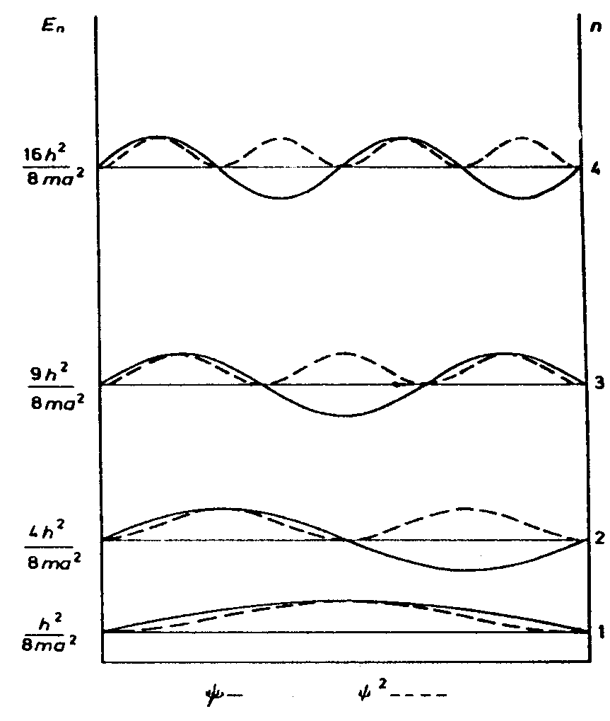
Particle in a One-Dimensional Box
Energy and wave function of a particle in a box
For a particle moving in a one dimensional box, we have shown that
and
We noticed from the graph that:
$$ψ_{n}\left(x\right)=\sqrt{\frac{2}{a}}\sin\left(\frac{nπx}{a}\right)$$
$$E_{n}= \frac{n^{2}h^{2}}{8ma^{2}}$$
Both $ψ$and $ψ$² take zero at the same certain points. These points are called nodes. At the nodes, the wave function of the particle vanishes and there is zero probability of finding the particle. The number of nodes for a given value of $n$ equals ($n −1$) and the number of nodes increases as then value of $n$ increases. This is in consistence with the de Broglie hypothesis ($λ=h/p$). As the kinetic energy increases the wave length decreases and the number of nodes increases.

Slide 24
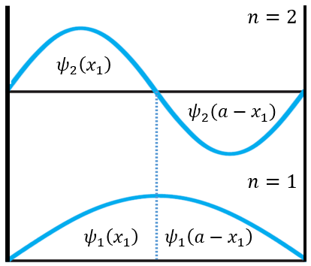
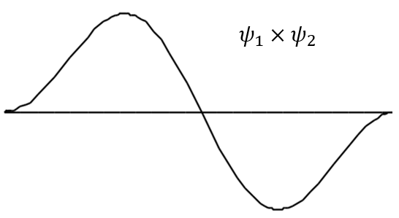
Particle in a One-Dimensional Box
The highest probability of finding the particle is in the middle of the distance between two nodes. The highest probability of finding the particle for $n=1$is at $a/2$, and for $n=2$is at $a/4$ and $3a/4$, and so on.
The orthogonality of the wave functions is clear. From the figure we can see that
$$ψ_{1}\left(x_{1}\right)=ψ_{1}\left(a−x_{1}\right)$$
$$ψ_{2}\left(x_{1}\right)={−ψ}_{2}\left(a−x_{1}\right)$$
$$ψ_{1}\left(x_{1}\right) ψ_{2}\left(x_{1}\right)={−ψ_{1}\left(a−x_{1}\right)ψ}_{2}\left(a−x_{1}\right)$$
The integration over all values of $x$ for the two equations between $x=0$ and $x=a/2$is equal but different in sign for the same integral between $x=a/2$and $x=a$. This means that the integration$\int{ψ_{1}ψ_{2}dτ=0 }$ is equal to zero.
$$⇓$$

Slide 25
Particle in a One-Dimensional Box
$E_{n}$ is inversely proportional to $a^{2}$and $m$: as the mass of the particle and or the size of the box get smaller the higher the energy of the particle.
Correspondence principle
“classical mechanics emerges from quantum mechanics at high quantum numbers.”
Note that in the particle in one dimensional box problem when the size of the box becomes very large or when the mass of the particle gets very large, the quantity $a^{2}m$ becomes very large compared to $n^{2}h^{2}$($a^{2}m≫n^{2}h^{2}$) and the energy of the system becomes continuum and we go back from quantum physics to classical physics.
This is always the case. When sizes get larger, the quantum physics problem converges with classical physics. This is called the correspondence principle. So it might be said that the classical physics laws are special case of quantum chemistry laws.

Slide 26
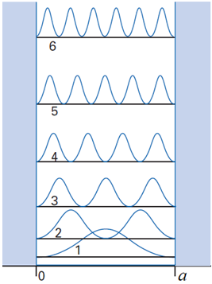
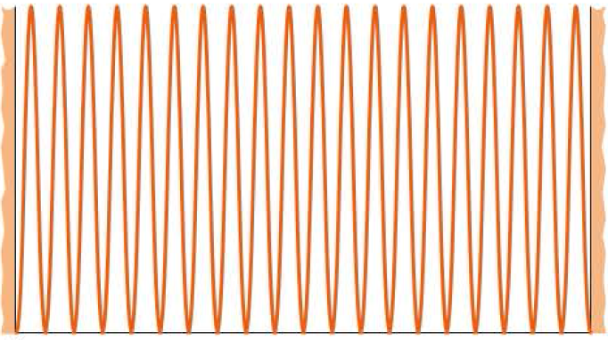
Particle in a One-Dimensional Box
Correspondence principle
The most probable position of the particle is near the center of the box for the $n=1$ state but that the probability density becomes more uniformly distributed as $n$ increases.
The probability density for higher energy levels (e.g. at $n=20$) is fairly uniformly distributed from 0 to $a$. the particle tends to behave classically in the limit of
large quantum numbers $n$ (as $n → ∞$each position is equally probable).
$${|ψ_{20}\left(x\right)|}^{2}$$
$$x →$$
The probability distribution of a particle in a box.
$$0 a$$
$$x →$$

Slide 27
Particle in a One-Dimensional Box
Example:
The wave function for a particle moving in a one-dimensional box of length $a$is given by
$$ψ\left(x\right)=\sqrt{\frac{2}{a}}\sin\left(\frac{nπx}{a}\right)$$
Calculate the probability that a particle is found between 0 and $a$ /2.
Solution:
If we integrate the square of the wave function over a given volume we find the probability that the particle is in that volume.
The probability that the particle is found between 0 and $a$ /2 is
$$\int_{0}^{\frac{a}{2}}{ψ^{∗}\left(x\right)ψ\left(x\right) dx=} \frac{2}{a}\int_{0}^{\frac{a}{2}}{\sin^{2}\frac{nπx}{a}dx}$$
using integration
$$\int{\sin^{2} bx dx}= \frac{x}{2}−\frac{\sin{2bx}}{4b}$$

Slide 28
Particle in a One-Dimensional Box
$$\int_{0}^{\frac{a}{2}}{ψ^{∗}\left(x\right)ψ\left(x\right) dx=}\frac{2}{a}{\left[\frac{x}{2}−\frac{sin\left(\frac{2nπ}{a}x\right)}{\frac{4nπ}{a}}\right]}_{0}^{\frac{a}{2}}$$
$$\int_{0}^{\frac{a}{2}}{ψ^{∗}\left(x\right)ψ\left(x\right) dx=}\frac{2}{a}{\left[\frac{x}{2}−\frac{a}{4nπ}sin\left(\frac{2nπ}{a}x\right)\right]}_{0}^{\frac{a}{2}}$$
$$=\frac{2}{a}\left[\left(\frac{a}{4}−\frac{a}{4nπ}sin nπ\right) −\left(\frac{0}{2}−\frac{a}{4nπ}sin 0\right)\right]$$
$$=\frac{2}{a}\left[\frac{a}{4}\right]=\frac{1}{2}$$
Thus, the probability that the particle found in the interval $0≤x≤a/2$ is one-half (50% of the time) which is physically reasonable.

Slide 29
Particle in a 1-D Box Model and the Real World
The particle in a box model can be applied to electrons moving freely ($π$ electrons) in a molecule.
Consider butadiene, H₂C=CH-CH=CH₂, which has four $π$ electrons.
Butadiene has an absorption band at 217 nm for the 1st $π→π^{∗}$ transition.
Although butadiene is not a linear molecule, we will assume for simplicity that the four $π$ electrons in butadiene move along a straight line.
The length of this straight line can be estimated as
2 C=C bond (2 x 135 pm) + C- C bond (154 pm) + the distance of a carbon atom radius at each end (2 x 77.0 pm= 154pm), giving a total distance of 578 pm (5.78 Å or 578 x 10⁻¹² m).
The allowed $π$ electronic energies are given by
$$E_{n}= \frac{n^{2}h^{2}}{8ma^{2}} n=1, 2, 3, …$$
$m$ is the electron mass.

Slide 30
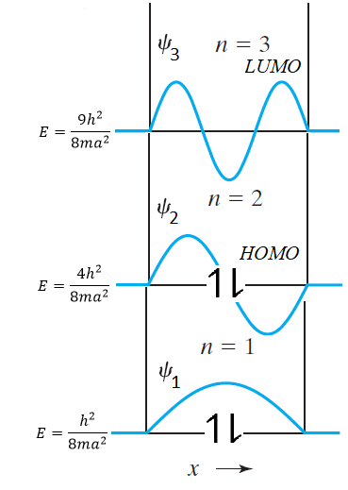
Particle in a 1-D Box Model and the Real World
According to the Pauli exclusion principle each energy level can hold only two electrons (with opposite spins), and so the four $π$ electrons fill the first two levels.
The first excited state of this system of four $π$ electrons is that which has one electron elevated from the $n=2$ state to the $n=3$ state. The energy needed to make a transition from the $n=2$ state to the $n=3$ state is
$$∆E=E_{LUMO}−E_{HOMO}$$
$$λ_{max}=\frac{hc}{∆E}$$
$$∆E= \frac{h^{2}}{8ma^{2}}(3^{2}−2^{2})$$
the mass $m$ of the electron is 9.109 x 10⁻³¹ kg, and the length of the box is taken to be 578 pm, or 578 x 10⁻¹² m.
$$remember that:$$
$1pm=1 ×{10}^{−12} m$
HOMO: Highest Occupied Molecular Orbital LUMO: Lowest Unoccupied Molecular Orbital

Slide 31
Particle in a 1-D Box Model and the Real World
$$∆E= \frac{{(6.626×{10}^{−34} J.s )}^{2} 5}{8(\text{9}\text{.}\text{109 }\text{x} \text{10}\text{−}\text{31 }\text{kg} ){(578×{10}^{−12} m )}^{2}}=\text{9}\text{.}\text{02 }\text{x} \text{10}\text{−}\text{19 }\text{J}$$
and
$$λ_{max}=\frac{(6.626×{10}^{−34} J.s )(\text{2}\text{.}\text{998}×{10}^{8} m/s )}{\text{9}\text{.}\text{02 }\text{x} \text{10}\text{−}\text{19 }\text{J} }$$
The causes of discrepancy between experimental value ($217 nm$) and calculated value ($220 nm$) is the approximations that have been made.
$$=2.20×{10}^{−7}m (or 220 nm)$$
$$remember that:$$
$1nm=1 ×{10}^{−9} m$

Slide 32
Postulates of Quantum Mechanics
Any theory is usually built on a number of postulates. A postulate is a theoretical assumption that has no prove but reasonable and found to be consistent with observation. A postulates can play a key rule in deriving the theory.
The following are some of the quantum mechanics postulates:
First postulate
The state of a system is fully described by its state function or wave function (often written as wavefunction) $ψ\left(r, t\right)$ that depends on the coordinates $\left(x, y, z\right)$ of the particle(s) and on time$\left(t\right)$.
For a system consisting of $N$ particles then this system can be fully described by a wave function $ψ$ which is given by
$ψ$ $≡ψ(q1, q2,q3, q4,…, q3N, t)$
where $q1, q2$, and $q3$ are the spatial coordinates ($x1, y1, z1$) for particle $1,\text{and} q4, q5\text{, }\text{and} q6 \text{are} \text{the} \text{spatial} \text{coordinates}\text{ (}x2, y2, z2\text{)} \text{for} \text{particle} \text{2 }\text{and} \text{so} \text{on}\text{. }\text{Whereas}$ $t$ is the time.

Slide 33
Postulates of Quantum Mechanics
When the function $ψ$ is independent of time the function is said to be stationary wave function. Fortunately, many applications of quantum mechanics to chemistry use stationary wavefunction.
The probability of finding particle lies in the volume element $dτ$, where $dτ$ refers to the region between $x$ and $x+dx$ , $y$ and $y+dy$, and $z$ and $z+dz$is given by
$ψ^{∗}ψ$ $dτ$
Now, because the particle has to be found some where in space, we must have
$$\int{ψ^{∗}ψ dτ}=1$$
The notation "all space" here means that we integrate over all possible values of $x,y$, and $z$.
The quantity $ψ^{∗}ψ$ is called the probability density.
$$all space$$

Slide 34
Postulates of Quantum Mechanics
There are requirements for a wave function to be acceptable. These requirements are:
The wave function must be single valued since a particle can be found in one space at a given time.
The wave function and its first derivative must be continuous since a particle can not transfer from one space to another without passing in the path connecting them.
The wave function must be finite.
The wave function must be quadratically integrable.
The wave function that fulfil these requirements is said to be well behaved wave function.

Slide 35
Postulates of Quantum Mechanics
Second postulate
To every measurable physical property (observable) in classical mechanics there is a linear Hermitian operator in quantum. mechanics. The value of the physical property for a system can be found when the corresponding operator operates on its wave function.
The linear and Hermitian operator have been defined earlier when we discussed operators. However we add here that a Hermitian operator also fulfil these requirements:
$$\int^{0}{ψ^{∗}\hat{O}ψ dτ }=\int^{0}{ψ}{(\hat{O}ψ)}^{∗}dτ$$
and
$$\int^{0}{ψ_{i}^{∗}\hat{O}ψ_{j} dτ }=\int^{0}{ψ_{j}}{(\hat{O}ψ_{i})}^{∗}dτ$$
For all well behaved functions.
$$all space$$
$$all space$$
$$all space$$
$$all space$$

Slide 36
Postulates of Quantum Mechanics
Physical observables and their corresponding quantum operators.
Classical mechanics |  | Quantum mechanics
Name | Symbol | Symbol | Operation
Position | $$r$$ | $$\hat{r}$$ | Multiply by $r$
Linear momentum | $$P$$ | $$\hat{P}$$ | $$−iℏ (\hat{i}\frac{∂}{∂x}+\hat{j}\frac{∂}{∂y}+\hat{k}\frac{∂}{∂z})$$
Kinetic energy | $$T$$ | $$\hat{T}$$ | $$−\frac{ℏ^{2}}{2m} (\frac{∂^{2}}{{∂x}^{2}}+\frac{∂^{2}}{{∂y}^{2}}+\frac{∂^{2}}{{∂z}^{2}})$$
Potential energy | $$V(r)$$ | $$\hat{V}(r)$$ | Multiply by $V_{(r)}$
Total energy | $$E=T+V(r)$$ | $$\hat{H}= \hat{T}+ \hat{V}(r)$$ | $$−\frac{ℏ^{2}}{2m} \left(\frac{∂^{2}}{{∂x}^{2}}+\frac{∂^{2}}{{∂y}^{2}}+\frac{∂^{2}}{{∂z}^{2}}\right)+V(r)$$
Angular momentum | $$l_{x}$$ | $${\hat{l}}_{x}$$ | $$−iℏ (y\frac{∂}{∂z}−z\frac{∂}{∂y})$$
 | $$l_{y}$$ | $${\hat{l}}_{y}$$ | $$−iℏ (z\frac{∂}{∂x}−x\frac{∂}{∂z})$$
 | $$l_{z}$$ | $${\hat{l}}_{z}$$ | $$−iℏ (x\frac{∂}{∂y}−y\frac{∂}{∂x})$$

Slide 37
Postulates of Quantum Mechanics
How to derive an operator of a property?
To derive the operator of a physical property, follow the next steps:
Write the equation of the desired property using the classical physics laws in terms of the coordinates, momentum and time.
Leave time and coordinates with no change.
When using the cartesian coordinates, replace the momentum $P_{q}$ by the operator
Example:
If we want to calculate the kinetic energy of the system, the corresponding operator is $\hat{T}$ and from classical physics we have

Slide 38
Postulates of Quantum Mechanics
Now, we make the replacement
Likewise
and
And substitution in the operator of the kinetic energy, we get
The operator $∇^{2}$is called the Laplacian operator (read as “del squared”).
$∇^{2}≡$ $\left(\frac{∂2}{∂x2}+ \frac{∂2}{∂y2}+\frac{∂2}{∂z2}\right)$

Slide 39
Postulates of Quantum Mechanics
Third postulate
If $ψ$is an eigenfunction of the operator $\hat{O}$, then in any measurement of the observable associated with the operator $\hat{O}$, the only values that will ever be observed are the eigenvalues $as$, which satisfy the eigenvalue equation
$$\hat{O}ψ_{s}=asψ_{s}$$
Fourth postulate
If $ψ$is not an eigenfunction of the operator $\hat{O}$, we still can calculate the average or expected value of that property using the relation
$expected value=\left\langle \hat{O}\right\rangle =$
If the wave function $ψ_{s}$is a normalized , then the average value of the observable corresponding to $\hat{O}$ is given by
$$\left\langle \hat{O}\right\rangle =\int{ψ_{s}^{∗}}\hat{O }ψ_{s} dτ$$
$$\frac{\int{ψ_{s}^{∗}}\hat{O }ψ_{s} dτ}{\int{ψ_{s}^{∗}ψ_{s}} dτ}$$

Slide 40
Applications of Postulates of Quantum Mechanics
Lets, for example, operate on the wave function for the particle in one dimensional box by the operator of the linear momentum in the $x$ direction, ${\hat{P}}_{x}$
It is clear that the function here is not an eigenfunction of the operator ${\hat{P}}_{x}$.
What if we operate by ${\hat{P}}_{x}^{2}$?
$${\hat{P}}_{x} ψ_{n}=− ℏ \frac{d}{dx}\left[\sqrt{\frac{2}{a}}\sin\left(\frac{nπx}{a}\right)\right]$$
$$=− ℏ\sqrt{\frac{2}{a}}\left(\frac{nπ}{a}\right)\cos\left(\frac{nπx}{a}\right)$$

Slide 41
Applications of Postulates of Quantum Mechanics
$${\hat{P}}_{x}^{2} ψ_{n}=− ℏ \frac{d^{2}}{{dx}^{2}} \left[\sqrt{\frac{2}{a}}\sin\left(\frac{nπx}{a}\right)\right]$$
$$=− ℏ\sqrt{\frac{2}{a}}\left(\frac{nπ}{a}\right) \frac{d}{d_{x}}\left[\cos\left(\frac{nπx}{a}\right)\right]$$
$$= ℏ\sqrt{\frac{2}{a}} {\left(\frac{nπ}{a}\right)}^{2}\sin\left(\frac{nπx}{a}\right)$$
$${\hat{P}}_{x}^{2} ψ_{n}= ℏ{\left(\frac{nπ}{a}\right)}^{2}ψ_{n}= \frac{n2π2ℏ2}{a2}ψ_{n}$$
It is clear that the function $ψ_{n}$ is an eigenfunction of the operator ${\hat{P}}_{x}^{2}$ and the eigenvalue is $\frac{n2π2ℏ2}{a2}$.

Slide 42
Applications of Postulates of Quantum Mechanics
Because the function $ψ_{n}$ is not an eigenfunction of the operator ${\hat{P}}_{x}$, we can calculate the expected value of ${\hat{P}}_{x}$ as the fourth postulate states.
Using the relation
$$\frac{\int{ψ_{n}^{∗}}{\hat{P}}_{x} ψ_{n} dτ}{\int{ψ_{n}^{∗}}ψ_{n} dτ}=\int{ψ_{n}^{∗}}{\hat{P}}_{x}ψ_{n} dτ$$
$$\left\langle {\hat{P}}_{x}\right\rangle =$$

Slide 43
Applications of Postulates of Quantum Mechanics
$$⇒$$
Therefore, the expectation value of ${\hat{P}}_{x}$ is zero.
It was found from the early discussion that:
Taking the square root of this equation gives
Thus for a large number of measurements of ${\hat{P}}_{x}$, we will have half of the results with ${\hat{P}}_{x}=nπℏ/a$, and the other half with ${\hat{P}}_{x}=−nπℏ/a$. Therefore, the average value of the results will be zero.

Slide 44
Particle in a Three-Dimensional Box
The importance of the particle in a 3-D box model arises from the idea that it shows the technique used to solve Schrodinger equation when it is a function of more than one variable.
This technique is called the separation of variables in which the total equation is separated into as many equations as there variables.
For the particle in three dimensional box, the wave function is a function of the three variables $x, y$and $z$
$$ψ=ψ(x,y,z)$$
Using the separation of variables technique, This equation can be divided into three equations, equation for each variable, and the original equation will be the product of these three equations.
$$ψ\left(x,y,z\right)= ψ\left(x\right)ψ\left(y\right)ψ\left(z\right)$$
The solution of the equation of each variable can be found separately, and the solution of the original equation can then be found.

Slide 45
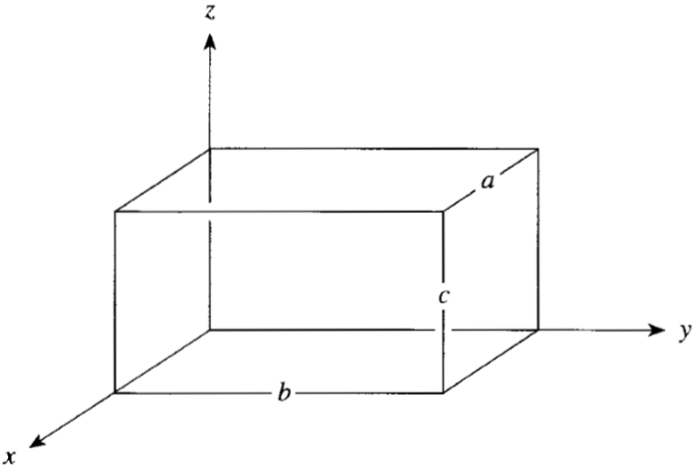
Particle in a Three-Dimensional Box
For the particle in three dimensional box, suppose we have a particle of mass $m$ moving inside a box of dimensions $a, b$and $c$.
The potential energy inside the box is zero and infinity any where else outside the box. In this case, the particle is confined to lie within a box.
The potential term can be treated by boundary conditions (i.e., infinite potential implies that the wavefunction must be zero there).
$$V\left(x,y,z\right)=0 in the region \left\{\begin{aligned}0<x<a \\ 0<y<b \\ 0<z<c\end{aligned}\right.$$
$$V\left(x,y,z\right)=∞ outside the box$$

Slide 46
Particle in a Three-Dimensional Box
Now, we want to solve the Schrodinger equation for this system
$$\hat{H}ψ=Eψ$$
Note that solving the Schrödinger equation means finding the right form of the Hamiltonian ($\hat{H}$), the wave function ($ψ$) and the energy ($E$) of the system.
We know that when the potential energy is zero, the Hamiltonian in three dimensions $x, y$and $z$ is given by
Now the equation we want to solve would be

Slide 47
Particle in a Three-Dimensional Box
To solve this equation, we use the separation of variables technique. We will try to make the function $ψ\left(x,y,z\right)$a product of three functions $X\left(x\right), Y\left(y\right),$ and $Z\left(z\right)$ where each function of the three functions is a function of only one variable that is separate of the other two variables.
$$ψ\left(x,y,z\right)=X\left(x\right)Y\left(y\right)Z\left(z\right)=XYZ$$
Now, because $X$ is independent of $y$ and $z$, we can write
$$\frac{dψ}{dx}=YZ\frac{dX}{dx}$$
and
$$\frac{d^{2}ψ}{{dx}^{2}}=YZ\frac{d^{2}X}{{dx}^{2}}$$

Slide 48
Particle in a Three-Dimensional Box
Likewise, we can write
$$\frac{d^{2}ψ}{{dy}^{2}}=XZ\frac{d^{2}Y}{{dy}^{2}} and \frac{d^{2}ψ}{{dz}^{2}}=XY\frac{d^{2}Z}{{dz}^{2}}$$
when we substitute by this into the total equation, we get
$$−\frac{h^{2}}{8π^{2}m}\left[YZ\frac{d^{2}X}{{dx}^{2}}+XZ\frac{d^{2}Y}{{dy}^{2}}+XY\frac{d^{2}Z}{{dz}^{2}}\right]=E XYZ$$
If we divide both sides be $XYZ$, we get
$$−\frac{h^{2}}{8π^{2}m}\left[\frac{1}{X}\frac{d^{2}X}{{dx}^{2}}+\frac{1}{Y}\frac{d^{2}Y}{{dy}^{2}}+\frac{1}{Z}\frac{d^{2}Z}{{dz}^{2}}\right]=E$$
We note that each one of the three terms inside the square brackets depends only on one variable and totally independent of the other two.
If the particle moves only on the coordinate $x$, then the energy of the other two directions is constant and we can solve for the energy in the $x$ direction ($Ex$).

Slide 49
Particle in a Three-Dimensional Box
In this case we can write
$$−\frac{h^{2}}{8π^{2}m}\frac{1}{X}\frac{d^{2}X}{{dx}^{2}}=E_{x}$$
Similarly, when the particle is moving in the other directions $y$ or $z$.
$$−\frac{h^{2}}{8π^{2}m}\frac{1}{Y}\frac{d^{2}Y}{{dy}^{2}}=E_{y} and −\frac{h^{2}}{8π^{2}m}\frac{1}{Z}\frac{d^{2}Z}{{dz}^{2}}=E_{z}$$
It is also clear that
$$E=E_{x}+E_{y}+E_{z}$$
Now, we can solve each equation of the above three equations separately.
If we start with the equation in the x direction, it can be written in the form
$$−\frac{h^{2}}{8π^{2}m}\frac{d^{2}X}{{dx}^{2}}=E_{x}X$$

Slide 50
Particle in a Three-Dimensional Box
The previous equation is just similar to the equation of a particle in one dimensional box, therefore, the solution is known and given by
$$X=\sqrt{\frac{2}{a}} sin\left(\frac{n_{x}πx}{a}\right) and E_{x}=\frac{n_{x}^{2}h^{2}}{8ma^{2}}{, n}_{x}=1, 2, 3,…$$
Likewise,
$$Y=\sqrt{\frac{2}{a}} sin\left(\frac{n_{y}πy}{a}\right) and E_{y}=\frac{n_{y}^{2}h^{2}}{8ma^{2}}{, n}_{y}=1, 2, 3,…$$
and
$$Z=\sqrt{\frac{2}{a}} sin\left(\frac{n_{z}πz}{a}\right) and E_{z}=\frac{n_{z}^{2}h^{2}}{8ma^{2}}{, n}_{z}=1, 2, 3,…$$

Slide 51
Particle in a Three-Dimensional Box
The total wave function equation is then given as
$$ψ(x,y,z)=\sqrt{\frac{8}{abc}}\sin\left(\frac{n_{x}πx}{a}\right)\sin\left(\frac{n_{y}πy}{b}\right)\left\{\begin{aligned}n_{x}=1, 2, 3,… \\ n_{y}=1, 2, 3,… \\ n_{z}=1, 2, 3,…\end{aligned}\right.$$
The total energy is given as
$$E_{n_{x}n_{y}n_{z}}=\frac{h^{2}}{8m}\left(\frac{n_{x}^{2}}{a^{2}}+\frac{n_{y}^{2}}{b^{2}}+\frac{n_{z}^{2}}{c^{2}}\right)\left\{\begin{aligned}n_{x}=1, 2, 3,… \\ n_{y}=1, 2, 3,… \\ n_{z}=1, 2, 3,…\end{aligned}\right.$$
For the case of a cubic box $a=b=c$, the total energy is give by
$$E_{n_{x}n_{y}n_{z}}=\frac{h^{2}}{8ma^{2}}\left(n_{x}^{2}+n_{y}^{2}+n_{z}^{2}\right)$$

Slide 52
Particle in a Three-Dimensional Box
Notice the following:
1. For a cubic box where ($a=b=c$), if $n_{x}=n_{y}=n_{z}=1$ then,
$$E_{111}=\frac{h^{2}}{8ma^{2}}$$
And this is called the zero point energy for the particle in a cubic box. This level, $E_{111}$, is said to be nondegenerate.
2. Each function $X, Y, and Z$ is normalized and so is the total function.
$$\int{ψ^{∗}ψ dτ=\int_{0}^{a}{\int_{0}^{b}{\int_{0}^{c}{X^{2}Y^{2}Z^{2}ⅆxⅆyⅆz}}}}$$
$$=\int_{0}^{a}{X^{2}ⅆx\int_{0}^{b}{Y^{2}ⅆy\int_{0}^{c}{Z^{2}ⅆz}}}=1·1·1=1$$
3. The three states $E_{112},E_{121}$, and $E_{211}$are equal in energy
$$E_{112}=E_{121}=E_{211}=\frac{6h^{2}}{8ma^{2}}$$
$$all space$$

Slide 53
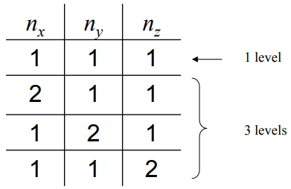
Particle in a Three-Dimensional Box
This means that it is possible to have different states with different quantum numbers taking the same energy. This is what is called degeneracy. Some other examples are:
$$E_{113}=E_{131}=E_{311}=\frac{11h^{2}}{8ma^{2}}$$
$$E_{221}=E_{212}=E_{122}=\frac{9h^{2}}{8ma^{2}}$$
Degeneracy – different wave functions with the same energy.
Reflects symmetry of the box.
When $a = b = c$, the lowest levels have the following degeneracy factors:

Slide 54
Particle in a Three-Dimensional Box
Example: Calculate the expectation value of the linear momentum along the direction of y-axis $\left\langle p_{y}\right\rangle$ for a particle in a three dimensional box with sides of lengths $a, b,$and $c$.
Solution:
The expected value of linear momentum in the y direction, can be estimated using the equation
$$\left\langle p_{y}\right\rangle =\frac{\int{ψ_{s}^{∗}}\hat{O }ψ_{s} dτ}{\int{ψ_{s}^{∗}ψ_{s}} dτ}$$
And since the wave function for a particle in 3-D box, $ψ\left(x,y,z\right),$ and $X, Y,$and $Z$ functions are normalized, then
$$\left\langle p_{y}\right\rangle = \int_{0}^{a}{X^{∗}X dx}\int_{0}^{b}{Y^{∗}Y dy}\int_{0}^{c}{Z^{∗}Z dz}$$
$$= \int_{0}^{b}{Y^{∗}Y dy}$$
It turns out to be a problem for a particle in a one dimensional box, and we can prove that $\left\langle p_{y}\right\rangle =0$ (see slides 42-43).

Slide 55
Particle in a Three-Dimensional Box
Example: Consider an electron in superfluid helium ($4He$) where it forms a solvation cavity with a radius of 18 $Å$. Calculate the zero-point energy and the energy difference between the ground and first excited states by approximating the electron by a particle in a 3-dimensional box.
Solution: The zero-point energy can be obtained from the lowest state energy (e.g. $n = 1$) with $a=b=c=36 Å$. The first excited state is triply degenerate ($E112,E121 and E211$).
$$E_{111}=\frac{h^{2}}{8m}\left(\frac{n_{x}^{2}}{a^{2}}+\frac{n_{y}^{2}}{b^{2}}+\frac{n_{z}^{2}}{c^{2}}\right)$$
$$=\frac{{\left(6.626×{10}^{−34} Js\right)}^{2}}{8\left(9.109×{10}^{−31}Kg\right)}×\left(\frac{1}{{\left(36×{10}^{−10} m\right)}^{2}}+\frac{1}{{\left(36×{10}^{−10} m\right)}^{2}}+\frac{1}{{\left(36×{10}^{−10} m\right)}^{2}}\right)$$
$$=1.39×{10}^{−20} J=87.0 meV$$
$$E_{211}=E_{121}=E_{112}$$
$$=\frac{{\left(6.626×{10}^{−34} Js\right)}^{2}}{8\left(9.109×{10}^{−31}Kg\right)}×\left(\frac{2^{2}}{{\left(36×{10}^{−10} m\right)}^{2}}+\frac{1^{2}}{{\left(36×{10}^{−10} m\right)}^{2}}+\frac{1^{2}}{{\left(36×{10}^{−10} m\right)}^{2}}\right)$$
$$=2.79×{10}^{−20} J=174 meV ⇒ ∆E=87meV$$
$$\left(Experimental value:105 meV;Phys. Rev. B 41, 6366 \left(1990\right)\right).$$
Undergraduate Quantum Chemistry by Jussi Eloranta (2018).

Slide 56
References
المراجع العربية:
الأزهري، عادل عباس و القحطاني عبدالله علي، أسس كيمياء الكم، الرياض: جامعة الملك سعود، إدارة النشر العملي والمطابع، 1425 هـ.
المبارك، راشد عبدالعزيز وخليل، معتصم إبراهيم. كيمياء الكم، الرياض، دار الخريجي للنشر والتوزيع، 1417 هـ.
English References:
McQuarrie, Donald A. “Quantum Chemistry.” 2nd Ed., University Science Books, Mill Valey, CA, 1983.
Levine, Ira N. “Quantum Chemistry.” 7th Ed., Pearson Education, 2014.
Atkins, P. W. “Molecular Quantum Mechanics.”, 2nd Ed., Oxford University Press. Oxford 1983.
Sherrill, C. D. “A Brief Review of Elementary Quantum Chemistry.” 2001
http://vergil.chemistry.gatech.edu/notes/quantrev/quantrev.html
Undergraduate Quantum Chemistry by Jussi Eloranta (2018).
Cockett, Martin; Doggett, Graham, “Maths for Chemists.” RSC publishing, 2012.
Cunningham, Allan; Whelan, Rory “Maths for Chemists.” University of Birmingham, University of Leeds 2014.

