Slide 1
CLINICAL ENZYMOLOGY
CLS 431

Slide 2
General properties
Enzymes are protein catalyst that increase the velocity of a chemical reaction.
Enzymes are not consumed during the reaction they catalyzed.
With the exception of catalytic RNA molecules, or ribozymes, enzymes are proteins.
In addition to being highly efficient, enzymes are also extremely selective catalysts.

Slide 3
General properties
As protein, each enzyme comprises a specific amino acid sequence leading to (primary, secondary, tertiary, and quaternary structure)
Active site → cavity where substrate interacts
  Often water-free site
  Reacts with charged amino acid residues
Allosteric site
  Another site on enzyme where co-factors or regulatory molecules interact

Slide 4
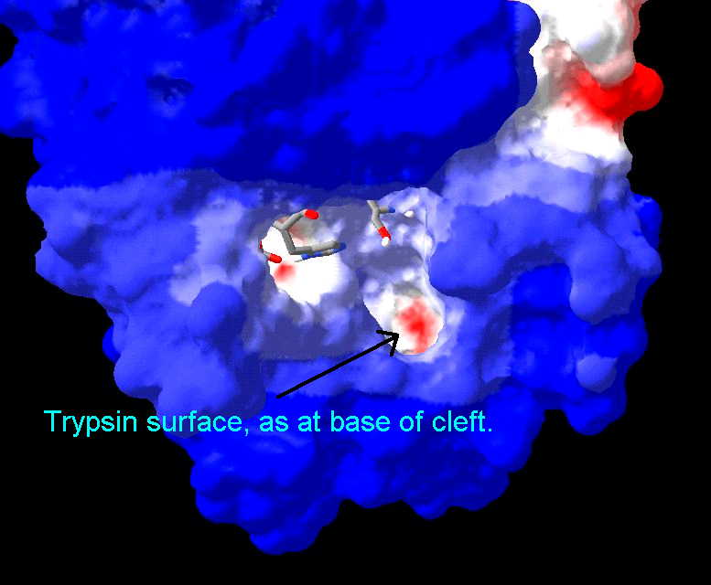
Active Site
Active site is a region in the enzyme that binds substrates and cofactors.
Takes the form of a cleft or pocket.
Takes up a relatively small part of the total volume of an enzyme.
Substrates are bound to enzymes by multiple weak attractions.
The specificity of binding depends on the precisely defined arrangement of atoms in an active site.
The active sites of multimeric enzymes are located at the interface between subunits and recruit residues from more than one monomer.

Slide 5
Active Site
Two models have been proposed to explain how an enzyme binds its substrate:
  lock-and –key model.
  Induced-fit model.

Slide 6
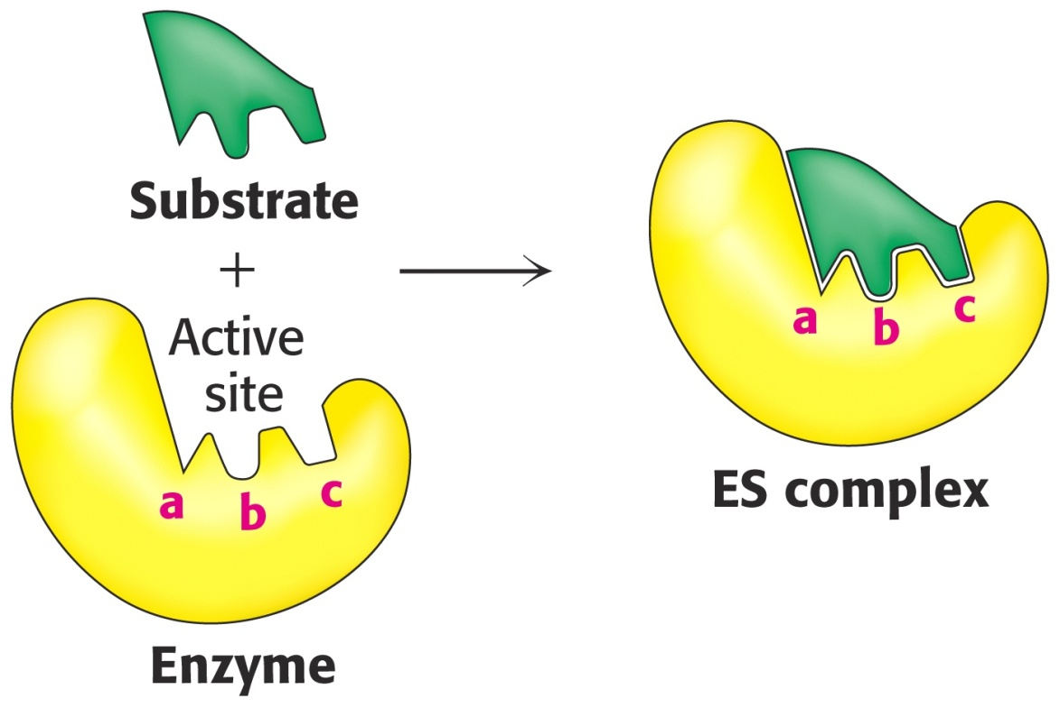
Lock & Key Model of Enzyme-Substrate Binding
In this model, the active site of the unbound enzyme is complementary in shape to the substrate.

Slide 7
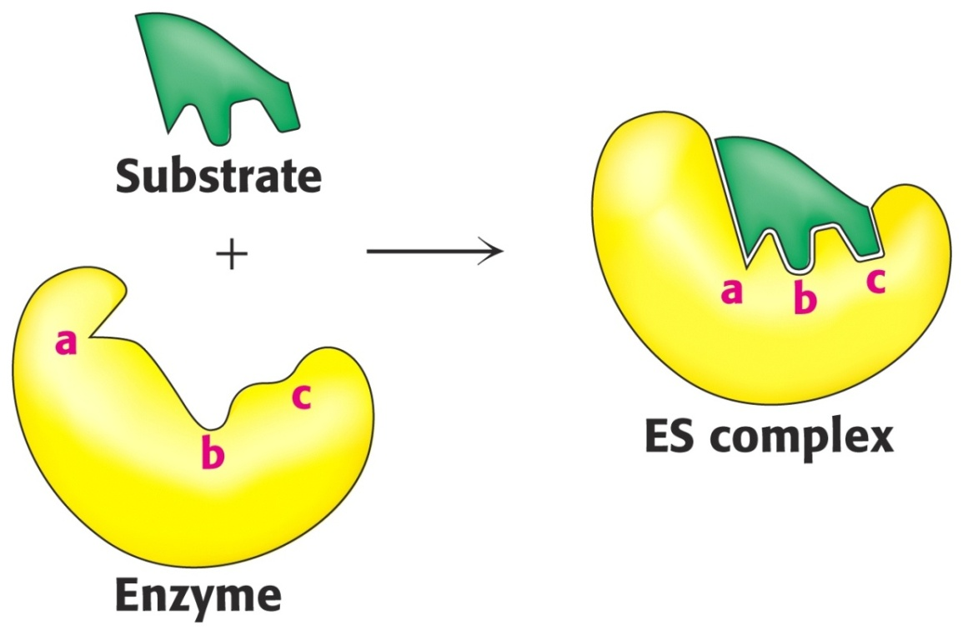
Induced-Fit Model of Enzyme-Substrate Binding
In this model, the enzyme changes shape on substrate binding.
The active site forms a shape complementary to the substrate only after the substrate has been bound.

Slide 8
Enzyme Specificity
In general, there are four distinct types of specificity:
Absolute specificity
The enzyme will catalyze only one reaction.
Group specificity
the enzyme will act only on molecules that have specific functional groups, such as amino, phosphate and methyl groups.
Linkage specificity
the enzyme will act on a particular type of chemical bond regardless of the rest of the molecular structure.
Stereo chemical specificity
the enzyme will act on a particular steric or optical isomer.

Slide 9
Absolute specificity
Is the highest degree of specificity.
The enzyme active site is recognized by a single substrate.
Example: Glucokinase catalyzes the conversion of glucose to glucose -6-phosphate

Slide 10
Group specificity
Enzyme active site can recognize many substrates , all belonging to same group of compounds.
Example:
Trypsin catalyzes the hydrolysis of peptide bond in several proteins.
Hexokinases act on six carbon sugars.

Slide 11
Reaction specificity
The enzyme catalyzes only one type of reaction
Example:
Oxidoreductases catalyze oxidation –reduction reactions

Slide 12
Optical specificity
Enzyme is stereospecific.
Is capable to differentiate between L- and D- isomers of a compound.
Example:
  L amino acid oxidase acts only on L-amino acid.
  α-glycosidase acts only on α-glycosidic bond which are present in starch and glycogen.
  β-glycosidase acts only on β -glycosidic bond that are present in cellulose.
  (think)***

Slide 13
Isoenzymes
Isoenzymes – are enzymes that differ in amino acid sequence but catalyze the same chemical reaction.
They have similar catalytic activity, but are different biochemically or immunologically.
Different forms may be differentiated from each other based on certain physical properties
  electrophoretic mobility,
  differences in absorption properties
  or by their reaction with a specific antibody

Slide 14
Classification of Enzymes
Class Reactions catalyzed
Oxidoreductases oxidation-reduction
Transferases transfer of moieties such as glycosyl, methyl, or phosphoryl groups
Hydrolases catalyze hydrolytic cleavage
Lyases add/remove atoms to/from a double bond
Isomerases geometric or structural changes within a molecule
Ligases joining together of two molecules coupled to the hydrolysis of ATP

Slide 15
https://www.khanacademy.org/test-prep/mcat/biomolecules/enzyme-structure-and-function/v/an-introduction-to-enzymes-and-catalysis

Slide 16
Coenzymes and Cofactors
Cofactors can be subdivided into two groups: metals and small organic molecules.
Cofactors that are small organic molecules are called coenzymes.
Most common cofactor are also metal ions.
If tightly bound, the cofactors are called prosthetic groups.
Loosely bound Cofactors serve functions similar to those of prosthetic groups but bind in a transient, dissociable manner either to the enzyme or to a substrate.

Slide 17
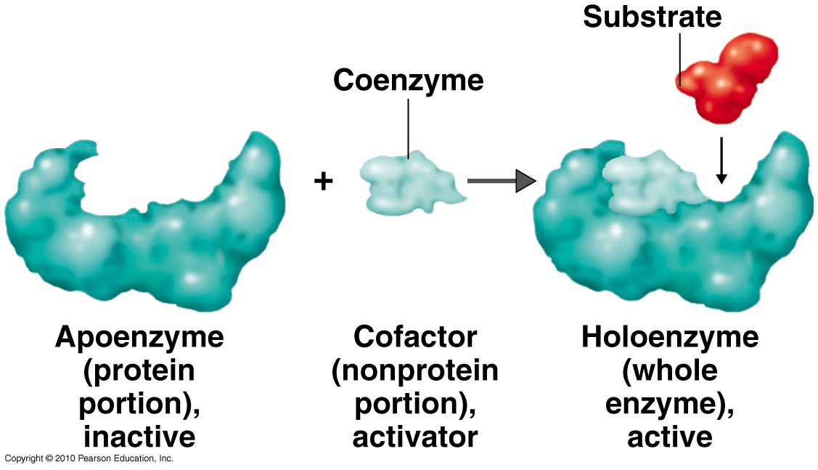
Coenzymes

Slide 18
Prosthetic group
Metals are the most common prosthetic groups.
Tightly integrated into the enzyme structure by covalent or non-covalent forces. e.g;
  Pyridoxal phosphate
  Flavin mononucleotide( FMN)
  Flavin adenine dinucleotide(FAD)
  Thiamin pyrophosphate (TPP)
  Biotin
  Metal ions – Co, Cu, Mg, Mn, Zn

Slide 19
Role of metal ions
Enzymes that contain tightly bound metal ions are termed – Metalloenzymes.
Enzymes that require metal ions as loosely bound cofactors are termed as metal-activated enzymes.
Metal ions facilitate
  Binding and orientation of the substrate.
  Formation of covalent bonds with reaction intermediates.
  Interact with substrate to render them more electrophilic or nucleophilic.

Slide 20
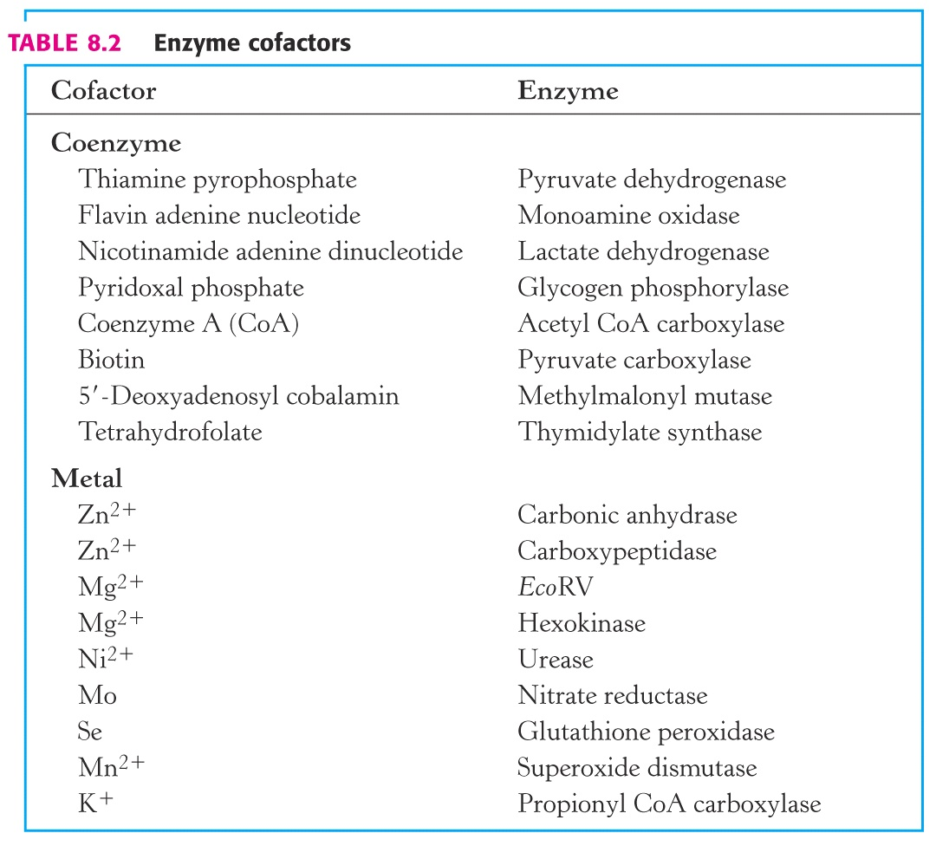

Slide 21
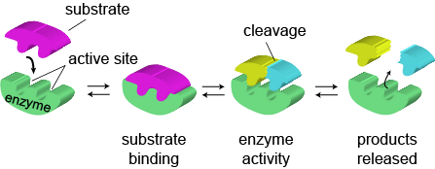
Mechanism of Action of Enzymes
How do enzymes catalyze?
The basic enzymatic reaction can be represented as follows
ES complex EX complex
http://www.wiley.com/college/pratt/0471393878/instructor/animations/enzyme_kinetics/index.html

Slide 22
How do enzymes increase the rate of reaction?
Enzymes increase reaction rates by decreasing the amount of energy required to form a complex of reactants that is competent to produce reaction products.
This complex is known as the activated state or transition state complex for the reaction.
Enzymes and other catalysts accelerate reactions by lowering the energy of the transition state.

Slide 23
Stabilization of the Transition State
The catalytic role of an enzyme is to reduce the energy barrier between substrate and transition state.
This is accomplished through the formation of an enzyme-substrate complex (ES).
This complex is converted to product by passing through a transition state (EX‡).
The energy of EX is lower than for X . Therefore, this decrease in energy partially explains the enzymes ability to accelerate the reaction rate.

Slide 24
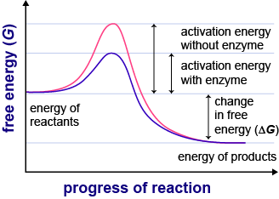

Slide 25
Mechanism of Enzymes Action
The combination formed by an enzyme and its substrates is called the enzyme–substrate complex.
When two substrates and one enzyme are involved, the complex is called a ternary complex;
one substrate and one enzyme are called a binary complex.
The substrates are attracted to the active site by electrostatic and hydrophobic forces, which are called noncovalent bonds because they are physical attractions and not chemical bonds

Slide 26
The mechanism of enzymes action can be explained by two perspectives
      Thermodynamic changes
      Processes at the active site

Slide 27
1) Thermodynamic changes
Enzymes accelerate reactions by lowering the free energy of activation
Enzymes do this by binding the transition state of the reaction better than the substrate
The lower activation energy means that more molecules have the required energy to reach the transition state.

Slide 28
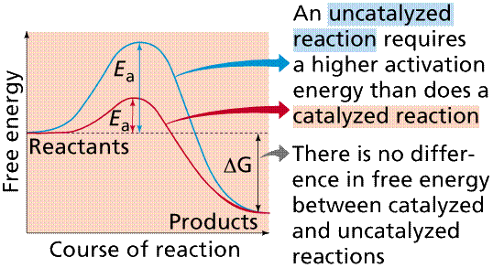

Slide 29
Free energy change
Standard free energy change ΔG (Gibbs free energy)→ is the energy difference in free energy between substrate and product.
ΔG º = G product – G substrate
ΔG º expresses the amount of energy capable of doing work during a reaction at constant temp. and pressure.
If free energy of substrate and product is same then ΔG° is zero. The reaction is said to be at equilibrium.
Given that ∆G’° for the reaction S⇋P is negative in the direction of S→P, reaction equilibrium favors the formation of P.

Slide 30
The addition of a catalyst to the reaction S⇋P would not affect the difference between the free energies of S and P in their ground states, therefore ∆G’° would not change.
The relationship between the equilibrium constant, Keq and ΔGº :-
ΔG º = -RT ln Keq
R : gas constant , ΔG°= -2.303 RT log Keq
T : absolute Temp (t + 273) →298k(c°)
Keq= [P][S]
Both ΔG°and Keq tell in which direction and how far a reaction will proceed when all substrates and products are 1M

Slide 31
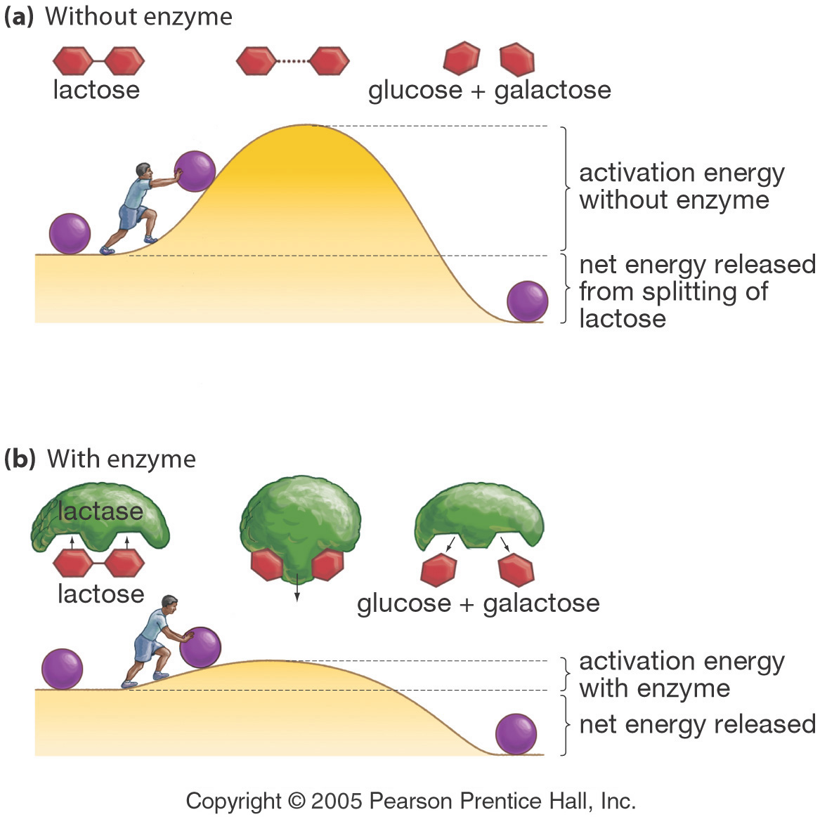
Effect of a Catalyst (enzymes) on Activation Energy

Slide 32
2) Processes at the active site
https://www.khanacademy.org/test-prep/mcat/chemical-processes/enzymes/v/an-introduction-to-enzymes-and-catalysis
Catalysis by proximity
When an enzyme binds substrate molecules at its active site, it creates a region of high local substrate concentration. Enzyme-substrate interactions orient reactive groups and bring them into proximity with one another.
Acid base catalysis
the ionizable functional groups of aminoacyl side chains of prosthetic groups contribute to catalysis by acting as acids or bases

Slide 33
Catalysis by strain
Enzymes that catalyze the lytic reactions involve breaking a covalent bond typically bind their substrates in a configuration slightly unfavorable for the bond that will undergo cleavage .
Covalent Catalysis
Involves the formation of a covalent bond between the enzyme and one or more substrates which introduces a new reaction pathway whose activation energy is lower

Slide 34
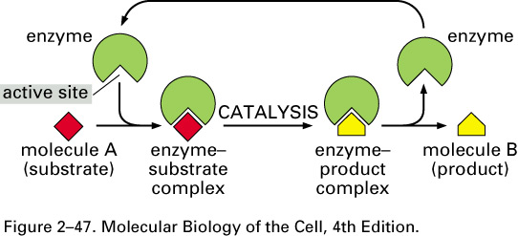
Enzyme Catalysis- overview

Slide 35
Enzyme Kinetics
Enzymes accelerate reactions by lowering the free energy of activation
Enzymes do this by binding the transition state of the reaction better than the substrate
Several terms to know:
rate or velocity
rate constant
rate law
order of a reaction

Slide 36
Michaelis Menten Kinetics

Slide 37
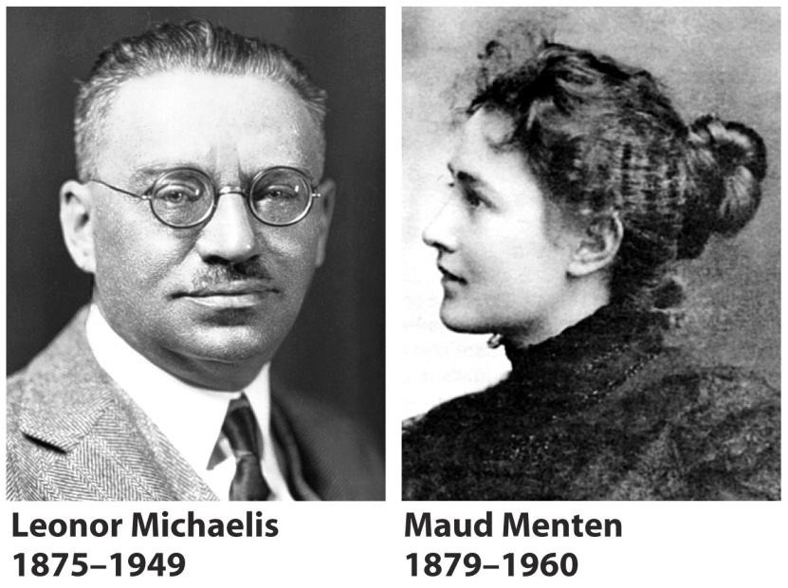
Leonor Michaelis and Maude Menten's theory
Assumes the formation of an enzyme-substrate complex
It assumes that the ES complex is in rapid equilibrium with free enzyme
Breakdown of ES to form products is assumed to be slower than
(1) formation of ES and
(2) breakdown of ES to reform E and S

Slide 38
Michaelis Menten equation
Michaelis and Menten proposed that the enzyme reversibly combines with its substrate to form an ES complex.
This complex subsequently breaks down to product, regenerating the free enzyme E.
k₁
k₋₁
k₂
E + S ES E + P
(k₋₂ is insignificant early in the reaction)
K1 is the rate constant of ES formation
k-1 is the rate constant of dissociation of ES back to E and S
K2 is the rate constant of dissociation of ES to E and P

Slide 39
k₁
k₋₁
k₂
E + S ES E + P
(k₋₂ is insignificant early in the reaction)
Rate of ES formation = k₁ [E][S] = k₁ ([E_{total}] - [ES]) [S]
Rate of ES breakdown = k₋₁ [ES] + k₂ [ES]
k₁ ([E_{total}] - [ES]) [S] = k₋₁ [ES] + k₂ [ES]
(steady state assumption)
Rate of ES formation = Rate of ES breakdown

Slide 40
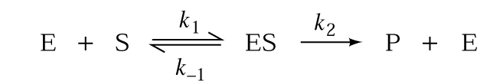
Michaelis Menten equation
The Michaelis Menten equation describes how reaction velocity varies with substrate concentration
V_{o} : Initial reaction velocity.
V_{max :} Maximum velocity
[S] : Substrate concentration.
K_{M} : Michaelis constant = (k₂ + k₋₁ )
___________
k₁
At saturation when [E_{total}] = [ES] ------→ V_{o} = V_{max}
V_{max}[S]
____________
K_{M} + [S]
V_{o} =

Slide 41
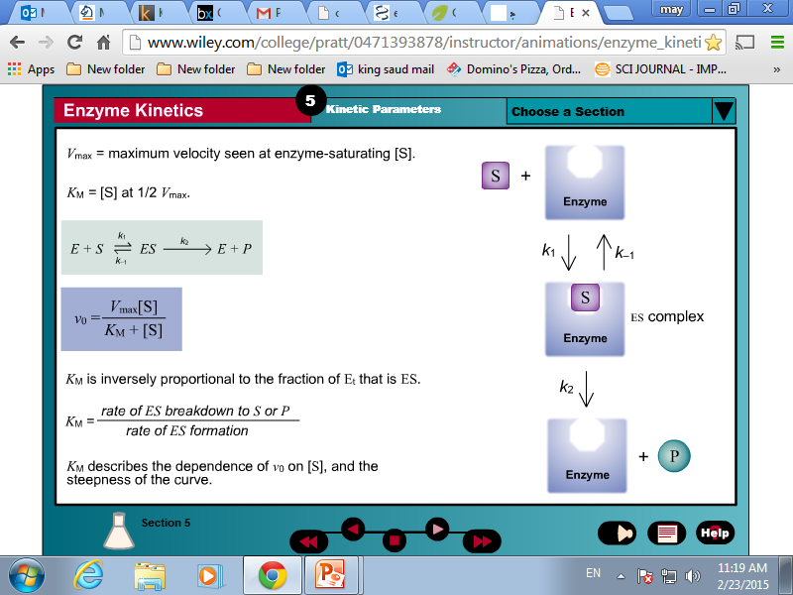

Slide 42
Understanding K_{m}
K_{m} is a constant that is characteristic of an enzyme and its particular substrate.
K_{m} reflects the affinity (estimate of the dissociation constant) of E from S.
K_{m} is numerically equal to the substrate concentration at which the reaction velocity is equal to ½ V_{max.}
K_{m} dose not vary with the concentration of enzyme. “think”
Small K_{m} means tight binding; high K_{m} means weak binding

Slide 43
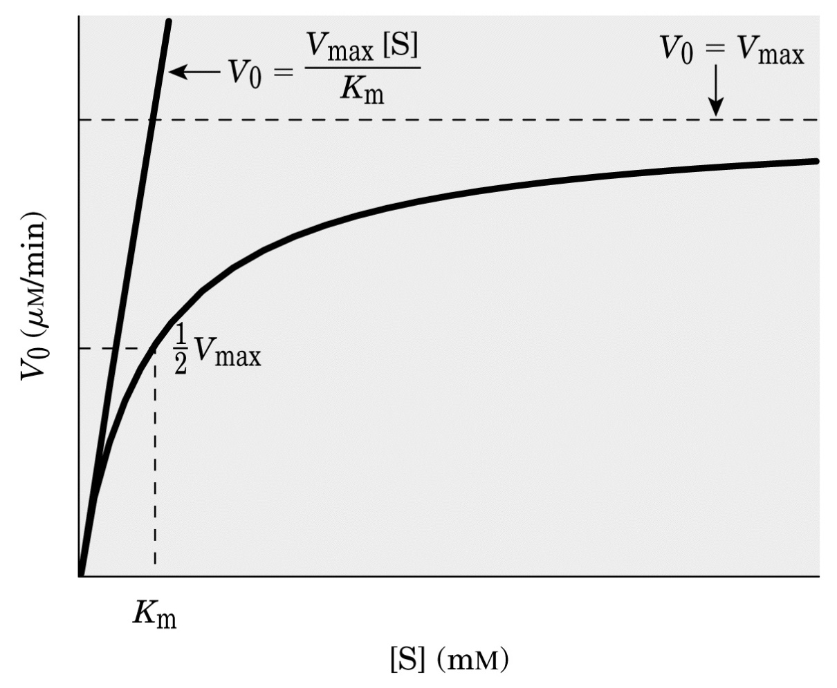
Enzyme Kinetics: Michaelis-Menton Equation
V_{max}[S]
V_{o} = ____________
K_{M} + [S]
K_{M} = [S]
when V_{o} = V_{max}
_____
2
Hyperbolic Michaelis–Menten plot
From Lehninger
Principles of Biochemistry

Slide 44
The following data were obtained in a study of an enzyme known to follow Michaelis Menten kinetics:
V₀ Substrate added
(mmol/min) (mmol/L)
—————————————
216 0.9
323 2
435 4
489 6
647 2,000
—————————————
Calculate the K_{m} for this enzyme.
K_{m} is the substrate concentration that corresponds to V_{max}
₂
Without graphing
V_{max} = 647
V_{max} /2 = 647 / 2 = 323.5
K_{m} = 2 mmol/L

Slide 45
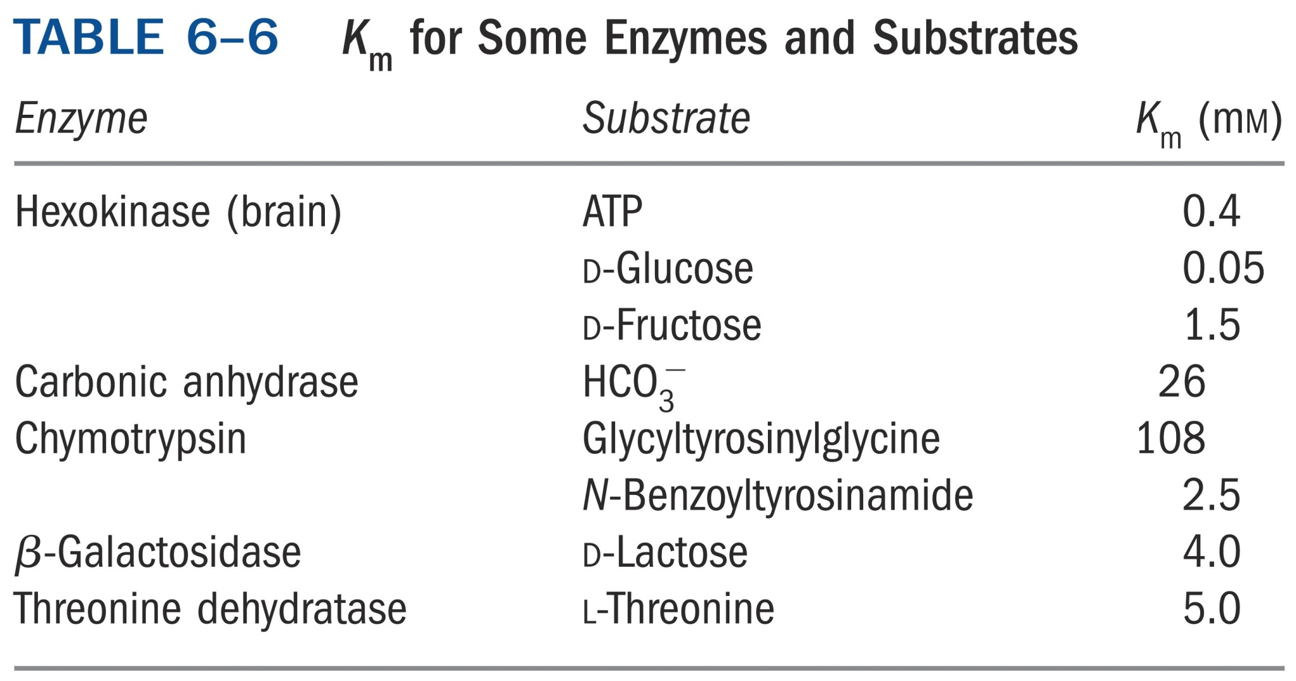

Slide 46
Understanding V_{max}
The theoretical maximal velocity
V_{max} is a constant
V_{max} is the theoretical maximal rate of the reaction - but it is NEVER achieved in reality
To reach V_{max} would require that ALL enzyme molecules are tightly bound with substrate
V_{max} is asymptotically approached as substrate is increased

Slide 47
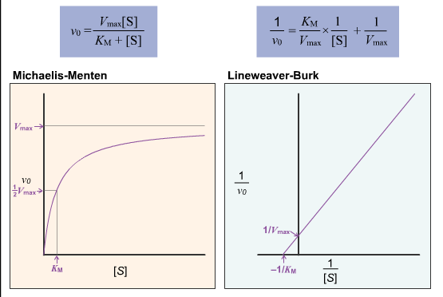
Lineweaver-Burk Plots
While computers can easily determine kinetic parameters from a hyperbolic Michaelis–Menten plot, these graphs are unwieldy for visually estimating values for V_{max} and K_{M}. For this purpose, the Michaelis–Menten equation can be rearranged to a linear equation with the form y = mx + b. The resulting plot is called a Lineweaver-Burk or double-reciprocal plot.
https://www.khanacademy.org/test-prep/mcat/biomolecules/enzyme-kinetics/v/enzymatic-inhibition-and-lineweaver-burke-plots

Slide 48
Clinical Enzymology
Measuring enzyme activity

Slide 49
Factors that influence enzymatic action
1- Substrate concentration
First Order Kinetics
Enzyme concentration exceeds substrate concentration
As substrate concentration increases , the reaction rate increases
The reaction rate is proportional to substrate concentration
This is not a good place to measure enzyme activity ( The reaction rate is dependent on substrate , not enzyme )
49

Slide 50
Zero Order Kinetics
Substrate concentration is in excess
Substrate “saturates” enzyme
All enzyme reacts with the excess substrate
The chemical reaction rate goes to maximum velocity
Reaction rate is dependent on enzyme activity [E]
Enzymes are not measured in terms of concentration , but activity
Zero Order conditions are suited for enzyme measurement because this is where the reaction rate is dependent on the enzyme’s ability to catalyze a chemical reaction

Slide 51
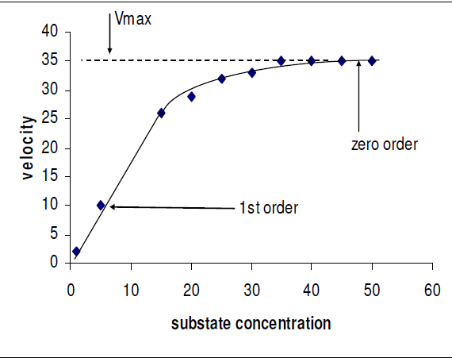
Relationship between substrate concentration and the reaction rate in a enzymatic reaction

Slide 52
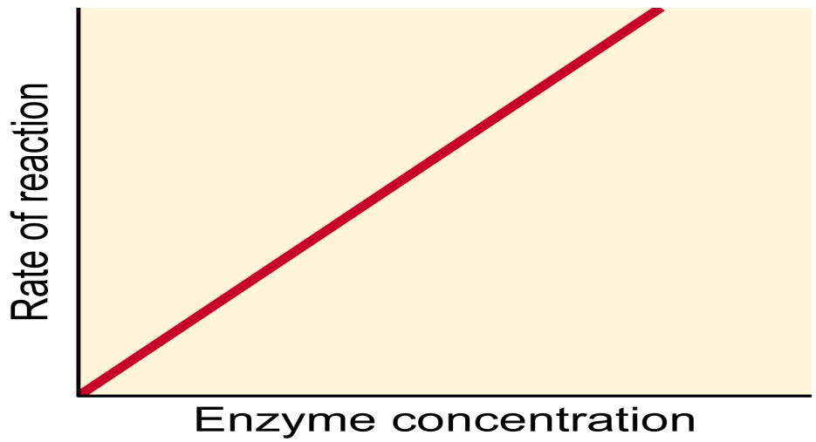
2- Enzyme “ concentration “
  Enzymes are not measured in terms of concentration
  Enzymes are measured is terms of their activity
  Enzyme activity = The rate at which an enzyme catalyzes a chemical reaction
  Increased activity is proportional to increased concentration
  Activity is measured under Zero Order conditions because this is where the reaction rate is dependent on the work ( activity ) of the enzyme

Slide 53
3- pH ( acidity )
  Enzymes are proteins and subject to changes in 3D structure from pH changes
  pH must be carefully controlled in enzymatic reactions
4- Temperature
  Reactions rates vary dramatically with temperature changes
  Reactions rates may double per 10°C increase in temperature
  Temperature must be defined and regulated for enzymatic reactions
  37°C is the common standardized temperature
5- Cofactors (non-protein substances needed for enzymatic activity )
  Activators ( Ca⁺² , Fe ⁺² , Mg ⁺² , Mn ⁺² , Zn ⁺² )
  Coenzymes ( Vitamins and nucleotide phosphates )
    Increased coenzyme concentration increases reaction rate

Slide 54
6- Inhibitors
  6.1Competitive Inhibitors
    Substances that bind at the enzyme’s active site
    Competes with substrate for the active site
    Addition of additional substrate increases the reaction rate
  6.2 Non – Competitive Inhibitors
    Substances that bind at an enzyme’s non – active site
    Enzymes 3D shape is altered, decreasing enzyme activity
    Addition of additional substrate has no effect on reaction rate
  6.3 Uncompetitive Inhibitors
    Substances that bind with enzyme – substrate complex

Slide 55
7- Coupled enzyme reactions
  Some enzyme testing utilizes other enzymatic reactions in a sequence of reactions.
  These other accessory enzymes are not being measured.
  Auxillary enzymes are used as reagents and added in excess so they do not become rate limiting factors in the overall process.
  All enzymatic reactions in a coupled assay must be performed at zero order kinetics.

Slide 56
https://www.youtube.com/watch?v=6cGdWi_DSGk
https://www.youtube.com/watch?v=FXWZr3mscUo&ebc=ANyPxKq40DhlpGfa1shcm0LCv_j4qxh2MUDITdZqWrGYl17OJ_4dhD8TOOV_51Aym6FM7TAt9MeJi1gmr_IFrgBDojZslR69VQ

Slide 57
  Measuring enzyme activity
  Enzymes are not directly measured
  Enzymes are commonly measured in terms of their catalytic activity
  We don’t measure the molecule ..We measure how much “work” it performs …(enzyme catalytic activity )
  The rate at which enzyme catalyzes the conversion of substrate to product
  The enzymatic activity is a reflection of its concentration
  Activity is proportional to concentration
  Enzyme activity can be tested by measuring
    Increase of product
    Decrease of substrate
    Decrease of co-enzyme
    Increase of altered co-enzyme
    If substrate and co-enzyme are in excess concentration, the reaction rate is controlled by the enzyme activity.

Slide 58
Enzyme assays
Enzyme assay – method to detect and quantitate the presence of an enzyme
  Often used to determine the purity of an enzyme
  Used to determine mechanism and kinetic parameters of a reaction
Features of a good assay
  Fast, convenient, and cost effective
  Quantitative, specific, and sensitive

Slide 59
Types of assays
Enzymatic reactions are measured in terms of the rate at which substrate is converted into product. This can be done in 2 different ways.
1. Fixed – Time Assay ( 2 Point )
    Zero Order Kinetics
    Substrate concentration is measured at set timed intervals to determine enzyme activity
    A slight delay from the beginning of the reaction to maximum velocity is the lag phase
    These times intervals may not be short enough to detect sudden changes
    Extreme elevations in enzyme activity may deplete the substrate between measured intervals - Substrate Depletion
    Substrate depletion causes falsely decreased activity results.

Slide 60
A Typical Enzyme Reaction
Linear phase
Lag phase

Slide 61
  2. Multipoint Continuous Monitoring ( Kinetic Assay )
    Continuous measurements of substrate – product concentration are recorded by the spectrophotometer of an automated analyzer
    Substrate depletion is detected because the analyzer is always “looking” and will see any sudden dramatic changes

Slide 62
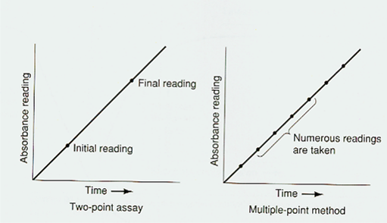
Comparison of 2 Point and Multipoint Enzyme Techniques

Slide 63
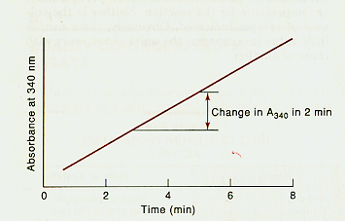
Enzyme Activity can be measured as a function of the change of absorbance values over a period of time
Remember that enzymes are measured in terms of “activity”
How much “work” is getting done? How fast are chemical reactions taking place?
A large change in absorbance per unit of time indicates that the reaction was occurring at a rapid rate, meaning that enzyme activity is high

Slide 64
Calculation of enzyme activity
  Remember, it’s not concentration – it’s activity
  Enzymes are measured in terms of how fast they convert substrate into product
  Activity is a measurement of how fast they work
  The common unit of enzyme activity is the International Unit (IU)
1 IU = That amount of enzyme that will convert 1 micromole (1 μmole ) of substrate to product per minute under defined conditions
  These “conditions” are such things as
    pH
    Temperature
    Substrate

Slide 65
  Mathematical expression of enzyme activity
    Δ A = The rate of change in Absorbance ( A ) of the substance being measured
    MIN = Time the reaction is measured
    TV = Total sample volume ( patient plasma + reagents )
    SV = Volume of patient plasma
    10⁶ = Conversion of moles into micromoles
    L = Length of the light path
    ε = Molar absorptivity

Slide 66
  Example of Molar Absorptivity calculation
    NADH ( a common co-enzyme ) absorbs light at 340 nm
    NAD ( the reduced form ) does not absorb light at 340 nm
    Increased ( or decreased ) NADH concentration in a solution will cause the Absorbance ( A ) to change.
    A 0.05 X 10-3 Molar NADH solution placed in a 1 cm light path has an absorbance of 0.311
The molar absorptivity of NADH is 6.22 x 103 Moles / Liter
Each chemical substance has it’s own unique molar absorptivity

Slide 67
Enzymes as reagents
  Enzymes are used as reagents in a wide variety of methodologies to measure other non-enzyme substances.
  Enzymes help to produce substances that can be easily measured.
  Enzyme specificity helps to eliminate interfering substances.
  If the enzyme is used as a reagent, we do not want the enzyme concentration to affect the chemical reaction to avoid this the enzyme is added in excess so that it cannot become a rate limiting factor.
67

Slide 68
Regulation of enzyme activity
Enzyme regulation
is the control of the rate of a reaction catalyzed by an enzyme by some effectors (e.g., inhibitors or activators) or by alteration of some condition (e.g., pH or ionic strength).

Slide 69
Five ways by which enzyme activity in the cell can be changed
Enzyme production – synthesis or degradation
Compartmentation – different metabolic pathways occur in different cell compartments
Activation and inhibition – by activators or inhibitors, for example feed back inhibition by one of products of the reaction
Post-translational modification – for example by phosphorylation, methylation, glycosylation
Localization to a different environment – from a reducing (cytoplasm) to an oxidizing (periplasm) environment, of high pH to a low pH, or low salinity to high salinity, high to low energy charge

Slide 70
2 Types of Regulation
Regulation of amount of enzyme made
  At the level of transcription = is RNA made?
  At the level of translation = is protein made?
  Slower process (minutes)
Regulation of enzyme activity
  After the protein is synthesized
  Posttranslational modification
  Very rapid process (seconds or less than a second)

Slide 71
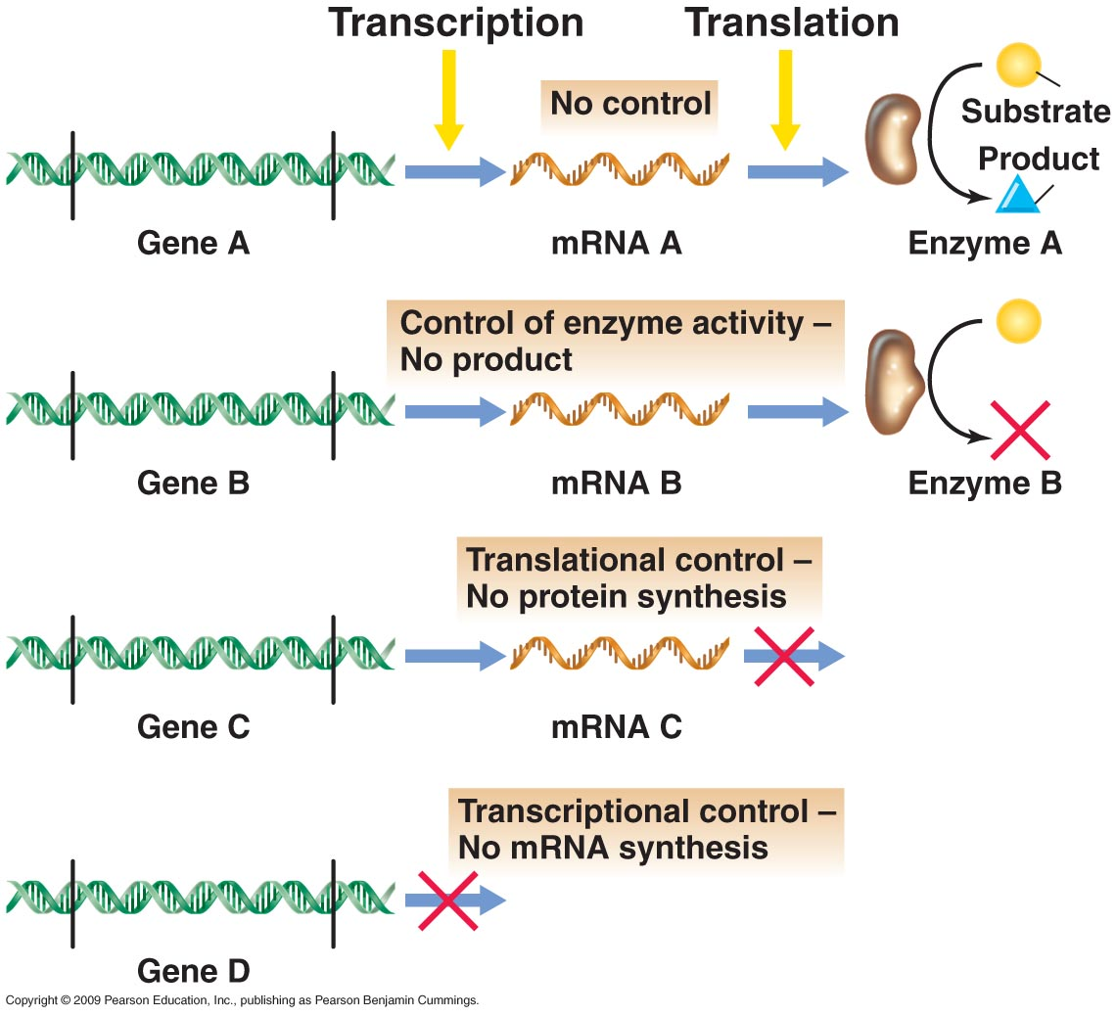
Mechanisms of Regulation

Slide 72
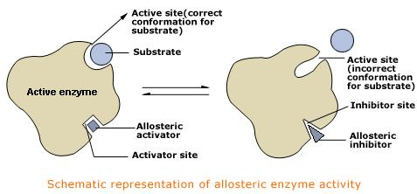

Slide 73
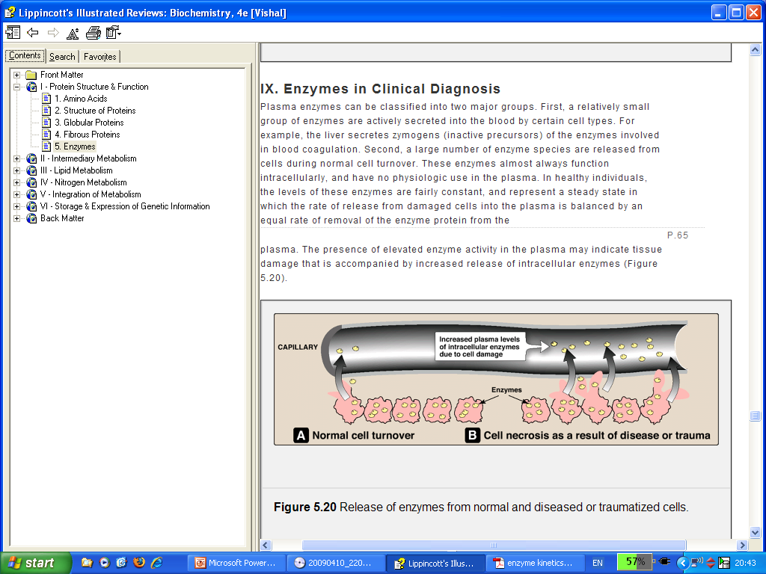
Diagnostic Enzymes
Tissue damage or necrosis resulting from injury or disease is generally accompanied by increases in the levels of several nonfunctional plasma enzymes.

Slide 74
Causes of increased enzyme serum levels
Increased release
  Necrosis of cell
  Increased permeability of cell without gross cellular damage
  Increased production of enzyme within the cell resulting in increase in serum by overflow
  Increase in tissue source of enzyme as in malignancy
Impaired disposition
  Increased levels in obstructive jaundice
  Increased levels in renal failure

Slide 75
Causes of Decreased enzyme serum levels
Decreased formation which may be
  Genetic
  Acquired
Enzyme inhibition
Lack of cofactors

Slide 76
Clinical Significance of enzyme estimation
Single or serial assay of serum activity of a selected enzyme :-
Helps in making the diagnosis/differential diagnosis/ early detection of a disease.
Helps in ascertaining prognosis of a disease.
Helps in ascertaining the response to drugs in a disease.
Also help in ascertaining the time course of disease.

Slide 77
Diagnostic Enzymes in different diseases:-
Enzyme estimations are helpful in the diagnosis of –
Myocardial Infarction
Liver diseases
Muscle diseases
Bone diseases
Cancers
GI Tract diseases

Slide 78
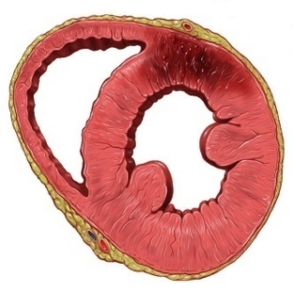
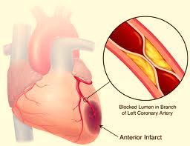
Diagnosis of Acute Myocardial Infarction (AMI):-
The diagnosis of AMI is usually predicated on the WHO criteria of chest pain, ECG changes, and increases in biochemical markers of myocardial injury.
Half of the patients with "typical" symptoms do not have AMI.
In contrast, biochemical markers have excellent sensitivity for diagnosing AMI.

Slide 79
Serum enzymes in Acute Myocardial Infarction
Enzyme assays routinely carried out for the diagnosis of Acute Myocardial Infarction are:-
Creatine Phosphokinase
Aspartate transaminase
Lactate dehydrogenase
Troponins
Myoglobin

Slide 80
1) Creatine Kinase (CK/ CPK)
Creatine + ATP phosphocreatine + ADP
(Phosphocreatine – serves as energy reserve during muscle contraction)
It is an enzyme found primarily in the heart and skeletal muscles, and to a lesser extent in the brain but not found at all in liver and kidney
Catalyzes the transfer of phosphate between creatine and ATP/ADP
Provides rapid regeneration of ATP when ATP is low

Slide 81
Creatine Kinase (CK/ CPK) Isoenzymes
There are three Isoenzymes.
Measuring them is of value in the presence of elevated levels of CK or CPK to determine the source of the elevation.
Each iso enzyme is a dimer composed of two promoters ‘M’ (for muscles) and ‘B’( for Brain).
These isoenzymes can be separated by Electrophoresis or by Ion exchange Chromatography.

Slide 82
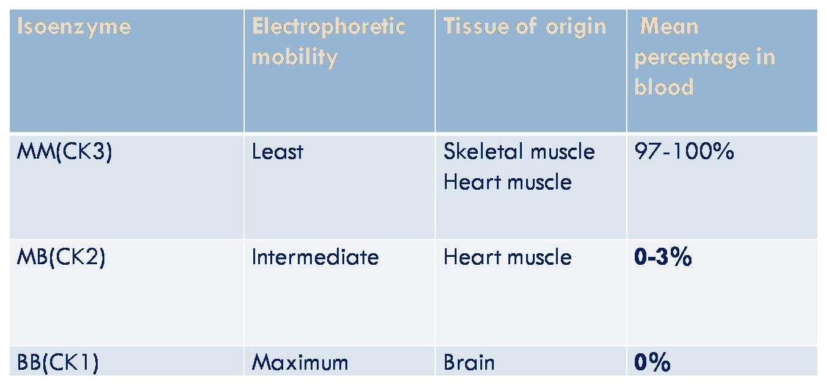
Creatine Kinase (CK/ CPK) Isoenzymes

Slide 83
Tissues Containing Highest Levels of CK
Skeletal muscle.
Cardiac muscle.
Brain.
Smooth muscle of the colon.
Small intestine.
Uterus.
Prostate.
Lungs.
Kidneys.

Slide 84
Diagnostic Applications
Total Serum CK
Normal:- 24 – 170 IU/L (women) 24 – 195 IU/L (men)
Mild or moderate elevation (2 – 4x normal)
  Hyper- or hypothermia
  Hypothyroidism
  After normal vaginal delivery – BB isoenzyme from myometrial contractions
  Reye’s syndrome

Slide 85
Creatine Kinase (CK/ CPK) Isoenzymes
Normal levels of CK/CPK are almost entirely MM, from skeletal muscle.
Elevated levels of CK/CPK resulting from acute myocardial infarction are about half MM and half MB.
Myocardial muscle is the only tissue that contains more than five percent of the total CK activity as the CK2 (MB) isoenzyme.

Slide 86
2) Aspartate amino Transferase (AST)
It is also called as Serum Glutamate Oxalo acetate Transaminase (SGOT).
The level is significantly elevated in Acute MI.
Normal Value:- 0-41 IU/L at 37°C
In acute MI- Serum activity rises sharply within the first 12 hours, with a peak level at 24 hours or over and returns to normal within 3-5 days.
The rise depends on the extent of infarction.

Slide 87
Aspartate amino Transferase (AST)
Prognostic significance
Levels> 350 IU/L are due to massive infarction (Fatal),
> 150 IU/L are associated with high mortality and levels,
< 50 IU/L are associated with low mortality.
Other diseases
The rise in activity is also observed in muscle and hepatic diseases. These can be well differentiated from simultaneous estimations of other enzyme activities like SGPT etc, which do not show and rise in activity in Acute MI.

Slide 88
3) Lactate dehydrogenase (LDH)
Lactate dehydrogenase catalyzes the reversible conversion of pyruvate and lactate.
Normal level :- 55-140 IU/L at 30°C.
The levels in the upper range are generally seen in children.
LDH level is 100 times more inside the RBCs than in plasma, and therefore minor amount of hemolysis results in false positive result.

Slide 89
In Acute MI
The serum activity rises within 12 to 24 hours, attains a peak at 48 hours (2 to 4 days) reaching about 1000 IU/L and then returns gradually to normal from 8th to 14th day.
The magnitude of rise is proportional to the extent of myocardial infarction.
Serum LDH elevation may persist for more than a week after CPK and SGOT levels have returned to normal levels.

Slide 90
Other diseases :-
Hemolytic anemia's,
Hepatocellular damage,
Carcinoma,
Leukemia's.

Slide 91
Isoenzymes of LDH
LDH enzyme is tetramer with 4 subunits.
The subunit may be either H(Heart) or M(Muscle) polypeptide chains.
These two chains are the product of 2 different genes.
Although both of them have the same molecular weight, there are minor amino acid variations.
There can be 5 possible combinations; H4, H3M1, H2M2, H1M3. M4, these are 5 different types of isoenzymes seen in all individuals.

Slide 92
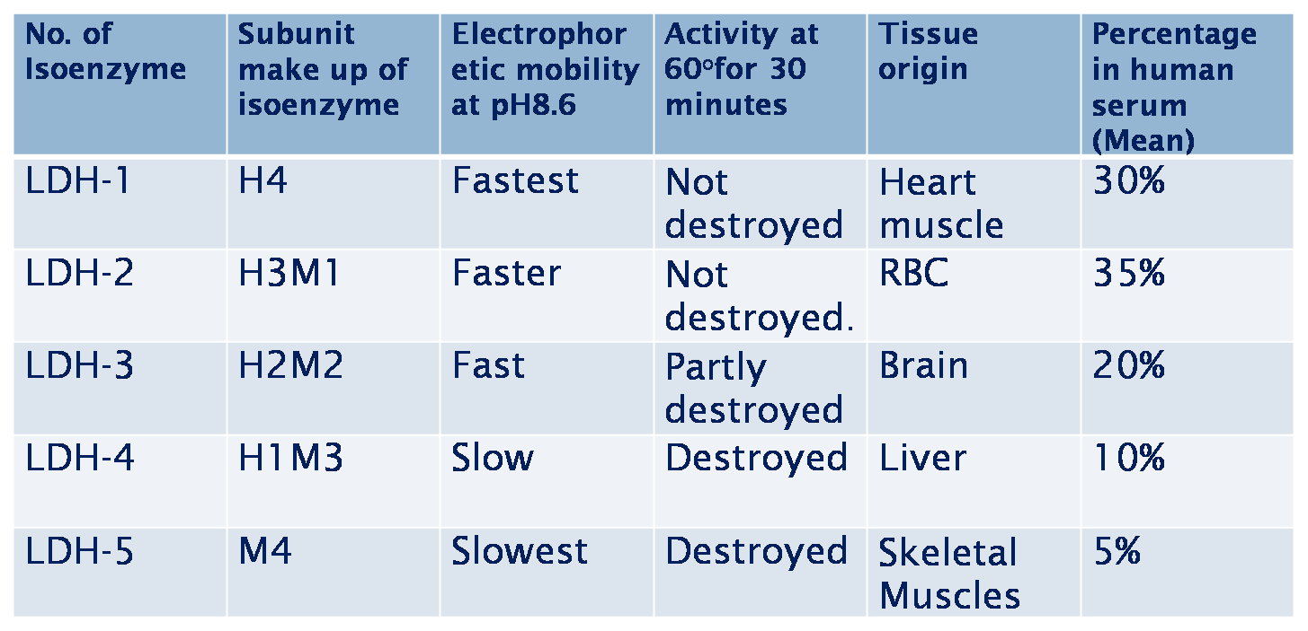

Slide 94
4) Cardiac Troponins
They are not enzymes; however they are accepted as markers of myocardial infarction.
The Troponin complex consists of 3 components;
Troponin C (Calcium binding).
Troponin I ( Actomyosin ATPase inhibitory element).
Troponin T(Tropomyosin binding element).

Slide 95
Troponin I is released in to the circulation within 4 hours of the onset of cardiac manifestations, peak is observed at 14-24 hours and remains elevated for 3-5 days post infarction.
Serum level of TnT increases within 6 hous of myocardial infarction, peaks at 72 hours and then remains elevated up to 7-10 days. The TnT2 estimation is 100% sensitive index for myocardial infarction

Slide 96
5) Myoglobin
One of earliest markers is myoglobin, which is very sensitive but, in certain clinical settings, lacks specificity.
Its level rises within 4 hours of infarction.
Falsely high levels may be observed in patients of Renal failure or patients having muscle injuries.

Slide 97
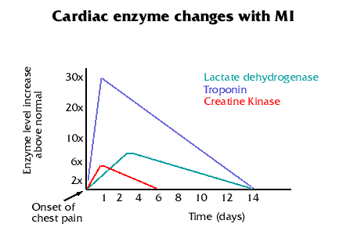
Enzymatic activity changes in Acute MI
VIGNAN PHARMACY COLLEGE

Slide 98
Liver diseases
Serum enzyme tests can be grouped into two categories:
Enzymes whose elevation in serum reflects damage to hepatocytes
Enzymes whose elevation in serum reflects cholestasis (a decrease in bile flow due to impaired secretion by hepatocytes or due to obstruction of bile flow through intra-or extra-hepatic bile ducts.).

Slide 99
Enzymes that Reflect Damage to
Hepatocytes
The Aminotransferases (transaminases) are sensitive indicators of liver cell injury and are most helpful in recognizing acute hepatocellular diseases such as hepatitis.
These include-
Aspartate aminotransferase (AST),
Alanine aminotransferase (ALT).

Slide 100
Amino Transferases
AST is found in the liver, cardiac muscle, skeletal muscle, kidneys, brain, pancreas, lungs, leukocytes, and erythrocytes in decreasing order of concentration.
Normal level :- 0-41 IU/L.
The Aminotransferases are normally present in the serum in low concentrations. These enzymes are released into the blood in greater amounts when there is damage to the liver cell membrane resulting in increased permeability.

Slide 101
Diagnostic significance of Aminotransferases
Levels of up to 300 U/L are nonspecific and may be found in any type of liver disorder.
Striking elevations i.e., aminotransferases > 1000 IU/L occur almost exclusively in disorders associated with extensive hepatocellular injury such as
viral hepatitis,
Ischemic liver injury (prolonged hypotension),
In most acute hepatocellular disorders, the ALT is higher than or equal to the AST.

Slide 102
Enzymes that reflect Cholestasis
The activities of three enzymes
Alkaline phosphatase,
5'-nucleotidase,
γ-Glutamyl transpeptidase (GGT).
Alkaline phosphatase and 5'-nucleotidase are found in or near the bile canalicular membrane of hepatocytes, while GGT is located in the endoplasmic reticulum and in bile duct epithelial cells.

Slide 103
1) Alkaline phosphatase in Liver diseases
The normal serum alkaline phosphatase consists of many distinct isoenzymes found in the liver, bone, placenta, and, less commonly, small intestine.
Normal level-0-45 IU/L
Patients over age 60 can have a mildly elevated alkaline phosphatase.
Individuals with blood types O and B can have an elevation of the serum alkaline phosphatase after eating a fatty meal due to the influx of intestinal alkaline phosphatase into the blood.

Slide 104
Isozymes of Alkaline phosphatase
Hepatic Isoenzyme: – Travels fastest towards the anode and occupies the same position as Alpha 2 globulin. Its level rises in extra hepatic biliary obstruction.
Bone Isoenzyme:- Increases die to osteoblastic activity and is normally elevated in children during periods of active growth .
Placental Isoenzyme :- Rises during last 6 weeks of pregnancy.
Intestinal Isoenzyme:- Rise occurs after a fatty meal. May increase during various GI disorders.

Slide 105
2) γ- Glutamyl transferase (γGT)
It is involved in amino acid transport across the membranes.
Found mainly in biliary ducts of the liver, kidney and pancreas.
Enzyme activity is induced by a number of drugs and in particular alcohol.
γ-GT increased in liver diseases especially in obstructive jaundice.
γ-GT levels are used as a marker of alcohol induced liver disease and in liver cirrhosis.

Slide 106
3) 5’ Nucleotidase
Moderately increased in hepatitis and highly elevated in biliary obstruction.
Unlike ALP the level is unrelated to osteoblastic activity and is thus unaffected by bone disease.
The enzyme hydrolyses 5’ nucleotides to 5’ nucleosides at an optimum p H of 7.5

Slide 107
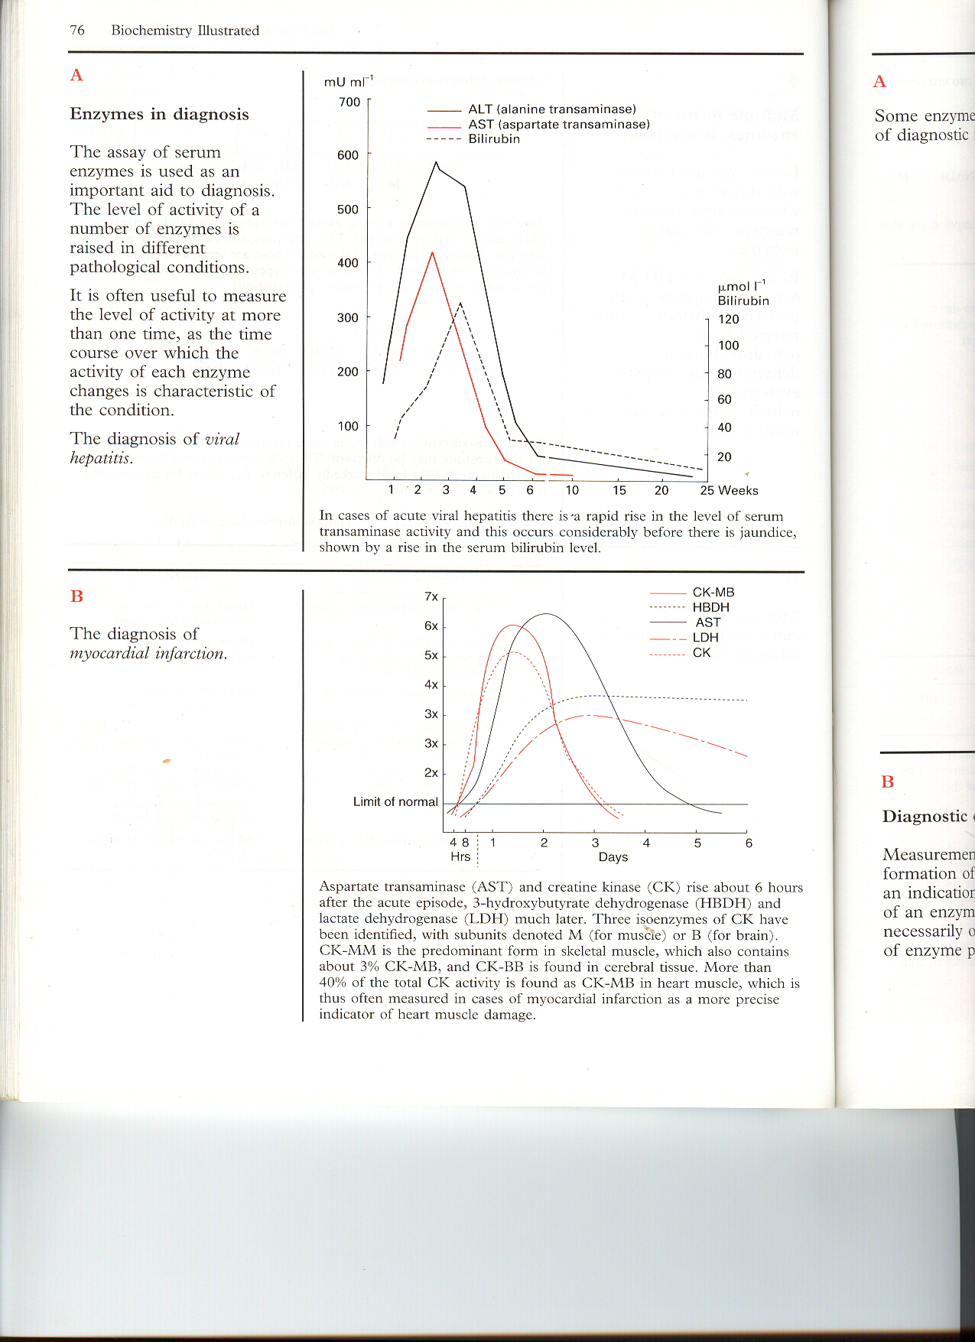
Serum enzymes in liver diseases
In viral hepatitis rapid rise in transaminases (AST & ALT) in serum occurs even before bilirubin rise is seen

Slide 108
Bone diseases
Alkaline Phosphatase
Rises in Rickets, osteomalacia, hyperparathyroidism and in Paget’s disease. Also rises in primary and secondary malignancies of bones.
Acid Phosphatase
Highly increased in bony metastasis of carcinoma prostate

Slide 109
GI tract diseases
Amylase:
Serum activity > 1000 units is seen within 24 hours in
acute Pancreatitis, values are diagnostic.
A raised serum activity is also seen in perforated peptic ulcer and intestinal obstruction.

Slide 110
Lipase
Levels as high as 2800 IU/L are seen in acute pancreatitis. Also reported high in perforated duodenal and peptic ulcers and intestinal obstruction.

Slide 111
Enzymes in diagnostic use
Serum Enzymes | Location of serum enzymes | Concentration increased in | Concentration decreased in
Lipase | Pancreas | Acute pancreatitis, Pancreatic carcinoma | Liver disease, vit-A deficiency, diabetes mellitus
Amylase | Saliva | High intestinal obstruction, Acute pancreatitis, Parotitis, Diabetes | Liver disease
Trypsin | Stomach | Acute disease of pancreas | -
Cholinesterase |  | Nephrotic syndrome | Liver disease, Malnutrition
Alkaline phosphatase | Bone, liver | Rickets, Jaundice, Metastatic carcinoma, kidney disease | -
Acid phosphatase | Prostrate | Metastatic prostatic carcinoma | -

Slide 112
Enzymes in diagnostic use
Serum Enzymes | Location of serum enzymes | Concentration increased in | Concentration decreased in
Lactate dehydrogenase | Heart, Kidney, RBC, Liver, Muscle | MI, acute hepatitis, anaemia | -
Isocitrate dehydrogenase | Liver | Cirrhosis | -
Creatine kinase | Brain, Bowel, Heart, Skeletal muscle | MI, Muscular dystrophy | -
Glucose-6- phosphate dehydrogenase | Heart | Myocardial Infraction | Congenital deficiency causes haemolytic anaemia
γ-glutamyl-transferase | Liver, Kidney, Pancreas | Hepatitis, Cholestatic liver diseases | -

Slide 113
Enzymes in diagnostic use
Serum Enzymes | Location of serum enzymes | Concentration increased in | Concentration decreased in
Ceruloplasmin (Ferroxidase activity) | Liver | Cirrhosis, Bacterial infection, Pregnancy | Wilsons disease (hepatolenticular degenaration)
Aldolase | Muscle, Liver, RBC | Muscular dystrophy, Hepatitis, Haemolytic anemia, Leukemia | -
Oxytocinase | Uterus | Normal pregnancy from fourth month. Increasing level shows good foetal prognosis. | Intrauterine foetal birth.

Slide 114
ENZYMES AS DIAGNOSTIC AGENTS
Enzyme | Used for testing
Urease | Urea
Uricase | Uric acid
Glucose oxidase | Glucose
Cholesterol oxidase | Cholesterol
Lipase | Triglyceride
Alkaline phosphatase | ELISA
Horse radish peroxidase | ELISA
Restriction endonuclease | Recombinant DNA technology
Reverse transcriptase | Polymerase chain reaction

