Slide 1
CLINICAL ENZYMOLOGY
CLS 431

Slide 2
General properties
Enzymes are protein catalyst that increase the velocity of a chemical reaction.
Enzymes are not consumed during the reaction they catalyzed.
With the exception of catalytic RNA molecules, or ribozymes, enzymes are proteins.
In addition to being highly efficient, enzymes are also extremely selective catalysts.

Slide 3
Coenzymes and Cofactors
Cofactors can be subdivided into two groups: metals and small organic molecules.
Cofactors that are small organic molecules are called coenzymes.
Most common cofactor are also metal ions.
If tightly bound, the cofactors are called prosthetic groups.
Loosely bound Cofactors serve functions similar to those of prosthetic groups but bind in a transient, dissociable manner either to the enzyme or to a substrate.

Slide 4
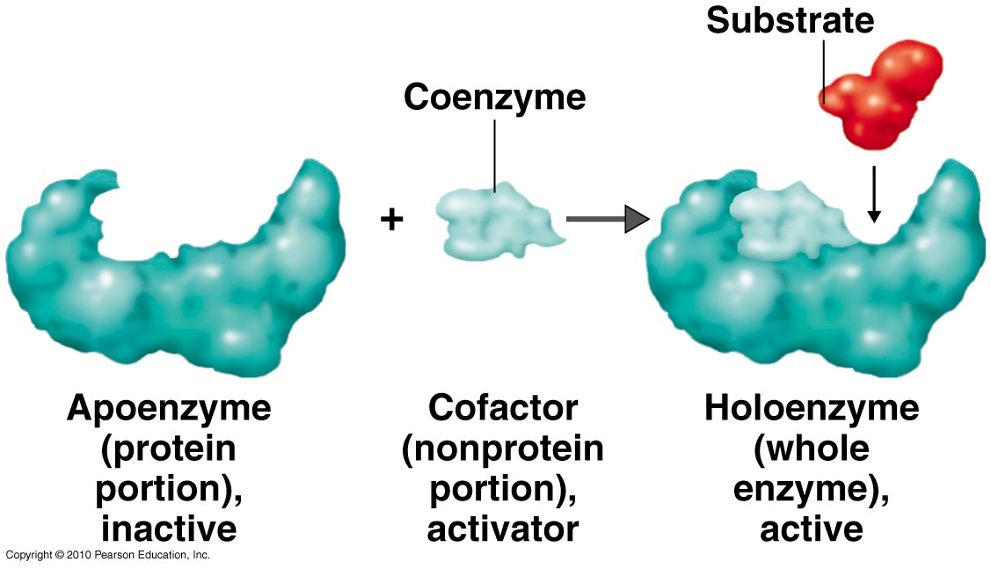
Coenzymes

Slide 5
Prosthetic group
Metals are the most common prosthetic groups.
Tightly integrated into the enzyme structure by covalent or non-covalent forces. e.g;
Pyridoxal phosphate
Flavin mononucleotide( FMN)
Flavin adenine dinucleotide(FAD)
Thiamin pyrophosphate (TPP)
Biotin
Metal ions – Co, Cu, Mg, Mn, Zn

Slide 6
Role of metal ions
Enzymes that contain tightly bound metal ions are termed – Metalloenzymes.
Enzymes that require metal ions as loosely bound cofactors are termed as metal-activated enzymes.
Metal ions facilitate
Binding and orientation of the substrate.
Formation of covalent bonds with reaction intermediates.
Interact with substrate to render them more electrophilic or nucleophilic.

Slide 7
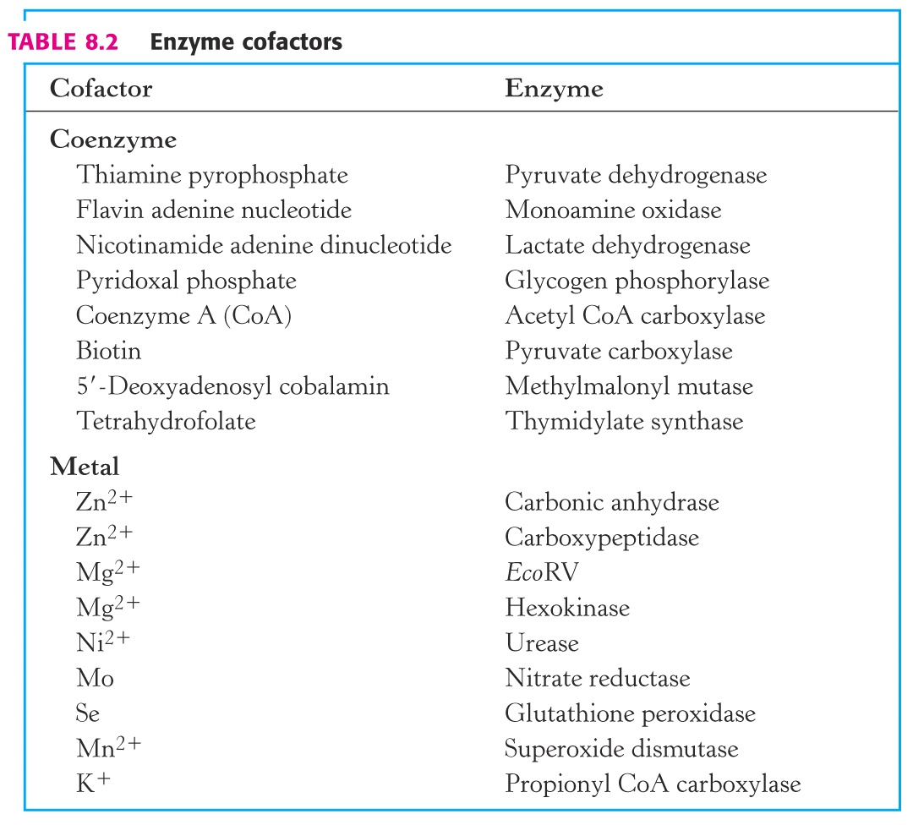

Slide 8
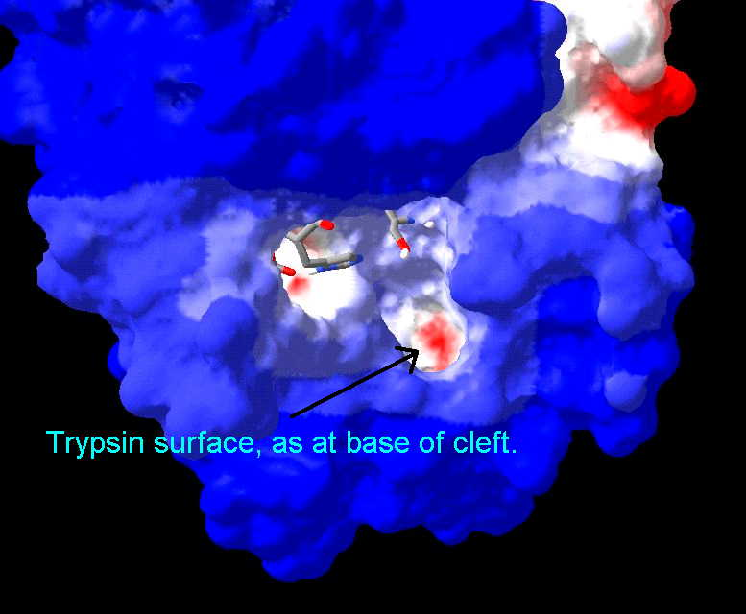
Active Site
Active site is a region in the enzyme that binds substrates and cofactors.
Takes the form of a cleft or pocket.
Takes up a relatively small part of the total volume of an enzyme.
Substrates are bound to enzymes by multiple weak attractions.
The specificity of binding depends on the precisely defined arrangement of atoms in an active site.
The active sites of multimeric enzymes are located at the interface between subunits and recruit residues from more than one monomer.

Slide 9
Active Site
Two models have been proposed to explain how an enzyme binds its substrate:
lock-and –key model.
Induced-fit model.

Slide 10
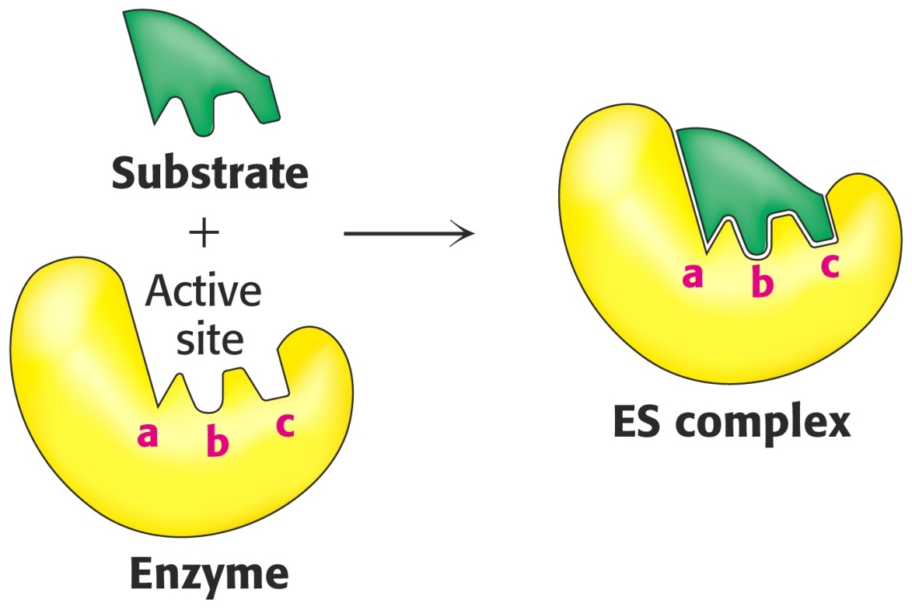
Lock & Key Model of Enzyme-Substrate Binding
In this model, the active site of the unbound enzyme is complementary in shape to the substrate.

Slide 11
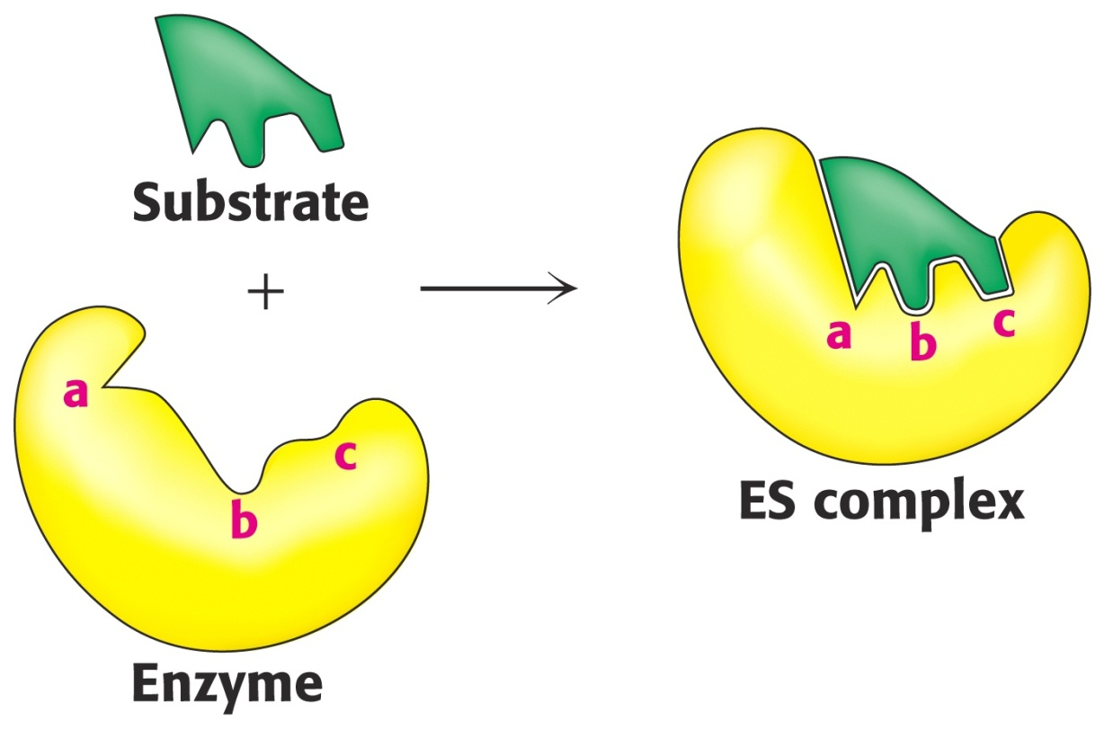
Induced-Fit Model of Enzyme-Substrate Binding
In this model, the enzyme changes shape on substrate binding.
The active site forms a shape complementary to the substrate only after the substrate has been bound.

Slide 12
Mechanism of Action of Enzymes How do enzymes catalyze?

