Slide 1
CLINICAL ENZYMOLOGY
CLS 431

Slide 2
General properties
Enzymes are protein catalyst that increase the velocity of a chemical reaction.
Enzymes are not consumed during the reaction they catalyzed.
With the exception of catalytic RNA molecules, or ribozymes, enzymes are proteins.
In addition to being highly efficient, enzymes are also extremely selective catalysts.

Slide 3
Coenzymes and Cofactors
Cofactors can be subdivided into two groups: metals and small organic molecules.
Cofactors that are small organic molecules are called coenzymes.
Most common cofactor are also metal ions.
If tightly bound, the cofactors are called prosthetic groups.
Loosely bound Cofactors serve functions similar to those of prosthetic groups but bind in a transient, dissociable manner either to the enzyme or to a substrate.

Slide 4
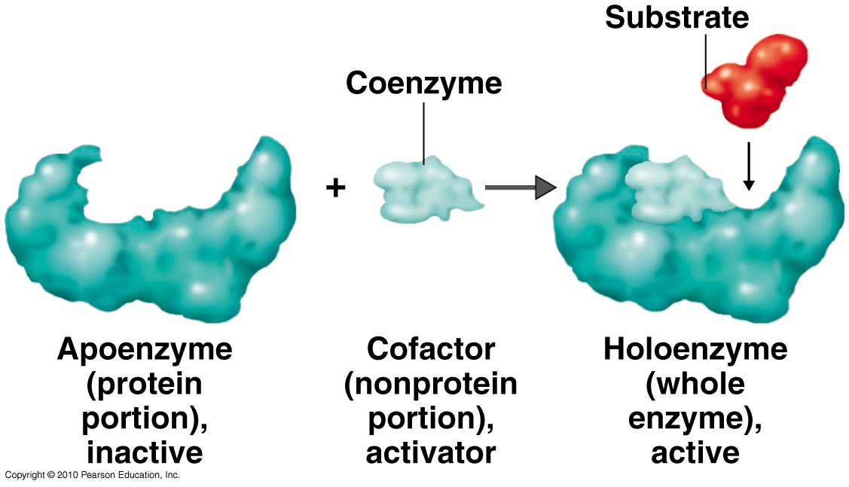
Coenzymes

Slide 5
Prosthetic group
Metals are the most common prosthetic groups.
Tightly integrated into the enzyme structure by covalent or non-covalent forces. e.g;
  Pyridoxal phosphate
  Flavin mononucleotide( FMN)
  Flavin adenine dinucleotide(FAD)
  Thiamin pyrophosphate (TPP)
  Biotin
  Metal ions – Co, Cu, Mg, Mn, Zn

Slide 6
Role of metal ions
Enzymes that contain tightly bound metal ions are termed – Metalloenzymes.
Enzymes that require metal ions as loosely bound cofactors are termed as metal-activated enzymes.
Metal ions facilitate
  Binding and orientation of the substrate.
  Formation of covalent bonds with reaction intermediates.
  Interact with substrate to render them more electrophilic or nucleophilic.

Slide 7
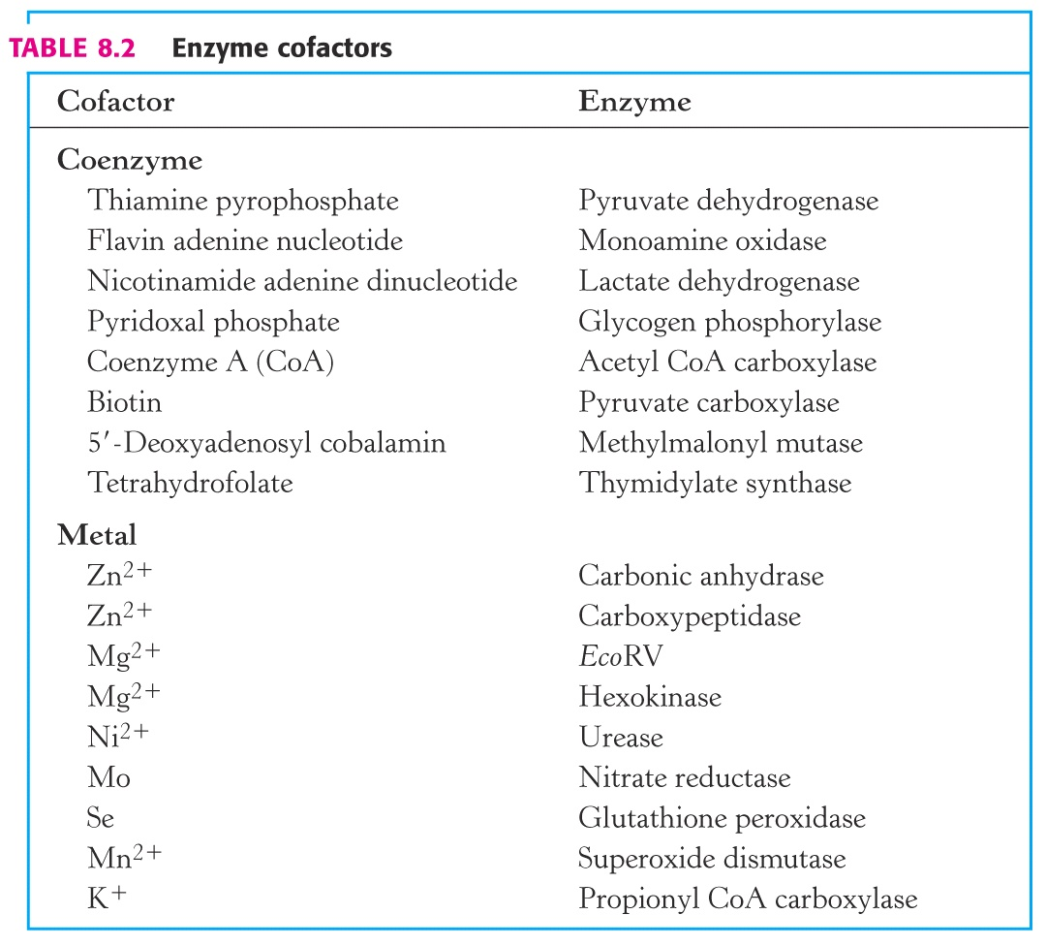

Slide 8
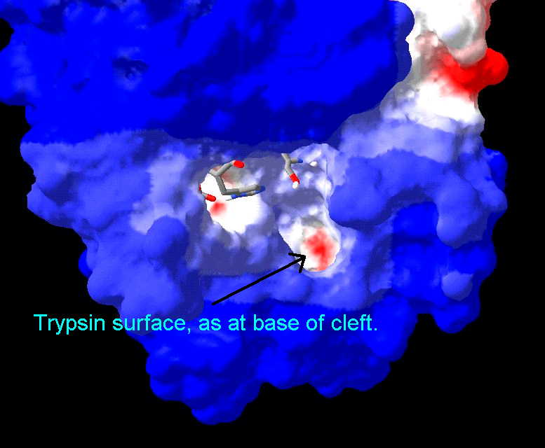
Active Site
Active site is a region in the enzyme that binds substrates and cofactors.
Takes the form of a cleft or pocket.
Takes up a relatively small part of the total volume of an enzyme.
Substrates are bound to enzymes by multiple weak attractions.
The specificity of binding depends on the precisely defined arrangement of atoms in an active site.
The active sites of multimeric enzymes are located at the interface between subunits and recruit residues from more than one monomer.

Slide 9
Active Site
Two models have been proposed to explain how an enzyme binds its substrate:
  lock-and –key model.
  Induced-fit model.

Slide 10
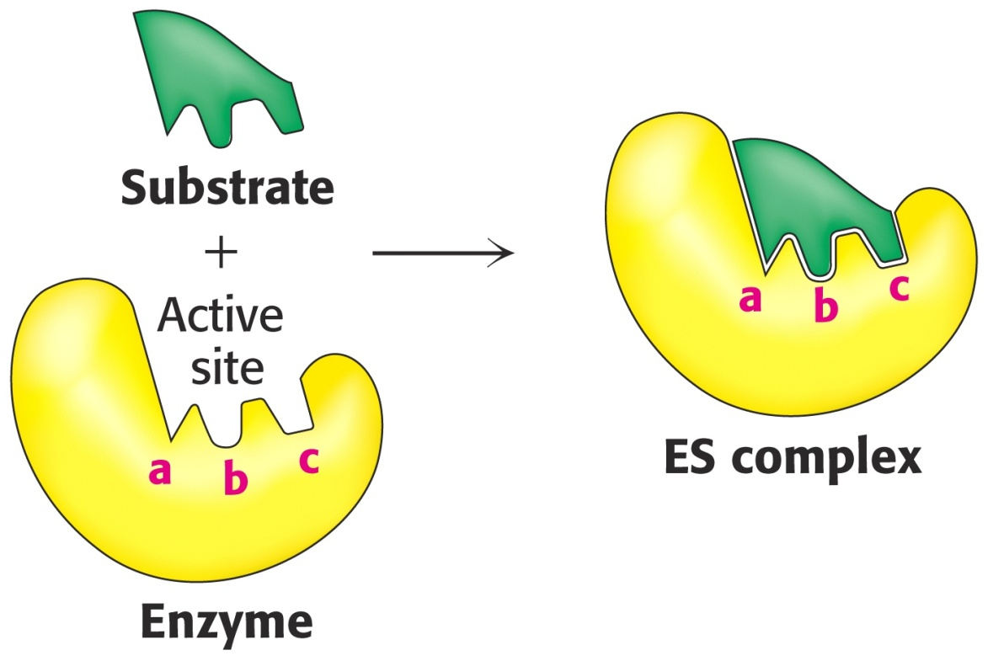
Lock & Key Model of Enzyme-Substrate Binding
In this model, the active site of the unbound enzyme is complementary in shape to the substrate.

Slide 11
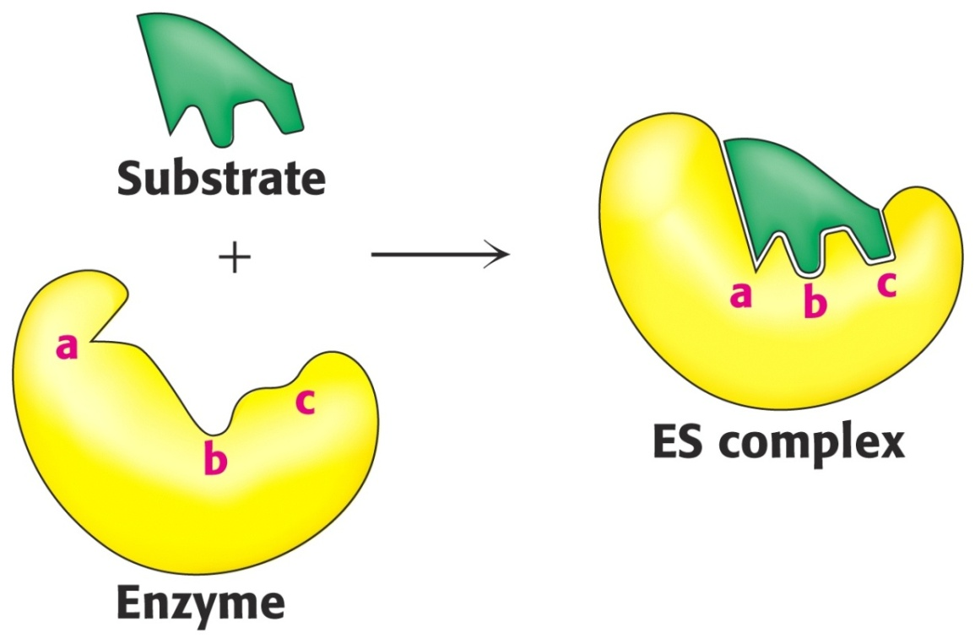
Induced-Fit Model of Enzyme-Substrate Binding
In this model, the enzyme changes shape on substrate binding.
The active site forms a shape complementary to the substrate only after the substrate has been bound.

Slide 12
Enzyme Specificity
In general, there are four distinct types of specificity:
Absolute specificity
The enzyme will catalyze only one reaction.
Group specificity
the enzyme will act only on molecules that have specific functional groups, such as amino, phosphate and methyl groups.
Linkage specificity
the enzyme will act on a particular type of chemical bond regardless of the rest of the molecular structure.
Stereo chemical specificity
the enzyme will act on a particular steric or optical isomer.

Slide 13
Absolute specificity
Is the highest degree of specificity.
The enzyme active site is recognized by a single substrate.
Example: Glucokinase catalyzes the conversion of glucose to glucose -6-phosphate

Slide 14
Group specificity
Enzyme active site can recognize many substrates , all belonging to same group of compounds.
Example:
Trypsin catalyzes the hydrolysis of peptide bond in several proteins.
Hexokinases act on six carbon sugars.

Slide 15
Reaction specificity
The enzyme catalyzes only one type of reaction
Example:
Oxidoreductases catalyze oxidation –reduction reactions

Slide 16
Optical specificity
Enzyme is stereospecific.
Is capable to differentiate between L- and D- isomers of a compound.
Example:
  L amino acid oxidase acts only on L-amino acid.
  α-glycosidase acts only on α-glycosidic bond which are present in starch and glycogen.
  β-glycosidase acts only on β -glycosidic bond that are present in cellulose.
  (think)***

Slide 17
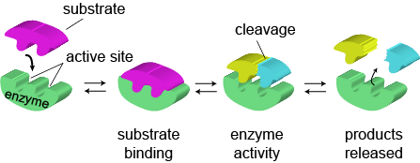
Mechanism of Action of Enzymes
How do enzymes catalyze?
The basic enzymatic reaction can be represented as follows
ES complex EX complex
http://www.wiley.com/college/pratt/0471393878/instructor/animations/enzyme_kinetics/index.html

Slide 18
How do enzymes increase the rate of reaction?
Enzymes increase reaction rates by decreasing the amount of energy required to form a complex of reactants that is competent to produce reaction products.
This complex is known as the activated state or transition state complex for the reaction.
Enzymes and other catalysts accelerate reactions by lowering the energy of the transition state.

Slide 19
Stabilization of the Transition State
The catalytic role of an enzyme is to reduce the energy barrier between substrate and transition state.
This is accomplished through the formation of an enzyme-substrate complex (ES).
This complex is converted to product by passing through a transition state (EX‡).
The energy of EX is lower than for substrate. Therefore, this decrease in energy partially explains the enzymes ability to accelerate the reaction rate.

Slide 20
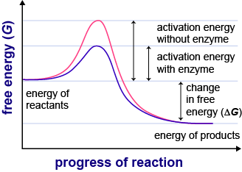

Slide 21
Mechanism of Action of Enzymes
The mechanism of action of enzymes can be explained by two perspectives
  Thermodynamic changes:
      The enzymes provide an alternate, energetically favorable reaction pathway different from the uncatalyzed reaction.
  Processes at the active site:
      Describes how the active site chemically facilitates catalysis.

Slide 22
1) Thermodynamic changes
All chemical reactions have an energy barrier separating the reactants and the products.
This barrier, called the free energy of activation, which is the energy difference between that of the reactants and a high-energy intermediate that occurs during the formation of product.
Enzymes accelerate reactions by lowering the free energy of activation
Enzymes do this by binding the transition state of the reaction better than the substrate
The lower activation energy means that more molecules have the required energy to reach the transition state.

Slide 23
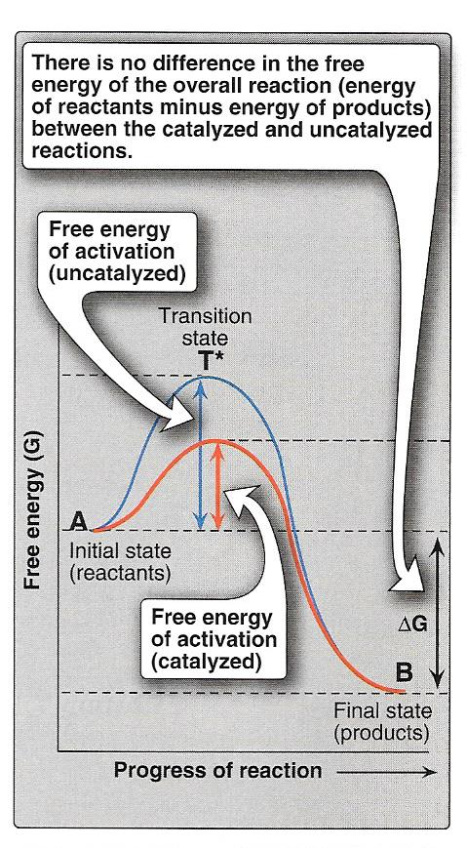
This figure shows the changes in energy during the conversion of a molecule of reactant A to product B as it proceeds through the transition state (high-energy intermediate), T*:
A & T* B

Slide 24
Energy changes occurring during the reaction
Free energy of activation:
    The peak of energy is the difference in free energy between the reactant and T* (transition state).
Rate of reaction:
    For molecules to react, they must contain sufficient energy to overcome the energy barrier of the transition state.
    In the absence of an enzyme, only a small proportion of a population of molecules may possess enough energy to achieve the transition state between reactant and product.
    The rate of reaction is determined by the number of such energized molecules.
    In general, the lower the free energy of activation, the more molecules have sufficient energy to pass through the transition state, and, thus, the faster the rate of the reaction.

Slide 25
Alternate reaction pathway:
An enzyme allows a reaction to proceed rapidly under conditions prevailing in the cell by providing an alternate reaction pathway with a lower free energy of activation (see Figure).
The enzyme does not change the free energies of the reactants or products and, therefore, does not change the equilibrium of the reaction.

Slide 26
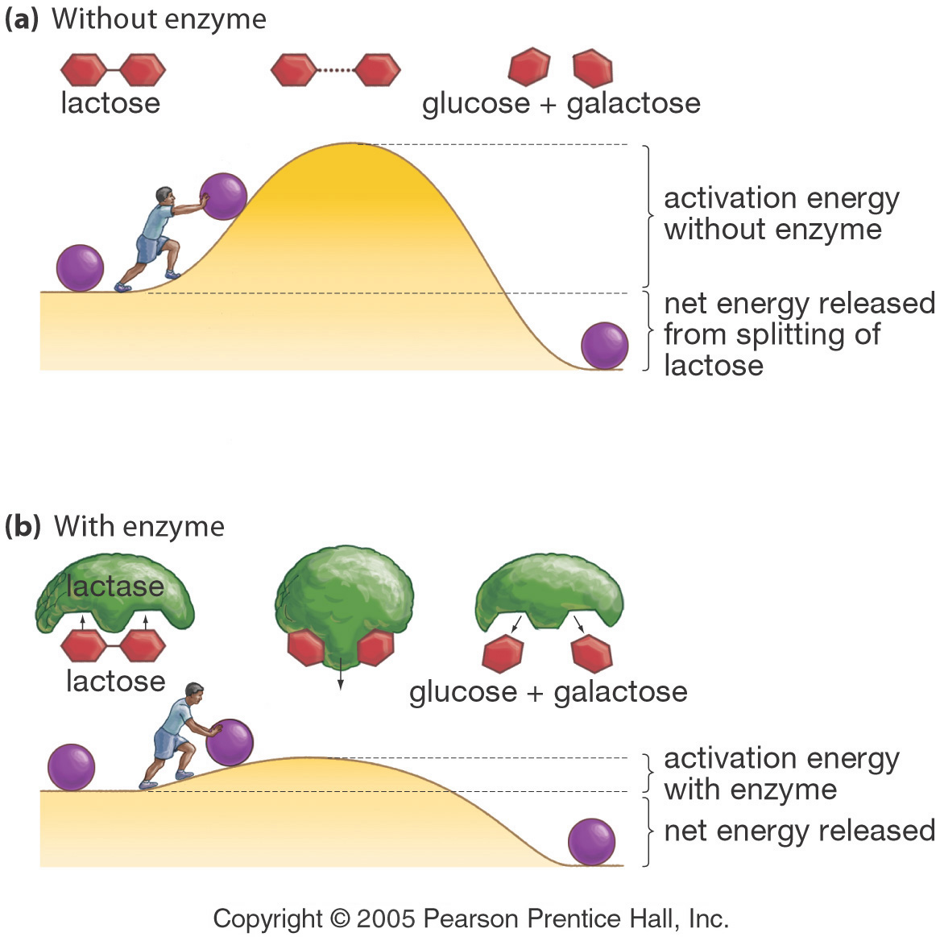
Effect of a Catalyst (enzymes) on Activation Energy

Slide 27
2) Processes at the active site
The combination formed by an enzyme and its substrates is called the enzyme–substrate complex.
When two substrates and one enzyme are involved, the complex is called a ternary complex;
One substrate and one enzyme are called a binary complex.
The substrates are attracted to the active site by electrostatic and hydrophobic forces, which are called noncovalent bonds because they are physical attractions and not chemical bonds

Slide 28
2) Processes at the active site
Catalysis by proximity
When an enzyme binds substrate molecules at its active site, it creates a region of high local substrate concentration.
Enzyme-substrate interactions orient reactive groups and bring them into proximity with one another.
Acid base catalysis
the ionizable functional groups of aminoacyl side chains of prosthetic groups contribute to catalysis by acting as acids or bases

Slide 29
Catalysis by strain
Enzymes that catalyze the lytic reactions involve breaking a covalent bond typically bind their substrates in a configuration slightly unfavorable for the bond that will undergo cleavage .
Covalent Catalysis
Involves the formation of a covalent bond between the enzyme and one or more substrates which introduces a new reaction pathway whose activation energy is lower

Slide 30
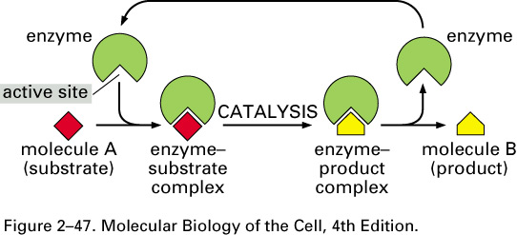
Enzyme Catalysis- overview

