Slide 1
CLINICAL ENZYMOLOGY
CLS 431

Slide 2
General properties
Enzymes are protein catalyst that increase the velocity of a chemical reaction.
Enzymes are not consumed during the reaction they catalyzed.
With the exception of catalytic RNA molecules, or ribozymes, enzymes are proteins.
In addition to being highly efficient, enzymes are also extremely selective catalysts.

Slide 3
Coenzymes and Cofactors
Cofactors can be subdivided into two groups: metals and small organic molecules.
Cofactors that are small organic molecules are called coenzymes.
Most common cofactor are also metal ions.
If tightly bound, the cofactors are called prosthetic groups.
Loosely bound Cofactors serve functions similar to those of prosthetic groups but bind in a transient, dissociable manner either to the enzyme or to a substrate.

Slide 4
Coenzymes

Slide 5
Prosthetic group
Metals are the most common prosthetic groups.
Tightly integrated into the enzyme structure by covalent or non-covalent forces. e.g;
Pyridoxal phosphate
Flavin mononucleotide( FMN)
Flavin adenine dinucleotide(FAD)
Thiamin pyrophosphate (TPP)
Biotin
Metal ions – Co, Cu, Mg, Mn, Zn

Slide 6
Role of metal ions
Enzymes that contain tightly bound metal ions are termed – Metalloenzymes.
Enzymes that require metal ions as loosely bound cofactors are termed as metal-activated enzymes.
Metal ions facilitate
Binding and orientation of the substrate.
Formation of covalent bonds with reaction intermediates.
Interact with substrate to render them more electrophilic or nucleophilic.

Slide 7
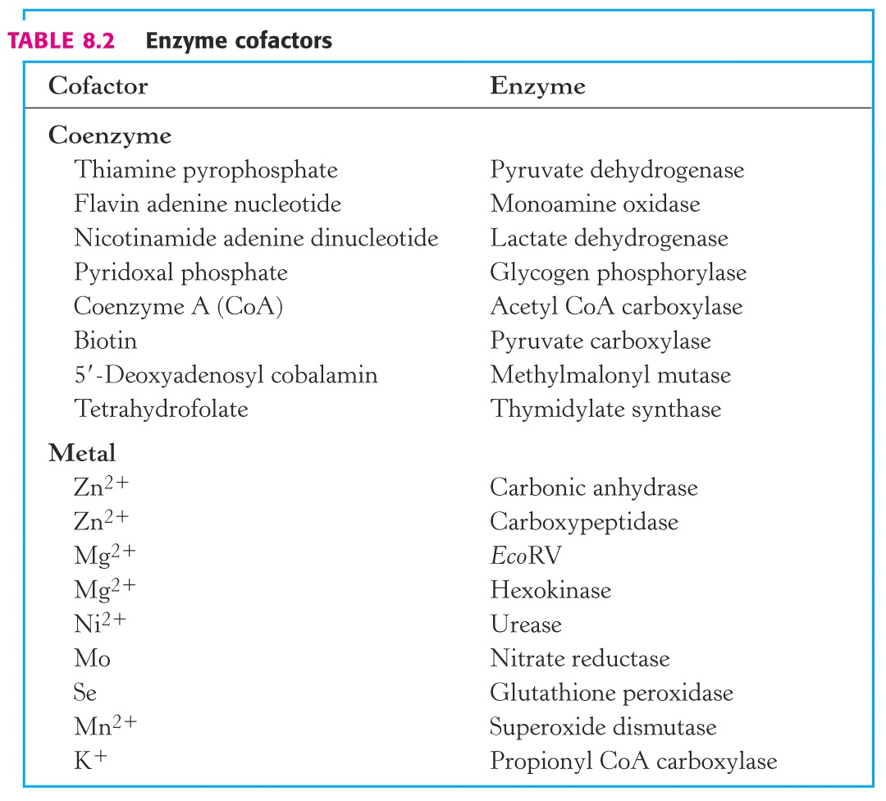

Slide 8
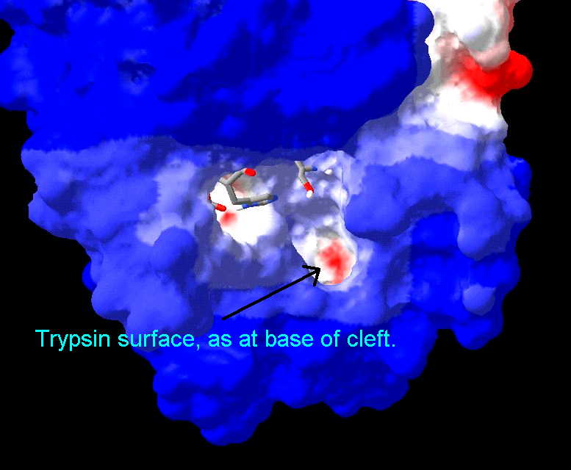
Active Site
Active site is a region in the enzyme that binds substrates and cofactors.
Takes the form of a cleft or pocket.
Takes up a relatively small part of the total volume of an enzyme.
Substrates are bound to enzymes by multiple weak attractions.
The specificity of binding depends on the precisely defined arrangement of atoms in an active site.
The active sites of multimeric enzymes are located at the interface between subunits and recruit residues from more than one monomer.

Slide 9
Active Site
Two models have been proposed to explain how an enzyme binds its substrate:
lock-and –key model.
Induced-fit model.

Slide 10
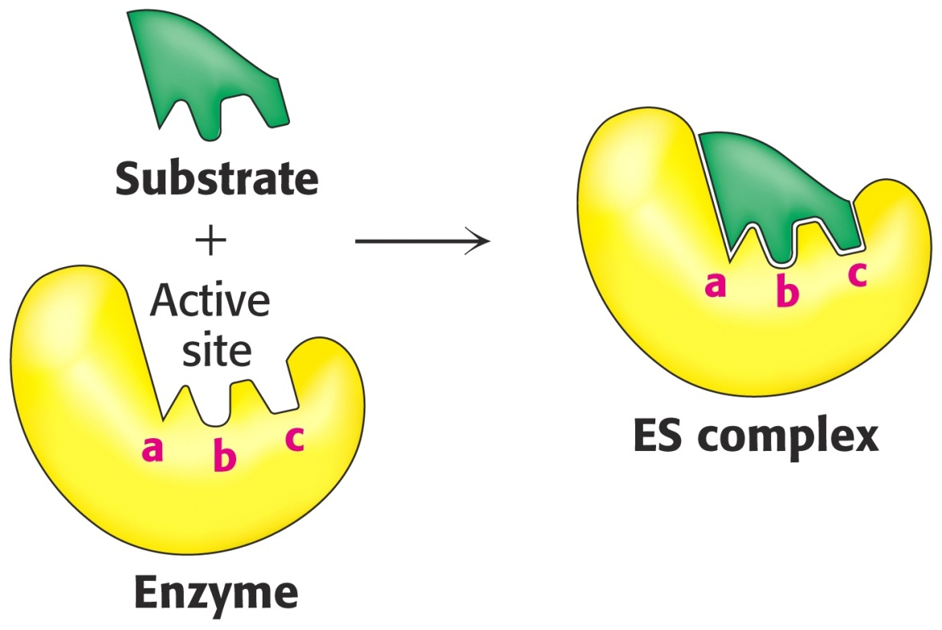
Lock & Key Model of Enzyme-Substrate Binding
In this model, the active site of the unbound enzyme is complementary in shape to the substrate.

Slide 11
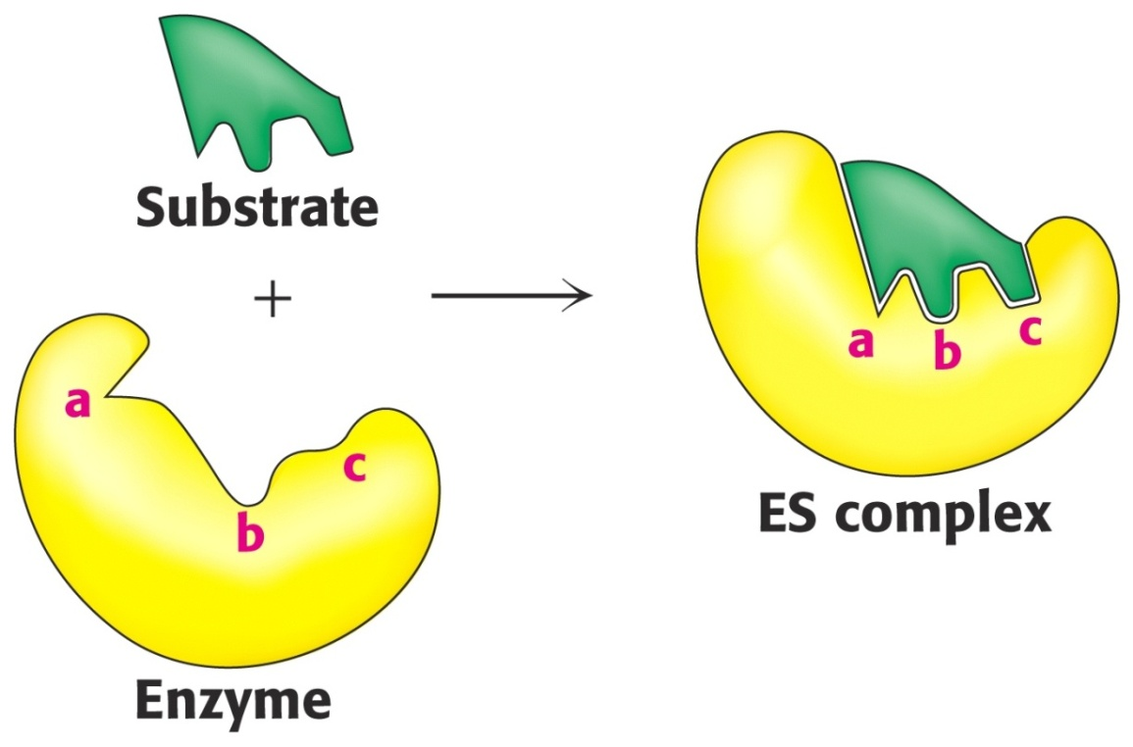
Induced-Fit Model of Enzyme-Substrate Binding
In this model, the enzyme changes shape on substrate binding.
The active site forms a shape complementary to the substrate only after the substrate has been bound.

Slide 12
Enzyme Specificity
In general, there are four distinct types of specificity:
Absolute specificity
The enzyme will catalyze only one reaction.
Group specificity
the enzyme will act only on molecules that have specific functional groups, such as amino, phosphate and methyl groups.
Linkage specificity
the enzyme will act on a particular type of chemical bond regardless of the rest of the molecular structure.
Stereo chemical specificity
the enzyme will act on a particular steric or optical isomer.

Slide 13
Absolute specificity
Is the highest degree of specificity.
The enzyme active site is recognized by a single substrate.
Example: Glucokinase catalyzes the conversion of glucose to glucose -6-phosphate

Slide 14
Group specificity
Enzyme active site can recognize many substrates , all belonging to same group of compounds.
Example:
Trypsin catalyzes the hydrolysis of peptide bond in several proteins.
Hexokinases act on six carbon sugars.

Slide 15
Reaction specificity
The enzyme catalyzes only one type of reaction
Example:
Oxidoreductases catalyze oxidation –reduction reactions

Slide 16
Optical specificity
Enzyme is stereospecific.
Is capable to differentiate between L- and D- isomers of a compound.
Example:
L amino acid oxidase acts only on L-amino acid.
α-glycosidase acts only on α-glycosidic bond which are present in starch and glycogen.
β-glycosidase acts only on β -glycosidic bond that are present in cellulose.
(think)***

Slide 17
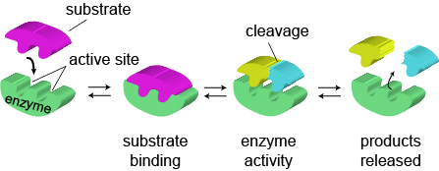
Mechanism of Action of Enzymes How do enzymes catalyze?
The basic enzymatic reaction can be represented as follows
ES complex EX complex
http://www.wiley.com/college/pratt/0471393878/instructor/animations/enzyme_kinetics/index.html

Slide 18
How do enzymes increase the rate of reaction?
Enzymes increase reaction rates by decreasing the amount of energy required to form a complex of reactants that is competent to produce reaction products.
This complex is known as the activated state or transition state complex for the reaction.
Enzymes and other catalysts accelerate reactions by lowering the energy of the transition state.

Slide 19
Stabilization of the Transition State
The catalytic role of an enzyme is to reduce the energy barrier between substrate and transition state.
This is accomplished through the formation of an enzyme-substrate complex (ES).
This complex is converted to product by passing through a transition state (EX‡).
The energy of EX is lower than for X . Therefore, this decrease in energy partially explains the enzymes ability to accelerate the reaction rate.

Slide 20
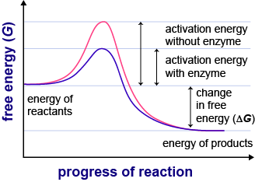

Slide 21
Mechanism of Action of Enzymes
The combination formed by an enzyme and its substrates is called the enzyme–substrate complex.
When two substrates and one enzyme are involved, the complex is called a ternary complex;
one substrate and one enzyme are called a binary complex.
The substrates are attracted to the active site by electrostatic and hydrophobic forces, which are called noncovalent bonds because they are physical attractions and not chemical bonds

Slide 22
The mechanism of action of enzymes can be explained by two perspectives
Thermodynamic changes
Processes at the active site

Slide 23
1) Thermodynamic changes
Enzymes accelerate reactions by lowering the free energy of activation
Enzymes do this by binding the transition state of the reaction better than the substrate
The lower activation energy means that more molecules have the required energy to reach the transition state.

Slide 24
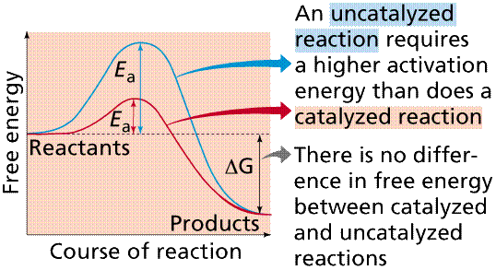

Slide 25
Free energy change
ΔG# :(Standard free energy change (Gibbs free energy)→it is ΔG under standard state conditions.
Standard free energy change (Gibbs free energy) It is energy difference in free energy between substrate and product.
ΔG º = G product – G substrate
ΔG º expresses the amount of energy capable of doing work during a reaction at constant temp. and pressure.
If free energy of substrate and product is same then ΔG° is zero. The reaction is said to be at equlibrium.

Slide 26
The relationship between Keq and ΔGº :-
ΔG º = -RT ln Keq
R : gas constant , ΔG°= -2.303 RT log Keq
T : absolute Temp (t + 273) →298k(c°)
Keq= [P][S]
Both ΔG°and Keq tell in which direction and how for a reaction will proceed
when all substrates and products are 1M

Slide 27
Effect of a Catalyst (enzymes) on Activation Energy

Slide 28
2) Processes at the active site
Catalysis by proximity
When an enzyme binds substrate molecules at its active site, it creates a region of high local substrate concentration. Enzyme-substrate interactions orient reactive groups and bring them into proximity with one another.
Acid base catalysis
the ionizable functional groups of aminoacyl side chains of prosthetic groups contribute to catalysis by acting as acids or bases

Slide 29
Catalysis by strain
Enzymes that catalyze the lytic reactions involve breaking a covalent bond typically bind their substrates in a configuration slightly unfavorable for the bond that will undergo cleavage .
Covalent Catalysis
Involves the formation of a covalent bond between the enzyme and one or more substrates which introduces a new reaction pathway whose activation energy is lower

Slide 30
Enzyme Catalysis- overview

Slide 31
Factors affecting reaction velocity
Numerous factors affect the reaction rate
Temperature:
The reaction rate increases with temperature to a maximum level, then abruptly declines with further increase of temperature.
Most animal enzymes rapidly become denatured at temperatures above 40ºC.
The optimal temperatures of the enzymes in higher organisms rarely exceed 50 °C.
The Q₁₀, or temperature coefficient, is the factor by which the rate of a biologic process increases for a 10 °C increase in temperature.

Slide 32
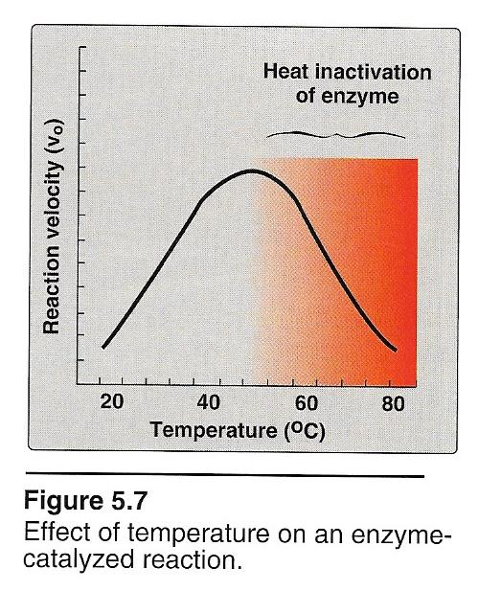
Effect of Temperature
For mammals and other homoeothermic organisms, changes in enzyme reaction rates with temperature assume physiologic importance only in circumstances such as fever or hypothermia.

Slide 33
Effect of pH on enzyme activity
The rate of almost all enzyme-catalyzed reactions exhibits a significant dependence on hydrogen ion concentration.
Most intracellular enzymes exhibit optimal activity at pH values between 5 and 9.
The relationship of activity to hydrogen ion concentration reflects the balance between enzyme denaturation at high or low pH and effects on the charged state of the enzyme, the substrates, or both.

Slide 34
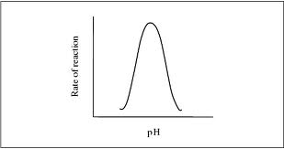
Effect of pH on enzyme activity
Except for Pepsin, acid phosphatase and alkaline phosphatase, most enzyme have optimum pH between 5 to 9

Slide 35
Effect of substrate concentration
At lower concentrations, the active sites on most of the enzyme molecules are not filled because there is not much substrate. Higher concentrations cause more collisions between the molecules. The rate of reaction increases (First order reaction).
The maximum velocity of a reaction is reached when the active sites are almost continuously filled. Increased substrate concentration after this point will not increase the rate. Reaction rate therefore increases as substrate concentration is increased but it levels off (Zero order reaction)

Slide 36
Effect of enzyme concentration
As the amount of enzyme is increased, the rate of reaction increases. If there are more enzyme molecules than are needed, adding additional enzyme will not increase the rate. Reaction rate therefore increases as enzyme concentration increases but then it levels off.

Slide 37
Enzyme Kinetics
Enzymes accelerate reactions by lowering the free energy of activation
Enzymes do this by binding the transition state of the reaction better than the substrate
Several terms to know:
rate or velocity
rate constant
rate law
order of a reaction

Slide 38
Michaelis Menten Kinetics

Slide 39
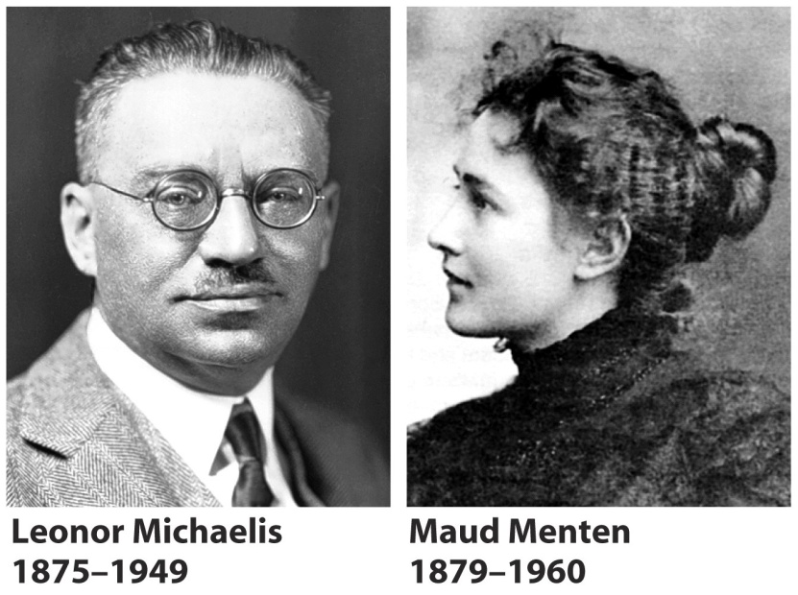
Leonor Michaelis and Maude Menten's theory
Assumes the formation of an enzyme-substrate complex
It assumes that the ES complex is in rapid equilibrium with free enzyme
Breakdown of ES to form products is assumed to be slower than
(1) formation of ES and
(2) breakdown of ES to reform E and S

Slide 40
Michaelis Menten equation
Michaelis and Menten proposed that the enzyme reversibly combines with its substrate to form an ES complex.
This complex subsequently breaks down to product, regenerating the free enzyme E.
k₁
k₋₁
k₂
E + S ES E + P
(k₋₂ is insignificant early in the reaction)
K1 is the rate constant of ES formation
k-1 is the rate constant of dissociation of ES back to E and S
K2 is the rate constant of dissociation of ES to E and P

Slide 41
k₁
k₋₁
k₂
E + S ES E + P
(k₋₂ is insignificant early in the reaction)
Rate of ES formation = k₁ [E][S] = k₁ ([E_{total}] - [ES]) [S]
Rate of ES breakdown = k₋₁ [ES] + k₂ [ES]
k₁ ([E_{total}] - [ES]) [S] = k₋₁ [ES] + k₂ [ES]
(steady state assumption)
Rate of ES formation = Rate of ES breakdown

Slide 42
Michaelis Menten equation
The Michaelis Menten equation describes how reaction velocity varies with substrate concentration
V_{o} : Initial reaction velocity.
V_{max :} Maximum velocity
[S] : Substrate concentration.
K_{M} : Michaelis constant = (k₂ + k₋₁ )
___________
k₁
At saturation when [E_{total}] = [ES] ------→ V_{o} = V_{max}
V_{max}[S]
____________
K_{M} + [S]
V_{o} =

Slide 43
Understanding K_{m}
K_{m} is a constant that is characteristic of an enzyme and its particular substrate.
K_{m} reflects the affinity (estimate of the dissociation constant) of E from S.
K_{m} is numerically equal to the substrate concentration at which the reaction velocity is equal to ½ V_{max.}
K_{m} dose not vary with the concentration of enzyme. “think”
Small K_{m} means tight binding; high K_{m} means weak binding

Slide 44
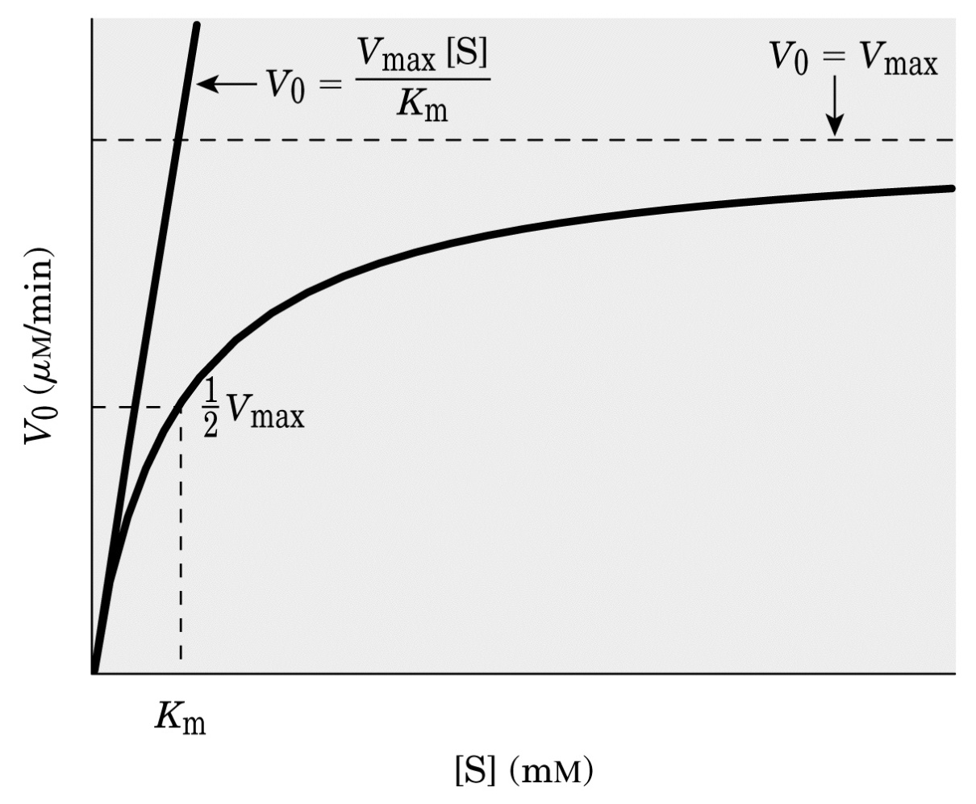
Enzyme Kinetics: Michaelis-Menton Equation
V_{max}[S]
V_{o} = ____________
K_{M} + [S]
K_{M} = [S]
when V_{o} = V_{max}
_____
2
From Lehninger
Principles of Biochemistry

Slide 45
The following data were obtained in a study of an enzyme known to follow Michaelis Menten kinetics:
V₀ Substrate added
(mmol/min) (mmol/L)
—————————————
216 0.9
323 2
435 4
489 6
647 2,000
—————————————
Calculate the K_{m} for this enzyme.
K_{m} is the substrate concentration that corresponds to V_{max}
₂
Without graphing
V_{max} = 647
V_{max} /2 = 647 / 2 = 323.5
K_{m} = 2 mmol/L

Slide 46
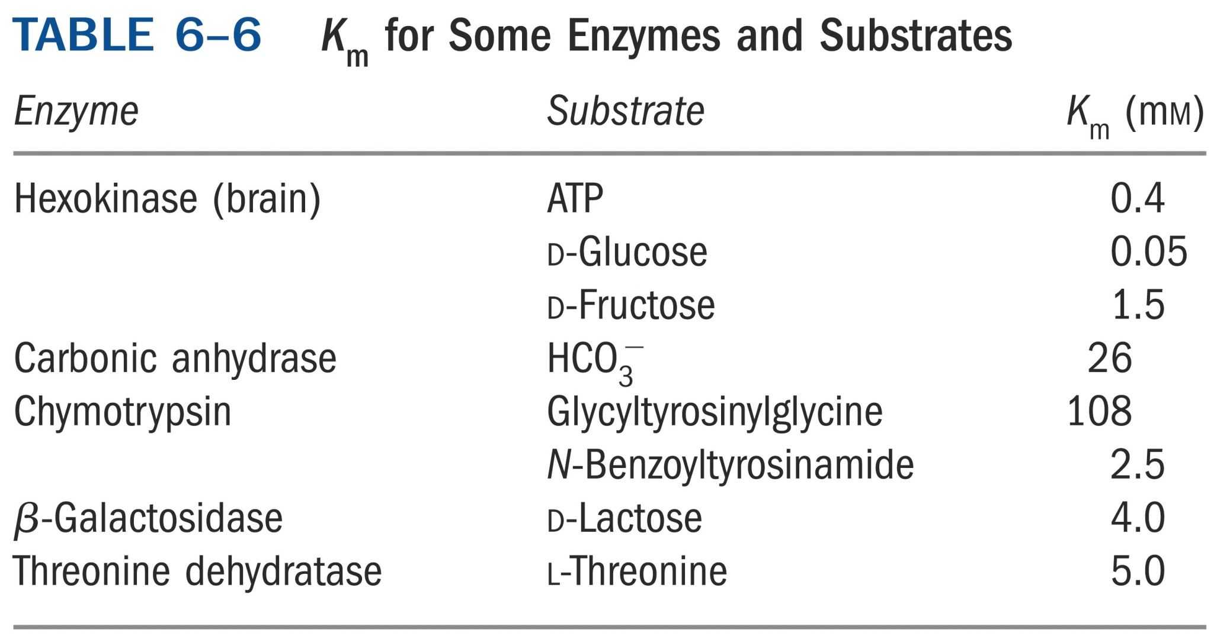

Slide 47
Understanding V_{max}
The theoretical maximal velocity
V_{max} is a constant
V_{max} is the theoretical maximal rate of the reaction - but it is NEVER achieved in reality
To reach V_{max} would require that ALL enzyme molecules are tightly bound with substrate
V_{max} is asymptotically approached as substrate is increased

Slide 48
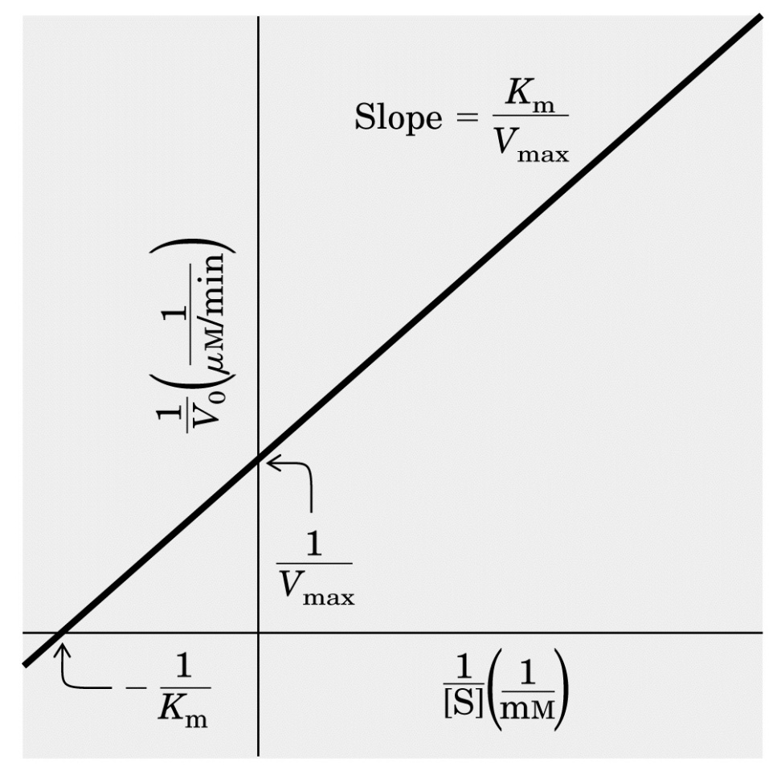
Lineweaver-Burk Plot (Double-Reciprocal)
A Linear Form of the Michaelis-Menten
Equation is used to determine km & V max
1 K_{M} 1
______ = _______ + ______
V_{o} V_{max}[S] V_{max}
Where the intercept on the x axis is equal to -1/ K_{M}, and the intercept on the Y axis is equal to 1/V_{max}
From Lehninger
Principles of Biochemistry

Slide 49
Enzyme Inhibition
Inhibitors are chemicals that reduce the rate of enzymatic reactions.
They are usually specific and they work at low concentrations.
They block the enzyme but they do not usually destroy it.
Many drugs and poisons are inhibitors of enzymes in the nervous system.
Inhibitors of the catalytic activities of enzymes provide both pharmacologic agents and research tools for study of the mechanism of enzyme action.

Slide 50
The effect of enzyme inhibition
Irreversible inhibitors: Combine with the functional groups of the amino acids in the active site, irreversibly.
Reversible inhibitors: These can be washed out of the solution of enzyme by dialysis.
Applications of inhibitors
Negative feedback: end point or end product inhibition
Poisons snake bite, plant alkaloids and nerve gases
Medicine antibiotics, sulphonamides, sedatives and stimulants

Slide 51
Types of Enzyme inhibition
Competitive Enzyme Inhibition
Non Competitive Enzyme Inhibition
Uncompetitive Enzyme Inhibition
Allosteric Enzyme Inhibition

Slide 52
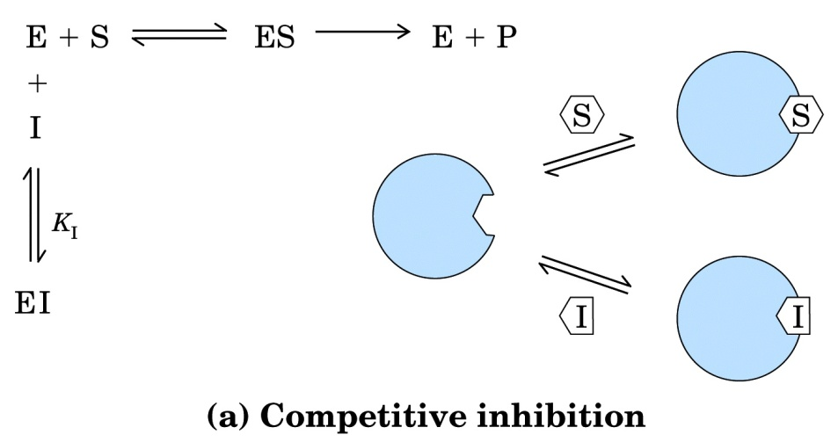
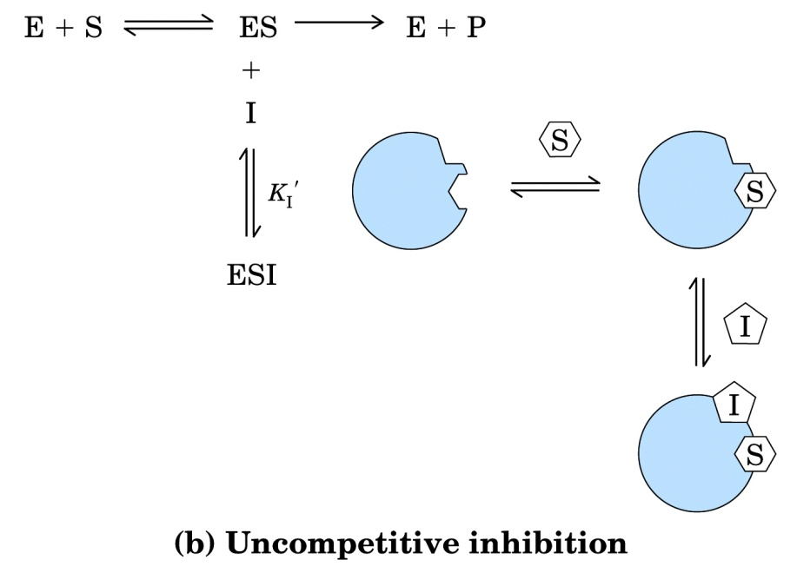
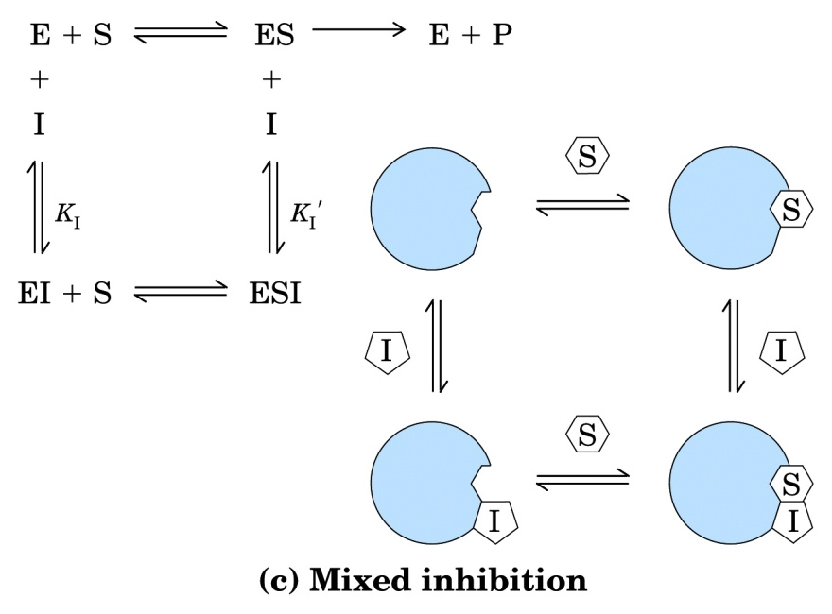
Enzyme Inhibition
Inhibitor (I) binds only to E, not to ES
Inhibitor (I) binds only to ES, not to E.
This is a hypothetical case that has never been documented for a real enzyme, but which makes a useful contrast to competitive inhibition
Inhibitor (I) binds to E and to ES.

Slide 53
Competitive Enzyme Inhibition
A competitive inhibitor
Has a structure similar to substrate (Structural Analog)
Occupies active site
Competes with substrate for active site
Has effect reversed by increasing substrate concentration
Vmax remains same but Km is increased

Slide 54
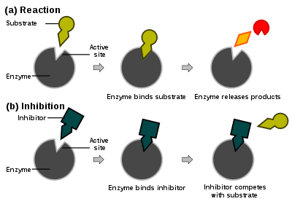
Competitive Enzyme Inhibition

Slide 55
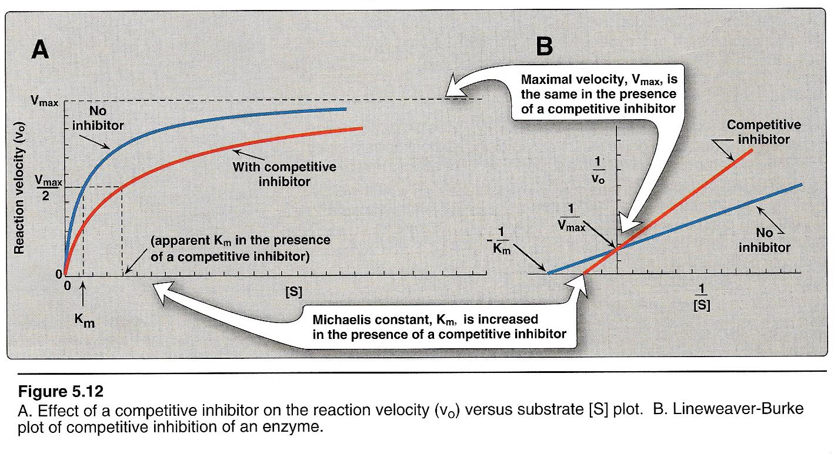

Slide 56
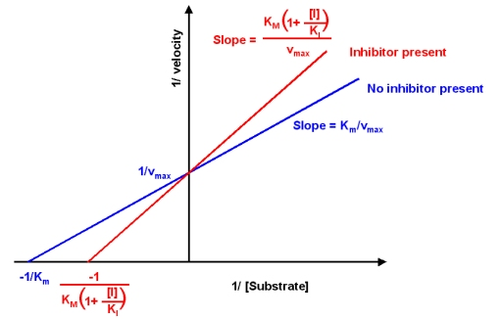
A competitive inhibitor will raise the apparent Km value for its substrate with no change in the apparent Vmax value.
competitive inhibition can be overcome, observed by an increase in the apparent Km value, at higher concentrations of substrate.
This characteristic will have physiological consequences on the observed efficiency of drugs.
As an enzyme’s reaction is inhibited by a competitive inhibitor, there is an increase in the local concentration of substrate.

Slide 57
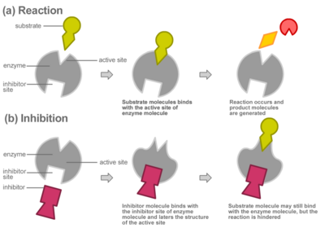
Noncompetitive Inhibition
A noncompetitive inhibitor binds equally well to both free enzyme and the enzyme-substrate complex. These binding events occur exclusively at a site distinct from the precise active site occupied by substrate.
when I binds at a separate site, the conformational change does not occur and enzyme activity is inhibited.

Slide 58
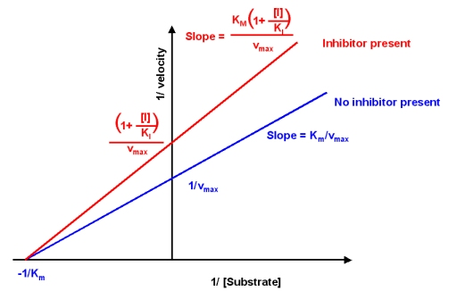
A noncompetitive inhibitor will lower the apparent Vmax value, yet there is no effect on the apparent Km value for its substrate.
Essentially, the K1 of the inhibitor does not change as a function of the substrate concentration.
In some circumstances, a compound may have unequal affinity for both free enzyme and the enzyme-substrate complex.
This mixture of competitive and noncompetitive phenotypes is called mixed inhibition.

Slide 59
Lineweaver Burk plot
In the presence of a competitive inhibitor, V_{max} can still be reached if sufficient substrate is available, one-half V_{max} requires a higher [S] than before and thus K_{m} is larger.
With noncompetitive inhibition, enzyme rate (velocity) is reduced for all values of [S], including
V_{max} and one-half V_{max} but
K_{m} remains unchanged

Slide 60
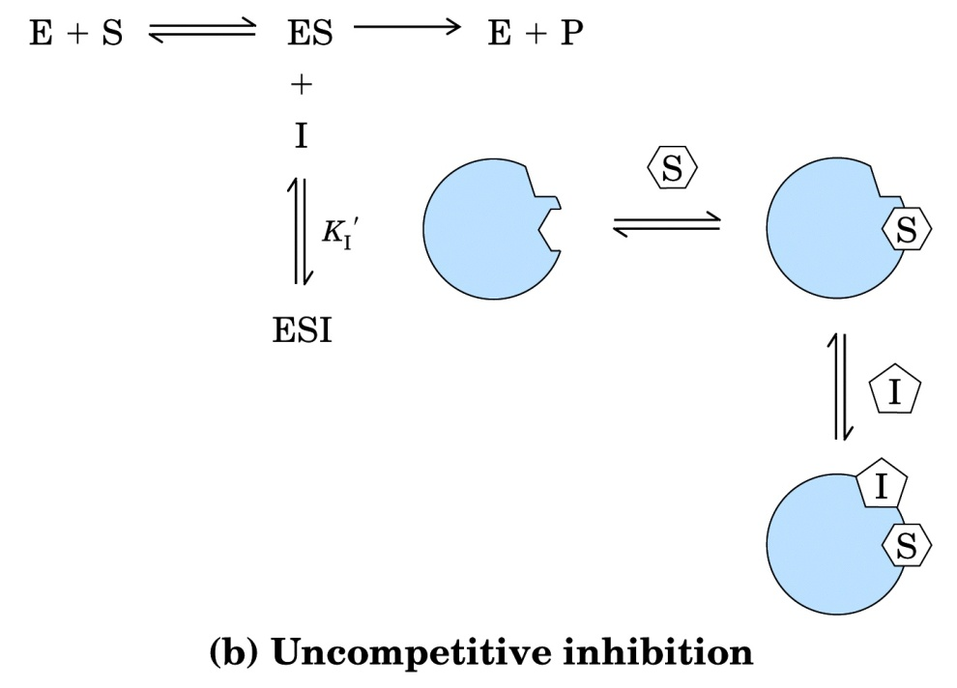
Uncompetitive Inhibition
An uncompetitive inhibitor binds exclusively to the enzyme-substrate complex yielding an inactive enzyme-substrate-inhibitor complex.
An uncompetitive inhibitors could have dramatic physiological consequences, as the inhibitor decreases the enzyme activity, there is an increase in the local concentration of substrate.

Slide 61
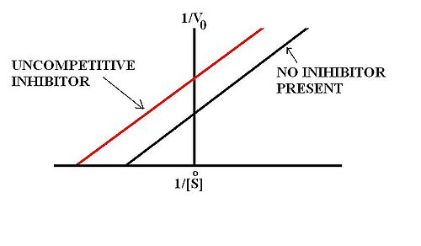
Vmax value and the apparent Km value should both decrease

Slide 62
Uncompetitive Enzyme Inhibition
Inhibitor binds to enzyme- substrate complex
Both Vmax and Km are decreased
e.g ; Inhibition of placental alkaline phosphatase (Regan isoenzyme) by phenylalanine

Slide 63
Competitive V/S Non competitive V/S Uncompetitive Enzyme Inhibition

Slide 64
Allosteric Inhibition
Allosteric means “other site”
These enzymes have one catalytic site (Active site) where the substrate binds and another separate allosteric site where the modifier binds.
The allosteric sites may or may not be physically adjacent.
The binding of the modifier may enhance (Positive modifier) or inhibit (Negative modifier) the enzyme activity.
E
Active site
Allosteric site

Slide 65
Allosteric Inhibition- Salient features
Inhibitor is not a substrate analogue
Partially reversible, when excess substrate is added
Km is usually increased(K series enzymes)
Vmax is reduced(V series enzymes)
When the inhibitor binds the allosteric site, the configuration of the active site is changed so that the substrate can not bind properly.
Most allosteric enzymes possess quaternary structure.

Slide 66
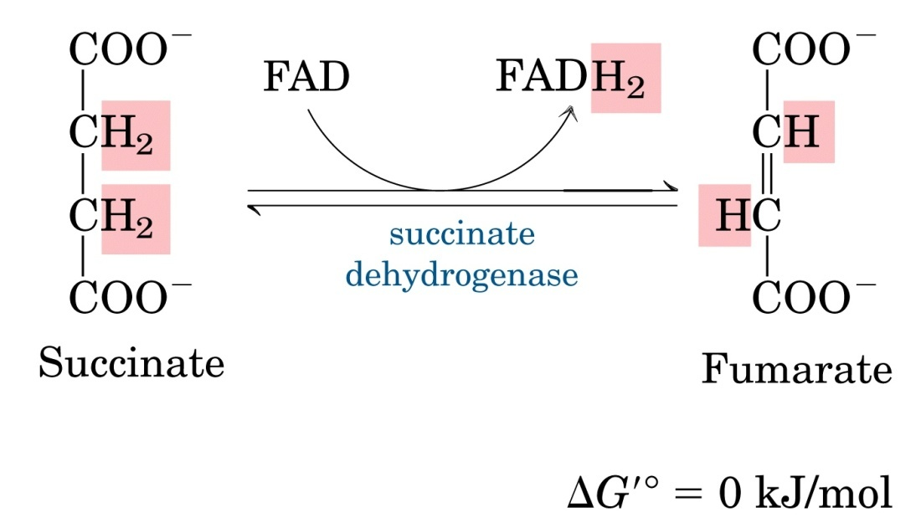
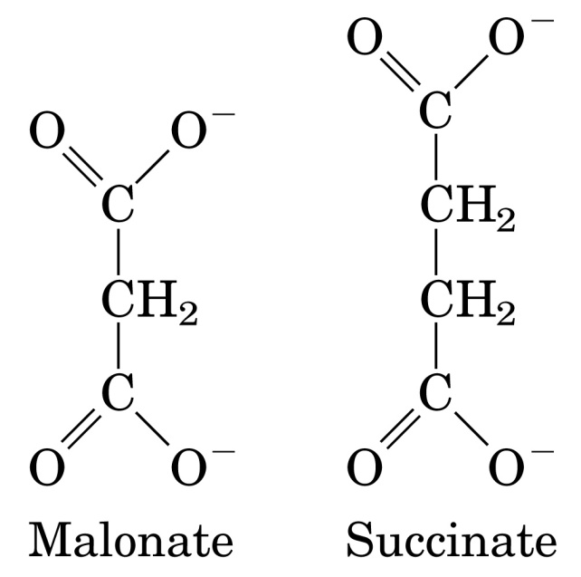
Succinate dehydrogenase is a classic example of competitive inhibition
Malonate is a strong competitive inhibitor of succinate dehydrogenase
From Lehninger
Principles of Biochemistry

Slide 67
Effects of Inhibitors on the parameters of Michaelis-Menten Equation
Type of inhibition V_{max}^{app} K_{M}^{app}
No inhibitor V_{max} K_{M}
Competitive V_{max} αK_{M}
Uncompetitive V_{max}/α’ K_{M}/α’
Noncompetitive (Mixed) V_{max}/α’ αK_{M}/α’
α = 1 + [I] α’ = 1 + [I]
K_{I} K_{I}’

Slide 68
Regulation of enzymatic activity
Two ways that this may occur:
Control of enzyme availability
Depends on rate of enzyme synthesis & degradation
Control of enzyme activity
Enzyme-substrate binding affinity may vary with binding of small molecules called allosteric effectors (ex: BPG for Hb)
Allosteric mechanisms can cause large changes in enzymatic activity

Slide 69
Regulatory Enzymes
important in controlling flux through metabolic pathways
Allosteric enzymes
2. Regulation by covalent modification
3. Induction and repression of enzyme synthesi
From Lehninger
Principles of Biochemistry

Slide 70
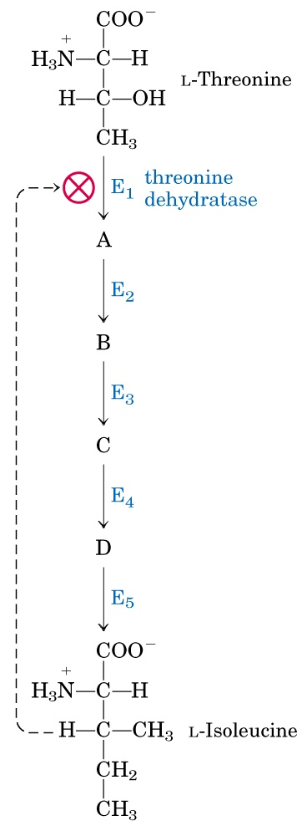
Regulation by Feedback Inhibition
Conversion of L-threonine to L-isoleucine catalyzed by a sequence five enzymes, E₁-E₅
L-isoleucine is an inhibitory allosteric modulator of E₁
From Lehninger
Principles of Biochemistry

Slide 71
