Slide 1
Let’s talk about Corpus Linguistics
by
Abdullah Alasmary
Associate Professor of Applied Linguistics & Academic Writing
English Dept
College of Languages & Translation
King Saud University
https://fac.ksu.edu.sa/aasmary
aasmary@ksu.edu.sa
abdulahalasmary

Slide 2
What is corpus linguistics? How important is it?
What is a corpus?
What can corpora do?
What software tools are there to create and analyze language patterns?
An example of a corpus-based study
https://fac.ksu.edu.sa/aasmary
aasmary@ksu.edu.sa
abdulahalasmary

Slide 3
Corpus linguistics is “an area which focuses upon a set of procedures, or methods, for studying language” (McEnery & Hardie, 2012)
Corpora are “ large, principled and computer-readable collections of texts that allow analysis of patterns of language use across different contexts” (Szudarski, 2018, p. 1)
_____________________________
1. McEnery, T., & Hardie, A. (2012). Corpus linguistics: Method, theory and practice. Cambridge: Cambridge University Press.
2. Szudarski, P. (2018). Corpus linguistics for vocabulary: A guide for research. London: Routledge.
https://fac.ksu.edu.sa/aasmary
aasmary@ksu.edu.sa
abdulahalasmary

Slide 4
it is empirical, analyzing the actual patterns of use in natural texts;
It is more representative of the linguistic phenomenon under investigation
it depends on both quantitative and qualitative analytical techniques.
_____________________________
1. Biber, D., Conrad, S. and Reppen, R. (1998). Corpus Linguistics: Investigating language structure and use. Cambridge: Cambridge University Press.
https://fac.ksu.edu.sa/aasmary
aasmary@ksu.edu.sa
abdulahalasmary

Slide 5
Corpus linguistics and other areas of linguistics
Discourse analysis
Historical linguistics
Lexicography
Pragmatics
Genre analysis
Academic writing/ESP/EAP
Error analysis
Translation and interpreting studies
https://fac.ksu.edu.sa/aasmary
aasmary@ksu.edu.sa
abdulahalasmary

Slide 6
Types of corpora
General corpora
Corpus of Contemporary American English(COCA) (https://www.english-corpora.org/coca/)
British National Corpus (BNC) (http://www.natcorp.ox.ac.uk/)
https://fac.ksu.edu.sa/aasmary
aasmary@ksu.edu.sa
abdulahalasmary

Slide 7
Types of corpora
Specialized corpora
Antconc (https://www.laurenceanthony.net/)
WordSmith tools (https://www.lexically.net/wordsmith/)
Corpus tools (https://corpus-analysis.com/)
https://fac.ksu.edu.sa/aasmary
aasmary@ksu.edu.sa
abdulahalasmary

Slide 8
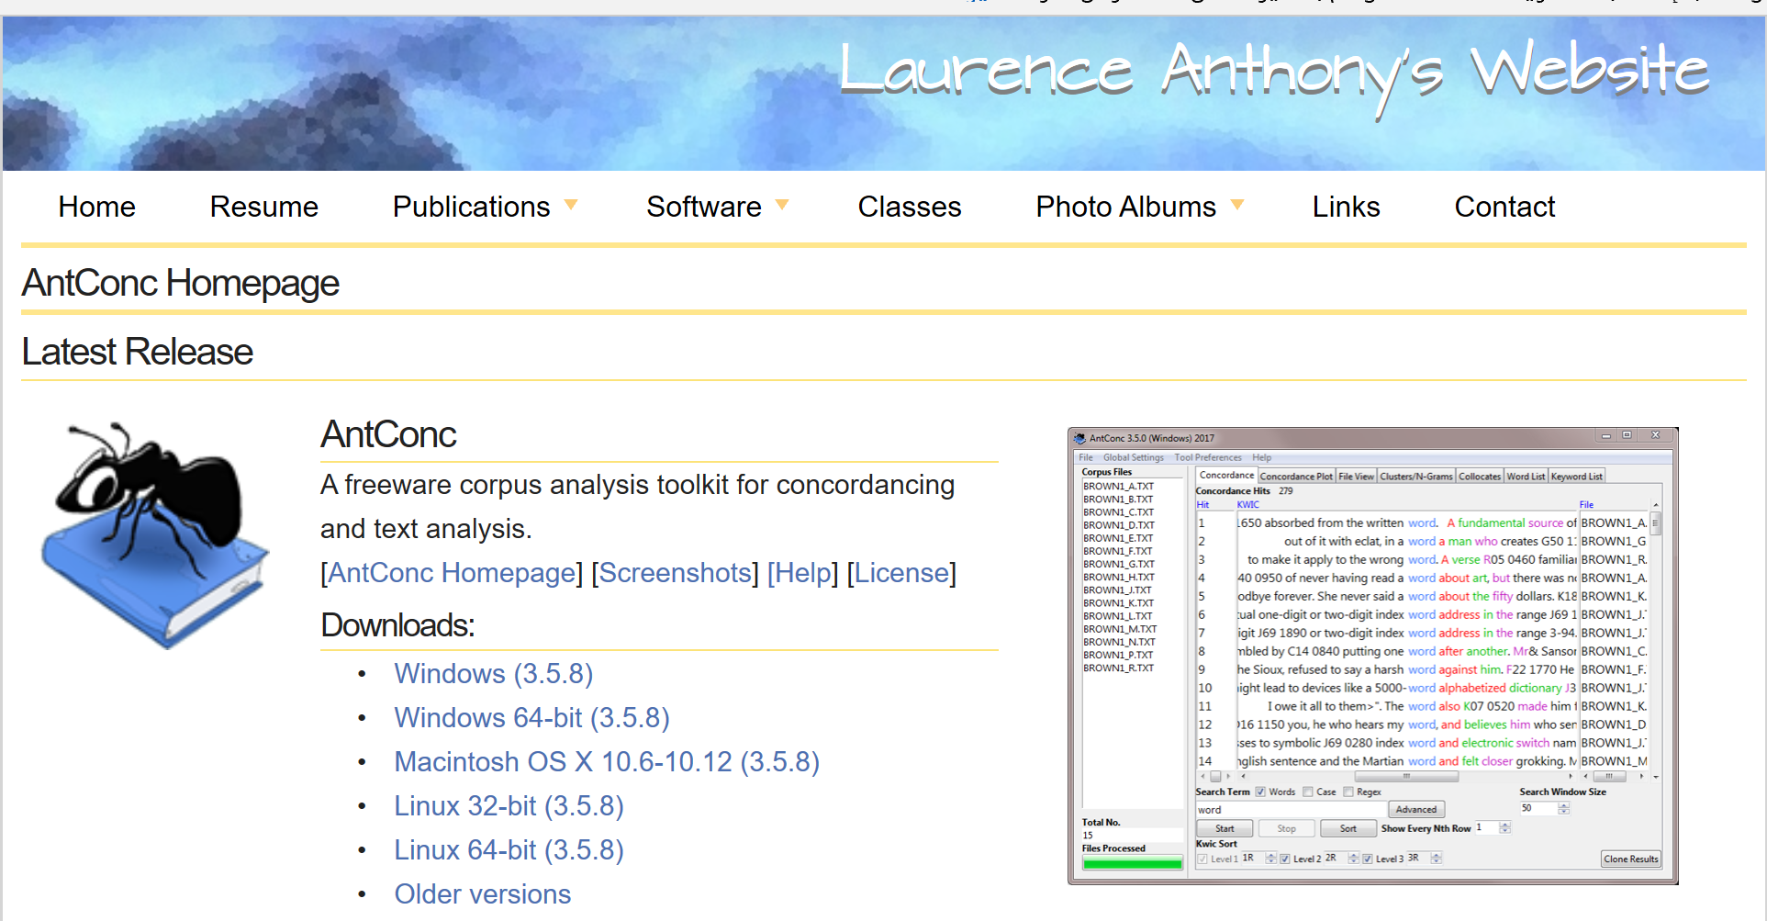
https://fac.ksu.edu.sa/aasmary
aasmary@ksu.edu.sa
abdulahalasmary

Slide 9
1. antconc
https://fac.ksu.edu.sa/aasmary
aasmary@ksu.edu.sa
abdulahalasmary

Slide 10
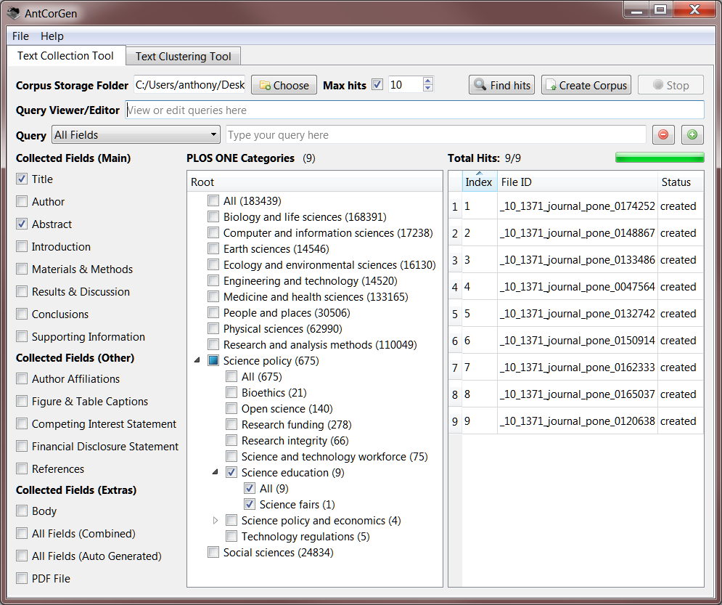
Corpus analysis tools
https://fac.ksu.edu.sa/aasmary
aasmary@ksu.edu.sa
abdulahalasmary

Slide 11
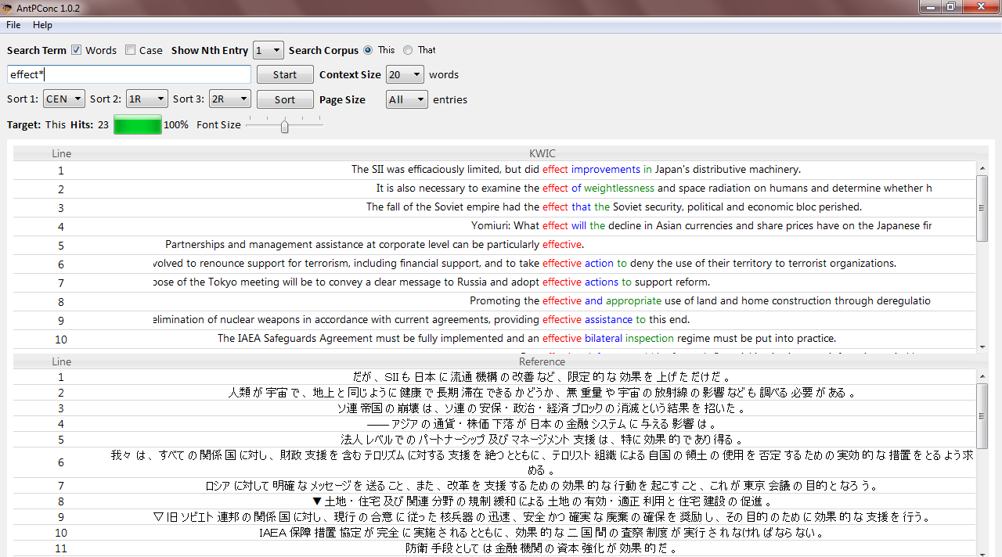
Parallel corpus
https://fac.ksu.edu.sa/aasmary
aasmary@ksu.edu.sa
abdulahalasmary

Slide 12
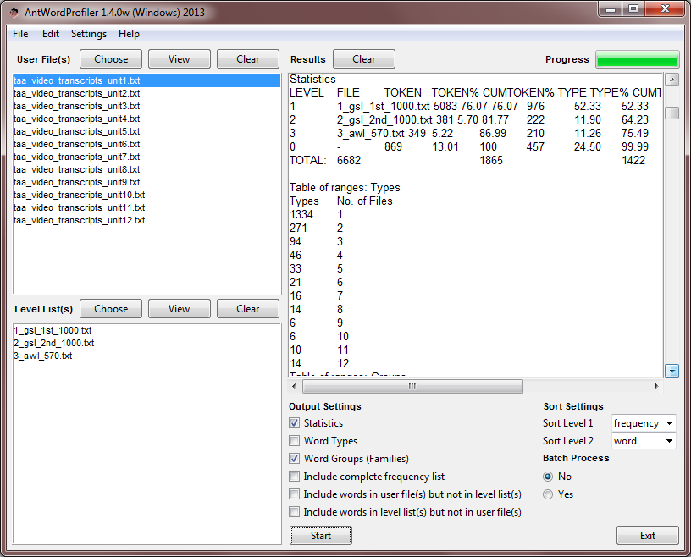
Parallel corpus
https://fac.ksu.edu.sa/aasmary
aasmary@ksu.edu.sa
abdulahalasmary

Slide 13
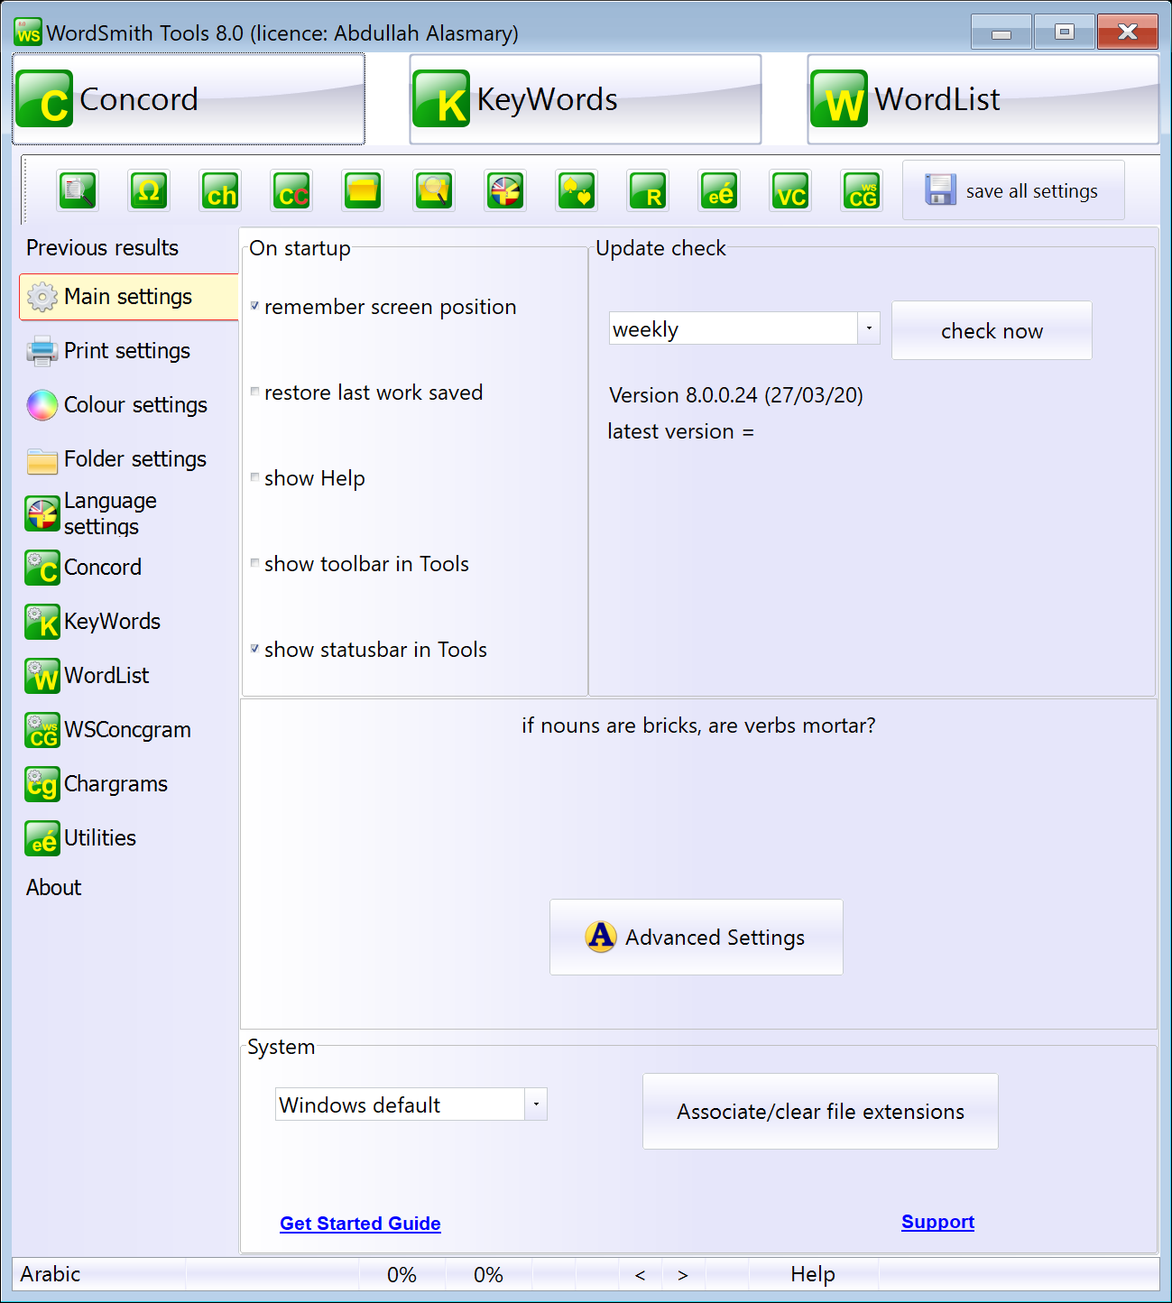
https://fac.ksu.edu.sa/aasmary
aasmary@ksu.edu.sa
abdulahalasmary

Slide 14
Practice
What are the most recurrent and most widely distributed lexical bundles in a corpus of written academic contract law texts?
https://fac.ksu.edu.sa/aasmary
aasmary@ksu.edu.sa
abdulahalasmary

Slide 15
Lexical bundles
length (4-word lexical bundles)
frequency (10 pmw)
distribution (5 texts)
2. Data (written academic textbooks)
3. Domain (legal discourse)
4. sub-domain (contract law)
https://fac.ksu.edu.sa/aasmary
aasmary@ksu.edu.sa
abdulahalasmary

Slide 16
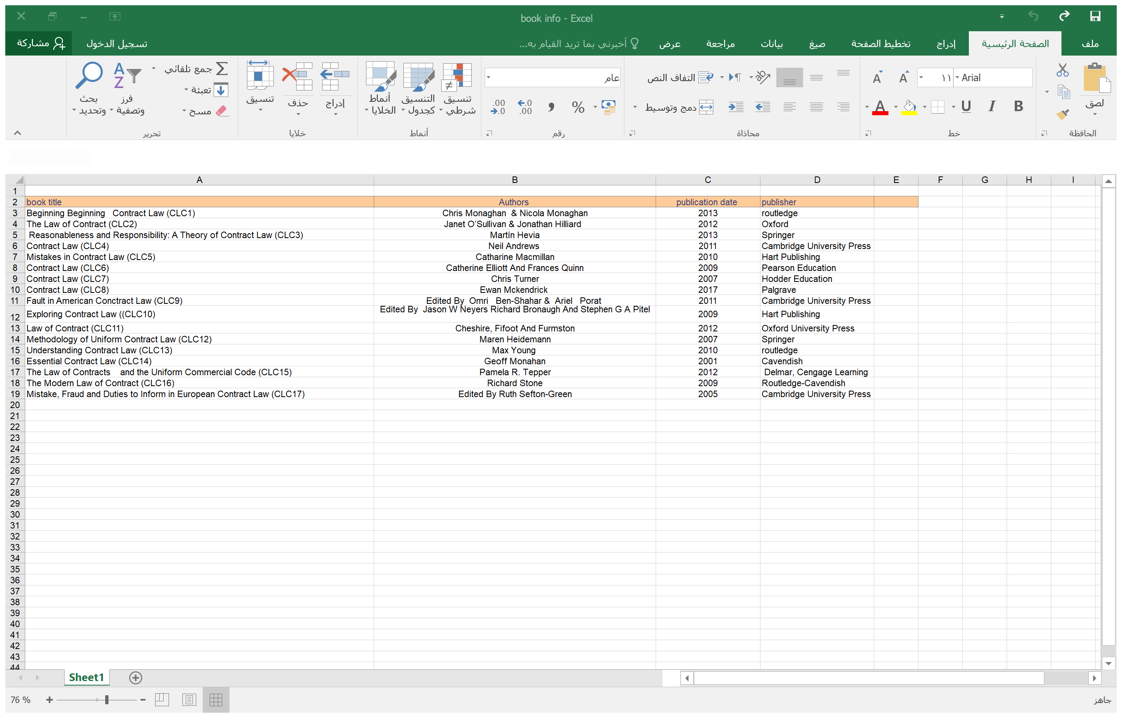
https://fac.ksu.edu.sa/aasmary
aasmary@ksu.edu.sa
abdulahalasmary

Slide 17
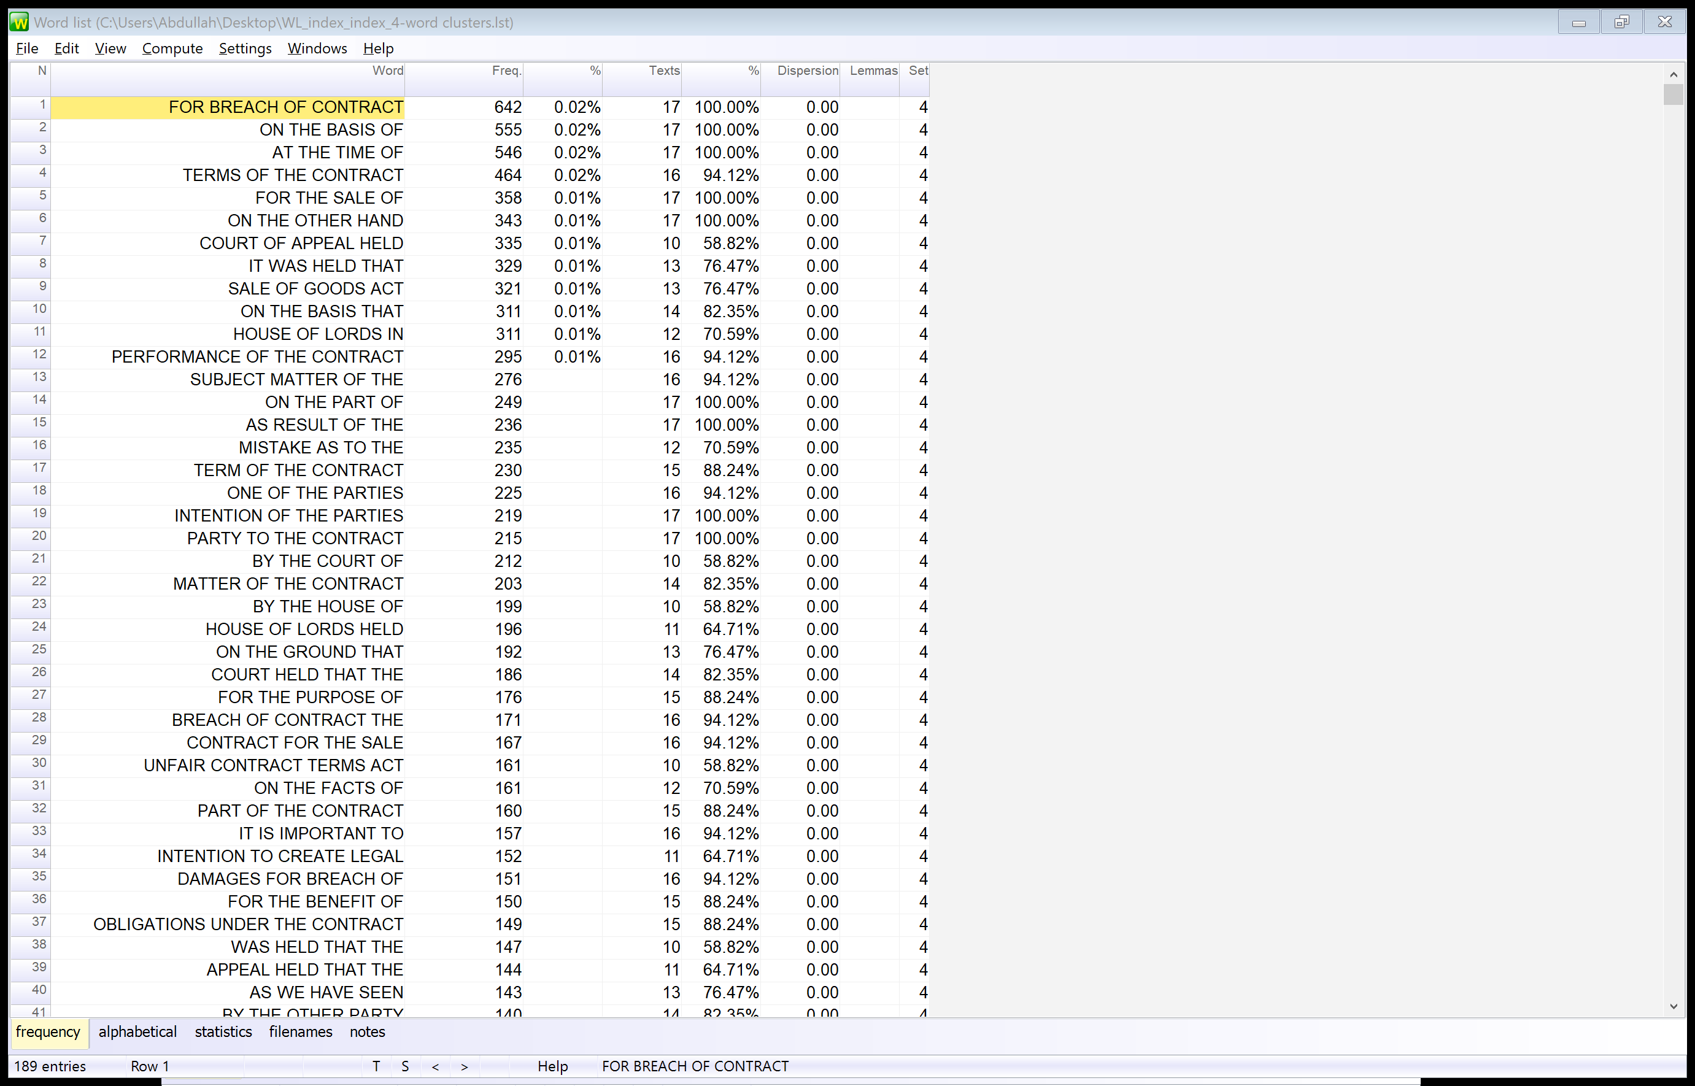
https://fac.ksu.edu.sa/aasmary
aasmary@ksu.edu.sa
abdulahalasmary

Slide 18
Structural analysis of data based on Biber et. al’s (2004)
noun-based bundles
preposition-based bundles
verb-based bundles
Functional analysis of lexical bundles based on Hyland’s (2008) framework
research-oriented bundles
text-oriented bundles
participant-oriented bundles
https://fac.ksu.edu.sa/aasmary
aasmary@ksu.edu.sa
abdulahalasmary

Slide 19
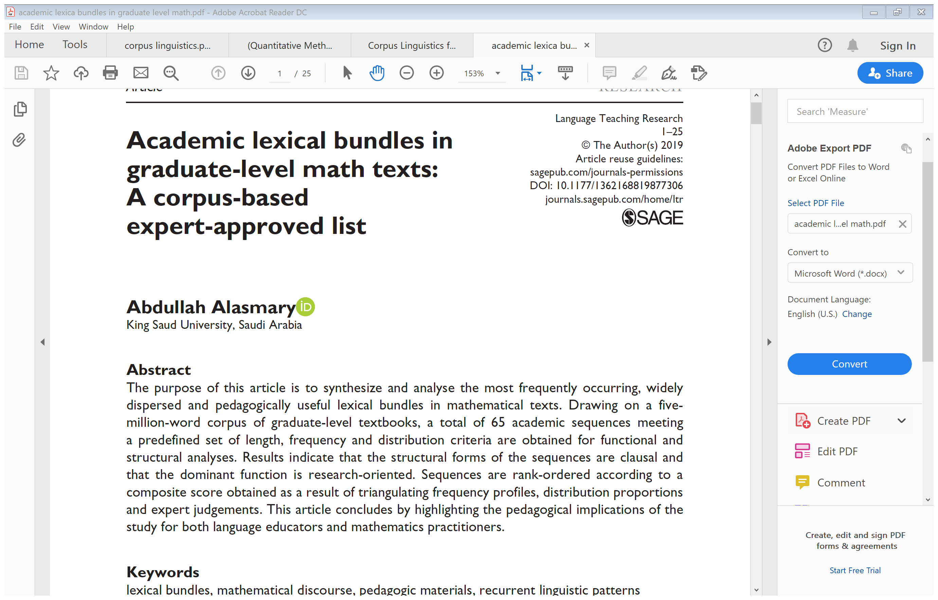
https://fac.ksu.edu.sa/aasmary
aasmary@ksu.edu.sa
abdulahalasmary

Slide 20
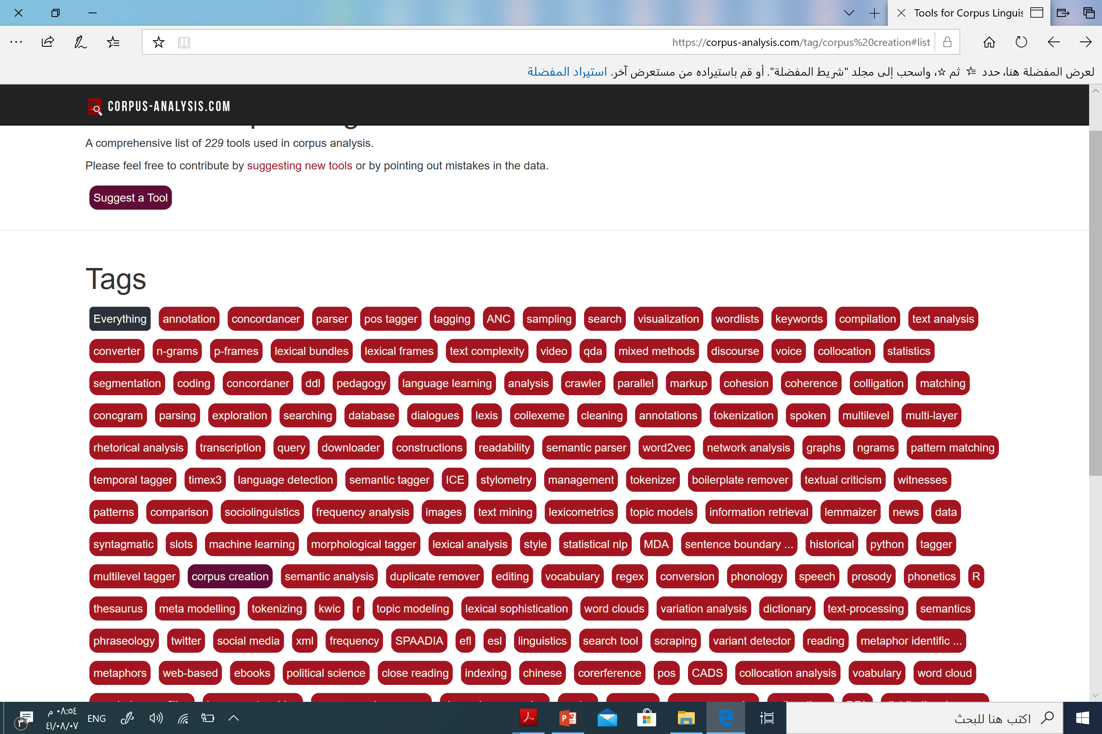
https://fac.ksu.edu.sa/aasmary
aasmary@ksu.edu.sa
abdulahalasmary

Slide 21
Thank you so much for zooming in
Q & A
https://fac.ksu.edu.sa/aasmary
aasmary@ksu.edu.sa
abdulahalasmary

