Slide 1

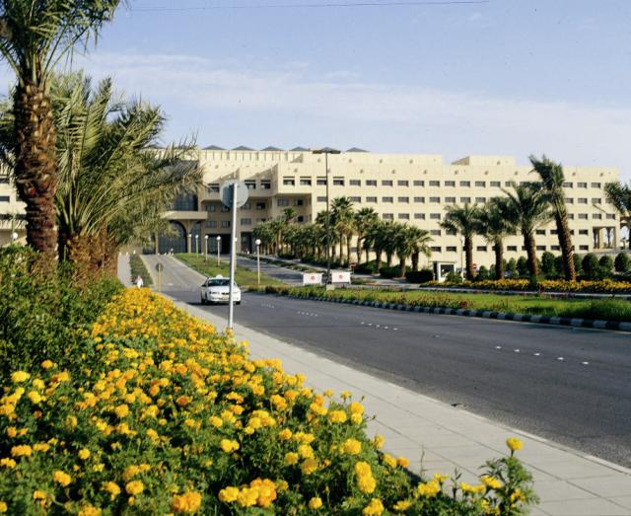
قسم الصيدلانيات
كلية الصيدلة
جامعة الملك سعود
PHT 432)) Industrial Pharmacy
Dr. Fars Alanazi
AA101

Slide 2
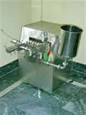
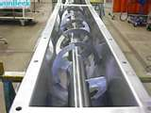
8-9
Lectures
Crystallization

Slide 3


Slide 4
Outline of the lecture:
Crystallization
  Pharmaceutical significance
  Crystal forms and crystal habit
  Solubility curves
  The mier’s supersaturation theory
  Factors affecting rate of crystal growth
  Caking of crystals
  Crystallization equipment
Batch crystallizers
  Agitated batch crystallizer
  Swenson walker crystallizer
  Wulf bock crystallizer
Continuous crystallizer
  Oslo crystallizers
  Oslo cooler crystallizer
  Oslo evaporative crystallizer
  Oslo vacuum crystallizer
  Howard crystallizer

Slide 5
Crystallization is an important operation in the chemical industry as a method of purification and as a method of providing crystalline materials in the desired size range.
In a crystal, the constituent molecules, ions or atoms are arranged in a regular manner with the result that the crystal shape is independent of size and if a crystal grows, each of the faces develops in a regular manner.
Energy saving is more in crystallization in comparison with distillation to obtain solid substance.

Slide 6
Crystallization is normally carried out either from a solution or from a melt. Rarely, crystals are formed directly by condensation from the vapor phases. Crystallization from solutions is important industrially.
Crystal forms:
The only logical and accepted method for the classification of crystals is according to the angles between the faces.
In this system, the types of crystal form have no relationship to the relative sizes of the faces since the relative development of the faces is not a constant characteristic of a specific material.
Any substance always crystallizes in such a way that the angle between a given Pair of faces is the same in all specimens and is characteristic of that particular substance.

Slide 7
Crystal habit:
This term is used to denote the relative development of different types of faces.
Example
Sodium chloride crystallizes from aqueous solutions with cubic faces only. On the other hand, if NaCL is crystallized from an aqueous solution containing small amount of urea, the crystals obtained will have octahedral faces.
Both types of crystals belong to the cubic system but differ in habit.
∴The word habit refers to the type of faces developed and not to the shape of the resulting crystal.

Slide 8
Crystal habit is affected by the following factors
  Presence of impurities
  Temperature
  Degree of supersaturation.
In some respects crystallizeation can be regarded as the inverse of dissolution but there are important differences.
The number of particles present during dissolution will remain constant or decrease whereas in crystallization the number of nuclei on which material is deposited may continuously increase.

Slide 9
The crystallization process consists essentially of two stages:
  Formation of small particles or nuclei.
  Growth of the nuclei.
And for crystallization to occur, saturation and supersaturation must happen.

Slide 10
Effect of Temperature on solubility
Generally, increase in the temperature of the solution usually increases the solubility of the solute. In some cases, the temp coefficient of solubility is negative and sometimes it is zero.
KNO₃ has a large positive temperature coefficient and is therefore readily crystallized by cooling a saturated solution. NaCL has a small coefficient and very little crystallization occurs on cooling and evaporation of solvent is therefore essential. (The solubility of KNO₃ is more affected by temperature than NaCL).
When the stable crystal form changes as temp is altered (e.g. with hydrated salts), the curve is discontinuous, the coefficient may be positive over part of the range of temp. (Na₂CO₃. 10H₂O) and negative over the remainder (Na₂CO₃.H₂O).

Slide 11
NaCl
KNO3
Na2 CO3. H2O
Na2 CO3. 10H2O

Slide 12
The Miers supersaturation theory:

Slide 13
Factors affecting rate of crystal growth :
1- Temperature and concentration of the liquid at the crystal face:
These conditions are not generally the same as those in the bulk of the solution because
  Concentration gradient is necessary for the transfer of solute towards the face
  Temperature gradient for the dissipation of the heat of crystallization.
Thus the problem involves both heat transfer and mass transfer.
Thus the concentration gradient is the driving force for crystal growth.

Slide 14
2. Rate of agitation: The rate of crystallization is improved by increasing the rate of agitation. The crystallization rate initially rises very rapidly by increasing agitation but a point is reached where further increase in the agitation produces no effect on the rate of crystal growth.
3. Degree of supersaturation: This increases the crystallization rate.
4. Presence of impurities: Any foreign solid bodies act as a nucleus and enhance crystallization.
5. Viscosity: As the viscosity increases, the rate of crystal growth decreases, because the viscosity decreases the rate of diffusion of solute to the crystal surface.

Slide 15
Caking of crystals:
The tendency for crystalline materials to cake is attributable to a small amount of dissolution taking place at the surface of the crystals and subsequent reevaporation of the solvent. The crystals become very tightly bonded together.
If a saturated solution of NaCL is brought into contact with air, water may be evaporated from the solution or may be absorbed from atmosphere.

Slide 16
This depends on
  Vapour pressure of the solution.
  Relative humidity (partial pressure of water in atmosphere)
If a saturated solution is brought into contact with air in which the partial pressure of water is less than the vapour pressure of the solution, the solution will evaporate. On the other hand, if the air contains more moisture than this limiting amount, the solution will absorb water until it is so dilute that its vapor pressure is equal to the partial pressure of the moisture of the air with which it is in contact.

Slide 17
If a crystal of a soluble salt is in contact with air that contains less water than would be in equilibrium with the saturated solution, the crystals stay dry due to evaporation of solution.
On the other hand, if the crystal is brought into contact with air containing more moisture than would be in equilibrium with its saturated solution, the crystal will become damp and will absorb water.

Slide 18
Example:
At 70 ° F, vapor pressure of saturated NaCL solution = 14.63 mm and partial vapor pressure of water = 18 .76 mm.
If partial pressure of water vapor in atmosphere is less than 14.63 mm, the crystal remains dry i.e. evaporation of water from solution to atmosphere.
If the partial pressure of water vapor in atmosphere is more than 14.63 mm, the crystal become damp due to absorption of water from atmosphere to the solution

Slide 19
Relative humidity:
∴ Relative humidity of saturated NaCL solution = (14.63)/ 18.76 x 100 = 77.8 %
∴ If salt at 70 °F is brought into contact with air its relative humidity > 78%, the partial pressure of water vapour in the air is more than that of saturated salt solution so moisture will be absorbed and condensed on the salt.
On the other hand, if NaCL is exposed to air its relative humidity < 78%, it will stay dry, due to evaporation of H₂O from the solution and caking Doesn’t occurs.
∴ 78% in referred to the critical humidity of NaCI.

Slide 20
Definition of critical humidity:
It is the relative humidity above which the crystals will become damp and below which they will stay dry.
Prevention of caking:
Suppose a sample of NaCl be exposed for a short time to an atmosphere more moist than its critical humidity and then removed to an atmosphere less moist than its critical humidity.
During the first period, it will absorb some moisture, and during the second period it will lose this moisture.

Slide 21
If the crystals are large so that there are few points of contact and there is a large free volume between the crystals so there is no appreciable bonding of the crystals, this will lead to caking minimization. On the other hand, if the crystals are fine or have small percentage of voids or are in contact with a moist atmosphere for a long time, sufficient moisture may be absorbed to fill the voids entirely with saturated solution and when this have been reevaporated, the crystals will lock into a solid mass.

Slide 22
To prevent the caking of crystals the following conditions are desirable:
    The highest possible critical humidity.
    A product containing uniform crystals with the maximum percentage of voids and the fewest possible points of contact.
    A coating of powdery inert material to the crystals that can absorb moisture such as magnesia or tricalcium phosphate.

Slide 23
The first condition:
(Maximum critical humidity) is often obtained by removing impurities such as CaCl₂ (or MgCl₂).
These impurities have a lower critical humidity than the product desired so absorb H2O from atmosphere and caking occurs.

Slide 24
In the second condition
To increase the percent of voids, it is not necessary to produce larger crystals but to produce a more uniform mixture. However, non - uniformity in particle size rapidly decreases the percent of voids. A fine product has more points of contact per unit volume than a coarse one and hence a greater tendency to cake.

Slide 25
Crystallization equipment (crystallizers)
Crystallization equipment is classified according to the method by which supersaturation is brought about:
  supersaturation by cooling
  supersaturation by evaporation
  supersaturation by adiabatic evaporation (cooling and evaporation)
  Salting out by adding a substance that reduces the solubility of the substance in question (High cost of production)

Slide 26
Outline of the lecture:
Crystallization
  Pharmaceutical significance
  Crystal forms and crystal habit
  Solubility curves
  The mier’s supersaturation theory
  Factors affecting rate of crystal growth
  Caking of crystals
  Crystallization equipment
Batch crystallizers
  Agitated batch crystallizer
  Swenson walker crystallizer
  Wulf bock crystallizer
Continuous crystallizer
  Oslo crystallizers
  Oslo cooler crystallizer
  Oslo evaporative crystallizer
  Oslo vacuum crystallizer
  Howard crystallizer

Slide 27
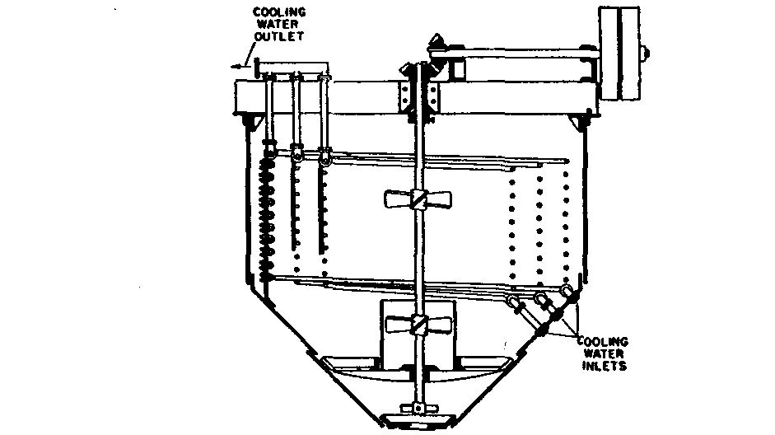
I- Batch crystallizers:
1- Agitated Batch crystallizer: Water is circulated though the cooling coils and the solution is agitated by the propellers mounted on the central shaft.

Slide 28
This agitation performs two functions:
It increases the rate of heat transfer and keeps the temperature of the solution more uniform.
It keeps the fine crystals in suspension, thus it gives them an opportunity to grow uniformly instead of forming large crystals or aggregates. (Production of uniform crystals)
The product of this operation is not only more uniform but it also very much finer than that from the older tanks.

Slide 29
Disadvantages
It is a batch or discontinuous apparatus.
The solubility is the least at the surface of the cooling coils. Therefore, crystal growth is most rapid at this point and the coils rapidly build up with a mass of crystals that decreases the rate of heat transfer.

Slide 30
2- Swenson - Walker Crystallizer
It consists of an open trough A, which is wide, a water jacket welded to the outside of the trough.
It also contains a slow - speed spiral agitator set as close as possible to the bottom of the trough.
A number of units may be joined together to give increased capacity.
The hot concentrated solution to be crystallized is fed at one end of the trough and cooling water usually flows through the jacket in counter - current to the solution.
In order to control crystal size, it is sometimes desirable to introduce an extra amount of water into certain sections in the jacket.

Slide 31
Functions of the spiral stirrer:
  It Prevents the accumulation of crystals on the cooling surface.
  It lifts the crystals that have already been formed and shower them down through the solution.
In this manner, the crystals grow while they are freely suspended in the liquid and therefore they are:
  Fairly perfect individuals.
  Uniform in size
  Free from inclusions or aggregations.
At the end of the crystallizer there may be an overflow gate where crystals and mother liquor overflow to a drain box from which the mother liquor is returned to the process and the wet crystals are fed to a centrifuge to remove mother liquor.

Slide 32
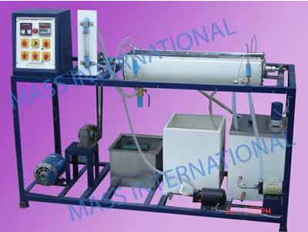
Advantages:
  Large saving in floor space.
  Large saving in material in process.
  Saving in labor.
  Uniform size crystals.
  Free from inclusions and aggregations.

Slide 33
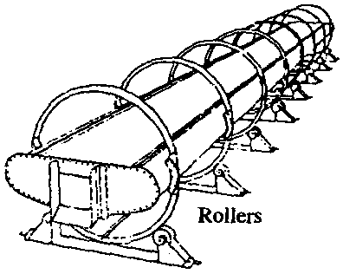
3- Wulf–Bock crystallizer:
It has similar characteristics to the swenson - walker but it depends on air cooling and gives more uniform crystals.
It consists of a shallow trough set inclined and mounted on rollers so that it can be rocked from side to side.
The slow rate of cooling in this crystallizer results in low capacity but it gives uniform crystals.

Slide 34
General disadvantages of batch crystallizers
  1- Need more workers so they are of high cost.
  2- Need large floor space.
  3- No control of the size and shape of crystals.

Slide 35
Continuous crystallizer
  Oslo crystallizers
  a- Oslo cooler crystallizer
  b- Oslo evaporative crystallizer
  c- Oslo vacuum crystallizer
  2. Howard crystallizer

Slide 36
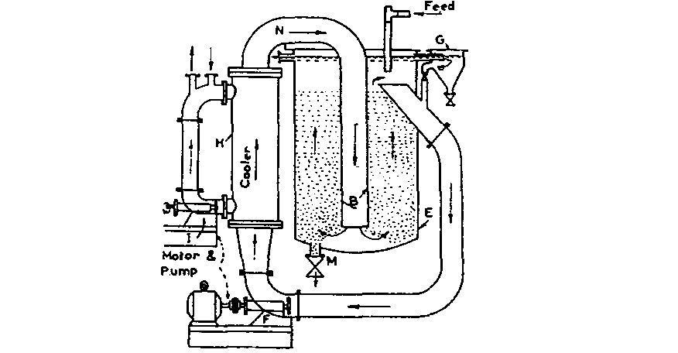
Oslo crystallizers: (or krystal crystallizers)
a- Oslo cooler crystallizers (or krystal cooler crystallizers)

Slide 37
The mother liquor is withdrawn near the feed point of the crystallizer by a circulating Pump and is passed through the cooler H where it becomes supersaturated and then fed back to the bottom of the crystallizer through the central pipe B
Some nuclei form spontaneously in the crystal bed and some forms as a result of breakage of the crystals.
A vessel G can be used to remove very small nuclei that reach the upper layers of the vessel E.
These nuclei pass again in the cooler and then to the vessel E through the tube B.
The nuclei circulate with the mother liquor until they have grown sufficiently large to be retained in the fluidized bed (liquid fluidization).
The final product is removed from the bottom of crystallizer though a valve M and a uniform product is therefore obtained because the crystals are not discharged until they have grown to the required size that settle opposing the flow from tube B.

Slide 38
Advantages
  Its a continuous crystallizer
  Give uniform size crystals.
  The size of crystals can be controlled by the pump flow rate.
It is used where large quantities of crystals of controlled size are required.
It is used for crystallization of KNO₃
Crystallization can be initiated by adding crystals to act as nuclei.

Slide 39
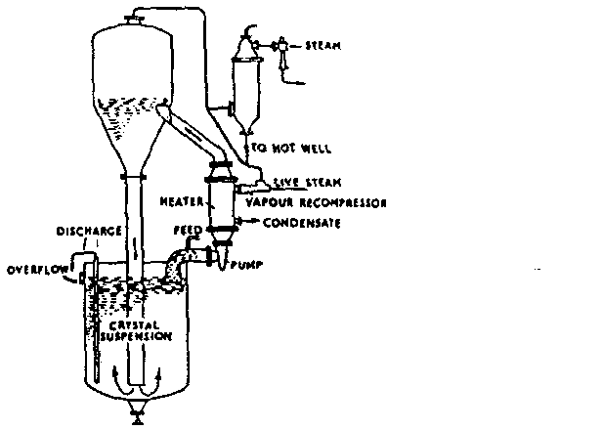
b- Oslo evaporative crystallizer (crystal evaporation crystallizer)
This method is used for substances not affected by heat.
  Small unclei reach the upper portion of the crystallizer body and enter again in the heater and the cycle repeated till the desired size is obtained.
  So the size of crystals can be controlled.
  It is a Continuous crystallizer.

Slide 40
In this apparatus, the solution is first passed through a heater and then to a flash evaporator before being returned to the crystallizer.
This method is called adiabatic cooling.
The solution is heated and then introduced into a vacuum where the total pressure is less than the vapour pressure of the solvent at the temperature at which it is introduced.
The solvent must flash and the flashing must produce adiabatic cooling, i.e. when the solution is introduced into a vacum, Flash evaporation occur. This results in drop in temperature and cooling which helps supersaturation, and removing of a part of the solvent leading to crystallization.

Slide 41
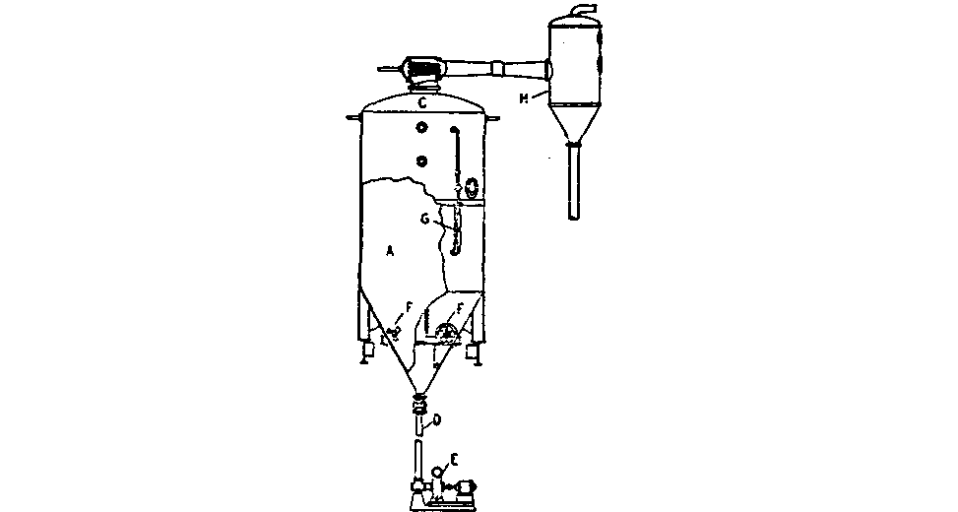
C. Oslo vacuum crystallizer:
Simple vacuum crystallizer A, crystallizer body; C, vapor outlet; D, discharge pipe; E, product pump; F, propeller stirrers, G, sight glass; H. condenser ( Swenson)
It acts by partial removal of vapor by vacuum application which leads to supersation and crystal formation. It is used mainly for crystallizing thermolabile substances.

Slide 42
2- Haward crystallizer:
This crystallizer consists essentially of a vertical conical device through which solution flows in an upward direction. The upper end of the crystallizer is the wide part of the cone.
A Concentric outer conical chamber serves as a cooling water channel.

Slide 43
Crystals that are suspended in the upward flowing stream of solution must grow to such a size that they will settle at the apex of the cone (bottom of crystallizer) be­fore they can escape.
By regulating the velocity of flow at the bottom of the crystallizer, the size of the product is controlled.

Slide 44
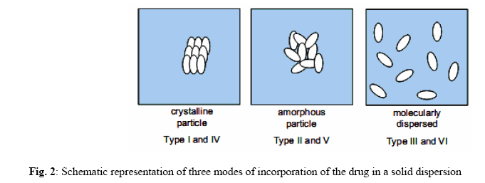
New Technology:
solid dispersions
Solid dispersion systems have been realized as extremely useful tool in improving the dissolution properties of poorly water-soluble drugs

Slide 45
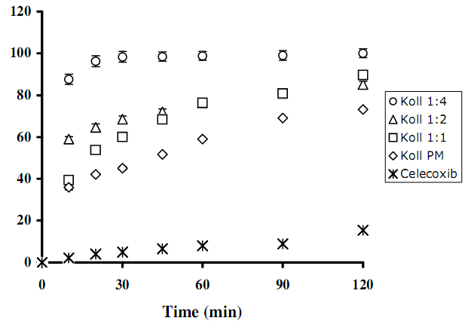
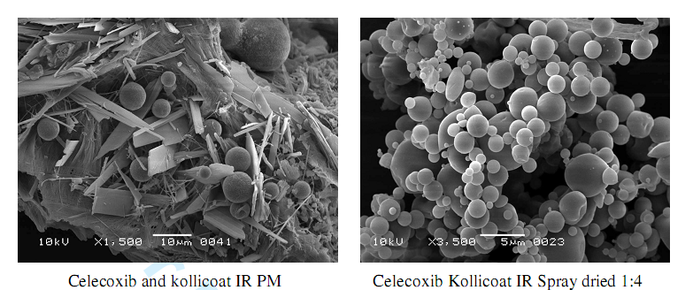

Slide 46
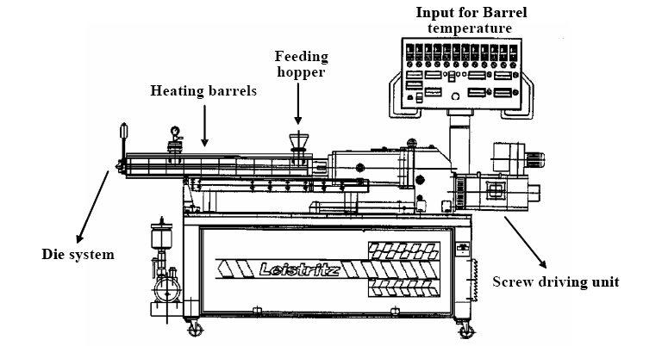
Hot-Melt Extrusion Technique

Slide 48
Outline of the lecture:
Crystallization
  Pharmaceutical significance
  Crystal forms and crystal habit
  Solubility curves
  The mier’s supersaturation theory
  Factors affecting rate of crystal growth
  Caking of crystals
  Crystallization equipment
Batch crystallizers
  Agitated batch crystallizer
  Swenson walker crystallizer
  Wulf bock crystallizer
Continuous crystallizer
  Oslo crystallizers
  Oslo cooler crystallizer
  Oslo evaporative crystallizer
  Oslo vacuum crystallizer
  Howard crystallizer

