Slide 1
CSC 201 Orientation
C Programming Language

Slide 2
Course Description
CSC 201 provides an introduction to the C programming language for those with no prior programming experience.
The course aims to teach the syntax and use of major constructs of the C language.
After successfully completing this course, the student will be able to write computer programs using C language.

Slide 3
Course Objectives
Understand introductory computer science terms.
Understand the program specification.
Translate the program specification into the C language
Compile and execute a C program in a programming environment.
Perform arithmetic, relational and logical operations.
Manipulate characters and strings.
Apply various selection constructs.
Implement repetition controls.
Use functions.
Manipulate arrays.

Slide 4
Course blog
https://csc201cs.wordpress.com

Slide 5
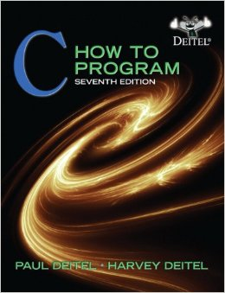
Textbook
Paul Deitel and Harvey Deitel.“C: How to Program”, Prentice Hall, 7th Edition, 2012

Slide 6
Midterm Dates
MID 1:
10/3/2015
19/5/1436
MID2:
28/4/2015
9/7/1436

Slide 7
Grades Distribution
Assignments 10%
Quiz 10%
MID 1 20 %
MID 2 20%
Final 40 %
------------------
Total : 100%

Slide 8
Any questions?

Slide 9
Interesting Background information
WHAT DO YOU KNOW ABOUT PROGRAMMING LANGUAGES ?

Slide 10
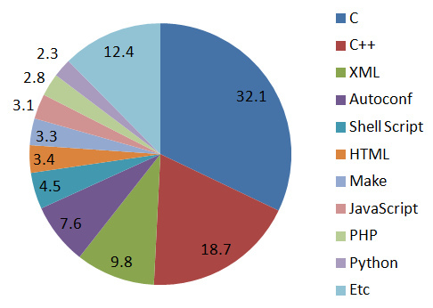
What is C???
C is a high-level and general purpose programming language .
Developed in the early 1970s.
Ranked among the most widely used languages, C has a compiler for most computer systems .
Operating system programs such as Windows, Unix, Linux are written in C language

Slide 11
What are high- level- programming language
languages that are closer to human languages and further from machine languages.
high- level- programming language : C/C++ , Java , Pascal , FORTRAN , BASIC
low- level- programming language : Assembly
The main advantage of high-level languages over low-level languages is that they are easier to read, write, and maintain.
programs written in a high-level language must be translated into machine language by a compiler or interpreter.

Slide 12
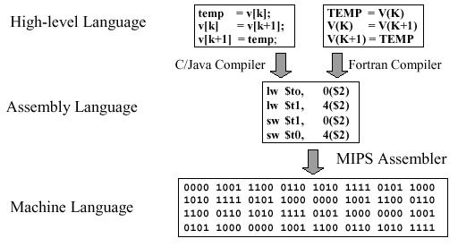
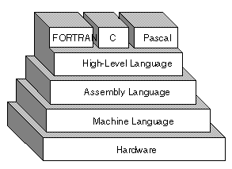

Slide 13
THE “HELLO WORLD” PROGRAM
C code:
/* Hello World program */
#include<stdio.h>
main() {
printf("Hello World");
}
Pascal code:
program HelloWorld;
begin
writeln('Hello World');
end.
JAVA code:
public class HelloWorld {
public static void main(String[]args) {
System.out.println("Hello World"); } }

