Slide 1
Function 2
Editedby : Nouf almunyif

Slide 2
Recursion
Main calls another function…..normal
A function calls another function2….normal
A function calls itself ?! Possible??
YES
→A recursive function is one that call itself.
General form
void recurse()
{ recurse(); //Function calls itself
}

Slide 3
Finding Factorial 5! = 5*4*3*2*1
5!
5!
Final value=120
5!=5*24=120 returned
5*4!
5*4!
4!=4*6=24 returned
4*3!
4*3!
3!=3*2=6 returned
3*2!
3*2!
2!=2*1=2 returned
2*1!
2*1!
1
1
1

Slide 4
Recursion
Recursive functions
Are functions that calls themselves
Example: factorial
n! = n * ( n – 1 ) * ( n – 2 ) * … * 1
Recursive relationship ( n! = n * ( n – 1 )! )
5! = 5 * 4!
4! = 4 * 3!…
Base case (1! = 0! = 1)

Slide 5
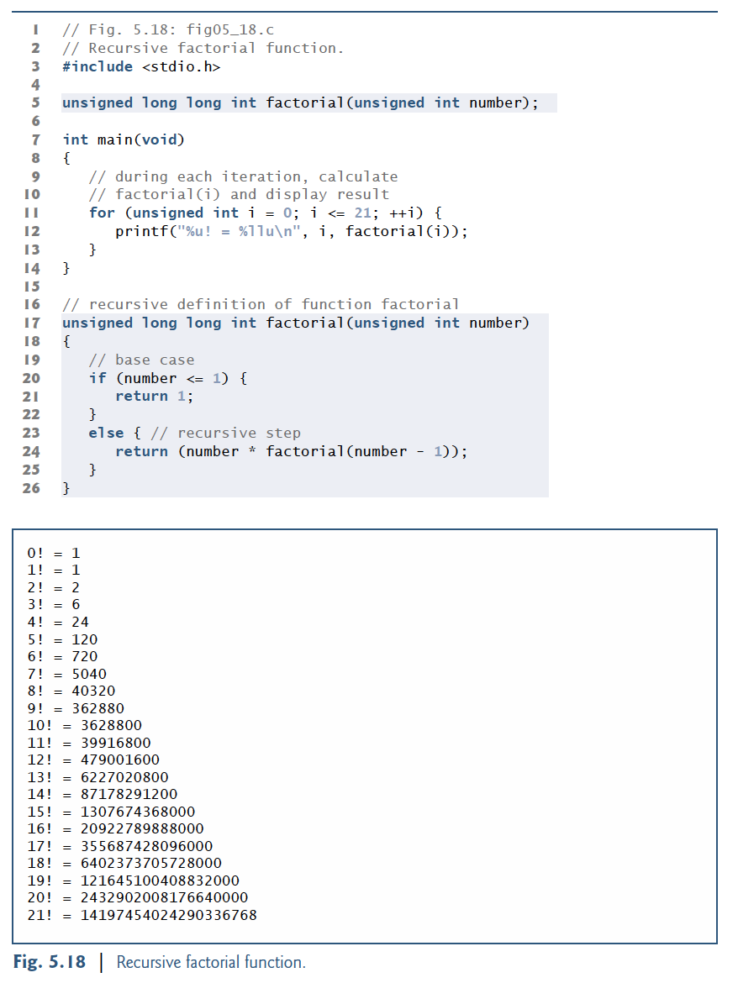

Slide 7
Example printing number counting doun
#include <stdio.h>
//////////////////////////////////
void printing( int counter);
//////////////////////////
void main()
{int input;
printf("enter positive number ");
scanf("%d", &input);
printing(input);}
///////////////////////////////////
void printing( int counter){
if(counter == 0)
return;
// no value returning just for EXIT the function
else {
printf ("%d \n",counter);
printing(--counter);
return;
// no value returning just for EXIT the function
}
}

Slide 8
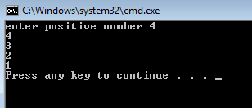

Slide 9
The Fibonacci Series
f( 3 )
Fibonacci series: 0, 1, 1, 2, 3, 5, 8...
Each number sum of two previous ones
Example of a recursive formula:
fib(n) = fib(n-1) + fib(n-2)
C code for fibonacci function
long fibonacci( long n )
{
if ( n == 0 || n == 1 ) // base case
return n;
else if ( n < 0 )
return –1;
else
return fibonacci( n - 1 ) + fibonacci( n – 2 );
}
return
f( 2 )
+
f( 1 )
return
f( 1 )
+
f( 0 )
return 1
return 1
return 0

Slide 10
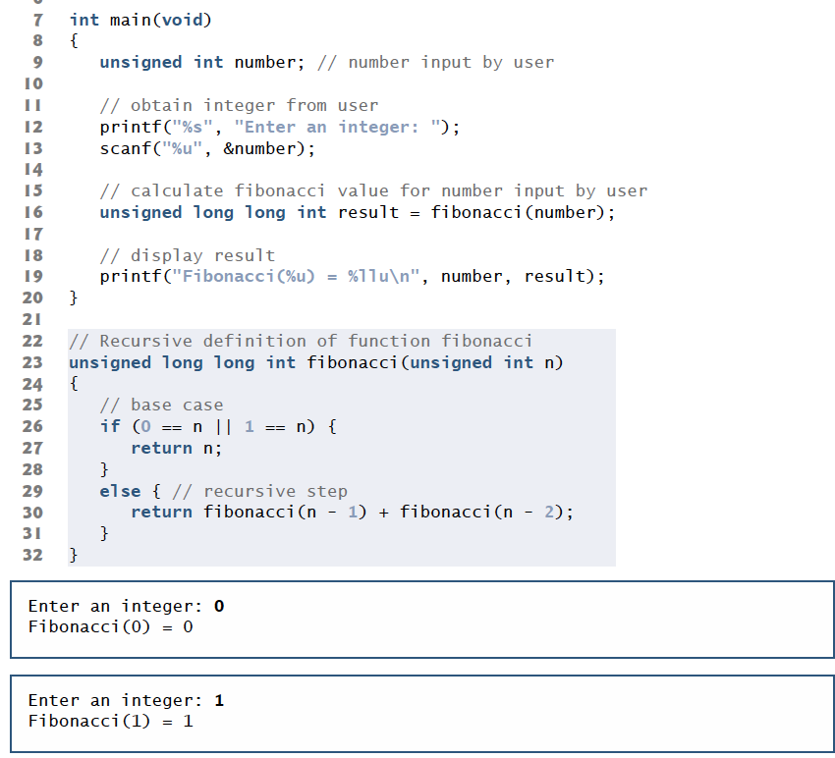
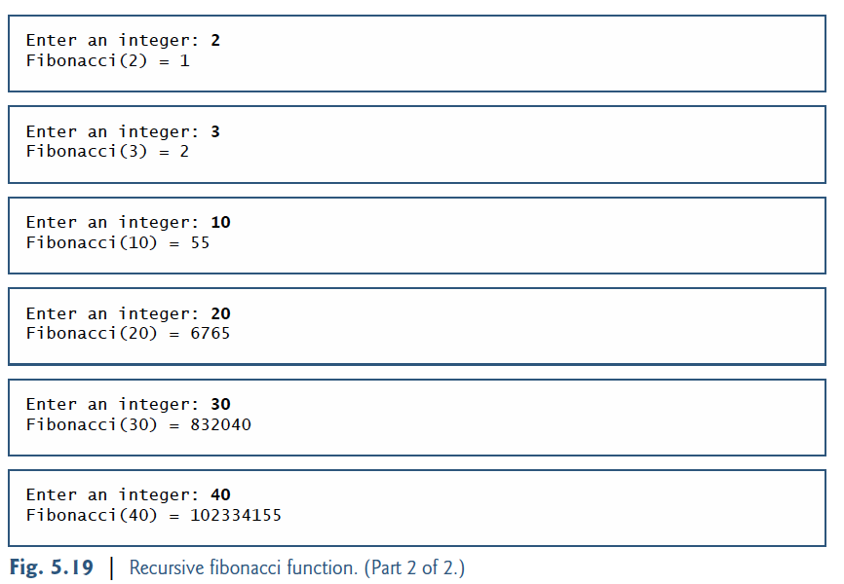

Slide 11
Recursion vs. Iteration
Repetition
Iteration: explicit loop
Recursion: repeated function calls
Termination
Iteration: loop condition fails
Recursion: base case recognized
Both can have infinite loops
Balance between performance (iteration) and good software engineering (recursion)

