Slide 1
Programming II
I/O Streams and Data Files

Slide 2
Objectives
In this chapter, you will learn about:
I/O file stream objects and functions
Reading and writing character-based files
Random file access
File streams as function arguments

Slide 3
Working with files
Binary files: store data in the same format that a computer has in main memory
Text files : store data in which numeric values have been converted into strings of ASCII characters
Files are opened in text mode (as text files) by default
There are three basic operations that you will need to perform when working with disk files:
Open the file for input or output.
Process the file, by reading from or writing to the file.
Close the file.

Slide 4
Files and Streams
C++ views each files as a sequential stream of bytes
Operating system provides mechanism to determine end of file
End-of-file marker → EOF()
Count of total bytes in file
When file opened
Object created, stream associated with it
File stream: A one-way transmission path used to connect a file stored on a physical device to a program

Slide 5
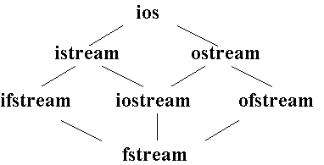
Classes for Stream I/O in C++
ios is the base class.
istream and ostream inherit from ios
ifstream inherits from istream (and ios)
ofstream inherits from ostream (and ios)
iostream inherits from istream and ostream (& ios)
fstream inherits from ifstream, iostream, and ofstream

Slide 6
Iostream & fstream
interactive (iostream)
cin - input stream associated with keyboard.
cout - output stream associated with display.
Cerr - standard output for error messages and associated with display.
file stream → fstream
ifstream -File stream that receives or reads data from a file to a program.
ofstream - File stream that sends or writes data to a file.

Slide 7
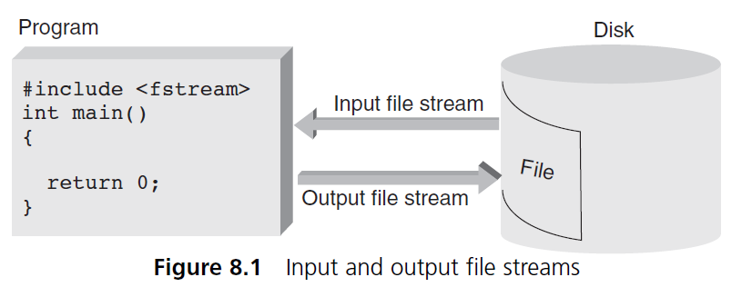
File Stream Objects (continued)
For each file your program uses, regardless of file’s type, a distinct file stream object must be created

Slide 8
General File I/O Steps
Include the header file fstream in the program.
Declare file stream variables.
Connecting stream object name to external filename: opening a file
Determining whether successful connection has been made
Use the file stream variables with >>, <<, or other input/output functions (ex:read , write).
Closing connection: closing a file

Slide 9
General File I/O Steps (cont.)
Include the header file fstream in the program.
#include <fstream>
Declare file stream variables.
ifstream inStream; //input : read
ofstream outStream; //Output :write
Fstream both; //Input+output
Connecting stream object name to external filename: opening a file
inStream.open("infile.dat");
outStream.open("outfile.dat");
Determining whether successful connection has been made
if (inStream.fail())
{ cout << "Input file open failed\n";
exit(1); // requires <cstdlib>}

Slide 10
General File I/O Steps (cont.)
5: Use the file stream variables with >>, <<, or other input/output functions.
Read:
int num;
inStream >> num; //[Compare: cin >> num;]
Write:
outStream << num; //[Compare: cout << num;]
NOTE: Streams are sequential – data is read and written in order – generally can't back up.
6: Closing connection: closing a file
inStream.close();
outStream.close();

Slide 11
Step#3 opening a file
Constructors take file name and file-open mode
ofstream outStream ( "filename", fileOpenMode );
To attach a file later
ofstream outStream;
outStream.open( "filename", fileOpenMode);
ofstream opened for output by default
ofstream outStream( "student.dat", ios::out );
ofstream outStream( "student.dat");
1)File name: "c:\data\student.dat"
tells compiler exactly where to look
2)File name: "student.dat"
this must be in the same directory as the program executable, or in the compiler's default directory

Slide 12
Step#3 opening a file :File Open Mode
Name | Description
ios::in | Open file to read
ios::out | Open file to write
ios::app | All the data you write, is put at the end of the file. It calls ios::out
ios::ate | All the data you write, is put at the end of the file. It does not call ios::out
ios::trunc | Deletes all previous content in the file. (empties the file)
ios::binary | Opens the file in binary mode.
If you want to set more than one open mode, just use the OR operator- |. This way:
ios::ate | ios::binary

Slide 13
Step#3 opening a file (cont.)
In the case of an input file:
The file must exist before the open statement executes.
If the file does not exist, the open statement fails and the input stream enters the fail state
In the case of an output file:
An output file does not have to exist before it is opened;
If the output file does not exist, the computer prepares an empty file for output.
If the designated output file already exists, by default, the old contents are erased when the file is opened.

Slide 14
Step#4 successful connection ?
Method #1 :By checking the stream variable;
If ( ! both)
{Cout << “Cannot open file”;}
Method #2 : By using bool fail() function
if ( both.fail() ) { cout << “Error opening input file…”; exit (1); //#include <cstdlib> }
Method #3 : By using bool is_open() function.
If ( !both.is_open())
{Cout << “File is not open.”;}

Slide 15
Sequential access vs. Random access
Sequential access:
start at beginning of file and go through data in file, in order, to end
to access 100th entry in file, go through 99 preceding entries first
Random access:
access data in a file in any order
can access 100th entry directly

Slide 16
Sequential access

Slide 17
Sequential access

Slide 18
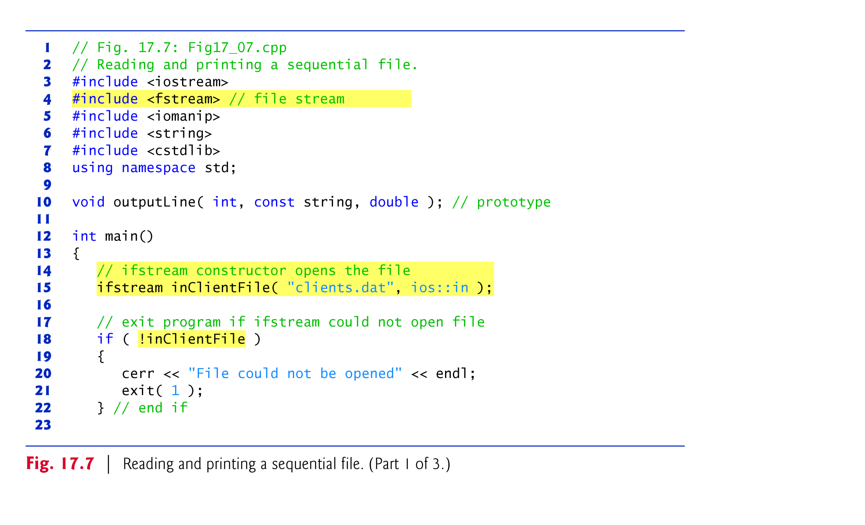
Sequential access

Slide 19
Sequential access
while(inClientFile>> myVariable)
Stops when EOF found (gets value 0)
//need #include <iomanip>
int i =40; double j=10.00;
cout<< setw(4) << i << setw(6) << j; //_ _40 _10.00

Slide 20
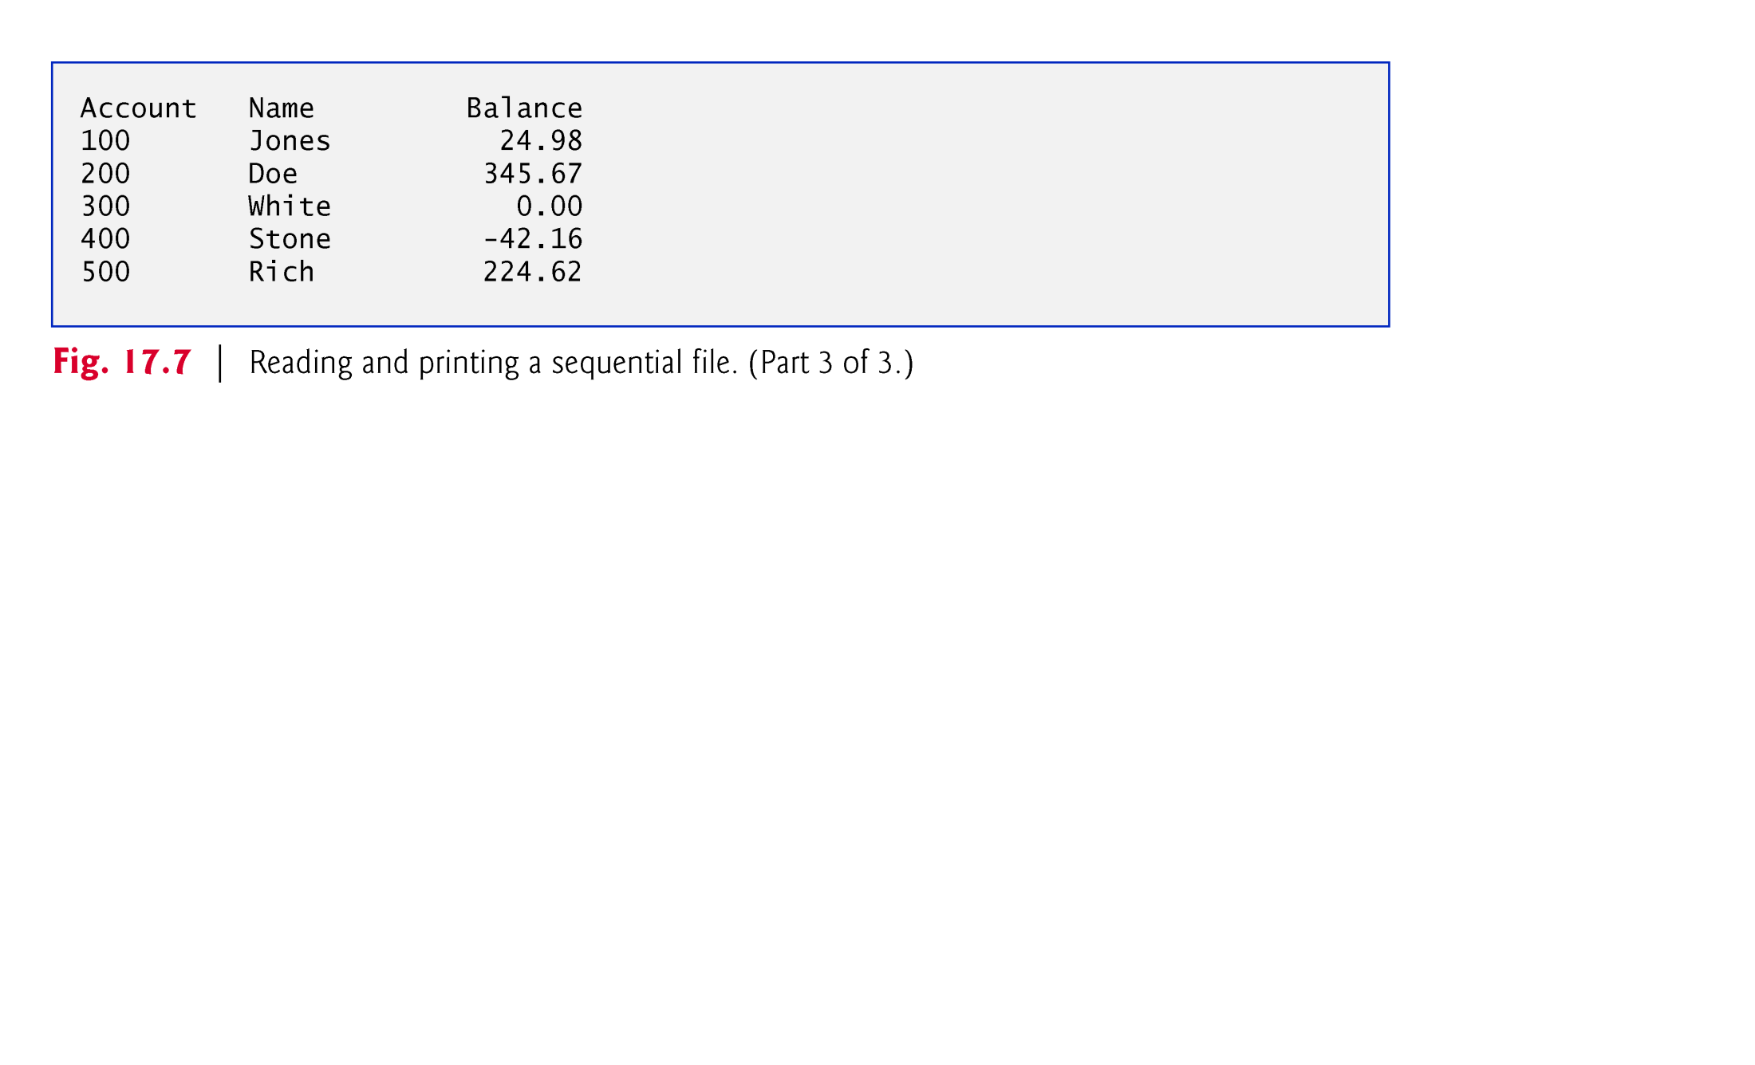
Sequential access

