Slide 1
Pointer Data Type and Pointer Variables III
CS1201: Programming Language 2
By:Nouf Aljaffan
Edited by : Nouf Almunyif

Slide 2
Dynamic Variables
Variables that are created during program execution are called dynamic variables.
new and delete operators used to create and destroy dynamic variables, respectively.
When a program requires a new variable, the operator new is used.
When a program no longer needs a dynamic variable, the operator delete is used.
In C++, new and delete are reserved words.

Slide 3
Operator new
The operator New has two forms:
New ALLOCATES memory (a variable) of the designated type and RETURNS a pointer to it—that is, the address of this allocated memory.
Moreover, the allocated memory is uninitialized.

Slide 4
Operator new
Consider the following declaration:
int *p;
int x;
The statement:
p = &x;
Similarly, the statement:
Char *q;
q = new char[16];
creates an array of 16 components of type char and stores the base address of the array in q.
stores the address of x in p. However, no new memory is allocated.
On the other hand, consider the following statement:
p = new int;
This statement creates a variable during program execution somewhere in memory and stores the address of the allocated memory in p.

Slide 5
int *p;
p=new int;
*p =10;
string *str;
str=new string;
*str="hello";

Slide 6
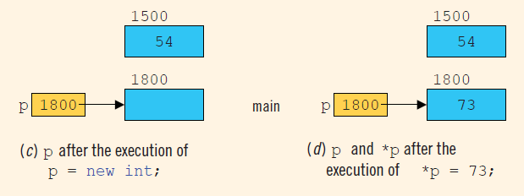

Slide 7
Operator delete
Example
only marks the memory spaces that these pointer variables point to as deallocated.

Slide 8
Dynamic Arrays
limitations of a static array is that
every time you execute the program, the size of the array is fixed.
Using the same data type.
It is ERROR to do int t=5;
int p[t];
Two approaches are used if you cannot even guess the array size.
to declare an array that is large enough to process a variety of data sets.
during program execution, you could prompt the user to enter the size of the array and then create an array of the appropriate size.
Pointers help in creating arrays during program execution and process.
An array created during the execution of a program is called a dynamic Array.

Slide 9
Dynamic Array
To create a dynamic array, we use the second form of the new operator.
allocates 10 contiguous memory locations, each of type int, and stores the address of the first memory location into p.
the statement:
*p = 25;
stores 25 into the first memory location, and the statements:
p++; //p points to the next array component
*p = 35;
store 35 into the second memory location.

Slide 10
Of course, after performing a few increment operations, it is possible to lose track of the first array component.
C++ allows us to use array notation to access these memory locations. For example, the statements:
p[0] = 25;
p[1] = 35;
p[0] refers to the first array component, p[1] refers to the second array component

Slide 11
p[i] refers to the (i)th array component. After the preceding statements execute, p still points to the first array component.
the following for loop initializes each array component to 0:
When the array notation is used to process the array pointed to by p, p stays fixed at the first memory location. Moreover, p is a dynamic array created during program execution.

Slide 12
The following program segment illustrates how to obtain a user’s response to get the array size and create a dynamic array during program execution.

Slide 13
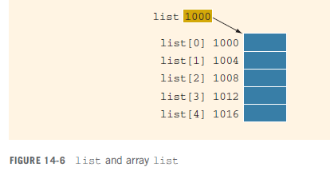
List itself is a variable, and the value stored in list is the base address of the array—that is, the address of the first array component. Suppose the address of the first array component is
1000.

Slide 14
Because the value of list, which is 1000, is a memory address, list is a pointer variable.
However, the value stored in list, which is 1000, cannot be altered during program execution. That is, the value of list is constant.
Therefore, the increment and decrement operations cannot be applied to list.
In fact, any attempt to use the increment or decrement operations on list results in a compile-time error.

Slide 15
copies the value of list, which is 1000, the base address of the array, into p.
We are allowed to perform increment and decrement operations on p.
An array name is a constant pointer.

