Slide 1
Cascading Style Sheets™ (CSS)

Slide 2
Inline Styles
Inline style
declare a style for an individual element by using the style attribute in the element’s start tag
Each CSS property is followed by a colon and the value of the attribute
Multiple property declarations are separated by a semicolon
color property sets text color
Color names and hexadecimal codes may be used as the value

Slide 3
Style attribute
Sets the paragraph’s font size to 20pt
Sets the paragraph’s color to light blue

Slide 4
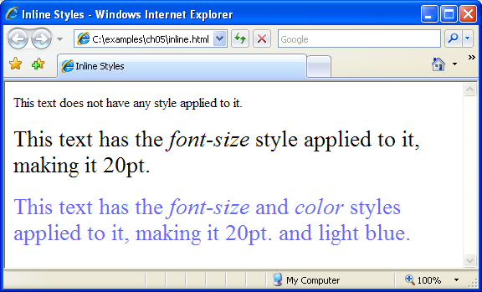

Slide 5
Embedded Style Sheets
Styles that are placed in a style element use selectors to apply style elements throughout the entire document.
style element attribute type specifies the MIME (Multipurpose Internet Mail Extensions) type (the specific encoding format) of the style sheet. Style sheets use text/css.
Each rule body in a style sheet begins and ends with a curly brace ({ and }).

Slide 6
Embedded Style Sheets Cont.
Style-class declarations are preceded by a period and are applied to elements of the specific class
The class attribute applies a style class to an element
CSS rules in a style sheet use the same format as inline styles:
The property is followed by a colon (:) and the value of that property
Multiple properties are separated by semicolons (;)

Slide 7
Embedded Style Sheets Cont.
font-weight property specifies the “boldness” of text. Possible values are:
bold
normal (the default)
bolder (bolder than bold text)
lighter (lighter than normal text)
Boldness also can be specified with multiples of 100, from 100 to 900 (e.g., 100, 200, …, 900). Text specified as normal is equivalent to 400, and bold text is equivalent to 700

Slide 8
Embedded Style Sheets Cont.
background-color attribute specifies the background color of the element
font-family attribute names a specific font that should be displayed
Generic font families allow authors to specify a type of font instead of a specific font, in case a browser does not support a specific font
font-size property specifies the size used to render the font

Slide 9
Sets the MIME type to text/css
Style sheet begins
Sets the properties for all elements in the document within em tags
Sets the properties for all h1 elements in the document
Sets the properties for all p elements in the document
Creates a special class
Style sheet ends

Slide 10
The special class is applied to this p element

Slide 11
Conflicting Styles
text-decoration property applies decorations to text in an element
underline
overline
line-through
blink

Slide 12
Conflicting Styles Cont.
Pseudoclasses give the author access to content not specifically declared in the document
Pseudoclasses are separated by a colon (with no surrounding spaces) from the name of the element to which they are applied
hover pseudoclass is activated when the user moves the mouse cursor over an element
To apply rules to multiple elements, separate the elements with commas in the style sheet
To apply rules to only a certain type of element that is a child of another type, separate the element names with spaces

Slide 13
Conflicting Styles Cont.
Relative length measurements:
px (pixels – size varies depending on screen resolution)
em (usually the height of a font’s uppercase M)
ex (usually the height of a font’s lowercase x)
Percentages (of the font’s default size)
Absolute-length measurements (units that do not vary in size):
in (inches)
cm (centimeters)
mm (millimeters)
pt (points; 1 pt = 1/72 in)
pc (picas; 1 pc = 12 pt)

Slide 14
Defines the class nodec that can only be used by anchor elements
Sets the properties for the hover pseudoclass for the a element, which is activated when the user moves the cursor over an anchor element
All em elements that are children of li elements set to bold
Applies underline style to all h1 and em elements

Slide 16
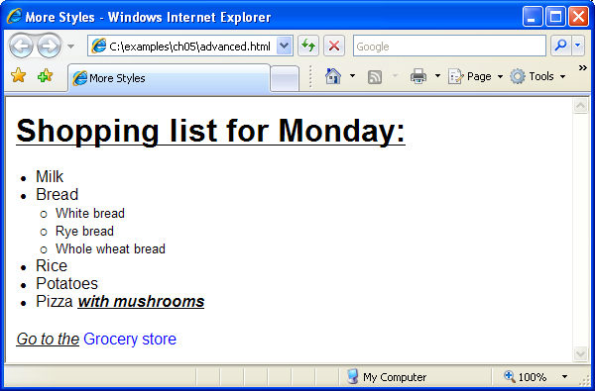

Slide 17
Linking External Style Sheets
External style sheets are separate documents that contain only CSS rules
Help create a uniform look for a website
separate pages can all use the same styles
Modifying a single style-sheet file makes changes to styles across an entire website
External style sheets separate content from presentation, allowing for more consistent look-and-feel, more efficient development, and better performance.

Slide 18
Linking External Style Sheets (Cont.)
link element
Uses rel attribute to specify a relationship between two documents
rel attribute declares the linked document to be a stylesheet for the document
type attribute specifies the MIME type of the related document
href attribute provides the URL for the document containing the style sheet

Slide 20
The linked document is declared to be the current one’s stylesheet
The linked document’s MIME type is text/css
The linked document’s URL is styles.css

Slide 21
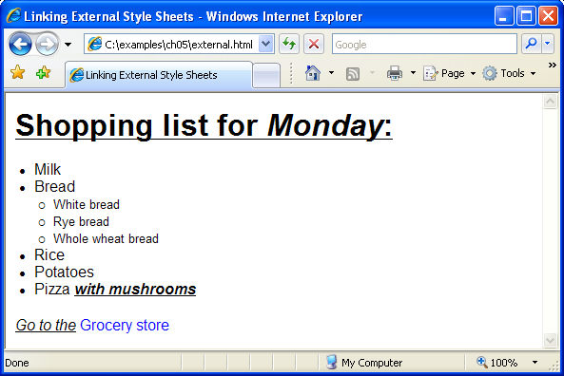
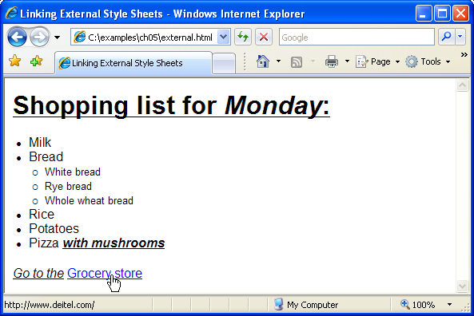

Slide 22
Positioning Elements
CSS position property
Allows absolute positioning, which provides greater control over where on a page elements reside
Normally, elements are positioned on the page in the order that they appear in the XHTML document
Specifying an element’s position as absolute removes it from the normal flow of elements on the page and positions it according to distance from the top, left, right or bottom margin of its parent element

Slide 23
Positioning Elements Cont.
The z-index property allows a developer to layer overlapping elements
Elements that have higher z-index values are displayed in front of elements with lower z-index values

Slide 24
Class that sets an element’s absolute position at the top left of the containing element
Lowest z-index, so this element is behind all the others
Set element’s position 25px from the top and 100 from the left
This element will appear on top of the first one, since it has a higher z-index
This element will appear on top of all others, since it has the highest z-index

Slide 25
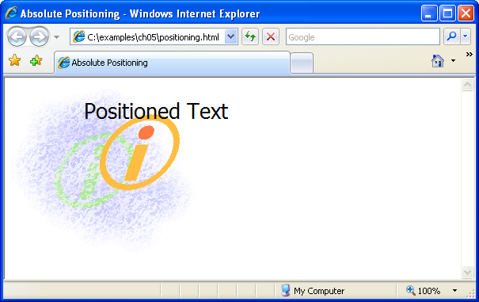

Slide 26
Positioning Elements Cont.
Relative positioning keeps elements in the general flow on the page and offsets them by the specified top, left, right or bottom value

Slide 27
Positions element 5 ex upwards
Positions element 1 ex downwards
Positions element 1 ex to the left
Positions element 1 ex to the right
Apply the super class to this span element

Slide 28
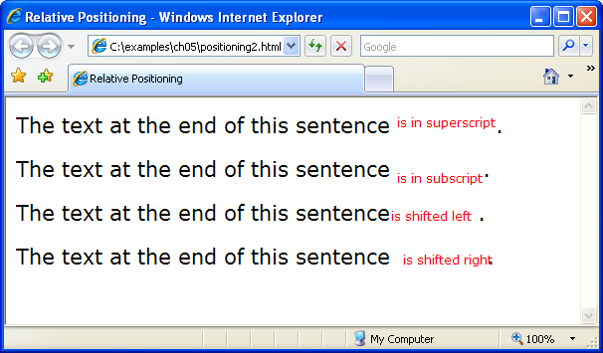
Apply the sub class to this span element
Apply the shiftleft class to this span element
Apply the shiftright class to this span element

Slide 29
Backgrounds
CSS can control the backgrounds of block-level elements by adding:
Colors
Images
Property background-image
Specifies the URL of the image, in the format url(fileLocation)
Property background-position
Places the image on the page using the values top, bottom, center, left and right individually or in combination for vertical and horizontal positioning. You can also position by using lengths

Slide 30
background-repeat property controls the tiling of the background image
Setting the tiling to no-repeat displays one copy of the background image on screen
Setting to repeat (the default) tiles the image vertically and horizontally
Setting to repeat-x tiles the image only horizontally
Setting to repeat-y tile the image only vertically

Slide 31
Property setting
background-attachment: fixed
fixes the image in the position specified by background-position. Scrolling the browser window will not move the image from its set position. The default value, scroll, moves the image as the user scrolls the window
text-indent property indents the first line of text in the element by the specified amount
font-style property allows you to set text to none, italic or oblique

Slide 32
Inserts the image at logo.gif as the background
Places the image at the bottom right of the page
Displays only one copy of the image
Keeps the image in place when the user scrolls in the browser window
Fills the remainder of the window with a light gray background
Indents the first line of text in the element by 1 em

Slide 34
Element Dimensions
Dimensions of elements on a page can be set with CSS by using properties height and width
Their values can be relative or absolute
Text in an element can be centered using text-align: center; other values for the text-align property are left and right
Problem with setting both vertical and horizontal dimensions of an element
Content might sometimes exceed the set boundaries, in which case the element must be made large enough for all the content to fit
Can set the overflow property to scroll, which adds scroll bars if the text overflows the boundaries set for it

Slide 35
Sets the width of the element to 20% of the browser’s screen’s size
Sets the width of the element to 80% of the browser’s screen’s size and centers it

Slide 36
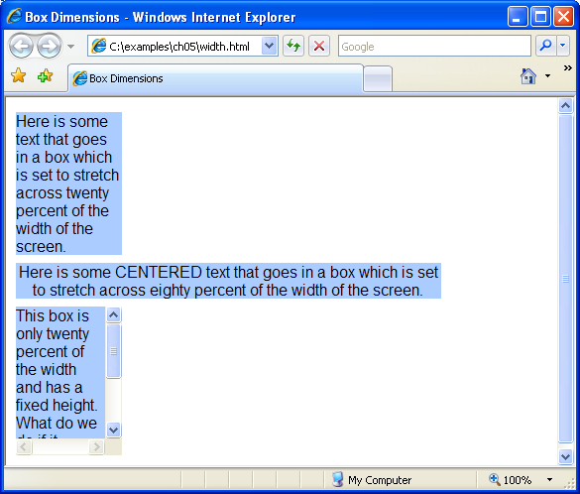
Sets the width of the element to 20% of the browser’s screen’s size, the height to 150 px, and allows the element to scroll if the text overflows the allotted size

Slide 37
Box Model and Text Flow
Block-level XHTML elements have a virtual box drawn around them based on the box model
When the browser renders using the box model, each element is surrounded by:
Padding
The padding property determines the distance between the content inside an element and the edge of the element
Padding be set for each side of the box by using padding-top, padding-right, padding-left and padding-bottom
Margin
Determines the distance between the element’s edge and any outside text
Margins for individual sides of an element can be specified by using margin-top, margin-right, margin-left and margin-bottom

Slide 38
Border
The border is controlled using the properties:
border-width
May be set to any of the CSS lengths or to the predefined value of thin, medium or thick
border-color
Sets the color used for the border
border-style
Options are: none, hidden, dotted, dashed, solid, double, groove, ridge, inset and outset

Slide 40
Defines several border classes

Slide 41
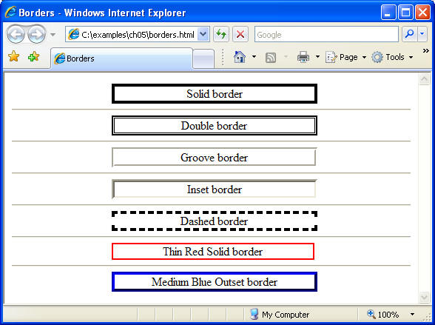
Applies several classes to the same element

Slide 42
Building a CSS Drop-Down Menu
:hover pseudoclass
used to apply styles to an element when the mouse cursor is over it
display property
allows a programmer to decide if an element is displayed as a block element, inline element, or is not rendered at all (none)

Slide 43
Sets anchor elements in a menu div to be displayed as block-level when the menu is moused-over
Prevents the browser from rendering the links inside the menu div
Sets anchor elements in a menu div to have a light-blue background when they are moused-over

Slide 44
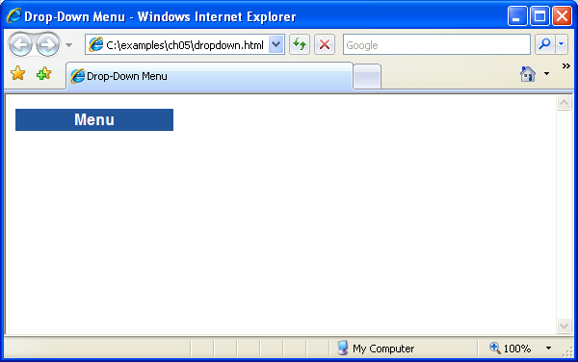
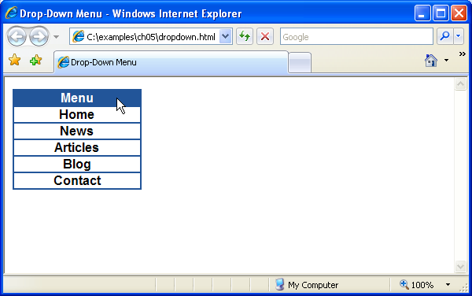
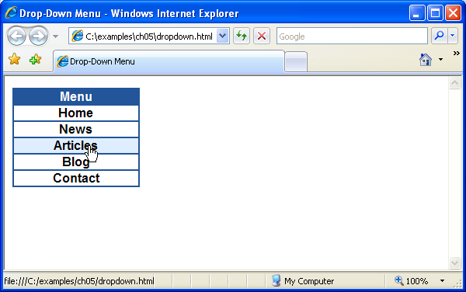

Slide 45
User Style Sheets
Users can define their own user style sheets to format pages based on their preferences
Absolute font size measurements override user style sheets, while relative font sizes will yield to a user-defined style
User style sheets are not linked to a document; rather, they are set in the browser’s options

Slide 46
A class defined by the author with absolute measurements: a font-size of 9 pt

Slide 47
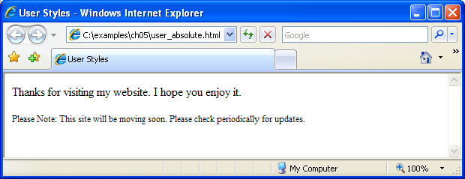
A different font-size of 20 pt is defined by the user for all body elements

Slide 48
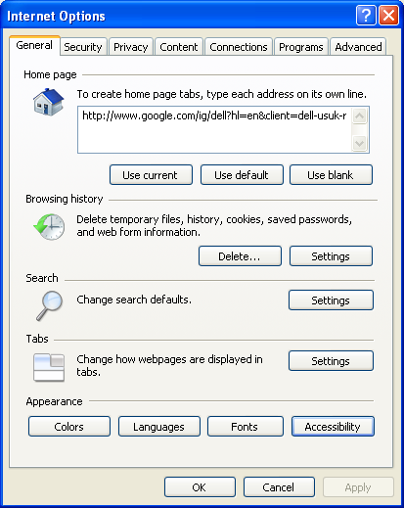
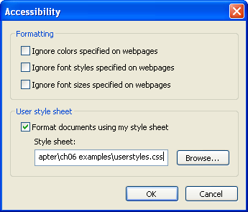

Slide 49
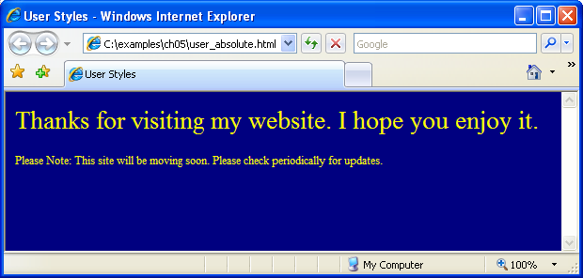
The author’s style has higher precedence than the user’s, so the font is 9 pt

Slide 50
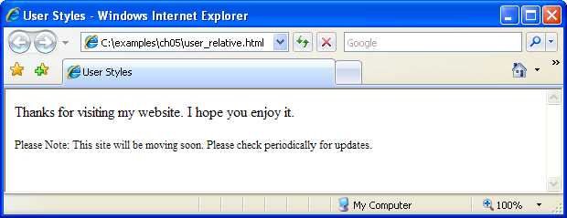
A relative measurement of .75 em is used by the author for the font size

Slide 51
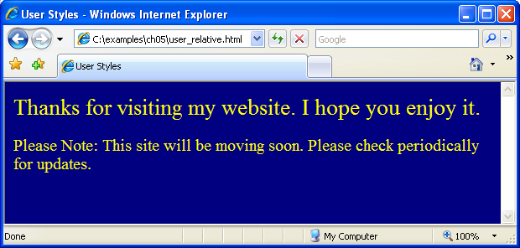
The user style sheet is considered, so the font-size is 15 pt (.75 em for 20 pt)

