Slide 1
Polymorphism
CT1513

Slide 2
Polymorphism
Can treat an object of a subclass as an object of its superclass
A reference variable of a superclass type can point to an object of its subclass
Person name, nameRef;
PartTimeEmployee employee, employeeRef;
name = new Person("John", "Blair");
employee = new PartTimeEmployee("Susan", "Johnson",
12.50, 45);
nameRef = employee;

Slide 3
Polymorphism
Late binding or dynamic binding (run-time binding):
Method to be executed is determined at execution time, not compile time
Polymorphism: to assign multiple meanings to the same method name
Implemented using late binding

Slide 4
Polymorphism (continued)
The reference variable name or nameRef can point to any object of the class Person or the class PartTimeEmployee
These reference variables have many forms, that is, they are polymorphic reference variables
They can refer to objects of their own class or to objects of the classes inherited from their class

Slide 5
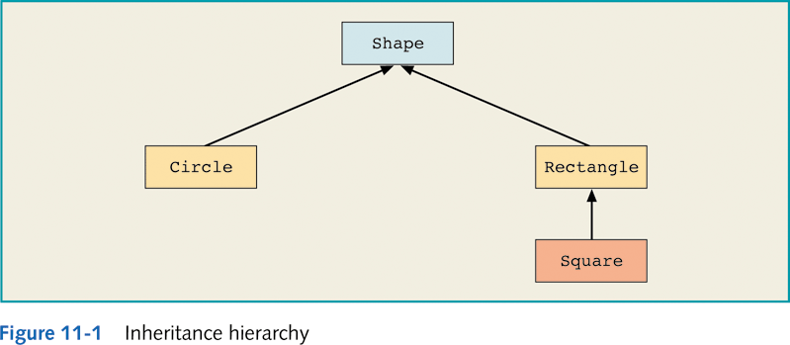
Polymorphism and References
Shape myShape = new Circle(); // allowed
Shape myShape2 = new Rectangle(); // allowed
Rectangle myRectangle = new Shape(); // NOT allowed

Slide 6
Note !
A
A reference variable from a class A
A ref;
Can point to an object of class B
as well as an object of class C
ref = new A();
ref = new B();
ref = new C();
B
C

Slide 7
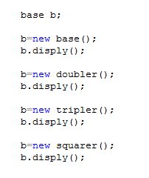
100
200
300
1000

Slide 8
Polymorphism
Can also declare a class final using the keyword final
If a class is declared final, then no other class can be derived from this class

Slide 9
Abstract Classes
A class that is declared with the reserved word abstract in its heading
An abstract class can contain instance variables, constructors, finalizers, and non-abstract methods

Slide 10
Abstract Classes (continued)
You cannot instantiate an object of an abstract class type; can only declare a reference variable of an abstract class type
You can instantiate an object of a subclass of an abstract class, but only if the subclass gives the definitions of all the abstract methods of the superclass

Slide 11
Abstract Class Example
public abstract class AbstractClassExample
{
protected int x;
public void abstract print();
public void setX(int a)
{
x = a;
}
public AbstractClassExample()
{
x = 0;
}
}

