Slide 1
Mouse Events
GUI

Slide 2
Types of Events
Below, are some of the many kinds of events, swing components generate.
Act causing Event | Listener Type
User clicks a button, presses Enter, typing in text field | ActionListener
User closes a frame | WindowListener
Clicking a mouse button, while the cursor is over a component | MouseListener

Slide 3
Event Listeners
Event listeners are the classes that implement the <type>Listener interfaces.
Example:
1. ActionListener receives action events
2. MouseListener receives mouse events.

Slide 4
The ActionListener Method
It contains exactly one method.
Example:
public void actionPerformed(ActionEvent e)
The above code contains the handler for the ActionEvent e that occurred.

Slide 5
The MouseListener Methods
Event handling when the mouse is clicked.
public void mouseClicked(MouseEvent e)
Event handling when the mouse enters a component.
public void mouseEntered(MouseEvent e)
Event handling when the mouse exits a component.
public void mouseExited(MouseEvent e)

Slide 6
The MouseListener Methods (contd..)
Event handling when the mouse button is pressed on a component.
public void mousePressed(MouseEvent e)
Event handling when the mouse button is released on a component.
public void mouseReleased(MouseEvent e)

Slide 7
The MouseMotionListener Methods
Invoked when the mouse button is pressed over a component and dragged. Called several times as the mouse is dragged
public void mouseDragged(MouseEvent e)
Invoked when the mouse cursor has been moved onto a component but no buttons have been pushed.
public void mouseMoved(MouseEvent e)

Slide 8
The WindowListener Methods
Invoked when the window object is opened.
public void windowOpened(WindowEvent e)
Invoked when the user attempts to close the window object from the object’s system menu.
public void windowClosing(WindowEvent e)

Slide 9
The WindowListener Methods (contd..)
Invoked when the window object is closed as a result of calling dispose (release of resources used by the source).
public void windowClosed(WindowEvent e)
Invoked when the window is set to be the active window.
public void windowActivated(WindowEvent e)

Slide 10
Illustration (contd..)
public class MyClass implements MouseListener {
... someObject.addMouseListener(this);
/* Empty method definition. */
public void mousePressed(MouseEvent e) { }
/* Empty method definition. */
public void mouseReleased(MouseEvent e) { }
/* Empty method definition. */
public void mouseEntered(MouseEvent e) { }
/* Empty method definition. */
public void mouseExited(MouseEvent e) { }
public void mouseClicked(MouseEvent e) {
//Event listener implementation goes here...
}
}

Slide 11
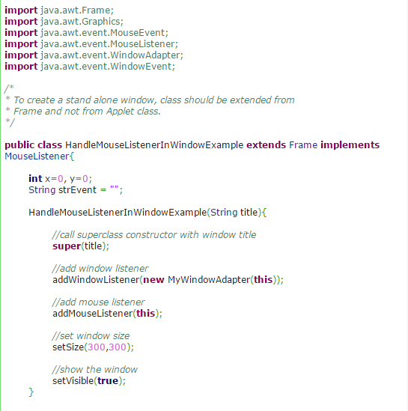
example

Slide 12
