Slide 1
Culture: Lecture 1
232 Najd

Slide 2
Defining Culture
Defining Cultures and Identities, Chapter 1, SAGE Publications,
http://www.sagepub.com/upm-data/45974_Chapter_1.pdf

Slide 3
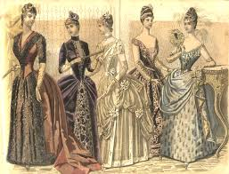
Culture: Nineteenth-Century Definition

Slide 4
Culture: Nineteenth-Century Definition
In the 19th century, the term culture was commonly used as a synonym for Western civilization.

Slide 5
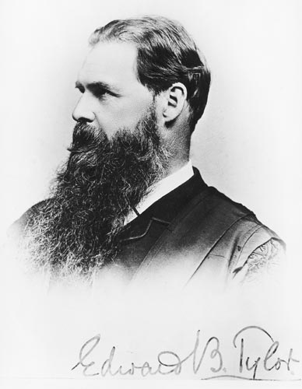
Culture: 19th Century Definition
The British anthropologist Sir Edward B. Tylor (1871) popularized the idea that all societies pass through developmental stages:

Slide 6
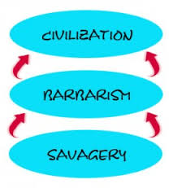
cultures based on writing and the urban life
cultures based on nomadic herding and agriculture
cultures based on hunting and gathering

Slide 7
Culture: 19th Century Definition
It’s easy to see that such a definition assumes that Western cultures were considered superior.
The study of multiple cultures without imposing the belief that Western culture was the ultimate goal was slow to develop.

Slide 8
Culture: Today’s Definition
Among other aspects, the term culture refers to the following:
A: A community or population sufficiently large enough to be self-sustaining; that is, large enough to produce new generations of members without relying on outside people.

Slide 9
Culture: Today’s Definition
B: The totality of that group’s thought, experiences, and patterns of behavior and its concepts, values, and assumptions about life that guide behavior and how those evolve with contact with other cultures.

Slide 10
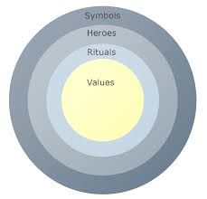
Culture: 19th Century Definition
B: Hofstede (1994) classified these elements of culture into four categories: values, rituals, heroes, and symbols.

Slide 11
B3: Values:
Values are the feelings not open for discussion within a culture about what is good or bad, beautiful or ugly, normal or abnormal, which are present in a majority of the members of a culture, or at least in those who occupy pivotal positions.

Slide 12
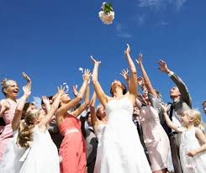
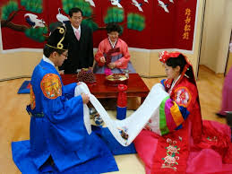
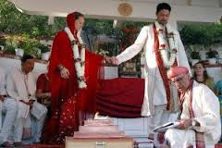
B2: Rituals:
Rituals are the socially essential collective activities within a culture.

Slide 13
B4: Heroes:
Heroes are the real or imaginary people who serve as behavior models within a culture. A culture’s heroes are expressed in the culture’s myths, which can be the subject of novels and other forms of literature.

Slide 14
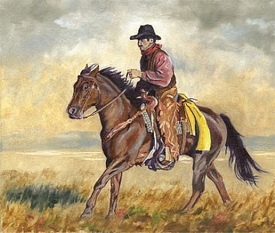
B4: Heroes:
Rushing (1983) has argued, for example, that an enduring myth in U.S. culture, as seen in films, is the rugged individualist cowboy of the American West.

Slide 15
B1: Symbols:
Symbols refer to verbal and nonverbal language.

Slide 16
Culture: Today’s Definition
C: The process of social transmission of these thoughts and behaviors from birth in the family and schools over the course of generations.

Slide 17
Culture: Today’s Definition
D: Members who consciously identify themselves with that group. Collier and Thomas (1988) describe this as cultural identity.

Slide 18
Self-Sustaining community/population
Totality of that group’s symbols, rituals, values and heroes
Social transmission of these thoughts /behaviors from birth in the family /schools over generations
Members who consciously identify themselves with that group

Slide 19
Culture is a regulator of human life and identity.

Slide 20
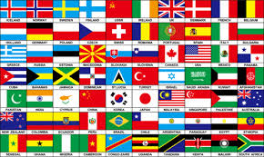
Cultural Identity
Each of us has a cultural identity. However, that identity may or may not be the same as citizenship in one of the world’s 200-some countries.
Cultures are not synonymous with countries.
Cultures do not respect political boundaries.

Slide 21
Understanding Culture
We can have no direct knowledge of a culture other than our own.
Our experience with and knowledge of other cultures are limited by the perceptual bias of our own culture. An adult Canadian will never fully understand the experience of growing up an Australian.

Slide 22
Understanding Culture
To begin to understand a culture, you need to understand all the experiences that guide its individual members through life.

Slide 23
Understanding Culture
Think of culture as everything you would need to know and do so as not to stand out as a “stranger” in a foreign land.

Slide 24
Understanding Culture
Culture is not a genetic trait. All these cultural elements are learned through interaction with others in the culture (see Focus on Culture 1.1).

