Slide 1
Publishing Papers in ISI-Indexed Journals: Tips and Tricks
Contents are derived from many sources
Presented by
Dr. Mohammad Mehedi Hassan Information Systems Dept, CCIS, kSU E-mail: mmhassan@ksu.edu.sa

Slide 2
Professional Research Service
Associate Editor: IEEE ACCESS Journal (Q1, ISI-IF: 3.4)
Guest Editor: IEEE Internet of Things Journal (Q1, ISI-IF: 7.4)
Guest Editor: Elsevier Future Generation Computer Systems (Q1, ISI-IF: 3.99)
Guest Editor: Elsevier Journal of Parallel and Distributed Computing System (Q2, ISI-IF: 1.93)
Guest Editor: Elsevier Journal of Computer sand Electrical Engineering (Q2, ISI-IF:1.57)
Springer Multimedia Tools and Applications (Q2, ISI-IF: 1.53)

Slide 3
Presenter Publication Lists
Publication Summary (2011-2018)
ISI-Indexed Published Journals | 107
Conference Papers | 33
Authored Book | 2
Google Scholar Citations | 2052
Google Scholar h-index | 22

Slide 4
Topics to be covered
Basic considerations for publishing in ISI journals: Why and For Whom
Understanding of journal indexing services (ISI, Scopus etc.) and how to evaluate
Discuss how ISI journals work
Discuss the most important general considerations in publishing in ISI journals
Reason of Rejection from an ISI-Journals
Some strategies for improving chances of publishing in ISI journals
Personal experience sharing

Slide 5
Why we need to publish?
Three Foci of Higher Education
Institute
Publication makes our research findings public, that is, opening to the examination and use by other scholars and knowledge users

Slide 6
Where to publish?
Indexed Journal
Level of Difficulty
Non Indexed Journal
Conference
Book Chapter

Slide 7
Why publishing in ISI-Indexed journals?
Requirement for graduation (PhD)
Requirement for promotion (Faculty Members)
To be recognized in the field/subfield of research
To disseminate knowledge
To get higher accreditation level (College and university)

Slide 8
Understanding of journal indexing services

Slide 9
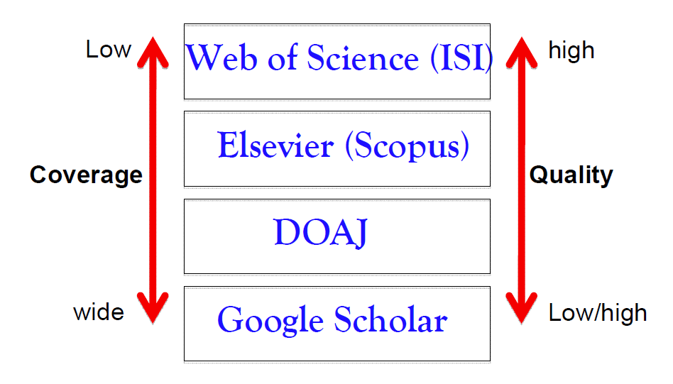
Major Journal indexing services

Slide 10
What is ISI?
ISI stands for Institute for Scientific Information (lSI)
It was founded by Dr. Eugene Garfield in 1960. It was part of Thomson Reuters company, Philadelphia, USA
Now it is owned by Clarivate Analytics (http://mjl.clarivate.com/ )
ISI covers thousands of academic journals which are available via ISI’s Web of Knowledge (part of web of Science) database service

Slide 11
Top Three ISI-Indexing services
Science Citation Index (SCI) or Science Citation Index Expanded (SCIE)
Social Sciences Citation Index (SSCI)
Arts and Humanities Citation Index (AHCI)
A new indexing service launched in 2015 named as Emerging Sources Citation Index (ESCI)

Slide 12
How to find an ISI-Indexed journal
There is a ISI Master List
Link: http://mjl.clarivate.com/cgi-bin/jrnlst/jloptions.cgi?PC=master
Submit Journal Name or Print ISSN number (most of the time) of any journal to check its in the ISI database or not

Slide 13
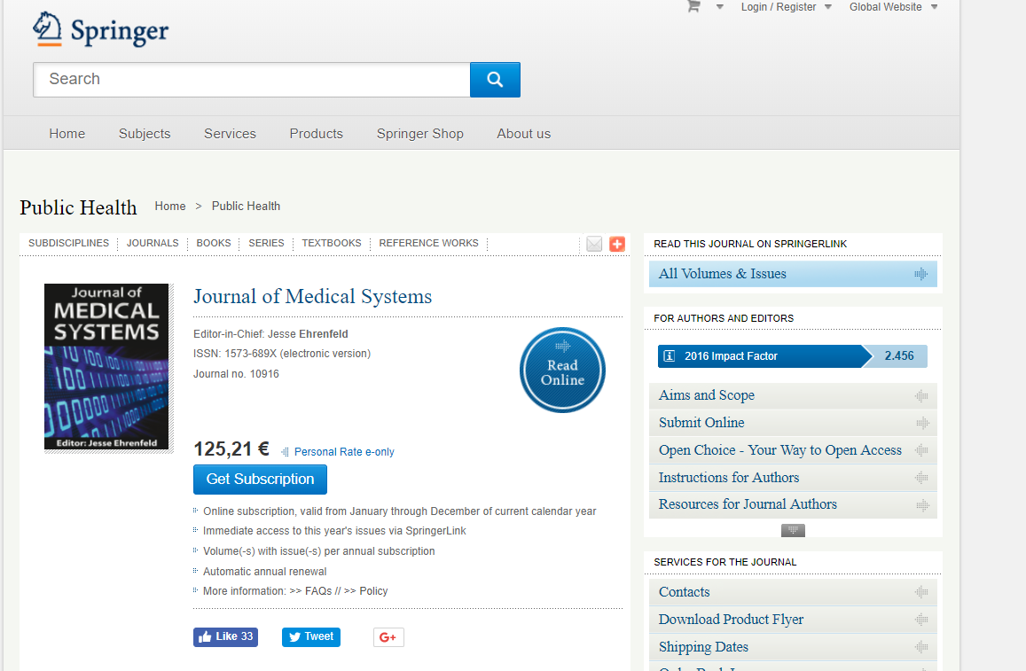
Example…

Slide 14
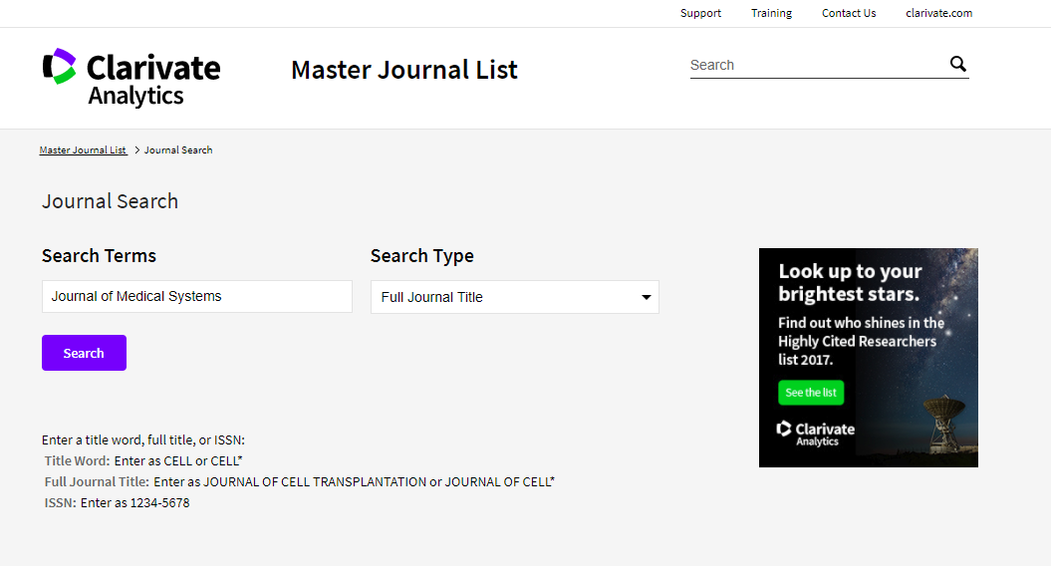
How to Check ISI journal

Slide 15
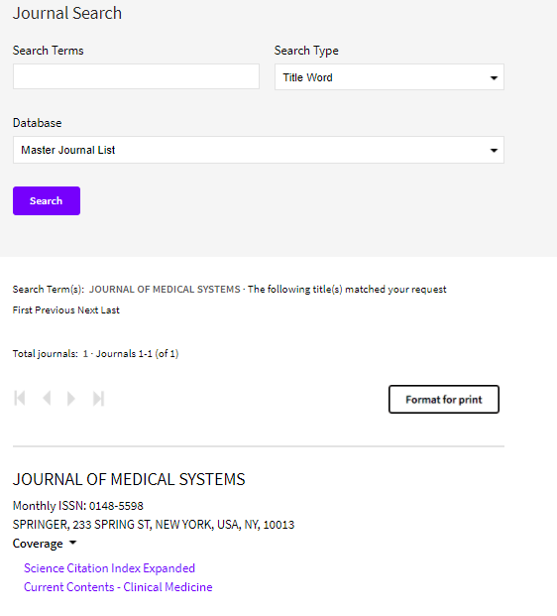

Slide 16
JCR (Journal Citation Reports)
JCR is an annual publication by Clarivate Analytics (previously Thomson Reuters)
JCR lists an impact factor for each of the journals that it tracks
(https://error.incites.thomsonreuters.com/error/Error?DestApp=IC2JCR&Alias=IC2&Domain=.thomsonreuters.com&Src=IP&Params=DestApp%3DIC2JCR&RouterURL=https%3A%2F%2Flogin.incites.thomsonreuters.com%2F&Error=IPError )
The impact factor is a measure of the frequency with which the "average article" in a journal has been cited in a particular year or period in other ISI-ranked journals
The Impact Factor is published every June and corresponds to the previous year’s data.
http://ipscience-help.thomsonreuters.com/incitesLiveJCR/8275-TRS.html

Slide 17
JCR (Journal Citation Reports)…
JCR has been integrated with the Web of Science and is accessed from the Web of Science-Core Collections
It is published annually in two editions:
JCR Web Science Edition: Contains data from about 5,700 journals in the areas of science and technology.
JCR Web Social Sciences Edition: Contains data from about 1,700 journals in the social sciences.
Now all journals listed in ISI Master list may not be in JCR
The lSI also publishes a list of highly cited researchers, one of the factors included in the Academic Ranking of World Universities (https://clarivate.com/products/researcherid/ )

Slide 18
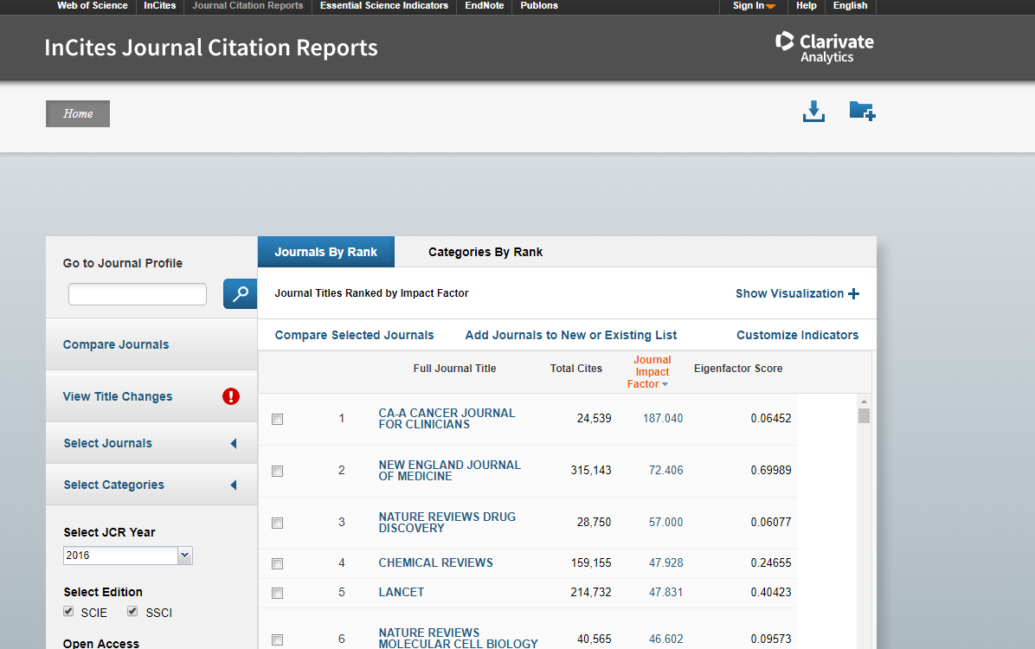
How to check JCR Impact factor
https://jcr.incites.thomsonreuters.com

Slide 19
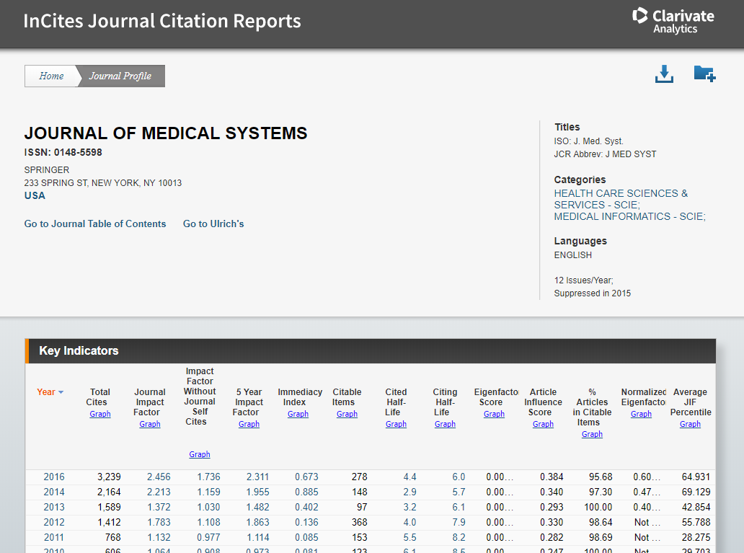
How to check JCR Impact factor..

Slide 20
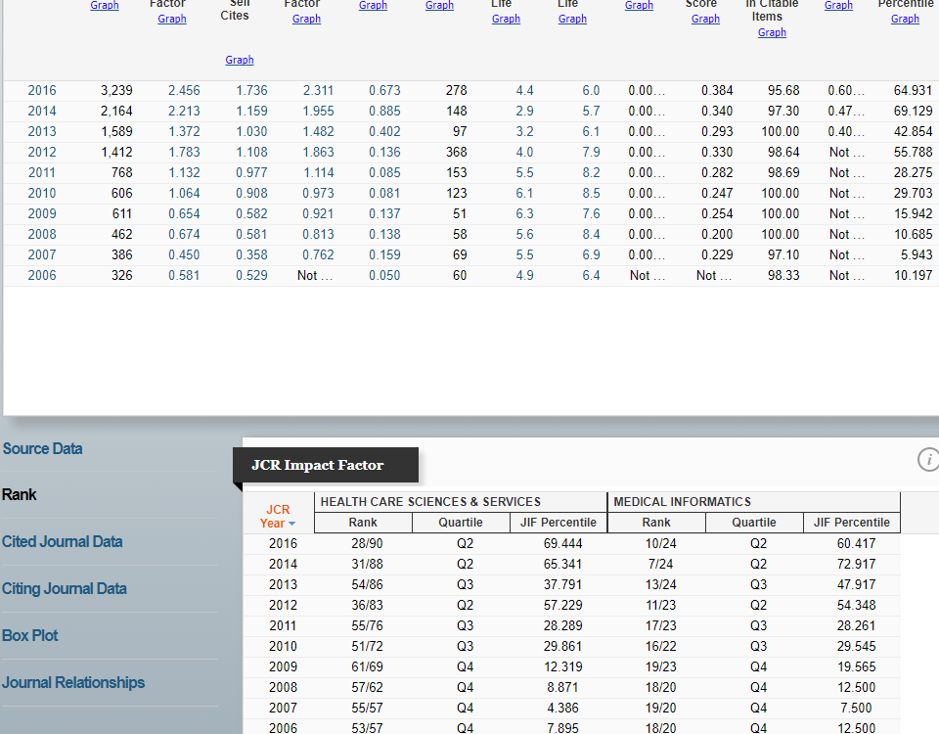
How to check Quartile in JCR

Slide 21
ISI-proceedings for Conference
lSI Proceedings is an index to the published literature of the most significant conferences, symposia, seminars, colloquia, workshops, and conventions in a wide range of disciplines
It enables to track emerging ideas and new research in specific area
It is known as Conference Proceedings Citation Index- Science (CPCI-S)
Web Link: http://libguides.stir.ac.uk/c.php?g=530418&p=3628671

Slide 22
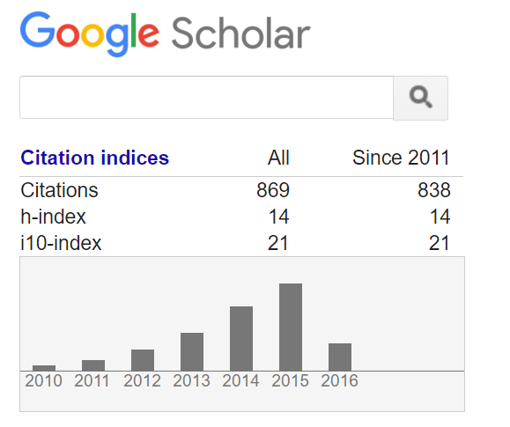
Google Scholar Indexing Service
H-index
The H-index quantifies both the scientific productivity and the scientific impact of a scientist
The index is based on the set of the scientist's most quoted papers and the number of citations that they have received in other people's publications
The index was suggested in 2005 by Jorge E. Hirsch

Slide 23
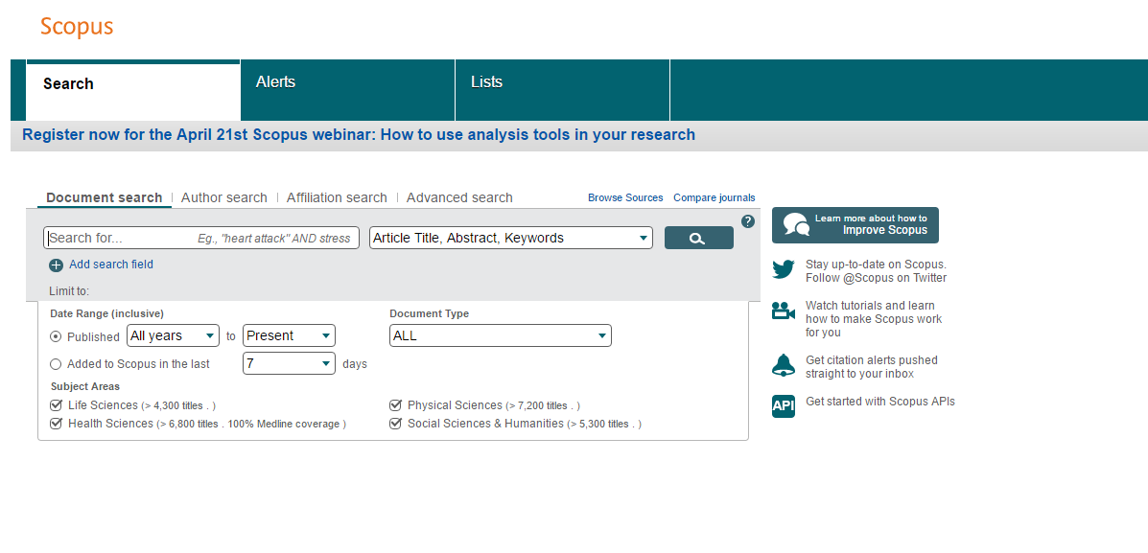
Scopus Indexing Service

Slide 24
DOAJ (Directory of Open Access Journal)

Slide 25
Unique Author Identifiers
In the context of research, unique author identifiers are one way to solve the problem of author ambiguity
Being able to consistently and accurately identify the author of a piece of research is valuable for researchers
because it means we can quickly find other work by the same author and ensure our own work is linked to him
Three main unique author identifiers are: ResearcherID: Developed by Thomson Reuters Scopus Author ID: Developed by Elsevier and used in Scopus and related products ORCID: Developed by ORCID Inc., which is a non-profit, community-driven organization

Slide 26
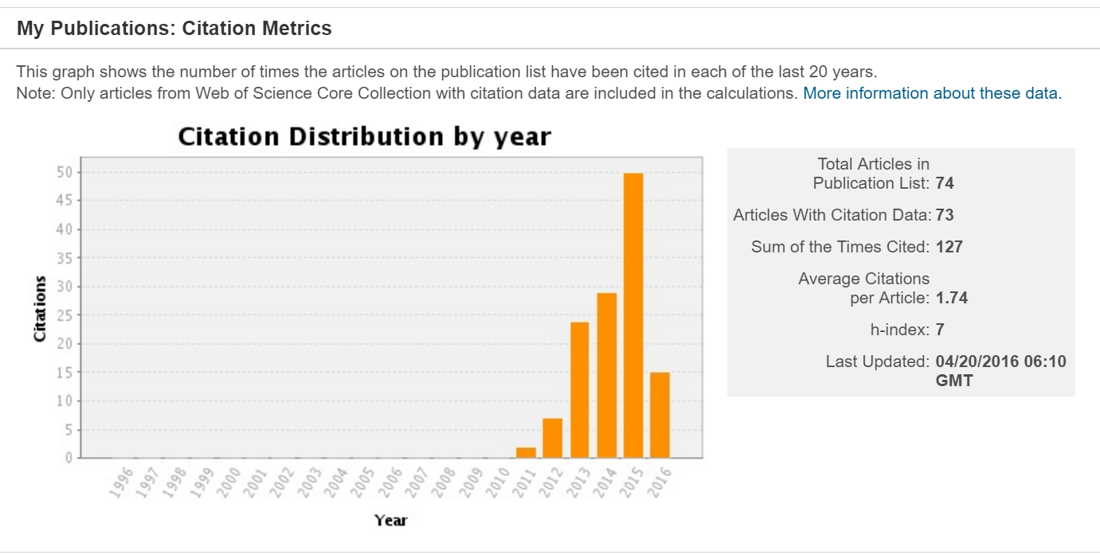
Researcher ID
Researcher ID (http://www.researcherid.com/) is used to identify authors and enables users to build a publication profile (h-Index) and generate citation metrics from Web of Science

Slide 27
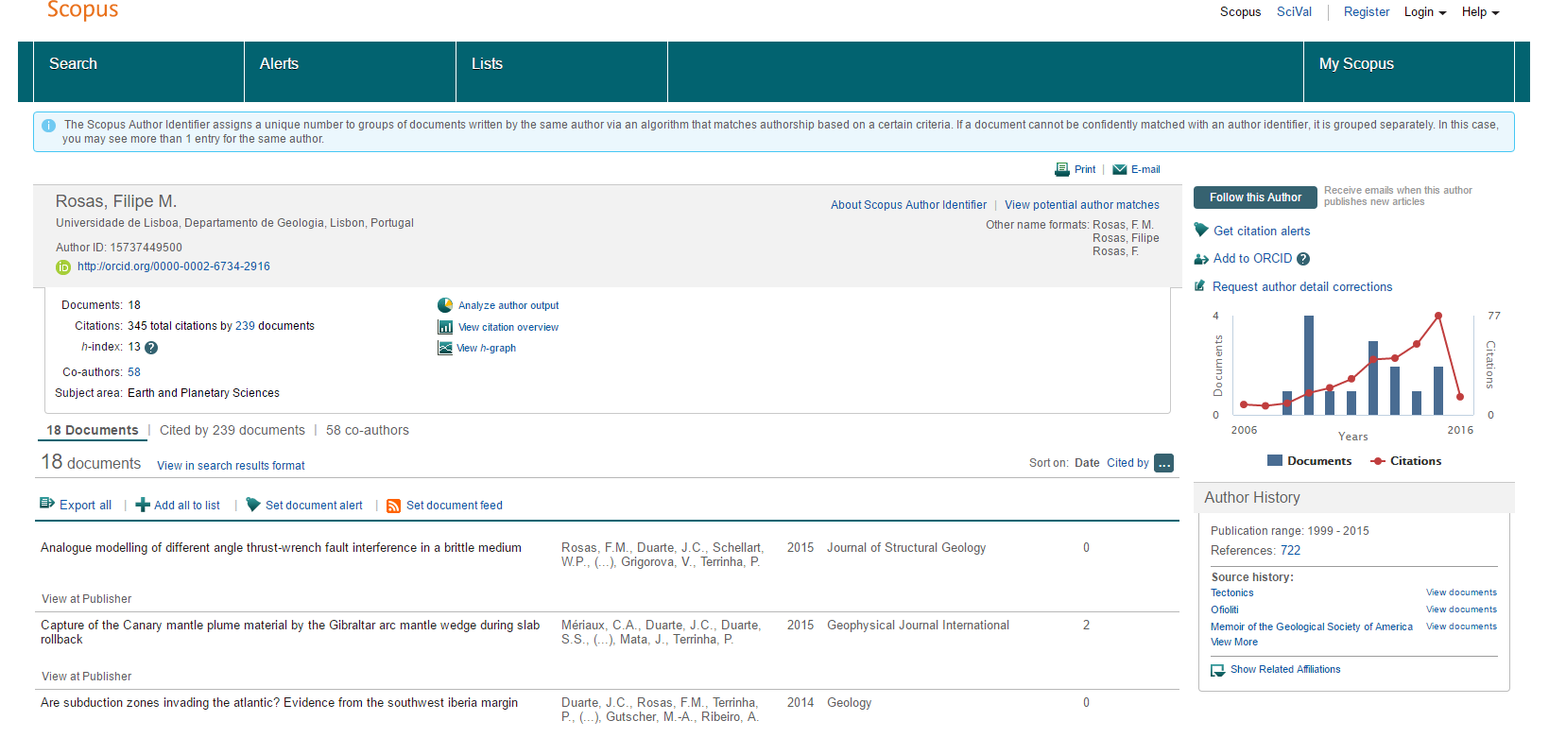
Scopus D

Slide 28
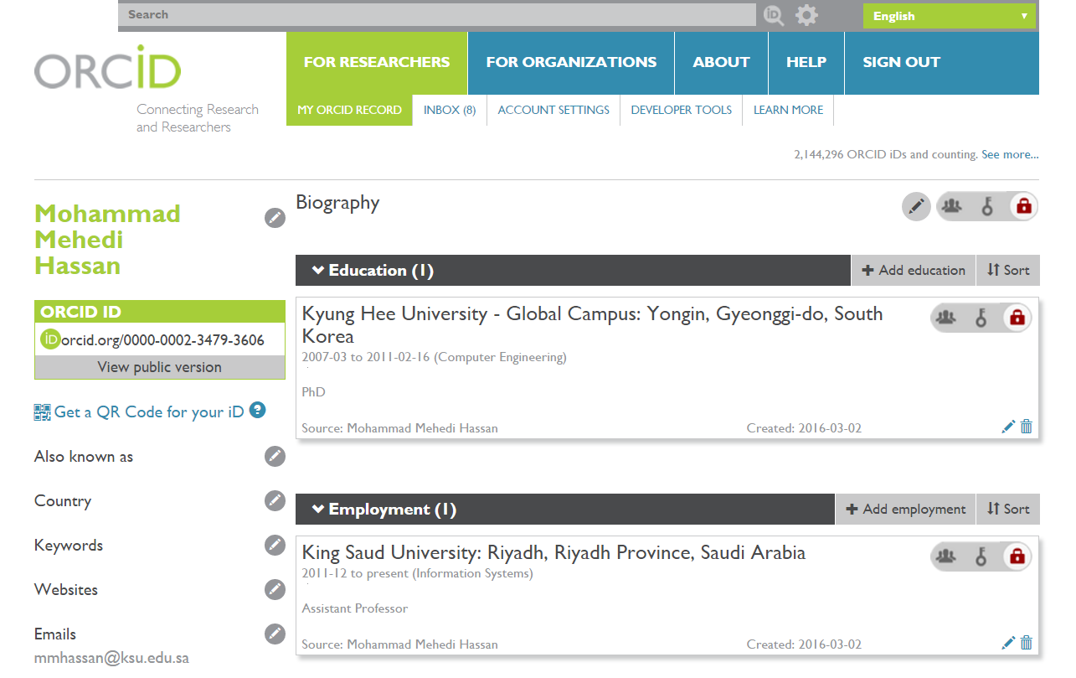
ORCID
Orcid creates a central registry of unique identifiers for individual researchers
It is now becoming a standard, and is supported by many publishers. It can be associated to Researcher iD and Scopus iD

Slide 29
Discuss how ISI journals work

Slide 30
What makes an ISI journals?
Strict refereeing process
From 2 to 4 referees for each manuscript submitted
Referees are from the highest levels of publishers in the field/subfield
Acceptance rate is less than 50% (some have less than 20% acceptance rate)
Articles published tend to be more highly cited in the field
There are sub-categories and levels within the category of ISI journals
The highest level of ISI journals typically define the most original and important contributions in the field/subfield
Publishing in an ISI journal is a very good indicator that one’s research is considered a significant contribution to the field/subfield

Slide 31
How to Select ISI journals
Choose field of knowledge
Determine journals’ Impact Factor and Quartiles
Select the journals within the quartile (Q1, Q2, Q3)
For all journals selected before visit their website and:
Check type of works accepted (Review, Original research article, Letters etc.)
Check the turnaround time for articles submitted to the journal
Check its publications per year
Check type of fees implanted
Check if it has online edition
Check the length and structure of the manuscript acceptable to the journal

Slide 32
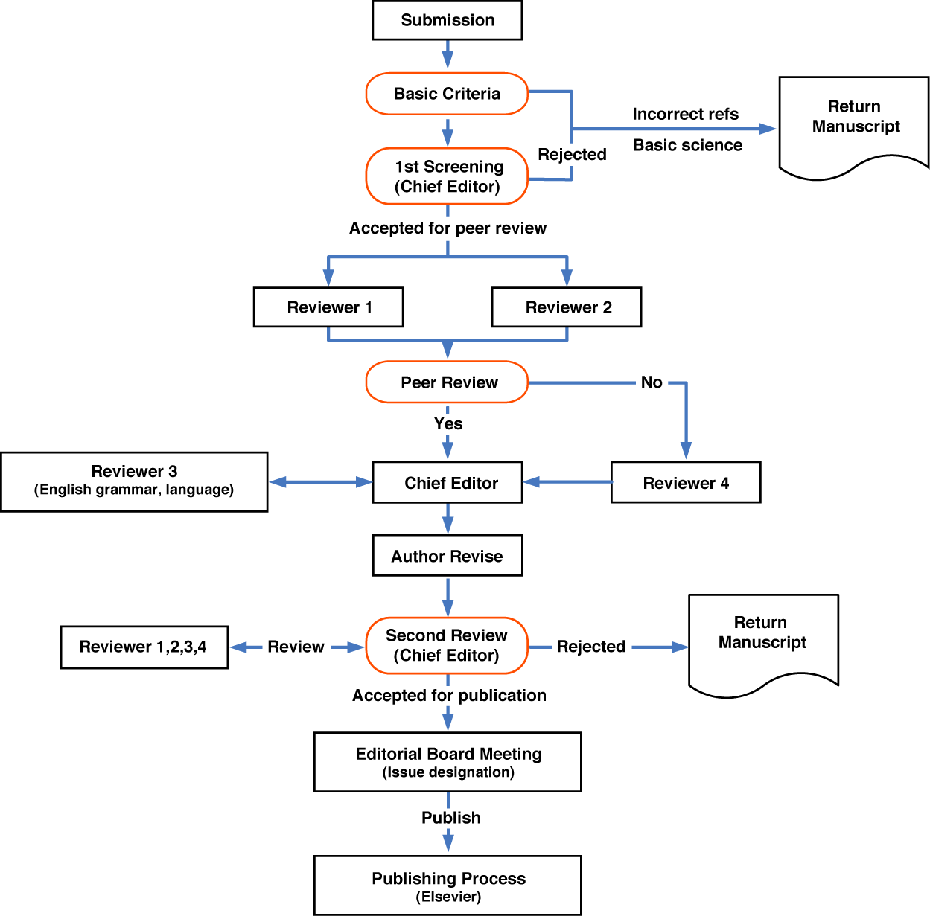
Review Process in a ISI Journal

Slide 33
Discuss the most important general considerations in publishing in ISI journals

Slide 34
Publishing in ISI journals (Questions)
“Is my research worth publishing?
“Is my research report describing an original and significant contribution to the research literature in my field/subfield?”
“How can I prepare my research paper in the shortest possible time?”
“ How the Journal acceptance procedure works, how many steps are needed?
“How to find a proper ISI Journal for my research?”
“ How to increase the citation of my papers?

Slide 35
Types of articles are published in ISI journals
Articles that describe and effectively present original and significant contributions to the research literature

Slide 36
What is a contribution to the research literature?
A contribution to the research literature needs to be defined in the context of the nature of the research enterprise
A significant contribution can only be understood in the context of the current research environment and the types of research outputs that are being or considered within
Most scholars in my field/subfield now think/say that __________________
My research shows that ____________
Other scholars should appreciate my research because _________________

Slide 37
What editors and reviewers look for in a research paper
Originality – what’s new about subject, or contributions
Relevance to and extension of existing knowledge
Research methodology – are conclusions valid and objective?
Clarity, structure and quality of writing
Sound, logical progression of argument
Theoretical and practical implications - the ‘so what’ factors
Experiment results- comparing with other works
Recency and relevance of references
Adherence to the editorial scope and objectives of the journal

Slide 38
Certain important points before sending the paper
“Many papers are rejected simply because they don’t fulfil journal requirements. They don’t even go into the review process.”
Identify a few possible target journals/series but be realistic
Follow the Author Guidelines – scope, type of paper, word length, references style, etc.
Find where to send your paper (editor, regional editor, subject area editor)
Send an outline or abstract and ask if this looks suitable and interesting (or how it could be made so)
Confirm how an editor would like a submission, e.g. e-mail; hard copy
Read at least one issue of the publication – visit your library for access

Slide 39
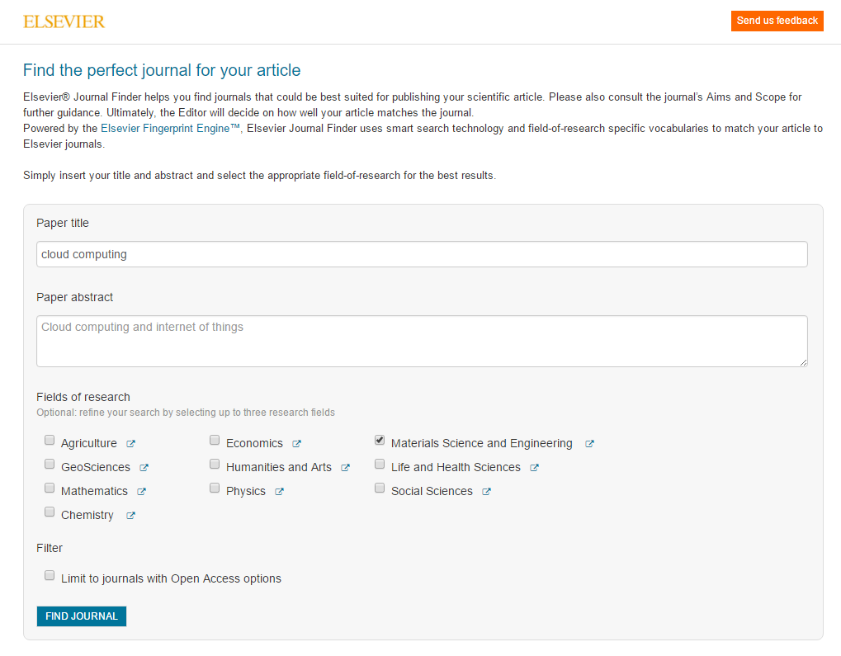
Finding Suitable ISI journals: Example
http://journalfinder.elsevier.com/

Slide 40
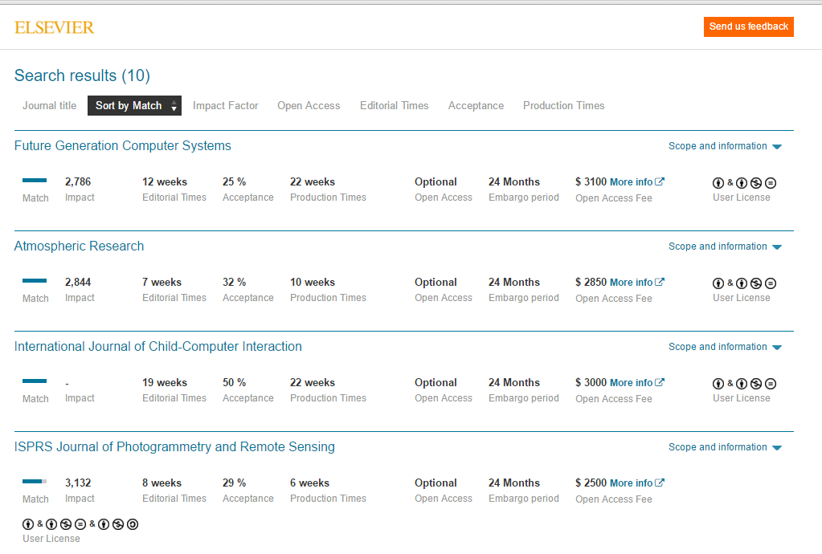
Finding Suitable ISI journals: Example

Slide 41
Some Useful Journal Finder Links
https://www.journalguide.com/
http://jane.biosemantics.org/suggestions.php
http://journalsuggester.springer.com/
https://www.edanzediting.com/journal-selector

Slide 42
Reason of Rejection from an ISI-Journals

Slide 43
General Problems
Issue not important
Not original
Not appropriate for journal (Out of Scope)
Failure to format the paper according to the Guide for Authors
Data old & now irrelevant
Practical difficulties -> doubtful results
Conflict of interest
Ethical issues
Notes:
As before, usually an editor’s judgment on original screen; some will be raised by reviewers;

Slide 44
Scientific Problems
Unclear hypotheses
Poor or weak design
Sample biased or too small
Statistics inappropriate or misapplied
Conclusions unjustified
References outdated
Notes:
Wont go into detail here; topic for another presentation and Platt and Barnes covered one of these topics at a previous round
will comment further on conclusions and references later

Slide 45
Presentation/style Problems
Poorly organized
Badly written
Careless errors
Terrible tables
Needless figures
Outdated or improperly cited references
Notes:
the crux of the matter; any of these tilt the balance sharply against you; if a reviewer has to struggle he or she is unlikely to view paper kindly and will probably look harder and find more scientific flaws; rarely a rejection saying your paper is so badly written we won’t accept
triggers a subconscious negative bias

Slide 46
Author Crimes
Duplicate publication (& not telling)
Salami slicing (& not telling) https://www.publishingcampus.elsevier.com/websites/elsevier_publishingcampus/files/Guides/Quick_guide_SS02_ENG_2015.pdf
Plagiarism

Slide 47
Some strategies for improving chances of publishing in ISI journals

Slide 48
Strategies
Strategy 1: Understand the chemistry of the “scholarly search.”
Strategy 2: Realize the importance of theory and literature
Strategy 3: Start writing during the initial stages (For doctoral program)
Strategy 4: Master the core concepts of impact factor, peer review, contribution to knowledge, and scientific knowledge
Strategy 5: Build networks and collaborations
Strategy 6: Check the plagiarism before submission

Slide 49
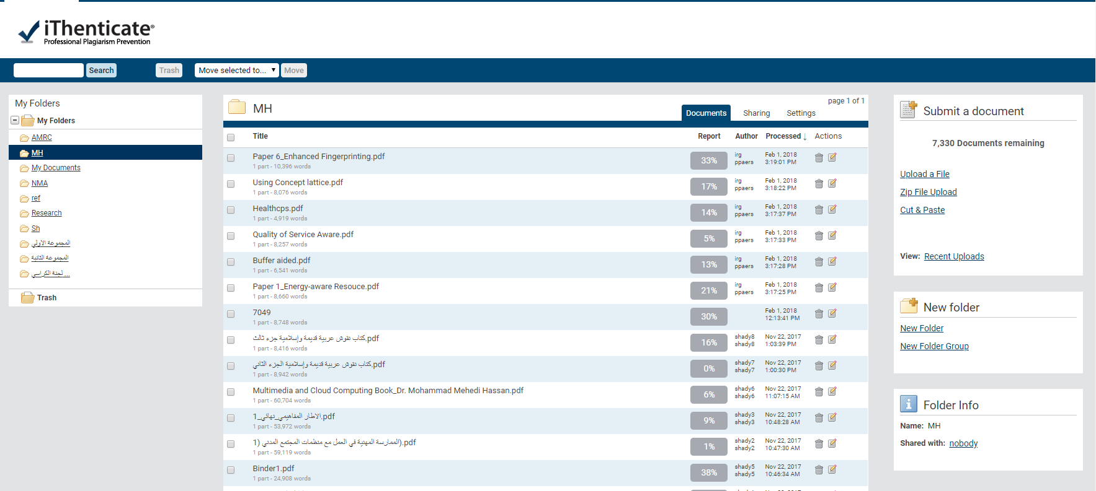
Plagiarism software
IThenticate: The Best Plagiarism Detection Software http://www.ithenticate.com/

Slide 50
Writing Focus
Abstract and Titles
Introduction
Methods
Results
Discussion
Revision after writing

Slide 51
Review Process and Responds
The journal decision will be one of the following:
Accepted without revisions
Accepted with minor revisions (indicated)
Accepted with major revisions (indicated)
Rejected but encouraged to resubmit with revisions
Rejected no revision will be accepted
If the papers gets revision, it important to carefully respond to reviewer comments

Slide 52
Personal Experience Sharing

Slide 53
Questions
and
Answers

Slide 54
References
https://www.elsevier.com/connect/7-steps-to-publishing-in-a-scientific-journal
https://www.researchgate.net/publication/47782388_Target_ISI_Journals-HOW_TO_WRITEPUBLISH_ISI_PAPERS
http://blogs.nature.com/naturejobs/2014/11/03/how-to-get-published-in-high-impact-journals-big-research-and-better-writing/
http://ched-zrc.dlsu.edu.ph/pdfs/getting_published_in_isi_journal.pdf
http://slideplayer.com/slide/6142638/
https://en.wikipedia.org/wiki/Journal_Citation_Reports
http://mjl.clarivate.com/
http://ipscience-help.thomsonreuters.com/incitesLiveJCR/8275-TRS.html
https://www.elsevier.com/connect/5-secrets-to-surviving-and-progressing-in-a-phd-program

