Slide 1
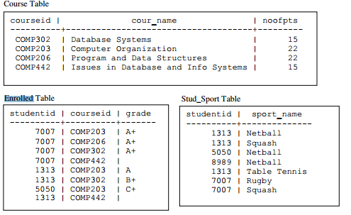
What is the PK?

Slide 2
