Slide 1
MS Excel
Management Information Systems

Slide 2
Contents
Functions
IF Function and nested IF
Sorting Data.
Filtering Data.
Data Form.
Data Validation.
Pivot Tables

Slide 3
Functions
Excel supplies more than 350 functions organized into 10 categories:
Database, Date and Time, Engineering, Financial, Information, Logical, Lookup, Math, Text and Data, and Statistical functions.
You can use the Insert Function button on the Formula bar to select from a list of functions.
A series of dialog boxes will assist you in filling in the arguments of the function and this process also enforces the use of proper syntax.

Slide 4
fx marks the spot!
Office Excel 2007 offers two methods to insert predefined functions into your spreadsheet ….
The first method is the use of the Function Button next to the Formula Bar:

Slide 5
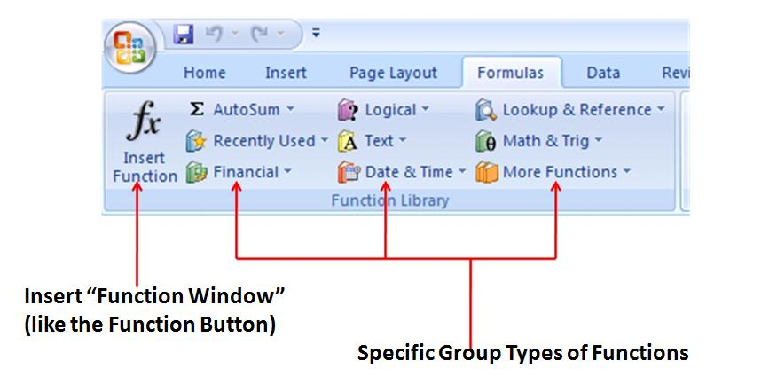
fx marks the spot! (Cont)
The second method is the use of the Formulas tab and the Function Library:

Slide 6
Inserting a Function

Slide 7
Functions YOU should know
Statistical Functions
MAX - find the greatest value in a range.
MIN - find the lowest value in a range.
AVERAGE - determine the average within a range (sum divided by number of values).
AVERAGEIF - find the Average of all numbers in a range based on a given criteria
Syntax : AVERAGEIF( range, criteria, [average_range] )

Slide 8
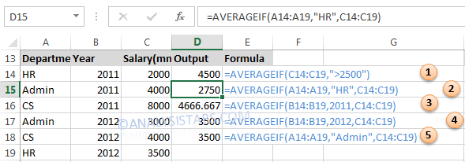
AVERAGEIF Function in Excel – Examples
Example 1: finding Average of the salaries more than 2500
Example 2: finding Average of all Salries of HR Department
Example 3: finding Average of all Salries of Year 2012
Example 4: finding Average of all Salries of Year 2012
Example 5: finding Average of all Salries of Admin Department

Slide 9
Functions YOU should know
Arithmetic Functions
SUM - syntax method:
Locate the pointer in the cell where you need the sum
Type =Sum(
Select the range of numeric values either through pressing Shift+Cursor key or dragging the mouse pointer. Cell addresses of the selected range will be displayed as A3:C3
Type ) and press Enter key to complete the formula. Sum will be shown immediately after pressing the Enter key.

Slide 10
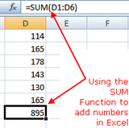
SUM - Excel function method:
Enter the following data into cells D1 to D6: 114, 165, 178, 143, 130, 165.
Click on cell D7 - the location where the results will be displayed.
Click on the Formulas tab of the ribbon menu.

Slide 11
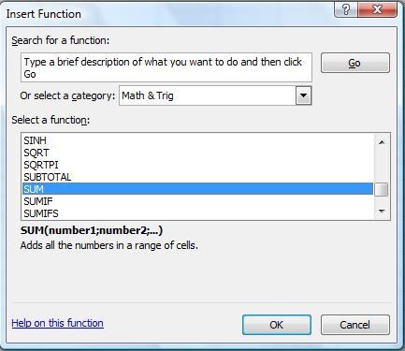
Choose Math & Trig from the ribbon to open the function drop down list.
Click on SUM in the list to bring up the function's dialog box.

Slide 12
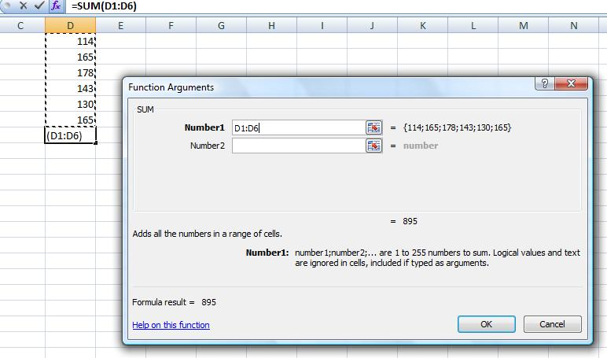
In the dialog box, click on the Number1 line .
Drag selected cells D1 to D6 in the spreadsheet.
Click OK.
The answer 895 should appear in cell D7.

Slide 13
The SUMIF Function
SUMIF adds the cells specified by a given criteria.
Syntax: =SUMIF(range,criteria,sum_range)
Range is the range of cells you want evaluated.
Criteria is the criteria in the form of a number, expression, or text that defines which cells will be added. For example, criteria can be expressed as 32, "32", ">32", "apples".
Sum_range are the actual cells to sum.
Remarks
The cells in sum_range are summed only if their corresponding cells in range match the criteria.
If sum_range is omitted, the cells in range are summed.

Slide 14
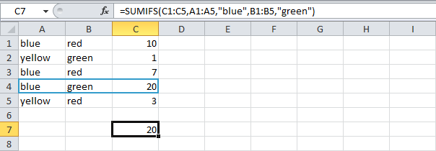
The Sumifs Function
To sum cells based on multiple criteria
for example,( blue and green), use the following SUMIFS function (first argument is the range to sum).

Slide 15
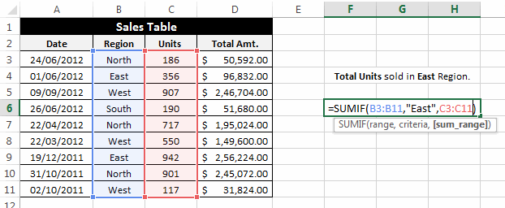
Example for SUMIF Function
Find the total units sold in East Region
Result =129

Slide 16
The COUNT Function
Count function is used to count numeric values.
Locate the pointer in the cell where you need to count a range of numeric values
Type =COUNT(
Select the range of numeric values either through pressing Shift+Cursor key or dragging the mouse pointer. Cell addresses of the selected range will be displayed as A3:C3
Type ) and press Enter key to complete the formula. Result is shown immediately after pressing the Enter key.

Slide 17
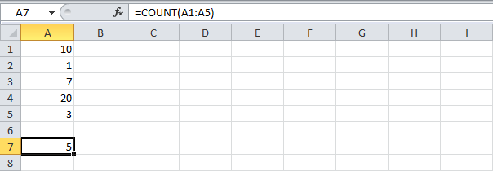
count the number of cells that contain numbers, use the COUNT function

Slide 18
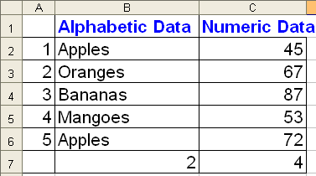
The COUNTIF Function
The COUNTIF function counts the number of cells within a range that meet the given criteria.
Syntax: COUNTIF(range,criteria)
Range is the range of cells from which you want to count cells.
Criteria is the criteria in the form of a number, expression, or text that defines which cells will be counted. For example, criteria can be expressed as 32, "32", ">32", "apples".

Slide 19
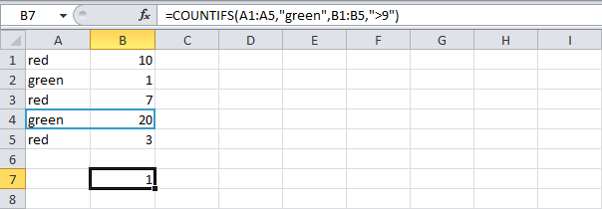
The COUNTIFS Function
To count cells based on multiple criteria
For example,( green and higher than 9), use the following COUNTIFS function.

Slide 20
COUNTA Counts the number of cells in a range that are not empty
COUNTBLANK Counts the number of cells in a range that are empty

Slide 21
Functions YOU should know (cont)
Logical Functions
IF - a decision making function used to determine the truth value for a condition.
AND - determines the truth value for a group of arguments as a whole (all must be true to be true)
OR - determines the truth value for a group of arguments separately (only one must be true)

Slide 22
The IF Function
IF checks whether a condition is met, and returns one value if TRUE, and another value if FALSE
General form:
=IF(logical_test, value_if_true, value_if_false)
Locate the pointer in the cell where IF function is required.
Type =IF(D5>=60,"Pass","Fail")
D5 is the cell address whose value is compared with 50. If its value is greater than or equal to 50, the Pass is displayed otherwise Fail is displayed.

Slide 23
Nested IF
The IF function can be nested, when you have multiple conditions to meet. The FALSE value is being replaced by another If function to make a further test
Syntax =IF(Condition_1,Value_if_True_1,IF(Condition_2,Value_if_True_2,Value_if_False_2))
EXAMPLE :
If cell A1 equals 1, the function returns Bad
If cell A1 equals 2, the function returns Good
If cell A1 equals 3, the function returns Excellent
If cell A1 equals another value, the function returns No Valid Score

Slide 25
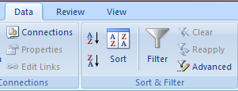
Sorting Data
Sorting data means rearranging records in ascending or descending order based on any Field / Column
TO sort the data do the two steps:
select data in worksheet to be sorted.
from the Data tab ,select either :
Ascending
Or Descending

Slide 26
Multiple key sorting

Slide 27
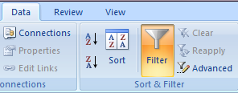
Filtering Data
Filtering is a quick and easy way to find and work with a subset of data in a range. A filtered range displays only the rows that meet the criteria
Unlike Sorting ,Filtering doesn't rearrange a range –filtering temporarily hides rows you don’t want displayed.
TO filter the data do the two steps:
select data in worksheet to be filtered.
from the Data tab ,select Filter.

Slide 28
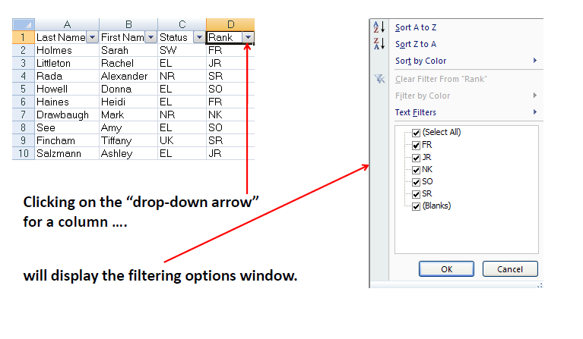
Filtering Data (cont)

Slide 29
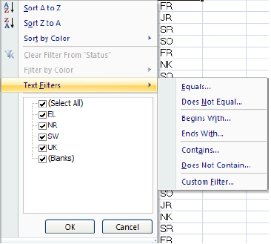
Filtering Data (cont)
By using Text Filters, you can specify a condition [to filter data by] that would normally take a great deal of time when you use the simple sort /remove method.

Slide 30
Data Form
Excel can generate a built-in data form (data form: A dialog box that displays one complete record at a time. You can use data forms to add, change, locate, and delete records.) for your range. The data form displays all of your column labels in a single dialog box, with a blank space beside each label for you to fill in data for the column. You can enter new data, find rows based on cell contents, update existing data, and delete rows from the range.
The first step to using the data entry form, therefore, is, to add the Form button to the Quick Access Toolbar so that we can use it.

Slide 31
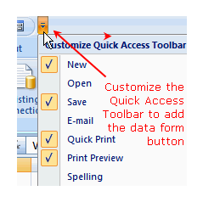
Data Form (cont)
How to Add the Data Form to the Quick Access Toolbar?
Click on down arrow at the end of the Quick Access Toolbar to open the drop down menu.
Choose More Commands from the list to open the Customize the Quick Access Toolbar dialog box.
Click on down arrow at the end of the Choose
commands from line to open the drop down menu.

Slide 32
Data Form (cont)
Choose All Commands from the list to see all the commands available in Excel 2007 in the left hand pane.
Scroll through this alphabetical list to find the Form command.
Click on Add button between the command panes to add the Form command to the Quick Access Toolbar.
Click OK.
The Form button should now be added to the Quick Access Toolbar.

Slide 33
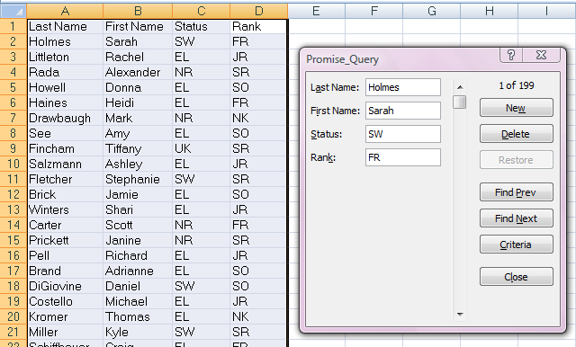
Method of Data Form
Select the data range.
Click on the Form button.
A form is displayed containing all the fieldnames. You can add, delete, or find records.

Slide 34
Data Validation
Ensuring valid data entry is an important task. You may want to restrict data entry to a certain range of dates, limit choices by using a list, or make sure that only positive whole numbers are entered.
Providing immediate help to instruct users and clear messages when invalid data is entered is also essential to make the data entry experience go smoothly.

Slide 35
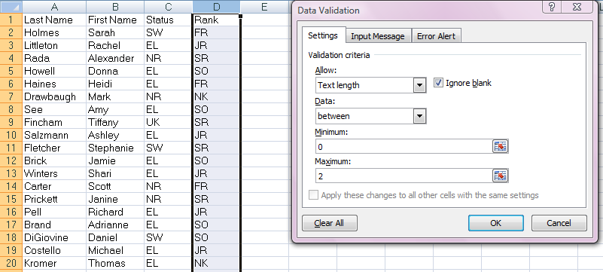
Method of Data Validation
Select one or more cells to validate.
On the Data tab, click Data Validation, and then click the Settings tab.
To specify the type of validation that you want, do one of the following:
Any value, whole number, decimal, List, Date, Time, Text Length or Custom
In Custom, any criteria can be given e.g. >=3000

Slide 36
Pivot Tables
Pivot tables are one of Excel's most powerful features. A pivot table allows you to extract the significance from a large, detailed data set.(http://www.excel-easy.com/examples/pivot-chart.html)

Slide 37
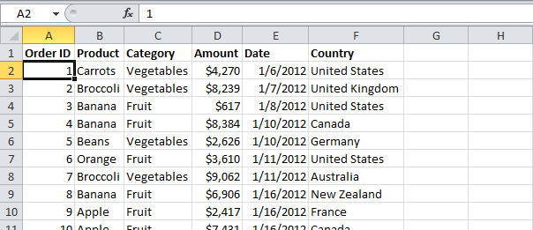
Our data set consists of 214 rows and 6 fields. Order ID, Product, Category, Amount, Date and Country.

Slide 38
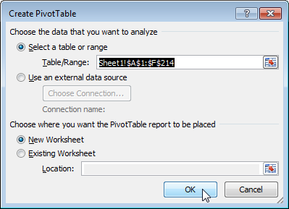
Insert a Pivot Table
To insert a pivot table, execute the following steps.
1. Click any single cell inside the data set.
2. On the Insert tab, click PivotTable.
he following dialog box appears. Excel automatically selects the data for you. The default location for a new pivot table is New Worksheet.
3. Click OK.

Slide 39
Drag fields
The PivotTable field list appears. To get the total amount exported of each product, drag the following fields to the different areas.
1. Product Field to the Row Labels area.
2. Amount Field to the Values area.
3. Country Field to the Report Filter area.

Slide 40
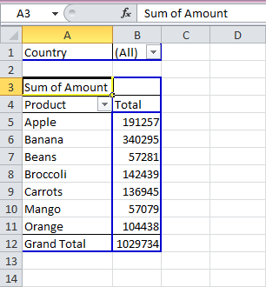
you can find the pivot table. Bananas are our main export product.

Slide 41
Sort
To get Banana at the top of the list, sort the pivot table.
1. Click any cell inside the Total column.
2. The PivotTable Tools contextual tab activates. On the Options tab, click the Sort Largest to Smallest button (ZA).

Slide 42
Filter
Because we added the Country field to the Report Filter area, we can filter this pivot table by Country. For example, which products do we export the most to France?
1. Click the filter drop-down and select France.
Result. Apples are our main export product to France.

Slide 43
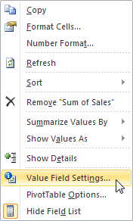
Change Summary Calculation
By default, Excel summarizes your data by either summing or counting the items. To change the type of calculation that you want to use, execute the following steps.
1. Click any cell inside the Total column.
2. Right click and click on Value Field Settings...

Slide 44
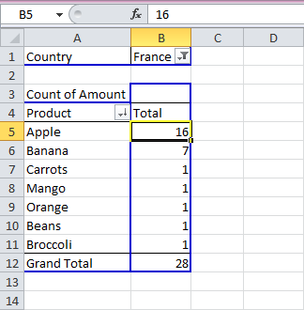
3. Choose the type of calculation you want to use. For example, click Count.
4. Click OK.
Result. 16 out of the 28 orders to France were 'Apple' orders.

Slide 45
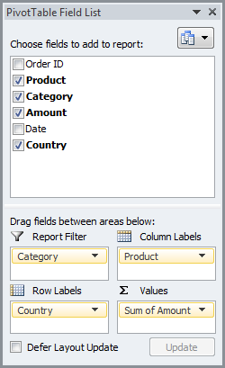
Two-dimensional Pivot Table
If you drag a field to the Row Labels area and Column Labels area, you can create a two-dimensional pivot table.
For example, to get the total amount exported to each country, of each product, drag the following fields to the different areas.
1. Country Field to the Row Labels area.
2. Product Field to the Column Labels area.
3. Amount Field to the Values area.
4. Category Field to the Report Filter area.

Slide 46
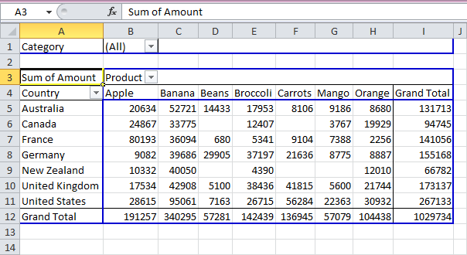
Result

Slide 47
Pivot Chart
A pivot chart is the visual representation of a pivot table in Excel.
Pivot charts and pivot tables are connected with each other.
Insert Pivot Chart
1. Click any cell inside the pivot table.
2. On the Insert tab, click Column and select one of the subtypes.
For example, Clustered Column.

Slide 49
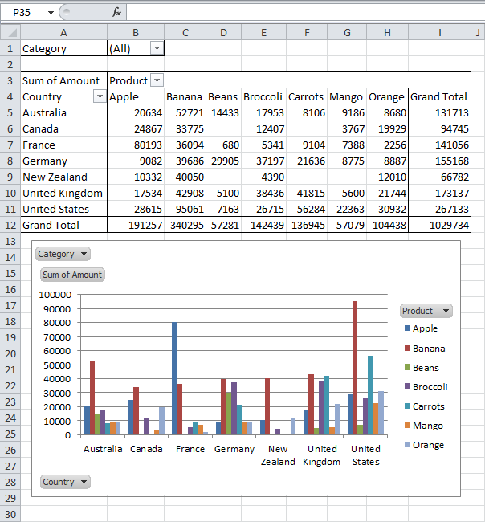
Result
Note : any changes you make to the pivot chart are immediately reflected in the pivot table and vice versa

Slide 50
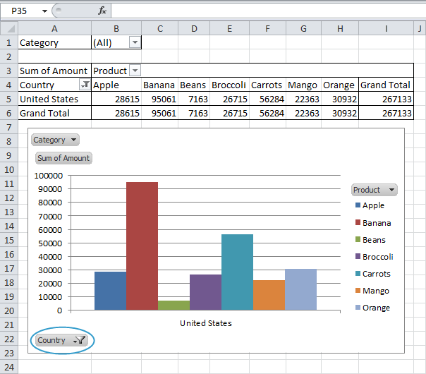
Filter Pivot Chart
To filter this pivot chart, execute the following steps.
1a. Use the standard filters (triangles next to Product and Country).
For example, use the Country filter to only show the total amount of each product exported to the United States.

Slide 51
1b. Because we added the Category field to the Report Filter area, we can filter this pivot chart (and pivot table) by Category.
For example, use the Category filter to only show the vegetables exported to each country.

Slide 52
The End………

