Slide 1
Cls 282 exp.# 3
The production of pyruvate and acetaldehyde during the fermentation of glucose by yeast

Slide 2
Introduction:
Glycolysis: is the metabolic pathway (catabolism) that converts glucose, into pyruvate, . The free energy released in this process is used to form the high-energy compounds ATP (adenosine triphosphate) and NADH .

Slide 3
The metabolic breakdown of glucose is essentially the same in yeast and animals up to the production of pyruvate but under anaerobic conditions ,lactate is the end product of glycolysis in animals while alcohol is produced in yeast.

Slide 4
There are 2 metabolic pathways for glucose regulation :
Glycolysis Gluconeogenesis

Slide 5
1- Glycolysis
•a metabolic process that breaks down glucose through
a series of reactions and releases energy for the body in the form of ATP.
Under aerobic conditions :
Glucose 10 steps Pyruvate (in animal &yeast)
Under anaerobic conditions:
Animals:
Glucose Pyruvate Lactate
Yeast:
Glucose Pyruvate Acetaldehyde Alcohol

Slide 6
2- Gluconeogenesis
• Is a metabolic pathway that results in the generation
of glucose from non-carbohydrate carbon substrates
such as lactate, glycerol.

Slide 7
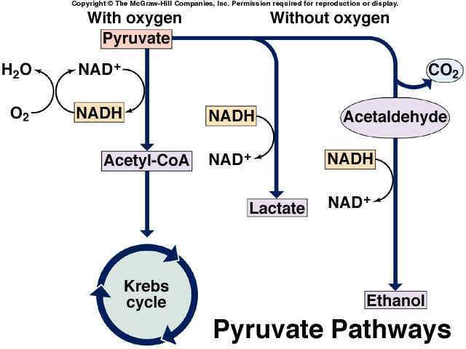

Slide 8
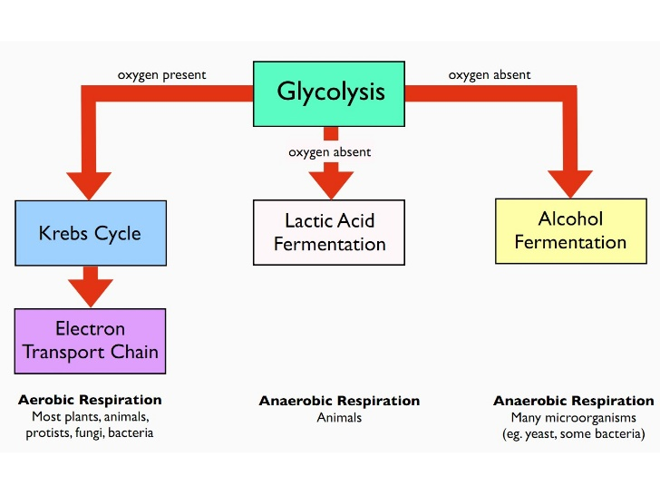

Slide 10
Principle:
C₆H₁₂O₆ + 2NAD⁺ -> 2C₃H₄O₃ + 2NADH + 2H⁺
C₃H₄O₃ + NADH + H⁺ → CO₂ + C₂H₅OH + NAD⁺
^{Pyruvic acid :}
^{In muscles gives lactic acid .}
^{In yeast gives ethanol} + co2

Slide 11
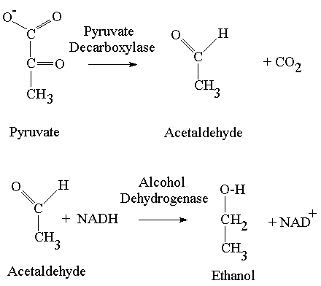
Alcohol is formed in yeast by the oxidative decarboxylation of pyruvate with the intermediate formation of acetaldehyde .
Oxidative decarboxylation reactions are oxidation reactions in which a carboxylate group is removed, forming carbon dioxide.

Slide 12
The metabolites pyruvate and acetaldehyde are normally present at only low conc. So,in order to demonstrate their existence as intermediate on the pathway, some means has to be found to prevent the reaction proceeding any further.

Slide 13
Methods to prevent the reactions proceeding:
1. blocking the enzyme that catalyses the conversion of the compound under investigation by:
Adding inhibitor
Changing the physiological conditions
e.g. pyruvate decarboxylase
2. Trapping agent :agent which reacts with the intermediate to form a compound that is not metabolized further.
e.g. sodium sulphite.
Glucose Pyruvate Acetaldehyde Alcohol
Pyruvate decarboxylase

Slide 14
Pyruvate decarboxylase is inactive in slightly alkaline solution so pyruvate accumulates and its presence is demonstrated by the reaction with sodium nitroprusside
or 2,4-dini-trophenylhydrazine.
In the 2nd experiment, sodium sulphite is added which traps the acetaldehyde. The presence of acetaldehyde is shown by blue colour produced with sodium nitroprusside and piperidine.

Slide 15
1/Formation of pyruvate from glucose
A ⁰
B ⁰
10% glucose | 5ml | 5ml
Alkaline yeast suspension | 5ml | --------
acidic yeast suspension | ---------- | 5ml
1-Mix and incubate in water bath at 37 C for 1 hour
2- Add 2ml of TCA ( trichloracetic acid) for each tubes (TCA:use to ppt. large particles)
3- Mix and centrifuge for 10 min at 2500 g.
4-take supernatant and throw precipitation
5-Boil about 3ml of supernatant for 5 min.

Slide 16
A/Sodium nitroprusside test for pyruvate
A1
B1
Add solid ammonium sulphate in new tubes A1&B1 | ½ inch (0.5g) | ½ inch (0.5g)
Supernatant A⁰ | 2ml (boiled)
supernatant B⁰ |  | 2ml(boiled)
5% Sodium nitroprusside | 2 drops | 2 drops
Add conc. ammonia carefully down the side of the tube so as to form 2 layers.
If pyruvate is present, a green or blue ring forms at the junction of the 2 liquids.
A transient pink ring at the junction is due to the presence of thiol group
(any protein with thiol group gives red color with nitroprusside sol.)

Slide 17
B/ 2,4-dini-trophenylhydrazine test for pyruvate
2ml of supernatant
A ⁰+1ml of 2,4-dini-trophenylhydrazine
Mix and take 3 drops
To new tube and add
1ml NaOH+2ml Water
2ml of supernatant B ⁰
+1ml of 2,4-dini-trophenylhydrazine
Mix and take 3 drops
To new tube and add
1ml NaOH+2ml Water
A2
B2
A red color forms if pyruvate is present

Slide 18
2/Formation of acetaldehyde from glucose
C ⁰
D ⁰
5ml of glucose solution
+5ml of yeast suspension
+0.5 g of sodium sulphite (trapping agent)
5ml of glucose
solution
+5ml of yeast suspension
Mix
1-Incubate the two tubes at 37 C for 1h
2- Mix and centrifuge for 10 min at 2500 g.
3-Remove the supernatant (2 ml each) to Tubes (C1 and D1)
4-add 0.5 ml freshly prepared sodium nitroprusside
5- add 2 ml of piperidine and mix
If acetaldehyde present ----→ blue colored observed

Slide 19
Report:
1-Title
2- aim
2-Principle
4- result of each part( with drawing)
5-Comment on your result.

