Slide 1
Exp 4 Enzymatic digestion of fat by pancreatic lipase
Cls 282 Daheeya Alenazi

Slide 2
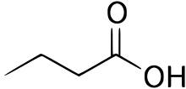
Introduction
Fats (lipid) : consist of a wide group of compounds that are generally soluble in organic solvents and largely insoluble in water.
A triglyceride consists of a glycerol and three fatty acids. It is the major type of lipid used for energy storage
Fatty Acids: The lipid building blocks.

Slide 3
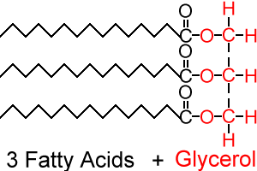
Triglycerides structure

Slide 4
Lipase Enzyme
Lipases: are enzymes which hydrolyse the triglycerides, releasing fatty acids.
Sources: Pancreatic tissue , Germinating oil seeds
+3H₂O lipase glycerol + 3 F.A
Substrate : any oil ( has to be emulsified) can be used or milk also can be used

Slide 5
Aim of the test
Study the effect of lipase enzyme.
Study the effect of physical changes on the enzyme function.

Slide 6
General hydrolysis of fat
The hydrolysis process can give all three fatty acids or it can yield one or two F.AS with diglycerides and monoglycerides...
FA1 FA2
FA3
FA2 Lipase + Lipase FA 2
FA1
FA3 FA2
2-Monoacylglycerol
Triacylglycerol
Diacylglycerol

Slide 7
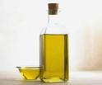
Materials
Fresh whole milk
Litmus solution ( or litmus paper) as an indicator.
Pancreatin solution (boiled, unboiled).
1% Calcium hydroxide solution (accelerator)

Slide 8
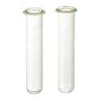
Procedure
In test tube (A), add 4ml of milk.
Add 10 drops of litmus sol.
Add 3 drops of Calcium hydroxide Ca(OH)
Transfer Half of tube (A) to another tube (B).
Add 1ml of (un-boiled) pancreatin to tube (A).
Add 1m of (boiled) pancreatin to tube (B).
Incubate both tubes in water bath (45c) or hot plate for 4-6 hrs.

Slide 9
Results
Accumulation of free fatty acids will gradually reduce the PH of the fat mixture as can be noted in the presence of an indicator.
Pink colour with indicator as positive result:
Because of F.A and salts react with indictor litmus sol.
Odour
Precipitate due to the presence of protein
Tube B not change because of using boiled pancreatin
Deactivation of enzyme.

