Slide 1
Paradigms for nursing research and Evidence Based-Practice (EBP)

Slide 2
Research
What does research mean? Nursing research?
a detailed study of a subject, especially in order to discover (new) information or reach a (new) understanding.
Nursing research is research that provides evidence used to support nursing practices.
From your clinical experiences, would you think about a nursing research question you would like an answer for?
e.g. Does the administration of pain medication at time of surgical incision reduce the need for pain medication twenty-four hours after surgery?
Should we use hypothermia units to lower temperatures in febrile patients?

Slide 3
Why research is important for nursing discipline?
Notes:
Students’ thoughts

Slide 4
Purpose of nursing research
Basic research: is a type of research, and it is driven purely by curiosity and a desire to expand our knowledge
Applied research: is one type of research that is used to answer a specific question that has direct applications.

Slide 5
“The evolution of nursing as a professional discipline necessitated the establishment of a scientific research base to increase disciplinary credibility” (Weaver & Olson, 2006).
Notes:
develop a scientific base for nursing and to seek professional status in esteemed medical and academic institutions, nurse researchers at first
followed the dominant positivist paradigm

Slide 6
What are the current trends and future directions?
EBP
Replication
Innovation
Systematic review
Interdisciplinary collaboration
Dissemination of research findings
Health disparities
Patient preferences

Slide 7
Sources of evidence for nursing practice
Clinical experience
Trial and error
Authority
Tradition
Assembled information
Logical reasoning
Research

Slide 8
Paradigm
What is paradigm?
It is based on ontological, epistemological, and methodological assumptions.
“A set of common beliefs and agreements shared between scientists about how problems should be understood and addressed” (Kuhan, 1962).
“What we see- the facts-is largely determined by what we are looking for, by our beliefs, expectations, orientations, by out theories” (Pedhazur & Schmelking, 1991).
P
Notes:
a simple distinction between epistemology and methodology. The term epistemology comes from the Greek word epistêmê, their term for knowledge. In simple terms, epistemology is the philosophy of knowledge or of how we come to know. Methodology is also concerned with how we come to know, but is much more practical in nature. Methodology is focused on the specific ways -- the methods -- that we can use to try to understand our world better. Epistemology and methodology are intimately related: the former involves the philosophy of how we come to know the world and the latter involves the practice
Methodologies associated with each paradigm reflected the ontological underpinnings of relativism or realism and epistemological underpinnings of objectivity, subjectivity or intersubjectivity
The goals of positivist and postpositivist paradigm research were control and prediction; the goal of interpretive research was understanding and that of critical theory was emancipation

Slide 9
 | Positivistالفلسفة الوضعية | Post-positivist | Interpretive تفسيري | Critical social theory النظرية الاجتماعية الحرجة
Ontologyعلم الوجود (entities) | -The reality is out there, but independent of human observation. -Truth is universal and has an absolute entity -Pure objectivity. -Nature is ordered and regular. -Naïve realism. -Determinism. | -Reality is out there and there is need to understand it. - Truth is an probable entity. -Pure objectivity is impossible…sought through replication -Critical realism. -Cause-effects | -Reality is not fixed. – Reality is subjective and constructed by individuals. -Human is inseparate from environment. -Relativism. - Subjectivity is inevitable. | Focus on oppression and distributing power and resources. -Truth is influenced by social, political, cultural, gender and economic factors. -Realism.
Epistemology نظرية المعرفة (process) | -Researchers hold personal beliefs and biases. -Use tight control of the research situation | - Researcher is independent of participants. | -Researcher and participants are connected. | Researcher and participants are connected.
Methodologyالمنهجية | -Deductive reasoning (hypothesis testing). -Defined concepts and variables. -Control of contextual variables. -Experiment (manipulation and observation). | -Deductive reasoning (hypothesis testing). -Defined concepts and variables -Control of contextual Variables. Representative sample. | -Inductive reasoning (hypothesis generation). -Holistic. -Insights from participants’ experiences. Flexible design. Not representative sample. | -Inductive reasoning (hypothesis generation). -Holistic. -Insights from participants’ experiences. Flexible design. Not representative sample.
Empirical paradigm
Notes:
We use deductive reasoning to postulate theories that we can test. Based on the results of our studies, we may learn that our theory doesn't fit the facts well and so we need to revise our theory to better predict reality. The positivist believed in empiricism -- the idea that observation and measurement was the core of the scientific endeavor. The key approach of the scientific method is the experiment, the attempt to discern natural laws through direct manipulation and observation
Positivist research methodology (methodological individualism) emphasizes micro-level experimentation in a lablike environment that eliminates the complexity of the external world (e.g., social, psychological, and economic linkages between unemployment, and crime or suicide).. this yields results that have internal validity …While the results obtained using experimental methods provide valuable insights into the nature of reality, those results may lack external validity.
That is, the relations observed in the laboratory may not be the same in the more complicated external world where a much greater number of factors interact.
Relativism, a view of truth as composed of multiple local and specific realities that can only be
subjectively perceived.
Positivist, postpositivist and critical theory paradigms are based on realism, a view of truth as universal and independent of human perception of it
Objective: value free’ or ‘value neutral’
Subjective: ‘value relative’, or ‘value mediated’

Slide 10
Do you think that research from a single paradigm is enough to meet nursing practice demands?
Does nursing discipline require to choose one paradigm?
“developing knowledge may be enhanced through the use of integrative strategies that maintain the theoretical perspectives of individual research paradigms” (Weaver & Olson, 2006).
Notes:
A pluralist approach may have greater utility to nursing because it holds that research from various paradigms
can contribute to the development of knowledge needed for nursing practice.

Slide 11
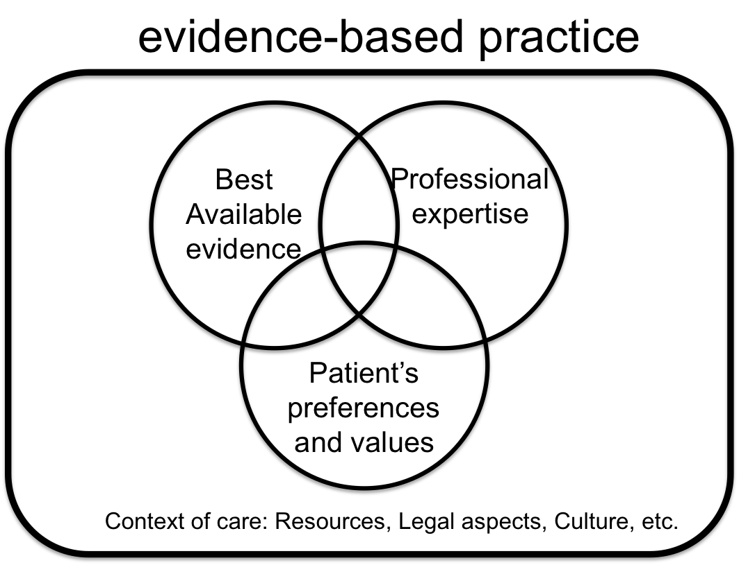
Evidence-based practice:
“The process of shared decision-making between practitioner, patient, and others significant to them based on research evidence, the patient’s experiences and preferences, clinical expertise or know-how, and other available robust sources of information” (Sigma Theta Tau, 2008).

Slide 12
Is Research Utilization (RU) is exactly similar to EBP? Or is RU a sub-set of EBP?
RU is closely related to evidence based practice (EBP) in the sense that EBP is research utilization that includes other influences or considerations specific to the problem at hand
What is Knowledge Translation (KT)?
“Best evidence refers to research findings that are methodologically appropriate, rigorous, and clinically relevant for answering persistent questions”

Slide 13
Systematic review
Single prospective/cohort study
Expert Opinion, case report
Single RCT
Single in-depth qualitative study
Single case-control study
Single cross sectional study
Single non-randomized trial (Quasi-experimental)

Slide 14
Issues in the literature related to EBP movement:
1. Difficulty defining the concept of evidence based on competing paradigms.
2. The nature of the evidence hierarchy.
Advocate for “theory-guided, evidence-based nursing practice”
Use four patterns of knowing (empirics, esthetics, personal knowledge, and ethics) to generate evidence relevant to nursing practice.
“RCT is considered the superior form of evidence……oversimplification of the complexity of clinical nursing practice and aligning nursing with a similar path as medicine”.
“EBP does indeed consist of a hierarchy of evidence that leads to valuing of some forms of evidence (i.e., empirical evidence) over other forms, but they raise a significant question for consideration, that being whether this is a good or a bad thing”
(Earle‐Foley, 2011).
Notes:
EBN has been criticized, as it does not support the use of Carper’s patterns of knowing (empirics, esthetics, personal knowledge, and ethics), since it reduces the patterns of knowing down to one validated bald empirics. Therefore, the clinical practice is diminished to a science and the ‘art’ of practice is dismissed, which leads some scholars to criticizing and characterizing EBP as a ‘cookbook’ approach to practice
It is important to acknowledge that within the conventional EBP agenda which promotes an evidence hierarchy, nurses struggle to reconcile their commitment to multiple ways of knowing

Slide 15
3. Whether EBP is even a realistic or attainable goal within the discipline of nursing.
If both quantitative and qualitative are equal evidence “then we must consider whether nurses have adequate knowledge and skills to locate, critically appraise, and then incorporate the ‘best’ evidence into clinical practice”
“Is it acceptable within the EBP movement for nurses to rely on other sources such as intuition, authority, tradition, and common sense?”
(Earle‐Foley, 2011).

Slide 16
EBP challenges:
Quality and nature of the research
Characteristics of nurses
Organizational factors
How individual nurse can adopt EBP?

Slide 17
Different levels of explanation:
Identification (e.g. studying adults’ experiences with osteoarthritis who had undergone total knee joint arthroplasty. In this stud, the researcher identified the process of adjustment).
Description (e.g. describing the prevalence of cancer among Saudi women or the describing the pain of postoperative head cancer patients who developed speech impairment)
Exploration (e.g. exploring whether the length of time patients spent on cardiac surgery waiting list influenced their psychosomatic conditions or exploring refugee mothers’ perception of healthy lifestyle).
Notes:
Description focuses on prevalence, incidence, size, and measurable attribute such as severity. Or is focuses on describing the dimensions and the importance of the phenomenon.
Exploratory research takes place when problems are in a preliminary stage. Exploratory research is used when the topic or issue is new and when data is difficult to collect. Exploratory research is flexible and can address research questions of all types (what, why, how). Exploratory research is often used to generate formal hypotheses. It investigates the full nature of the phenomenon.
Explanatory research offer understanding of the causes and the systematic relations among phenomenon

Slide 18
Different levels of explanation:
Explanation ( e.g. testing theoretical model that explains exercise behavior in older adults or developing framework for understanding women’s journey after separation from an abusive partner)
Prediction and control (identify predictors of successful weaning from mechanical ventilation)

