Slide 1
Statistical analysis using R

Slide 2
Written by:
عواطف المطيري سناء أبو نصرة
نوره المسعود خلود باسالم
العنود الزغيبي زهراء الكعبي
Presented by:
نوره المسعود
أمل المحيسن

Slide 3
Outline
Introduction. What & Why R
Brief Navigation of R.
Types of R objects and Data.
Basic Command in R.
Matrices.
Some Statistical Distributions.
Graphics.

Slide 4
Statistical analysis
Once you have collected quantitative data, you will have a lot of numbers.
It’s now time to carry out some statistical analysis to make sense of,
and draw some inferences from, your data.
There is a wide range of possible techniques that you can use.
We will provides a brief summary of some of the most common techniques for summarizing
your data, and explains when you would use each one by using R

Slide 5
What is R ?
R is a programming language.
R is an open-source software environment for statistical computing and graphics .
R works with a command-line interface, meaning you type in commands telling R what to do .
For more information and to download R, visit Cran.r-project.org

Slide 6
Why learn R ?
It supports larger data sets. Excel ~ 1 Million , R~2 Billion vector index limit
Faster. i.e. 100K in excel ~15 mins vs 1M ~30 second
It reads any type of data.
Availability of instant access to over 7800 packages customized for various computation tasks.
Get high performance computing experience.
Advanced Statistics capabilities.
The community support is overwhelming. There are numerous forums to help you out. For example:
Numerous Discipline Specific R Groups
Numerous Local R User Groups (including R-Ladies Groups)
Stack Overflow
Learning Resources (quantity and quality)
R books
(Free Online) R Books
https://www.datasciencecentral.com/profiles/blogs/600-websites-about-r
Reproducibility (important for detecting errors)

Slide 7
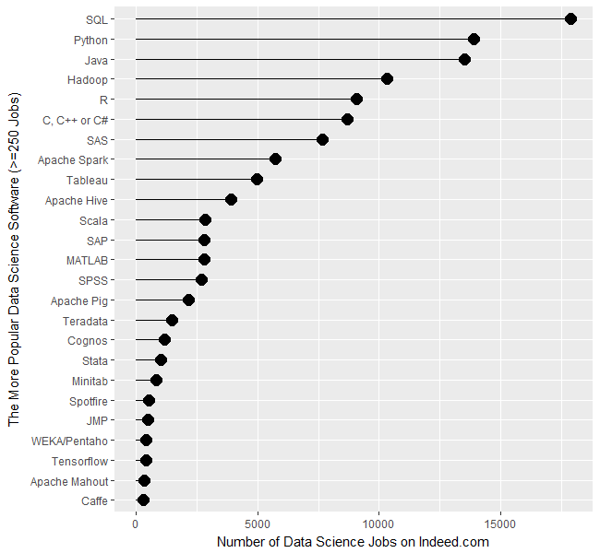

Slide 8
Difference Between R & RStudio
Notes:
More precisely, R is a programming language that runs computations while RStudio is an integrated development environment (IDE) that provides an interface by adding many convenient features and tools. So the way of having access to a speedometer, rearview mirrors, and a navigation system makes driving much easier, using RStudio’s interface makes using R much easier as well.

Slide 9
Getting started with R
How to install R and R Studio ?
https://www.youtube.com/watch?v=Ohnk9hcxf9M&feature=youtu.be
R studio ( nice editor and features )

Slide 10
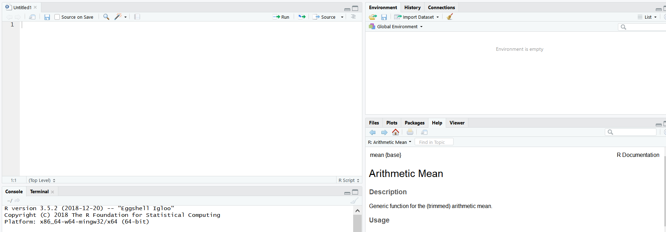
R studio
R script (work space)
CONSOLE
Files,plot,packages,help

Slide 11
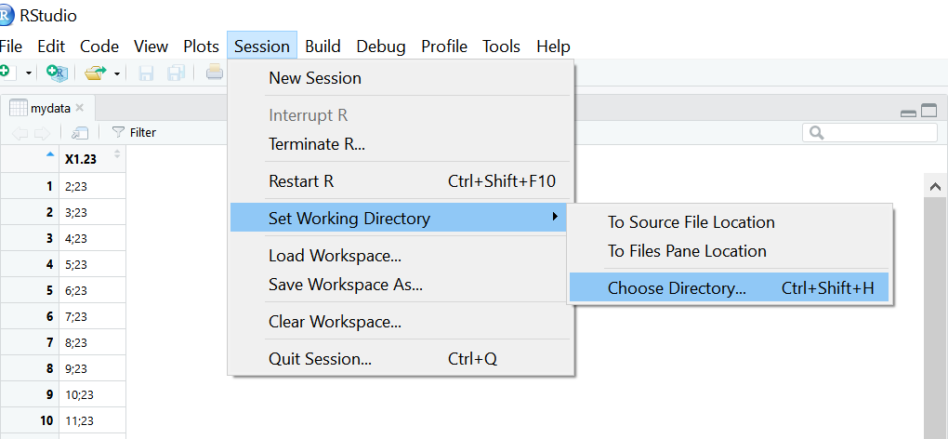
Working directory
If you need to check the current working directory use :getwd()
If you need to change the current working directory use the following step :

Slide 12
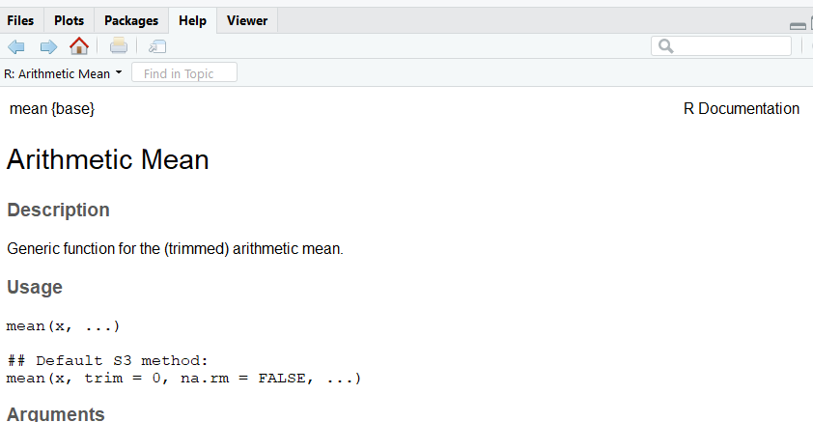
Help in R
To get more information on any built-in R commands, simply type the following and this will bring up a separate help page.

Slide 13
Loading Data
From your spreadsheet editing program (Excel, Google Docs, etc ) save your spreadsheet as a csv. File on your computer.
In R, decide on a name for your dataset. Usually a short name relevant to the particular dataset is best. Lets assume you picked the name (mydata).
Type

Slide 14
R packages
Installation
install.packages(“packagename")
2. Loading
Library(packagename)
3. Use
?packagename

Slide 15
Saved files
You can scroll back to previous commands typed by using the `up' arrow key and `down' to scroll back again.
You can also `copy' and `paste' using standard windows editor techniques (for example, using the `copy' and `paste' dialog buttons).
If at any point you want to save the transcript of your session, click on `File' and then `Save', which will enable you to save a copy of the commands you have used for later use.
As an alternative you might copy and paste commands manually into a note pad editor or something similar. You finish an R session by typing
> q( ) .

Slide 16
Five basic classes of objects
What is an object?
Numeric :(Real Numbers)
Integer : (Whole Numbers)
character
Logical (True / False)
complex

Slide 17
Example
<- c(1.8, 4.5) #numeric
b <- c(1 + 2i, 3 - 6i) #complex
d <- c(23, 44) #integer
e <- rep(c("Male”,Female"),each=5)

Slide 18
Data Types in R
Vector: a vector contains object of same class.
Ex: bar <- 0:5
Matrices: When a vector is introduced with row and column i.e. a dimension attribute, it becomes a matrix. A matrix is represented by set of rows and columns. It is a 2 dimensional data structure. It consist of elements of same class.
Ex: my_matrix <- matrix(1:6, nrow=3, ncol=2)
Data Frame: This is the most commonly used member of data types family. It is used to store tabular data. It is different from matrix. In a matrix, every element must have same class. But, in a data frame, you can put list of vectors containing different classes.
Ex: df <- data.frame(name = c(“Sara",“Wafa",“Norah",“Reem"), score = c(67,56,87,91))
List: A list is a special type of vector which contain elements of different data types.
Ex: my_list <- list(22, "ab", TRUE, 1 + 2i)

Slide 19
Basic Commands

Slide 20
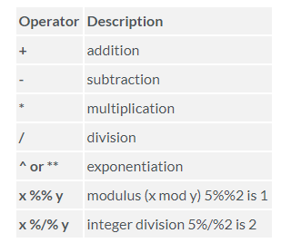
Arithmetic operations:

Slide 21
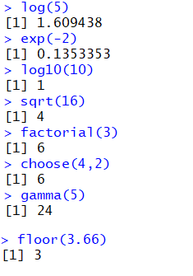
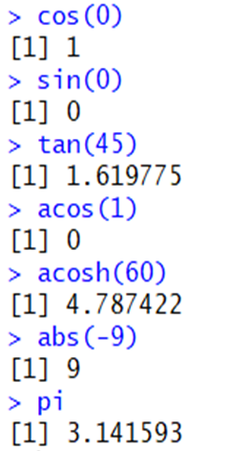
Mathematical functions :

Slide 22
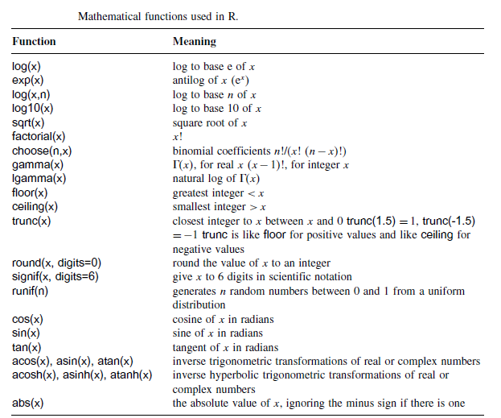

Slide 23
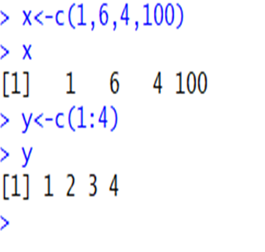
Vector :

Slide 24
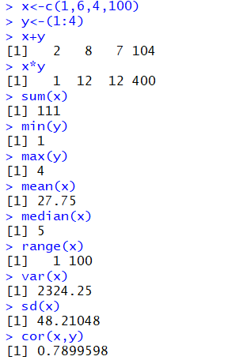
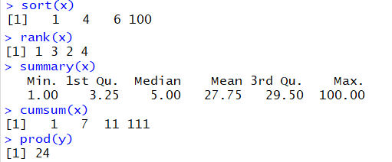
Vector Functions:

Slide 25
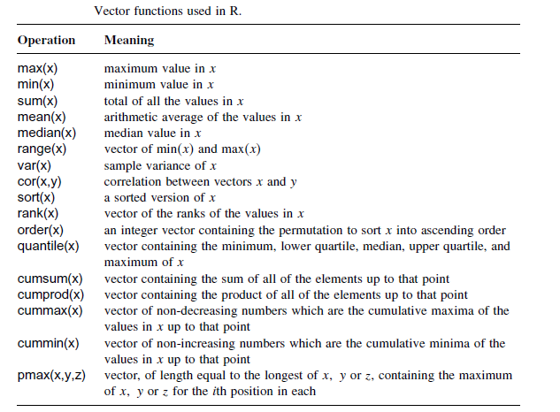

Slide 26
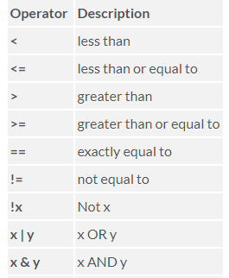
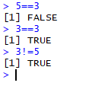
Logical Operators

Slide 27
Matrices

Slide 28
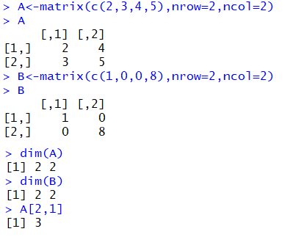
Write matrix and Dimensions

Slide 29
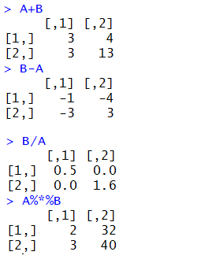
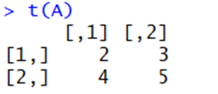
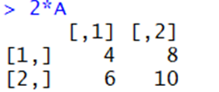
Multiplication
Transpose
Inverse

Slide 30
Statistical distributions in R

Slide 31
Common Probability Distribution Functions in R
Probability functions
f(x)
P(X=x)
d
Cumulative distribution function
F(x)=p(X≤x)
p
Inverse distribution function
X=${F(x)}^{−1}$
X=〖𝐹(𝑥)〗^(−1)
q
Random sample
r

Slide 32
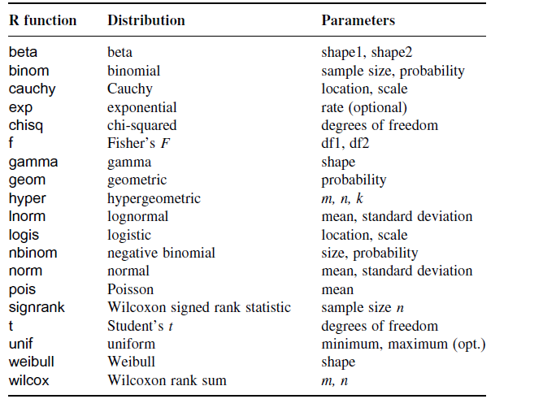

Slide 33
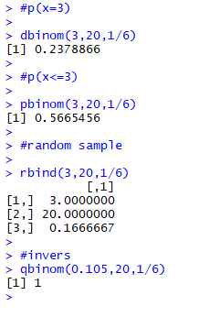
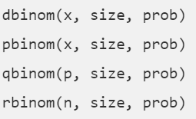
Discrete Probability Distributions
The binomial distribution:
X is Binomial Distribution with n=20 trials and p=1/6 probability of success
X~BIN(n=20 ,p=1/6)

Slide 34
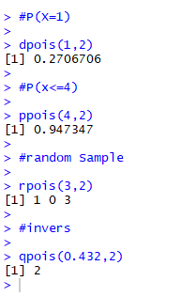
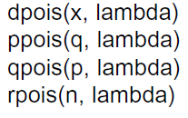
Discrete Probability Distributions
The Poisson distribution:
X is Poisson Distribution with =2 X~Pois(2)

Slide 35
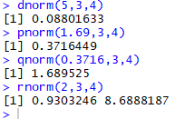
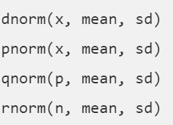
Continuous Probability Distributions
The Normal distribution:
X is Normal Distribution with µ=3 and =4 ,
X~N(3,4)

Slide 36
Continuous Probability Distributions
The Exponential distribution:

Slide 37
Basic Graphics

Slide 38
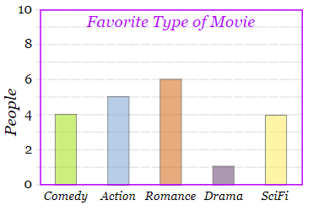
1- Bar Graph
is a graphical display of data using bars of different heights.
is a graphical display of data using bars of different heights.
Example:
Favorite Type of Movie
Comedy | Action | Romance | Drama | Science fiction
4 | 5 | 6 | 1 | 4

Slide 39
barplot(H , xlab = , ylab= , main = ,names.arg )

Slide 40
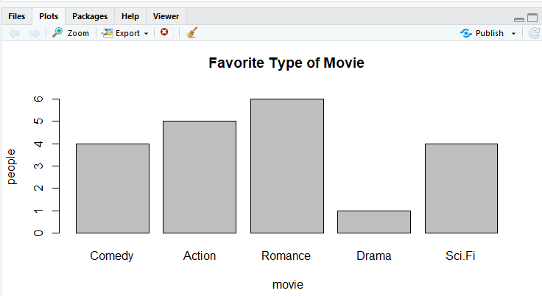

Slide 41
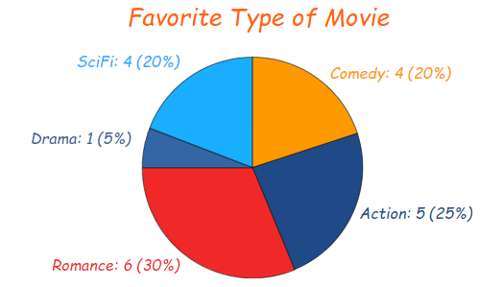
2- pie Graph
a special chart that uses "pie slices" to show relative sizes of data.
is a graphical display of data using bars of different heights.
Example:
Favorite Type of Movie
Comedy | Action | Romance | Drama | Science fiction
4 | 5 | 6 | 1 | 4

Slide 42
pie(x ,main= ,labels= )

Slide 43
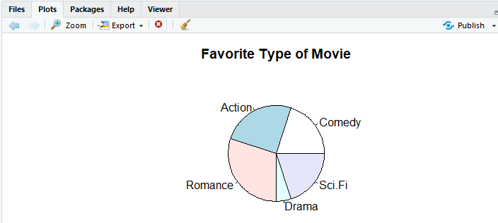

Slide 44
3- Line Graph:
a graph that shows information that is connected in some way (such as change over time)
Example:
Ice Cream Sales
Mon | Tue | Wed | Thu | Fri | Sat | Sun
10 | 15 | 20 | 25 | 5 | 22 | 7

Slide 45
plot(y ,type= ,xlab= ,ylab= ,main= )

Slide 46
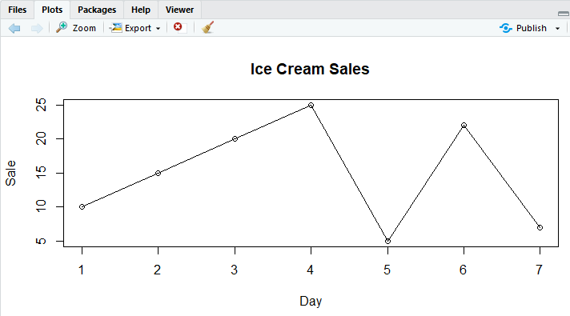

Slide 47
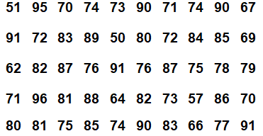
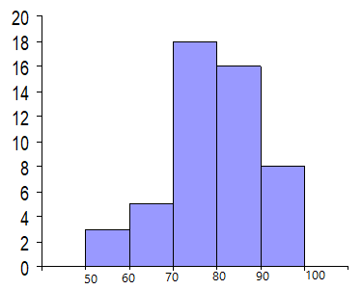
4- Histogram Graph
graphical display of data using bars of different heights.
is a graphical display of data using bars of different heights.
Example:

Slide 48
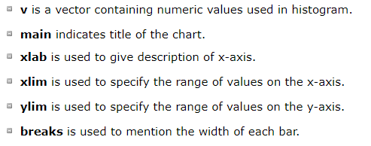
hist(v ,main= ,xlab= ,ylab= ,xlim= ,ylim= , breaks = )

Slide 49
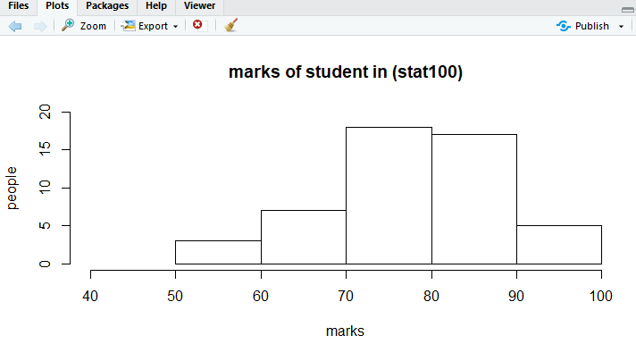

Slide 50
5- Scatter plot
Each point represents the values of two variables. One variable is chosen in the horizontal axis and another in the vertical axis.
Example:
Hours spent studying, x | Test score, y
0 | 40
1 | 41
2 | 51
4 | 48
4 | 64
5 | 69
5 | 73

Slide 51
plot(x , y , main= ,xlab= ,ylab= )

Slide 52
