Slide 1
Staining of Fungus by using Lactophenol cotton blue
Aim
To stain fungal hyphae by using Lactophenol cotton blue.
Requirement
-Young fungal culture
-Glass slide
-Cover slip
-Needle
-Lactophenol cotton blue stain.

Slide 2
Procedure
1- Take a clean grease free slide.
2- Add a drop of mounting fluid that is lactophenol cotton blue solution on a slide.
3- Sterilize the needle and cool it then transfer a mycellial mat on fluid and press it gently so that it easily mix with the stain.
4- Take a clean cover slip and with the help of a forceps place the cover slip on mycellial mat.
5- Take a blotting paper and wipe the excess stain .
6- Observe under low to high power objectives of microscope.

Slide 3
Slide Culture; Mycology
Principle:
The slide culture is the best method for preserving and observing the actual structure of a fungus.
Materials:
Actively growing fungus on Potato Dextrose agar.
Petri dish
2. Sterile water
3. Potato Dextrose agar
4 Coverslip
5. Glass slide
6. Lactophenol cotton blue
Procedure:
1. Place a slide on a bent-glass rod and a piece of filter paper in the bottom of a petri dish
2. Prepare a drop of potato dextrose agar by using sterilized pipette in the center of the slide in a petri dish and allow to solidify.
3. Inoculate the sides of PDA agar drop with a small fragment of fungus being studied.
5. Sterilize coverslip by passing it briefly through a flame. Cover inoculated drop with the sterile cover slip.
6. Add sterile water to bottom of petri dish.
7. Incubate at 25 °C until sporulation occurs (usually 1-2 weeks, occasionally faster). The slide preparation may be checked periodically under the low power of a microscope.
When sporulation is complete, carefully lift off cover slip and place onto a drop of lactophenol cotton blue on a clean slide, making your first slide.

Slide 4
NOTES
-Phenol will kill any live organisms
-Lactic acid preserves fungal structures
-Lactophenol cotton blue stains the chitin in the fungal cell walls.

Slide 5
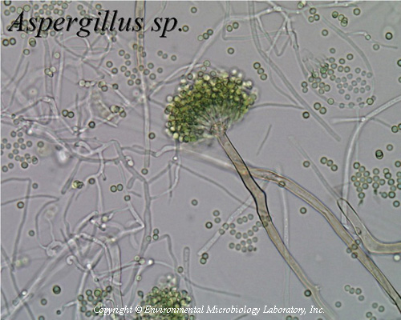
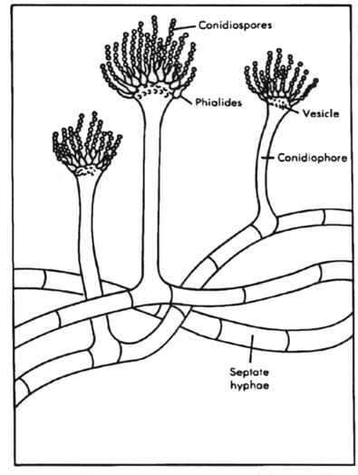
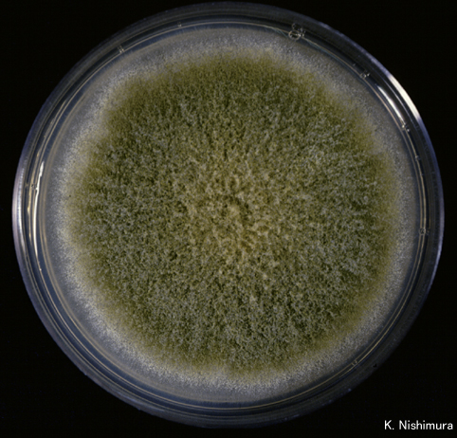
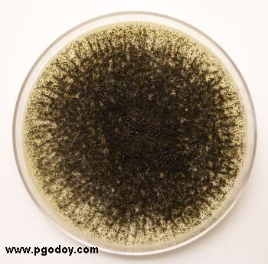
Aspergillus falvus
Aspergillus niger

Slide 6
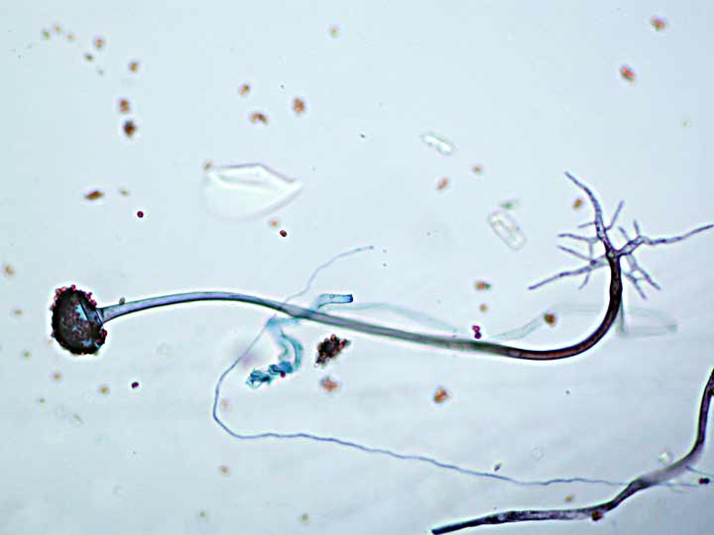
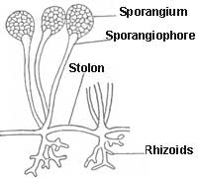
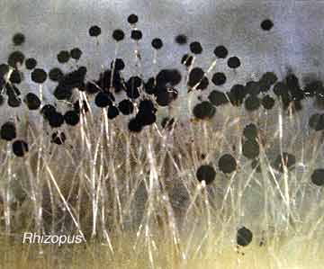
Rhizpous

Slide 7
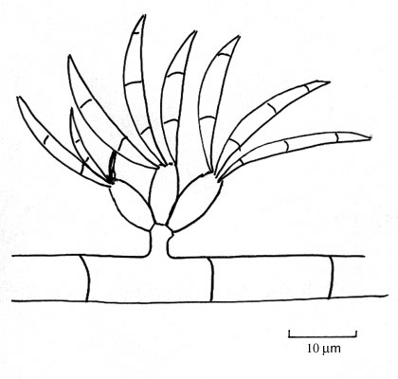
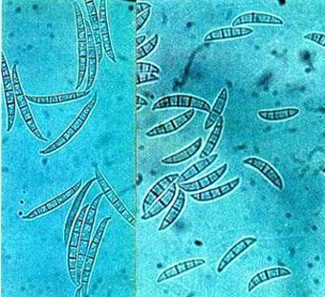
Fusarium

Slide 8
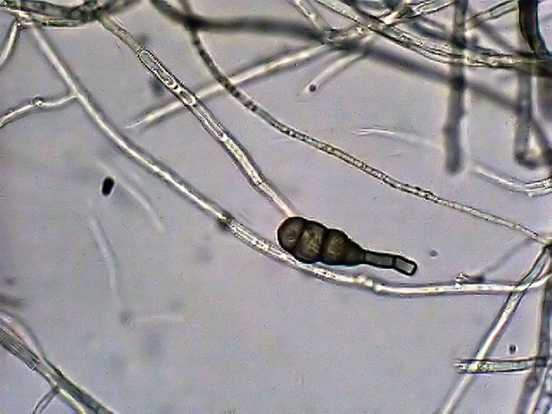
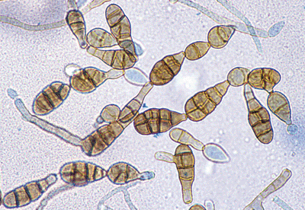
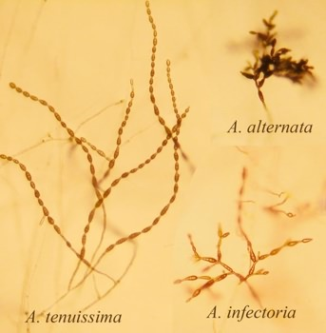
Alternaria

Slide 9
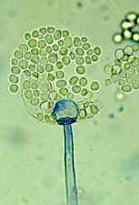
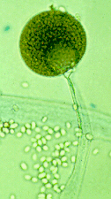
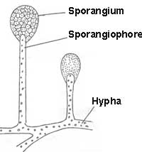
Mucor

Slide 10
Making a wet mount slide and observing yeast under microscope
Aim
To prepare a wet mount of yeast cell and to observe them under the microscope
Materials
-Yeast cell suspension
-Glass slides
-Cover slip
-Needle
-safranin
Procedure
1- Take a sample of yeast suspension provided and add a single drop to a clean microscope slide
2- Place a cover slip on the drop without causing air bubbles
3- Observe the yeast cells under low magnification at first and under high power
4- Stain the cells with safranin
Results
Draw a picture of the cells that you see on the wet mount slide.

Slide 11
الخمائر
Saccharomyces
Schizosachromyces
Rhodotorula
Hansenulla

Slide 12
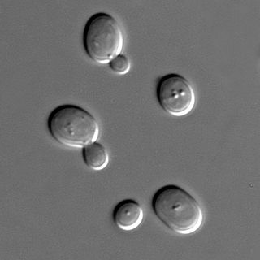
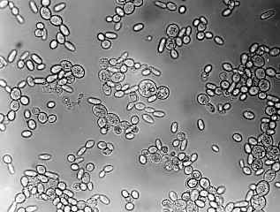
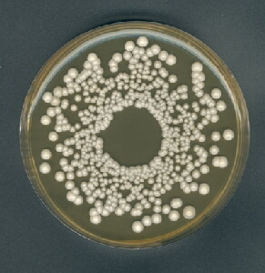
Saccharomyces

Slide 13
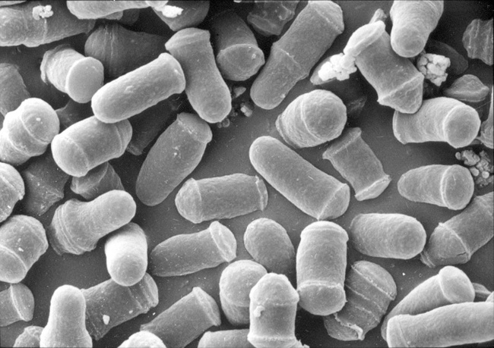
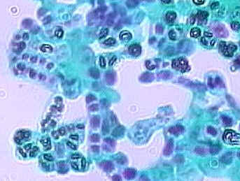
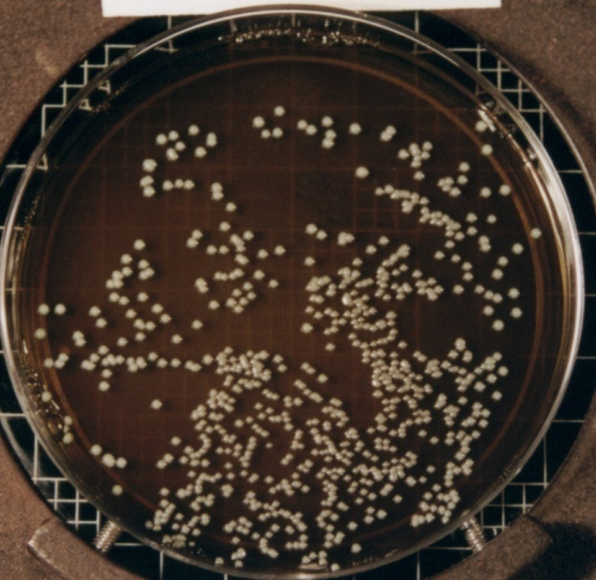
Schizosachhromyces

Slide 14
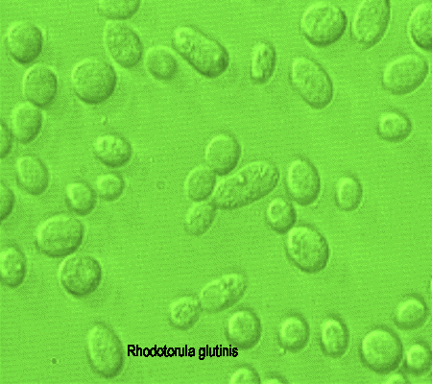
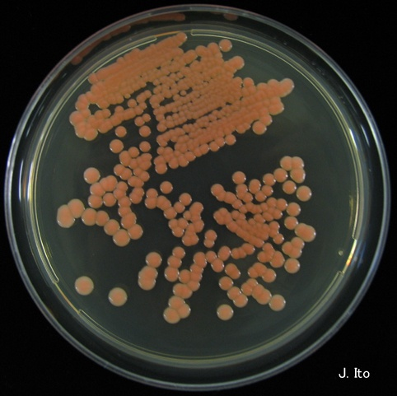
Rhodotorula

Slide 15
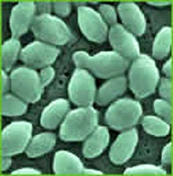
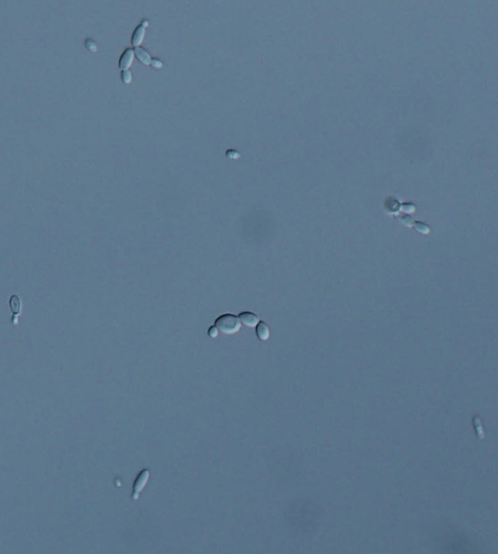
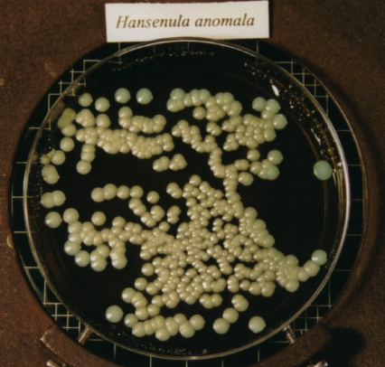
Hansenula

