Slide 1

CHAPTER 3
Built-in MATLAB Functions

Slide 2
Table 3.1: abs(x), sqrt(x), sign(x), rem(x,y), exp(x), log(x), log10(x)
Table 3.2: round(x)
Table 3.3: factorial(x)
Table 3.4
Table 3.5
Table 3.6
Table 3.7: sum(x), prod(x)
Table 3.8: sort(x),sort(x,'descend')
Table 3.10
Table 3.12
Table 3.13: rand(n),rand(m,n)
Table 3.14: Not included
Table 3.15:
Table 3.16:

Slide 3
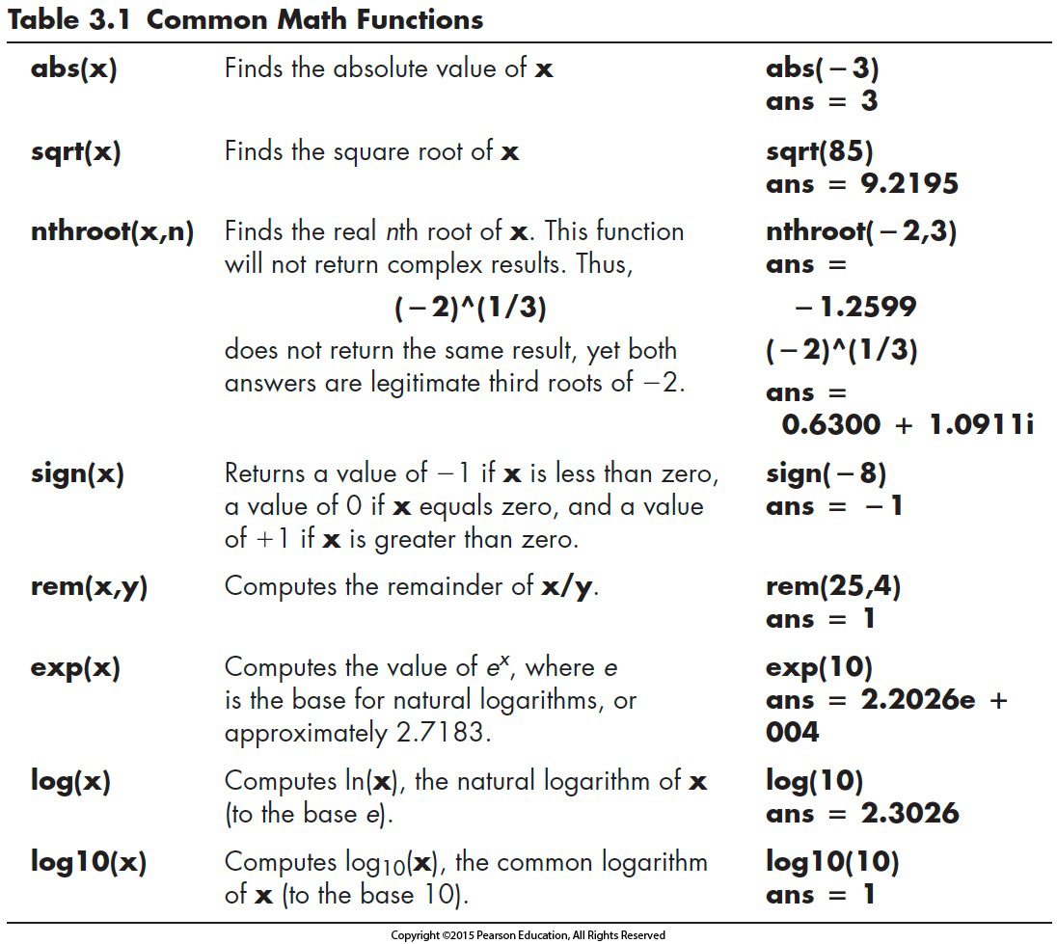
Notes:
Argument = input
Matrix or scalar
Same as other languages
Complext syntax (sin(sqrt(x))
Exp (3) = e^3

Slide 4
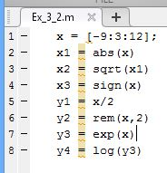
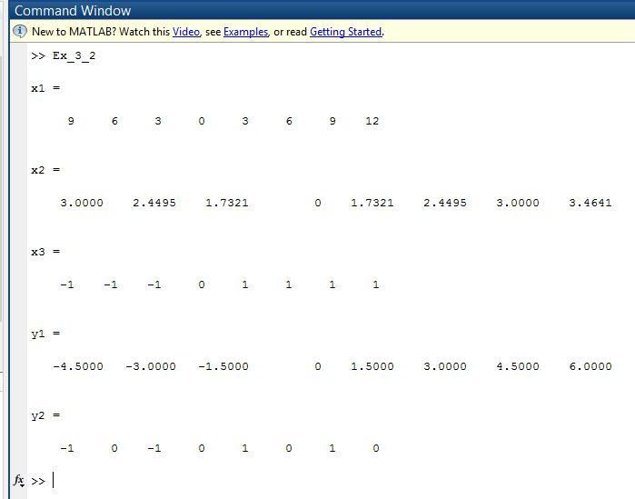
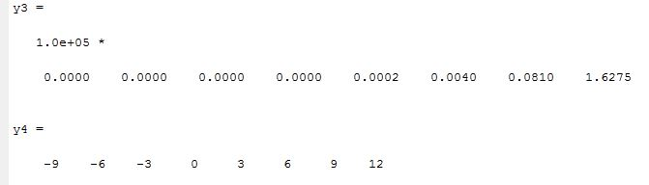

Slide 5
3.2 Using the Help Feature
MATLAB includes extensive help tools, which are especially useful in understanding how to use functions.
There are two ways to get help from within MATLAB : a command-line help function (help) and an HTML-based set of documentation available by selecting Help from the menu bar, selecting the help icon (a question mark) or by using the F1 function key
To use the command-line help function, type help in the command window:
help
A list of help topics will appear:
To get help on a particular topic, type help <topic> . (Recall that the angle brackets, < >, identify where you should type your input; they are not included in your actual MATLAB statement.)
For example, to get help on the tangent function, type
help tan

Slide 6
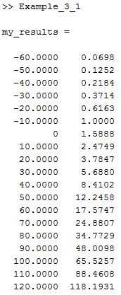
%Example 3.1
%Using the Clausius–Clapeyron Equation, find the
%saturation vapor pressure for water at different
%temperatures
TempF=[-60:10:120]; %Define temp matrix in F
TempK=(TempF + 459.6)/1.8; %Convert temp to K
Delta_H=2.45e6; %Define latent heat of
%vaporization
R_air = 461; %Define ideal gas constant
%for air
%
%Calculate the vapor pressures
Vapor_Pressure=6.11*exp((Delta_H/R_air)*(1/273 - 1./TempK));
%Display the results in a table
my_results = [TempF',Vapor_Pressure']
Test it manually

Slide 7
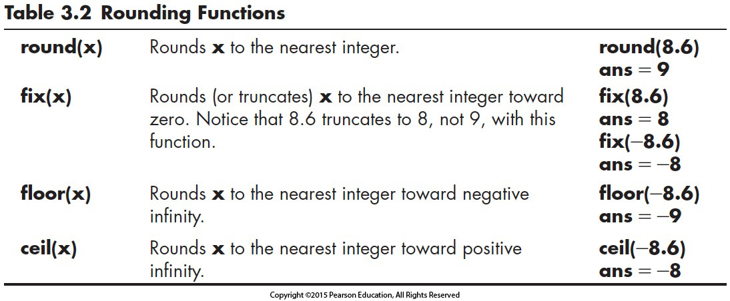
Notes:
Fix – apples

Slide 8
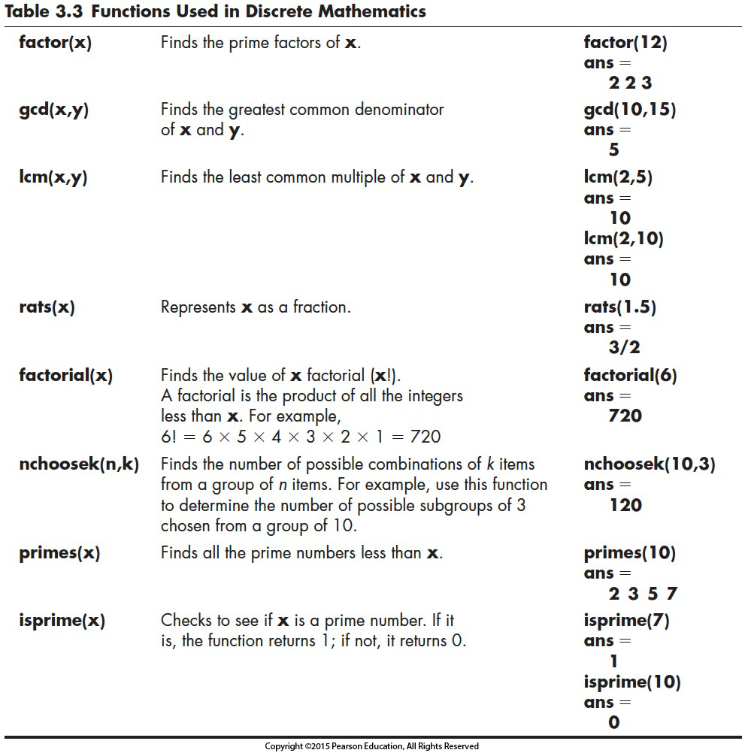
Notes:
Factorial not factor
Fact = <= 170!
! Is not used
Primes

Slide 9
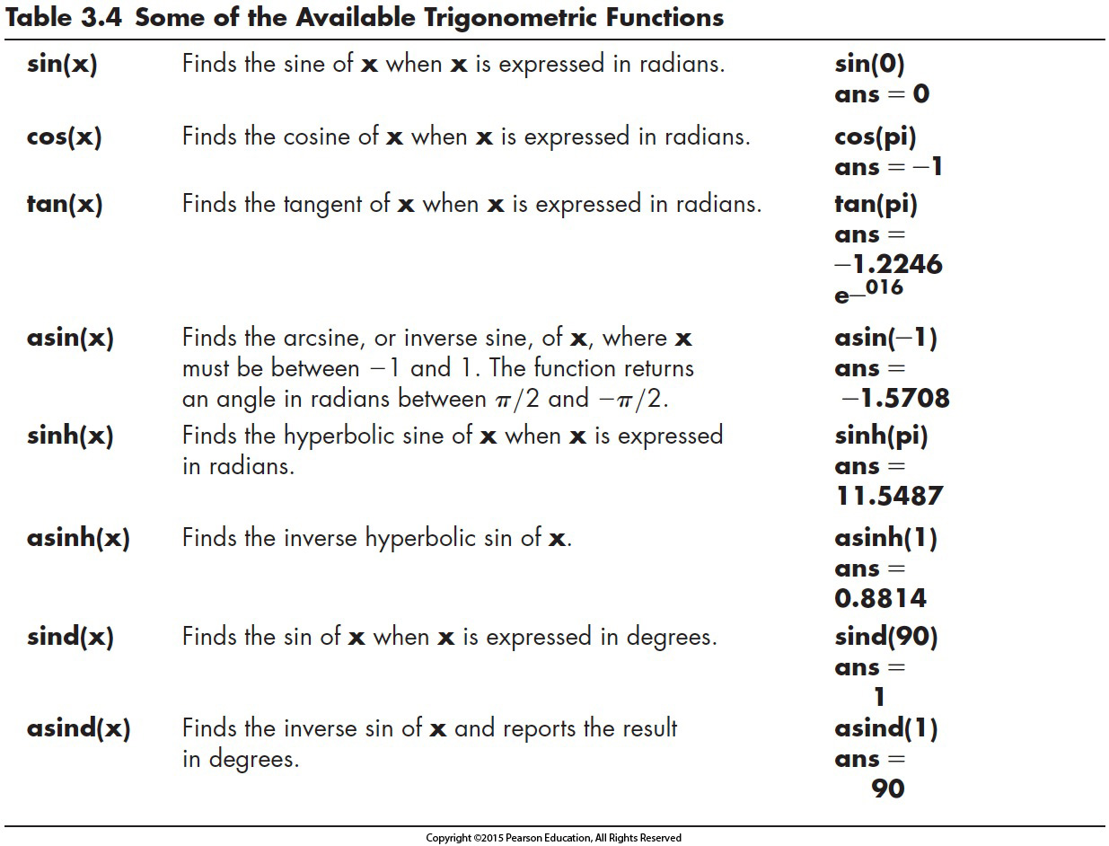
Available Trigonometric Functions
Notes:
Same for cos, sin, tan
Same for other languages
deg2rad

Slide 10
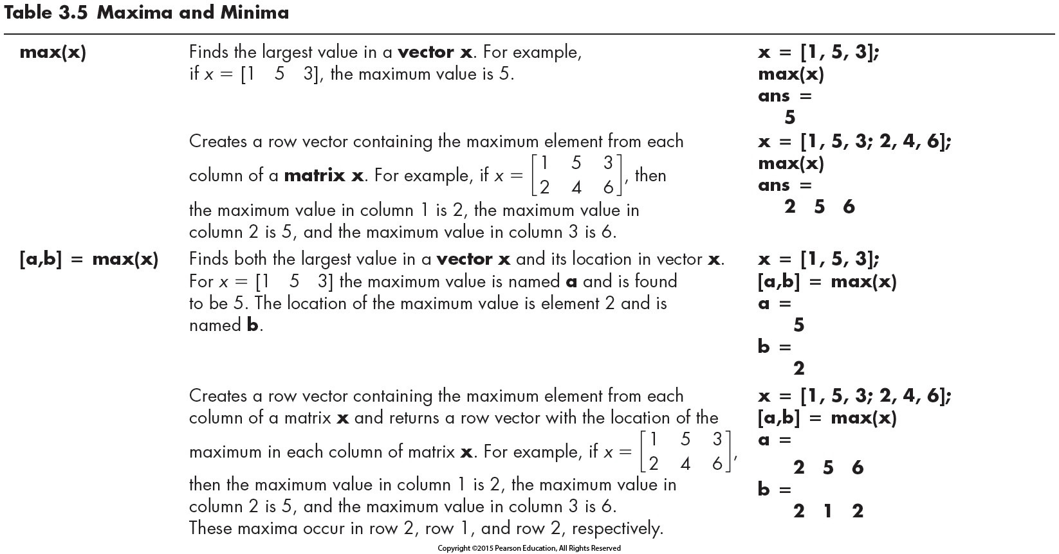

Slide 11
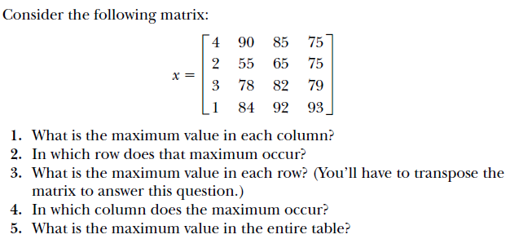

Slide 12
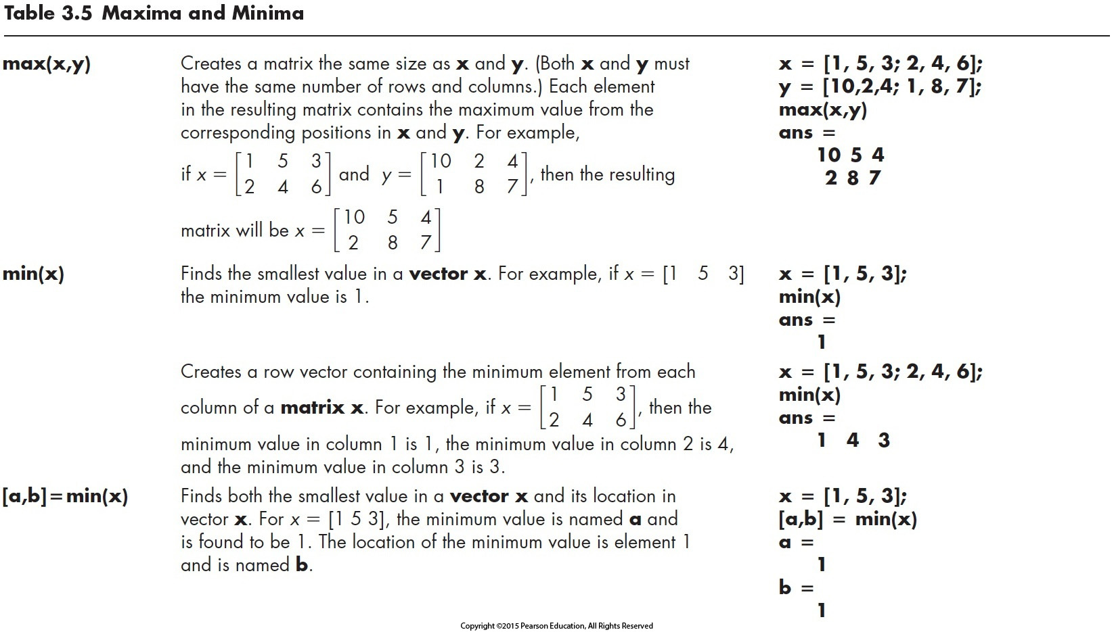
Note the generation of new matrix
Note the similarity with max function
Notes:
max(A,[],2) max in rows
or
Transpose to find max in row instead of columns

Slide 13
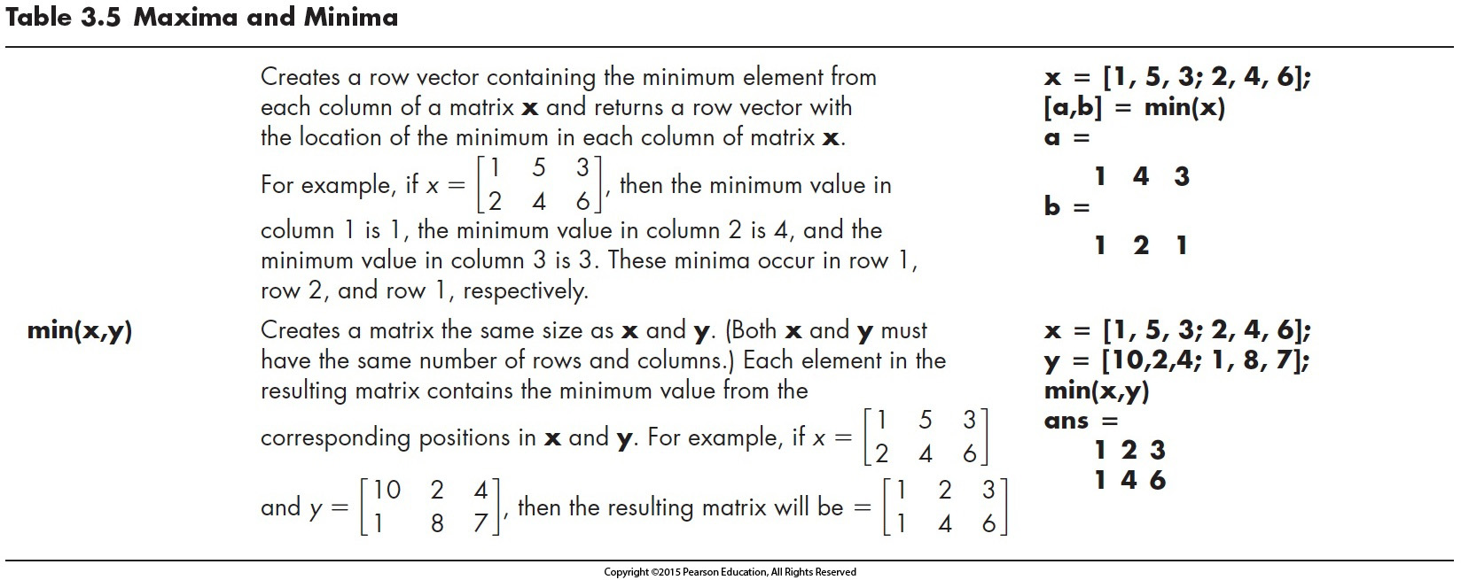
Note the generation of new matrix with elements being the minimum of the two

Slide 14
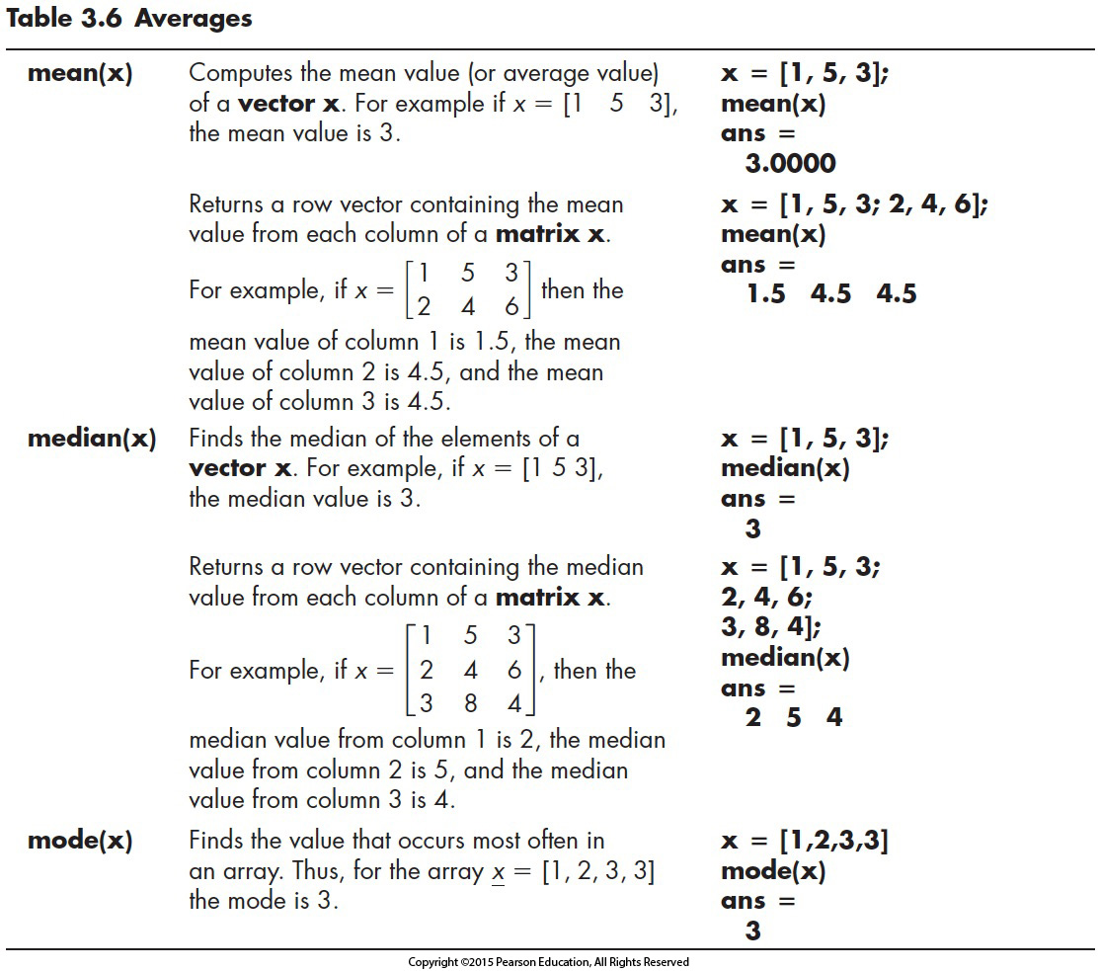
Mean of each column

Slide 15
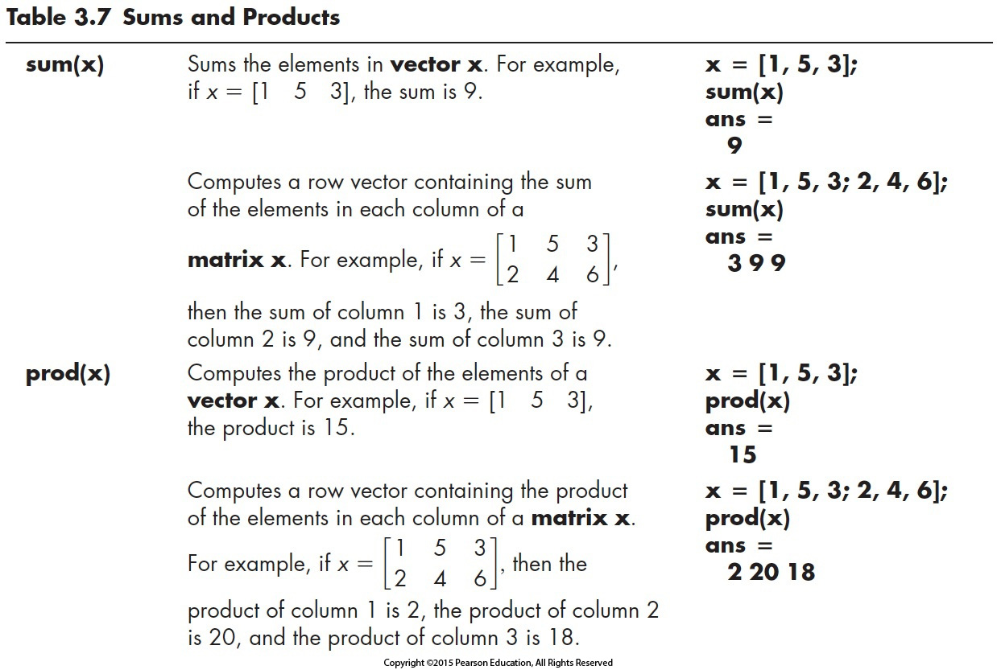
Sum of each column
Product of each column
sum(prod(x)) = ???

Slide 16
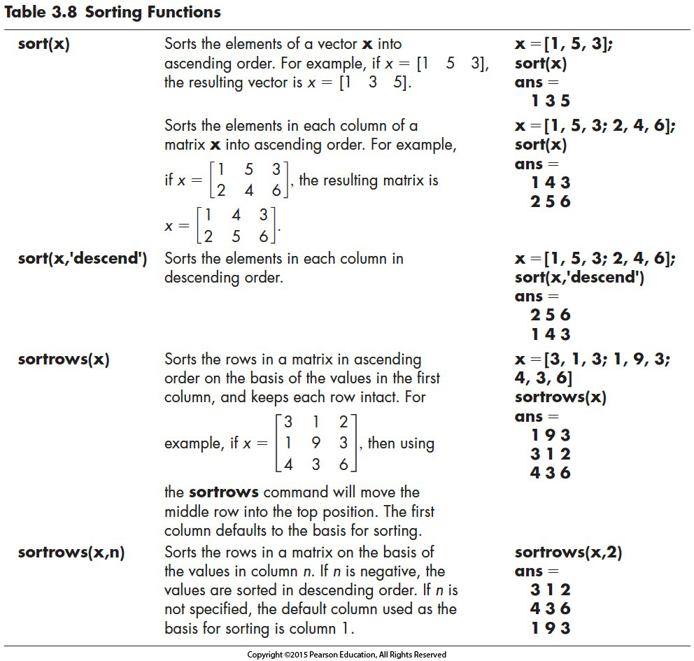
default is ascending order

Slide 17
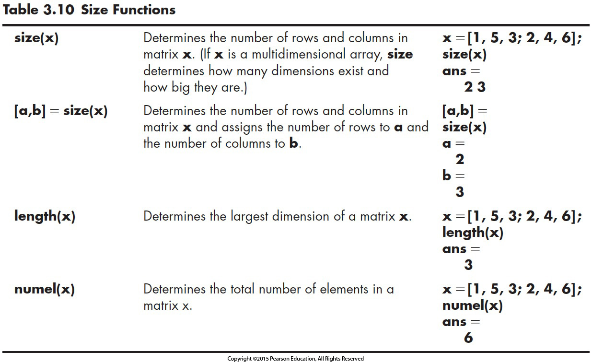

Slide 18
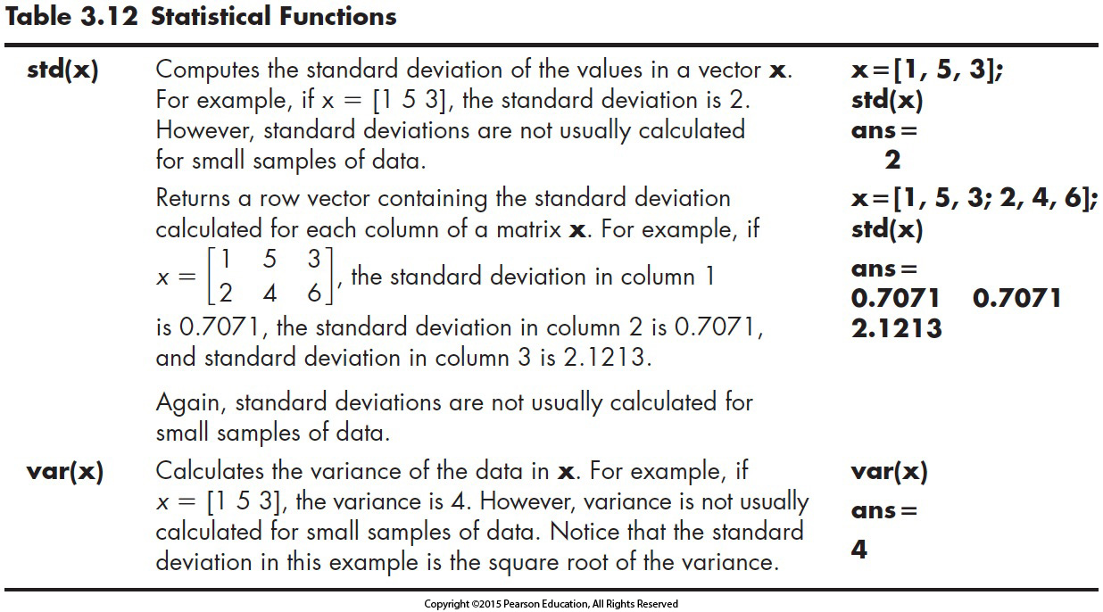
Notes:
Variance = 1/n sum (xi-xلآ)^2

Slide 19
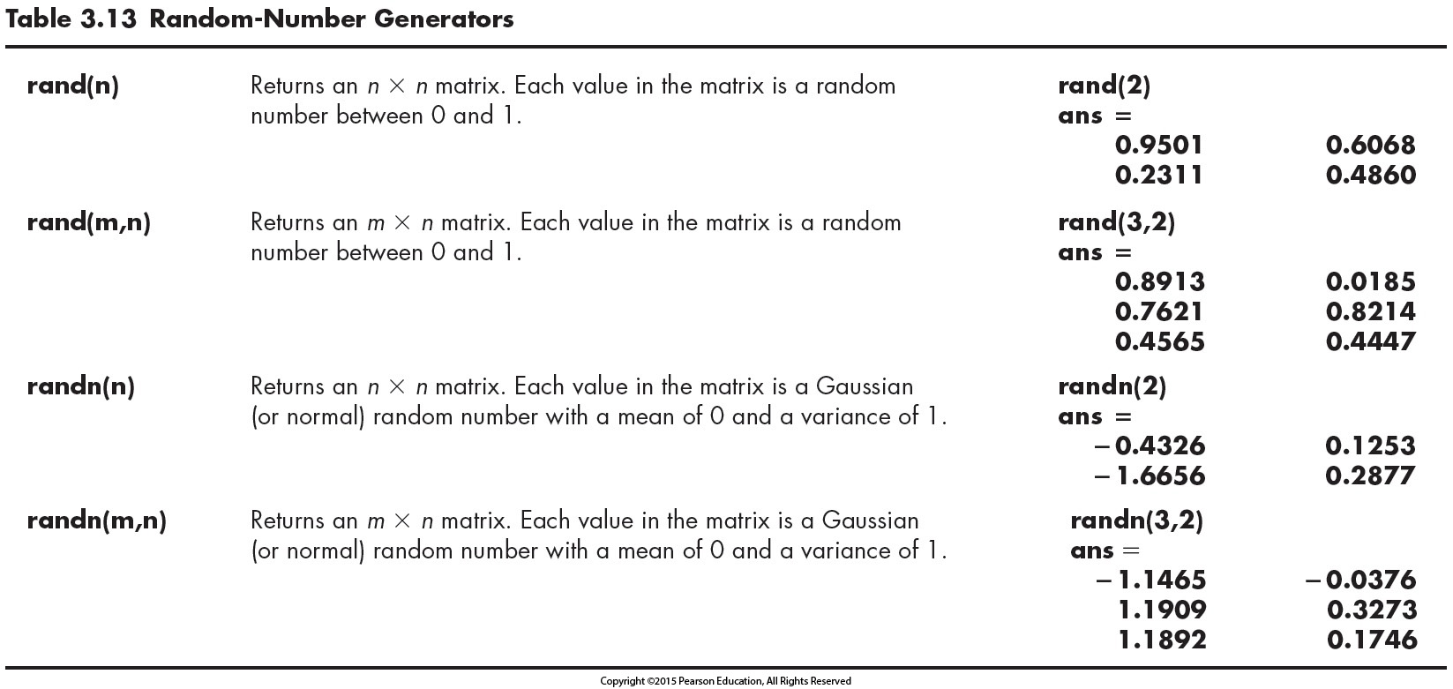

Slide 20
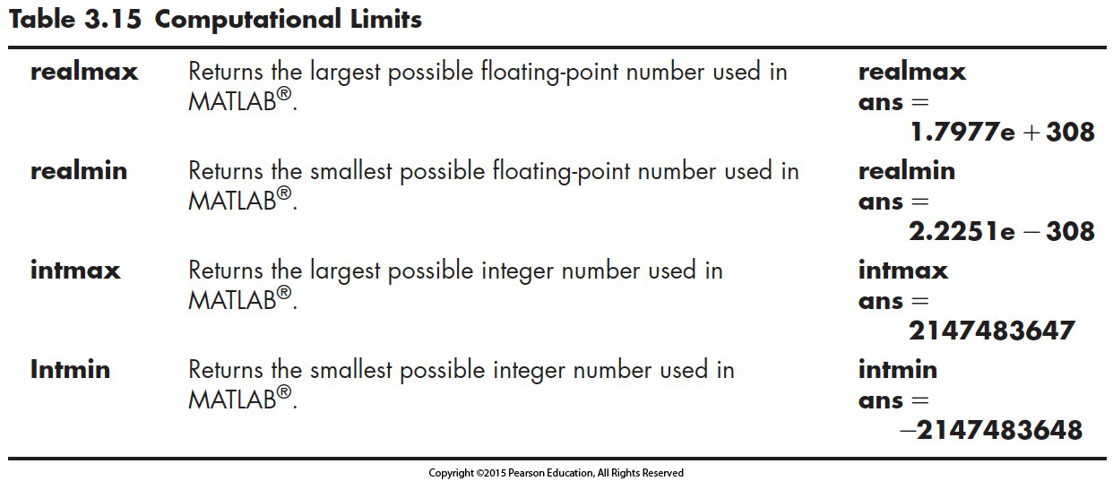


3.8 COMPUTATIONAL LIMITATIONS
OVERFLOW
When the result is too large for the computer
program to handle
UNDERFLOW
When the result is too small for the computer program to distinguish from zero
$\left(2.5×{10}^{200}\right)×\left(2×{10}^{200}\right)×\left(1×{10}^{−100}\right)$ = ??
$\left(2.5×{10}^{200}\right)×\left(1×{10}^{−100}\right)×\left(2×{10}^{200}\right)$ = ??

Slide 21
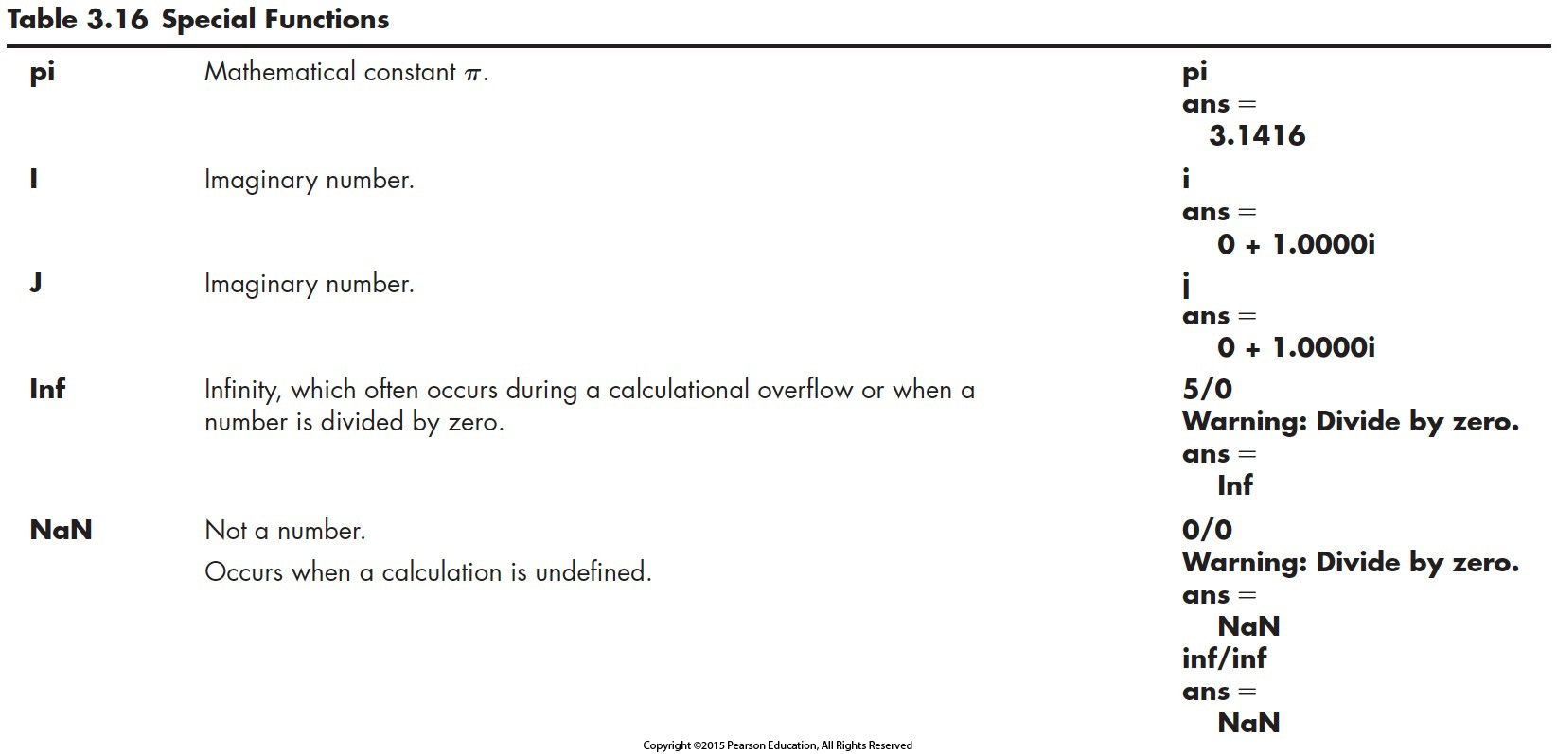
Notes:
A = [1 NaN 2];
B = A(~isnan(A))

Slide 22
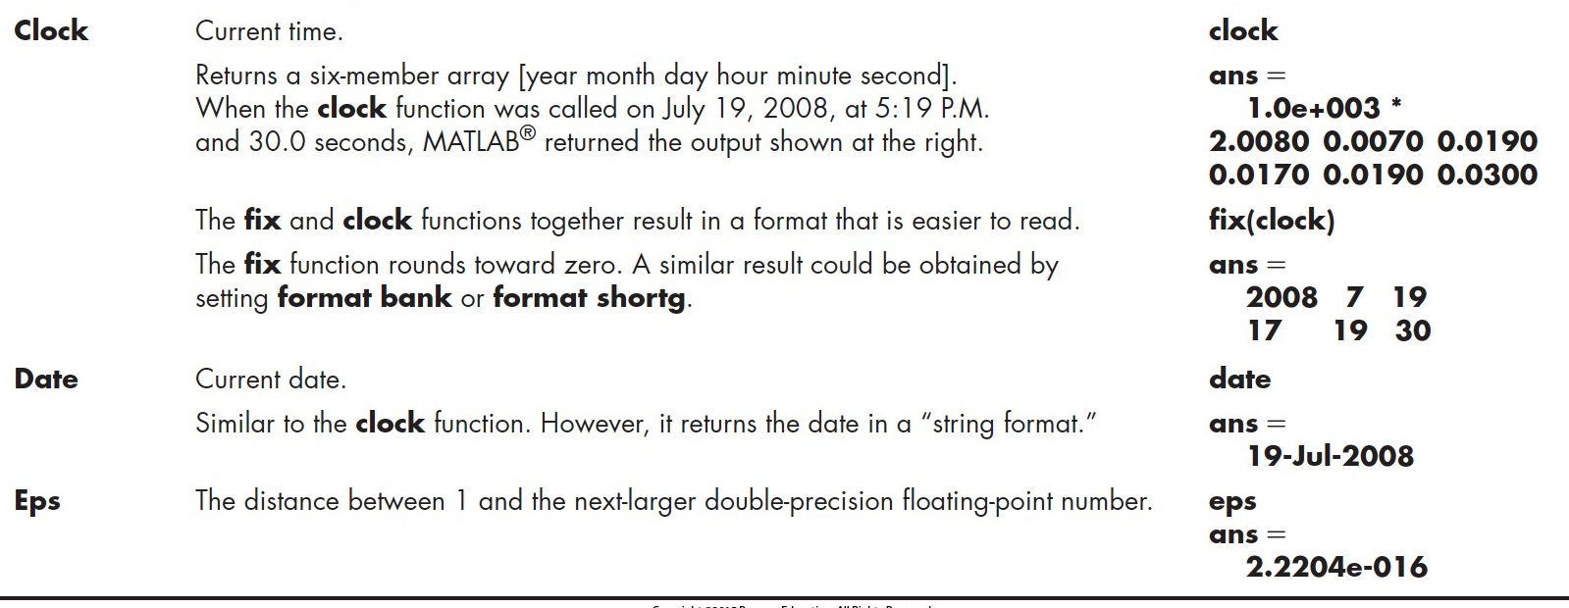
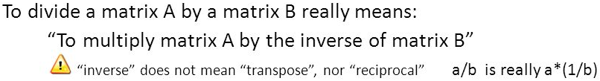
Notes:
Inverse = math
Transpose = switching

Slide 23
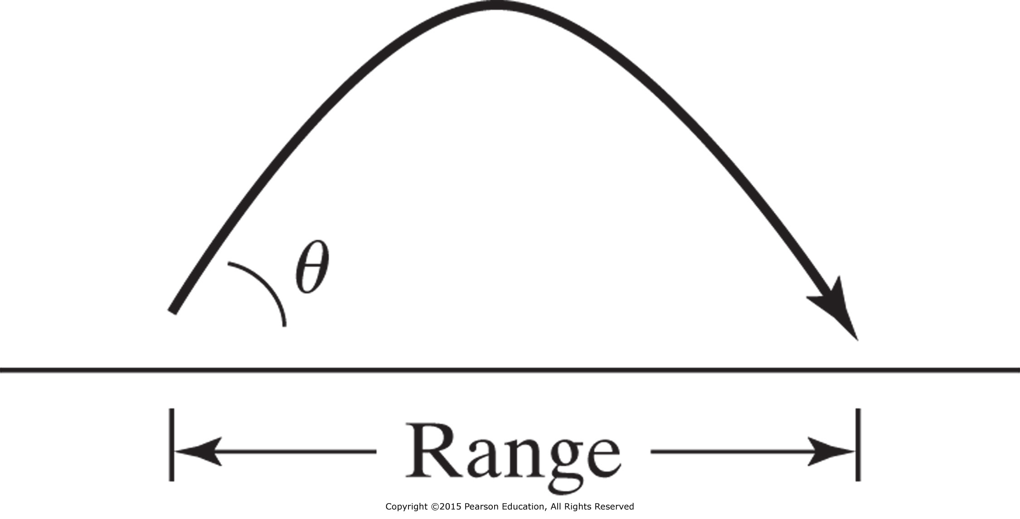
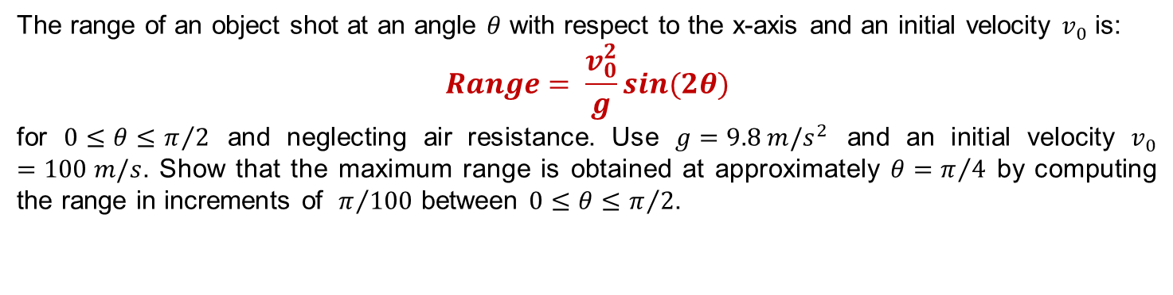
LET US TRY THIS OUT
The range of an object shot at an angle $θ$ with respect to the x-axis and an initial velocity $v_{0}$ is:
$$Range= \frac{v_{0}^{2}}{g}sin⁡(2θ)$$
for $0≤θ≤π/2$ and neglecting air resistance. Use $g=9.8 m/s^{2}$ and an initial velocity $v_{0}=100 m/s$. Show that the maximum range is obtained at approximately $θ=π/4$ by computing the range in increments of $π/{100}$ between $0≤θ≤π/2$.
Figure P3.16 The range depends on the launch angle and the launch velocity.

Slide 24
LET US TRY
Final grades in a section of GE 209 course is:
G = [68, 83, 61, 70, 75, 82, 57, 5, 76, 85, 62, 71, 96, 78, 76, 68, 72, 75, 83, 93]
Use appropriate function to determine the number of grades in array G and to sort them into ascending order.
Compute the following:
Mean
Median
Mode
Standard deviation
Which better represents the “most typical grade,” the mean, median, or mode? Why?
Will the sorting affect the values of mean, median, mode and standard deviation values?
Generate 10,000 Gaussian random numbers with a mean of 80 and standard deviation of 23.5.
Verify your results using the mean and std functions.

