Slide 1
Chapter 2
MATLAB Environment
Sections:
2-1
2-2-1 to 2-2-8
2-3-1 to 2-3-3
2-4-1 to 2-4-3

Slide 2
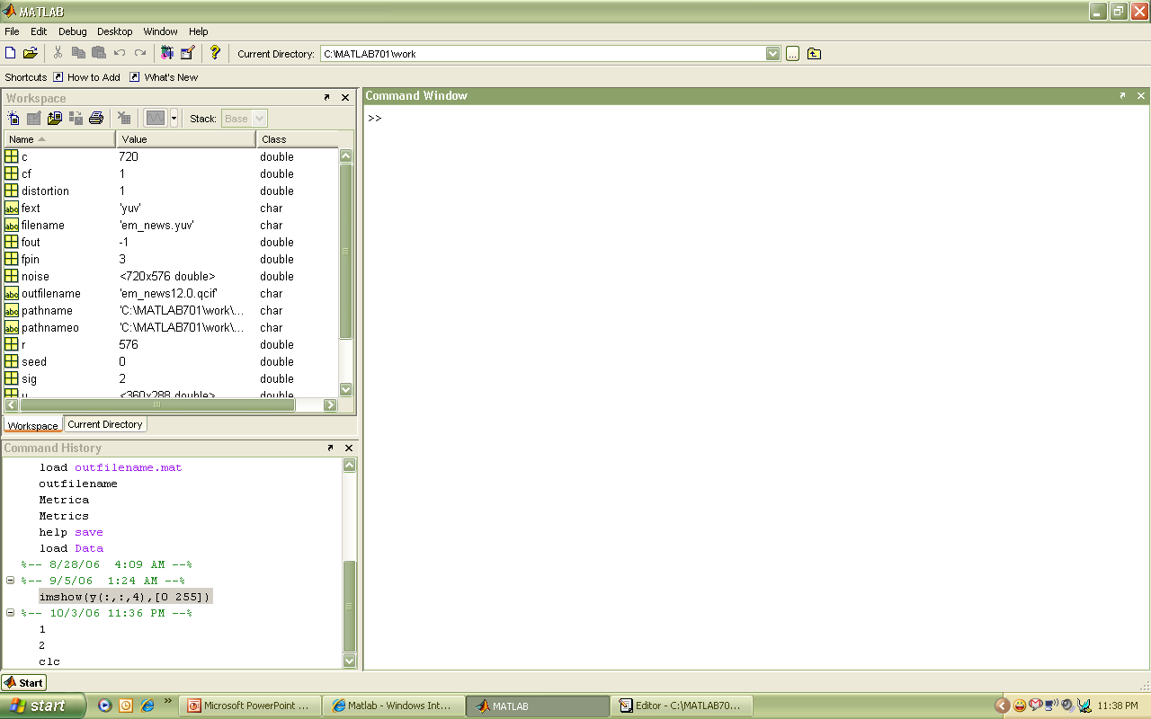
A snap shot of the MATLAB working environment
Command Window
  type commands at >>
Current Directory
  View folders and m-files
Workspace
  View program variables
  Double click on a variable
  to see it in the Array Editor
Command History
  view past commands
  save a whole session
  using diary
Workspace
Command Window
Command History
Notes:
2

Slide 3
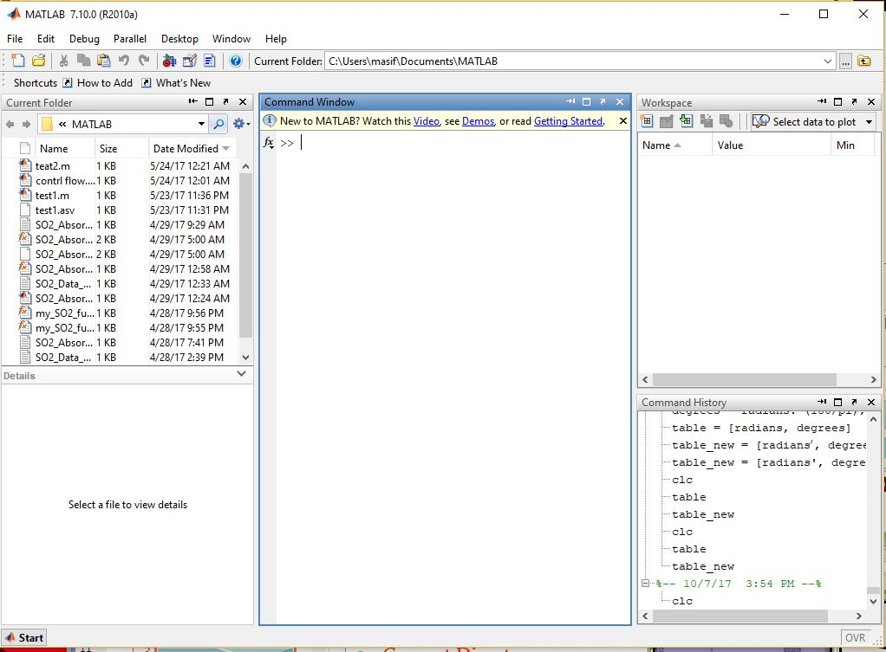

Slide 4
2.2.1 Command Window:
To type a command, the cursor must be placed next to the command prompt ( >> ). Pressing Enter key executes the command.
Several commands can be typed in the same line. This is done by typing a comma between the commands. When Enter key is pressed, the commands are executed in order from left to right.
A previously typed command can be recalled to the command prompt with the up arrow key (↑). When the command is displayed at the command prompt, it can be modified if needed and then executed. The down-arrow key (↓) can be used to move down the list of previously typed commands.
If a command is too long to fit in one line, it can be continued to the next line by typing three periods … (called an ellipsis) and pressing the Enter key. The continuation of the command is then typed in the new line. The command can continue line after line up to a total of 4,096 characters.
2.2.2 Command History:
The command history window records the commands issued in the command window.
clc command only clears the command window not the history
Any command from the command history window can be transferred to the command window by double-clicking (which also executes the command) or by clicking and dragging the line of code into the command window

Slide 5
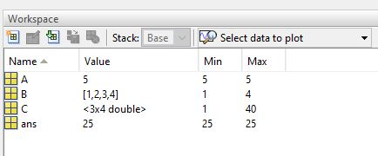
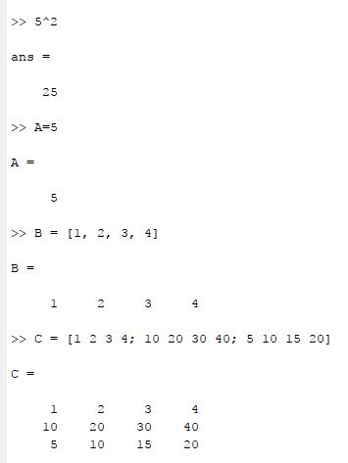
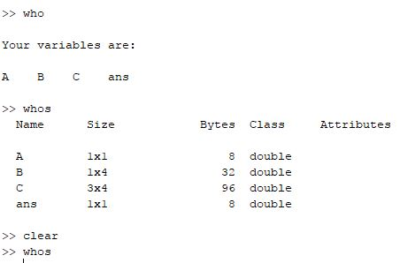
2.2.3 Workspace Window

Slide 6
2.2.4 Current Folder Window
The current folder window lists all the files in the active directory. When MATLAB either accesses files or saves information, it uses current folder unless specified otherwise.

Slide 7
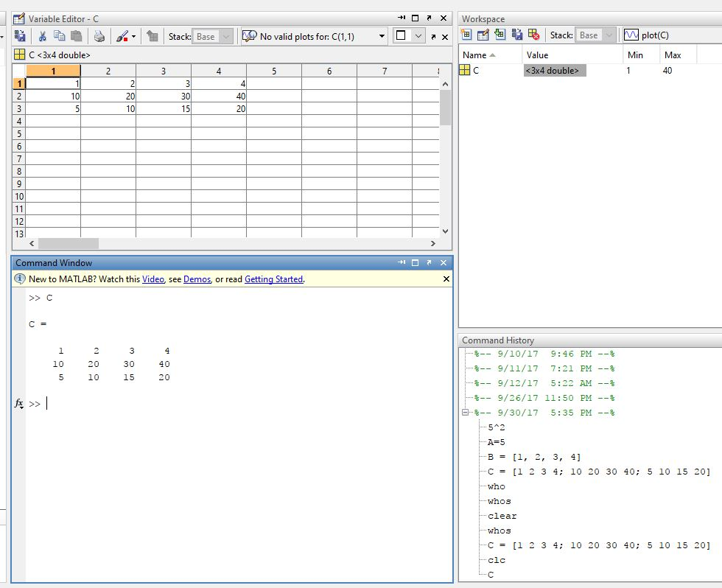
2.2.5 Document Window: Double-clicking on any variable listed in the workspace window launches a document window, containing the variable editor. Values stored in the
variable are displayed in a spreadsheet format, which can be edited or changed.

Slide 8
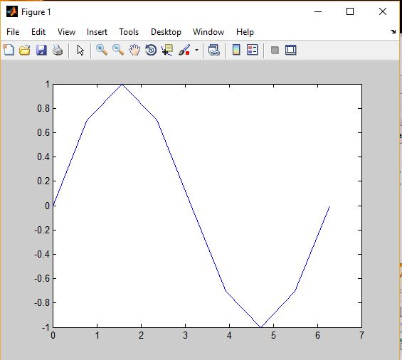
2.2.6 Graphics Window
x = [0, pi/4, pi/2, 3*pi/4, pi, 5*pi/4, 3*pi/2, 7*pi/4, 2*pi];
y = sin(x);
plot(x,y)

Slide 9

2.2.7 Edit Window
To open the edit window, choose File from the menu bar, then New, and, finally Script
File New Script
This window allows to type and save a series of commands without executing them. One may also open the edit window by typing edit at the command prompt or by selecting the New Script button on the toolbar.
2.2.8 Start Button
The start button is located in the lower left-hand corner of the MATLAB ® window.
It offers alternative access to the various MATLAB ® windows, as well as to the help
function, Internet products, demos and MATLAB ® toolboxes.

Slide 10
2.3 Solving Problems with MATLAB

Slide 11
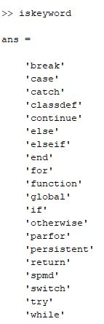
2.3.1 Using Variables
HIGHLY RECOMMENDED to assign a unique name to values used in MATLAB.
All names must start with a letter. The names can be of any length, but only the first 63 characters are used in MATLAB. (Use namelengthmax command to check)
Names are case sensitive. The variable x is different from variable X
The only allowable characters are letters, numbers, and the underscore. Use isvarname command to check. Output is 1 (allowed) or 0 (not allowed). Don’t use built-in functions as variable names.
Use which command to check built-in functions (Try for sin/cos)
MATLAB reserves a list of keywords for use by the program, which cannot be assigned as variable names. The iskeyword command causes MATLAB to list these reserved names.
If variable is not selected, MATLAB calculates the expression and responds by displaying ans = followed by the numerical result of the expression in the next line.

Slide 12
Practice Exercise 2.2

Slide 13
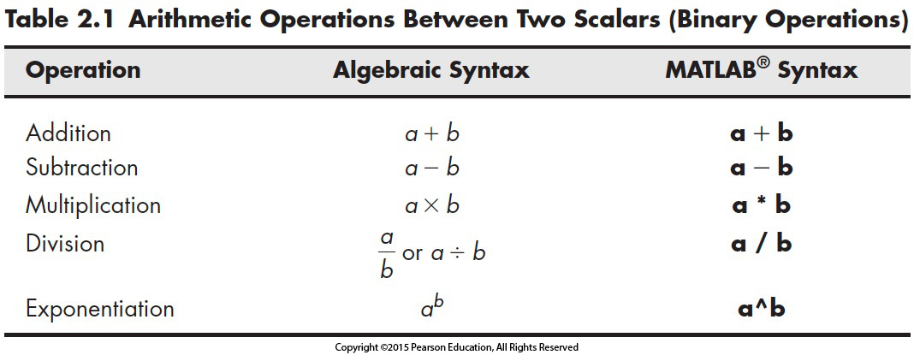
2.3.2 Matrices: Scalar Operations
Scalars are single-valued matrices. Their operations can be carried out using:
Priority rule
PEMDAS (Parentheses, Exponentiation, Multiplication, Division, Addition, Subtraction)
>> ((2+5)^2+2*2-10/5) → = ?

Slide 14
Priority rules
Precedence is the order operations are preformed, remember PEMDAS
>> ((2+5)^2+2*2-10/5) innermost parentheses is done first
  7^2 exponentiation is next
  2*2 or 10/5 multiplication or division next
  (49 + 4 – 2) addition or subtraction next
Operations are done from left to right
→ final result gives 51

Slide 15
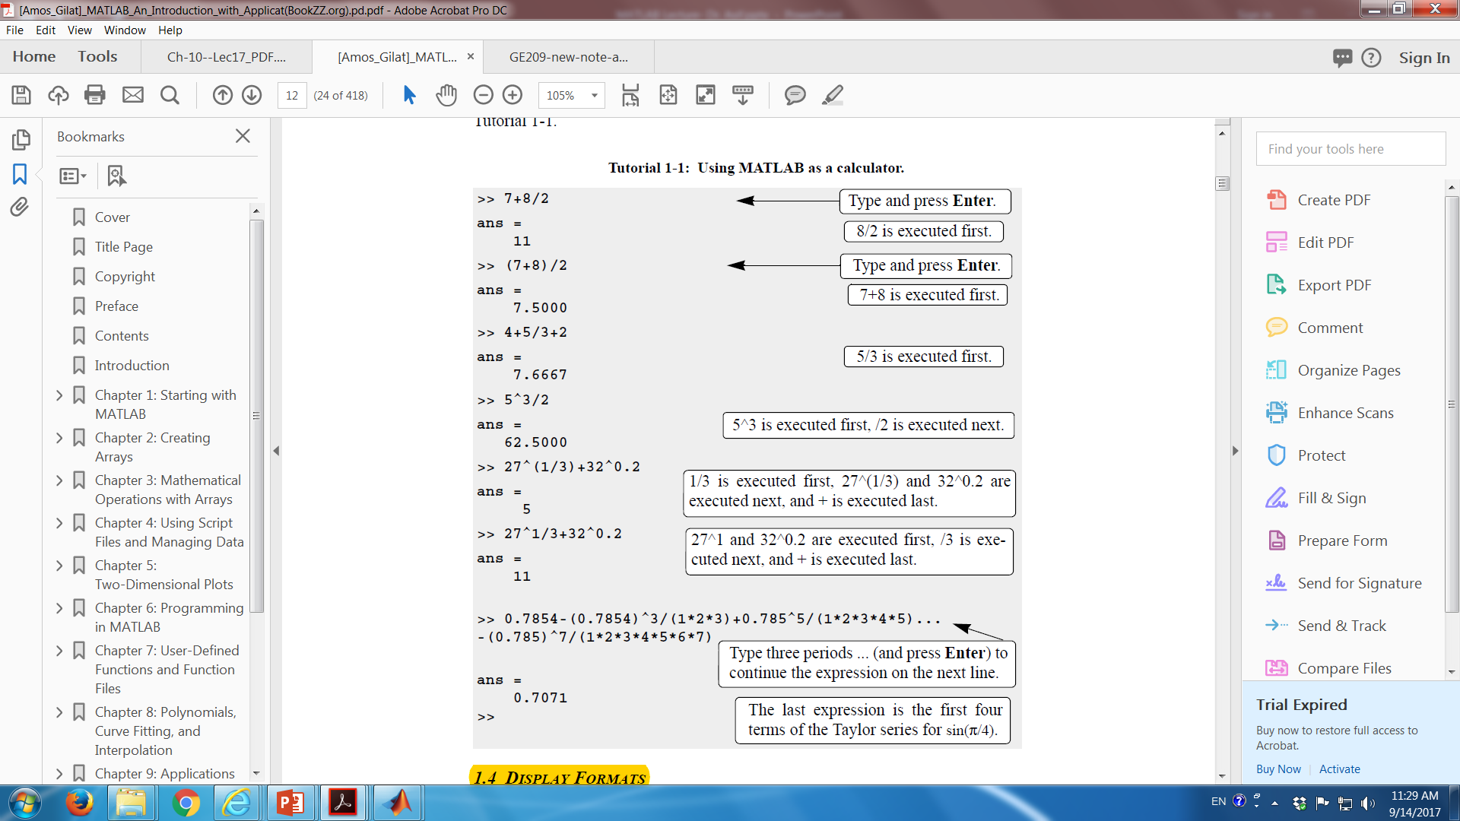

Slide 16
Practice Exercise 2.3

Slide 17
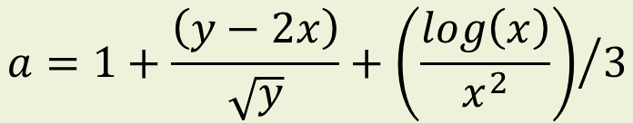
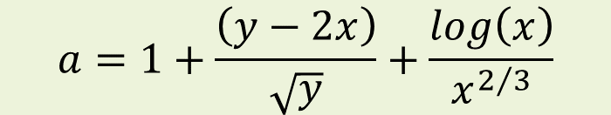
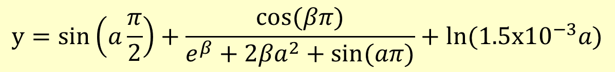
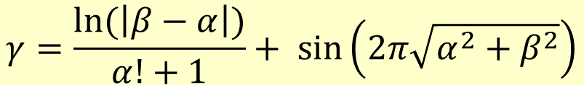
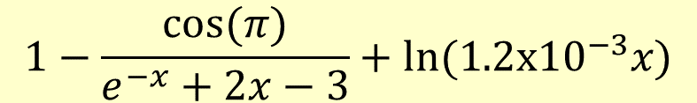
>> 5-25^1/2*2+19
>> 5*11–5^(3*4–9)
>> a=1+(y-2*x)/sqrt(y)+log(x)/x^2/3
$$a=1+\frac{\left(y−2x\right)}{\sqrt{y}}+\frac{log\left(x\right)}{x^{2/3}}$$
$$a=1+\frac{\left(y−2x\right)}{\sqrt{y}}+{\left(\frac{log\left(x\right)}{x^{2}}\right)}/3$$
>>(0.6*b*H*sqrt(2*g*(h1-h2))-Q)*Q^(1-b)/(dx*a*be)
$$1−\frac{cos⁡(π)}{e^{−x}+2x−3}+ln⁡(1.2x{10}^{−3}x)$$
$$γ=\frac{ln⁡(\left|β−α\right|)}{α!+1}+ sin⁡\left(2π\sqrt{α^{2}+β^{2}}\right)$$
$$y=sin\left(a\frac{π}{2}\right)+\frac{cos⁡(βπ)}{e^{β}+2{βa}^{2}+sin⁡(aπ)}+ln⁡(1.5x{10}^{−3}a)$$

Slide 18
Array
A collection of data values organized into rows and columns, and is fundamental unit of data in MATLAB
Scalars: Arrays with 1 row and 1 column
Vector: Array with one dimension
Matrix: Array with more than one dimension
Size of an array is specified by the number of rows and the number of columns, with the number of rows mentioned first (For example: n x m array)
Total number of elements in an array is the product of the number of rows and the number of columns

Slide 19
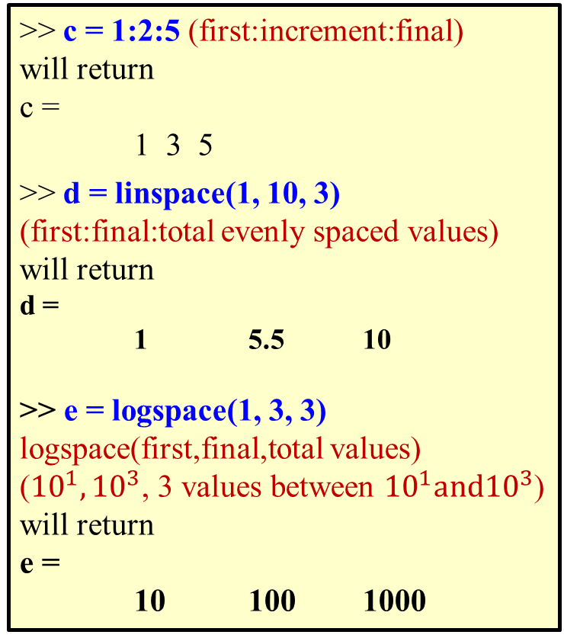
Row vector: x = [1 2 3 4]
Column vector: y = [1; 2; 3; 4]
>> a = [1 2 3 4; 2 3 4 5 ; 3 4 5 6]
and will return
a =
1 2 3 4
2 3 4 5
3 4 5 6
>>b = 1:5 & >>b = [1:5] are same Both will return a row matrix
b =
1 2 3 4 5
Square bracket is optional
Increment is 1 (default value)
>> c = 1:2:5 (first:increment:final)
will return
c =
1 3 5
>> d = linspace(1, 10, 3)
(first:final:total evenly spaced values)
will return
d =
1 5.5 10
>> e = logspace(1, 3, 3)
logspace(first,final,total values)
(${10}^{1},{10}^{3}$, 3 values between ${10}^{1}and{10}^{3}$)
will return
e =
10 100 1000
2.3.2 Matrices: Array Operations
What do you think???
x1 = [0, pi/4, pi/2, 3*pi/4, pi, 5*pi/4, 3*pi/2, 7*pi/4, 2*pi]
x2 = 0: pi/4:2*pi
x3 = linspace(0,2*pi,9);

Slide 20
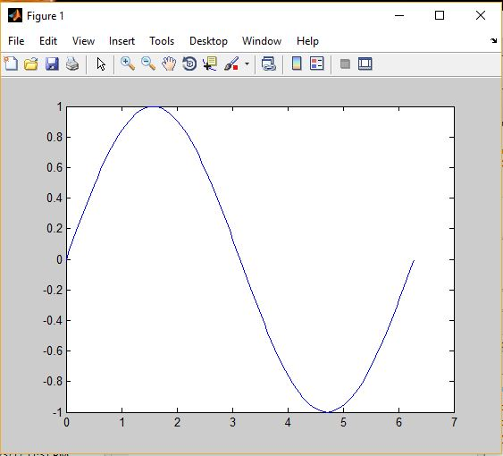
Make a CHOICE
x = [0, pi/4, pi/2, 3*pi/4, pi, 5*pi/4, 3*pi/2, 7*pi/4, 2*pi];
y = sin(x);
plot(x,y)
x = linspace(0, 2*pi, 101);
y = sin(x);
plot(x,y)
Smooth??;
9 data points
Smooth;
101 data points

Slide 21
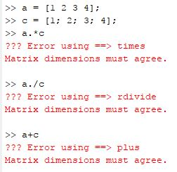
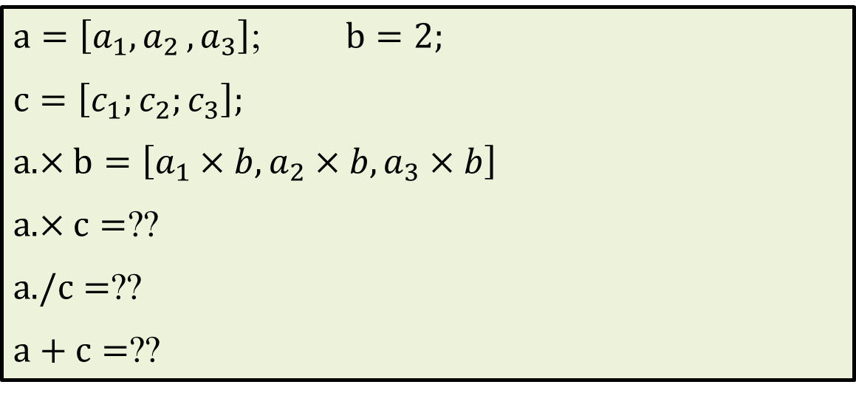
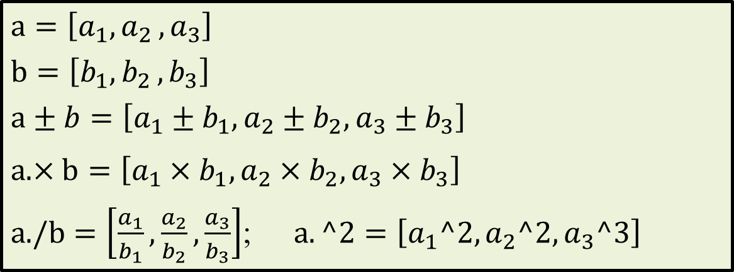
Element by element array operation using (.)
Arrays MUST have same dimension
$$a=\left[a_{1}{,a}_{2},a_{3}\right]$$
$$b=\left[b_{1}{,b}_{2},b_{3}\right]$$
$$a±b=\left[a_{1}±b_{1},a_{2}±b_{2},a_{3}±b_{3}\right]$$
$a.×b=\left[a_{1}×b_{1},a_{2}×b_{2},a_{3}×b_{3}\right]$
$a./b=\left[\frac{a_{1}}{b_{1}},\frac{a_{2}}{b_{2}},\frac{a_{3}}{b_{3}}\right]$; $a.^2=\left[a_{1}^2,a_{2}^2,a_{3}^3\right]$
2.3.2 Matrices: Array Operations
$a=\left[a_{1}{,a}_{2},a_{3}\right]$; $b=2$;
$c=\left[c_{1};c_{2};c_{3}\right]$;
$a.×b=\left[a_{1}×b,a_{2}×b,a_{3}×b\right]$
$a.×c=$??
$a./c=$??
$a+c=$??

Slide 22
Practice Exercise 2.4

Slide 23
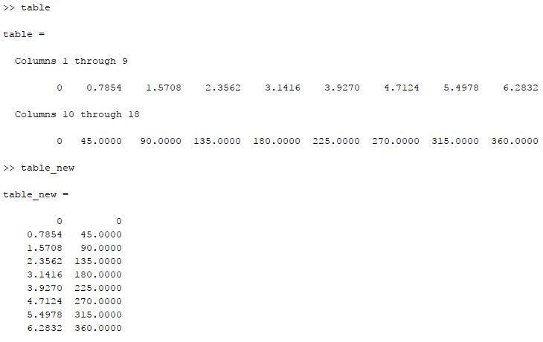
Example-1
>>radians = [0, pi/4, pi/2, 3*pi/4, pi, 5*pi/4, 3*pi/2, 7*pi/4, 2*pi];
>>degrees = radians.*(180/pi); %; prevents output of results
>>table = [radians, degrees] % row vector of 18 elements
>>table_new = [radians’, degrees’] % two columns
radians
radians
degrees
degrees

Slide 24
2.4 Saving Work Sessions/Variables/Command Files

Slide 25
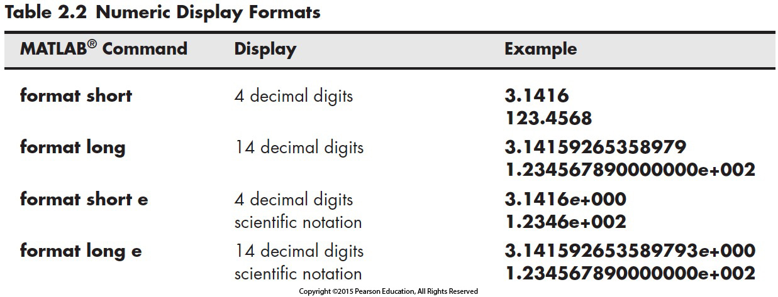
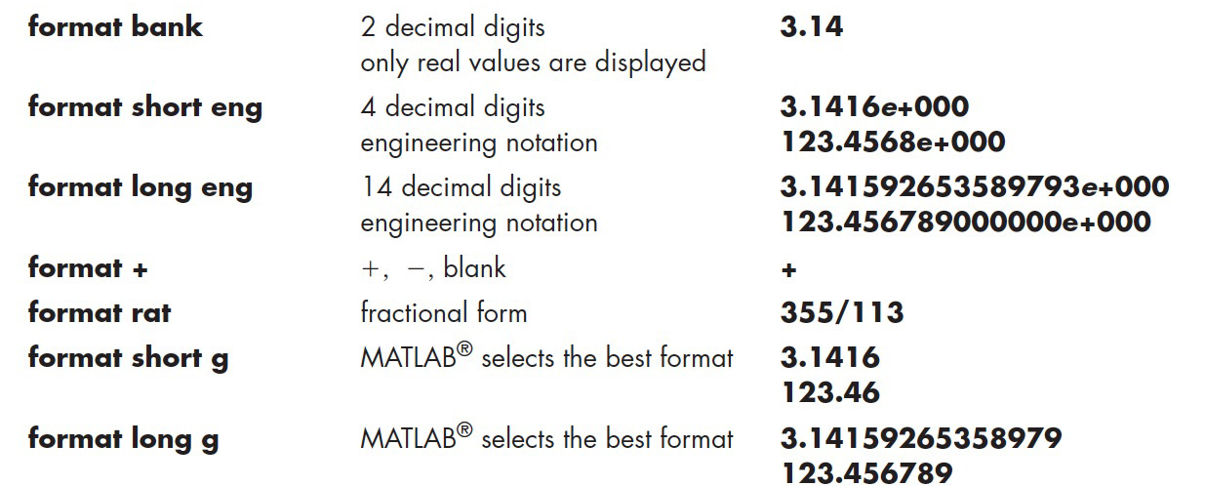
2.3.3 Number Display
Display DOES NOT affect the accuracy of calculations

Slide 26
2.4.1 Diary
To completely record and save work sessions, use diary or or diary on. To end a recording session type diary again, or diary off. A file named diary should appear in the current folder that can be retrieved by a double click. Subsequent sessions are added to the end of the file.
Filename can also be specified using either diary <filename> or diary('filename'), e.g. diary my_diary or diary(‘my_diary').
2.4.2 Saving Variables
Type save to save the workspace to a file matlab.mat. Use save <filename> to assign a name.
Alternatively, choose File Save Workspace As from the menu bar and the assign the file name. Type load <filename> to restore the workspace.
Even selected variables (e.g. matrices) can be stored in a specified file (default extension .mat) for later use with save <filename> <list_of_variables>
For ASCII format, use save <filename> <list_of_variables> -ascii. Use extension .dat or .txt in the file name, e.g.

Slide 27
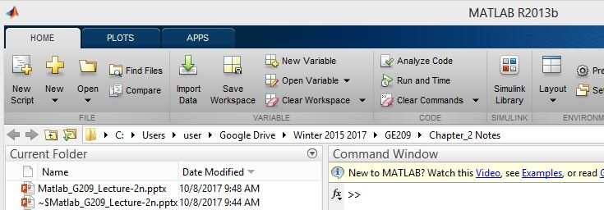
2.4.3 Script M-Files
MATLAB commands can be created and saved in files, called M-files
An M-file is an ASCII text file.
Can be modified whenever needed
Tremendous flexibility for problem solving.
M-files are stored in the current folder
File name must be a valid MATLAB variable name (starting with a letter and containing only letters, numbers, and the underscore. No spaces are allowed)
Two kinds of M-files, called scripts and functions

Slide 28
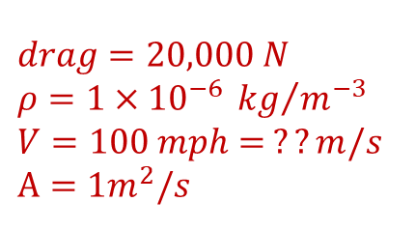
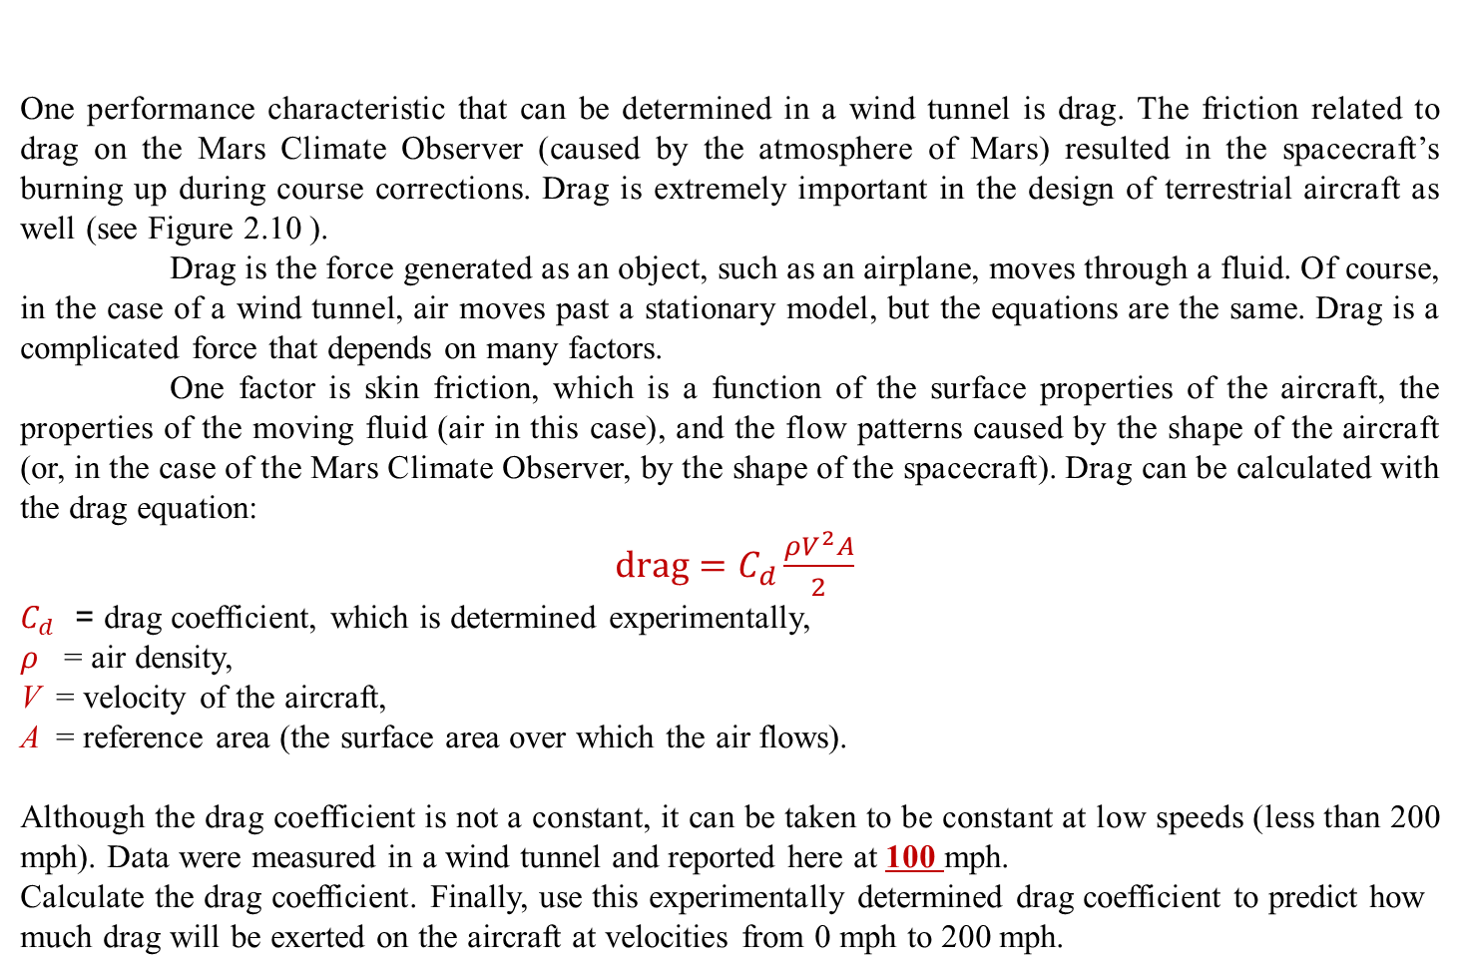
One performance characteristic that can be determined in a wind tunnel is drag. The friction related to drag on the Mars Climate Observer (caused by the atmosphere of Mars) resulted in the spacecraft’s burning up during course corrections. Drag is extremely important in the design of terrestrial aircraft as well (see Figure 2.10 ).
Drag is the force generated as an object, such as an airplane, moves through a fluid. Of course, in the case of a wind tunnel, air moves past a stationary model, but the equations are the same. Drag is a complicated force that depends on many factors.
One factor is skin friction, which is a function of the surface properties of the aircraft, the properties of the moving fluid (air in this case), and the flow patterns caused by the shape of the aircraft (or, in the case of the Mars Climate Observer, by the shape of the spacecraft). Drag can be calculated with the drag equation:
$drag=C_{d}\frac{ρV^{2}A}{2}$
$C_{d}$ = drag coefficient, which is determined experimentally,
$ρ$ = air density,
V = velocity of the aircraft,
A = reference area (the surface area over which the air flows).
Although the drag coefficient is not a constant, it can be taken to be constant at low speeds (less than 200 mph). Data were measured in a wind tunnel and reported here at 100 mph.
Calculate the drag coefficient. Finally, use this experimentally determined drag coefficient to predict how much drag will be exerted on the aircraft at velocities from 0 mph to 200 mph.
Example-2.3
$$drag=20,000 N$$
$$ρ=1×{10}^{−6} {kg}/{m^{−3}}$$
$$V=100 mph= ??m/s$$
$$A=1m^{2}/s$$

Slide 29
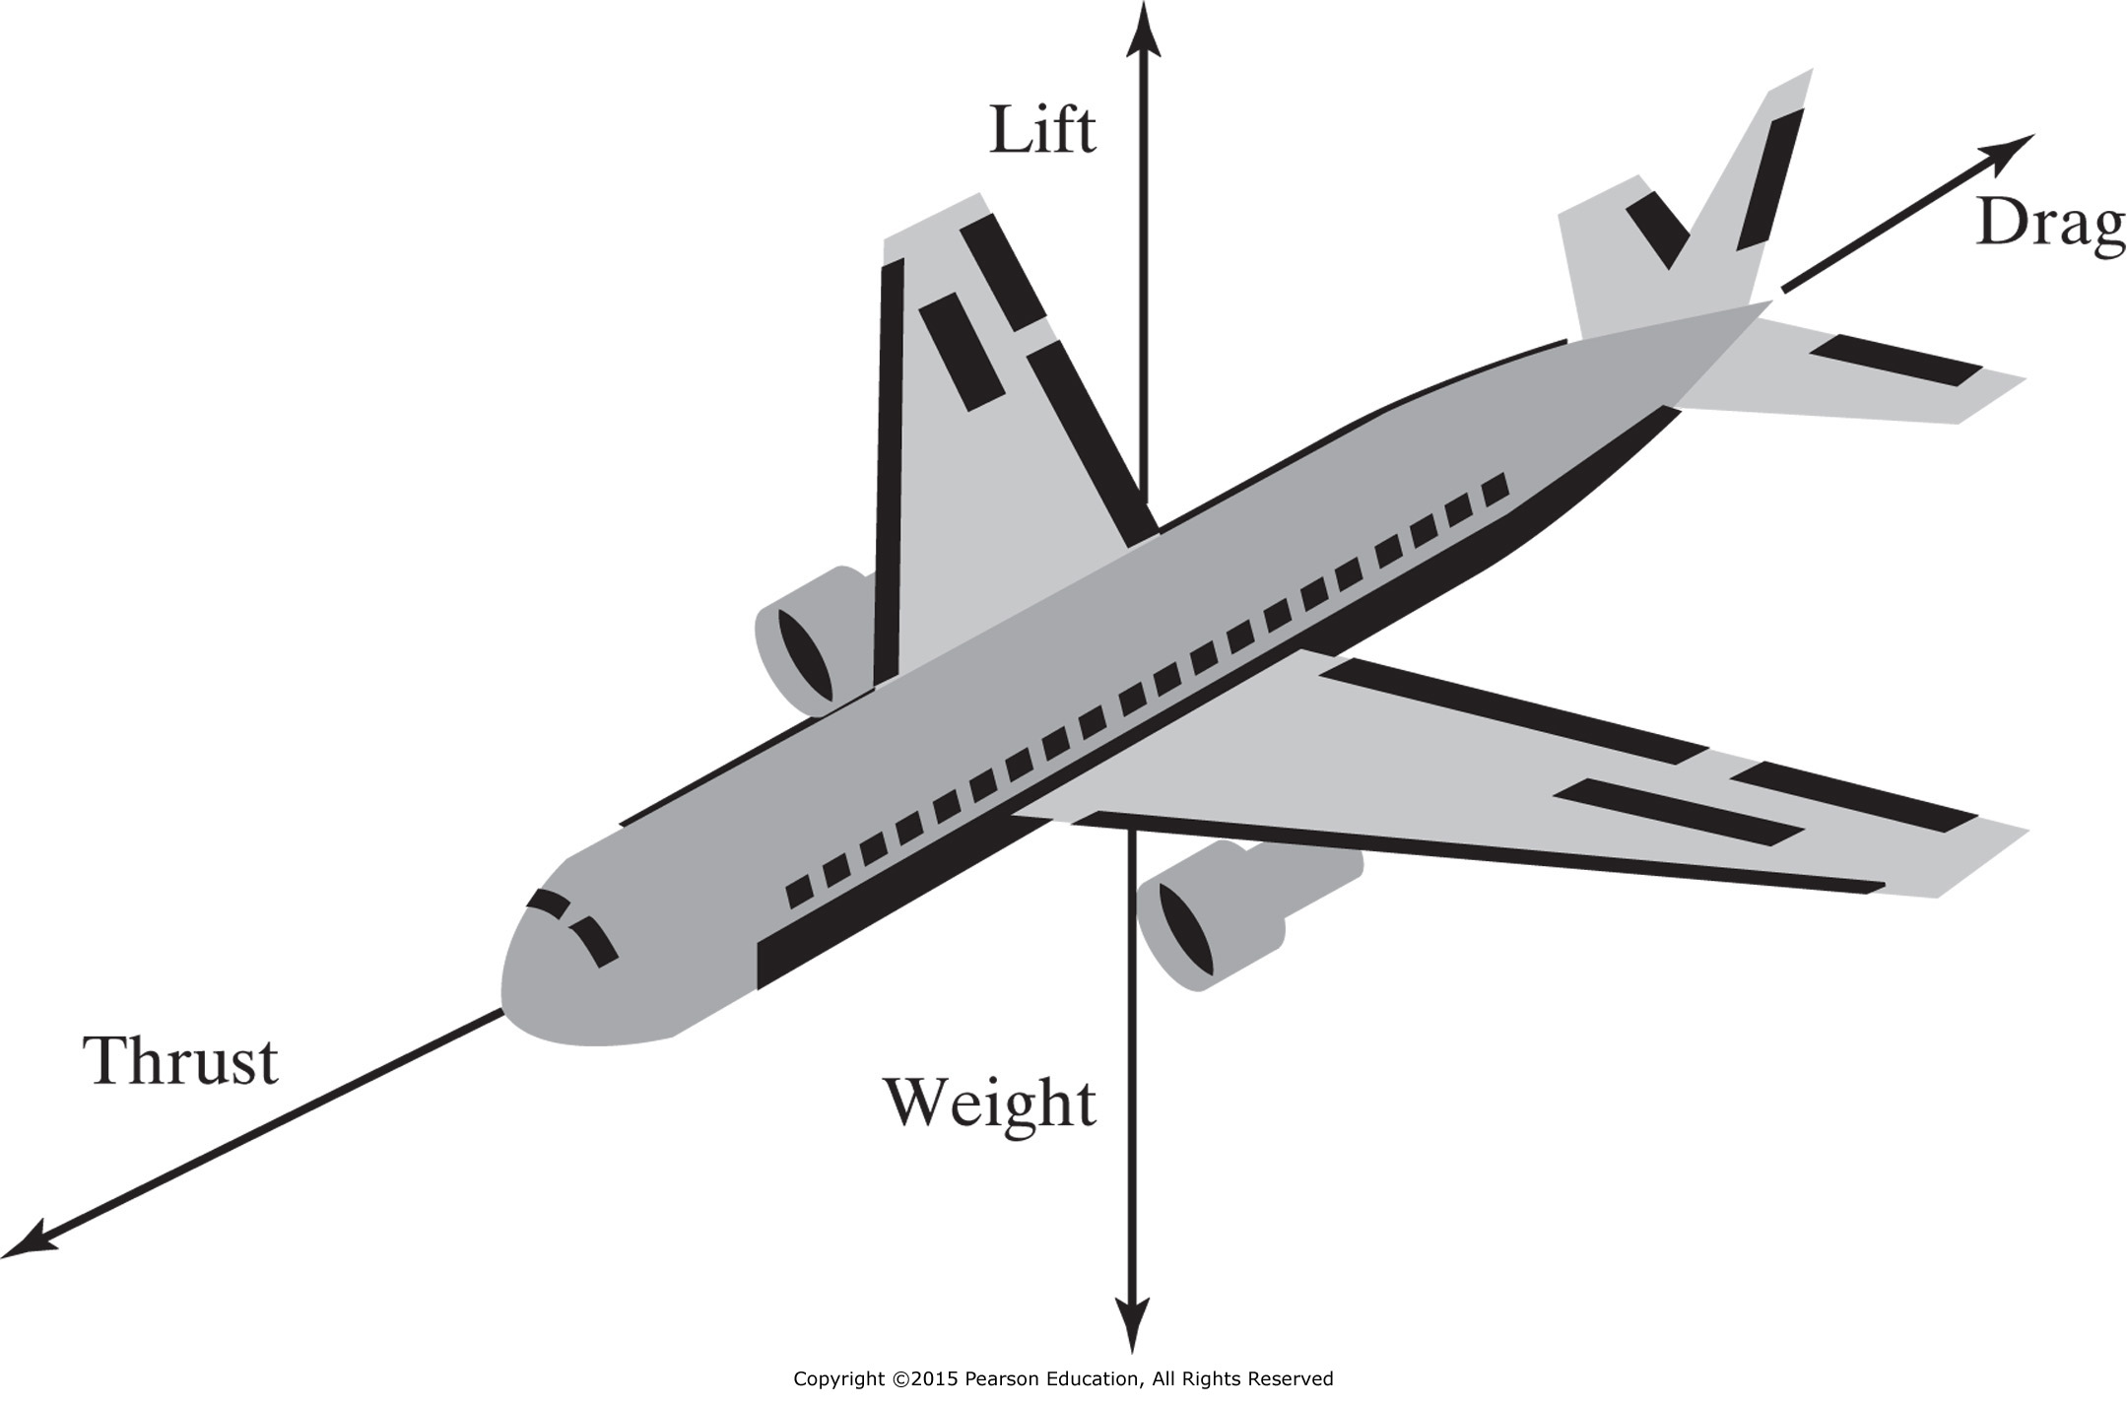
Drag is a mechanical force generated by a solid object moving through a fluid.

Slide 30
Example of MATLAB code in an M-file to solve Example 2.3
clear, clc
% A Script M-file to find Drag
% First define the variables
drag = 20000; %Define drag in Newtons
density= 0.000001; %Define air density in kg/m^3
velocity = 100*0.4470; %Define velocity in m/s
area = 1; %Define area in m^2
% Calculate coefficient of drag
cd = drag *2/(density*velocity^2*area);
% Find the drag for a variety of velocities
velocity = 0:20:200; %Redefine velocity
velocity = velocity*.4470; %Change velocity to m/s
drag = cd*density*velocity.^2*area/2; %Calculate drag
table = [velocity',drag'] %Create a table of results

