Slide 1
Examples

Slide 2
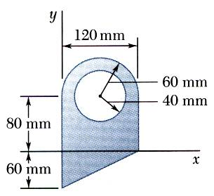
Sample Problem 1
SOLUTION:
Divide the area into a triangle, rectangle, and semicircle with a circular cutout.
Calculate the first moments of each area with respect to the axes.
Find the total area and first moments of the triangle, rectangle, and semicircle. Subtract the area and first moment of the circular cutout.
For the plane area shown, determine the first moments with respect to the x and y axes and the location of the centroid.
Compute the coordinates of the area centroid by dividing the first moments by the total area.

Slide 3
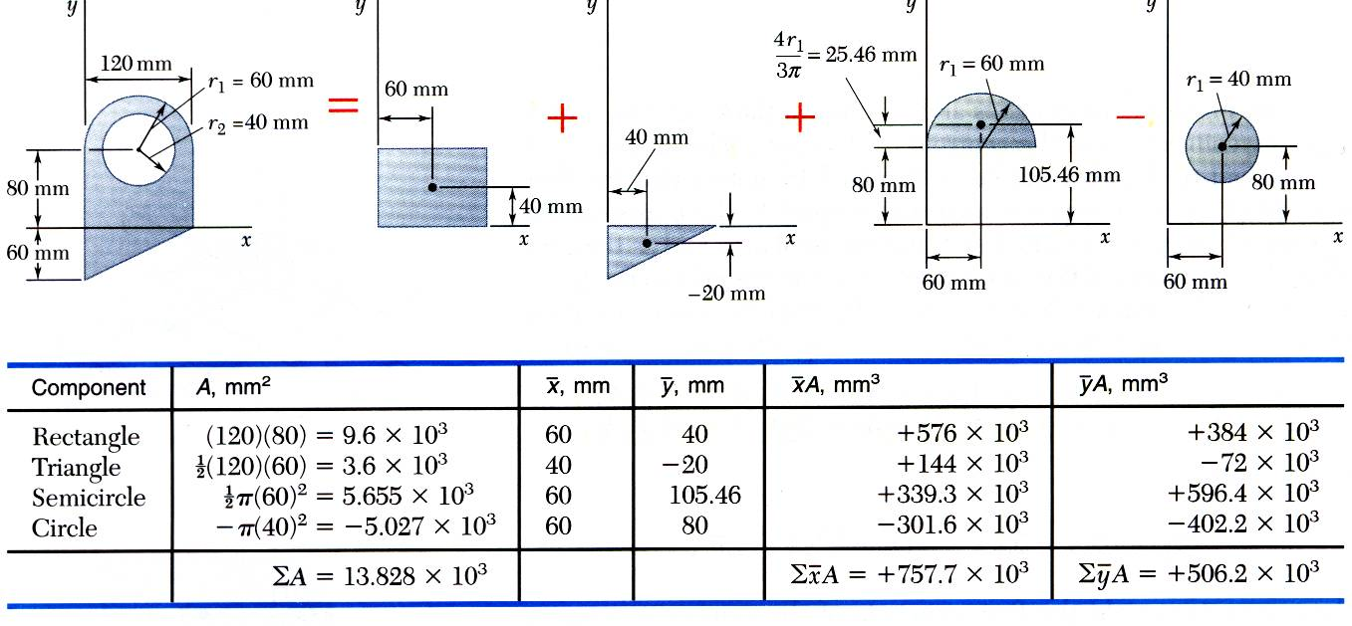
Sample Problem 1 - Continued
Subtract the area of circular cutout section.
First Moments of the Area

Slide 4
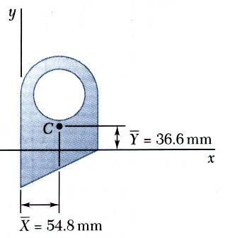
Sample Problem 1 - Continued
Compute the coordinates of the centroid by dividing the first moments of areas by the total area as below:

Slide 5
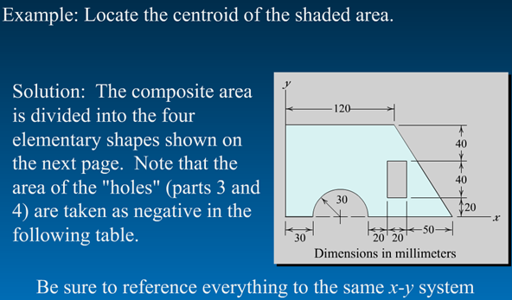
Sample Problem 2
5 - 5

Slide 6
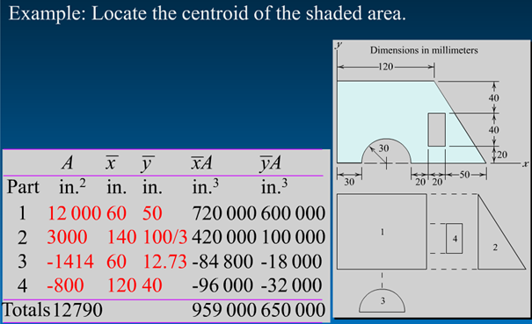
Sample Problem 2 - Continued
Part mm² mm mm mm³ mm³
5 - 6

Slide 7
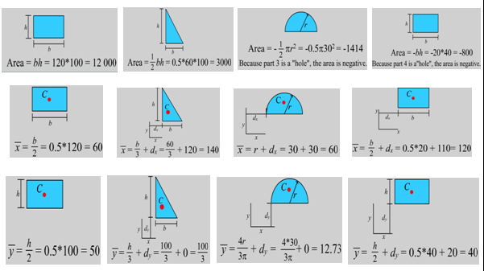
Sample Prolem 2 - Continued
Part1
Part2
Part3
Part4
Part1
Part2
Part3
Part4
Part1
Part2
Part3
Part4
5 - 7

Slide 8
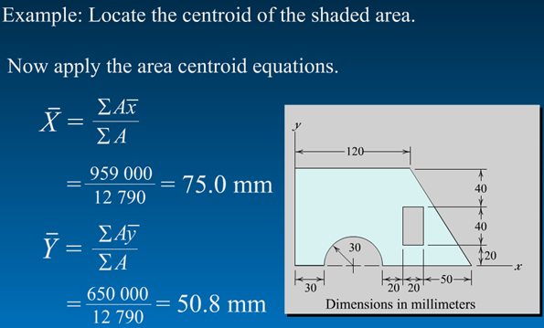
Sample Problem 2 - Continued
5 - 8

Slide 9
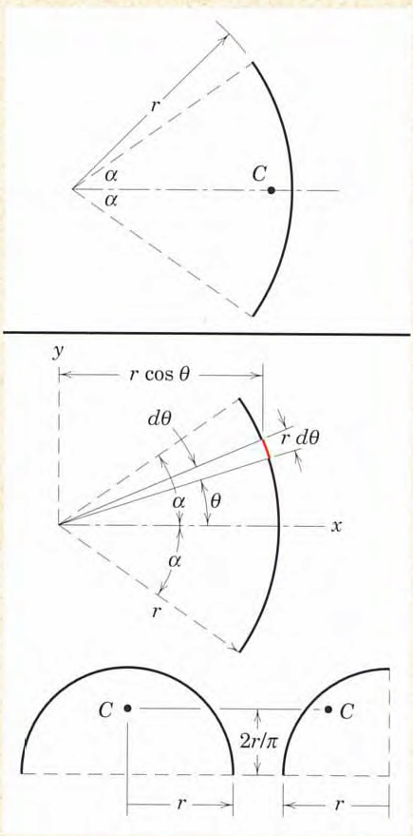
Problem-1
Locate the centroid of a circular arc as shown in the figure.

Slide 10
Solution

Slide 11
Problem-2
Locate the centroid of a half and quarter-circular arcs using the formula derived in Problem-1.
Solution
Line of symmetry

Slide 12


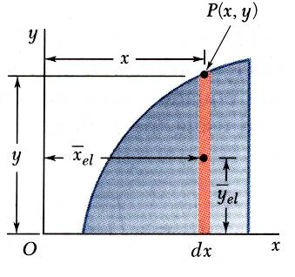
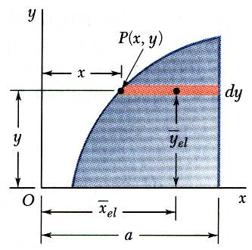
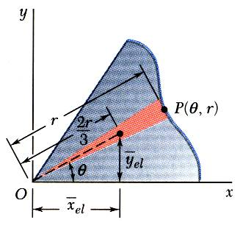
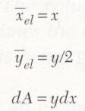
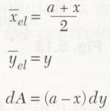
Determination of Centroids by Integration
Double integration to find the first moment may be avoided by defining dA as a thin rectangle or strip.
Rectangular Coordinates
Polar Coordinates

Slide 13
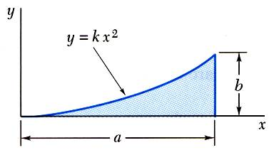
Sample Problem 3
SOLUTION:
Determine the constant k.
Evaluate the total area.
Using either vertical or horizontal strips, perform a single integration to find the first moments.
Determine by direct integration the location of the centroid of a parabolic spandrel shown.
Evaluate the centroid coordinates.

Slide 14
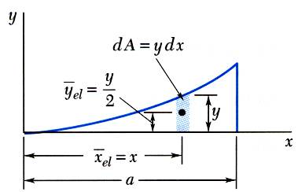
Sample Problem 3 - Continued
SOLUTION:
Determine the constant k.
Evaluate the total area.

Slide 15
Sample Problem 3 - Continued
Using vertical strips, perform a single integration to find the first moments.

Slide 16
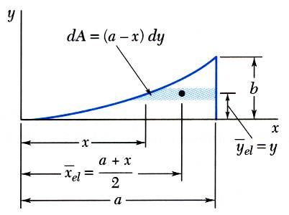
Sample Problem 3 - Continued
Or, using horizontal strips, perform a single integration to find the first moments.

Slide 17



Sample Problem 3 - Continued
Evaluate the coordinates of centroid.
dA
dy
dx
Alternatively; if we take any differential element dA=dx.dy
Q_{y}=∫ ∫x.dx.dy=∫ [ ∫dy ].x.dx
Q_{y}=
a
0
0
a
Q_{x}=∫ ∫y.dx.dy=∫ [ ∫y.dy ].dx
Q_{x}=
0
0
5 - 17

Slide 18
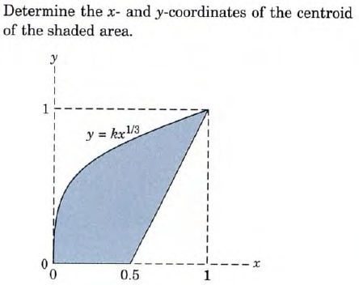
Sample Problem 4
5 - 18

Slide 19
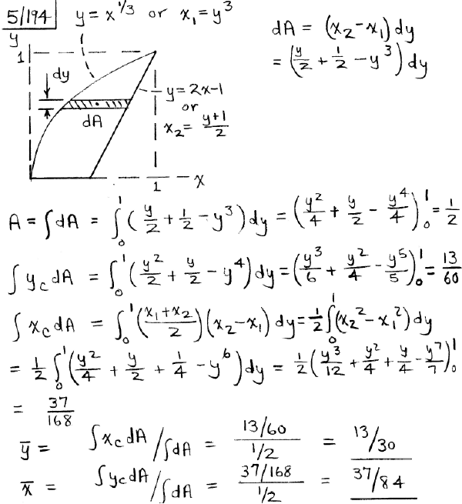


Sample Problem 4 - Continued
y_{el}=y_{c}= y
x_{el}=x_{c}= x₁+(x₂-x₁)/2 = (x₁+x₂)/2
5 - 19

Slide 20
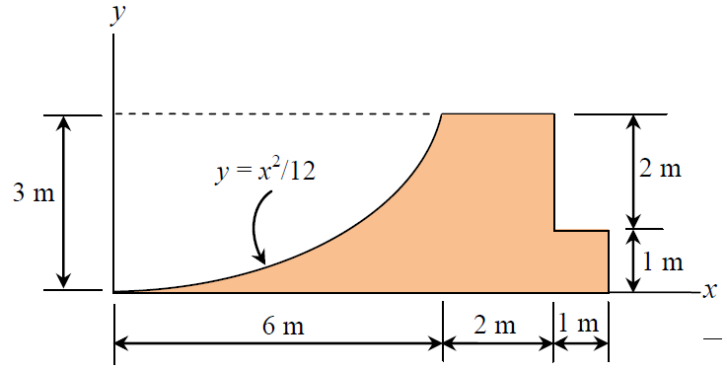

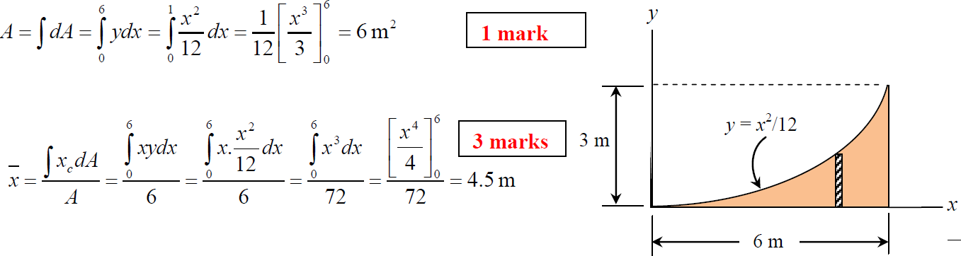
Sample Problem 5
5 - 20

Slide 21
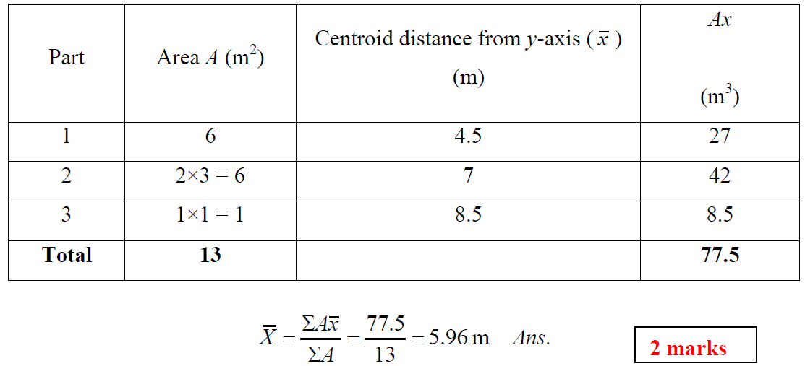
Sample Problem 5 - Continued
2
1
3
5 - 21

Slide 22
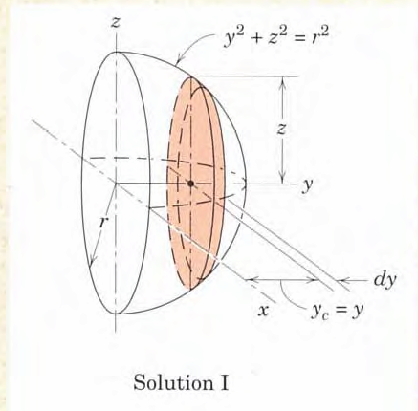
Problem-3
Locate the centroid of the volume of a hemisphere of radius r with respect to its base.

Slide 23
Solution

