Slide 1
Examples

Slide 2
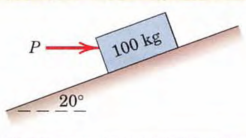
Problem-3
Determine the magnitude and direction of the friction force acting on the 100-kg block shown if, first, P = 500 N and , second, P = 100 N. The coefficient of static friction is 0.20, and the coefficient of kinetic friction is 0.17. The forces are applied with the block initially at rest.

Slide 3
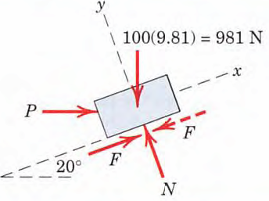
Solution
Assume friction force F is acting up the plane

Slide 4
Solution (Contd.)

Slide 5
Solution (Contd.)

Slide 6
Problem-4
The uniform 10-kg ladder in Figure shown rests against the smooth wall at B, and the end A rests on the rough horizontal plane for which the coefficient of static frction µ_{s} = 0.3. Determine the angle of inclination θ of the ladder and the normal reaction at B if the ladder is on the verge of slipping.
B
4m
Smooth vertical wall
A
θ
Rough horizontal plane

Slide 7
Solution
N_{B}
B
4m
4 sinθ
10g
A
θ
F_{max}
2 cosθ
2 cosθ
N_{A}
Free Body Diagram
(At the verge of slipping)

Slide 8
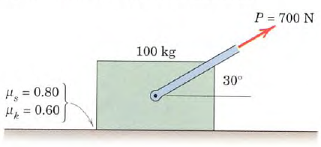
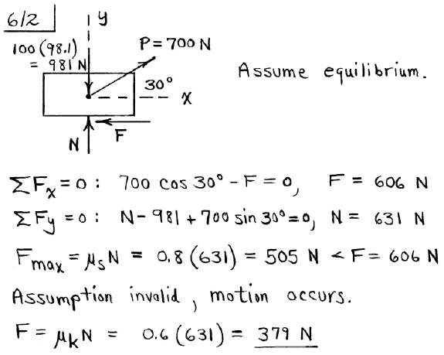
Example 6
not moving
static

Slide 9
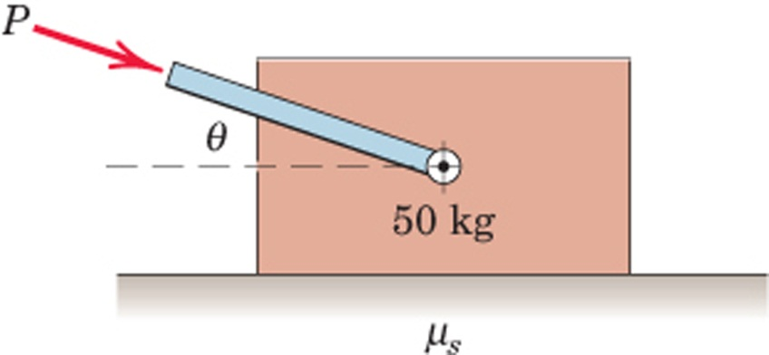
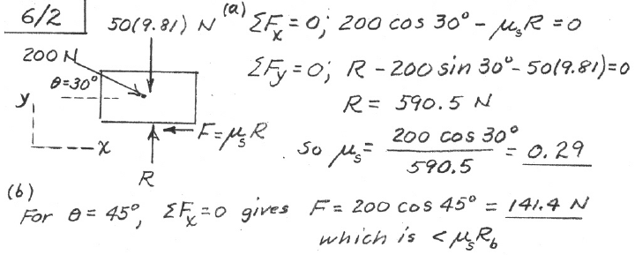
Example 7
The 50-kg block rests on the horizontal surface and a
force P=200 N, whose direction can be varied, is
applied to the block.
If the block begins to slip when Ө is reduced to 30⁰, calculate the coefficient of static friction µ_{s} between the block and the surface
If P is applied with 45⁰, calculate the friction force F.
=0.29(632)=183.3 N
ΣFy=0: -200Sin45⁰-50(9.81)=0
=632 N
Since there will be no motion, F=141.4 N

Slide 10
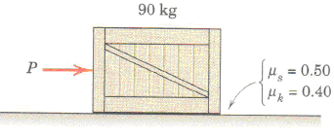
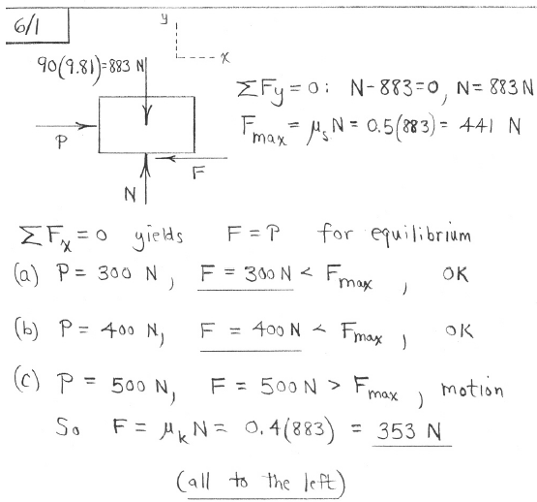
Example 8

Slide 11
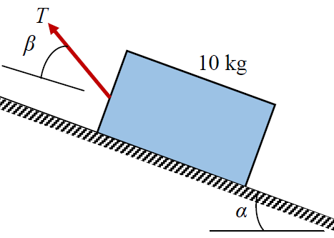
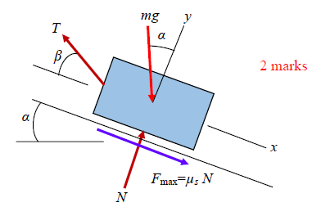
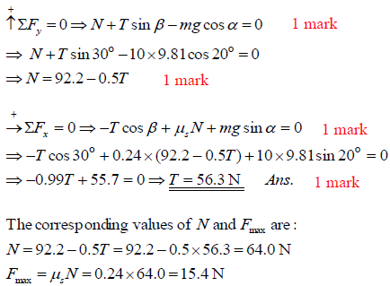
Final Exam Question (2nd Semester of 2013-14)

Slide 12
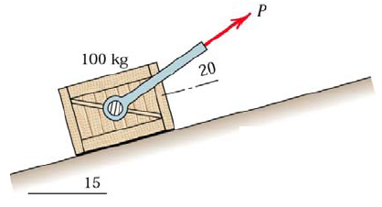
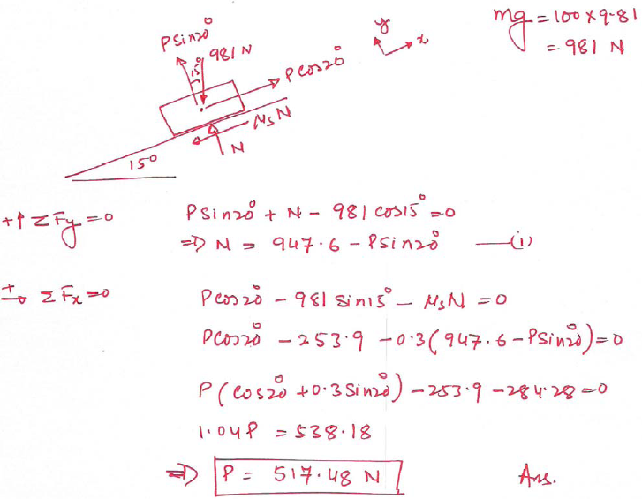
Final Exam Question (1st Semester of 2013-14)

Slide 13
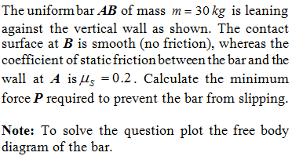
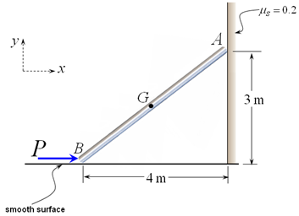
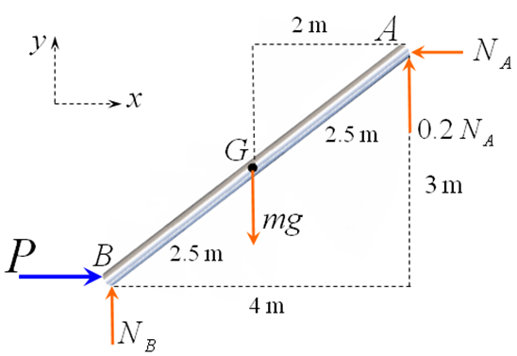
Final Exam Question (2nd Semester of 2012-13)

Slide 14
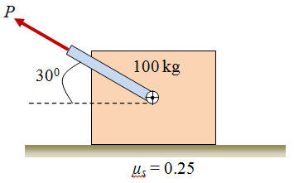
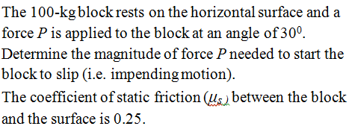
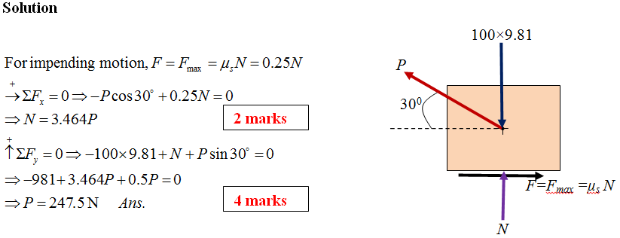
Final Exam Question (1st Semester of 2012-13)

Slide 15
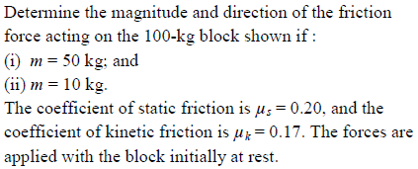
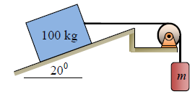
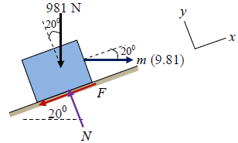
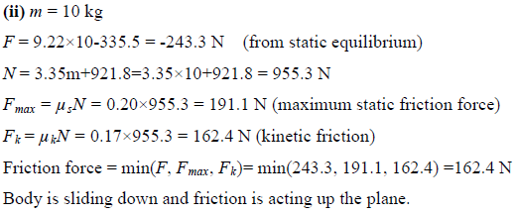
Final Exam Question (2nd Semester of 2011-12)

Slide 16
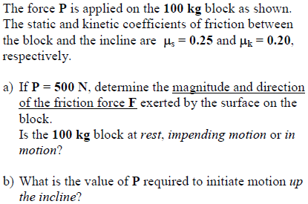
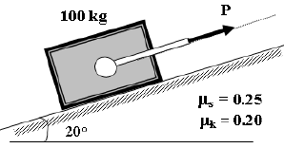
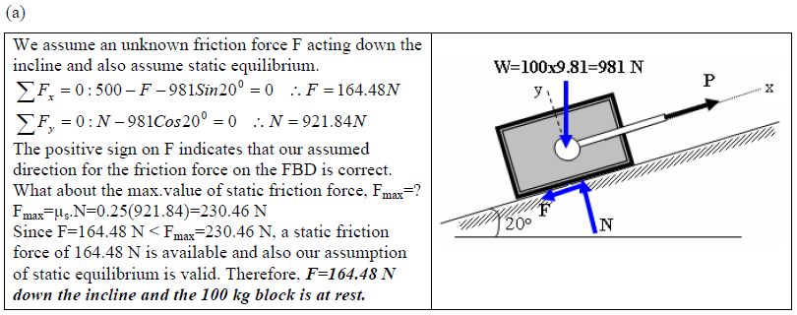
Final Exam Question (1st Semester of 2011-12)

Slide 17
Final Exam Question-Continued (1st Semester of 2011-12)

