Slide 2
STATICS (ENGINEERING MECHANICS-I)
بسم الله الرحمن الرحيم
Lecture #1
Course Description and Introduction
By
Dr. Fahed Alrshoudi
Notes:
This is a title slide.

Slide 3
About the Instructor
Name: Dr. Fahed Alrshoudi
Designation: Assistant Professor
Department: Civil Engineering
Office: 2A69
Email: falrshoudi@ksu.edu.sa
Website: http://fac.ksu.edu.sa/falrshoudi
Office Hours: Displayed on the office wall.

Slide 4
Contents
Course Description
Course Learning Objectives
Objective of the present lecture (#1)
Mechanics
A Real life application
Newton’s laws
Units

Slide 5
Course Description
Force systems; vector analysis, moments and couples in 2D and 3D
Equilibrium of force systems
Analysis of structures; plane trusses and frames.
Distributed force system
Centroid of simple and composite bodies
Area moments of inertia
Analysis of beams
Friction

Slide 6
Course Learning Outcomes
Students completing this course will be able to
Analyze 2D and 3D force system and calculate moment in a 2D and 3D structures
Analyze beam, and frame structures using equilibrium equations
Analyze truss structures using various methods
Locate centroid of regular and composite cross sections
Evaluate area moment of inertia of engineering cross sections about different axes.
Analyze and solve friction related equilibrium problems

Slide 7
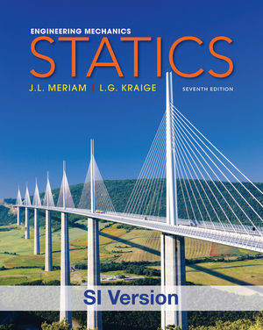
Text Book
STATICS
Authors: JL Meriam & LG Kraige
Publisher: John Wiley & Sons.
Edition: Seventh (in SI Units)

Slide 8
Outcome Assessment
Two Midterm Exams 45%
Model Demonstration and Report Writing 5%
Tutorial and Homework 10%
Final Exam 40%

Slide 9
Midterm Exams
First Midterm
Date: 21 Jumada I 1437 (1 March 2016 )
Day: Tuesday
Time: 5:00pm– 6:30 pm
Second Midterm
Date: 5 Rajab 1437H (12 April 2016)
Day: Tuesday
Time: 5:00pm– 6:30 pm

Slide 10
Objectives of the Present lecture
To explain what the “Statics” is.
To provide an overview of the course contents
To explain the learning outcomes of the present course

Slide 11
Engineering Mechanics
A branch of science concerned with the action of forces on material bodies in rest or in motion
Categories of Mechanics:
Rigid bodies
Statics (deals with equilibrium of bodies at rest)
Dynamics (deals with the accelerated motion of bodies)
Deformable bodies
Fluids

Slide 12
A Real Life Application
Engineering Design of a building is an application of Statics knowledge.
Design of its various components are primarily based on the Principles of Static equilibrium and Strain compatibility.

Slide 13
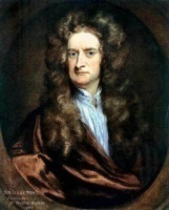
Newton’s Laws
Law I: If the resultant force on a particle is zero, the particle will remain at rest (if originally at rest) or will move with constant speed in a straight line (if originally in motion).
Law II: The acceleration of a particle is proportional to the resultant force acting on it in the direction of this force.
If above Law (II law) is applied to a particle of mass m, it may be stated as
Law III: The forces of action and reaction between interacting bodies are equal in magnitude, opposite in direction, and collinear.

Slide 14
Weight of the body
The gravitational attraction of the earth on a body is known as the weight of the body. This force exists whether the body is at rest or in motion.
Since this attraction is a force, the weight of a body should be expressed in Newtons (N) in SI units and in pounds (lb) in U.S. customary units.
Note: Unfortunately in common practice the mass unit kilogram (kg) has been frequently used as a measure of weight. This usage should disappear in time because in SI units the kilogram is used exclusively for mass and the Newton is used for force, including weight.

Slide 15
Law of sines and cosines
Law of sines
Law of cosines

Slide 16
Systems of Units
ENGINEERING MECHANICS : STATICS
International System of Units (SI) or Metric System : The basic units of length, time, and mass which are defined as meter (m), second (s), and kilogram (kg).
The unit of Force is derived as below,
3/2/2016 February

Slide 17
U. S. Customary UNITS
U.S. Customary units (or foot-pound-second (FPS) units):
Mass : slugs ( No symbol)
Length: foot (symbol ft)
Time: second (symbol sec)
Force: pound ( symbol lb)
Note: In U.S. units the pound is also used on occasion as a unit of mass. When distinction between the two units is necessary, the force unit is frequently written as lbf and the mass unit as lbm.
Other units of force in the U.S. system which are in frequent use, are the kilopound (= 1000 lb), and the ton (= 2000 lb)

Slide 18
Thank You For Your Attention
Questions

