Slide 1
ENGINEERING MANAGEMENT (GE 404)
بسم الله الرحمن الرحيم
Lecture #14
Outlines of Microsoft Project
Presented by
Dr. Nadeem A. Siddiqui
Notes:
This is a title slide.

Slide 2
Contents
Objectives of the present lecture
Basic Interface of Microsoft Project 2013
Defining Project Information and Project Properties
Creating and Assigning Calendar to the Project
Entering and Editing Project Tasks (or Activities)
Assigning, Leveling and Allocating Resources
Creating Baseline, Tracking Progress and Rescheduling Tasks
Cash Flow and Project Reports

Slide 3
Objectives of the Present lecture
To give an outline of MS Project 2013 software
To explore the capabilities of MS Project 2013

Slide 4
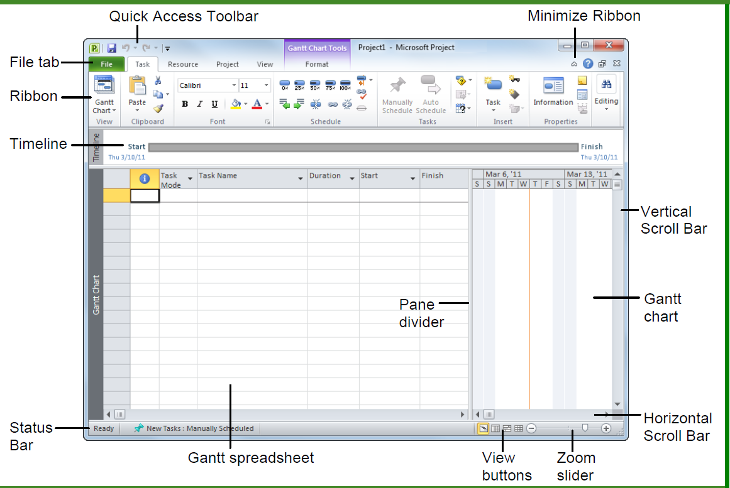
Basic Interface of MS Project
Note: The shown interface is for Microsoft Project 2010. Similar interface exists for Microsoft Project 2013

Slide 5
Defining Project Information and Project Properties
Create a New Project:
File→ New → Blank Project
Project Information
Project →Properties → Project Information (Enter dates e.g. start date, finish date; status date; current date etc.)
Project Properties (e.g. Project title, Project manager etc.)
File → Info →Project Information → Advanced Properties
To set ES or LS based schedule
Schedule From → Project start date (all tasks begin on ES i.e. as soon as possible)
Schedule From → Project Finish date (all tasks begin on LS i.e. as late as possible)

Slide 6
Creating and Assigning Calendar to the Project
Create New Calendar
Project → Change working time →Create New calendar
Work Weeks →Details →Set days to working times (or Set days to nonworking time)
To Set Working Time: Enter the working time e.g. : 8:00 AM – 12:00 PM; 1:00 PM-5:00 PM
Assign ‘new calendar’ to the Project
Project → Properties → Project Information →Calendar (Select the defined calendar)

Slide 7
Entering and Editing Project Tasks (or Activities)
Entering tasks
Task →Gantt Chart → Gantt Chart or Task sheet (Enter the tasks)
Organizing tasks into phases
In the entered tasks use indent to create phases
Adding a recurring tasks
Task →Insert → +Task → Recurring task
Displaying WBS Codes
In the work sheet add new Column → Select the Name → WBS

Slide 8
Contd.
Defining predecessors
In a cell of Predecessor column→ Right click → Information→ Predecessors →Enter Task ID, Type and Lag
Splitting tasks
Task →Schedule → Split task
Setting task constraints
In a cell→ Right click → Information→ Advanced →Enter constraint information
Setting milestones
Enter in the worksheet a task with zero duration

Slide 9
Precedence Diagram and Critical Tasks
Seeing Critical Tasks
Task →view → Gantt Chart → Format →Critical Tasks
To see Total slack and/or Free slack
In a work sheet select new column and in the top cell (click twice)→Total Slack
To see Network diagram
Task →view → Gantt Chart → Network Diagram
To Print Network diagram
File→ Print→ Page setup →Fit to 1 pages wide by 1 tall →Print

Slide 10
Assigning, Leveling and Allocating Resources
Adding Resources
View → Resource views→ Resource Sheet (Enter resource Name, Type Cost (rate /hour or /day) etc.)
Assigning resources to tasks
View → Gantt Chart →Go to Resource names → Right click to go to Information →Enter the resources
To not have leveling during assigning resources go to resource tab and clear leveling
View the resource Graph
View → Other views →Resource Graph
Resource leveling and allocation
Resource →Level → Leveling Options →(To perform leveling without effecting the project duration, select “level only within the available slack”)
Resource → Level → Level Resource → Level Now

Slide 11
Creating Baseline, Tracking Progress and Rescheduling Tasks
To compare how project is changing over time Baselines are set
Project→ Schedule → Set Baseline
To see the variance with respect to Baseline
View→ Data → Tables →Variance
Tracking a Project as scheduled
Add one column in task sheet to show % complete
Project→ Status → Status Date
Project→ Status → Update Project
Entering actual values for tasks
View→ Data → Tables →Work
Rescheduling uncompleted Tasks
Project→ Status → Update Project → Reschedule uncompleted work to start after

Slide 12
Cash Flow and Project Reports
To view reports
Report→ View Reports →Costs →Cash Flow
To print the report
File→ Print → Print Entire Project

Slide 13
Thank You
Questions Please

