Slide 1

ENGINEERING MANAGEMENT
(GE 404)
بسم الله الرحمن الرحيم
Lecture #7
Limited Resource Allocation
Notes:
This is a title slide.

Slide 2
Contents
Objectives of the present lecture
Resource Allocation
Why Resource Allocation
Project Resource Requirement
Resource Loading Diagram
Management of Resources—Resource Allocation
Scheduling Activities with Limited Resources
Series Method
Problem
Further reading

Slide 3
Objectives of the Present lecture
To discuss the issues involved in Limited Resource Allocation
To explain how to carry out limited resource allocation using series method

Slide 4
Resource Allocation
Resource Allocation is the scheduling of activities and the resources required by those activities (while taking into consideration both the resource availability and the project time).
Resource allocation permits efficient use of physical assets
  Within a project, or across multiple projects
  Drives both the identification of resources, and timing of their application
There are generally two conditions for allocating resources:
  “Normal” Most likely task duration
  “Crashed” Expedite an activity, by applying additional resources together with cost considerations
    Specialized or additional equipment/material
    Extra labor (e.g., borrowed staff, temps)
    More hours (e.g., overtime, weekends)

Slide 5
Why Resource Allocation?
To complete and finalize project schedule for completion of the project at maximum efficiency of time and cost
Better managing of resource utilization over the life of the project
To smooth the use of resources for better assignment and levelling of Manpower, equipment, materials, subcontractors, and information
To estimate cost properly for finding optimum project budget (money resource) and close management control
To schedule resource constraints properly to take care of shortage of resources
Note: Duration of a project may be increased by delaying the late start of some of its activities if resources are not adequate to meet peak demands

Slide 6
Goal of Resource Allocation/Planning
The basic objective of resource management is to supply and support field operations with the resources required so that established time objectives can be met and costs can be kept within the budget.
Hence, the goal is to optimize use of limited resources
This requires making trade-offs
  time constrained
  resource constrained

Slide 7
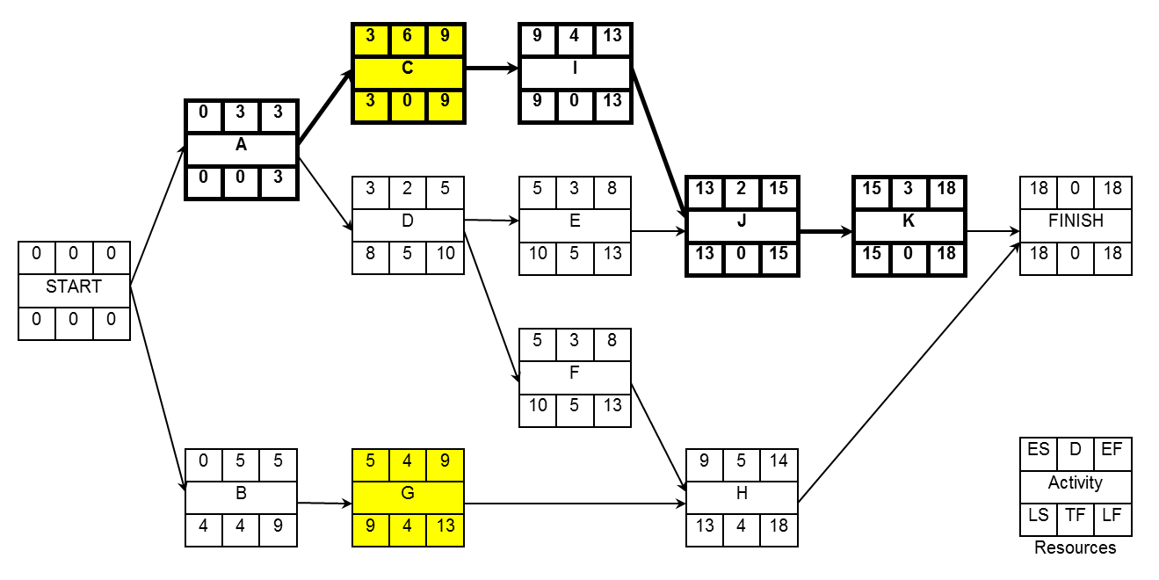
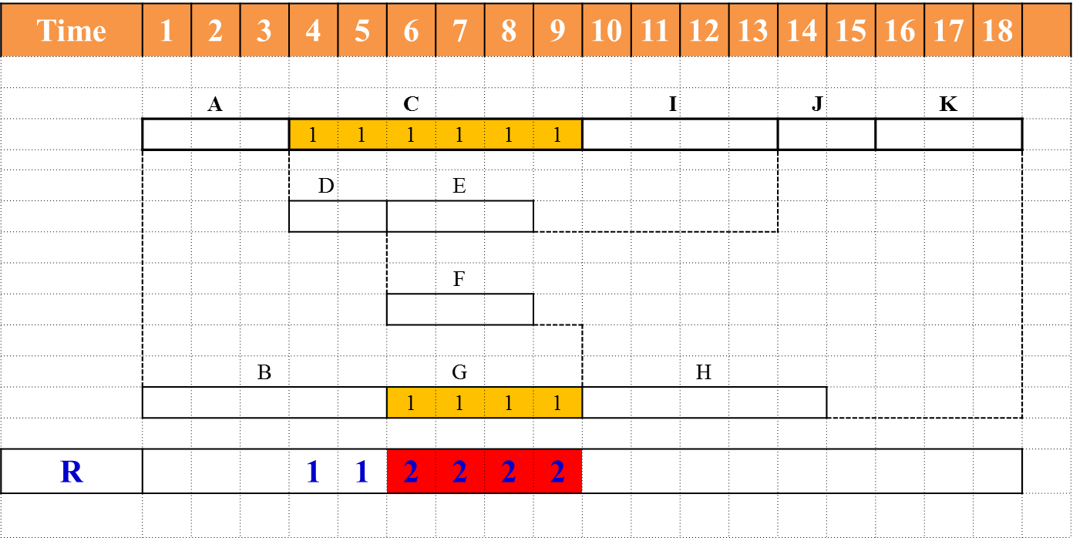
Effect of Limited Resources on Schedule slack
Assume that activities “C” and “G” each require the use of a special piece of equipment, such a hoist crane. But only one crane is available.
The direct result of this resource constraint is that activities “C” and “G” can not be performed simultaneously as indicated by the ES time-only schedule. One or the other of the activities in each pair must be given priority.

Slide 8
Contd.
Resource constraints reduce the total amount of schedule slack.
Slack depends both upon activity relationships and resource limitations.
The critical path in resource-constrained schedule may not be the same continuous chain(s) of activities as occurring in the unlimited resources schedule.

Slide 9
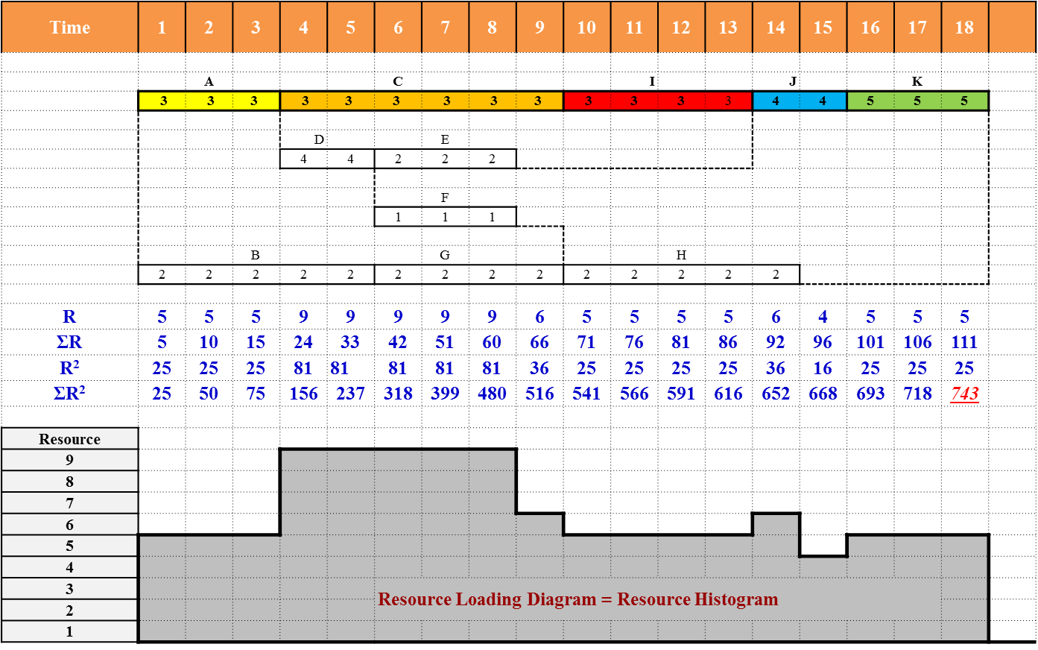
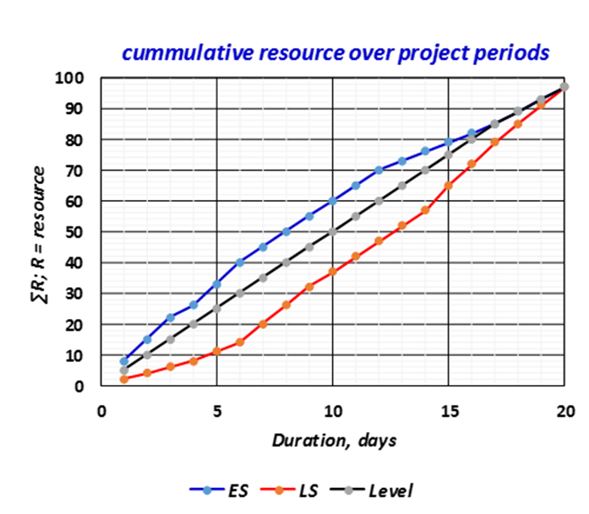
Project Resource Requirement
Resource Loading Diagram
  A diagram that highlights the period-by-period resource implications of a particular project schedule
Project Resource Requirement =
  Resource Loading Diagram =
    Resource Histogram =
      Resource Profile and S curve
Notes:
implication (of something) (for something) a possible effect or result of an action or a decisionThey failed to consider the wider implications of their actions.

Slide 10
Project Resource Requirement (Contd.)
We need
We make
Project network
Resource requirement for each activity
Bar chart or time-scaled network
Resource loading diagram
Period-by-period total requirements of units of resources
Cumulative resource requirement curve (S curve)

Slide 11
Resource Loading Diagram
(Based on ES schedule)
Time | 1 | 2 | 3 | 4 | 5 | 6 | 7 | 8 | 9 | 10 | 11 | 12 | 13 | 14 | 15 | 16 | 17 | 18
 |  | A |  |  |  | C |  |  |  |  | I |  |  | J |  |  | K
 | 3 | 3 | 3 | 3 | 3 | 3 | 3 | 3 | 3 | 3 | 3 | 3 | 3 | 4 | 4 | 5 | 5 | 5
 |  |  |  | D |  |  | E
 |  |  |  | 4 | 4 | 2 | 2 | 2
 |  |  |  |  |  |  | F
 |  |  |  |  |  | 1 | 1 | 1
 |  |  | B |  |  |  | G |  |  |  |  | H
 | 2 | 2 | 2 | 2 | 2 | 2 | 2 | 2 | 2 | 2 | 2 | 2 | 2 | 2
R | 5 | 5 | 5 | 9 | 9 | 9 | 9 | 9 | 6 | 5 | 5 | 5 | 5 | 6 | 4 | 5 | 5 | 5
ΣR | 5 | 10 | 15 | 24 | 33 | 42 | 51 | 60 | 66 | 71 | 76 | 81 | 86 | 92 | 96 | 101 | 106 | 111
R² | 25 | 25 | 25 | 81 | 81 | 81 | 81 | 81 | 36 | 25 | 25 | 25 | 25 | 36 | 16 | 25 | 25 | 25
ΣR² | 25 | 50 | 75 | 156 | 237 | 318 | 399 | 480 | 516 | 541 | 566 | 591 | 616 | 652 | 668 | 693 | 718 | 743
Resource
9
8
7
6
5
4
3 |  |  |  |  |  | Resource Loading Diagram = Resource Histogram
2
1

Slide 12
Resource Loading Diagram
(Based on LS schedule)
Time | 1 | 2 | 3 | 4 | 5 | 6 | 7 | 8 | 9 | 10 | 11 | 12 | 13 | 14 | 15 | 16 | 17 | 18
 |  | A |  |  |  | C |  |  |  |  | I |  |  | J |  |  | K
 | 3 | 3 | 3 | 3 | 3 | 3 | 3 | 3 | 3 | 3 | 3 | 3 | 3 | 4 | 4 | 5 | 5 | 5
 |  |  |  |  |  |  |  |  | D |  |  | E
 |  |  |  |  |  |  |  |  | 4 | 4 | 2 | 2 | 2
 |  |  |  |  |  |  |  |  |  |  |  | F
 |  |  |  |  |  |  |  |  |  |  | 1 | 1 | 1
 |  |  |  |  |  |  | B |  |  |  | G |  |  |  |  | H
 |  |  |  |  | 2 | 2 | 2 | 2 | 2 | 3 | 3 | 3 | 3 | 2 | 2 | 2 | 2 | 2
R | 3 | 3 | 3 | 3 | 5 | 5 | 5 | 5 | 9 | 10 | 9 | 9 | 9 | 6 | 6 | 7 | 7 | 7
ΣR | 3 | 6 | 9 | 12 | 17 | 22 | 27 | 32 | 41 | 51 | 60 | 69 | 78 | 84 | 90 | 97 | 104 | 111
R² | 9 | 9 | 9 | 9 | 25 | 25 | 25 | 25 | 81 | 100 | 81 | 81 | 81 | 36 | 36 | 49 | 49 | 49
ΣR² | 9 | 18 | 27 | 36 | 61 | 86 | 111 | 136 | 217 | 317 | 398 | 479 | 560 | 596 | 632 | 681 | 730 | 779
10aaa
9
8
7
6
5
4
3 |  |  |  |  |  | Resource Loading Diagram = Resource Histogram
2
1

Slide 13
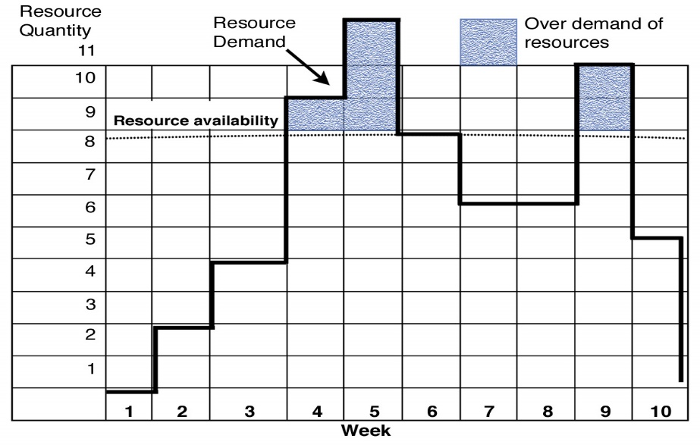
Management of Resources—Resource Allocation
(Main Aspects)
Also often called constrained-resource scheduling
There are definite limitations on the amount of resources available to carry out the project (or projects) under consideration.
Project duration may increase beyond the initial duration determined by the usual “time only” CPM calculations.
The scheduling objective is to minimize the duration of the project (or projects) being scheduled, subject to stated constraints on available resources.
Note: Resource leveling ensures that resource demand does not exceed resource availability.

Slide 14
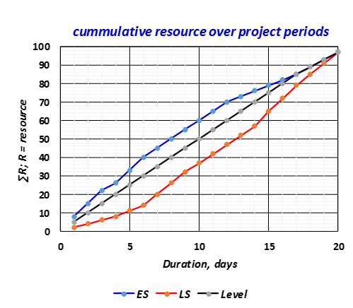
Cumulative Resource Requirement Curve
Cumulative resource requirement curve (S-curve) may be used for:
Planning and Control of progress
Preliminary resource allocation

Slide 15
Resource allocation measures

Slide 16
Significance of Resource Criticality Index
Higher values of resource criticality index are associated with the most critical (i.e., most tightly constrained) resources.
Values of resource criticality index significantly below 1.0 typically are associated with non-constraining resources.
Values around and above 1.0 indicate that project delays (beyond the original critical path duration) will be encountered.

Slide 17
Scheduling Activities with Limited Resources
Series Method
  The series method relies on the assumption that once an activity has been started, it cannot be interrupted.
Parallel Method
  The parallel method is similar to the series method with one basic difference: The parallel method permits activities to be interrupted.

Slide 18
Series Method
Schedule activities to start as soon as their predecessors have been completed
Determine the Eligible Activity Set (EAS) i.e. those activities with all predecessor activities completed.
From among the members of the current EAS, determine the Ordered Scheduling Set (OSS) of activities giving priority to the earliest late start
If the activities are tied for the early late start date, give priority to the activity with least activity duration
If the activities are tied for activity duration, give priority to the activity with the largest number of resources
If no activity has been selected with the above rules, start the activity that occurs first in the input order

Slide 19
Form for the Resource Allocation
Time | 1 | 2 | 3 | 4 | 5 | 6 | 7 | 8 | 9 | 10 | 11 | 12 | 13 | 14 | 15 | 16 | 17 | 18 | 19 | 20 | 21 | 22 | 23 | 24 | 25 | 26 | 27 | 28 | 29 | 30 | 31
EAS
OSS
use
R

Slide 20
Problem-1
The work of a small engineering project is planned according to the AON shown below. The labour requirement of each activity is shown below each activity box.
(a) Calculate the requirements of labour each day when all the activities start at their (i) early start and (ii) late start.
(b) What will be the minimum contract duration if no more than 6 labours can be made available for the work and if it is assumed that having started an activity it must be completed without a break?

Slide 21
Solution

Slide 22
EST
 | 1 | 2 | 3 | 4 | 5 | 6 | 7 | 8 | 9 | 10 | 11 | 12 | 13 | 14 | 15 | 16 | 17 | 18 | 19 | 20 | 21 | 22 | 23 | 24
A | 4 | 4 | 4
C |  |  |  | 3 | 3 | 3 | 3
E |  |  |  |  |  |  |  | 1 | 1 | 1
H |  |  |  |  |  |  |  |  |  |  | 2 | 2 | 2 | 2 | 2 | 2 | 2 | 2
Y |  |  |  |  |  |  |  |  |  |  |  |  |  |  |  |  |  |  | 3
X |  |  |  |  |  |  |  |  |  |  |  |  |  |  |  |  |  |  |  | 1 | 1 | 1 | 1 | 1
B |  |  |  | 2 | 2
D |  |  |  | 5 | 5 | 5 | 5 | 5
F |  |  |  |  |  |  |  |  | 3 | 3 | 3 | 3 | 3
G |  |  |  |  |  |  |  |  | 4 | 4 | 4 | 4 | 4 | 4 | 4
Z |  |  |  |  |  |  |  |  |  |  |  |  |  |  |  | 2 | 2
R | 4 | 4 | 4 | 10 | 10 | 8 | 8 | 6 | 8 | 8 | 9 | 9 | 9 | 6 | 6 | 4 | 4 | 2 | 3 | 1 | 1 | 1 | 1 | 1
ΣR | 4 | 8 | 12 | 22 | 32 | 40 | 48 | 54 | 62 | 70 | 79 | 88 | 97 | 103 | 109 | 113 | 117 | 119 | 122 | 123 | 124 | 125 | 126 | 127
R² | 16 | 16 | 16 | 100 | 100 | 64 | 64 | 36 | 64 | 64 | 81 | 81 | 81 | 36 | 36 | 16 | 16 | 4 | 9 | 1 | 1 | 1 | 1 | 1
Σ R² | 16 | 32 | 48 | 148 | 248 | 312 | 376 | 412 | 476 | 540 | 621 | 702 | 783 | 819 | 855 | 871 | 887 | 891 | 900 | 901 | 902 | 903 | 904 | 905
Solution (a)
DR_{A} =(ΣR/D) = 127/24 = 5.292
Eff =DR_{A}²×D = (5.291)²×24 = 5.292 =672.042
LST
 | 1 | 2 | 3 | 4 | 5 | 6 | 7 | 8 | 9 | 10 | 11 | 12 | 13 | 14 | 15 | 16 | 17 | 18 | 19 | 20 | 21 | 22 | 23 | 24
A | 4 | 4 | 4
C |  |  |  | 3 | 3 | 3 | 3
E |  |  |  |  |  |  |  | 1 | 1 | 1
H |  |  |  |  |  |  |  |  |  |  | 2 | 2 | 2 | 2 | 2 | 2 | 2 | 2
Y |  |  |  |  |  |  |  |  |  |  |  |  |  |  |  |  |  |  | 3
X |  |  |  |  |  |  |  |  |  |  |  |  |  |  |  |  |  |  |  | 1 | 1 | 1 | 1 | 1
B |  |  |  |  |  | 2 | 2
D |  |  |  |  |  | 5 | 5 | 5 | 5 | 5
F |  |  |  |  |  |  |  |  |  |  |  |  | 3 | 3 | 3 | 3 | 3
G |  |  |  |  |  |  |  |  |  |  | 4 | 4 | 4 | 4 | 4 | 4 | 4
Z |  |  |  |  |  |  |  |  |  |  |  |  |  |  |  |  |  | 2 | 2
R | 4 | 4 | 4 | 3 | 3 | 10 | 10 | 6 | 6 | 6 | 6 | 6 | 9 | 9 | 9 | 9 | 9 | 4 | 5 | 1 | 1 | 1 | 1 | 1
ΣR | 4 | 8 | 12 | 15 | 18 | 28 | 38 | 44 | 50 | 56 | 62 | 68 | 77 | 86 | 95 | 104 | 113 | 117 | 122 | 123 | 124 | 125 | 126 | 127
R² | 16 | 16 | 16 | 9 | 9 | 100 | 100 | 36 | 36 | 36 | 36 | 36 | 81 | 81 | 81 | 81 | 81 | 16 | 25 | 1 | 1 | 1 | 1 | 1
Σ R² | 16 | 32 | 48 | 57 | 66 | 166 | 266 | 302 | 338 | 374 | 410 | 446 | 527 | 608 | 689 | 770 | 851 | 867 | 892 | 893 | 894 | 895 | 896 | 897

Slide 23
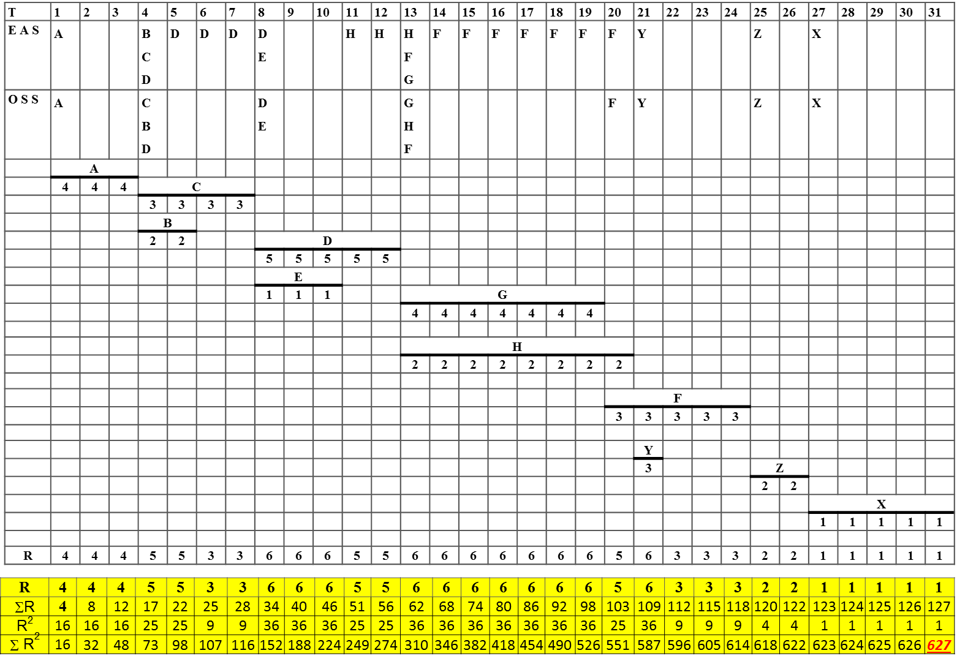
Solution (b)
Minimum contract duration if no more than 6 labours can be made available = 31 days

Slide 24
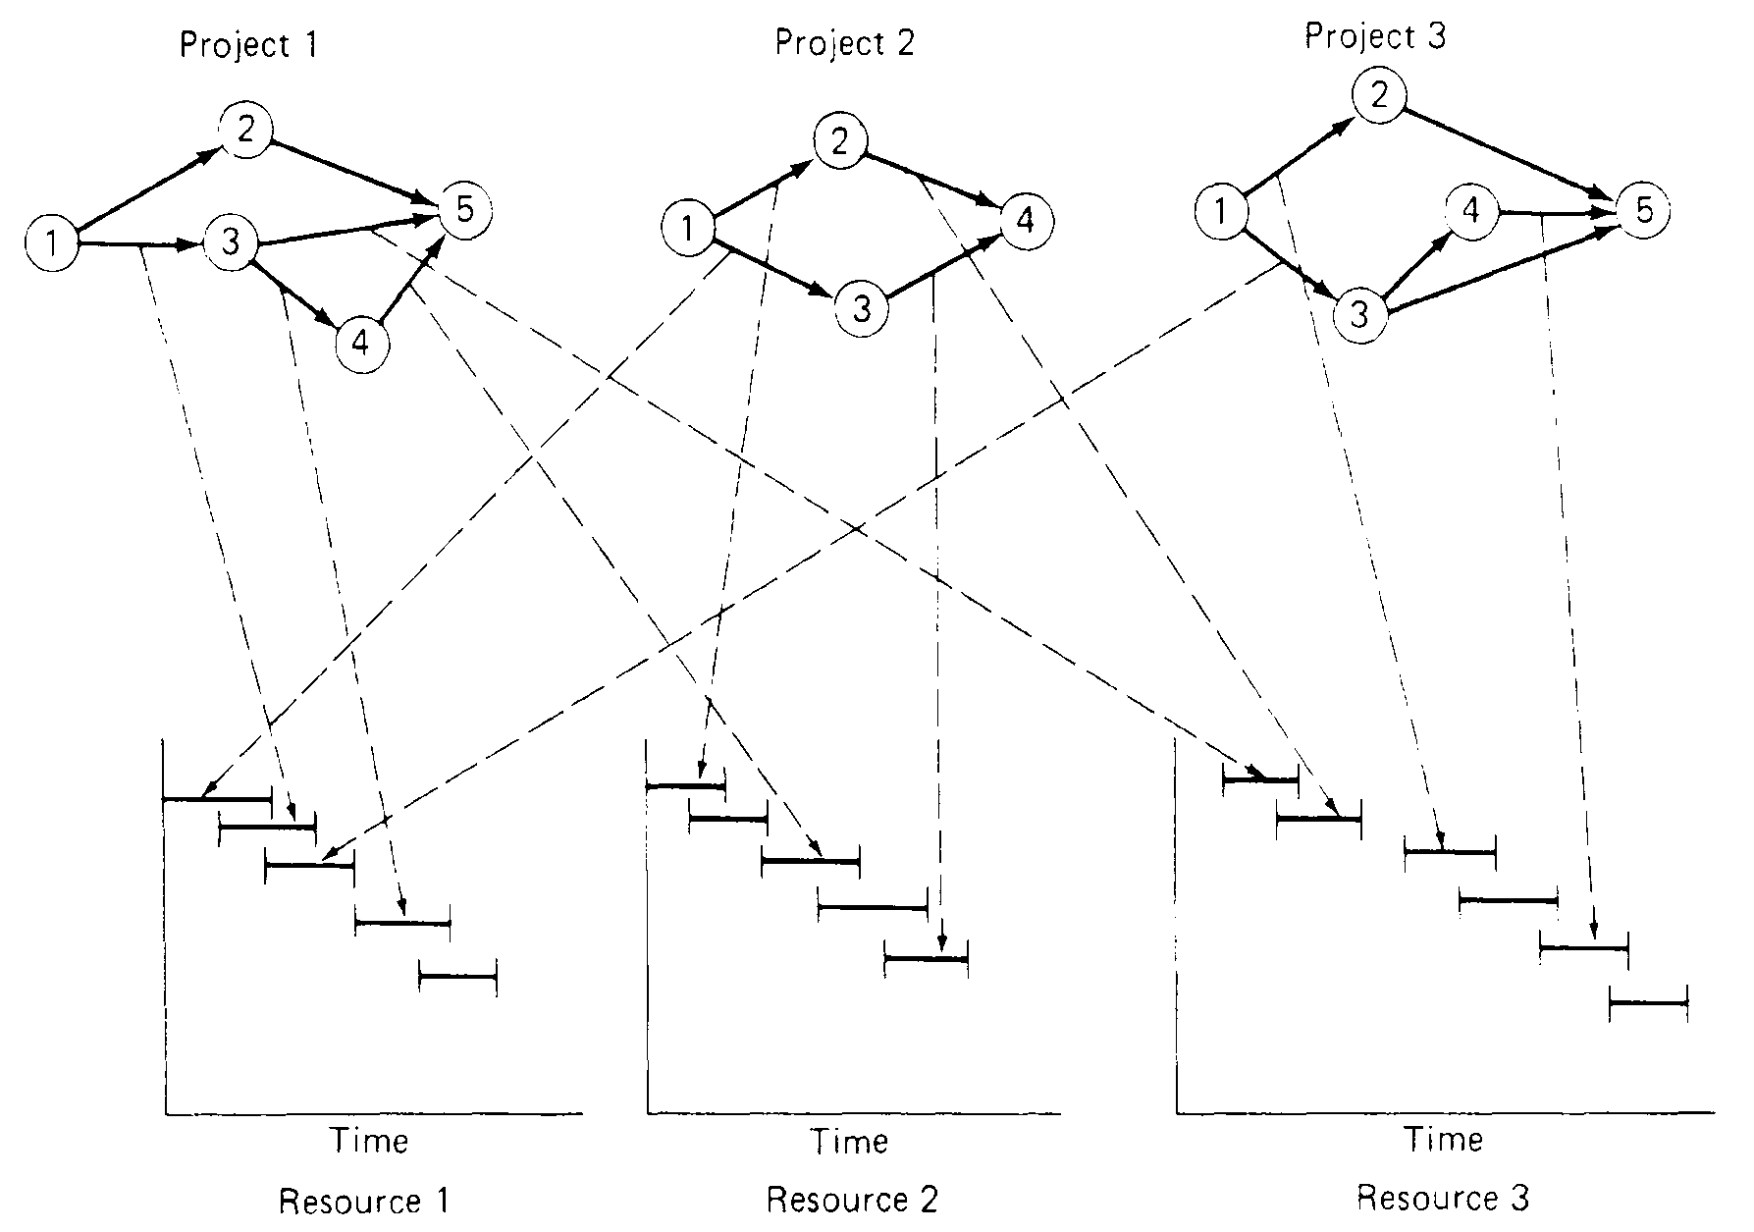
Multiple Project Scheduling Interactions
Example of multi project scheduling interactions

Slide 25
Further Reading
Read more about the resource allocation from:
Jimmie W. Hinze. “Construction Planning and Management,” Fourth Edition, 2012, Pearson.

Slide 26


Thank You
Questions Please

