Slide 1
Getting Started with Oracle11g
Abeer bin humaid

Slide 2
Create database user
You should create at least one database user that you will use to create database objects.
A database user is a type of database object: a user is associated with a database schema, you connect to the database as a database user, and the database user is the owner of any database objects (tables and so on) that you create in the schema associated with the user.

Slide 3
Create database user
Two ways to create new user :
1- Using SQL command line
2- Using SQL DEVELOPER (this is the way we are going to use in lab)

Slide 4
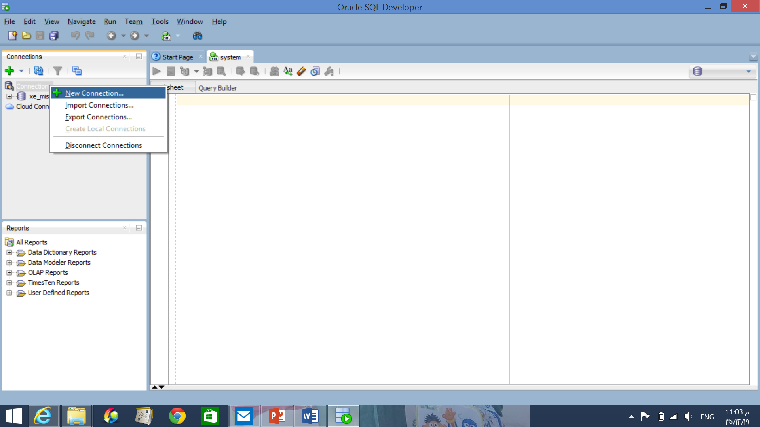
2- using SQL DEVELOPER
SQL Developer as an Alternative for Creating Database Users:
Create a database connection for the SYSTEM user.
Write SYSTEM as username
And password as you put when installing the oracle

Slide 5
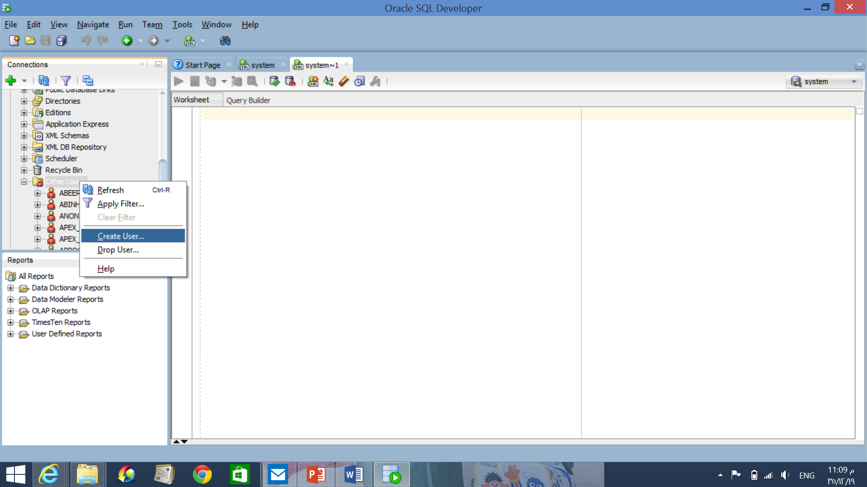
2- using SQL DEVELOPER
Open that database connection for the SYSTEM user.
Right-click the Other Users node in the Connections navigator under that connection . select Create user

Slide 6
2- using SQL DEVELOPER
specify the necessary information.
(Under System Privileges, grant ALTER SESSION, CREATE SESSION, CREATE DATABASE LINK, CREATE MATERIALIZED VIEW, CREATE PROCEDURE, CREATE PUBLIC SYNONYM, CREATE ROLE, CREATE SEQUENCE, CREATE SYNONYM, CREATE TABLE, CREATE TRIGGER, CREATE TYPE, CREATE VIEW, and UNLIMITED TABLESPACE.)

Slide 7
2- using SQL DEVELOPER

Slide 8
2- using SQL DEVELOPER
Or you can write your own command using the SQL tab

