Slide 1
Cont. Inflammation
GRANULOMA

Slide 2
Granuloma:
It’s a type of chronic specific inflammation, characterized by accumulation of tumor like masses, can be: infective, or non-infective.
The single tubercule composed of central necrotic tissue, epithellioid cells, layers of lymphocytes and plasma cells, then outer layer of fibroblasts to kill any bacilli escapes without dyeing.

Slide 3
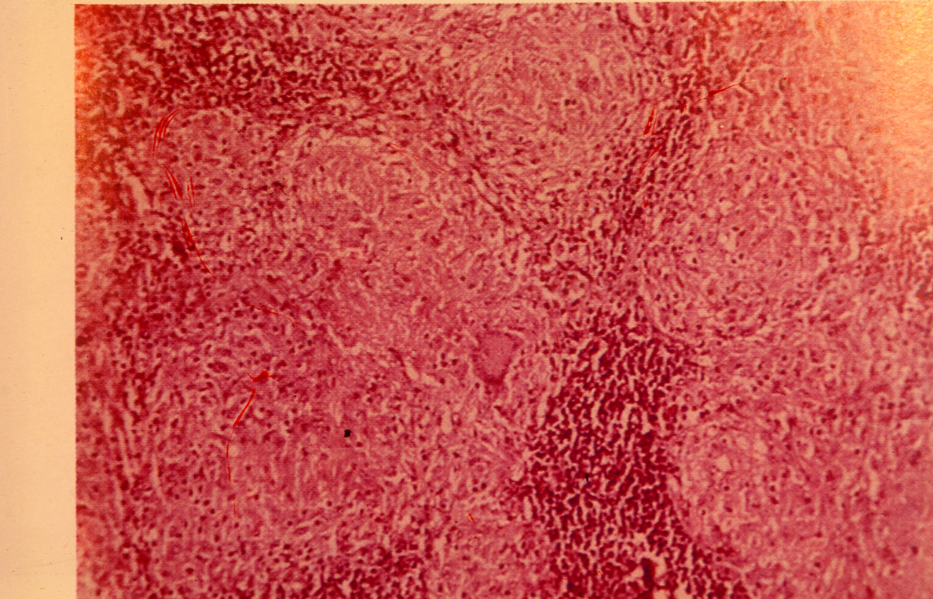
1- Early T.B in lymph node:

Slide 4
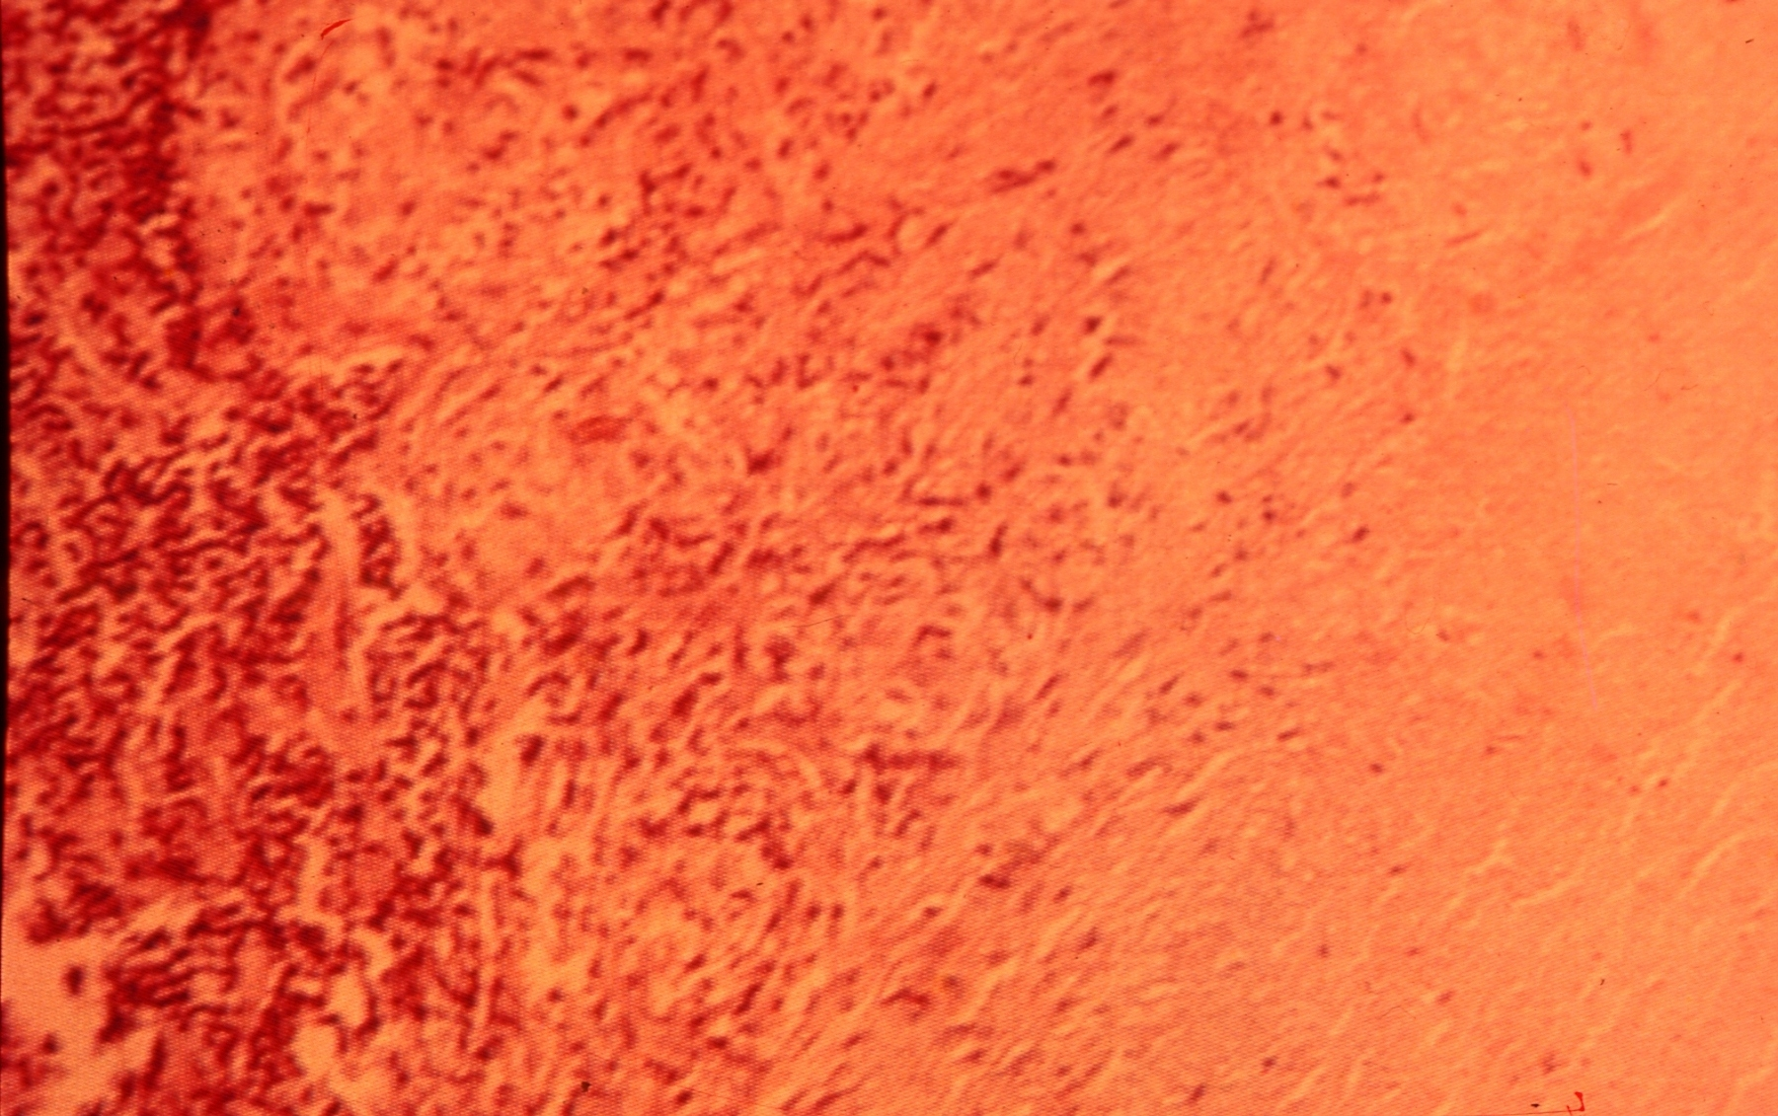
2- Casiating T.B in LN

Slide 5
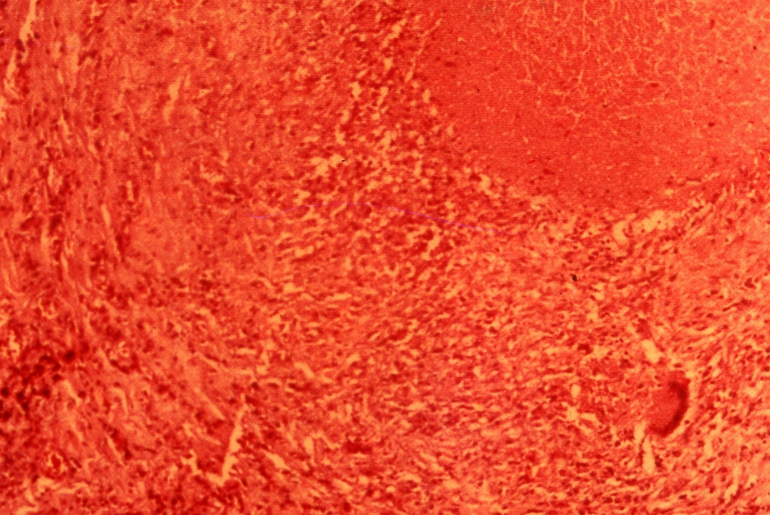
3- Chronic fibrocasious T.B in lung:

Slide 6
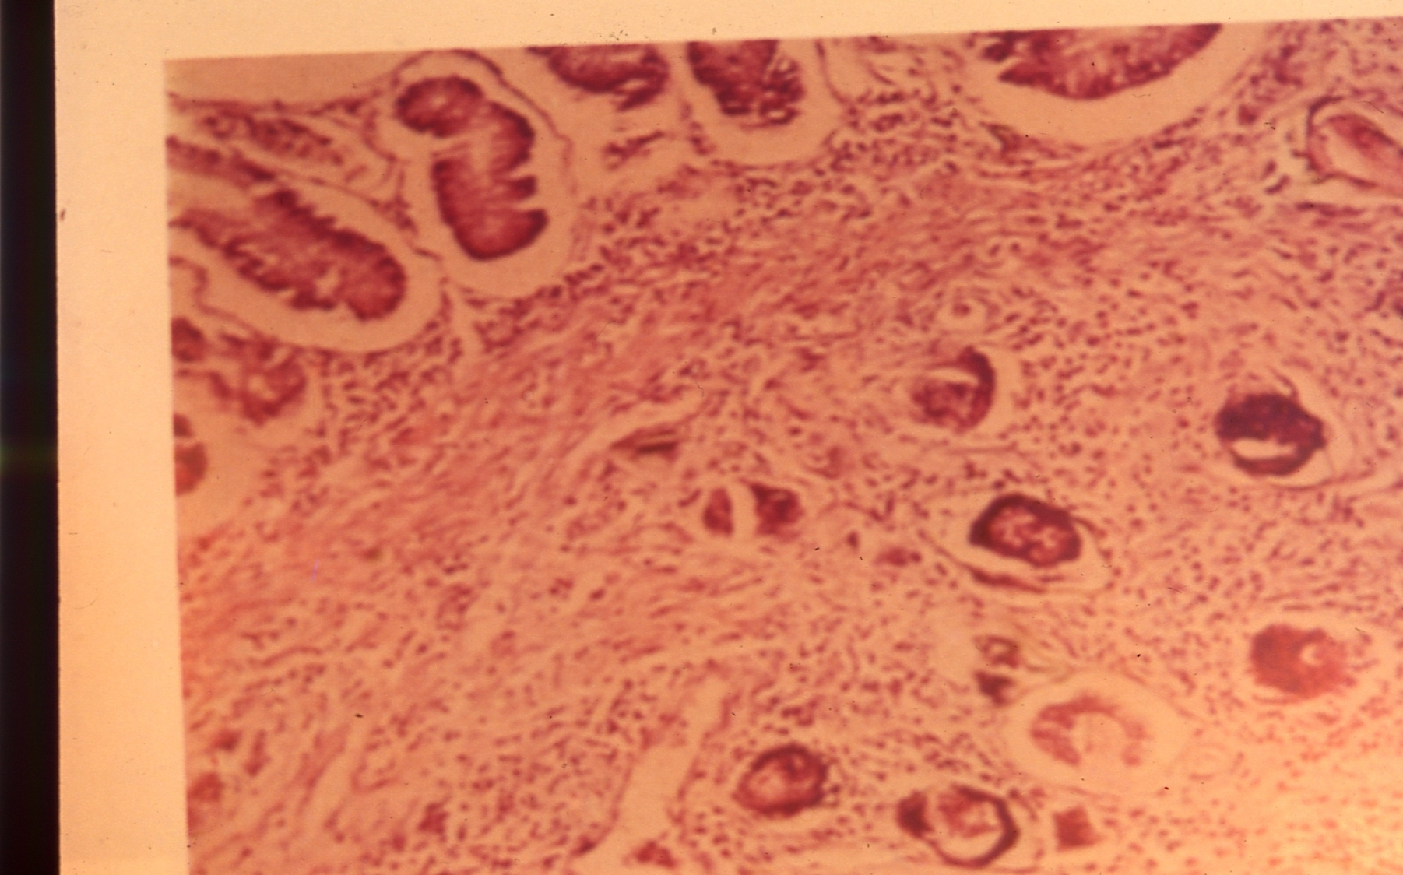
4- Belharziasis in rectum:

Slide 7
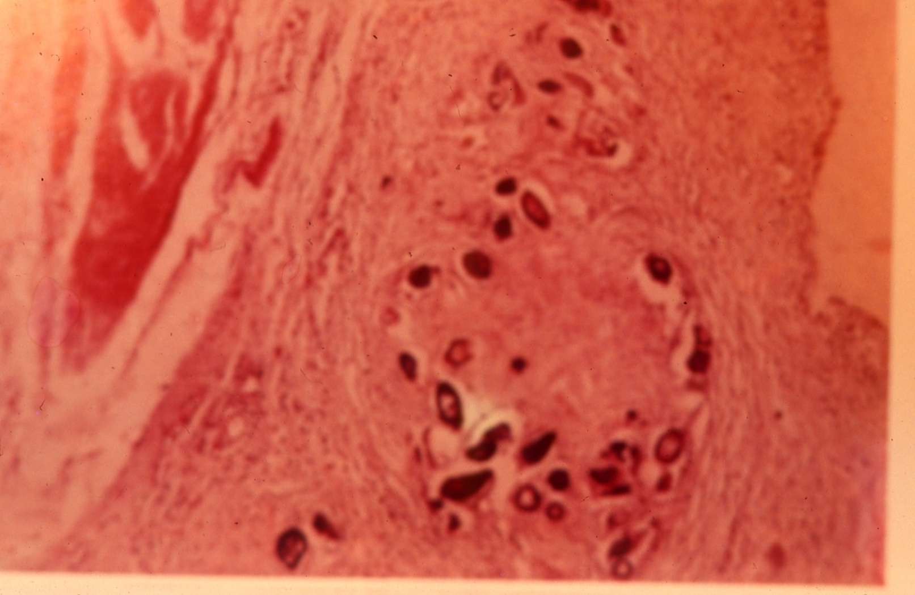
5- Belharziasis in Urinary Bladder:

Slide 8
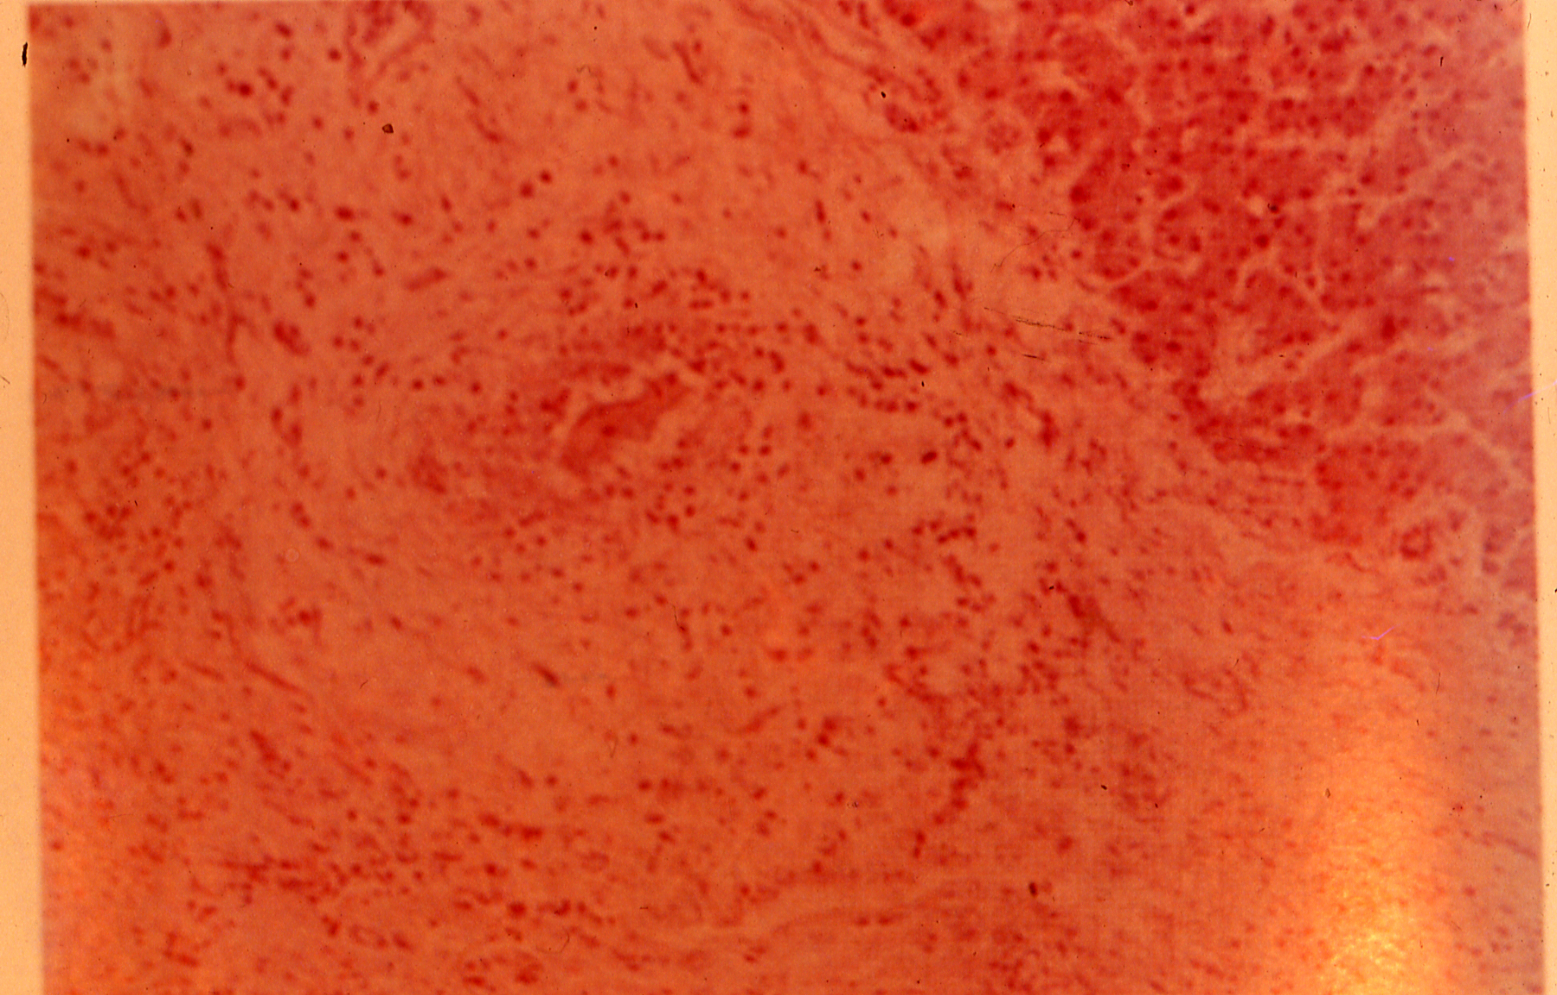
6- Belharziasis in liver:

