Slide 1
Growth Disturbance

Slide 2
Injury have types:
1- Mild
2- Moderate
3- Severe
The injury is : any process applied on cells or tissues. Or any change in cellular function.

Slide 3
Causes of injury:
Hypoxia
Physical agents
Chemicals
Microorganisms
Immunological reactions
Genetic defects
Nutritional imbalances

Slide 4
Body response against injury:
It depends on:
1- Types of cells or tissues affected
2- Strength of injury.
According to these 2 points we will have either :
1- Adaptive changes
2- Non-adaptive changes

Slide 5
Adaptive changes:
1- Change in structure “ GROWTH DISTURBANCE”
2- Inflammation
3- Abnormal Immune response “ Hypersensitivity”

Slide 6
Changes in structure:
1- Atrophy
2- Hypertrophy
3- Metaplasia
3- Hyperplasia

Slide 7
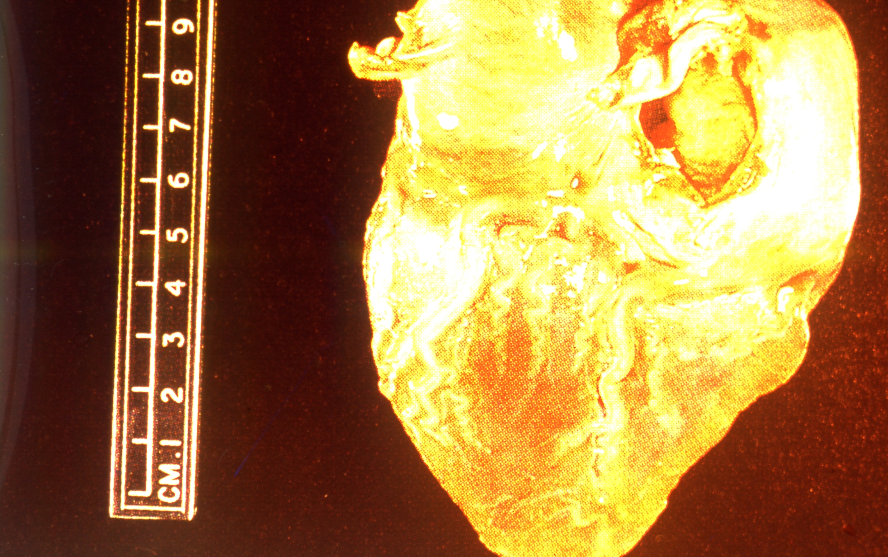
1- Brown atrophy in the heart “Gross pic.”

Slide 8
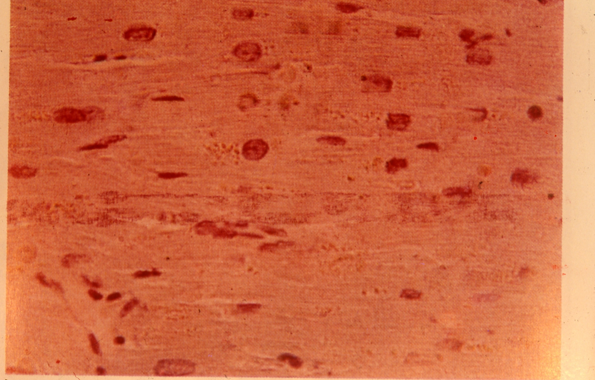
2- Brown atrophy in the heart “Microscopic pic.”

Slide 9
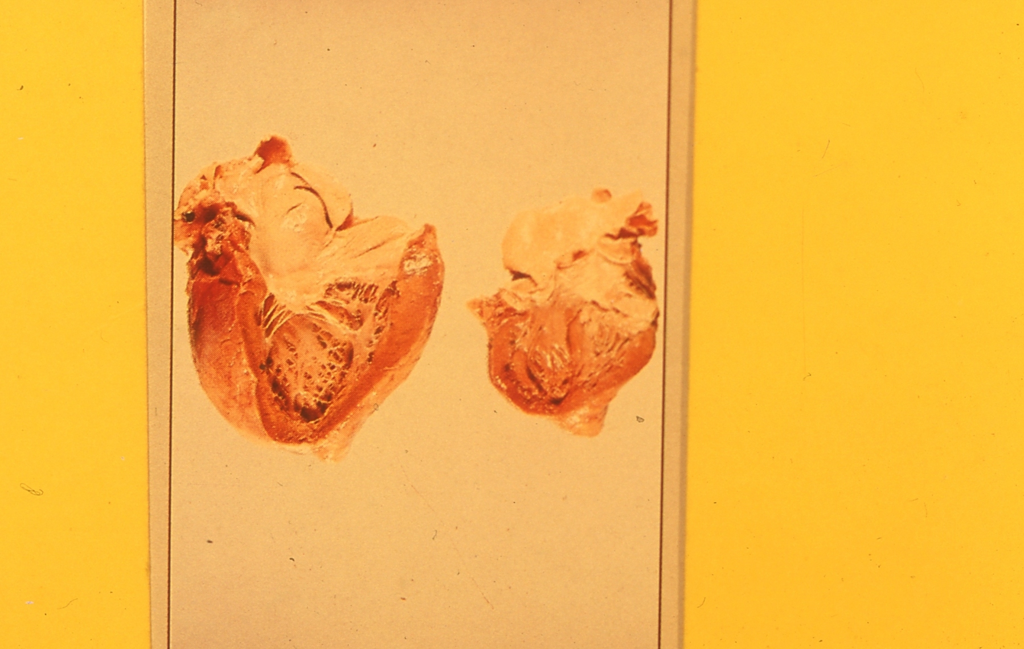
3- Normal and hypertrophic heart “Gross”

Slide 10
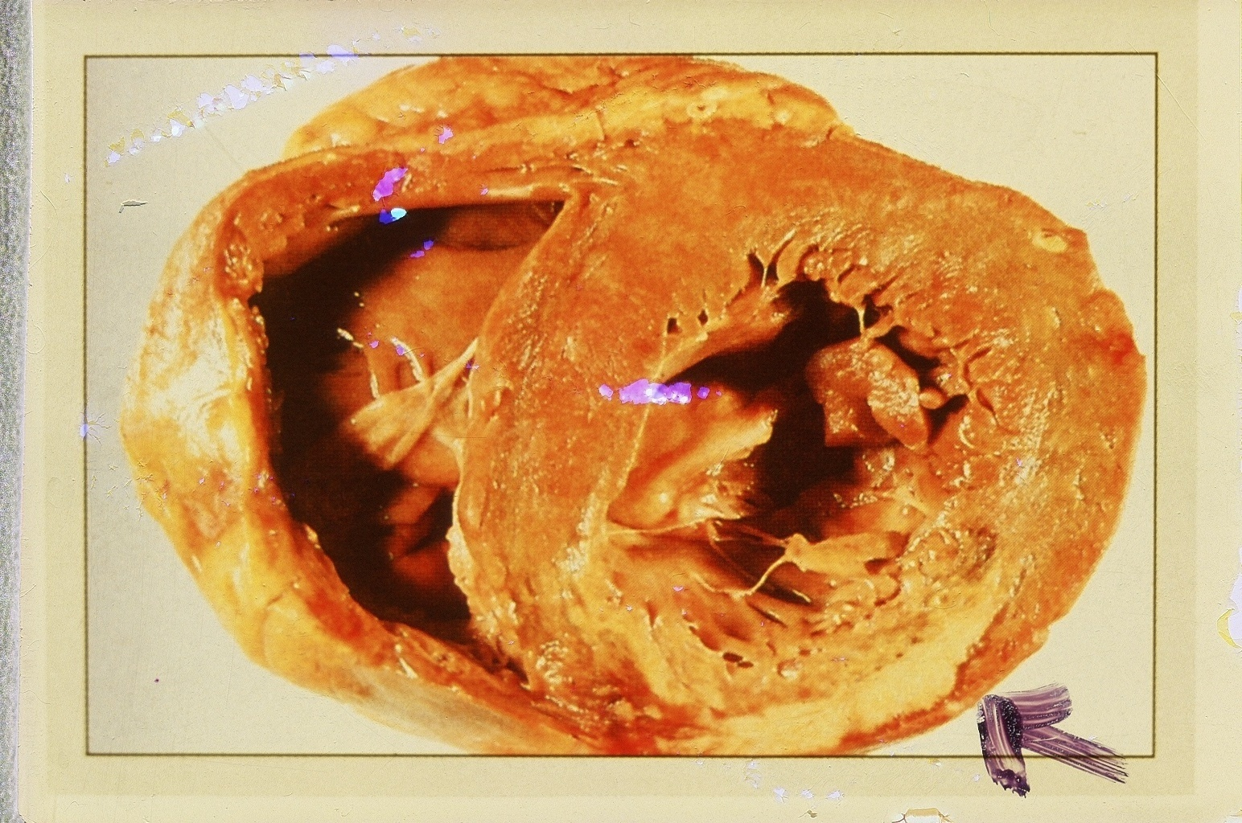
4- Left ventricle hypertrophy “Gross”

Slide 11
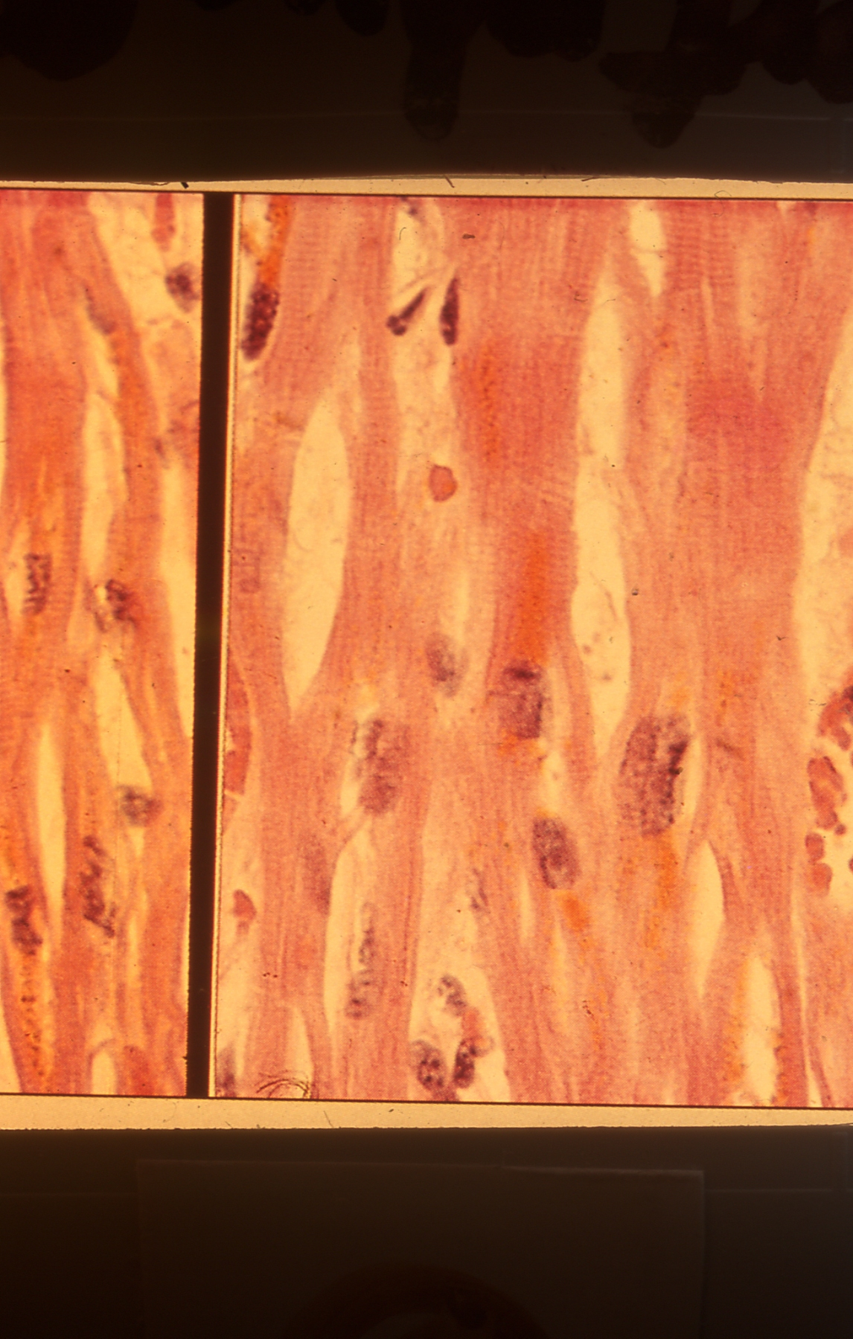
5- Atrophy and Hypertrophy of cardiac muscles:

Slide 12
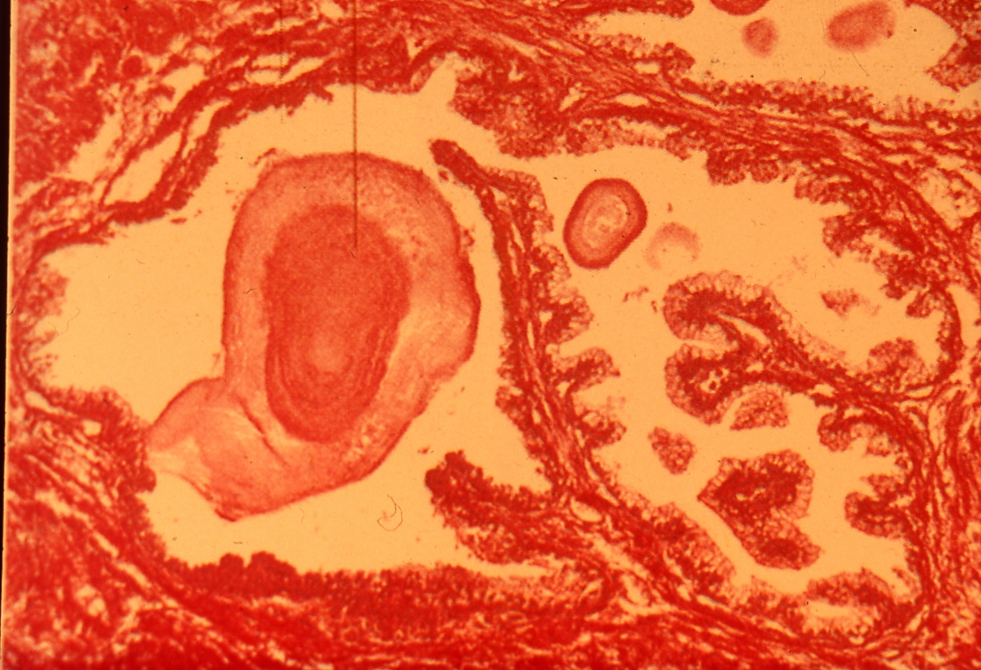
6- Senile hyperplasia in prostate:

