Slide 1
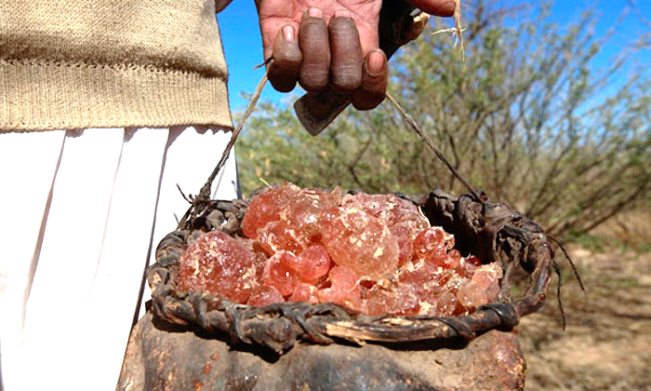

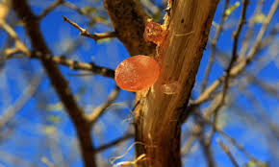
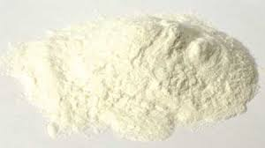
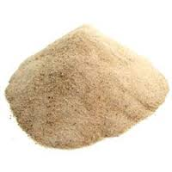
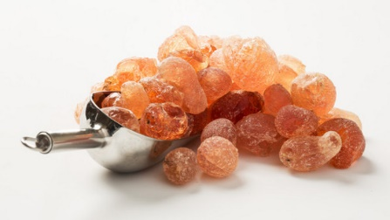

Gum Arabic: A Rich Source of Natural Dietary Fiber and Prebiotic
Prof. Bakri Hussein Hassan
Agricultural Engineering Department, College of Food and Agriculture Sciences, King Saud University, Riyadh, Kingdom of Saudi Arabia

Slide 2
[1]Introduction
Gum Arabic (Acacia Gum) is a natural and unique forest product and one of the best known among all natural gums. It is a remarkably useful natural product.
It is a food hydrocolloid and an edible biopolymer collected as dried exudate from stems and branches of Acacia senegal (Volgaris) and Acacia seyal (Gummiferae) trees (Leguminosae family).
It is a global commodity predominantly produced in Africa across sub-saharan countries.
Sudan is the largest Gum Arabic (GA) producer in the world producing nearly 80% of the world total production of Acacia, in the GA belt zone of 520000 km² .

Slide 3
Acacia senegal (Hashab) produces high quality gum accounting for about 90% of Sudan gum production, whereas Acacia seyal (Talha) accounts for less than 10% of the total GA production, and is comparatively lower in quality and price.
Gum Arabic (GA) produced in Sudan is an organic, free of genetically modified organisms (GMO-free) and sustainable ingredient with considerable health benefits, and meets clean label and natural requirements.
The world food industry consumes about 80% of the total industrial uses of GA.

Slide 4
The main obstacle in recognizing GA as a natural dietary fiber and prebiotic in FDA food regulations is its classification as a "food additive" under the E number (E414) for its use as an emulsifier, stabilizer and a thickening agent .
Recently FDA has amended food additives regulations to allow expanded safe use of GA.
In this context, the major target for Sudan as the major GA producer in the world, is global recognition and approval of GA as a natural dietary fiber and prebiotic.

Slide 5
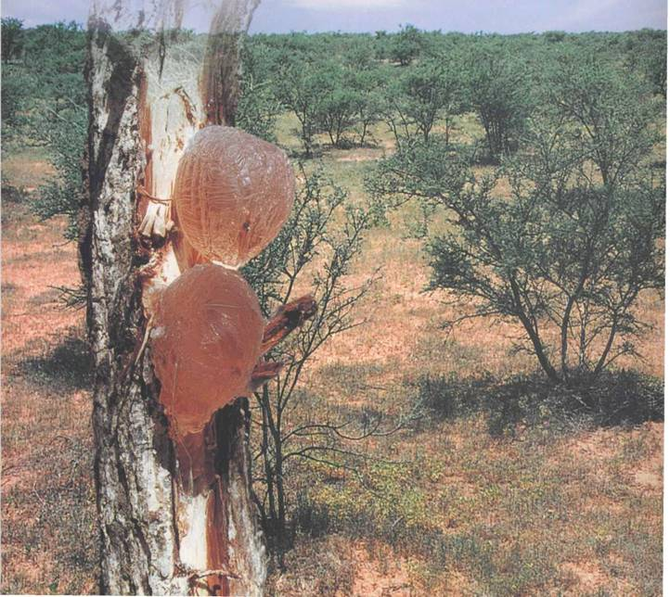
Fig 1. Gum Arabic (Hashab) and Acacia senegal trees

Slide 6
[2]Chemical Composition and Physical Properties of GA
Gum Arabic (Acacia gum) has been identified as a complex mixture of complex carbohydrates with a molecular weight ranging between 2.5X10⁵ to 1X10⁶ Dalton , containing small amount (about 2-3%) proteinaceous material and it has been categorized as an arabinogalactan-protein complex.
GA is either neutral or slightly acidic (pH=4.5 to 5)
GA is rich in calcium, magnesium and potassium salts. It is very soluble in water, and forms a solution over a wide range of concentrations without becoming highly viscous.
On total mass basis GA is predominantly constituted of about 89% Arabinogalactan (AG), 10% Arabinogalactan-Protein (AGP), and 1% Glycoprotein (GP).

Slide 8
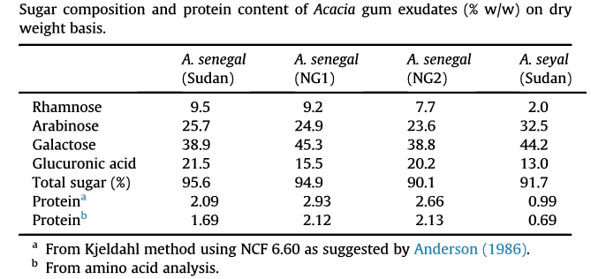
Table 2
Gashua et al., 2015. Food Hydrocolloids, 51, 405-413.

Slide 9
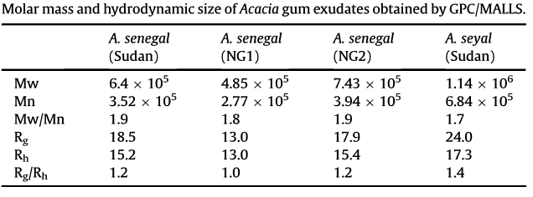
Table 3
Gashua et al., 2015. Food Hydrocolloids, 51, 405-413.

Slide 11
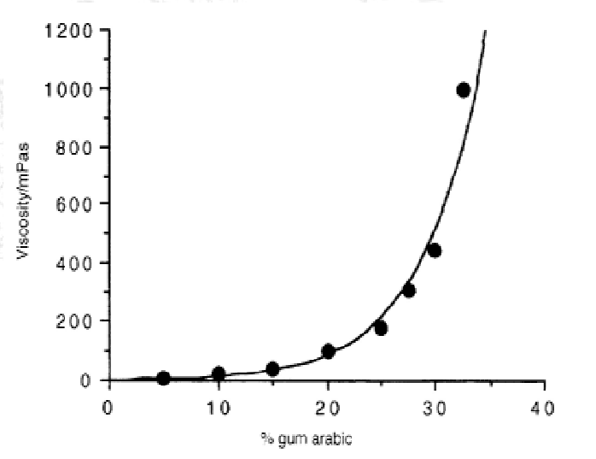
Fig 2. GA solution viscosity as a function of concentration (Roeper GmbH, Hamburg, Germany)

Slide 12
Dietary Fiber[3]
Food rich in dietary fiber have a positive effect on health since their consumption have been related to decreased incidence of several diseases.
Definition:
(American Association of Cereal Chemists, AACC, 2000).
Dietary fiber is the edible parts of plants or analogous carbohydrates that are resistant to digestion and absorption in the human small intestine with complete and partial fermentation in the large intestine. Dietary fiber includes polysaccharides, oligosaccharides, lignin, and associated plant substances. Dietary fiber promote beneficial physiological effects including laxation, and/or blood cholesterol attenuation, and/or blood glucose attenuation.

Slide 13
Importance:
Dietary fiber is a key component in healthy eating.
Dietary fiber reduces risk for developing several diseases, namely, coronary artery disease, stroke, obesity, and certain gastrointestinal disorders such as constipation, diverticulitis and large bowl cancers.
Increased consumption of DF improves serum lipid concentrations, lowers blood pressure, improves blood glucose in diabetes, promote regularity, aid in weight loss, improves immune functions, and provide clinical benefit for patients with chronic kidney disease.
Importance of DF has led to the development of a large and potential market for fiber rich products and ingredients.

Slide 14
DF is conventionally classified in two categories according to their water solubility: [1] insoluble dietary fiber (IDF) such as cellulose, part of hemicellulose, and lignin and [2] soluble dietary fiber (SDF) such as gums, pectin, pentosans, and mucilage.
Dietary fibers are consumed from cereals, fruits, vegetables, and nuts, but are also added in purified form to food preparations.
Both the nutritional value and technological properties of dietary fibers are important in the potential development of a wide range of fiber-enriched foods (e.g. bakery products, snacks, sauces, drinks, cereals, biscuits, dairy products, meat products, confectionary, extruded products, and nutritional supplements).

Slide 15
The recommendation of adequate intake (AI) of dietary fiber is 14 g/1000 kcal (28 and 36 g/day for adult women and men , respectively).
Most nutritionists and diet experts suggest that approximately 20-30% of daily fiber intake should come from soluble fiber.

Slide 17
GA as a Natural Dietary Fiber[4]
Gum Arabic is a natural dietary fiber .It is a non-starch polysaccharide not digested in the intestine but fermented in the colon producing short-chain fatty acids leading to a wide range of potential health benefits.
GA is considered as the best of all soluble fibers as a direct additive to liquid foods.
GA is high in fiber, lowest in viscosity, odourless, tasteless, stable in acidic solutions, improves mouthfeel and enhance flavor release, and safe.

Slide 18
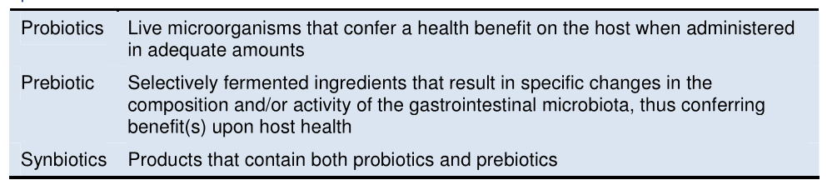
GA as a Natural Prebiotic[5]
Prebiotic is defined as: “a selectively fermented ingredient that allows specific changes, both in the composition and/or activity in the gastrointestinal microflora, that confer benefits”.
Prebiotics stimulate the growth of beneficial bacteria (Probiotics) such as Lactobacilli and bifidobacteria representing usual target genera for prebiotics.

Slide 19
GA is prebiotic that enhances the growth of intestinal flora, it is similar to breast milk and inulin in its importance.
1.5-6% GA could be added as a prebiotic natural fiber and declared in the package as an ingredient not an additive.
Classification of a food ingredient as a prebiotic requires the following:
  Resist gastric acidity, hydrolysis by human enzymes, and absorption in the upper gasrtointestinal tract
  Is fermented by the intestinal microflora
  Selectively stimulates the gross and/or activity of intestinal bacteria potentially associated with health and well being.

Slide 20



The food industry need to find prebiotics and probiotics that are fully compatible with formulation, processing, packaging, and distribution.
Examples of commercially available GA dietary fiber and prebiotic are:
  Fibregum (Healthy prebiotic fiber), from NEXIRA http://www.nexira.com/, a French Company.
  Simply Nature’s Gum Arabic ; http:// www.simplnatures.com.my/, Malaysia

Slide 21
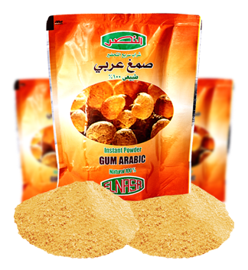
  Alnasr Industrial Trading Limited; http:// www.alnasrltd.com/, Sudan

Slide 22
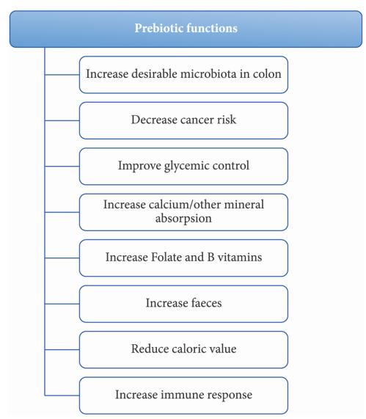
Fig 3. Main Prebiotic Functions (Rolem, P.N, 2015, Food Science and Technology,35(1), 3-10)

Slide 23
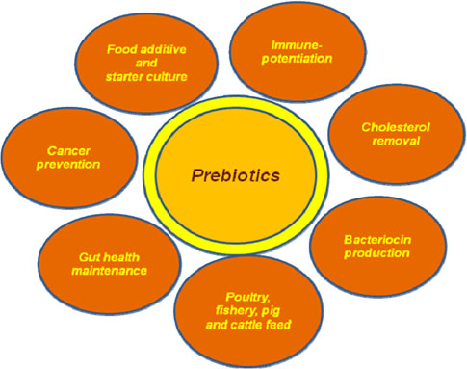
Fig 4. Potential applications of prebiotics (Patel and Goyal, 2012)

Slide 24
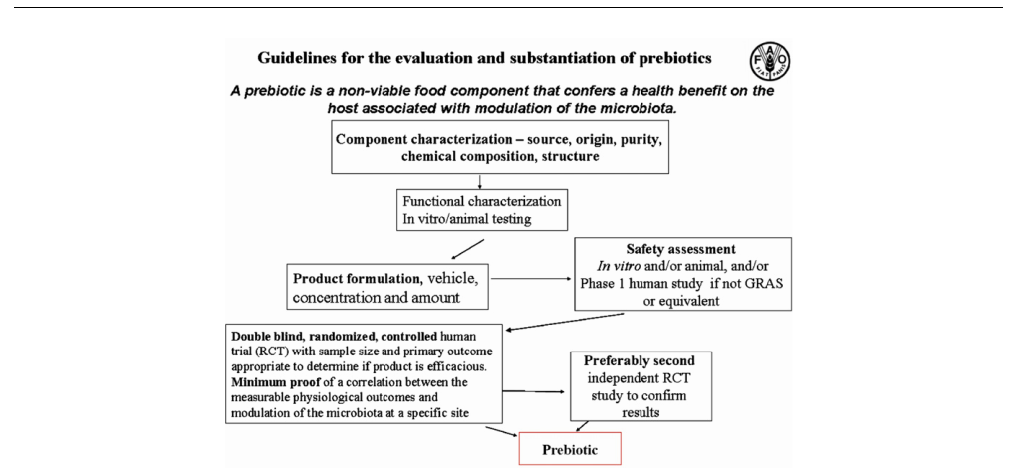
Fig 5. Guidelines for evaluation and substantiation of prebiotics (Phillips, 2013; Bioactive Carbohydrates and Dietary Fiber, 1, 3-9.)

Slide 25
Regulatory Aspects[6]
Gum Arabic was first classified as a “food additive” and was authorized to be used in food on this basis under the E-number (E414), as an emulsifier, stabilizer, and thickening agent.
GA codes include: 1- Harmonized System (HS): 130120 2- E-number: E414 3- Chemical Administration Service (CAS): 9000-01-5 4- Codex Alimentarius SIN No 414, INS No 414. GRAS 184-1330.
GA was accorded status of food ingredient as well as food additive in EC member states.
GA is approved in European Union and Codex Alementarius as a food dietary fiber.

Slide 27
Concluding Remarks[7]
Gum Arabic is a natural dietary fiber recognized by the European Union and Codex Alimentarius.
Wide natural variability of GA is hindering regulatory approval of health applications. Hence, GA with guaranteed structural, chemical composition, and quality reproducibility need to be produced.
The evidence demonstrates that GA acts as a prebiotic at a dose of 10g/day.

Slide 28
Thank You for Your Attention

