Slide 1
Introduction TO Network Operating System

Slide 2
What is a Network?
A network is a group of computers connected to each other to share information.
Networks help businesses work smarter by allowing them to:
Share and protect resources. Networks centralize data so it can be shared with appropriate people while preventing access from unauthorized users. In addition, data can be backed up to protect against loss.
Improve efficiency. Employees are more efficient when important files, computer programs, and Internet access are available to them all the time. A network with remote access capability enables employees to access e-mail and other information quickly and easily whether they're in the office or on the road.*
Reduce costs. Networks allow many users to access one device or service, eliminating the need for extra printers, modems, and Internet accounts.
Centralized Administration and Support:
the network administrator (Administrator) can any device associated with the management of the network from a single location.

Slide 3
Types of Networks
There are two main types of networks:
Peer-to-peer networks
client/server networks.

Slide 4
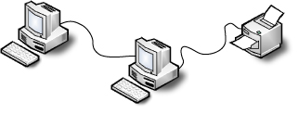
Peer-to-peer Networks
Peer-to-peer Networks:
Use cables to link together multiple computers and other devices such as printers and fax machines.
Offer a simple, low-cost, easy solution for sharing files, printers, and other devices.
Do have drawbacks: data may be lost if one computer crashes, or access to information may not always be available if the computer is turned off.
Best for home & small office use.

Slide 5
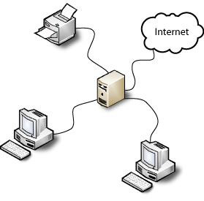
Client/server Networks
Client/server Networks:
Use a single, specialized computer (the server) as the central hub.
Connect individual desktop PCs, laptops, printers, or mobile devices.
Allow users to be more productive because they can share files, business applications, Internet access, and equipment.
Decrease the risk of data loss if a PC's hard drive crashes because all information saved on the server can be backed up.
Are ideal for large-scale organizations that require fast network access for video, publishing, multimedia, spreadsheet, database, and accounting operations.

Slide 6
The Server
What is a Server?
A server is a specialized computer dedicated to manage shared resources.
A server manages access to other devices such as printers, fax machines, and other computers.
A server also manages access to files and data such as financial files, graphics, and business presentations.
Any computer or device serving out applications or services can technically be called a server.

Slide 7
Client/server Networks
Clients
Make requests
Format data on the desktop
Usually connects to a small number of servers at one time
Typically interacts directly with end-users using a graphical user interface
Servers
Process requests from clients
Store and protect data
Usually accepts connections from a large number of clients
Typically does not interact directly with end-users

Slide 8
Term usage in information technology
A server computer (often called server)
is a computer system that has been designated for running a specific server application or applications. A computer that is designated for only one server application is often named for that application. For example, when Apache HTTP Server (software) is a company's web server, the computer running it is also called the web server.
Server operating system
is intended, enabled, or better able to run server applications.
The differences between the server version and the "workstation" version of an operating system vary. Sometimes (as in the case of Windows 2000 and Windows 2000 Server),
Some server editions include additional server applications bundled with the operating system.
In Server or server computer any "workstation" computer can run server operating systems and server applications, but server computer usually has special features intended to make it more suitable.
include faster processor and memory, more RAM, larger hard drives, higher reliability, redundant power supplies..etc.

Slide 9
Operating system (OS)
Operating system (OS)
Set of basic programming instructions to computer hardware
Forms layer of programming code on which most other functions of the computer are built
Desktop operating system
Typically installed on a PC type of computer used by one person at a time
Computer may or may not be connected to a network
Server operating system
installed on a more powerful computer that is connected to a network
act in many roles to enable multiple users to access information, such as electronic mail, files, and software

Slide 10
Examples of Server Operating System
FreeBSD an open source OS that can handle up to 4 processers.
Linux RedHat an open source OS than can handle up to 32 processers.

